Slide 1
Work Zone Safety
Notes:
Revised 6/16/25
The information in this presentation is provided voluntarily by the N.C. Department of Labor, Education Training and Technical Assistance Bureau as a public service and is made available in good faith. This presentation is designed to assist trainers conducting OSHA outreach training for workers. Since workers are the target audience, this presentation emphasizes hazard identification, avoidance, and control – not standards. No attempt has been made to treat the topic exhaustively. It is essential that trainers tailor their presentations to the needs and understanding of their audience.
The information and advice provided on this Site and on Linked Sites is provided solely on the basis that users will be responsible for making their own assessment of the matters discussed herein and are advised to verify all relevant representations, statements, and information.
This presentation is not a substitute for any of the provisions of the Occupational Safety and Health Act of North Carolina or for any standards issued by the N.C. Department of Labor. Mention of trade names, commercial products, or organizations does not imply endorsement by the N.C. Department of Labor.

Slide 2
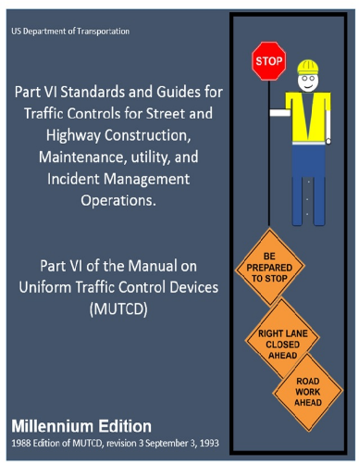
Objectives
At the end of this course, students will be
aware of:
  Process for identification of work zones
  Work zone elements
  Manual on Uniform Traffic Control Devices (MUTCD)
  OSHA standards
  Control zones and measures
  Flagger safety
  Employer/employee responsibilities
NCDOL Photo Library

Slide 3
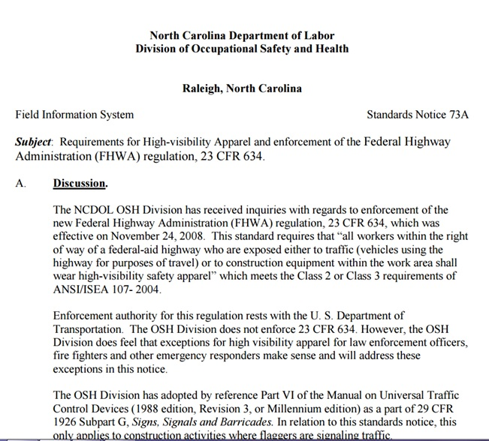
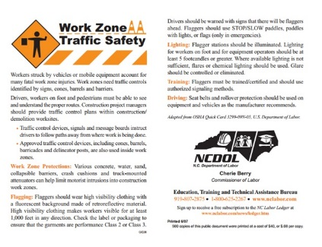
N.C. Department of Labor
Because traffic crashes are the leading cause of death in the workplace, the N.C. Department of Labor launched some driver safety outreach initiatives.
  Quick Card – Work Zone Traffic Safety
  Standards Notice 73 – High Visibility Apparel
NCDOL Photo Library
NCDOL Photo Library

Slide 4
What is a Work Zone?
A designated area on a street or highway where construction is taking place.
“An area of a traffic-way where construction, maintenance, or utility work activities are identified by warning signs/signals/indicators/, including those on transport devices that mark the beginning and end of a construction, maintenance, or utility work activity …signals”.

Slide 5

What is a Work Zone?
For the purposes of this section, "state highway work zone" means an area that is within a state highway right-of-way and that is subject to preliminary engineering work or construction, repair or maintenance work.
NCDOL Photo Library

Slide 6


Work Zone Identified
NCGS Section 1A.07
Any agency performing construction and/or maintenance work on or adjacent to a street or highway on the State Highway System is responsible for using the proper traffic control devices.
Devices used are subject to approval by the Division of Highways and shall conform to the MUTCD and the N.C. Supplement to the MUTCD.
NCDOL Photo Library
NCDOL Photo Library

Slide 7
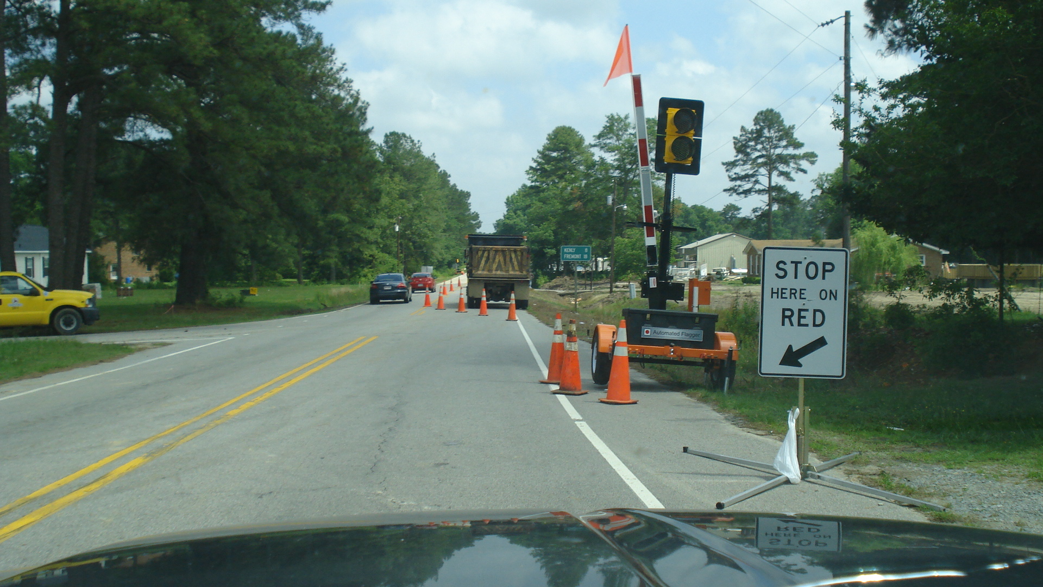
Work Zone Identified
1926.201(a)
Is this correct?
NCDOL Photo Library

Slide 8
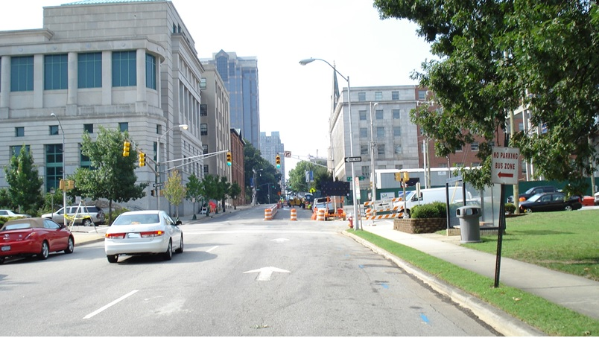
Work Zone Hazards
Is this correct?
NCDOL Photo Library

Slide 9
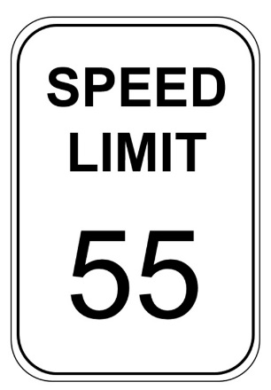
Work Zone Statistics
More than four out of five persons killed in work zone crashes are motorists.
Speeding and distracted driving account for more than 50% of all work zone crashes.
NCDOL Photo Library
Notes:
9

Slide 10

Manual on Uniform Traffic Control Devices
Current edition of the MUTCD is published by the Federal Highway Administration (FHWA).
NCDOL has adopted 29 CFR 1926 Subpart G, Signs, Signals and Barricades.
NCDOL Photo Library

Slide 11
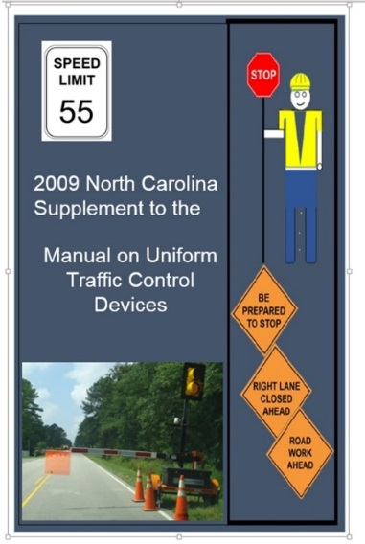
N.C. Supplement to the MUTCD
The North Carolina Supplement to the Manual Uniform Traffic Control Devices Manual (NC MUTCD) is published to provide a document containing standards, guidelines, and policies for traffic control devices not contained in the MUTCD.
NCDOL Photo Library

Slide 12
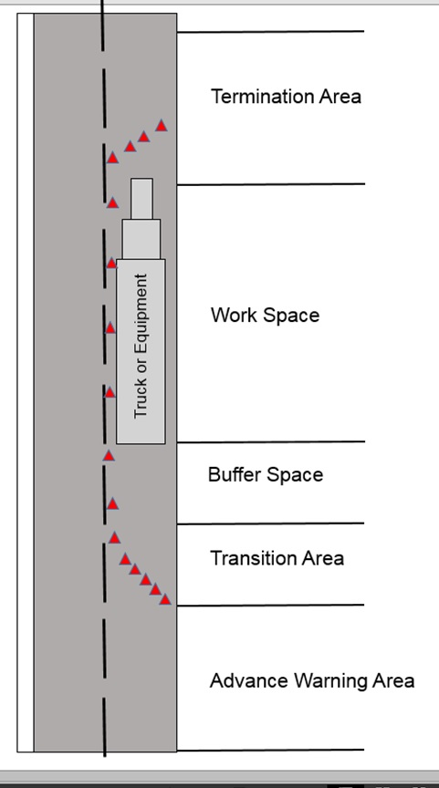




Work Zone Elements
Advance warning area
Transition area
Buffer space
Activity (work) area
Termination area
NCDOL Photo Library
NCDOL Photo Library

Slide 13
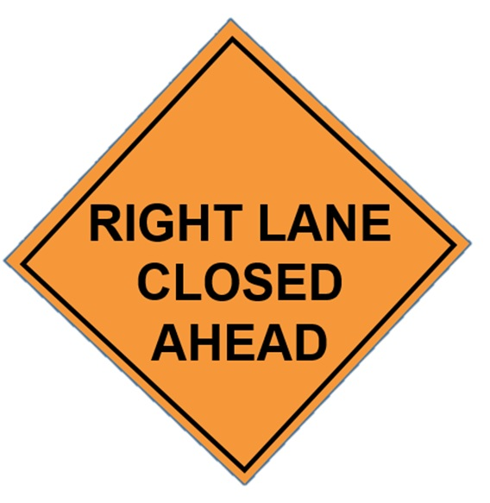


Work Zone Elements
Advance warning area
  Advises drivers about what to expect in the upcoming work zone area or areas.
NCDOL Photo Library
Notes:
.

Slide 14
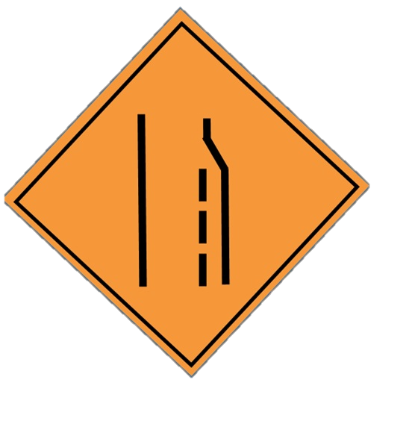
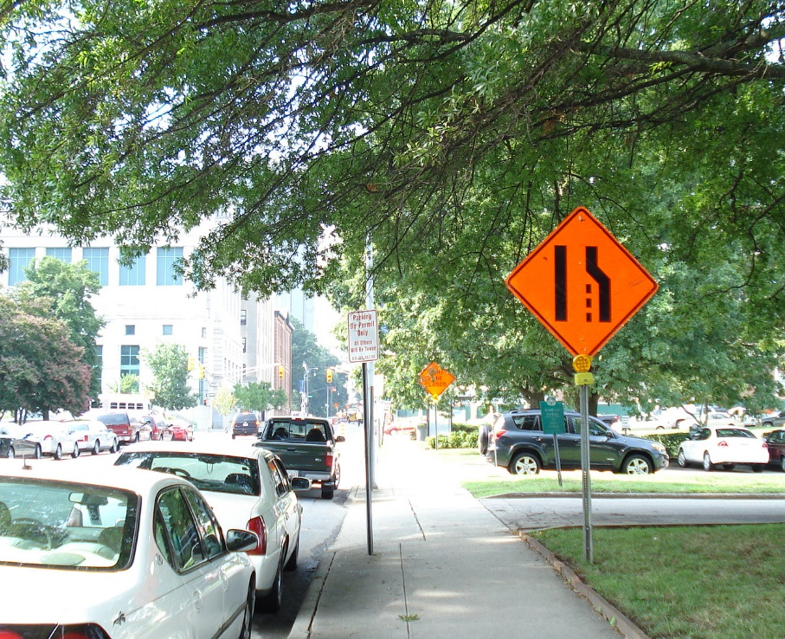
Work Zone Elements
Transition area
  Redirect traffic from a normal traffic flow to a new flow.
NCDOL Photo Library
NCDOL Photo Library

Slide 15

Work Zone Elements
Buffer space
  Provides protection for traffic and workers
NCDOL Photo Library

Slide 16
Work Zone Elements
Activity/work area
  Area where work takes place which may also include a “lateral” buffer space.
NCDOL Photo Library

Slide 17
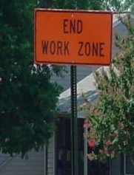
Work Zone Elements
Termination area
  Shall be used to return road users to their normal path.
  Shall extend from the downstream end of the work area to the last Temporary Traffic Control (TTC) device.
NCDOL Photo Library

Slide 18
Other Potential Hazards
Environmental hazards
  Heat stress
  Cold stress
  Sunburn
  Contact with poisonous plants
  Animal bites or stings
  Aggressive driver behavior
NCDOL Photo Library

Slide 19
Work Zone Safety - Heat Stress
High air temperatures, radiant heat sources, high humidity, direct physical contact with hot objects, or strenuous physical activities cause heat-related illness.
  Limit the intake of caffeinated and alcoholic beverages
  Reduce physical exertion levels
  Wear light-colored clothing
  Use fans/ventilation to provide air movement for cooling
  Gradually increasing work period/workload over the course of several days
  Take frequent rest/water breaks in areas that are shaded or air conditioned

Slide 20
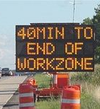
Signs, Signals and Barricades
1926.200(a)
Signs and symbols required by this subpart shall be visible at all times when work is being performed.
NCDOL Photo Library

Slide 21

Flagger PPE
1926.201(a)
Signaling by flaggers, and the use of flaggers, including warning garments worn by flaggers, shall conform to Part VI of the MUTCD.
Flaggers
NCDOL Photo Library

Slide 22
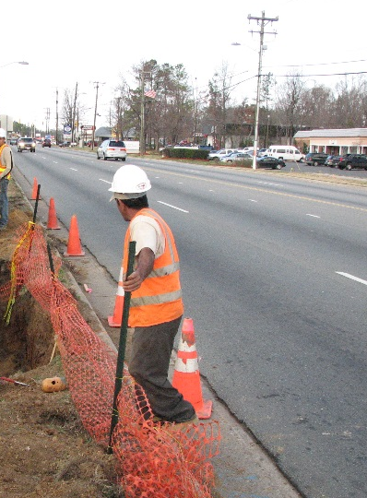
Flagger PPE
1926.201(a)
High-visibility safety apparel
  All workers exposed to the risks of moving roadway traffic or construction equipment should wear high-visibility safety apparel meeting the requirements of ISEA “American National Standard for High-Visibility Safety Apparel” or equivalent revisions, and labeled as ANSI 107-1999 standard
  performance for Class 1, 2, or 3 risk exposure.
Flagger certification and training
  July 1, 2010, North Carolina requires flagger training/certification.
NCDOL Photo Library

Slide 23
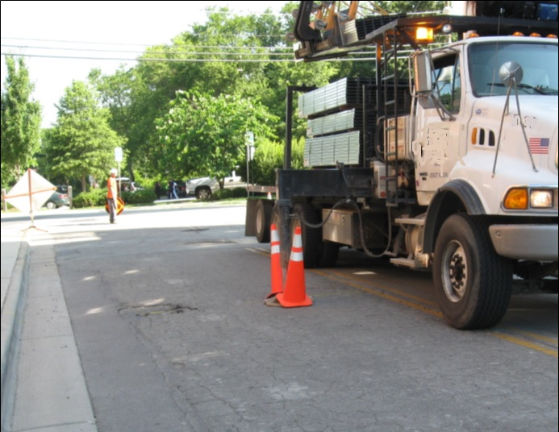
Flagger Safety
Flaggers should:
  Stay alert
  Stand alone in clear view
  Plan escape route for emergencies
  Stay in communication with other flaggers
  Treat motorists with respect
  Be sure the motorists understand the flow of traffic

Slide 24
Flagger Safety
What’s wrong with this picture?
NCDOL Photo Library

Slide 25
Flagger Safety
1926.201(a)
Flaggers should not:
  Stand where they could be crushed by equipment
  Stand where not visible to motorist or other equipment
  operators
  Turn their back on traffic
  Step in front of any vehicle
  Assume a vehicle is going to stop
  Stand over the crests of a hill
  Stand around sharp curves
NCDOL Photo Library

Slide 26
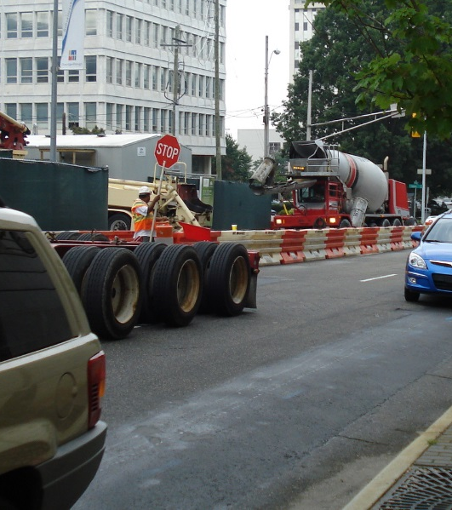
Employer’s Responsibility
On the worksite:
  Never allow unauthorized workers to ride on equipment.
  Set up a means of communication with workers around you.
  Always keep other workers in
  mind.
NCDOL Photo Library

Slide 27
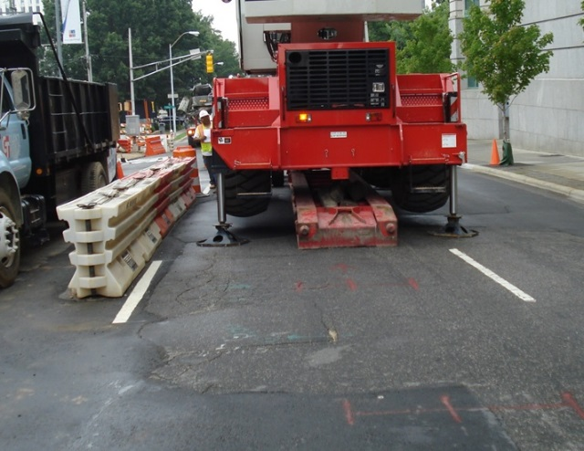
Employer’s Responsibility
Know the Job!
  Know the internal traffic control plan.
  Identify rollover hazards such as unleveled areas, embankments, and unstable soil.
  Know the work zone and your position in it.
  Use designated equipment
  routes and areas.
NCDOL Photo Library

Slide 28
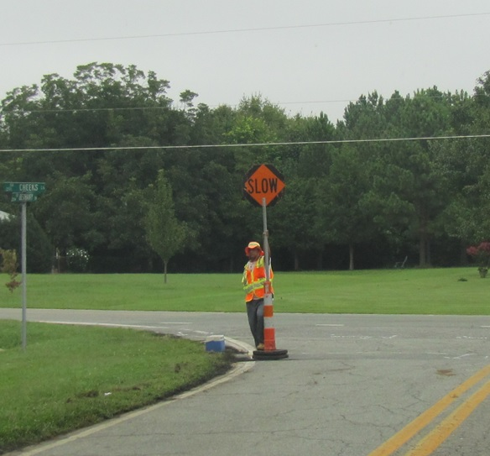
Employee’s Responsibility
Put into practice all training provided by the employer.
Always wear high visibility clothing and other PPE as required.
NCDOL Photo Library

Slide 29


Safety Awareness
As a motorist:
  Pay attention to the orange diamond shaped warning signs
  Stay alert
  Minimize distractions
  Follow posted speed limits
  Be prepared for the unexpected
NCDOL Photo Library
NCDOL Photo Library

Slide 30
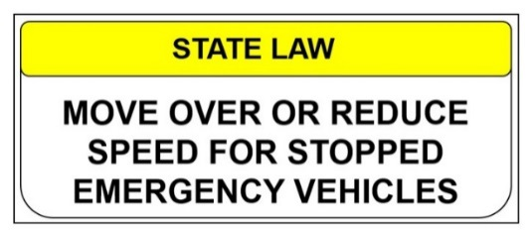
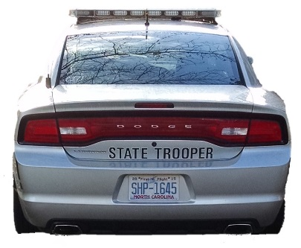
“Move Over” Law
G.S. 20‑157(f)
Motorists are required to move over to another lane away from the emergency vehicle on a multi-lane highway or slow down on a two-lane highway and can do so safely.
Motorists must slow down while maintaining a safe speed.
NCDOL Photo Library
NCDOL Photo Library

Slide 31
Additional Information
American Society of Safety Engineers
National Highway Traffic Safety Administration
National Institute of Occupational Safety and Health
Federal Highway Administration
Federal OSHA
N.C. Department of Transportation

Slide 32
Summary
In this course, we discussed the following:
  Identification of work zones
  Work zone elements
  Manual on Uniform Traffic Control Devices
  OSHA standards
  Control zones and measures
  Flagger safety
  Employer/employee responsibilities

Slide 33
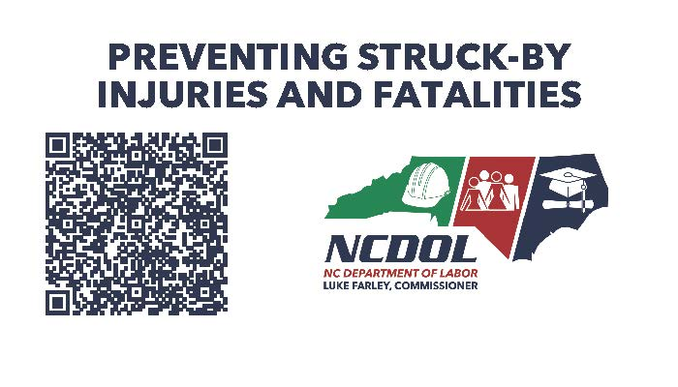
Thank You For Attending!
Final Questions?

