Slide 1
Welding and Cutting
29 CFR 1910 - Subpart Q
Presented by:
Notes:
1
Revised 06-2021
The information in this presentation is provided voluntarily by the N.C. Department of Labor, Education Training and Technical Assistance Bureau as a public service and is made available in good faith. This presentation is designed to assist trainers conducting OSHA outreach training for workers. Since workers are the target audience, this presentation emphasizes hazard identification, avoidance, and control – not standards. No attempt has been made to treat the topic exhaustively. It is essential that trainers tailor their presentations to the needs and understanding of their audience.
The information and advice provided on this Site and on Linked Sites is provided solely on the basis that users will be responsible for making their own assessment of the matters discussed herein and are advised to verify all relevant representations, statements, and information.
This presentation is not a substitute for any of the provisions of the Occupational Safety and Health Act of North Carolina or for any standards issued by the N.C. Department of Labor. Mention of trade names, commercial products, or organizations does not imply endorsement by the N.C. Department of Labor.

Slide 2
Objectives
At the end of this course, students will:
Recognize fire hazards associated with welding
Understand selection of eye protection for welding operations
Understand management’s responsibility
Know the general requirements - 1910.252
through 1910.255
NCDOL Photo Library

Slide 3
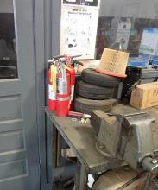
Fire Protection
1910.252(a)(1)(i)-(ii)
If object to be welded or cut cannot readily be moved, all movable fire hazards in the vicinity shall be taken to a safe place.
If object to be welded or cut cannot be moved and all fire hazards cannot be removed, then guards shall be used to confine heat, sparks, and slag, and to protect the immovable fire hazards.
NCDOL Photo Library

Slide 4
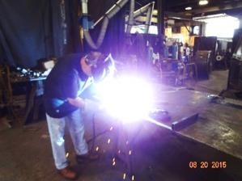
Basic Precautions
1910.252(a)(1)
Management on whose property cutting and welding is to be performed must follow the NFPA Standard.
Standard for Fire Prevention in Use of Cutting and Welding Processes, NFPA Standard 51B,1962, which is incorporated by reference.
NCDOL Photo Library

Slide 5
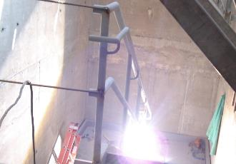
Combustible Material
1910.252(a)(2)(i)
Ensure no combustible materials on the floor below will be exposed to sparks which might drop through the floor.
Same precautions observed with cracks or holes in walls, open
doorways and open or broken windows.
NCDOL Photo Library
Notes:
5

Slide 6
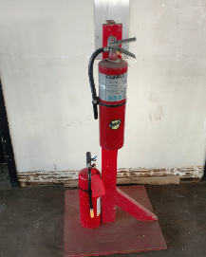
Fire Extinguishers
1910.252(a)(2)(ii)
Suitable fire extinguishing equipment maintained in state of readiness for instant use.
Such equipment may consist of pails of water, buckets of sand, hose or portable extinguishers depending upon the nature and quantity of the combustible material exposed.
NCDOL Photo Library
Notes:
6

Slide 7
Fire Watch
1910.252(a)(2)(iii)(A)(1)-(2)
Fire watchers required whenever welding or cutting is performed where other than a minor fire might develop, or any of the following conditions exist:
Combustible material closer than 35 feet to the point of operation.
Combustibles more than 35 feet away but are easily ignited by sparks.
Notes:
7

Slide 8
Fire Watch
1910.252(a)(2)(iii)(B)
Fire watchers
Shall have fire extinguishing equipment available and be trained in use.
Familiar with facilities for sounding an alarm.
Try to extinguish fire if within capacity of available equipment, otherwise sound the alarm.
Watch maintained at least a half hour after completion of welding or cutting operations.
Notes:
8

Slide 9
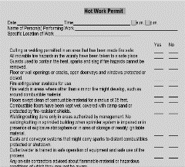
Authorization
1910.252(a)(2)(iv)
Individual responsible for authorizing cutting and welding operations must inspect area before work starts.
They shall designate precautions to be followed in granting authorization to proceed preferably in form of a written permit.
NCDOL Photo Library
Notes:
9

Slide 10
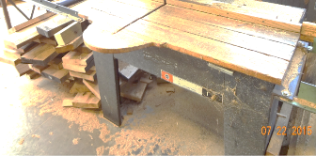
Prohibited Areas
1910.252(a)(2)(vi)
Cutting or welding shall not be permitted in the following situations:
Areas not authorized by management.
In sprinklered buildings while such protection is impaired.
Near storage of large quantities of exposed, readily ignitable materials such as bulk sulfur, baled paper, or cotton.
OR….
NCDOL Photo Library
Notes:
10

Slide 11
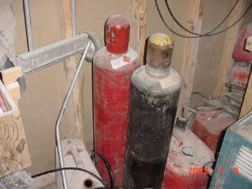
Prohibited Areas
1910.252(a)(2)(vi)(C)
In presence of any of the following:
Explosive atmospheres (mixtures of flammable gases, vapors, liquids, or dusts with air).
Explosive atmospheres that may develop inside uncleaned or improperly prepared tanks or equipment.
Areas that may develop an accumulation of combustible dusts.
NCDOL Photo Library
Notes:
11

Slide 12
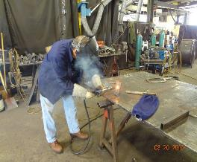
Management
1910.252(a)(2)(xiii)
Responsible for safe use of cutting and welding equipment.
Establish areas for cutting and welding.
Designate an individual responsible for authorizing cutting and welding operations.
Ensure personnel are properly trained in operation and use.
Advise all contractors about flammable
materials or hazardous conditions.
NCDOL Photo Library
Notes:
12

Slide 13
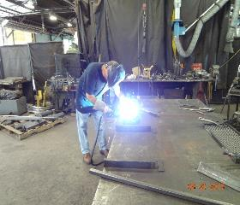
Supervisor
1910.252(a)(2)(xiv)
Responsible for safe handling of equipment and safe use of the process.
Determines combustible and hazardous areas.
Protects combustibles from ignition.
Secures authorization for welding and cutting operations.
Gives approval to cutter or welder.
Determines that fire protection and
extinguishing equipment are properly
located.
Ensures fire watchers are available.
NCDOL Photo Library

Slide 14
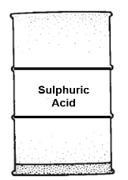
Welding or Cutting Containers
1910.252(a)(3)(i)
Welding, cutting, or other hot work shall not be performed on used drums, barrels, tanks or other containers until thoroughly cleaned.
Pipelines and connections to the drum or vessel shall be disconnected or blanked.
NCDOL Photo Library

Slide 15
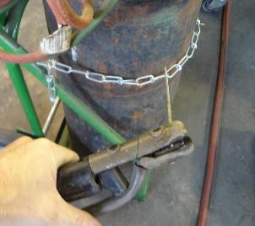
Confined Spaces
1910.252(a)(4)(v)
When arc welding is suspended for any substantial period, all electrodes shall be removed from holders.
Holders located to prevent accidental contact.
Machine shall be disconnected from the power source.
NCDOL Photo Library

Slide 16
Confined Spaces
1910.252(a)(4)(vi)
Torch valves shall be closed and gas supply to the torch shut off at some point outside confined area whenever torch is not used for a substantial period such as during lunch hour or overnight.
Where practicable, the torch and hose shall be removed from the confined space.

Slide 17
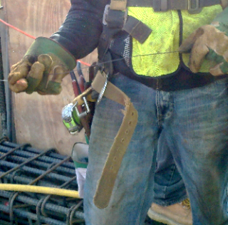
Protection of Personnel
1910.252(b)(1)(i)
Welder or helper working on platforms, scaffolds, or runways shall be protected against falling.
May be accomplished by use of railings, safety belts, lifelines, or other equally effective safeguards.
NCDOL Photo Library

Slide 18
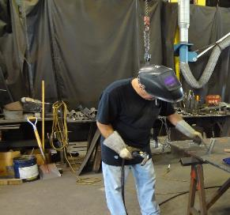
Protection from Arc Welding Rays
1910.252(b)(2)(iii)
Where work permits, welders should be enclosed in individual booths or by noncombustible screens.
Workers adjacent to welding areas shall be protected from rays by noncombustible or flameproof screens/shields or be required to wear appropriate goggles.
NCDOL Photo Library

Slide 19
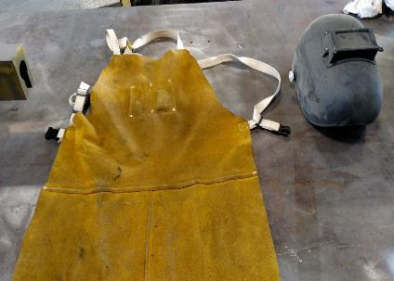
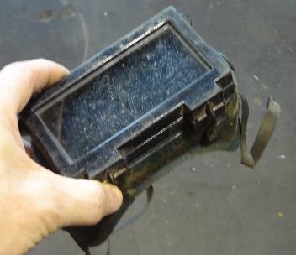
Protective Clothing
1910.252(b)(3)
Employees exposed to hazards created by welding, cutting, or brazing operations shall be protected by personal protective equipment.
NCDOL Photo Library
NCDOL Photo Library

Slide 20
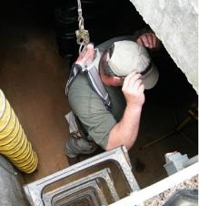
Confined Spaces
1910.252(b)(4)(iii)&(iv)
Securing cylinders and machinery
When welding or cutting is being performed in any confined spaces the gas cylinders and welding machines shall be left on the outside.
Lifelines
Means shall be provided for rescuing a welder quickly in case of emergency.
Lifelines cannot limit the welder’s egress
though a small exit opening.
Must have an attendant with a
pre-planned rescue procedure
stationed outside.
NCDOL Photo Library

Slide 21
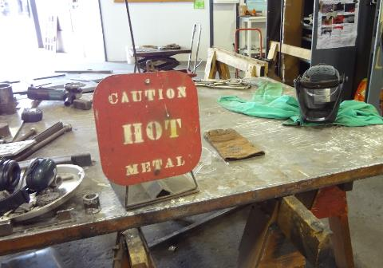
Warning Sign
1910.252(b)(4)(vii)
After welding operations are completed, the welder shall mark the hot metal or provide some other means of warning other workers.
NCDOL Photo Library

Slide 22
Standards Interpretation - 07/30/1993
Conflict between requirements of 1910.252 and 1910.146
Section 1910.252(b)(4)(iv) – Work in confined spaces, Lifelines; requires that an attendant be stationed outside a confined space which a welder must enter through a manhole or other small opening “to observe” the welder at all times.
Appendix C of 1910.146 lists “tapping or rapping codes on tank walls” as an example of an adequate means of communication and observation between an attendant and a welder working in a permit-required confined space.

Slide 23
Standards Interpretation - 07/30/1993
Conflict - RESOLVED
The present requirement in 1910.252(b)(4)(iv) –
Work in confined spaces, Lifelines; is based upon a similar requirement in an out-of-date voluntary standard (ANSI Z49.1-1967).
The most recent version (1988) of the same ANSI standard contains language which is slightly different than that contained in the older version.
The newer voluntary standard states that the attendant shall “observe the workers inside or be in constant communication with them”.

Slide 24
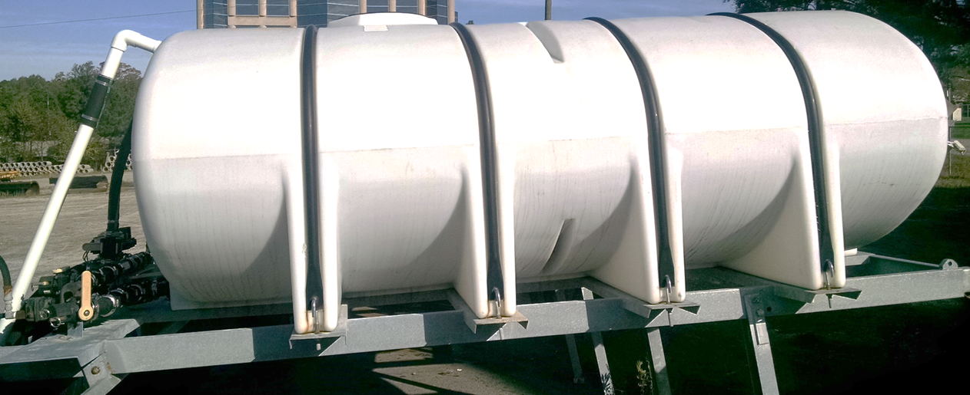
Standards Interpretation - 07/30/1993
Federal OSHA believes, as indicated in Appendix C of the Permit-Required Confined Spaces Standard (1910.146), that “tapping on tank walls” can be an adequate means of communication between an entrant and an attendant.
NCDOL Photo Library
NCDOL Photo Library

Slide 25
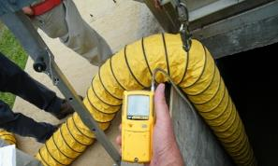
Health Protection & Ventilation
1910.252(c)(1)(i)(A)-(C)
Three factors govern the amount of contamination to which welders may be exposed:
Dimensions of space
Number of welders
Possible evolution of hazardous fumes, gases, or dust
Management responsible for ensuring welders have proper protection and ventilation.
NCDOL Photo Library

Slide 26
Health Protection & Ventilation
1910.252(c)(1)(ii)-(v)
Employers are responsible for ensuring welders have proper protection and ventilation.
Screens
Must not block the ventilation
Maximum allowable concentration
Local exhaust or general ventilating systems shall be provided and arranged to keep the amount of toxic fumes, gases, or dusts below the maximum allowable concentration as specified in 1910.1000 of this part.
Hazard communication
Include the potentially hazardous materials employed in fluxes, coatings, coverings, and filler metals, all of which are potentially used in welding and cutting, or are released to the atmosphere during welding and cutting.
The employer shall ensure that each employee has access to labels on containers of such materials and safety data sheets.

Slide 27
NIOSH Study Control Technology Assessment for Welding Operations
Epidemiological evidence indicates that welders generally have a 40 percent increase in relative risk of developing lung cancer as a result of their work.
Other cancers associated with welding include leukemia, cancer of the stomach, brain, nasal sinus, and pancreas.
Cadmium poisoning can affect the respiratory system and damage the liver and kidneys.
A common reaction to overexposure to metal fumes, particularly zinc oxide fumes, is metal fume fever, with symptoms resembling the flu.

Slide 28
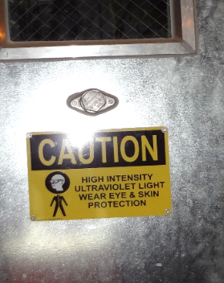
NIOSH Study Control Technology Assessment for Welding Operations
Other health hazards during welding can include vision problems and dermatitis arising from ultraviolet radiation exposures, burns, and musculoskeletal stress from awkward work positions.
NCDOL Photo Library

Slide 29
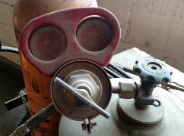
Oxygen-Fuel Gas
1910.253(a)(1)-(3)
Mixtures of fuel gases and air or oxygen may be explosive and shall be guarded against.
Under no condition shall acetylene be utilized at a pressure in excess of 15 psig or 30 psia.
Only approved apparatus may be used
Torches, regulators or pressure-reducing valves, acetylene generators, and
manifolds.
NCDOL Photo Library

Slide 30
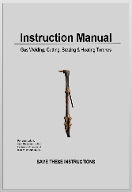
Oxygen-Fuel Gas
1910.253(a)(4)
Workmen in charge of the oxygen or fuel-gas supply equipment, including generators, and oxygen or fuel-gas distribution piping systems shall be instructed and judged competent by their employers.
Rules and instructions covering the operation and maintenance of oxygen or fuel-gas supply equipment shall be readily available.
NCDOL Photo Library

Slide 31
Standards Interpretation – 05/13/1998
Training and competency for oxygen-fuel gas welding equipment.
A trained workmen that demonstrates proficiency in following the rules and instructions.
Would be considered competent to perform the duties of a workman in charge of an oxygen-fuel gas welding or cutting system.
Welding, Cutting and Brazing and any other employer determined safety and health requirements that are applicable to the particular workplace application.

Slide 32
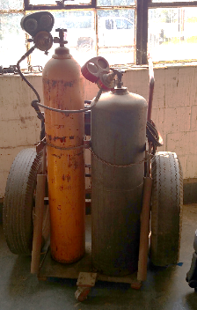
Oxygen-Fuel Gas
1910.253(b)(1)(ii)&(iv)
Compressed gas cylinders shall be legibly marked for the purpose of identifying the gas content with either the chemical or the trade name of the gas.
All cylinders with a water weight
capacity of over 30 pounds (13.6 kg)
shall be equipped with means of
connecting a valve protection cap
or with a collar or recess to protect
the valve.
NCDOL Photo Library

Slide 33
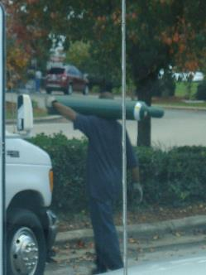
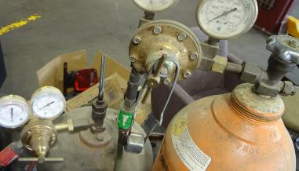
Storage of Cylinders - General
1910.253(b)(2)(i)-(iii)
Kept away from radiators and other sources of heat.
Stored in a well-protected, well-ventilated, dry location, at least 20 (6.1 m) feet from highly combustible materials.
Empty cylinders shall have
their valves closed.
NCDOL Photo Library
NCDOL Photo Library

Slide 34
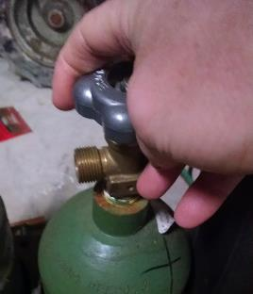
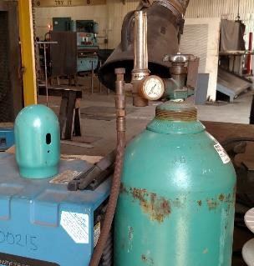
Storage of Cylinders - General
1910.253(b)(2)(iv)
Valve protection caps, where cylinder is designed to accept a cap, shall always be in place, hand-tight, except when cylinders are in use or connected for use..
NCDOL Photo Library
NCDOL Photo Library

Slide 35
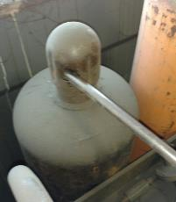
Operating Procedures
1910.253(b)(5)(ii)[C]
Valve-protection caps shall not be used for lifting cylinders from one vertical position to another.
Bars shall not be used under valves or valve-protection caps to pry cylinders loose when frozen to the ground or otherwise fixed.
The use of warm (not boiling) water is recommended.
NCDOL Photo Library

Slide 36
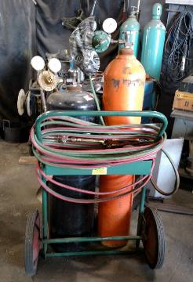
Operating Procedures
1910.253(b)(5)(ii)[D]
Unless cylinders are secured on a special truck, regulators shall be removed and valve-protection caps, when provided for, shall be put in place before cylinders are moved.
NCDOL Photo Library

Slide 37
Operating Procedures
1910.253(b)(5)(iii)[A]
Fuel-gas cylinders shall be placed with valve end up whenever they are in use.
Liquefied gases shall be stored and shipped with the valve end up.
NCDOL Photo Library

Slide 38
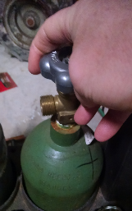
Operating Procedures
1910.253(b)(5)(iii)[C]
Before connecting a regulator to a cylinder valve, the valve shall be opened slightly and closed immediately.
Valve shall be opened while standing to one side of the outlet; never in front of it.
Never crack a fuel-gas cylinder valve near other welding work or near sparks, flame,
or other possible sources of ignition.
NCDOL Photo Library

Slide 39
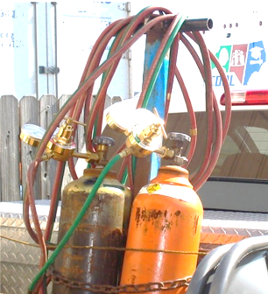
Operating Procedures
1910.253(b)(5)(iii)[E]
Nothing shall be placed on top of an acetylene cylinder when in use which may damage the safety device or interfere with the quick closing of the valve.
NCDOL Photo Library

Slide 40
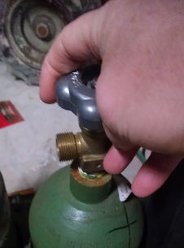
Operating Procedures
1910.253(b)(5)(iii)[J]-[K]
The cylinder valve shall always be opened slowly.
An acetylene cylinder valve shall not be opened more than one and one-half turns of the spindle, and preferably no more than three-fourths of a turn.
NCDOL Photo Library

Slide 41
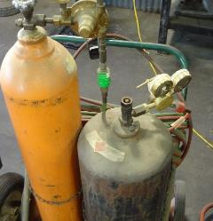
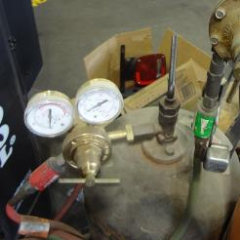
Operating Procedures
1910.253(b)(5)(iii)[L]
Where a special wrench is required, it shall be left in position on the stem of the valve while the cylinder is in use so that the fuel-gas flow can be quickly turned off in case of emergency.
In the case of manifolded or coupled cylinders at least one such wrench shall always be available for immediate use.
NCDOL Photo Library
NCDOL Photo Library

Slide 42
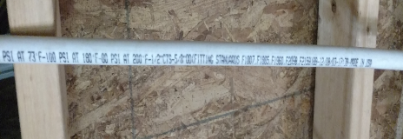
Service Piping Systems
1910.253(d)(1)(i)[A]-[B]
Materials and design
Piping and fittings shall comply with section 2, Industrial Gas and Air Piping Systems, of the American National Standard Code for Pressure Piping ANSI B31.1-1967 which is incorporated by reference.
Pipe shall be at least Schedule 40 and fittings shall be at least standard weight in sizes up to and including 6-inch nominal.
NCDOL Photo Library

Slide 43
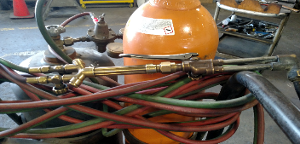
Protective Equipment
1910.253(e)(3)(ii)[C]]3]-[4]
Flash-back protection shall be provided by an approved device that will prevent flame from passing into the fuel-gas system.
Back-pressure protection shall be provided by an approved pressure-relief device set at a pressure not greater than the pressure rating of the backflow or the flashback protection device, whichever is lower.
The pressure-relief device shall
be located on the downstream
side of the backflow and
flashback protection devices.
NCDOL Photo Library

Slide 44
Protective Equipment
Acetylene cylinders involved in a flashback
You should pay particular attention to any acetylene cylinder which has been involved in a flashback or affected by a fire.
There is a risk that the acetylene could start to decompose, and the cylinder could explode.
If an acetylene cylinder becomes hot or starts to vibrate, you must evacuate immediately.
NCDOL Photo Library

Slide 45
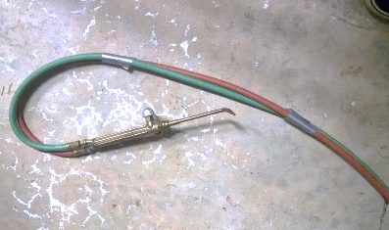
Hose and Hose Connections
1910.253(e)(5)(i)-(ii)
Hose for oxygen-fuel gas service shall comply with the Specification for Rubber Welding Hose, 1958, Compressed Gas Association.
When parallel lengths of oxygen and acetylene hose are taped together for convenience and to prevent tangling, not more than 4 inches out of 12 inches covered by tape.
NCDOL Photo Library

Slide 46
Hose and Hose Connections
1910.253(e)(5)(iii)
Hose connections shall comply with the Standard Hose Connection Specifications, 1957, Compressed Gas Association.
NCDOL Photo Library

Slide 47
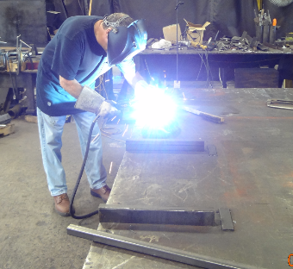
Arc Welding and Cutting
1910.254(a)(3)
Workmen designated to operate arc welding equipment shall have been properly instructed and qualified to operate such equipment.
NCDOL Photo Library

Slide 48
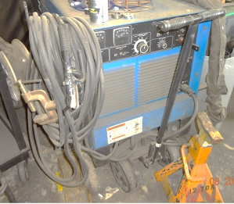
Arc Welding and Cutting
1910.254(b)(1)
Assurance of consideration of safety in design is obtainable by choosing apparatus complying with:
Requirements for Electric Arc-Welding Apparatus NEMA EW-1-1962, National Electrical Manufacturers Association, or
Safety Standard for Transformer-Type Arc-Welding Machines, ANSI C33.2-1956, Underwriters' Laboratories.
Both are incorporated by reference.
NCDOL Photo Library

Slide 49
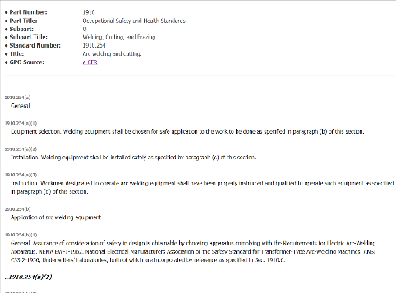
Arc Welding and Cutting
1910.254(d)(1)
Workmen assigned to operate or maintain arc welding equipment shall be acquainted with the requirements of this standard.
NCDOL Photo Library

Slide 50
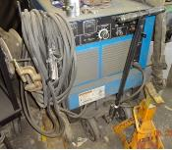
Arc Welding and Cutting
1910.254(d)(2)
Before starting operations, all connections to the machine shall be checked to make certain they are properly made.
Work lead shall be firmly attached to the work; magnetic work clamps shall be freed from adherent metal particles of spatter on contact surfaces.
Coiled welding cable shall be spread out before use to avoid serious overheating and damage to insulation.
NCDOL Photo Library

Slide 51
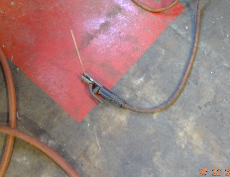
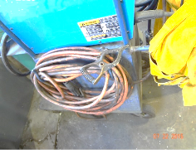
Arc Welding and Cutting
1910.254(d)(7)-(8)
Electrode holders when not in use shall be so placed that they cannot make electrical contact with persons, conducting objects, fuel or compressed gas tanks.
Electric shock
Cables with splices within 10 feet of the holder shall not be used.
Welder should not coil or loop welding electrode cable around parts of his body.
NCDOL Photo Library
NCDOL Photo Library

Slide 52
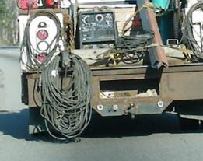
Arc Welding and Cutting
1910.254(d)(9)(ii)-(iii)
Machines which have become wet shall be thoroughly dried and tested before being used.
Cables with damaged insulation or exposed bare conductors shall be replaced.
Joining lengths of work and electrode cables shall be done by the use of connecting means specifically intended for the purpose.
The connecting means shall have insulation adequate for the service conditions.
NCDOL Photo Library

Slide 53
Resistance Welding
1910.255(a)(1)
All equipment shall be installed by a qualified electrician.
There shall be a safety-type disconnecting switch
Can be a circuit breaker or
Circuit interrupter to open each power circuit to the machine.
It shall be conveniently located at or near the machine, so that the power can be shut off when the machine or its controls are to be serviced.

Slide 54
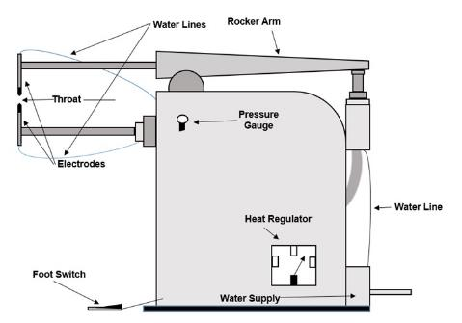
Resistance Welding
1910.255(b)
Spot and seam welding machines
Non-portable Machines
Voltage
Capacitor welding
Interlocks
Guarding
Shields
Foot switches
Stop buttons
Safety pins
Grounding
NCDOL Photo Library

Slide 55
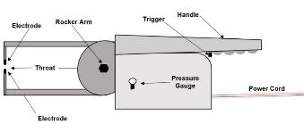
Resistance Welding
1910.255(b)
Portable Machines
Counterbalance
Safety chains
Clevis
Switch guards
Moving holder
Grounding
Safety Chain
NCDOL Photo Library

Slide 56
Resistance Welding
1910.255(e)
Maintenance of machines
Periodic inspection shall be made by qualified maintenance personnel, and a certification record maintained.
The certification record shall include the date of inspection, the signature of the person who performed the inspection and the serial number, or other identifier, for the equipment inspected.
The operator shall be instructed to report any equipment defects to his supervisor and the use of the equipment shall be discontinued until safety repairs have been completed.

Slide 57
New Welding Technologies
New technologies in welding, such as the use of laser welding and electron beam welding, bring new hazards to the welder's environment.
Special precautions must be taken when using these welding methods.
Laser Welding - Laser welding uses a focused beam of light to achieve very precise welds. The major hazard of this powerful beam is to the eyes, which can be partially blinded when hit with the beam. Special eye protection must be used, and care must be taken with any reflective surfaces since both the original and reflected beam are extremely dangerous.

Slide 58
New Welding Technologies
Electronic Beam Welding - Electronic beam welding uses a focused beam of electrons to produce high precision and deep penetration welds.
Since x-rays are produced as a by-product, the process should be enclosed and shielded with lead or other materials suitable for preventing x-ray exposure.
All doors, ports, and other openings must have proper seals and should be checked periodically to prevent x-ray leakage.
Operators should wear film badges to detect accidental radiation exposure.
The high voltages required also present an electrical hazard.

Slide 59
New Welding Technologies
Robot Welders - Many industries are beginning to use robot welders in place of workers on the assembly line.
This removes workers from the hazard, but focuses on job elimination rather than workplace improvements. In addition, workers can be injured by industrial welding robots.

Slide 60
Summary
In this course, we discussed:
Fire hazards associated with welding
Selection of eye protection for welding operations
Management’s responsibility
General requirements – 1910.252
Oxygen-fuel gas welding – 1910.253
Arc welding – 1910.254
Resistance Welding – 1910.255

Slide 61
Thank You For Attending!
Final Questions?

