Slide 1
Welding and Cutting
29 CFR 1926 – Subpart J
Notes:
Revised 6/16/25
The information in this presentation is provided voluntarily by the N.C. Department of Labor, Education Training and Technical Assistance Bureau as a public service and is made available in good faith. This presentation is designed to assist trainers conducting OSHA outreach training for workers. Since workers are the target audience, this presentation emphasizes hazard identification, avoidance, and control – not standards. No attempt has been made to treat the topic exhaustively. It is essential that trainers tailor their presentations to the needs and understanding of their audience.
The information and advice provided on this Site and on Linked Sites is provided solely on the basis that users will be responsible for making their own assessment of the matters discussed herein and are advised to verify all relevant representations, statements, and information.
This presentation is not a substitute for any of the provisions of the Occupational Safety and Health Act of North Carolina or for any standards issued by the N.C. Department of Labor. Mention of trade names, commercial products, or organizations does not imply endorsement by the N.C. Department of Labor.

Slide 2
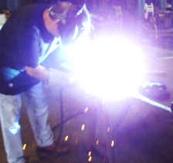
Objectives
In this course, we will discuss the following:
  OSHA’s minimum requirements for:
    Gas welding and cutting
    Arc welding and cutting
    Fire prevention
    Ventilation and protection
  Safe use, handling, and precautions to take when welding and cutting
  Hazard identification and abatement methods
NCDOL Photo Library

Slide 3
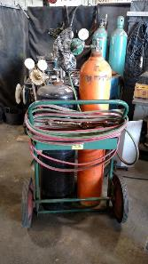
Subpart J – Welding and Cutting
1926.350 – Gas welding and cutting
1926.351 – Arc welding and cutting
1926.352 – Fire prevention
1926.353 – Ventilation and protection in
welding, cutting, and heating
1926.354 – Welding, cutting, and heating
in way of preservative coatings
NCDOL Photo Library

Slide 4
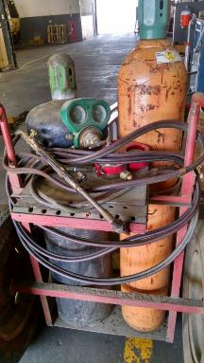
Gas Welding and Cutting
1926.350(a)(1)
Compressed gas cylinders must have valve protection caps in place and secured except when in use
NCDOL Photo Library
NCDOL Photo Library

Slide 5
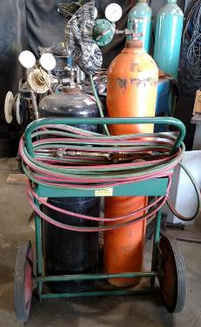
Gas Welding and Cutting
1926.350(a)(2)
Compressed gas cylinders must only be hoisted while secured, as on a cradle or pallet
Cylinders must not be hoisted
by magnet, choker sling, or
cylinder caps
NCDOL Photo Library

Slide 6
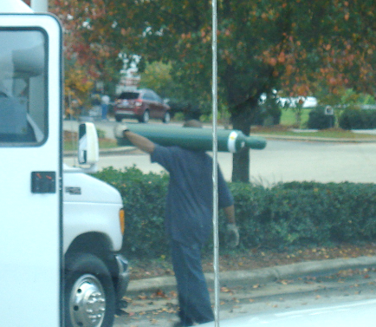
Gas Welding and Cutting
1926.350(a)(3)
Cylinders shall be moved by tilting or rolling on their bottom edges
NCDOL Photo Library

Slide 7
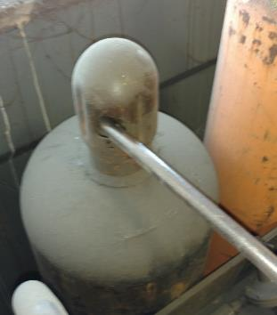
Gas Welding and Cutting
1926.350(a)(5)
Valve protection caps must not be used for lifting cylinders
Frozen cylinders must not be:
  Pried loose with bars under valves
  or valve protection caps
  Hit with a tool
  Thawed using boiling water
NCDOL Photo Library

Slide 8
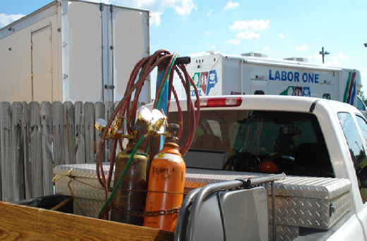
Gas Welding and Cutting
1926.350(a)(6)
Unless cylinders are firmly secured on a special carrier intended for this purpose, regulators shall be removed and valve protection caps put in place before cylinders are moved
NCDOL Photo Library
NCDOL Photo Library

Slide 9
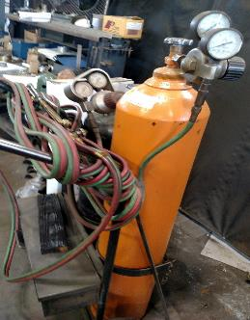
Gas Welding and Cutting
1926.350(a)(7)
Cylinders must be secured while in use
A suitable cylinder truck, chain, or other steadying device must be used
to keep cylinders from being
knocked over
NCDOL Photo Library
NCDOL Photo Library

Slide 10
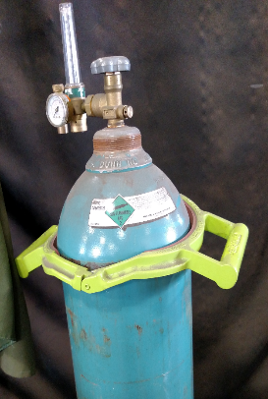
Gas Welding and Cutting
1926.350(a)(8)-(9)
Valves must be closed when work is finished, cylinders are empty or when
moved
Cylinders must be secured
upright except when being
hoisted or carried
NCDOL Photo Library
NCDOL Photo Library

Slide 11
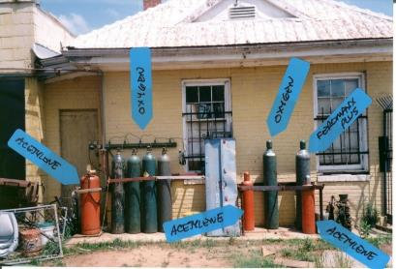
Gas Welding and Cutting
1926.350(a)(10)
Oxygen cylinders must be separated from fuel gas cylinders and combustible materials
  Either a minimum of 20 feet, or
  A barrier at least 5 feet high having a fire resistance rating of 30 minutes
NCDOL Photo Library

Slide 12
Gas Welding and Cutting
1926.350(b)(1)-(4)
Cylinders must not be exposed to sparks, hot slag or flame
Cylinders must not become part of an electrical circuit or have electrodes struck against them
Fuel gas cylinders must be placed with valve end up when in use
Fuel gas cylinders shall not be taken into confined spaces

Slide 13
Gas Welding and Cutting
1926.350(c)(1) & (c)(3)
Cylinders must not be used as rollers or supports
No damaged or defective cylinder shall be used
  Cylinders can become damaged from falling, heat, electric circuits, motion, vibration or anything else that may cause a weakness or crack in the cylinder wall or shell

Slide 14
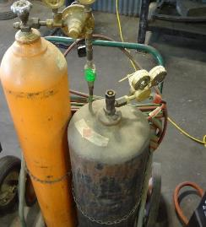
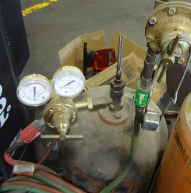
Gas Welding and Cutting
1926.350(d)(1)-(d)(2)
Before regulators are connected, valve must be slightly opened and then immediately closed to clear away dust or dirt
Where a special wrench is required to close valve, it must be left in position on the stem
NCDOL Photo Library
NCDOL Photo Library

Slide 15
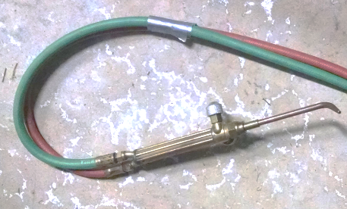
Gas Welding and Cutting
1926.350(f)(1)
Fuel gas and oxygen hoses must be easily distinguishable from each other by color or sense of touch
Oxygen and fuel gas hoses must not be interchangeable
NCDOL Photo Library

Slide 16
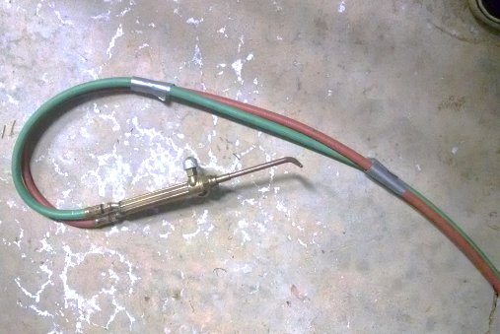
Gas Welding and Cutting
1926.350(f)(2)
When parallel sections of oxygen and fuel gas hoses are taped together, not more than 4″ out of 12″ shall be covered by tape
NCDOL Photo Library

Slide 17
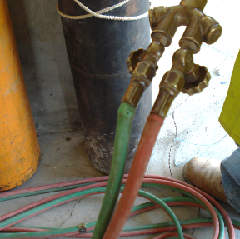
Gas Welding and Cutting
1926.350(f)(3)-(4)
Hoses must be inspected before use
Defective hose must not be used
Hose subjected to flashback,
severe wear or damage
must be tested to twice the
normal working pressure
NCDOL Photo Library

Slide 18
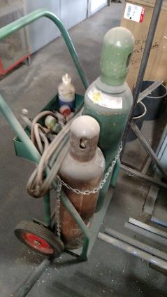
Gas Welding and Cutting
1926.350(d)(4)
When not in use or work is completed
  Close valve
  Bleed lines of pressure
NCDOL Photo Library
NCDOL Photo Library

Slide 19
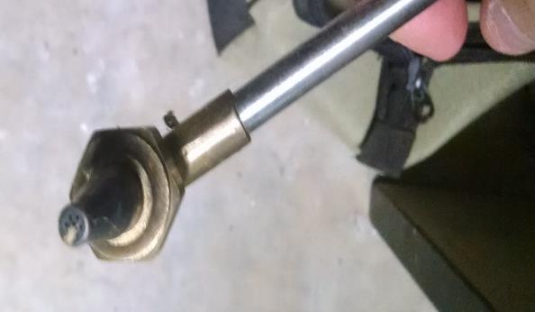
Gas Welding and Cutting
1926.350(g)(1)
Torch tip openings must only be cleaned with devices designed for that purpose
NCDOL Photo Library

Slide 20
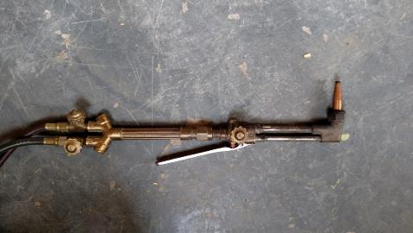
Gas Welding and Cutting
1926.350(g)(2)
Torches must be inspected before each use for leaking valves, hose couplings and tip connections
Defective torches must not be used
NCDOL Photo Library

Slide 21
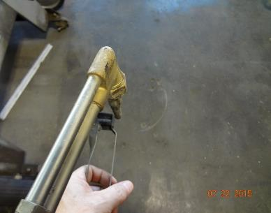
Gas Welding and Cutting
1926.350(g)(3)
Torches must not be lit from matches, cigarette lighters, other flames or hot work
They must be lighted by friction lighters or other approved devices
NCDOL Photo Library
NCDOL Photo Library

Slide 22
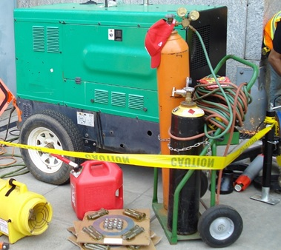
Gas Welding and Cutting
1926.350(i)
Oxygen cylinders and fittings must be kept away from oil and grease
Sparks and flames
NCDOL Photo Library

Slide 23
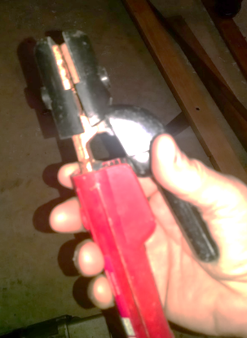
Arc Welding and Cutting
1926.351(a)(1)
Only manual electrode holders designed for arc welding must be used
NCDOL Photo Library
NCDOL Photo Library

Slide 24
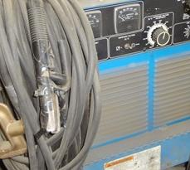
Arc Welding and Cutting
1926.351(a)(2)
Current-carrying parts passing through a manual electrode holder to be held by the user must be insulated against the maximum voltage
NCDOL Photo Library

Slide 25
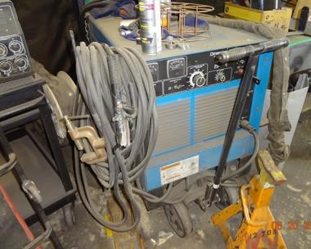
Arc Welding and Cutting
1926.351(b)(2) & (b)(4)
Cables must be free of repair or splices for 10 feet from holder unless insulated to equal value of cable
Worn or exposed cable must be protected by insulation equal to original value of cable or not used
NCDOL Photo Library

Slide 26
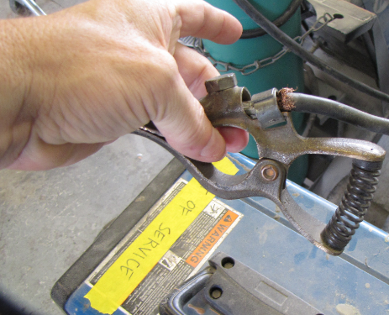
Arc Welding and Cutting
1926.351(c)(1)
Ground return cables must have maximum current carrying capacity of unit served
NCDOL Photo Library

Slide 27
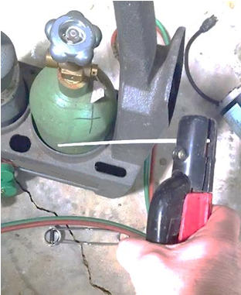
Arc Welding and Cutting
1926.351(d)(1)
Unattended electrode holders must be made safe by removing electrodes and placed or protected to prevent injury
NCDOL Photo Library
NCDOL Photo Library

Slide 28
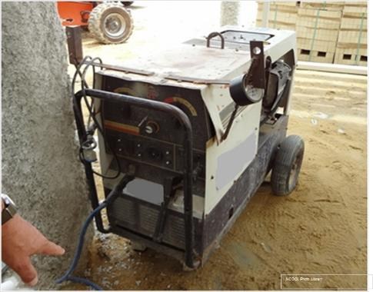
Arc Welding and Cutting
1926.351(d)(3)
Whenever the welder leaves, stops work, or moves the welding machine, power supply switch must be
turned off
NCDOL Photo Library

Slide 29
Arc Welding and Cutting
1926.351(d)(4)
Arc welding or cutting equipment that is faulty or defective must not be used
NCDOL Photo Library

Slide 30
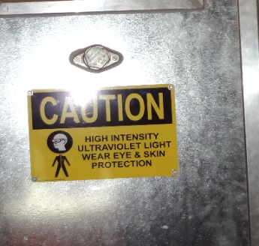
Arc Welding and Cutting
1926.351(e)
Arc welding/cutting operations shall be shielded or screened off to protect employees in the vicinity from direct rays and sparks
NCDOL Photo Library

Slide 31
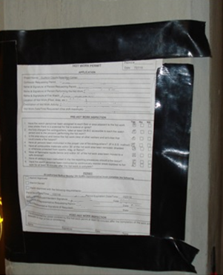
Fire Prevention
1926.352(a)-(b)
To the extent possible, hot work must be performed in designated areas free of fire hazards
Hot work done in areas
not free of fire hazards
  Precautions taken to confine
  heat, sparks, and slag
  Cannot contact flammable or
  combustible material
NCDOL Photo Library

Slide 32
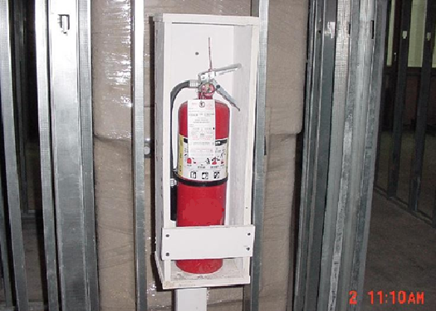
Fire Prevention
1926.352(d)-(e)
Fire extinguishing equipment must be readily available and maintained in readiness for use
When normal fire prevention precautions are not sufficient, additional personnel must be assigned to guard
against fire during
hot work
NCDOL Photo Library

Slide 33
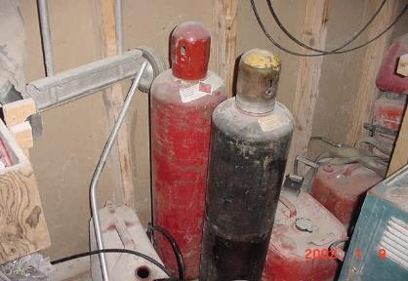
Fire Prevention
1926.352(h)
Drums and containers of flammable or combustible liquids must be kept closed
Empty containers must be removed from the hot work area
NCDOL Photo Library

Slide 34
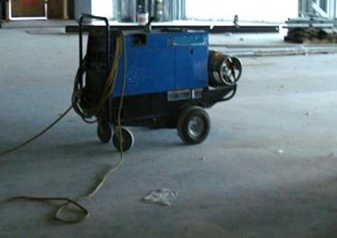
Ventilation and Protection
1926.353(a)(1)
Local exhaust ventilation must keep smoke and fumes in the breathing zone within safe limits
  As defined in Subpart D – Occupational Health and Environmental Controls
NCDOL Photo Library

Slide 35
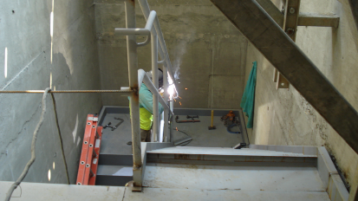
Ventilation and Protection
1926.353(b)(1)-(3)
When hot work is performed in a confined space:
  General mechanical or local exhaust must be provided, or
  Employees in the space must wear supplied air respirators, and
  An attendant on the
  outside must be
  equipped and prepared
  to provide emergency
  aid
NCDOL Photo Library

Slide 36
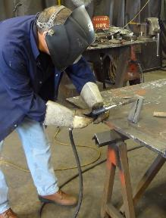
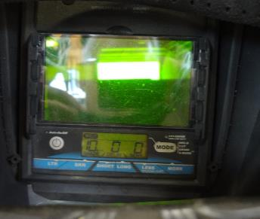
Ventilation and Protection
1926.353(d)(1)(ii)
Employees exposed to welding arcs or sparks must be protected by filter lenses
  Meet the requirements of Subpart E
    1926.102 – Eye and face protection
NCDOL Photo Library
NCDOL Photo Library

Slide 37
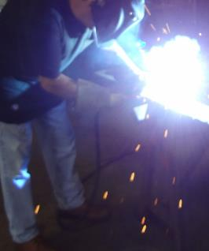
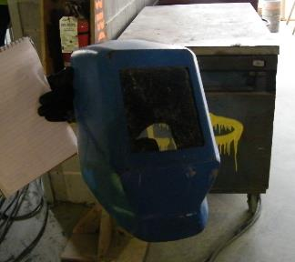
Ventilation and Protection
1926.353(d)(1)(iii)
Workers exposed to radiation must be suitably protected to prevent burns by ultraviolet rays
Welding helmets and hand shields must be free of leaks and openings
Damaged
NCDOL Photo Library
NCDOL Photo Library
NCDOL Photo Library

Slide 38
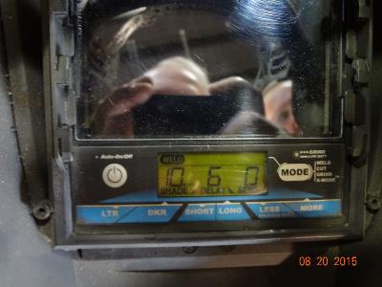
Ventilation and Protection
1926.353(e)(2)
Employees performing any type of welding, cutting or heating must be protected by suitable eye protective equipment
  In accordance with requirements of Subpart E
NCDOL Photo Library

Slide 39
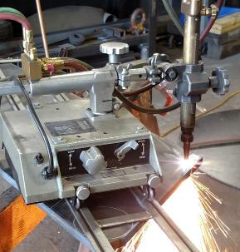
Welding, Cutting, and Heating
1926.354(a)-(b)
Before hot work is commenced on any surface covered by a preservative coating:
  Test must be made by competent person to determine flammability
  If flammable, must be stripped
  from area to be heated to
  prevent ignition
NCDOL Photo Library

Slide 40
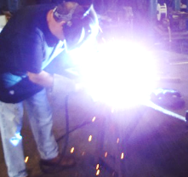
Summary
During this course, we discussed:
  OSHA’s minimum requirements for:
    Gas welding and cutting
    Arc welding and cutting
    Fire prevention
    Ventilation and protection
  Safe use, handling, and precaution to take when welding and cutting
  Hazard identification and abatement methods
NCDOL Photo Library

Slide 41
Thank You For Attending!
Final Questions?

