Slide 1
Special Emphasis Program for Warehousing and Storage and Related Product Distribution Industries
OPN 145
Notes:
Rev: 6/2025
The information in this presentation is provided voluntarily by the N.C. Department of Labor, Education Training and Technical Assistance Bureau as a public service and is made available in good faith. This presentation is designed to assist trainers conducting OSHA outreach training for workers. Since workers are the target audience, this presentation emphasizes hazard identification, avoidance, and control – not standards. No attempt has been made to treat the topic exhaustively. It is essential that trainers tailor their presentations to the needs and understanding of their audience.
The information and advice provided on this Site and on Linked Sites is provided solely on the basis that users will be responsible for making their own assessment of the matters discussed herein and are advised to verify all relevant representations, statements, and information.
This presentation is not a substitute for any of the provisions of the Occupational Safety and Health Act of North Carolina or for any standards issued by the N.C. Department of Labor. Mention of trade names, commercial products, or organizations does not imply endorsement by the N.C. Department of Labor.

Slide 2
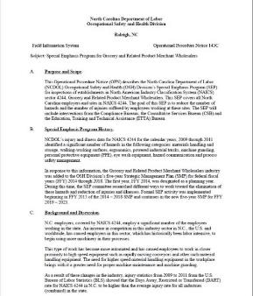
Objectives
OPN 145
At the end of this course, students will be aware of:
  Details of the Operational Procedure Notice (OPN) 145 – Special Emphasis Program (SEP) for Warehousing and Storage and Related Product Distribution Industries.
  Standards and hazards covered by
  this OPN.
  Employer and employee responsibilities
  related to the SEP.

Slide 3
Purpose and Scope
OPN 145
This OPN describes the NC OSH Division’s SEP for inspections of grocery and related product wholesalers, warehousing and storage, distribution centers, delivery and courier services, and certain retail establishments where similar hazards may be found in their loading and storage areas.

Slide 4
Special Emphasis Program Coverage
Covers North Carolina employers and sites in the following North American Industry Classification System (NAICS) codes:
  4244 - Grocery and Related Product Merchant Wholesalers
  493 - Warehousing and Storage
  492110 - Couriers and Express Delivery Services
  492210 - Local Messengers and Local Delivery

Slide 5
Special Emphasis Program Coverage
It also includes NAICS codes for loading and storage areas of retail establishments that have the same or similar hazards as warehousing and distribution facilities:
  444110 - Home Centers
  444130 - Hardware Stores
  444190 - Other Building Material Dealers
  445110 - Supermarkets, and Other Grocery (except convenience stores
  452311 - Warehouse Clubs and Supercenters

Slide 6
Strategic Management Plan
SEP goals for Federal Fiscal Year (FFY)
2024 - 2028 Strategic Management Plan:
  Reducing the rate of workplace injuries and illness by 2% by the end of FFY 2028.
  Reducing the NC Bureau of Labor Statistics (BLS) Days Away, Restricted or Transferred (DART) rate for establishments in North Carolina in this SEP by 1% per year.

Slide 7
Strategic Management Plan Goals
Goals will be accomplished through:
  Identifying types and trends of injuries and illnesses.
  Providing hazard identification through inspections.
  Offering free, confidential consultative services.
  Forming alliances with those employers covered by this SEP.
  Developing training materials and publications.
  Providing free education and training.

Slide 8
Recordkeeping
Who Must Record?
1904.1 & 1904.2
All employers in North Carolina except:
  Any employer with 10 or fewer employees at all times for the previous calendar year unless OSHA or the BLS informs you in writing that you must keep records.
  Any employer who is on the updated list of NAICS codes.
Exemptions above do not change employers’ reporting requirements for fatalities, hospitalizations, loss of an eye or amputations.

Slide 9
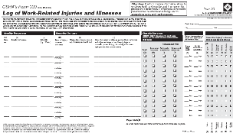
Recordkeeping
What is Recordable?
1904.4(a)
Fatality, injury, or illness
  Work-related
  New case
  Meets one or more of the general recording criteria
NCDOL Photo Library

Slide 10
Recordkeeping
General Recording Criteria
1904.7(a)-(b)
Death
Days away from work
Restricted work or transfer to another job
Medical treatment beyond first aid
Loss of consciousness
Diagnosed as a significant injury or illness

Slide 11
Recordkeeping
OSHA Form 300 Log
29 CFR 1904
NCDOL Photo Library

Slide 12
Recordkeeping
Who Must Report?
1904, Subpart E
All employers must still report:
  All work-related fatalities within 8 hours.
  All work-related in-patient hospitalizations of one or more employees within 24 hours.
  All work-related amputations within 24 hours.
  All work-related losses of an eye within 24 hours.
All employers must participate in OSHA and BLS surveys when requested.

Slide 13
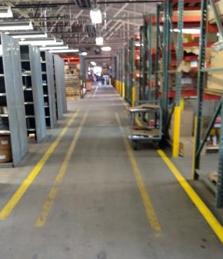
Handling Materials
General
1910.176(a)
Where mechanical equipment is used, sufficient safe clearances shall be maintained.
  Aisles
  Loading docks
  Through doorways
  Turns of passage
NCDOL Photo Library

Slide 14
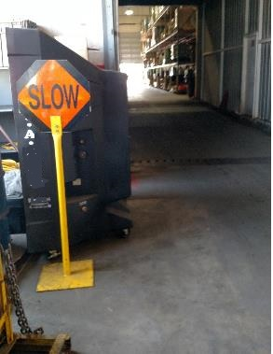
Handling Materials
General
1910.176(a)
Aisles and passageways shall be kept clear and in good repair.
NCDOL Photo Library
Notes:
14

Slide 15
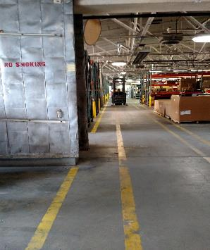
Handling Materials
General
1910.176(a)
Permanent aisles and passageways shall be marked.
NCDOL Photo Library

Slide 16
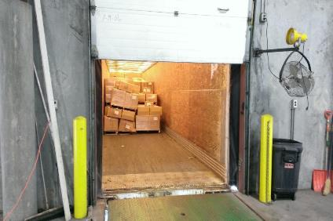
Handling Materials
Secure Storage
1910.176(b)
Storage of material shall not create a hazard.
NCDOL Photo Library
Notes:
16

Slide 17
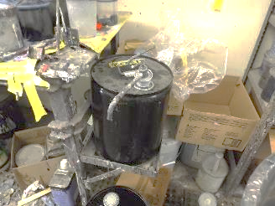
Walking-Working Surfaces
General Requirements
1910.22(a)(1)-(3)
Surface conditions
  All places of employment, passageways, storerooms, service rooms, and walking-working surfaces are kept in a clean, orderly, and sanitary condition.
    Free of hazards such as
    sharp or protruding objects,
    loose boards, corrosion,
    leaks, spills, snow and ice.
NC Photo Library
NCDOL Photo Library

Slide 18
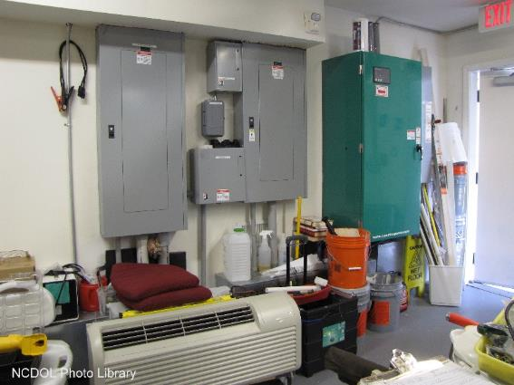
Walking-Working Surfaces
General Requirements
1910.22(a)(1)-(3)
Is this in a clean, orderly, and sanitary condition?
NCDOL Photo Library

Slide 19
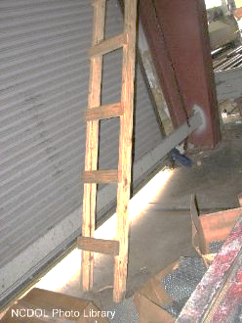
Walking-Working Surfaces
Ladders
1910.23(a)
Employer must ensure that each ladder meets requirements of this section.
Covers all ladders, except when the ladder is:
  Used in emergency operations
  (firefighting, rescue, and tactical
  law enforcement operations) or
  training for these operations.
  Designed into or is an integral part
  of machines or equipment.

Slide 20
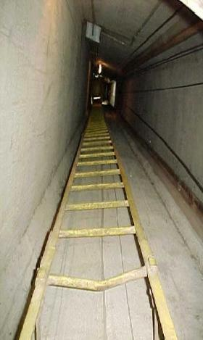
Walking-Working Surfaces
Ladders
1910.23(b)(9)
Ladders are inspected before initial use in each work shift, and more frequently as necessary, to identify any visible defects that could cause employee injury.
NCDOL Photo Library

Slide 21

Walking-Working Surfaces
Ladders
1910.23(b)(10)
Any ladder with structural or other defects is immediately tagged “Dangerous: Do Not Use” or with similar language and removed from service until repaired or replaced.

Slide 22

Walking-Working Surfaces
Stairways
1910.25(b)
General requirements
  Handrails, stairrail systems, and guardrail systems are provided as required by the standard.
  Vertical clearance above any stair tread to any overhead obstruction is at least 6 feet, 8 inches as measured from leading edge of tread (except for spiral stairs).
NCDOL Photo Library
> 6’8”

Slide 23
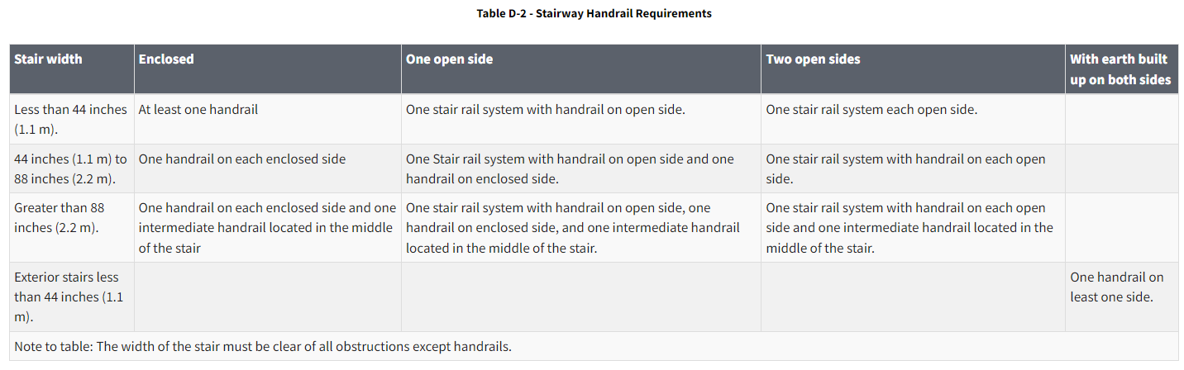
Walking-Working Surfaces
Stairways
1910.28(b)(11)(ii)
Each flight of stairs having at least 3 treads and at least 4 risers is equipped with stairrail systems and handrails.
NCDOL Photo Library

Slide 24
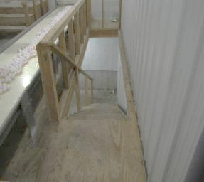
Walking-Working Surfaces
Handrails/Stair rail Systems
1910.29(f)(1)
Height criteria
  Handrails are not less than 30 inches and not more than 38 inches, as measured from leading edge of stair tread to top surface of handrail.
  Height of stairrail systems must meet not less than 42 inches from leading edge of stair tread to top surface of top rail.
Stairrail
No Mid-rail
NCDOL Photo Library
No Handrail

Slide 25
Ergonomics
Ergonomics
  Greek derivation
    Ergo (work)
    Nomos (law)
  Interfacing man, machine and environment to optimize safety, productivity and comfort.
  “Fitting the task to the human”

Slide 26

Ergonomics
OSH Division Perspective
North Carolina employers can be cited for ergonomic violations without a specific OSHA standard for ergonomics.
Field Operations Manual (FOM) Chapter XVII – Ergonomic Inspection Procedures
  Phase 1
  Phase 2
  Phase 3
Citations for ergonomic violations are issued under the General Duty Clause (GDC).

Slide 27
Ergonomics
General Duty Clause
NCGS 95-129(1)
For GDC violations, the following criteria must be met:
  Employees must be exposed to a hazard.
  Hazard must be likely to cause death or serious physical harm.
  Hazard must be recognized in industry.
  Must be a feasible way to abate the hazard.

Slide 28
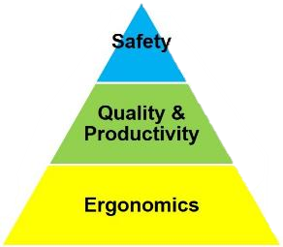
Ergonomics
Workplace Problems
Increased discomfort, pain, injury or illness
Workers’ compensation costs
Lost or restricted work time
Short- or long-term disability
Increased absenteeism
Greater turnover
Low morale
Decreased productivity and/or quality
NCDOL Photo Library

Slide 29

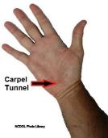
Ergonomics
Injuries
NCGS 95-129(1)
Definition
  Ergonomics is defined as the science related to man and his work, embodying the anatomic, physiologic, and mechanical principles affecting the efficient use of human energy.
Injury examples:
  Carpal tunnel syndrome; tendinitis; rotator cuff injuries (a shoulder problem); epicondylitis (an elbow problem); trigger finger; muscle strains and lower back injuries.

Slide 30
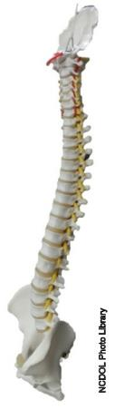
Ergonomics
Types of Back Injuries
Ligament sprains
Muscle or tendon strains
Lumbar strain/sprain
Low back pain
Disc disorders

Slide 31

Musculoskeletal Disorders (MSD)
Signs and Symptoms
Discomfort or pain
Numbness or tingling
Redness
Limited range of motion
Fullness, tightness or swelling
Weakness (trouble holding objects)
NCDOL Photo Library
Early reporting of symptoms and early treatment may resolve problems without lost work time, restricted activity or surgery.

Slide 32

Ergonomics
Proper Lifting Technique
Plan the lift and path.
Check the weight of the load.
Keep the load close to your body.
Face the load, do not twist.
Bend using your knees, not your back.
Lift with your legs, not your back.

Slide 33
Exit Routes
1910.34(a)-(b)
Applies to all workplaces in general industry except mobile workplaces such as vehicles or vessels.
Exit routes are covered.
  Minimum requirements for exit routes to allow for the safe evacuation of employees during an emergency.
  Also covers the minimum requirements for emergency action plans (1910.38) and fire prevention plans (1910.39).

Slide 34
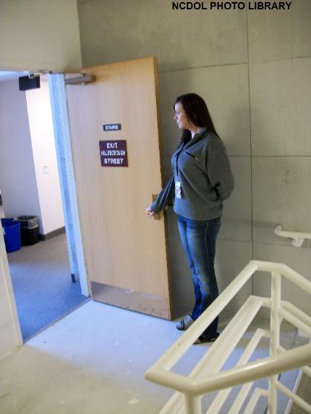
Exit Routes
Design Basic Requirements
1910.36(a)(1)-(3)
Exit routes must be:
  Permanent
  Separated by fire resistant materials
  Openings into an exit must be limited

Slide 35
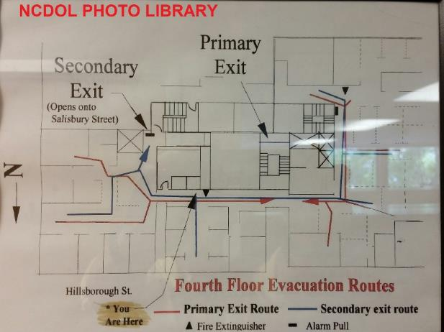
Exit Routes
Number of Exit Routes
1910.36(b)
Number of exit routes must be adequate.
  Two exit routes
  More than two exit routes
  A single exit route

Slide 36
Exit Routes
Unlocked and Unrestricted
1910.36(d)
Must be able to open door from inside without keys, tools, or special knowledge.
  Panic bars that lock from the outside are permitted.
Must be free of device or alarm that could restrict emergency use if device or alarm fails.
May be locked from inside in mental, penal, or correctional facilities.
  And only if supervisory personnel are continuously on duty and there is an emergency plan.

Slide 37
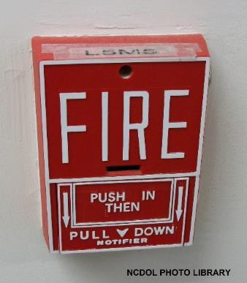
Exit Routes
Maintenance and Safeguards
1910.37(a)-(e)
Danger to employees minimized.
Adequate and appropriate lighting and marking.
Fire retardant properties maintained.
Exit routes maintained during construction and repairs.
Employee alarm system must be operable.

Slide 38
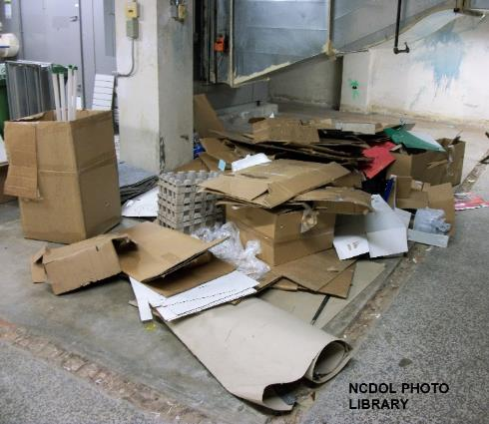
Exit Routes
Danger to Employees Minimized
1910.37(a)
Kept free of explosive or highly flammable furnishings or other decorations.
Arranged so employees will not travel toward a high hazard area.
Must be free and unobstructed.
Safeguards designed to protect
employees during an emergency
must be in proper working order
at all times.

Slide 39

Exit Routes
Lighting and Marking
1910.37(b)(1)-(4)
Adequately lighted.
Clearly visible and marked by a
sign reading “Exit”.
Free of decorations or signs that obscure visibility of exit.
If direction of travel to exit is not apparent, signs must be posted along exit access indicating direction of travel to nearest exit.

Slide 40
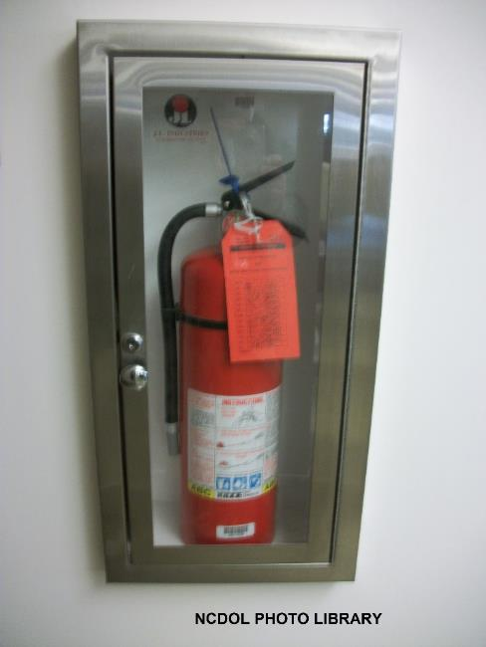
Fire Extinguishers
General Requirements
1910.157(c)(1)
Employer shall:
  Provide portable fire extinguishers.
  Mount, locate and identify them so they are readily accessible to employees without subjecting employees to possible injury.

Slide 41
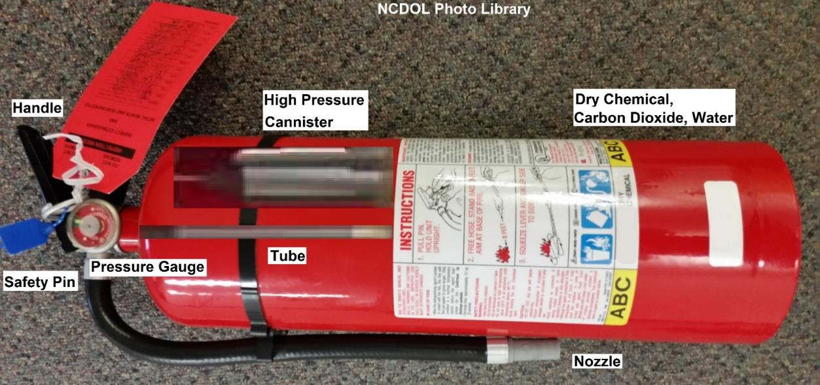
Fire Extinguishers
General Requirements
1910.157(c)(2)
Only approved portable fire extinguishers shall be used.

Slide 42
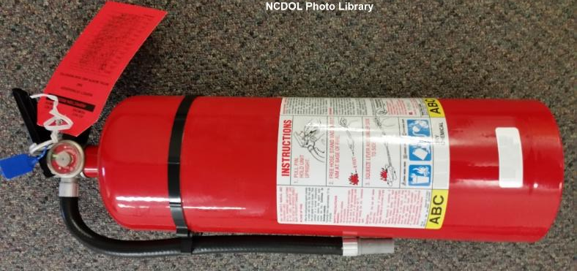
Fire Extinguishers
Selection and Distribution
1910.157(d)(1)
Portable fire extinguishers shall be provided for employee use.
Selected and distributed based on the classes of anticipated workplace fires, size and degree of hazard.

Slide 43
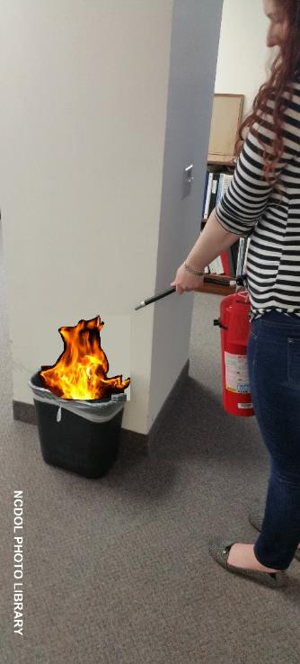
Fire Extinguishers
Selection and Distribution
1910.157(d)(2)
Employer shall distribute:
  Class A fire extinguishers within a travel distance of 75 feet or less.
  Class A - Ordinary combustibles
    Wood
    Paper
    Plastic
    Cloth
    Rubber

Slide 44

Fire Extinguishers
Inspection, Maintenance and Testing
1910.157(e)(1)-(2)
Employer shall be responsible for the inspection, maintenance and testing of all portable fire extinguishers in the workplace.
Fire extinguishers or hose shall be visually inspected monthly.

Slide 45

Fire Extinguishers
Inspection, Maintenance and Testing
1910.157(e)(3)
Employer shall:
  Assure that fire extinguishers are subjected to an annual maintenance check.
  Record the annual maintenance date and retain record for one year.
  Record available to the Assistant
  Secretary upon request.

Slide 46
Heat Stress
Excessive heat in the work environment can lead to:
  Serious physical harm and/or death.
The keys are:
  Recognition of the hazards.
  Preventive measures.
NCDOL Photo Library
Notes:
46

Slide 47
Heat Stress
The “Perfect Storm”
Dark and heavy tight wool, nylon or polyester clothing
Working in direct sunlight
No water provided
Heavy physical work (such as using an axe or shovel)
High heat index (>115º F)
No breaks
No hat
Long workday
Worker not acclimated
NCDOL Photo Library
Notes:
47

Slide 48
Heat Stress
Causal Factors
Age, weight, degree of physical fitness
Degree of acclimatization, metabolism
Use of alcohol or drugs
A variety of medical conditions such as hypertension all affect a person’s sensitivity to heat
NCDOL Photo Library
Notes:
48

Slide 49
Heat Stress
Heat Disorders and Health Effects
Heat rash
Heat cramps
Heat exhaustion
Heat stroke
NCDOL Photo Library
Notes:
49

Slide 50
Heat Stress
Citations for Heat Stress?
Heat stress hazards are cited using the General Duty Clause.
  Each employer will furnish to each of his employees conditions of employment and a place of employment that are free from recognized hazards that are causing or are likely to cause death or serious physical harm to his employees.

Slide 51
Heat Stress
Action Items for Affected Employers
A heat illness prevention program
A heat acclimatization program
Access to an adequate supply of potable water
Means for employees to cool off (e.g., shaded areas, air-conditioned rooms, vehicles, fans)
Adequate number of rest periods
Appropriate protective clothing such as cooling vests
Heat stress training
First aid training (e.g., recognition, treatment of heat illnesses

Slide 52
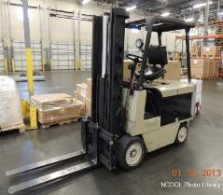
Powered Industrial Trucks
General Requirements
1910.178(a)(1)
Covers safety requirements related to fire protection, design, maintenance, and use of:
  Forklifts
  Tractors
  Platform lift trucks
  Motorized hand trucks
  Other specialized industrial trucks
    Powered by electric motors or internal combustion engines

Slide 53

Powered Industrial Trucks
General Requirements
1910.178(a)(2)-(3)
Powered Industrial Trucks “PITs” acquired and used by an employer shall meet the design requirements of:
  American National Standard for Powered Industrial Trucks, Part II, ANSI B56.1 – 1969’’, which is incorporated by reference as specified in § 1910.6.
Approved trucks shall bear a label or some other identifying mark indicating approval by the testing laboratory.

Slide 54
Powered Industrial Trucks
General Requirements
1910.178(a)(4-5)
Modifications and additions which affect capacity and safe operation must have prior written approval from manufacturer.
Trucks equipped with front-end attachments, other than factory installed must:
  Be marked to identify the attachments.
  Show approximate weight of truck and attachment combination at maximum elevation with load laterally centered.

Slide 55
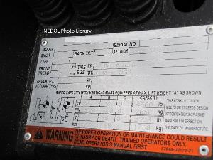
Powered Industrial Trucks
General Requirements
1910.178(a)(6)-(7)
All nameplates and markings in place and maintained in a legible condition.
The term, “approved truck or approved industrial truck”, means:
  A truck that is listed or approved for fire safety purposes for the intended use by a national recognized testing laboratory.

Slide 56

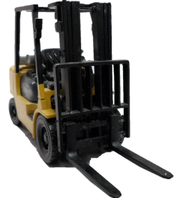
Powered Industrial Trucks
Truck Operations
1910.178(m)(9)-(10)
Overhead guard used as protection against falling objects.
Load backrest extension used when necessary.
NCDOL Photo Library
NCDOL Photo Library

Slide 57

Powered Industrial Trucks
Operator Training
1910.178(l)(1)(i)
Employer shall ensure each powered industrial truck operator is competent to operate a powered industrial truck safely.
  As demonstrated by successful completion of training and evaluation.
NCDOL Photo Library

Slide 58
Powered Industrial Trucks
Trucks, Railroad Cars and Dockboards
1910.178(j)-(k)
Brakes on trucks must be set and wheel chocks placed under rear wheels to prevent rolling.
Wheel stops or other positive protection provided to prevent railroad cars from moving.
Dockboards must be strong enough to carry imposed load.

Slide 59
Machine Guarding
Conveyors
1910, Subpart O
Conveyors are safe when used correctly, but they can be dangerous, and even deadly, if workers fail to follow safety procedures when working on or around them.
  Use of guarding and not bypassed.
  Materials should be placed on the conveyor so that they will ride safely.
  Workers should remain alert and safeguard their hands; the moving material can create pinch points.
  How someone is dressed – loose clothing, long hair, and jewelry.

Slide 60
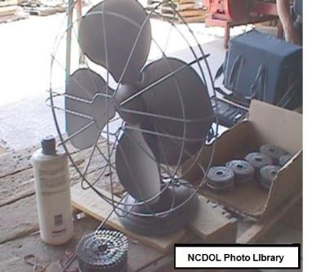
Machine Guarding
Exposure of Blades
1910.212(a)(5)
Exposure of blades
  Blades of fans less than
  7 feet above floor or
  working level must be
  guarded.
  Guard openings must
  be no larger than ½
  inch.
This fan does not comply
with the requirement.

Slide 61
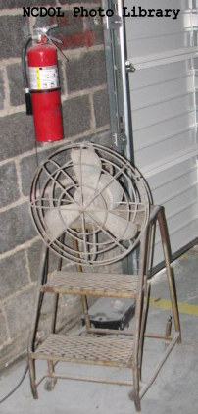
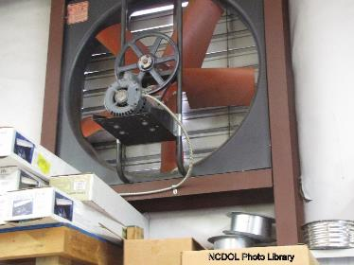
Machine Guarding
Fan Blades Not Properly Guarded
Corrective Action
  Install proper guard over fan blades with opening no larger than ½ inch.
These fans do not comply
with the requirement.

Slide 62
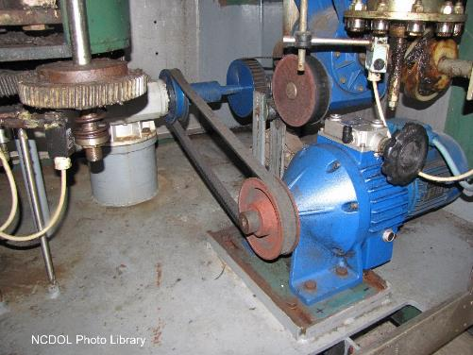
Machine Guarding
Mechanical Power-Transmission Apparatus 1910.219
Gears and belts must be guarded by complete enclosures or standard guard.
This does not comply with the requirement.

Slide 63
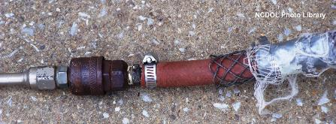

Portable Powered Tools 1910.243(b)(2)
Pneumatic powered tools and hose
  Hose and hose connections shall be designed for pressure and service which they are subjected.
Improper Hose Connection
Proper Tool Connection

Slide 64
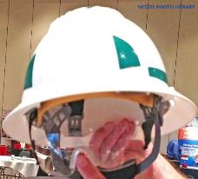

Personal Protective Equipment
Worn to minimize exposure to hazards that cause serious workplace injuries and illnesses.
  PPE examples include hard hats, goggles, gloves and hearing protection.
  Should be a temporary measure.
NCDOL Photo Library

Slide 65

Personal Protective Equipment
Hazard Assessment and Equipment Selection
1910.132(d)
Must be job and area based.
Requires written certification identifying the document as such including:
  Workplace evaluated
  Person certifying that the evaluation
  Date of hazard assessment
NCDOL Photo Library

Slide 66
Personal Protective Equipment
Training
1910.132(f)
Training subjects:
  What PPE is required.
  When PPE is required.
  How to don, doff, adjust and wear PPE.
  Limitations of PPE.
  How to maintain and clean PPE.
  When to replace PPE.

Slide 67
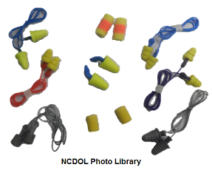
Occupational Noise Exposure
1910.95
Noise - No employee shall be exposed above the permissible exposure limit (PEL).
  PEL = 90 decibels on the A scale (dBA) for an 8-hour time-weighted average (TWA).
Feasible administrative or
engineering controls are required.
Duration per day, hours | Sound level dBA slow response
8 | 90
6 | 92
4 | 95
3 | 97
2 | 100
1.5 | 102
1 | 105
0.5 | 110
0.25 or less | 115 NCDOL Photo Library

Slide 68
Medical Services and First Aid
1910.151
Employer shall ensure the ready availability of medical personnel for advice and consultation on matters of plant health.
In the absence of an infirmary, clinic, or hospital in near proximity to the workplace which is used for the treatment of all injured employees, a person or persons shall be adequately trained to render first aid.
When required to have a person adequately trained to render first aid then adequate first aid supplies shall be readily available.

Slide 69
Medical Services and First Aid
“In Near Proximity”
1910.151
Letter of Interpretation (LOI)
  3/23/2007: Clarification of "in near proximity" and OSHA's discretion in enforcing first aid requirements in particular cases.
OSHA has long interpreted the term “in near proximity” to mean that emergency care must be available within no more than 3-4 minutes from the workplace.
OSHA can exercise discretion in some cases.
  Where the possibility of serious work-related injuries is less, such as an office.
    Up to 15 minutes may be reasonable.

Slide 70
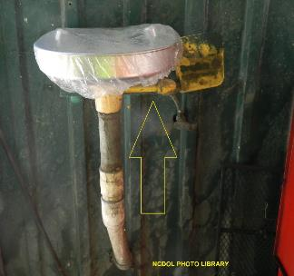
Medical Services and First Aid
Eye Wash Stations
1910.151(c)
Where the eyes or body of any person may be exposed to injurious corrosive materials, suitable facilities for quick drenching or flushing of the eyes and body shall be provided within the work area for immediate emergency use.

Slide 71
Hazard Communication
1910.1200(b)(1)
Requires employers to provide information to their employees about the hazardous chemicals to which they are exposed by the following means:
  Hazard communication program
  Labels and other forms of warning
  Safety data sheets (SDS)
  Information and training

Slide 72
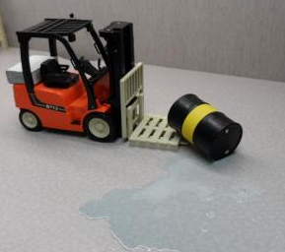
Hazard Communication
1910.1200(b)(2)
Applies to chemicals known to be present in the workplace.
Employees that may have a potential for exposure:
  Under normal conditions, or
  Foreseeable emergency.
NCDOL Photo Library
Nova Development

Slide 73
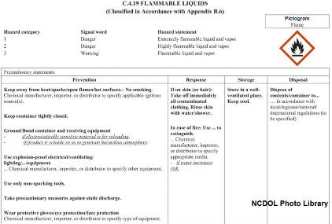
Hazard Communication
Key Elements
1910.1200
Hazard classification
Written program
Labeling
Safety Data Sheets
Employee training

Slide 74
Process Safety Management
1910.119
Prevent catastrophic releases of highly hazardous chemicals.
Grocery warehouse operations often require large scale industrial refrigeration. The quantities of ammonia required for these operations often place these operations within the Process Safety Management (PSM) Threshold Quantities.

Slide 75
Process Safety Management
Threshold Quantity (TQ)
1910.119(a)
Toxic or reactive process chemical(s) ≥ TQ:
  Chemicals covered in appendix A
  Ammonia TQ = 10,000 Lbs.
  Chlorine TQ = 1,500 Lbs.
  Flammable liquids and gasses TQ =10,000 Lbs.
    (Except [A] and [B])

Slide 76
Summary
Students should now be aware of:
  Details of OPN 145 - Special Emphasis Program for Warehousing and Storage and Related Production Distribution Industries.
  Standards and hazards covered by this OPN.
  Employer and employee responsibilities related to the SEP.

Slide 77
Thank You For Attending!
Final Questions?

