Slide 1
Walking - Working Surfaces
29 CFR Part 1910 Subpart D
Notes:
Revised 11/05/25 – minor correction made
The information in this presentation is provided voluntarily by the N.C. Department of Labor, Education Training and Technical Assistance Bureau as a public service and is made available in good faith. This presentation is designed to assist trainers conducting OSHA outreach training for workers. Since workers are the target audience, this presentation emphasizes hazard identification, avoidance, and control – not standards. No attempt has been made to treat the topic exhaustively. It is essential that trainers tailor their presentations to the needs and understanding of their audience.
The information and advice provided on this Site and on Linked Sites is provided solely on the basis that users will be responsible for making their own assessment of the matters discussed herein and are advised to verify all relevant representations, statements, and information.
This presentation is not a substitute for any of the provisions of the Occupational Safety and Health Act of North Carolina or for any standards issued by the N.C. Department of Labor. Mention of trade names, commercial products, or organizations does not imply endorsement by the N.C. Department of Labor.
NCDOL Reference Information:
WALKING AND WORKING SURFACES
Adopted May 1, 2017, these documents will be under review.
SN 3A Aisles and Passageways
SN 33A Guardrails-Petroleum Loading Racks
SN 71 Guarding Floors and Wall Openings
STD 1-1.1 Nominal Diameter
STD 1-1.6 Clearance of Handrails and Railings
STD 1-1.9 Fixed Ladders-Manhole (Rungs) Steps
STD 1-1.11 Alternating Tread Type Stair

Slide 2
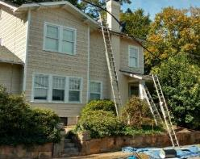
Objectives
29 CFR 1910, Subpart D
In this course, we will discuss:
  Definitions
  General requirements
  Ladders
  Step bolts and manhole steps
  Stairways
  Dockboards
  Scaffolds and rope descent systems
  Duty to have fall protection and falling object protection
  Fall protection systems
  Training requirements
NCDOL Photo Library

Slide 3
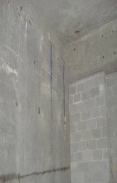
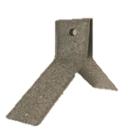
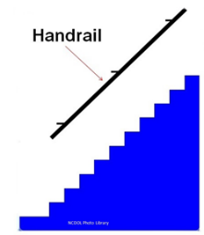
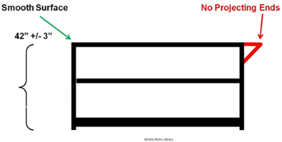
Definitions
1910.21
Anchorage
Guardrail system
Handrail
NCDOL Photo Library
NCDOL Photo Library

Slide 4
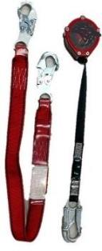
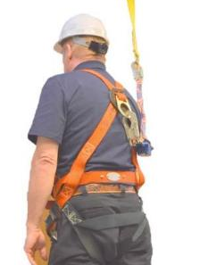
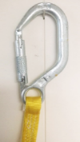
Definitions
1910.21
Personal fall arrest system
Travel restraint systems
Positioning systems
NCDOL Photo Library
NCDOL Photo Library
NCDOL Photo Library

Slide 5
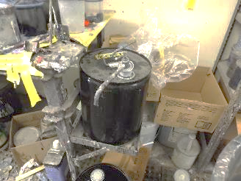
General Requirements
1910.22(a)(1)-(3)
Surface conditions
  All places of employment, passageways, storerooms, service rooms, and walking-working surfaces are kept in a clean, orderly, and sanitary condition
    Free of hazards such as
    sharp or protruding objects,
    loose boards, corrosion,
    leaks, spills, snow and ice
NC Photo Library
NCDOL Photo Library
Notes:
.

Slide 6
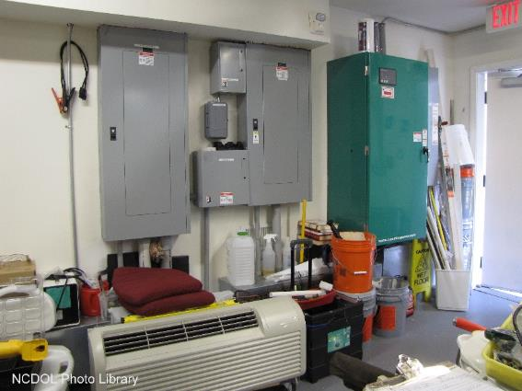
General Requirements
1910.22(a)(1)-(3)
Is this in a clean, orderly, and sanitary condition?
NCDOL Photo Library

Slide 7
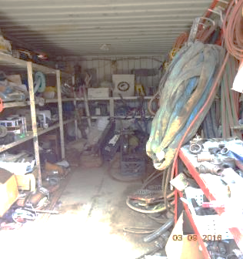
General Requirements
1910.22(d)
Inspection, maintenance and repair
  Surfaces are inspected regularly, and as necessary, and maintained in safe condition
NCDOL Photo Library

Slide 8
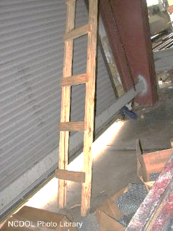
Ladders
1910.23(a)
Application
  Employer must ensure that each ladder meets requirements of this section
  Covers all ladders, except when
  the ladder is:
    Used in emergency operations
    (firefighting, rescue, and tactical
    law enforcement operations) or
    training for these operations
    Designed into or is an integral part
    of machines or equipment

Slide 9
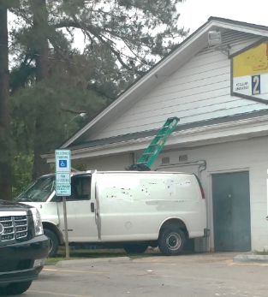
Ladders
1910.23(b)
General requirements
  Must meet the technical and dimensional standards as listed in this section
  Are used only for the
  purposes for which
  they were designed
NCDOL Photo Library
NCDOL Photo Library

Slide 10
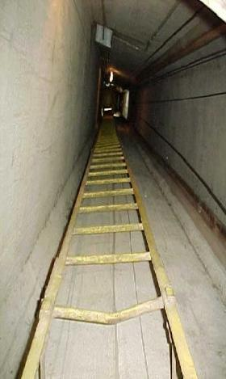
Ladders
1910.23(b)(9)
Ladders are inspected before initial use in each work shift, and more frequently as necessary, to identify any visible defects that could cause employee injury
NCDOL Photo Library

Slide 11
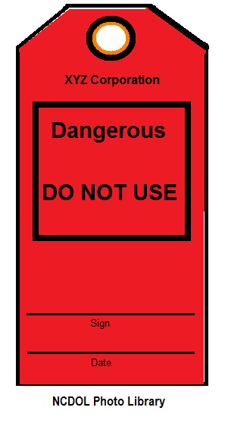
Ladders
1910.23(b)(10)
Any ladder with structural or other defects is immediately tagged “Dangerous: Do Not Use” or with similar language and removed from service until repaired or replaced

Slide 12
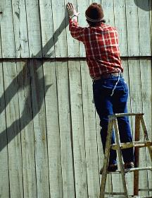
Ladders
1910.23(b)(11)-(13)
Each employee faces ladder when climbing up or down
Each employee uses at least one hand to grasp ladder when climbing up or down
No employee carries any object or load that could cause them to lose balance and fall while climbing up or down
NCDOL Photo Library
Improper Ladder Use

Slide 13

Portable Ladders
1910.23(c)(1)-(3)
Meets design standards
Not loaded beyond maximum intended load
  Maximum intended load includes total load (weight and force) of employee and all tools, equipment and materials being carried

Slide 14
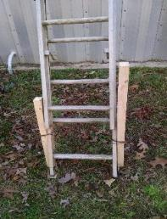
Portable Ladders
1910.23(c)(4)-(7)
Use only on stable and level surfaces unless secured or stabilized to prevent accidental displacement
  Single rail ladders are not to be used
  No ladder is moved, shifted, or
  extended while an employee is on it
  Not placed in locations such as
  passageways, doorways, or
  driveways where they can be
  displaced by other activities or traffic
NCDOL Photo Library

Slide 15
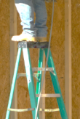
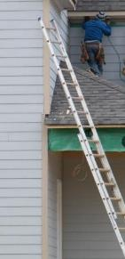
Portable Ladders
1910.23(c)(8)-(10)
Cap and top step of a stepladder are not to be used
When used on slippery surfaces, are secured and stabilized
Top of a non-self-supporting ladder is placed so that both side rails are supported
  Unless ladder is equipped with a
  single support attachment
NCDOL Photo Library
NCDOL Photo Library
NCDOL Photo Library
NCDOL Photo Library

Slide 16
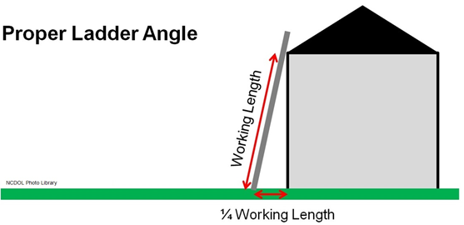
Portable Ladders
1910.23(c)(11)
When used to gain access to an upper landing, surface must have side rails that extend at least 3 feet above the upper landing surface
3 Feet

Slide 17
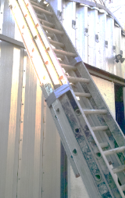
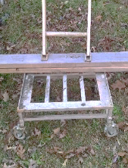
Portable Ladders
1910.23(c)(12)-(13)
Never tied or fastened together to provide added length unless they are specifically designed for such use
Never placed on boxes, barrels, or other unstable bases to obtain additional height
NCDOL Photo Library
NCDOL Photo Library

Slide 18
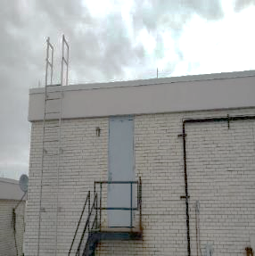
Fixed Ladders
1910.23(d)
Capable of supporting their maximum intended load
Meet design specifications listed in the standard
  One example:
    Side rails of through or side-step ladders extend 42 inches above top of access level or landing platform served by ladder
NCDOL Photo Library
Notes:
.

Slide 19
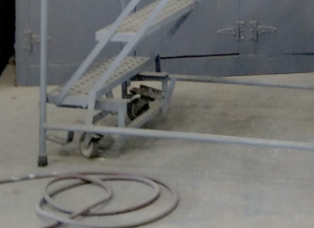
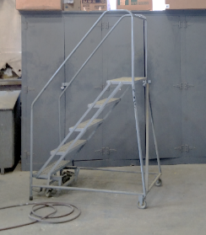
Mobile Ladder Stands/Platforms
1910.23(e)
Meet all design specifications
  Capable of supporting at least four times intended load
  Those equipped with wheels or casters
    Must be designed with a system to impede horizontal movement when an employee is on stand or platform so it does not move
NCDOL Photo Library
NCDOL Photo Library

Slide 20
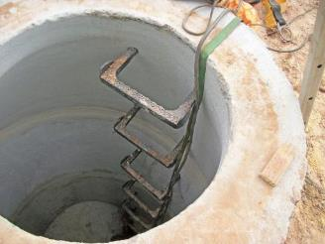
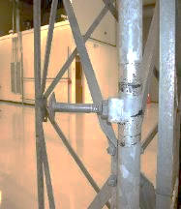
Step Bolts and Manhole Steps
1910.24(a)-(b)
Capable of supporting the maximum intended load
Must be inspected at the start of the work shift and properly maintained
Meets the design specifications as listed in the standard
NCDOL Photo Library
NCDOL Photo Library

Slide 21
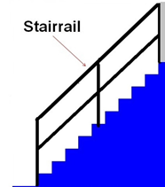
Stairways
1910.25(a)
Application
  Covers all stairways (including standard, spiral, ship, and alternating tread-type stairs)
    Except for stairs serving floating roof tanks, stairs on scaffolds, stairs designed into machines or equipment, and stairs on self-propelled motorized equipment
NCDOL Photo Library

Slide 22
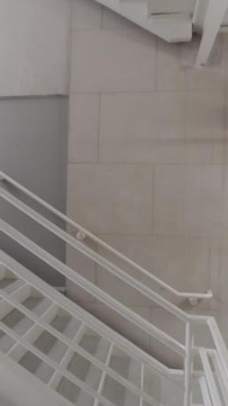
Stairways
1910.25(b)
General requirements
  Handrails, stairrail systems, and guardrail systems are provided as required by the standard
  Vertical clearance above any stair tread to any overhead obstruction is at least 6 feet, 8 inches as measured from leading edge of tread (except for spiral stairs)
NCDOL Photo Library
> 6’8”

Slide 23
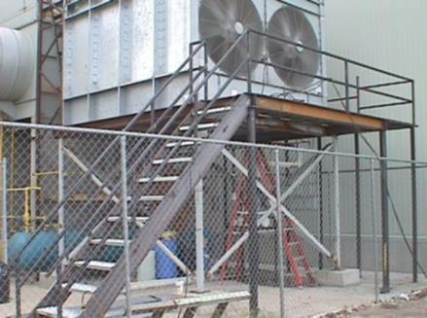
Standard Stairs
1910.25(c)(1)
Stairway rise and run
  Fixed stairs shall be installed at angles from the horizontal between 30 degrees and 50 degrees
NCDOL Photo Library
Notes:
23

Slide 24
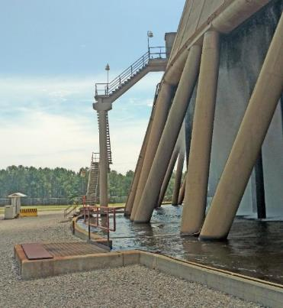
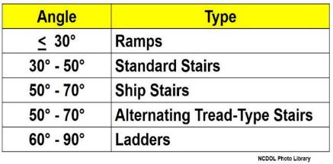
Stairs, Ramps and Ladders
1910.25
Angles for stairs, ramps and ladders
  Figure D-10
NCDOL Photo Library

Slide 25
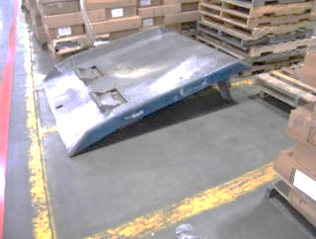
Dockboards
1910.26(a)-(c)
Capable of supporting maximum intended load
  Must be designed, constructed, and maintained to prevent transfer vehicles from running off the dockboard edge
    Exception: When employer demonstrates there is no hazard of transfer vehicles running off dockboard edge, employer may use dockboards that do not have run-off protection
Portable dockboards
  Must be secured by anchoring
  in place or using equipment or
  devices that prevent them from
  moving out of a safe position
NCDOL Photo Library

Slide 26

Dockboards
NCDOL Photo Library

Slide 27
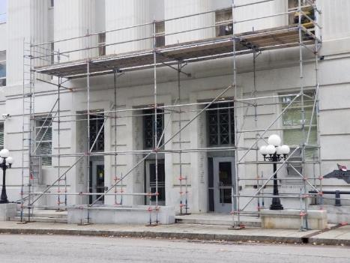
Scaffolds
1910.27(a)
All scaffolds are now regulated under Construction standards, 29 CFR Part 1926, Subpart L - Scaffolds
NCDOL Photo Library

Slide 28
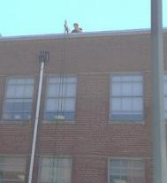
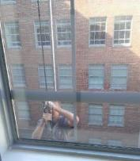
Rope Descent Systems
1910.27(b)
Anchorages
  Prior to use, building owners must inform employers in writing, that each anchorage point has:
    Been identified, tested, certified, and maintained
    Had an annual inspection by a qualified person
NCDOL Photo Library
NCDOL Photo Library

Slide 29
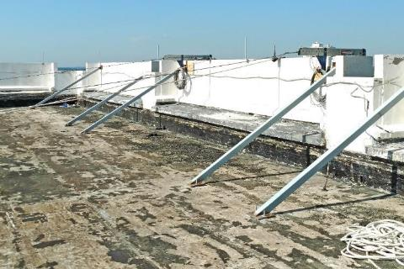
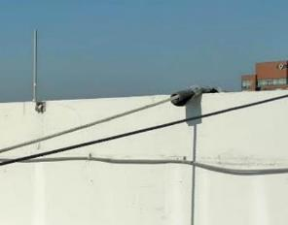
Rope Descent Systems
1910.27(b)
Anchorages
NCDOL Photo Library
NCDOL Photo Library

Slide 30
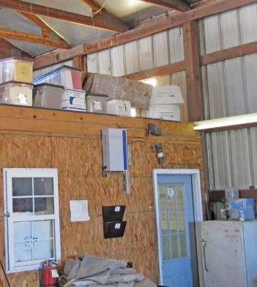
Fall Protection
1910.28(a)(1)
Employers must provide protection for each employee exposed to falls and falling object hazards
  Fall protection – 4 feet or more
  Falling object protection
NCDOL Photo Library
NCDOL Photo Library

Slide 31
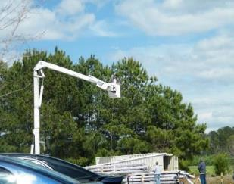
Fall Protection
1910.28(a)(2)
Powered platforms - covered by 1910.66(j)
Aerial lifts - covered by 1910.67(c)(2)(v)
Telecommunications work - covered by 1910.268(n)(7) and (8)
Electric power generation,
transmission, and distribution
work - covered
by 1910.269(g)(2)(i)
NCDOL Photo Library
NCDOL Photo Library

Slide 32
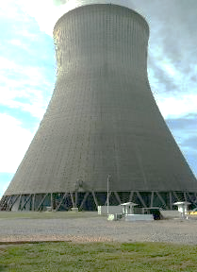

Protection From Fall Hazards
1910.28(b)(1)(i)
Unprotected sides and edges
  All employees on a walking - working surface with an unprotected side or edge that is 4 feet or more above a lower level must be provided some type of fall protection
NCDOL Photo Library
NCDOL Photo Library

Slide 33
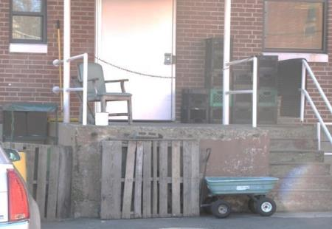
Protection From Fall Hazards
1910.28(b)(1)(i)
Fall protection:
  Guardrail systems
  Safety net systems, or
  Personal fall protection systems
    Personal fall arrest
    Travel restraint
    Positioning systems
NCDOL Photo Library
NCDOL Photo Library

Slide 34
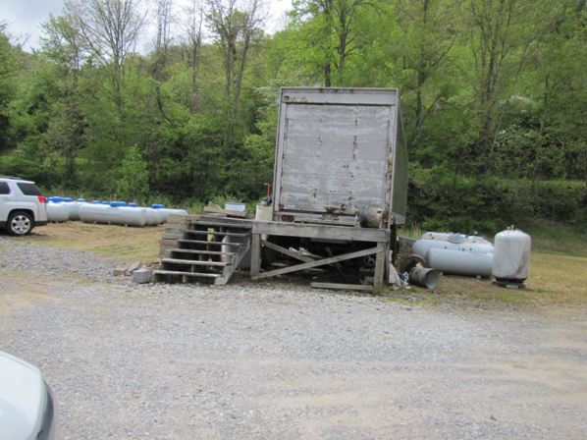
Unprotected Sides and Edges
1910.28(b)(1)(i)
Is this correct?
NCDOL Photo Library

Slide 35
Unprotected Sides and Edges
1910.28(b)(1)(i)
No
Is this correct?
Stairrails
and standard railing
NCDOL Photo Library

Slide 36
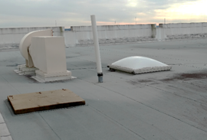
Holes
1910.28(b)(3)
Employees must be protected from falling through any hole (including skylights) that is 4 feet or more above a lower level:
  Covers
  Guardrail systems
  Travel restraint systems
  Personal fall arrest systems
  Employees must be protected
  from tripping into, or stepping
  into, or through any holes
NCDOL Photo Library
NCDOL Photo Library

Slide 37
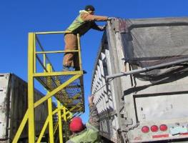
Runways/Similar Walkways
1910.28(b)(5)
Employer must ensure each employee on a runway or similar walkway is protected from falling 4 feet or more to a lower level by a guardrail system
  If not feasible to have guardrails on both sides of a runway used exclusively for a special purpose, employer may omit the guardrail on one side of runway, provided employer ensures:
    Runway is at least 18 inches wide, and
    Each employee is provided with,
    and uses:
      Personal fall arrest system, or
      Travel restraint system
NCDOL Photo Library

Slide 38
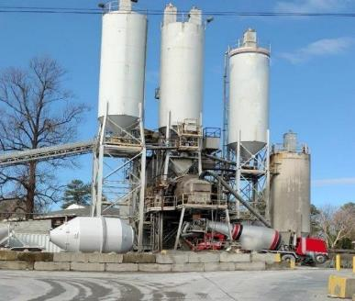
Dangerous Equipment
1910.28(b)(6)
Each employee less than 4 feet above dangerous equipment is protected from falling into or onto dangerous equipment
NCDOL Photo Library

Slide 39
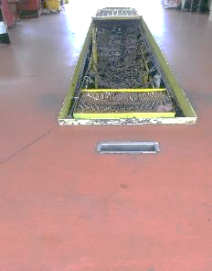
Repair, Service, and Assembly Pits
1910.28(b)(8)
Use of a fall protection system is not required for a repair pit, service pit, or assembly pit that is less than 10 feet deep, provided the employer:
  Limits access within 6 feet of
  edge of the pit to authorized
  employees trained in accordance
  with 1910.30 - Training
  Requirements
NCDOL Photo Library
NCDOL Photo Library

Slide 40
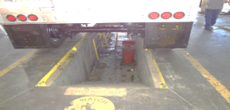
Repair, Service, and Assembly Pits
1910.28(b)(8)
  Applies floor markings at least 6 feet from edge of the pit; or
  Places a warning line at least 6 feet from edge of the pit as well as stanchions; or
  Places a combination of floor markings and warning lines at least 6 feet from edge of the pit, and
  Post readily visible caution signs that meet requirements of 1910.145 – Specifications for Accident Prevention Signs and Tags, and state “Caution—Open Pit”
NCDOL Photo Library

Slide 41
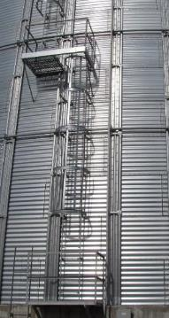
Fixed Ladders
1910.28(b)(9)(i) & (iii)
Fixed ladders that extend more than 24 feet above a lower level
  Must ensure ladder sections having a cage or well are offset from adjacent sections, and
  Have landing platforms provided at maximum
  intervals of 50 feet
  They may use a cage or well in combination
  with a personal fall arrest system or ladder
  safety system
    Provided it doesn’t interfere with that system
    Note: Final Deadline - All fixed ladders must be equipped with a personal fall arrest system or a ladder safety system after November 18, 2036
NCDOL Photo Library
NCDOL Photo Library

Slide 42
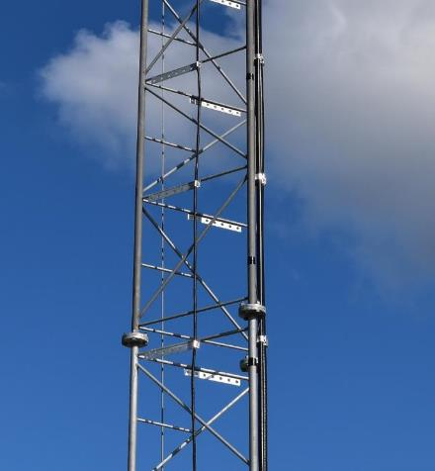

Fixed Ladders
Fixed Step / Ladder System
Rope for Fall Protection
NCDOL Photo Library
NCDOL Photo Library

Slide 43

Outdoor Advertising
Billboards
1910.28(b)(10)
NCDOL Photo Library
NCDOL Photo Library

Slide 44
Outdoor Advertising Billboards
1910.28(b)(10)
For employees engaged in outdoor advertising that climb a fixed ladder that is not equipped with a cage, well, personal fall arrest system, or a ladder safety system
  Employer must ensure the employee:
    Receives training and demonstrates physical capability to perform necessary climbs in accordance with 1910.29(h) – Outdoor Advertising
    Wears a body harness equipped with an 18-inch rest lanyard
    Keeps both hands free of tools or material when climbing on ladder
    Is protected by a fall protection system upon reaching work position
NCDOL Photo Library

Slide 45

Stairways
1910.28(b)(11)(ii)
Each flight of stairs having at least 3 treads and at least 4 risers is equipped with stairrail systems and handrails

Slide 46


Work on Low-Slope Roofs
1910.28(b)(13)
Work is performed less than 6 feet from roof edge
  Employer must ensure each employee is protected by some type of fall protection
Work is performed at least 6 feet but less than 15 feet from the roof edge
  Employer must ensure each employee is protected from falling by some type of fall protection
    Employer may use a designated
  area when performing work that
  is both infrequent and temporary
NCDOL Photo Library
NCDOL Photo Library

Slide 47

Work on Low-Slope Roofs
1910.28(b)(13)
If work is performed 15 feet or more from roof edge, employer must:
  Protect each employee from falling by a guardrail system, safety net system, travel restraint system, or personal fall arrest system or a designated area
    Employer is not required to provide any fall protection, provided work is both infrequent and temporary
  Implement and enforce a work rule
  prohibiting employees from going
  within 15 feet of roof edge without
  using a fall protection
NCDOL Photo Library

Slide 48

Slaughtering Facility Platforms
1910.28(b)(14)(i)
Employer must protect each employee on unprotected working side of a slaughtering facility platform that is 4 feet or more above a lower level from falling by using:
  Guardrail systems, or
  Travel restraint systems
NCDOL Photo Library

Slide 49

Surfaces Not Otherwise Addressed
1910.28(b)(15)
Employers must ensure that each employee on a walking - working surface 4 feet or more above a lower level is protected from falling by one of the following:
  Personal fall protection systems (such as personal fall arrest, travel restraint, or positioning systems)
  Guardrail systems, or
  Safety net systems

Slide 50

Surfaces Not Otherwise Addressed
1910.28(b)(15)
Employers must ensure that each employee on a walking - working surface 4 feet or more above a lower level is protected
NCDOL Photo Library
NCDOL Photo Library

Slide 51

Protection From Falling Objects
1910.28(c)
When an employee is exposed to falling objects, the employer must ensure that each employee wears head protection
Protection from falling objects
  Toeboards
    Requirements under 1910.29(k)(1)
  Screens
  Guardrail system
  Barricaded area
  Canopy structures
NCDOL Photo Library

Slide 52

Fall Protection Systems and Falling Object Protection
1910.29(a)
General requirements
  Criteria and practices
    Provide and install all fall protection systems and falling object protection
    Comply with the standard before any employee begins work that necessitates fall or falling object protection
NCDOL Photo Library

Slide 53

Guardrail Systems
1910.29(b)(1)
Top edge height of top rails, or equivalent guardrail system members, are 42 inches, plus or minus 3 inches, above the walking - working surface

Slide 54
Guardrail Systems
1910.29(b)(3)-(4)
Guardrail systems are capable of withstanding, without failure, a force of at least 200 pounds
  The 200-pound test load must not deflect to a height of less than 39 inches above walking/working surface

Slide 55

What is the requirement here?
NCDOL Photo Library

Slide 56

Great Example!
NCDOL Photo Library

Slide 57

Safety Net Systems
1910.29(c)
Must meet the requirements under the Construction standards, 29 CFR Part 1926, Subpart M – Fall Protection
NCDOL Photo Library

Slide 58

Designated Areas
1910.29(d)(1)
When employer uses a designated area, employer must ensure:
  Employees remain within designated area while work operations are underway; and
  Perimeter of designated area is delineated with a warning line consisting of a rope, wire, tape, or chain
    A minimum breaking strength of 200 pounds
NCDOL Photo Library

Slide 59


Designated Areas
1910.29(d)(2)-(3)
  Clearly visible from a distance of 25 feet away, and anywhere within the designated area
  Erected as close to the work area as the task permits; and
  Are erected not less than 6 feet from the roof edge for work that is both temporary and infrequent, or not less than 15 feet for other work
NCDOL Photo Library
NCDOL Photo Library

Slide 60


Covers
1910.29(e)
Employer must ensure each cover for a hole in a walking-working surface:
  Are capable of supporting without failure, at least twice the maximum intended load that may be imposed on cover at any one time, and
  Must be secured to prevent accidental displacement
NCDOL Photo Library
NCDOL Photo Library

Slide 61

Handrails/Stair Rail System
1910.29(f)(1)
Height criteria
  Handrails are not less than 30 inches and not more than 38 inches, as measured from leading edge of stair tread to top surface of handrail
  Height of stairrail systems must meet not less than 42 inches from leading edge of stair tread to top surface of top rail
Stairrail
No Mid-rail
NCDOL Photo Library
No Handrail

Slide 62

Handrails/Stairrail System
1910.29(f)(3)
Surfaces
  Handrails and stairrail systems are smooth-surfaced to protect employees from injury, such as punctures or lacerations, and to prevent catching or snagging of clothing
NCDOL Photo Library

Slide 63

Handrails/Stairrail System
1910.29(f)(4)-(5)
Openings in stairrails
  No opening in a stairrail system exceeds 19 inches at its least dimension
Handhold
  Handrails have shape
  and dimension
  necessary so that
  employees can grasp
  handrail firmly
¾” inch
NCDOL Photo Library

Slide 64

Cages, Wells and Platforms
1910.29(g)(1)-(4)
Used with fixed ladders
  Are designed, constructed, and maintained to permit easy access to, and egress from, the ladder that they enclose
  Are continuous throughout the length of the fixed ladder, except for access, egress, and other transfer points
  Designed, constructed, and maintained
  to contain employees in the event of a
  fall, and to direct them to a lower
  landing; and
    Platforms used with fixed ladders
    provide a horizontal surface of at
    least 24 inches by 30 inches
NCDOL Photo Library

Slide 65

Outdoor Advertising
1910.29(h)
Applies only to employers engaged in outdoor advertising operations
  Employers must ensure that each employee who climbs a fixed ladder without fall protection:
    Employees must be physically capable
    Employees completed training or apprenticeship program
    Employees have skill to climb ladders safely
    Performs climbing duties as part of routine work activity
NCDOL Photo Library

Slide 66
Ladder Safety Systems
1910.29(i)(1)
Allows employee to climb up and down using both hands and does not require the employee to continuously hold, push, or pull any part of the system while climbing
NCDOL Photo Library

Slide 67

Personal Fall Protection Systems
1910.29(j)
Body belts, harnesses, and other components used in personal fall arrest systems, work positioning systems, and travel restraint systems must meet requirements of 1910.140, Subpart I – Personal Protective Equipment
NCDOL Photo Library

Slide 68

Training Requirements
1910.30(a)(1)-(2)
Fall hazards
  Employees exposed to a fall hazard, employer must provide training
    Personal fall protection systems, or who is required to be trained as specified elsewhere
  Trained by a qualified person
NCDOL Photo Library

Slide 69

Training Requirements
1910.30(a)(3)
Each employee trained in at least the following topics:
  Nature of fall hazards and how to recognize them
  Correct procedures for installing, inspecting, operating, maintaining, and disassembling
    Proper hook-up
    Anchoring
    Tie-off techniques
    Methods of equipment inspection
    and storage
NCDOL Photo Library

Slide 70

Retraining
1910.30(c)(1)-(3)
Employee does not have the understanding and skill required by this section
Situations requiring retraining include:
  Changes in workplace render previous training obsolete or inadequate
  Inadequacies in knowledge or use of fall protection systems
  Equipment indicate that employee no longer has requisite understanding or skill
NCDOL Photo Library
NCDOL Photo Library

Slide 71


Training Requirements
1910.30(d)
Training must be understandable
  Employer must provide information and training to each employee in a manner that employee understands
NCDOL Photo Library

Slide 72
Summary
29 CFR 1910, Subpart D
In this course, we discussed:
  Definitions
  General requirements
  Ladders
  Step bolts and manhole steps
  Stairways
  Dockboards
  Scaffolds and rope descent systems
  Duty to have fall protection
  Fall protection systems and falling object protection
  Training requirements

Slide 73

Thank You For Attending!
Final Questions?

