Slide 1
Occupational Exposure to Tuberculosis (TB)
Notes:
Revised 6/16/25
The information in this presentation is provided voluntarily by the N.C. Department of Labor, Education Training and Technical Assistance Bureau as a public service and is made available in good faith. This presentation is designed to assist trainers conducting OSHA outreach training for workers. Since workers are the target audience, this presentation emphasizes hazard identification, avoidance, and control – not standards. No attempt has been made to treat the topic exhaustively. It is essential that trainers tailor their presentations to the needs and understanding of their audience.
The information and advice provided on this Site and on Linked Sites is provided solely on the basis that users will be responsible for making their own assessment of the matters discussed herein and are advised to verify all relevant representations, statements, and information.
This presentation is not a substitute for any of the provisions of the Occupational Safety and Health Act of North Carolina or for any standards issued by the N.C. Department of Labor. Mention of trade names, commercial products, or organizations does not imply endorsement by the N.C. Department of Labor.
NCDOL References:
TUBERCULOSIS
CPL 02-02-078 Enforcement Procedures and Scheduling for Occupational Exposure to Tuberculosis
OPN 132 Special Emphasis Program: Long Term Care Facilities

Slide 2
Objectives
Provide a basic understanding regarding the transmission and pathogenesis of M. tuberculosis (TB)
Discuss the epidemiology of TB in the United States and North Carolina
Provide an overview regarding the enforcement procedures for occupational exposure to TB

Slide 3
Reported TB Cases United States, 1982-2014
Cases
2013 down 3.6% from 2012
Year
NCDOL Photo Library
*Updated as of August 4, 2015

Slide 4
TB Morbidity – United States, 2009-2014
Year | No. | Rate*
2009 | 11,519 | 3.8
2010 | 11,164 | 3.6
2011 | 10,509 | 3.4
2012 | 9,940 | 3.2
2013 | 9,582 | 3.0
2014 | 9412 | 3.0
*Cases per 100,000. Updated as of August 4,2015
NCDOL Photo Library

Slide 5
Case Rate per 100,000 Population
NCDOL Photo Library
DATA SOURCE: NC DHHS Website

Slide 6
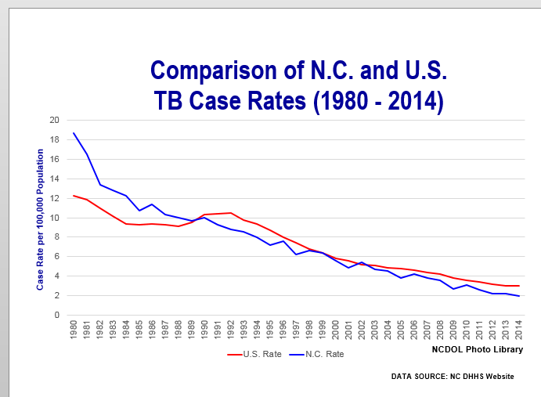
North Carolina 2014 TB Cases
North Carolina’s Tuberculosis Case Rate decreased from 2.7 to 2.0 from 2009 through 2014
  During the same time frame, Tuberculosis Case Rate in the United States decreased from 3.8 to 3.0

Slide 7
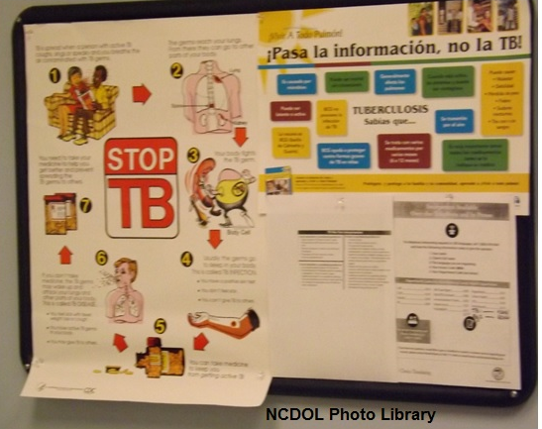
Transmission and Pathogenesis

Slide 8
Transmission of M. Tuberculosis
Spread by droplet nuclei (1-5 micrometers)
Expelled when person with infectious TB coughs, sneezes, speaks, or sings
Close contacts at highest risk of becoming infected
Transmission occurs from person with infectious TB disease (Not latent TB infection)

Slide 9
Probability of TB Transmission
Infectiousness of person with TB
Environment in which exposure occurred
Duration of exposure
Virulence of the organism

Slide 10
TB Pathogenesis – Latent TB Infection
Once inhaled, bacteria travel to lung alveoli and establish infection
2-12 weeks after infection, immune response limits activity; infection is detectable
Some bacteria survive and remain dormant but viable for years (Latent TB Infection, or LTBI)

Slide 11
TB Pathogenesis - Latent TB Infection
Persons with LTBI are:
  Asymptomatic
  Not infectious
LTBI formerly diagnosed only with tuberculin skin test (TST)
Now QuantiFeron® – TB Gold Test (QFT-G) can be used

Slide 12
TB Pathogenesis - Active TB Disease
LTBI progresses to TB disease in:
  Small number of persons soon after infection
  5-10% of people with untreated LTBI sometime during lifetime
  About 10% of people with Human Immunodeficiency Virus (HIV) and untreated LTBI per year

Slide 13
Pathogenesis
10% of infected people with normal immune systems develop TB at some point in life
HIV strongest risk factor for development of TB, if infected
  Risk of developing TB disease 7-10% each year
Certain medical conditions increase risk that TB infection will progress to TB disease

Slide 14
Conditions That Increase Risk …
… of progression to TB disease
HIV infection
Substance abuse
Recent infection
Chest radiograph findings suggestive of previous TB
Diabetes mellitus
Silicosis
Cancer of the head and neck

Slide 15
Conditions That Increase Risk …
… of progression to TB disease
Hematologic and reticuloendothelial diseases
End-stage renal disease
Intestinal bypass or gastrectomy
Chronic malabsorption syndromes
Low body weight (10% or more below the ideal)
Prolonged corticosteroid therapy
Other immunosuppressive therapy

Slide 16
Common Sites of TB Disease
Lungs
Pleura
Central nervous system
Lymphatic system
Genitourinary systems
Bones and joints
Disseminated (miliary TB)

Slide 17
Drug-Resistant TB
Drug-resistant TB transmitted same way as drug-susceptible TB
Drug resistance is divided into two types:
  Primary resistance develops in persons initially infected with resistant organisms
  Secondary resistance (acquired resistance) develops during TB therapy

Slide 18
First-Line Anti-TB Drug Products
Isoniazid (INH)
Rifampin (RIF)
Pyrazinamide (PZA)
Ethambutol (EMB) or Streptomycin (SM)*
* Streptomycin is given by injection; the others are administered as pills

Slide 19
Second-Line Anti-TB Drug Products
Capreomycin
Kanamycin
Amikacin
Ethionamide
Para-aminosalicylic acid
Cycloserine
Ciprofloxacin*
Ofloxacin*
Levofloxacin*
Clofazamine
*Broad-spectrum antibiotics belonging to class of drugs called fluoroquinolones.

Slide 20
Chronology
May 1992 – Region II OSHA issues “Enforcement Guidelines for Occupational Exposure to Tuberculosis” in response to increasing complaints
October 8, 1993 – Memorandum from Roger A. Clark, Directorate of Compliance Programs
  Based on 1990 Center for Disease Control (CDC) TB guidelines
  Utilizes General Duty Clause (GDC) to enforce CDC guidelines
February 9, 1996 – OSHA Instruction CPL 2.106, “Enforcement Procedures and Scheduling for occupational Exposure to Tuberculosis”
  Based on 1994 CDC revised guidelines

Slide 21
Chronology
October 17, 1997 – Proposed standard (notice of proposed rulemaking – NPRM) on occupational exposure to TB
December 31, 2003 – OSHA terminates rulemaking and revokes 29 CFR 1910.139 (Respiratory protection against tuberculosis)
March 2, 2004 – NCDOL adopts revocation of 29 CFR 1910.139, effective 6/30/04
  Operational Procedure Notice (OPN) 131 subsequently delays enforcement of 29 CFR 1910.134 – Respiratory Protection for TB to 1/1/05

Slide 22
Chronology
December 8, 2004 – P.L. 108-447 (Consolidated Appropriations Act) prohibits OSHA from using Fiscal Year 2005 appropriations to administer and enforce annual fit-testing requirement for respirators worn to protect against TB, 29 CFR 1910.134(f)(2)
January 4, 2005 – NCDOL enforcement policy revised (OPN 131A) to reflect similar action
June 30, 2015 – OSHA places new compliance directive in place: “Enforcement Procedures and Scheduling for Occupational Exposure to Tuberculosis”

Slide 23
OSHA Instruction CPL 02-02-078
Enforcement Procedures and Scheduling for Occupational Exposure to Tuberculosis

Slide 24
Inspection Scheduling and Scope
Inspections conducted in response to:
  TB-related fatality/catastrophes
  Employee complaints about TB exposure
  Part of all industrial hygiene inspections in workplaces containing healthcare settings
  NCDOL Special Emphasis Program for Long Term Care Facilities

Slide 25
Healthcare Settings
Inpatient healthcare settings
Outpatient healthcare settings
Non-traditional facility-based settings
Home healthcare
Notes:
*Enforcement directive, CPL 02-02-078 is based
on the 2005 CDC guidelines

Slide 26
Inpatient Healthcare Settings
Examples include:
Patient rooms
Emergency departments
Intensive care units (ICU)
Surgical suites
Laboratories/laboratory procedure areas
Bronchoscopy suites
Sputum induction or inhalation/respiratory therapy rooms
Autopsy suites
Embalming rooms

Slide 27
Outpatient Healthcare Settings
Examples include:
TB treatment facilities
Medical offices
Ambulatory-care settings
Dialysis units
Dental care settings

Slide 28
Nontraditional Facility-based Settings
Examples include:
Emergency medical service (EMS) facilities
Correctional institutions
Long-term care settings
Drug treatment centers
Homeless shelters

Slide 29
Inspection Procedures
Has the facility had a suspect or confirmed active case within previous 6 months?
  No – TB enforcement procedures do not apply
  Yes – Proceed with TB portion of inspection

Slide 30
Inspection Procedures
Employer’s TB plan will be verified through employee interviews and direct observation where feasible
When smoke-trail visualization tests are used
  Be prepared to present safety data sheet (SDS) for smoke
  Use testing methods for airborne infection isolation rooms (AIIR) in Appendix B

Slide 31
Citation Policy
Employers of employees occupationally exposed to TB must comply with the following provisions:
  NCGS 95-129(1) – General Duty Clause
  29 CFR 1910.134 – Respiratory Protection
  29 CFR 1910.145 – Accident Prevention Signs and Tags
  29 CFR 1910.1020 – Access to Employee Exposure and Medical Records
  29 CFR 1904 – Recording and Reporting Occupational
  Injuries and Illnesses
  29 CFR 1910.132 – Personal Protective Equipment, General Requirements

Slide 32
General Duty Clause
NCGS: 95-129(1)
  Each employer shall furnish to each of his employees conditions of employment and a place of employment which are free from recognized hazards that are causing or are likely to cause death or serious injury or serious physical harm to his employees

Slide 33
General Duty Clause Violation
Four Required Elements
  The employer failed to keep the workplace free of a hazard to which employees of that employer were exposed;
  The hazard was recognized in the industry;
  The hazard was causing or likely to cause death or serious physical harm; and
  There was a feasible and useful abatement method to correct (abate) the hazard.

Slide 34
Invoking the General Duty Clause
The basis of a General Duty Clause violation is exposure to the hazard, not the absence of a particular abatement method

Slide 35
Recognizing Exposure to a Serious Hazard
Employers with employees:
  Working in one of the high-risk occupational settings
  Not provided with appropriate protection, and
  Who have occupational exposure to TB

Slide 36
Occupational Exposure to Tuberculosis
Exposure to exhaled air of an individual with suspected or confirmed pulmonary TB disease, or
Employee exposure without appropriate protection to a high hazard procedure performed on individual with suspected or confirmed infectious TB disease and which has potential to generate infectious airborne droplet nuclei

Slide 37
High Hazard Procedures
Aerosolized medication treatment
Bronchoscopy
Sputum induction
Endotracheal intubation and suctioning procedures
Emergency dental procedures
Endoscopic procedures
Autopsies conducted in hospitals

Slide 38
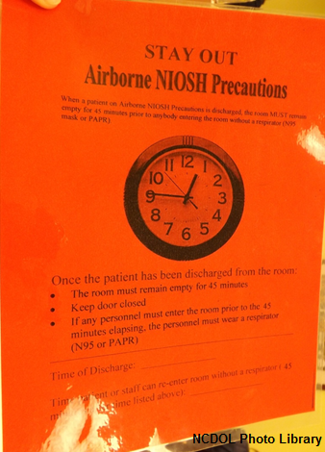
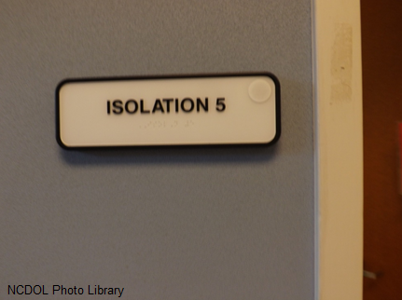
High Hazard Procedures

Slide 39
Feasible and Useful Abatement Methods
Early identification of patient/client
  Employer must implement a protocol for early identification of individuals with active TB
  Program must identify and characterize each area within the facility (See 2005 CDC Guidelines, pp. 9-10 and Appendix B – TB Risk Assessment Worksheet)

Slide 40
Medical Surveillance
Initial exams
  TB Skin Tests (TST) or
  BAMT (Blood assay for Mycobacterium tuberculosis)
  At no cost to:
    Current potentially exposed employees
    All new employees prior to exposure

Slide 41
TST or BAMT
Two-step baseline TST or one BAMT upon hire
TST/BAMT to be offered at time and location
convenient to workers
BAMT
  Alternative to TST
  Only single test required to establish baseline

Slide 42
Medical Surveillance
Periodic evaluations
  TBT/BAMT to be conducted for workers in the following categories:
    Potential ongoing transmission – as needed in the investigation of potential ongoing transmission
    Medium risk – annually
    Low risk – none
    Exemption for workers with documented history of disease, positive test result or who have documented completion of treatment for disease or preventive therapy for infection
Reassessment is required following exposure or change in health

Slide 43
Medical Surveillance
Case management of infected employees must include:
  Protocol for new converters
  Conversion to positive TST or BAMT to be followed ASAP by appropriate evaluations
    Physical
    Laboratory
    Radiographic
  Work restrictions for infectious employees

Slide 44
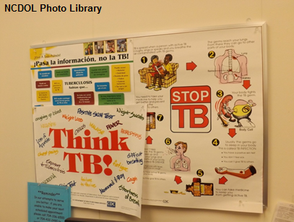
Worker Education and Training
Training to be repeated as needed
Elements:
    Mode of TB transmission
    Signs and symptoms of TB
    Medical surveillance and therapy
    Site specific protocols (including purpose and use of controls )
    Recognition of suspected TB disease

Slide 45
Engineering Controls
Individuals with suspected or confirmed infectious TB disease must be placed in an AIIR
High hazard procedures must be performed in:
  AIIR isolation treatment rooms
  AIIR isolation rooms, local exhaust booths and/or local exhaust hoods

Slide 46
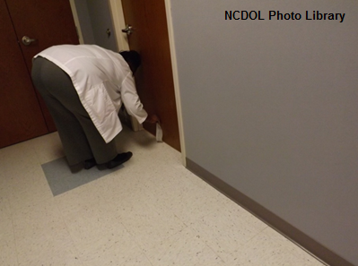
Engineering Controls
Isolation and treatment rooms in use by individuals with suspected or confirmed infectious TB disease must be kept under negative pressure (smoke test, etc.)

Slide 47
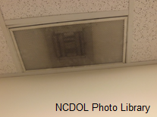
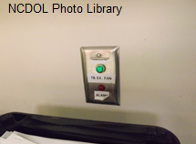
Engineering Controls
Air exhausted from isolation or treatment rooms must be exhausted directly outside and not recirculated into general ventilation system
Where recirculation unavoidable, high efficiency particulate air (HEPA) filters to be installed in duct system from room to general ventilation
  HEPA filters to be monitored on regular schedule

Slide 48
Engineering Controls
All potentially contaminated air which is ducted through facility must be kept under negative pressure until safely discharged outside (i.e., away from occupied areas and air intakes), or
Air from isolation and treatment rooms must be decontaminated by a recognized process (e.g., HEPA filter) before recirculated back to isolation/treatment room.
Use of UV radiation as the sole means of decontamination shall not be used.

Slide 49
Engineering Controls
If high hazard procedures performed within airborne infection isolation or treatment rooms
  Without source control or local exhaust ventilation and droplets released into environment
  Purge time interval must be imposed during which respirators required when entering room
Interim or supplemental ventilation units equipped with HEPA filters are acceptable

Slide 50
Respiratory Protection
1910.134(a)(2)
Respirators shall be provided by the employer when such equipment is necessary to protect the health of the employee.
The employer shall provide the respirators which are applicable and suitable for the purpose intended.
The employer shall be responsible for the establishment and maintenance of a respiratory protection program which shall include the requirements outlined in paragraph (c) of this section.
The program shall cover each employee required by this section to use a respirator.

Slide 51
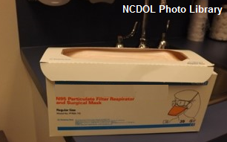
Respiratory Protection
NIOSH respirator certification criteria (42 CFR Part 84 Subpart K)
  Flow rate of 85 liters/minute
  Tested for penetration by particles with median Aerodynamic diameter of 0.3 micrometers (μm)
Three categories of certified respirators
  Type 100 (99.97% efficient)
  Type 99 (99% efficient)
  Type 95 (95% efficient) – minimum for TB

Slide 52
Respiratory Protection
HEPA respirators or respirators certified under 42 CFR Part 84 Subpart K are required:
  When workers enter rooms housing individuals with suspected or confirmed infectious TB
  When workers present during performance of high hazard procedures on individuals with suspected or confirmed infectious TB
  When emergency medical response personnel or others transport, in a closed a vehicle, an individual with suspected or confirmed infectious TB

Slide 53
Respirator Program Requirements
1910.134(c)
Written operating
procedures
Proper selection
Training and fitting
Cleaning and disinfecting
Storage
Inspection and maintenance
Work area surveillance
Inspection/evaluation of program
Approved respirators

Slide 54
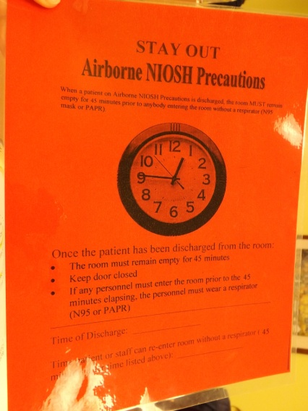
Accident Prevention Signs and Tags
1910.145(f)(8)
A warning shall be posted outside the respiratory isolation or treatment room or a message referring one to the nursing station for instruction may be posted.
NCDOL Photo Library

Slide 55
Accident Prevention Signs and Tags
1910.145
A signal word/phrase (“Danger,” “Caution,” “Biological Hazard,” or “BIOHAZARD”), or
Biohazard symbol
Biological hazard tags are also required on air transport components (e.g., fans, ducts, filters) that transport contaminated air

Slide 56
Employee Medical/Exposure Records
1910.1020
Employee access to records
  A record concerning employee exposure to TB is an employee exposure record.
  A record of TB skin test or BAMT results and medical evaluations and treatment are employee medical records.

Slide 57
OSHA 300 Log
1904.11/1904.33
Both TB infections (positive skin test) and TB disease are recordable
Original entry must be updated if TB infection progresses to TB disease during 5 year maintenance period

Slide 58
OSHA 300 Log
1904.11
Case need not be recorded if:
  Worker lives in household with known active case;
  Public health department identified worker the contact of person with active TB unrelated to the workplace; or
  Medical investigation shows infection caused by exposure away from work or not related to the workplace.

Slide 59
Outreach and Assistance
N.C. Department of Labor
1-800-NC-LABOR
http://www.ncdol.com
Consultative Services
1-800-NC-LABOR or 919-807-2899
Education, Training and Technical Assistance
  1-800-NC-LABOR or 919-807-2875
NIOSH
1-800-35-NIOSH
http://www.cdc.gov/niosh/homepage.html

Slide 60
Thank You For Attending!
Final Questions?

