Slide 1
Toxic and Hazardous Substances
1910 Subpart Z
Notes:
Revised 06/2025
The information in this presentation is provided voluntarily by the N.C. Department of Labor, Education, Training and Technical Assistance Bureau as a public service and is made available in good faith. This presentation is designed to assist trainers conducting OSHA outreach training for workers. Since workers are the target audience, this presentation emphasizes hazard identification, avoidance, and control – not standards. No attempt has been made to treat the topic exhaustively. It is essential that trainers tailor their presentations to the needs and understanding of their audience.
The information and advice provided on this Site and on Linked Sites is provided solely on the basis that users will be responsible for making their own assessment of the matters discussed herein and are advised to verify all relevant representations, statements, and information.
This presentation is not a substitute for any of the provisions of the Occupational Safety and Health Act of North Carolina or for any standards issued by the N.C. Department of Labor. Mention of trade names, commercial products, or organizations does not imply endorsement by the N.C. Department of Labor.

Slide 2
Objectives
At the end of this course, students will be able to:
  Identify toxic and hazardous substances.
  Identify where to find toxicological information.
  Recognize what a PEL is and how it differs from a TLV, REL, and IDLH.
  Become comfortable with the information contained in 29 CFR 1910 Subpart Z.

Slide 3
29 CFR 1910 Subpart Z – Partial List
1910.1045 – Acrylonitrile
1910.1047 – Ethylene oxide
1910.1048 – Formaldehyde
1910.1050 – Methylenedianiline
1910.1051 – 1,3-Butadiene
1910.1052 – Methylene chloride
1910.1053 – Respirable Crystalline Silica
1910.1096 – Ionizing radiation
1910.1200 – Hazard communication
1910.1201 – Retention of DOT markings, placards and labels
1910.1450 – Hazardous chemicals in laboratories

Slide 4
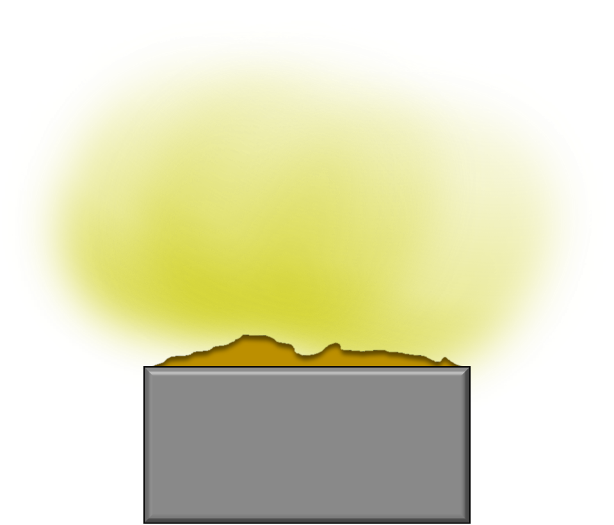
Toxic and Hazardous Substances
Chemicals present in the workplace in various forms, and which exert health effects.
Examples include:
  Dusts
  Mists
  Vapors
  Fumes
  Mixtures
Dust Particles

Slide 5
Health Hazard Definition
1910.1200
Chemical that poses one of the following effects:
  Acute toxicity (any route of exposure)
  Skin corrosion or irritation
  Serious eye damage or eye irritation
  Respiratory or skin sensitizer
  Germ cell mutagen
  Carcinogen
  Reproductive toxicity
  Specific target organ toxicity (single or repeated exposure)
  Aspiration hazard
Notes:
5

Slide 6
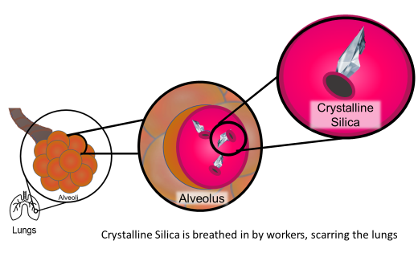
Routes of Exposure
Three major routes:
  Skin (dermal absorption)
  Respiratory tract (inhalation)
  Digestive tract (ingestion)
Additional routes:
  Eyes
  Mucous membranes
  Injection (parenteral)

Slide 7
Toxicological Information Resources
SDS – Safety Data Sheet
OSHA – Chemical Sampling Information
NIOSH – Pocket Guide
CDC – Agency for Toxic Substances and Disease Registry

Slide 8
Terminology

Slide 9
Permissible Exposure Limit (PEL)
Maximum airborne concentration (chemical) an employee may be exposed to for a particular time period.
Regulatory limits enforced by OSHA.
Based on an 8-hour time weighted average (TWA) exposure.
May contain a skin designation.
Notes:
9

Slide 10
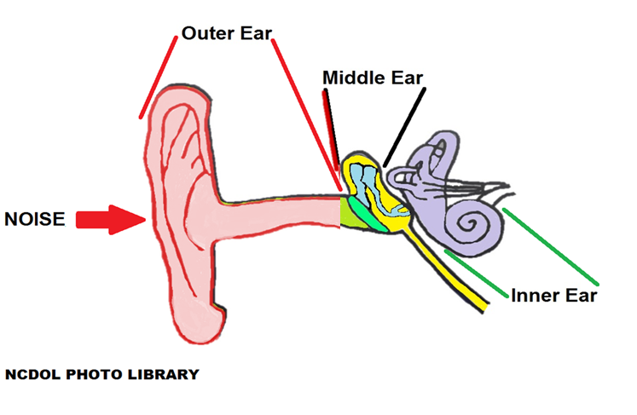
Permissible Exposure Limit
PELs for physical hazards:
  Noise
  Non-ionizing radiation
Notes:
10

Slide 11

Permissible Exposure Limit
No PELs for biological hazards
  Mold
  Bacteria
Mold on ceiling tiles
Notes:
11

Slide 12
Occupational Exposure Guidelines
TLV – Threshold Limit Value
  Established by American Conference of Governmental Industrial Hygienists (ACGIH)
REL – Recommended Exposure Limit
  Established by National Institute for Occupational Safety and Health (NIOSH)
WEEL – Workplace Environmental Exposure Level
  Established by American Industrial Hygiene Association (AIHA)

Slide 13
Occupational Exposure Guidelines
IDLH – Immediately Dangerous to Life or Health
  Exposure to which can cause:
    Death,
    Adverse health effects, or
    Prevent escape from that environment.
  Encompasses exposures that might hinder a worker form escaping a contaminated area.
Notes:
13

Slide 14
Averaging Time
PELs for chemicals subclassified by their time weighted average (TWA).
  8-hour TWA
Short -Term Exposure Limit or STEL
    15-minute TWA
Ceiling Limit
    Instantaneous limit

Slide 15
29 CFR 1910.1000
Air Contaminants
Notes:
Revised 9/2022

Slide 16
29 CFR 1910.1000
An employee’s exposure to any substance listed in these tables must be limited:
  Table Z-1 Limits for Air Contaminants
  Table Z-2
  Table Z-3 Mineral Dusts

Slide 17
Table Z-1 – Limits for Air Contaminants
Substance | CAS No. | ppm | mg/m³ | Skin designation
Acetone | 67-64-1 | 1000 | 2400
Chlorine | 7782-50-5 | (C)1 | (C)3
Nicotine | 54-11-5 |  | 0.5 | X

Slide 18
Table Z-1 – Limits for Air Contaminants
Substance | CAS No. | ppm | mg/m³ | Skin designation
Acetone | 67-64-1 | 1000 | 2400
Chlorine | 7782-50-5 | (C)1 | (C)3
Nicotine | 54-11-5 |  | 0.5 | X
Substance:
  Many substances have multiple synonyms
  Synonyms for acetone: Dimethyl ketone, Ketone propane, 2-Propanone

Slide 19
Table Z-1 – Limits for Air Contaminants
Substance | CAS No. | ppm | mg/m³ | Skin designation
Acetone | 67-64-1 | 1000 | 2400
Chlorine | 7782-50-5 | (C)1 | (C)3
Nicotine | 54-11-5 |  | 0.5 | X
Chemical Abstracts Service (CAS) Registry Number:
  Unique identifier
  Used in many resources, including:
    OSHA’s Chemical Sampling Information
    NIOSH Pocket Guide

Slide 20
Table Z-1 – Limits for Air Contaminants
Substance | CAS No. | ppm | mg/m³ | Skin designation
Acetone | 67-64-1 | 1000 | 2400
Chlorine | 7782-50-5 | (C)1 | (C)3
Nicotine | 54-11-5 |  | 0.5 | X
Parts per million (ppm): Parts of vapor or gas per million parts of contaminated air by volume.
PELs are 8-hour TWAs unless otherwise noted.

Slide 21
Table Z-1 – Limits for Air Contaminants
Substance | CAS No. | ppm | mg/m³ | Skin designation
Acetone | 67-64-1 | 1000 | 2400
Chlorine | 7782-50-5 | (C)1 | (C)3
Nicotine | 54-11-5 |  | 0.5 | X
Milligrams of substance per cubic meter of air (mg/m³)
  Exact when entry is only in this column.
  Approximate when listed along with a ppm entry.
PELs are 8-hour TWAs unless otherwise noted.

Slide 22
Table Z-1 – Limits for Air Contaminants
Substance | CAS No. | ppm | mg/m³ | Skin designation
Acetone | 67-64-1 | 1000 | 2400
Chlorine | 7782-50-5 | (C)1 | (C)3
Nicotine | 54-11-5 |  | 0.5 | X
An entry in this column indicates the substance may be absorbed through the skin.
To avoid exceeding the PEL, cutaneous absorption should also be prevented.

Slide 23
Table Z-1 – Limits for Air Contaminants
Substance | CAS No. | ppm | mg/m³ | Skin designation
Acetone | 67-64-1 | 1000 | 2400
Chlorine | 7782-50-5 | (C)1 | (C)3
Nicotine | 54-11-5 |  | 0.5 | X
Ceiling values “C” – employee’s exposure shall at no time exceed the exposure limit.
If instantaneous monitoring is not feasible, assess using 15-minute TWA (STEL).

Slide 24
Table Z-2
Substance | 8-hour TWA | Acceptable ceiling concentration | Acceptable max peak above acceptable ceiling for an 8-hr shift
 |  |  | Concentration | Duration
Benzene | 10 ppm | 25 ppm | 50 | 10 minutes

Slide 25
Table Z-2
1910.1000(b)
Substance | 8-hour TWA | Acceptable ceiling concentration | Acceptable max peak above acceptable ceiling for an 8-hr shift
 |  |  | Concentration | Duration
Benzene | 10 ppm | 25 ppm | 50 | 10 minutes
An employee’s exposure to any substance listed in Table Z-2, in any 8-hour work shift of a 40-hour work week, shall not exceed the 8-hour TWA limit given for that substance in Table Z-2.

Slide 26
Table Z-2
1910.1000(b)
Substance | 8-hour TWA | Acceptable ceiling concentration | Acceptable max peak above acceptable ceiling for an 8-hr shift
 |  |  | Concentration | Duration
Benzene | 10 ppm | 25 ppm | 50 | 10 minutes
An employee’s exposure to a substance listed in Table Z-2 shall not exceed at any time during an 8-hour shift, the acceptable ceiling concentration limit given for the substance in the table, except for a time period, and up to a concentration not exceeding the maximum duration and concentration allowed in the column under “acceptable maximum peak above the acceptable ceiling concentration for an 8-hour shift”.

Slide 27
Table Z-2
1910.1000(b)
Substance | 8-hour TWA | Acceptable ceiling concentration | Acceptable max peak above acceptable ceiling for an 8-hr shift
 |  |  | Concentration | Duration
Benzene | 10 ppm | 25 ppm | 50 | 10 minutes
Example. During an 8-hour work shift, an employee may be exposed to a concentration of Benzene (with a 10 ppm TWA, 25 ppm ceiling and 50 ppm peak) above 25 ppm (but never above 50 ppm) only for a maximum period of 10 minutes. Such exposure must be compensated by exposures to concentrations less than 10 ppm so that the cumulative exposure for the entire 8-hour work shift does not exceed a weighted average of 10 ppm.

Slide 28
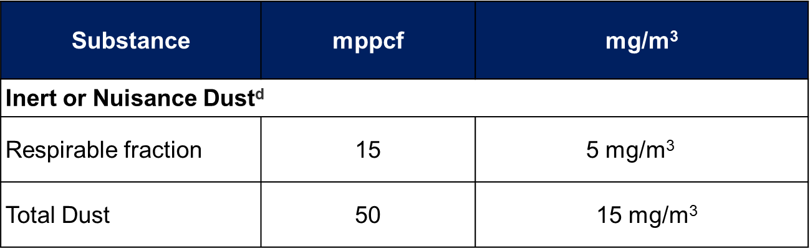
Table Z-3 – Mineral Dusts
mppcf – millions of particles per cubic foot of air

Slide 29
Table Z-3 – Mineral Dusts
Substance | mppcf | mg/m³
Inert or Nuisance Dust^{d}
Respirable fraction | 15 | 5 mg/m³
Total Dust | 50 | 15 15 mg/m³
^{d} All inert or nuisance dusts, whether mineral, inorganic, or organic, not listed specifically by substance name are covered by this limit, which is the same as the Particulates Not Otherwise Regulated (PNOR) limit in Table Z-1.

Slide 30
Table Z-3 – Mineral Dusts
Example: 50 mppcf or 15 mg/m³ of total dust is permissible exposure level for total dust.

Slide 31

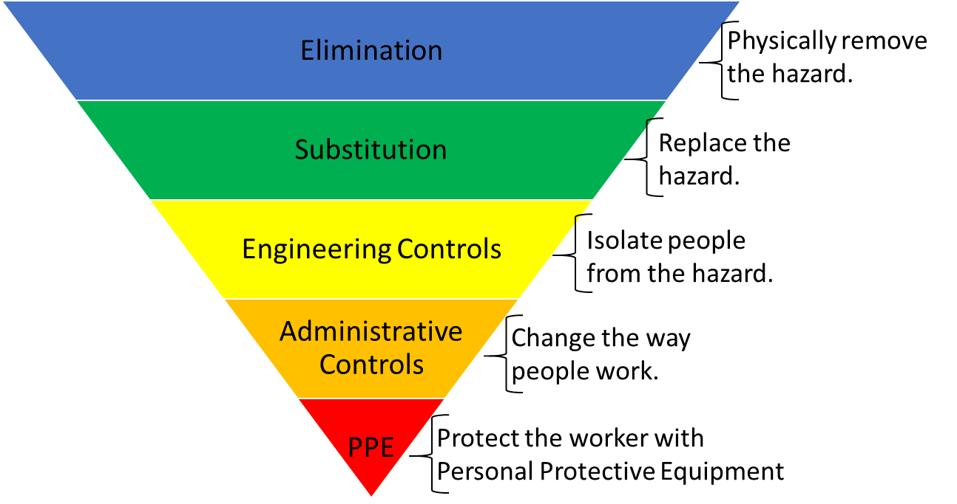
Hierarchy of Controls
NCDOL Photo Library

Slide 32
29 CFR 1910.1000(e)
To achieve compliance with paragraphs (a) through (d), administrative or engineering controls must first be determined and implemented whenever feasible.
When such controls are not feasible to achieve full compliance, protective equipment or any other protective measures shall be used to keep the exposure of employees to air contaminants within the limits prescribed in this section.
Any equipment and/or technical measures used for this purpose must be approved for each particular use by a competent industrial hygienist or other technically qualified person. Whenever respirators are used, their use shall comply with 1910.134 – Respiratory Protection.

Slide 33
Expanded Health Standards
1910.1052 – Methylene Chloride
Notes:
Revised 06/2025

Slide 34
Methylene Chloride
Organic solvent often used in furniture stripping and spray adhesives.
Metabolized to carbon monoxide in the body.
  Concern about hypoxia in addition to normal central nervous system solvent effects.
  Possible carcinogen
Routes of exposure:
  Skin
  Respiratory tract (inhalation)

Slide 35
Methylene Chloride Health Risks
Exposures to methylene chloride have been known to:
  Affect the heart, central nervous system and liver
  Irritate the eyes and skin
  Increase the risk of cancer

Slide 36
1910.1052 – Methylene Chloride
Scope and application
Definitions
Permissible exposure limits
Exposure monitoring
Regulated areas
Methods of compliance
Respiratory protection
Protective work clothing and equipment
Hygiene facilities

Slide 37
1910.1052 – Methylene Chloride
Medical surveillance
Hazard communication
Employee information and training
Recordkeeping
Reserved
Appendices
  Appendix A: Substance Safety Data Sheet and Technical Guidelines for Methylene Chloride
  Appendix B: Medical Surveillance for Methylene Chloride
  Appendix C: Questions and Answers – Methylene Chloride Control in Furniture Stripping

Slide 38
Summary
We have covered the following items, during this presentation:
  Toxic and hazardous substances
  Where to find toxicological information
  PELs and how they differ from TLVs, RELs, IDLHs
  29 CFR 1910 Subpart Z

Slide 39
Thank You For Attending!
Final Questions?

