Slide 1
Steel Erection
§1926 Subpart R
Presented by:
Notes:
1
Revised 06/16/25
The information in this presentation is provided voluntarily by the N.C. Department of Labor, Education Training and Technical Assistance Bureau as a public service and is made available in good faith. This presentation is designed to assist trainers conducting OSHA outreach training for workers. Since workers are the target audience, this presentation emphasizes hazard identification, avoidance, and control – not standards. No attempt has been made to treat the topic exhaustively. It is essential that trainers tailor their presentations to the needs and understanding of their audience.
The information and advice provided on this Site and on Linked Sites is provided solely on the basis that users will be responsible for making their own assessment of the matters discussed herein and are advised to verify all relevant representations, statements, and information.
This presentation is not a substitute for any of the provisions of the Occupational Safety and Health Act of North Carolina or for any standards issued by the N.C. Department of Labor. Mention of trade names, commercial products, or organizations does not imply endorsement by the N.C. Department of Labor.

Slide 2
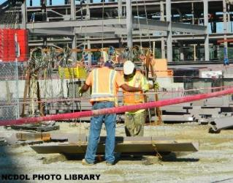
Objectives
After this course, students will:
  Be aware of the conception of the steel erection rule.
  Recognize the scope of the steel erection standard.
  Be able to reference key provisions of 1926 Subpart R.
  Be familiar with hazards and safe working practices related to steel erection.

Slide 3
Amputations Special Emphasis Program
Goal to reduce occupational exposures to amputations.
Struck by and caught between injuries.
  Lockout/tagout
  Machine guarding
Increase outreach to employers and employees.
  Training Events (Internal and external)
  Compliance Inspections
  Consultation Visits
  Publications
Amputations must be reported within 24 hours.

Slide 4
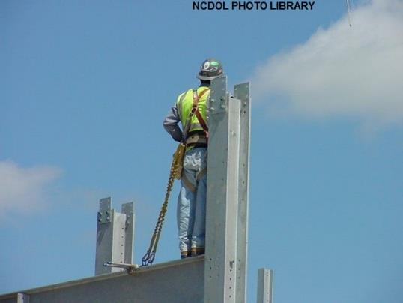
Subpart R - Final Rule
Steel erection rule was published on January 18, 2001.
Operational Procedure Notice 121

Slide 5
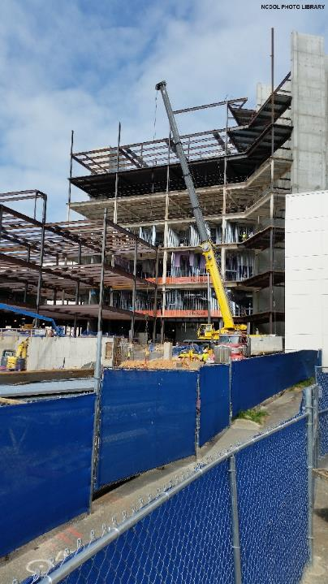
Scope
1926.750(a)
Sets forth requirements to protect employees from the hazards associated with steel erection activities involved in:
  Construction, alteration, and/or repair of:
    Single and multi-story buildings
    Bridges
    Other structures where steel
    erection occurs

Slide 6
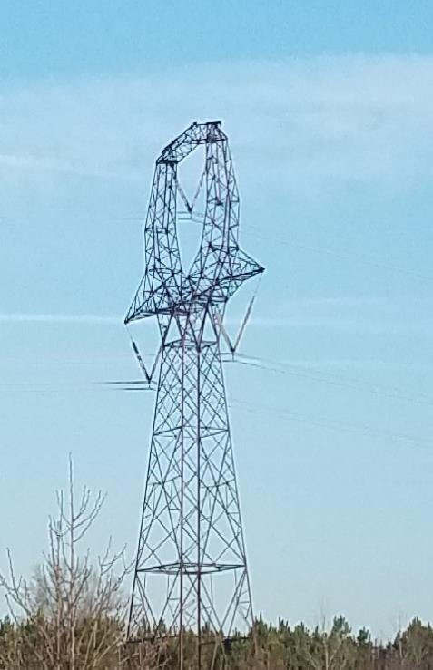
Scope
1926.750(a)
Does not include:
  Electrical transmission towers
  Communication and broadcast towers
  Tanks
NCDOL Photo Library

Slide 7
Scope
1926.750(b)
Covers all employers engaged in steel erection activities.
Contains two lists of activities:
  Primary list
    All are covered (such as connecting, bracing, guying).
  Ancillary list
    Covered only “when they occur during and are a part of steel erection activities”.

Slide 8
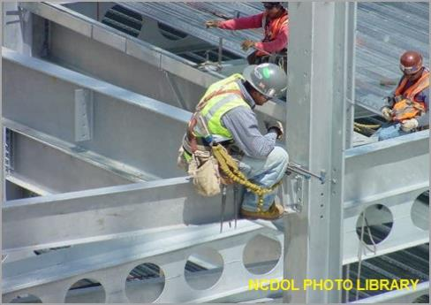
Scope
13 NCAC 07F .0205(b)(1)
Steel erection activities include:
  Hoisting, laying out, placing, connecting, welding, burning, guying, bracing, bolting, plumbing and rigging structural steel, steel joists, bridge steel girders and metal buildings; installing metal decking and moving point-to-point while performing these activities.

Slide 9
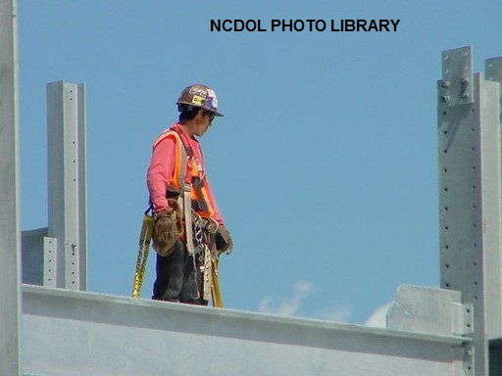
Scope
13 NCAC 07F .0205(b)(2)
Employer has the burden of establishing and determining when to implement employee fall protection measures.

Slide 10
Steel Erection Decision Tree
Is the activity at the jobsite
listed in 1926.750(b)(1)?
Yes
No
Is the activity listed in
.750(b)(2)?
Then this activity is
covered by Subpart R
Yes
No
Then you must determine if this is going on in
conjunction with (during and a part of) steel
erection activities in (b)(1). A question to ask:
Does this (b)(2) activity have to be done for
steel erection to continue: If yes, and if done
during (b)(1) activities, then it is covered by
the standard.
Because it is not listed in either
(b)(1) or (b)(2), it is not
covered by the standard.

Slide 11
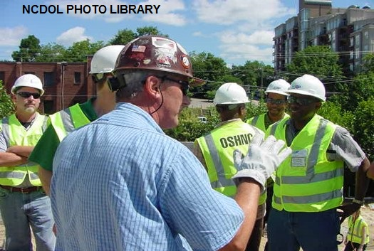
Key Provisions of 1926 Subpart R
Site layout, site-specific erection plan and construction sequence
Hoisting and rigging
Structural steel stability requirements
Structural steel assembly
Column anchorage
Beams and columns
Open web steel joists

Slide 12
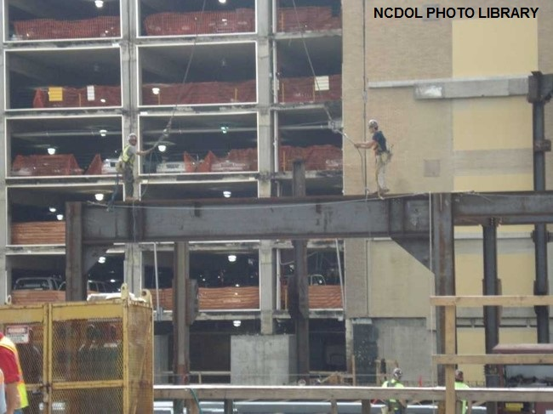
Key Provisions of 1926 Subpart R
Systems-engineered metal buildings
Falling object protection
Fall protection
Worker training

Slide 13
Site Layout, Site-Specific Erection
Plan and Construction Sequence
1926.752(a)-(b)
Controlling contractor ensures the steel erector is provided with written notification.
  Concrete being used has reached sufficient strength to support the intended load.
  Repair, replacements and modification of steel bolts were conducted in accordance with 1926.755(b).
Steel erection contractor shall not proceed without ensuring that concrete has reached sufficient strength to support intended load.

Slide 14
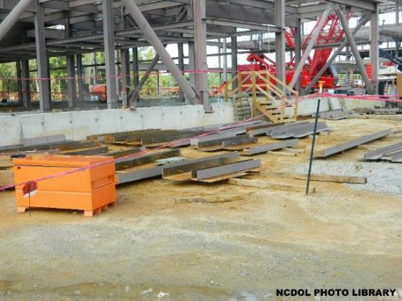
Site Layout, Site-Specific Erection
Plan and Construction Sequence
1926.752(c)
Site layout
  Adequate access roads
    Safe delivery of supplies
    Movement of equipment
  Firm, properly graded,
  and drained area
    Allows for work with adequate space
    Allows for safe operation of equipment

Slide 15
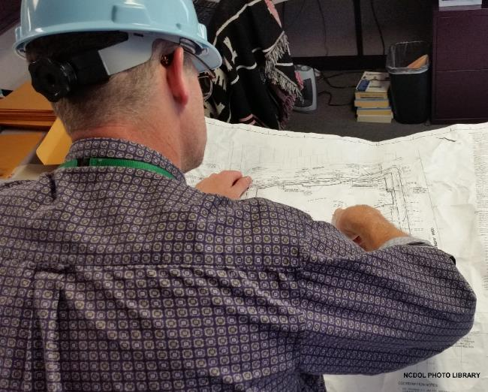
Site Layout, Site-Specific Erection
Plan and Construction Sequence
1926.752(e)
Site-specific erection plan
  See 1926 Subpart R, Appendix A
    Provides guidelines for a non-mandatory site-specific erection plan.

Slide 16
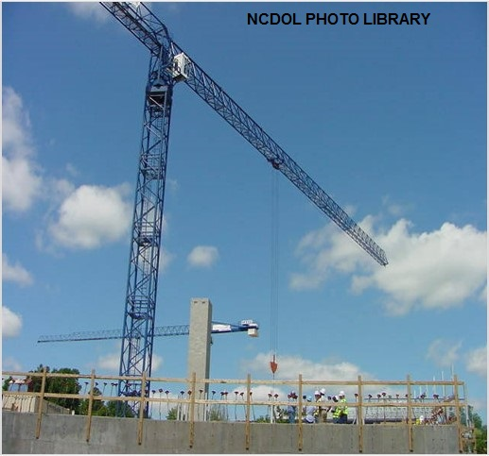
Hoisting and Rigging
1926.753(c)-(d)
Provides additional crane safety for steel erection by requiring a pre-shift crane inspection.
Minimizes employee exposure to overhead loads through pre-planning and work practice requirements.

Slide 17
Hoisting and Rigging
1926.753(d)(2)(iii)
All loads shall be rigged by a qualified rigger.

Slide 18
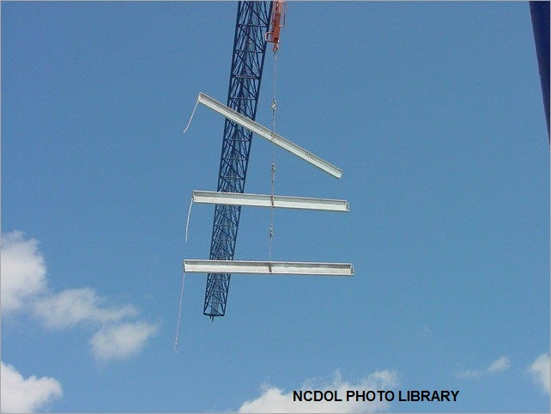
Hoisting and Rigging
1926.753(e)
Provides multiple lift rigging procedures (Christmas-treeing).

Slide 19
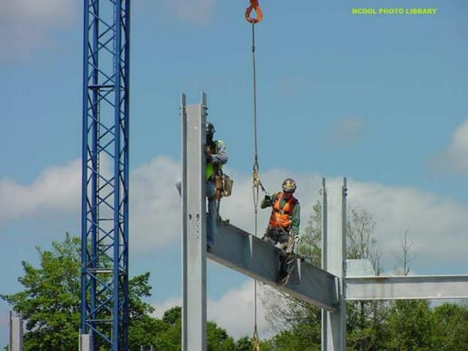
Structural Steel Assembly
1926.754
Structural stability
Metal decking
Plumbing up
Walking/working surface

Slide 20
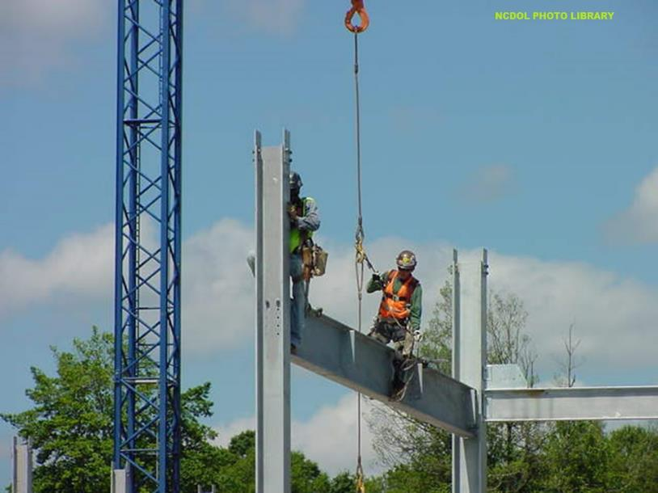
Structural Stability
1926.754(a)
Shall be maintained at all times during construction.

Slide 21
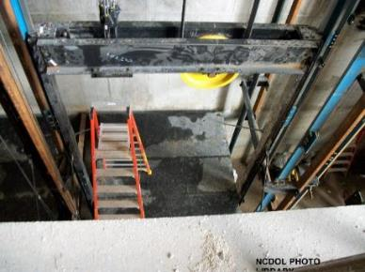
Structural Stability
1926.754(b)
Multi-story structures
  Permanent floors installed as erection progresses.
    Eight stories maximum between erection floor and upper-most permanent floor.
  Four floors maximum (or 48 feet) of unfinished bolting or welding above foundation or uppermost permanently secured floor.
  Fully planked floor or nets maintained
  within two stories (or 30 feet) directly
  under erection work.

Slide 22
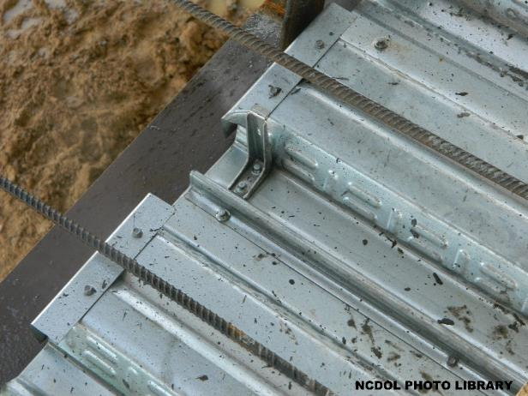
Walking/Working Surfaces
1926.754(c)
Shear connectors and other similar devices
  Field-installed rather than shop installed.
  Installed after the metal decking.
  Not attached until after
  walking/working surface
  has been installed.
Shear connectors

Slide 23
Walking/Working Surfaces
13 NCAC 07F .0205(c)(1)
Tripping hazards
  Employees protected from falls due to tripping hazards.
    Employees protected from falling hazards greater than
    6 feet by suitable fall protection systems.
    Shear connectors not welded or applied until working/walking surface is installed.
    Shear connectors covered by temporary decking, metal, or wood box until walking/working surface is installed.

Slide 24
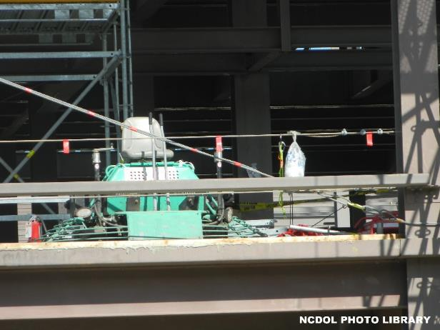
Plumbing-Up Equipment
1926.754(d)
Installed in conjunction with steel erection process to ensure stability of structure.
In place and properly installed before structure is loaded with construction material.
Be removed only with
approval of competent
person.

Slide 25
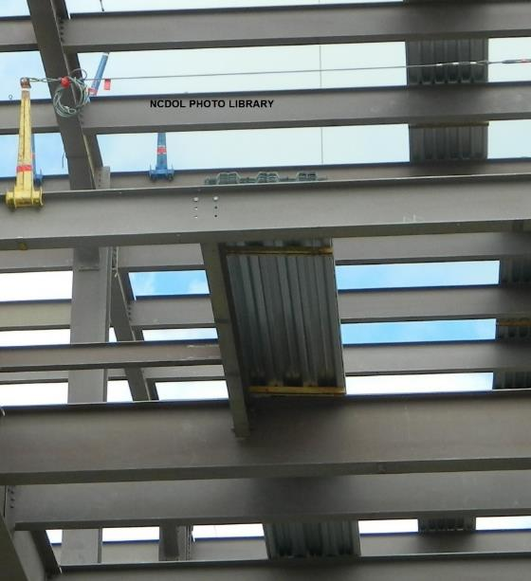
Metal Decking
1926.754(e)(1)
Bundle packaging and strapping cannot be used for hoisting.
Any loose items placed on
top of metal decking bundles
must be secured.
Support provided so bundles
will not be dislodged when
bands are removed.
Metal decking secured at end
of shift.

Slide 26
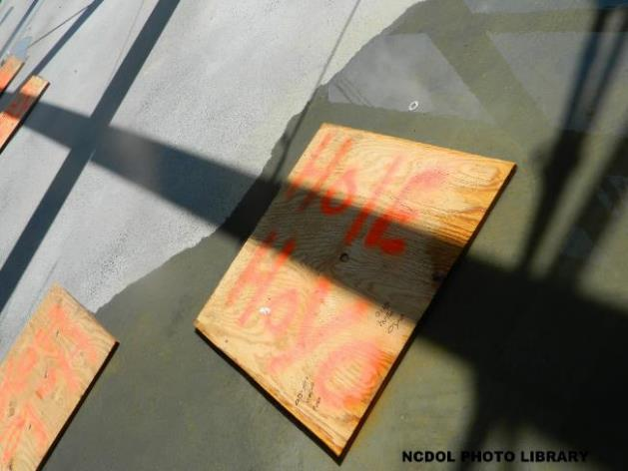
Metal Decking
1926.754(e)(2)
Structural member turned down to allow continuous deck installation.
Roof and floor holes and openings shall be decked over.
Holes and openings
shall not be cut prior
to its intended use.

Slide 27

Metal Decking
1926.754(e)(3)
Covers for roof and floor openings should support twice the weight of their intended load.
Covers shall be
marked with the word
“HOLE” or “COVER”.

Slide 28
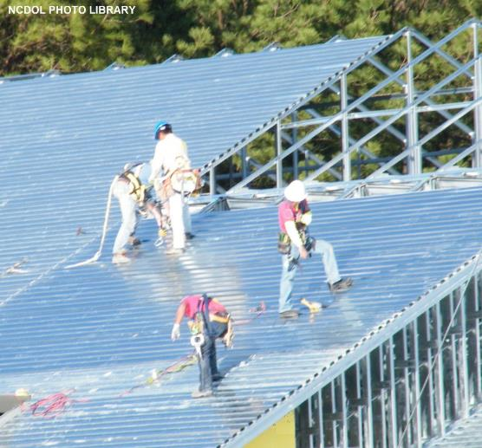
Metal Decking
1926.754(e)(5)
Installation of metal decking
  Laid tightly and immediately secured to prevent accidental movement or displacement.
  Metal decking panels
  placed to ensure full
  support by structural
  members.

Slide 29
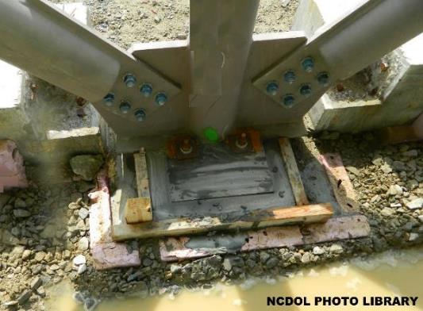
Column Anchorage
1926.755(a)
Minimum 4 anchor bolts per column.
Set on level finished floor, pre-grouted leveling plates, leveling nuts, or shim packs.
Competent person determines whether guying or bracing is needed.

Slide 30

Column Anchorage
1926.752(b) and 1926.755(b)
Written notification
  Of proper curing of concrete in footings, piers, walls for steel columns.
  Of adequacy of anchor bolts modified, replaced or repaired in the field.

Slide 31
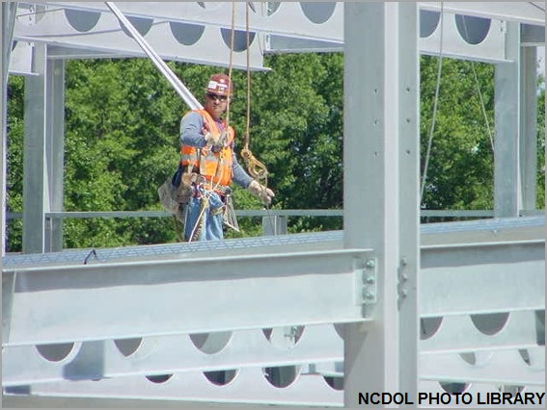
Beams and Columns
1926.756
Placing and bolting solid web structural members
Double connections and seats
Column splices
Diagonal bracing
Perimeter columns

Slide 32
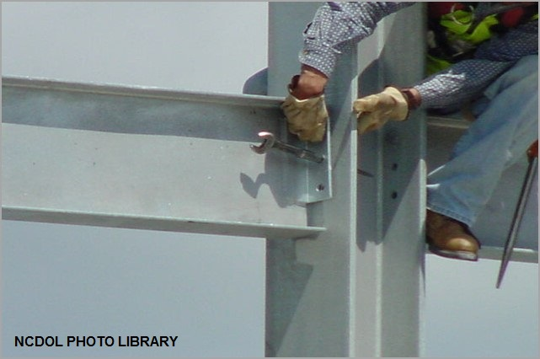
Beams and Columns
1926.756(a)
Two bolts per connection installed before releasing the hoisting line.
  Competent person shall determine if more are needed to ensure the stability of cantilevered members.

Slide 33
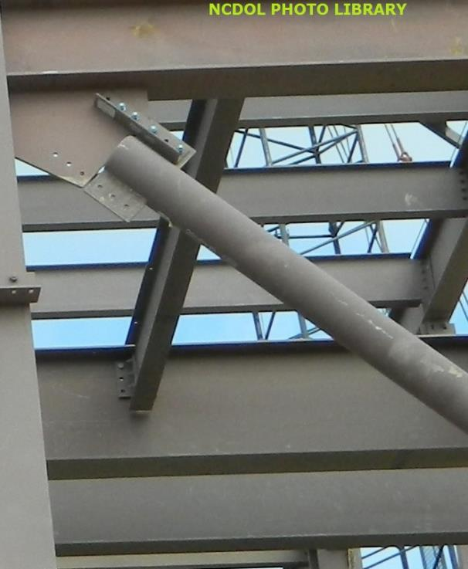
Diagonal Bracing
1926.756(b)
Solid web structural members used as diagonal bracing secured by at least one bolt drawn up wrench tight.

Slide 34
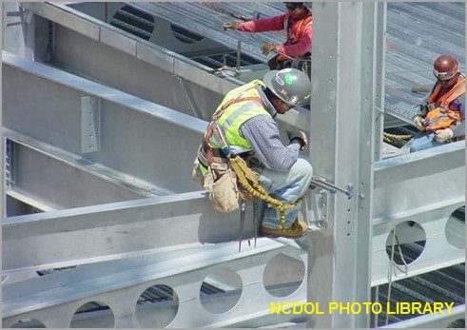
Double Connections
1926.756(c)(1)
When connecting two structural members, at least one bolt shall remain connected to the first member.
  Unless a seat is supplied to prevent the column from being displaced.

Slide 35
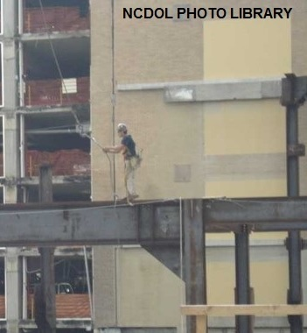
Seat Design
1926.756(c)(2)
Seats designed to support the load during the double connection process.
Seat

Slide 36
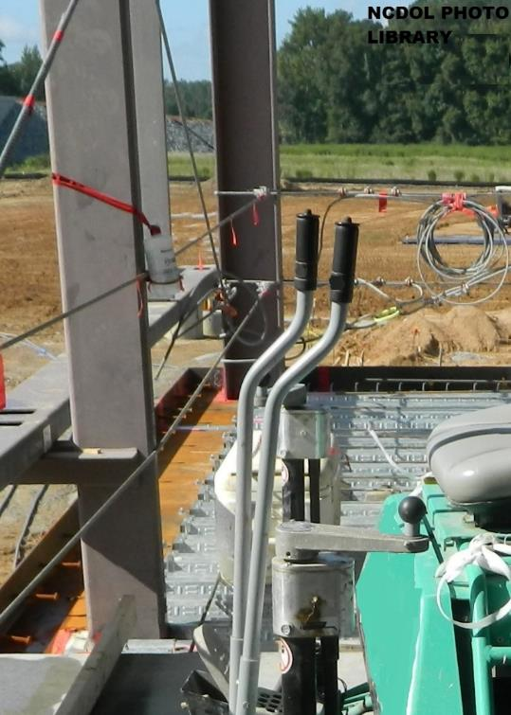
Perimeter Columns
1926.756(e)(1)
Perimeter columns must extend a minimum of 48 inches above the finished floor to permit installation of perimeter safety cables prior to erection of next tier.

Slide 37
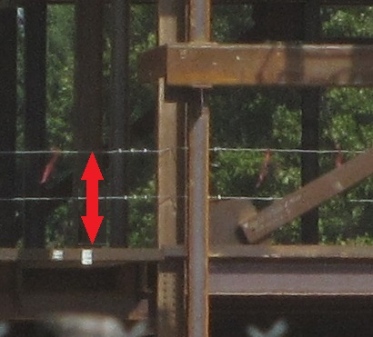
Perimeter Columns
1926.756(e)(2)
Perimeter columns must have holes in/attached to perimeter columns at 42 - 45 inches above finished floor and midpoint between finished floor
and top cable.
NCDOL Photo Library

Slide 38
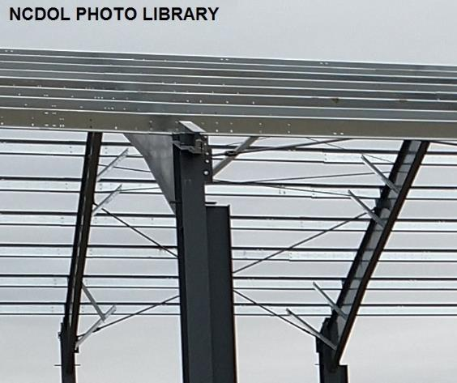
Open Web Steel Joists
1926.757
Attachment of steel joists and joist girders
Erection of steel joists
Erection bridging
Landing and placing
loads

Slide 39

Open Web Steel Joists
1926.757(a)
Steel joist shall be field-bolted at column to provide lateral stability during erection.
Where constructability does not allow it, an alternate means shall be installed.
  Designed by qualified person
  Shop installed
  Included in erection drawings

Slide 40
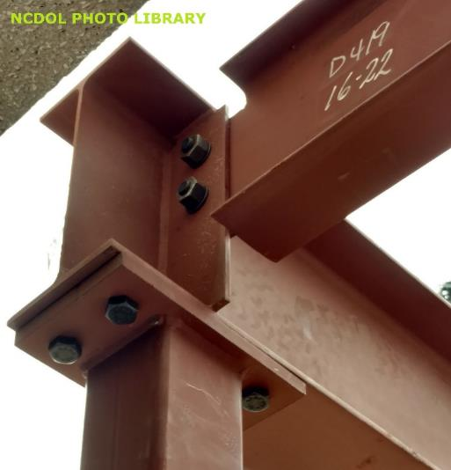
Field-Bolted Joists
1926.757(a)
Connections of individual steel joists to steel structures in bays of 40 feet or more shall be fabricated to allow field bolting during erection.
Steel joists and girders shall not be used as anchorage points for fall arrest systems.

Slide 41
Attachment of Steel Joists and Girders
1926.757(b)
Attachment of “K”, “LH”, & “DLH” series steel joists and girders.
Each steel joist must be attached to support structure:
  Immediately upon placement in the final erection position, and
  Before additional joists are placed.
Pre-assembled panels attached with bridging to structure at each corner before hoisting cables are released.

Slide 42
Erection of Steel Joists
1926.757(c)(1)-(3)
Attach both sides of the seat of one end of each steel joist to support structure before hoisting cables are released.
For joists over 60 feet:
  Both ends of the joist must be attached, and
  Meet provisions of paragraph (d) before releasing hoisting cables.
Only one employee allowed on steel joists that do not require erection bridging under Tables A and B until all bridging is installed and anchored.

Slide 43
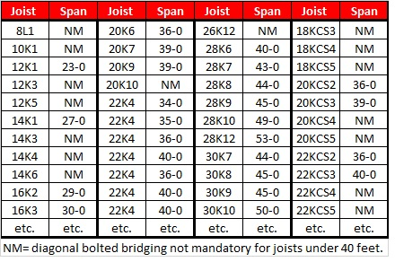
Erection of Steel Joists
1926.757(c)(4)-(5)
Employees not allowed on steel joists where span of joist is equal to or greater than span shown in Tables A and B.
When permanent bridging terminus points cannot be used during erection, temporary bridging required.
NCDOL Photo Library

Slide 44
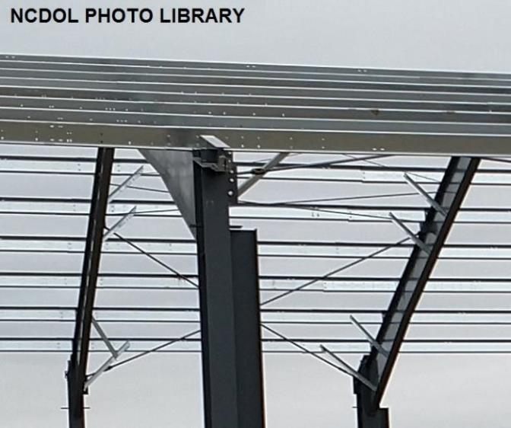
Erection Bridging
1926.757(d)
Specific procedures related to span of steel joists.
  Bolted diagonal
  bridging and
  installation.
  Releasing of hoisting
  cables.
  Number of employees
  allowed on these
  spans during bridging.

Slide 45
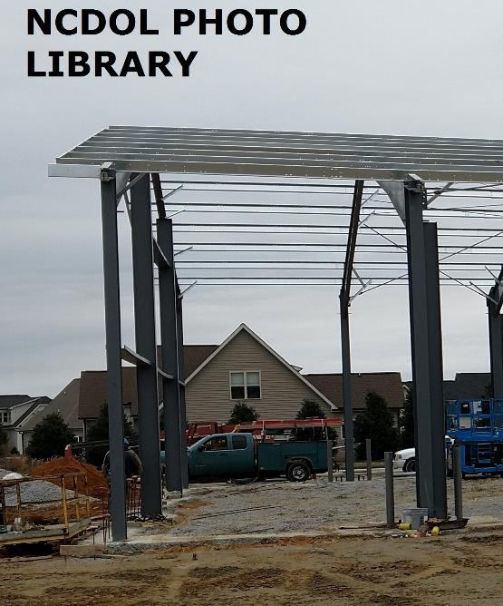
Landing and Placing Loads
1926.757(e)
Loads not to exceed carrying capacity of steel joists.
Attention paid to weight and placement of load within the structure.
No bundle of decking placed on joists until bridging is installed.

Slide 46
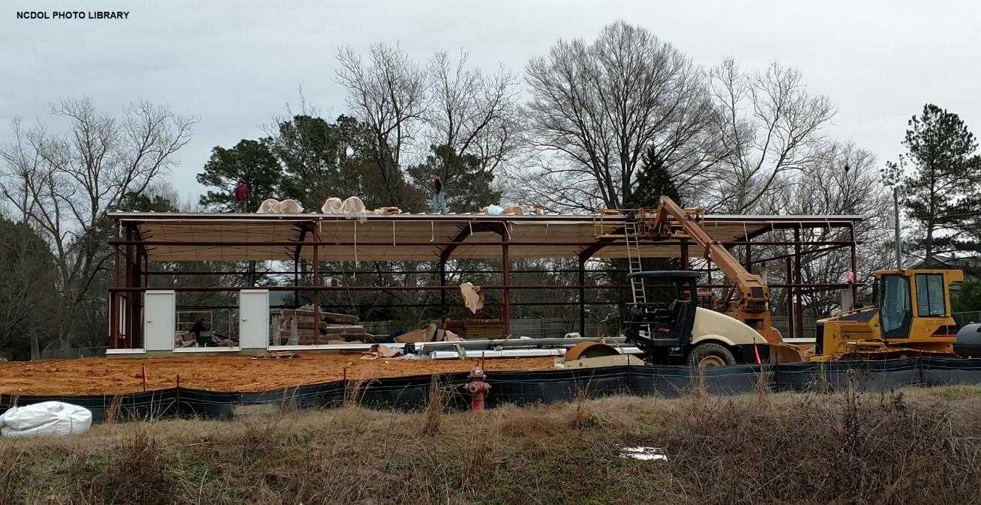
Systems-Engineered Buildings

Slide 47
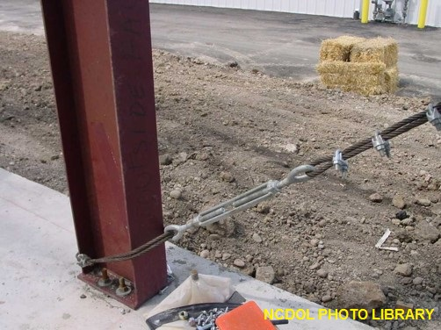
Systems-Engineered Metal Buildings
1926.758(a)-(c)
Structural columns anchored by a minimum of four anchor bolts.
Rigid frames
  Shall have 50% of their bolts or number specified by manufacturer installed
  before releasing hoisting
  equipment.

Slide 48
Systems-Engineered Metal Buildings
1926.758(d)-(e)
Construction loads not placed on structural steel framework unless secured.
When girts or eave struts share common connection holes:
  At least one bolt must remain connected to the first member.
  Field-attached seat supplied by the manufacturer may be used in lieu of the bolt.

Slide 49
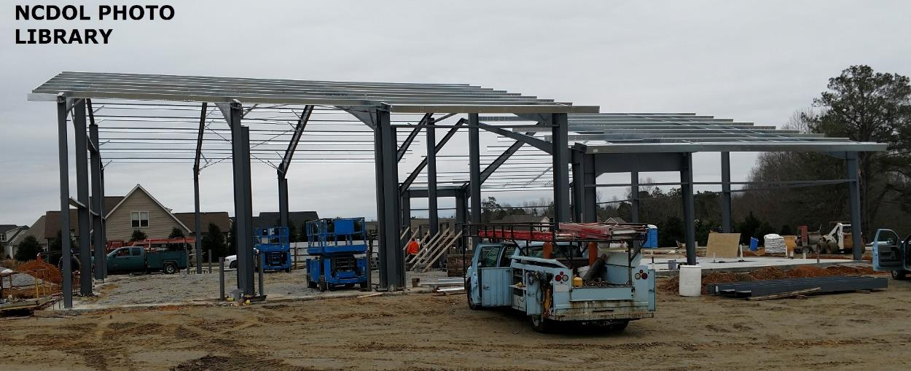
Systems-Engineered Metal Buildings
1926.758(d)-(e)

Slide 50
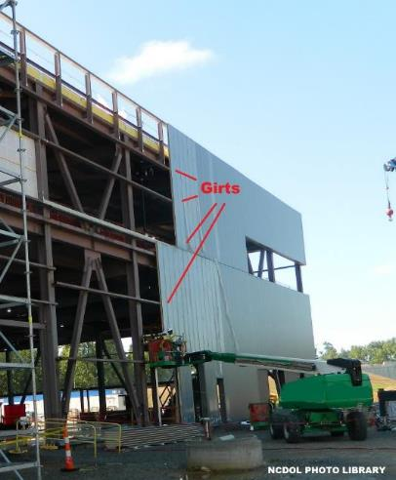
Systems-Engineered Metal Buildings
1926.758(f)-(g)
Both ends of steel or cold-formed joists fully bolted or welded before:
  Releasing cables.
  Allowing employees on the joists.
  Allowing construction loads on
  the joists.
Purlins and girts not used as
anchorage points for a fall arrest
system.

Slide 51
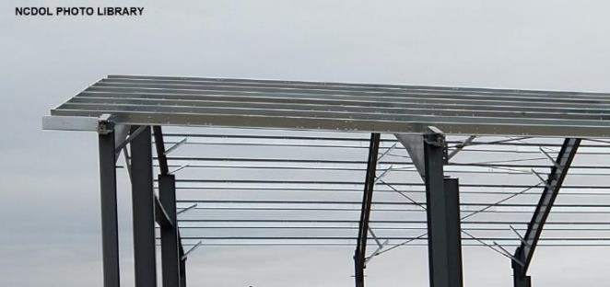
Systems-Engineered Metal Buildings
1926.758(h)-(i)
Purlins may be used as a walking/working surface when installing safety systems.
  After installation of permanent bridging, and
  Fall protection provided.
Construction loads placed within a zone that is within 8 feet of the center-line of the primary support member.
Purlins

Slide 52
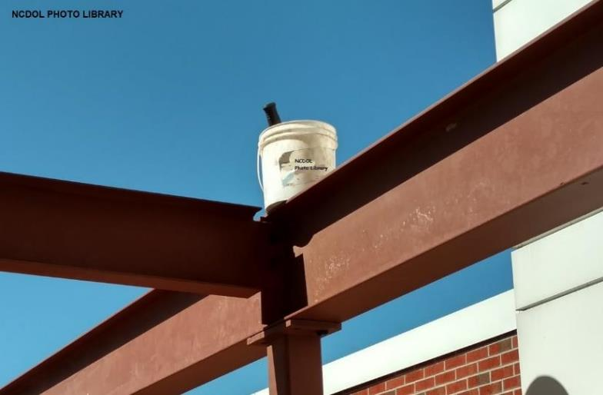
Falling Object Protection
1926.759(a)-(b)
Secure loose items aloft.
Protection from falling objects other than materials being hoisted.

Slide 53
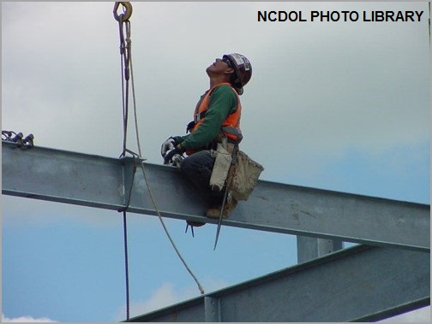
Fall Protection
1926.760
Fall protection requirements
Controlled decking zone (CDZ)
Criteria for fall protection equipment
Connectors
Custody of fall protection

Slide 54
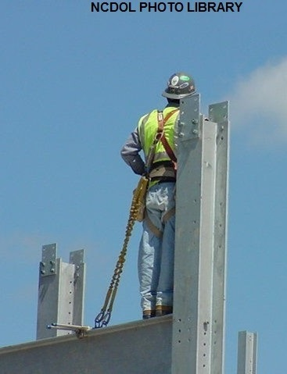
Fall Protection
1926.760(a)
Employees must be protected by conventional fall protection.
  When on walking/working surface with unprotected edge more than 15 feet above lower level.
Perimeter cables required
  Must be installed “as soon as the
  metal decking has been installed”.
Connectors and employees working
in CDZ shall be protected from fall
hazards.

Slide 55
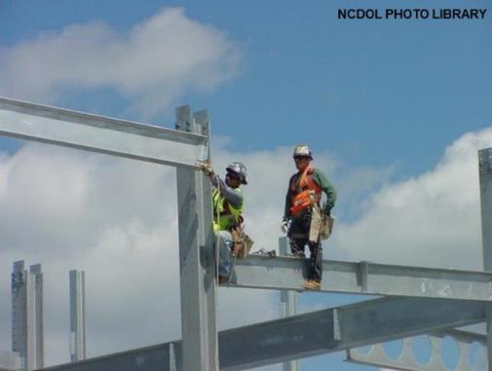
Connectors
1926.760(b)
Connectors between 15 and 30 feet (2 stories):
  Provided all equipment necessary to be tied off or provided other fall protection.
  Completed connector training.
  Not required to tie off.

Slide 56

Controlled Decking Zone
1926.760(c)
Deckers between 15 and 30 feet/2 stories can use a controlled decking zone (CDZ) instead of fall protection.
Be no more than 90 feet wide and 90 feet deep from leading edge.
Limited access to CDZ.
Boundaries designated and
clearly marked.
Employees must complete
CDZ training.

Slide 57

Fall Protection Equipment
1926.760(d)
Fall protection equipment must conform to 1926.502
Fall arrest system components shall be used in fall restraint systems.
Body belts or body harnesses shall be used in fall restraint systems.
Perimeter safety cables shall
meet criteria for guardrail
systems.

Slide 58
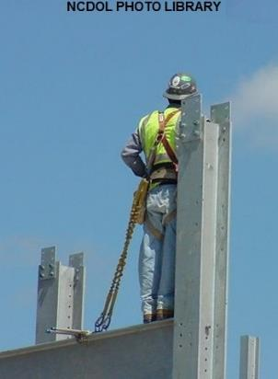
Custody of Fall Protection
1926.760(e)
Steel erector may leave fall protection in place so it may be used by other trades if the controlling contractor:
  Has directed the steel erector to leave fall protection in place, and
  Has inspected and accepted control
  and responsibility of fall protection
  before authorizing other trades to work
  in the area.

Slide 59
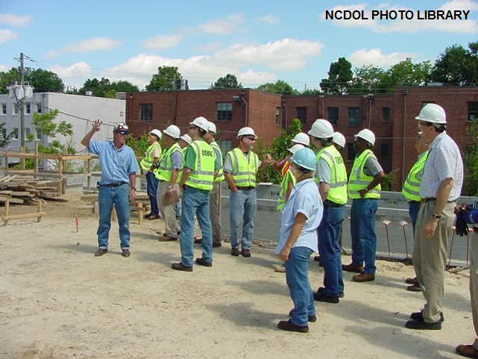
Training
1926.761(a)
Training provided by a qualified person.

Slide 60
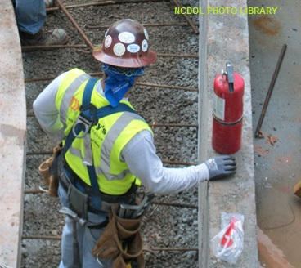
Fall Hazard Training
1926.761(b)
Training shall include the following:
  Recognition and identification of fall hazards
  Use and operation of guardrail systems
  Correct procedures for
  erecting, maintaining,
  disassembling, and
  inspecting fall protection
  systems
  Procedures to prevent falls
  Fall protection requirements

Slide 61
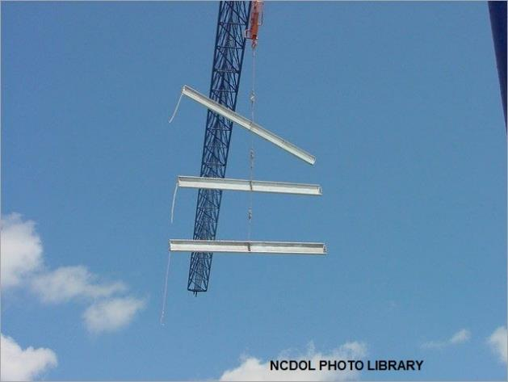
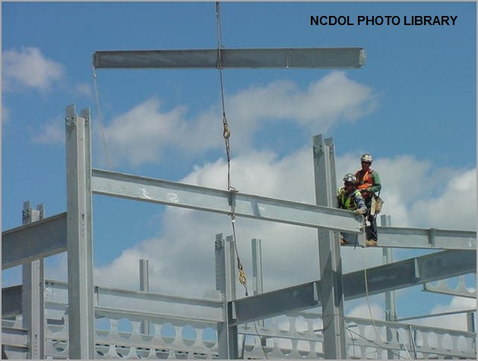
Special Training
1926.761(c)(1)
Multiple lift rigging
  Hazards associated with multiple lifts.
  Procedures and equipment to perform multiple lifts.

Slide 62
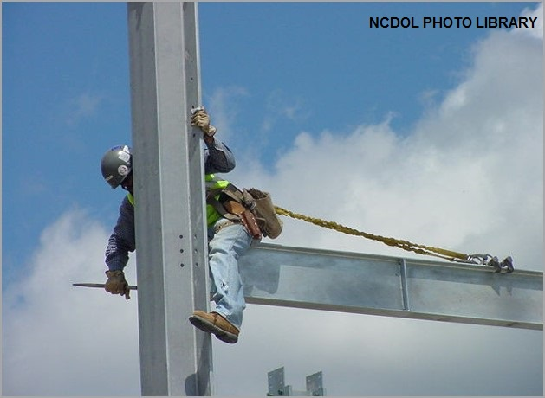
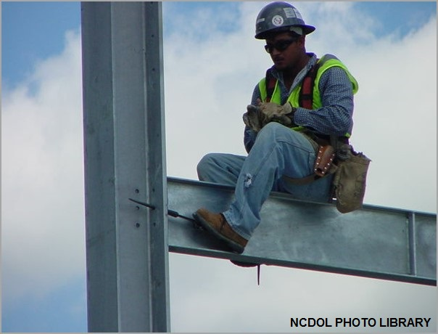
Special Training
1926.761(c)(2)
Connector procedures
  Hazards associated with connecting.
  Establishment, access, proper connecting techniques and work practices.

Slide 63

Special Training
1926.761(c)(3)
Controlled decking zone procedures
  Hazards associated with work within a controlled decking zone.
  Establishment, access, proper connecting techniques and work practices.

Slide 64
Summary
In this course, we discussed the following:
  Conception of the steel erection rule
  Scope of the standard
  Key provisions of 1926 Subpart R
  Steel erection hazards and safe working practices

Slide 65
Thank You For Attending!
Final Questions?

