Slide 1
Stairways and Ladders
1926 Subpart X
Notes:
Revised 6/16/25
The information in this presentation is provided voluntarily by the N.C. Department of Labor, Education Training and Technical Assistance Bureau as a public service and is made available in good faith. This presentation is designed to assist trainers conducting OSHA outreach training for workers. Since workers are the target audience, this presentation emphasizes hazard identification, avoidance, and control – not standards. No attempt has been made to treat the topic exhaustively. It is essential that trainers tailor their presentations to the needs and understanding of their audience.
The information and advice provided on this Site and on Linked Sites is provided solely on the basis that users will be responsible for making their own assessment of the matters discussed herein and are advised to verify all relevant representations, statements, and information.
This presentation is not a substitute for any of the provisions of the Occupational Safety and Health Act of North Carolina or for any standards issued by the N.C. Department of Labor. Mention of trade names, commercial products, or organizations does not imply endorsement by the N.C. Department of Labor.

Slide 2
Objectives
1926 Subpart X
In this course, we will cover:
  Scope, application and definitions (1926.1050)
  General requirements (1926.1051)
  Stairways (1926.1052)
  Ladders (1926.1053)
  Training requirements (1926.1060)
  Appendix A, [Non-Mandatory] American National Standards Institute (ANSI) standards meeting requirements of 1926.1053(a)(1)

Slide 3
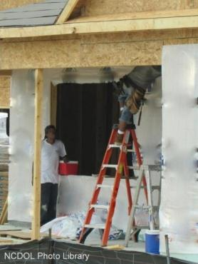
Scope and Application
1926.1050(a)
Applies to all ladders and stairways used in:
  Construction
  Alteration repair
    Includes painting and decorating
  Demolition

Slide 4
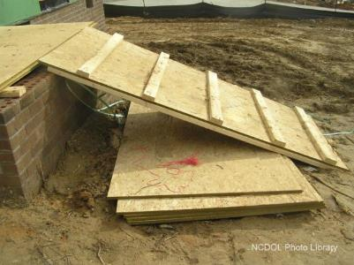
General Requirements
1926.1051(a)
A stairway or ladder must be provided for all personnel points of access where there is a break in elevation of 19 inches (48 cm) or more
Is this a stairway or ladder?

Slide 5
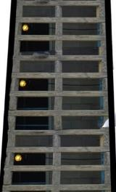
General Requirements
1926.1051(a)(2)
Use a double-cleated ladder (with center rail) or 2 or more ladders:
  When ladders are the only way to enter or exit a working area with 25 or more employees, or
  When a ladder will serve simultaneous two-way traffic
NCDOL Photo Library

Slide 6
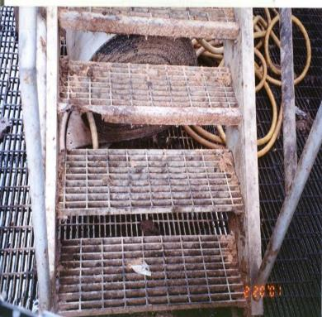
General Requirements
1926.1051(a)(3)
All points of access must be kept clear to permit free passage of employees
NCDOL Photo Library

Slide 7
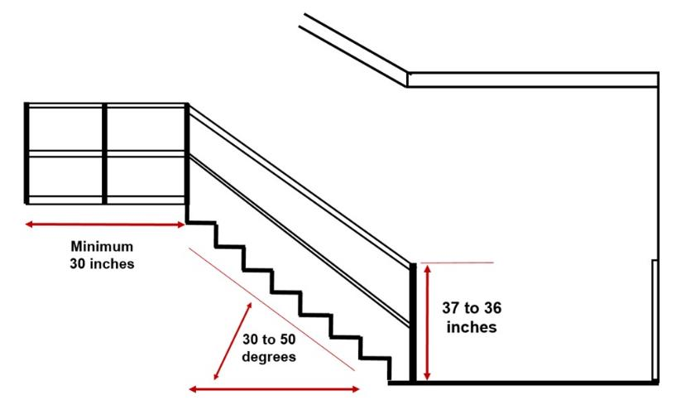
Temporary Stairways
1926.1052(a)(1)-(7)
NCDOL Photo Library

Slide 8
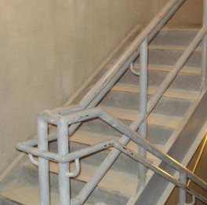
Temporary Stairways
1926.1052(b)(1)-(3)
Except during construction, foot traffic is prohibited with:
  Pan stairs and skeleton metal stairs where permanent treads and landings are to be filled at a later date unless treads are filled and secured
NCDOL Photo Library
Stair Pans –
Filled with Cement

Slide 9
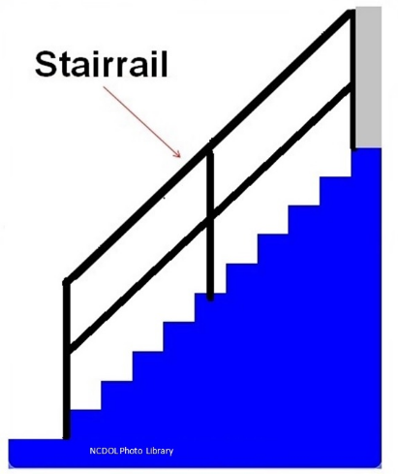
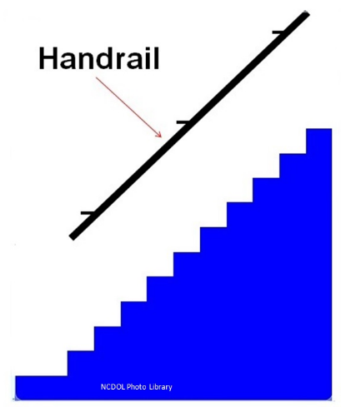
Stairrails and Handrails
1926.1052(c)

Slide 10
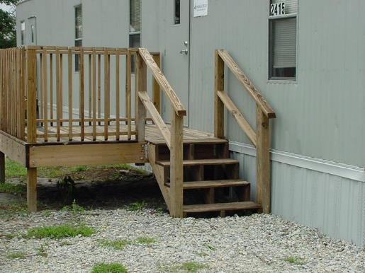
Stairrails and Handrails
1926.1052(c)
Is this correct?
NCDOL Photo Library

Slide 11


Stairrails and Handrails
1926.1052(c)(1)(i)-(ii)
Stairways having four or more risers or rising more than 30 inches must be equipped with:
  At least one handrail, and
  One stairrail system along each
  unprotected side or edge

Slide 12
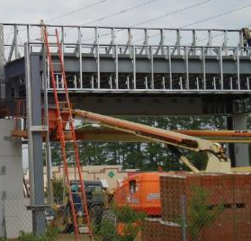
Stairrails and Handrails
1926.1052(c)(5), (8), (10)
Stairrail and handrail systems must be:
  Capable of withstanding without failure 200 lbs.
  Surfaced to prevent injury to employees
  Constructed so not to constitute a projection
  hazard
The metal studs were used as the handrails and guardrails.
NCDOL Photo Library

Slide 13

Handrails
1926.1052(c)(6), (9), (11)
Requirements are:
  Not more than 37″ and not less than 30″ from upper surface of rail to tread
  Provide adequate handhold for employees
  For a non-permanent part of structure: minimum 3″ between handrail and walls

Slide 14
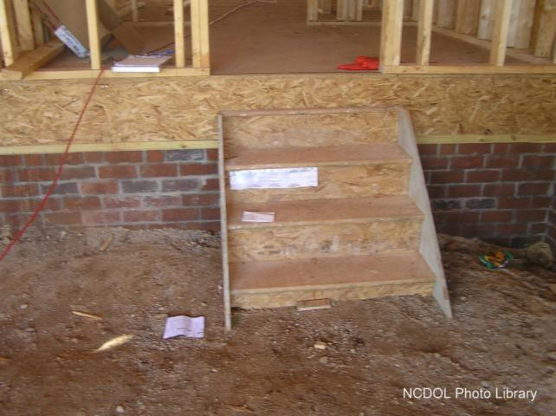
Stairrail Violation
1926.1052

Slide 15
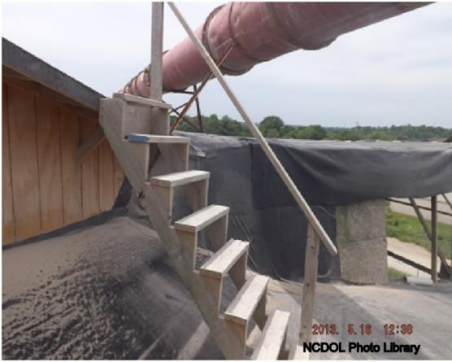
Stairrails and Handrails
1926.1052(c)
Is this correct?

Slide 16
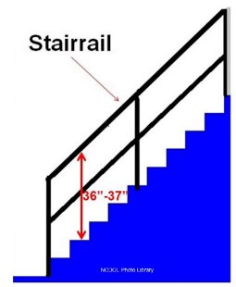
Stairrail System
1926.1052(c)(3), (4), (7)
Top edge of stairrail system:
  Must not be less than 36″ in height
  When serving as handrail, the height must not be
  more than 37″ and not less than 36″
  Midrail, screens, mesh,
  intermediate vertical members, or
  equivalent intermediate structural
  members, must be provided
  between top rail of system and
  stairway step

Slide 17
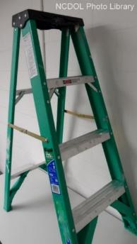
Ladder Support
1926.1053(a)(1)(i)-(ii)
Self-supporting and non-self-supporting ladders must be capable of supporting at least four times the maximum intended load
  Except type 1A metal or plastic
  ladders must sustain at least
  3.3 times maximum intended load

Slide 18
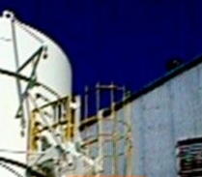
Ladder Support
1926.1053(a)(1)(iii)
Fixed ladders
  At least two loads of 250 pounds each, concentrated between any two consecutive attachments … plus anticipated loads caused by ice buildup, winds, rigging, and impact loads from ladder safety devices
NCDOL Photo Library

Slide 19
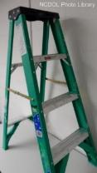
Ladder Rungs
1926.1053(a)(2)-(4)(i)
Ladder rungs, cleats, and steps must be parallel, level and uniformly spaced when the ladder is in position for use
Minimum distance between the side
of individual rung/step must be
16 inches

Slide 20
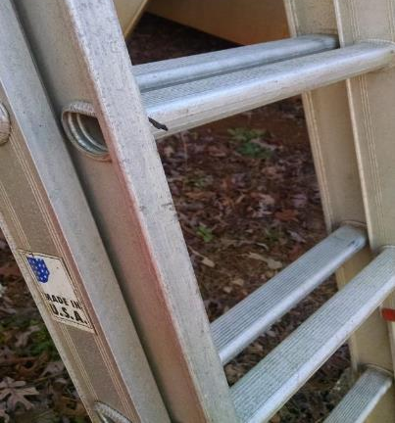
Ladder Rungs
1926.1053(a)(6)(i)
Rungs and steps of metal ladders must be corrugated, knurled, dimpled, coated with skid-resistant material or treated to minimize slipping
NCDOL Photo Library

Slide 21
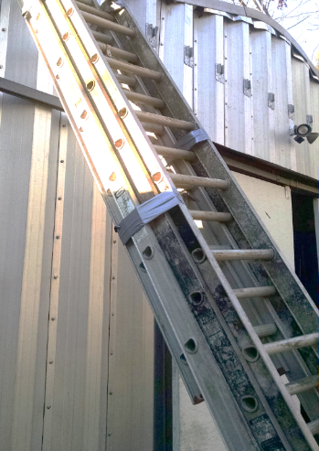
Ladder Use
1926.1053(a)(7)
Ladders must not be tied or fastened together to extend unless by design
NCDOL Photo Library

Slide 22

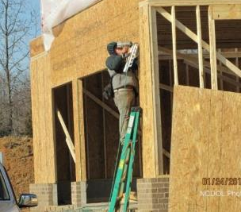
Ladder Use
1926.1053(a)(8)
A metal spreader or locking device must be provided on each stepladder to hold the front and back sections in an open position when the ladder is being used
Correct Setup
Improper Use
NCDOL Photo Library

Slide 23
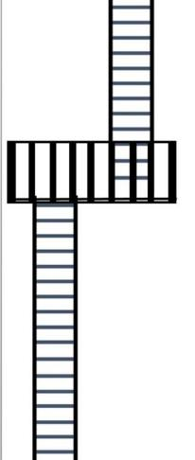
Ladder Use
1926.1053(a)(10)
Except when portable ladders are used to gain access to a fixed ladder, … when two or more separate ladders are used … the ladders must be offset by a platform or landing
NCDOL Photo Library

Slide 24

Ladder Use
1926.1053(a)(12)
Wood ladders must not be coated with any opaque covering, except for identification or warning labels which may be placed on one face only of a siderail

Slide 25
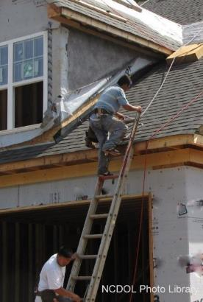
Ladder Use
1926.1053(b)(1)
When portable ladders are used for access to an upper landing surface, the ladder side rails must extend at least 3′ above the upper landing surface
Improper Use

Slide 26
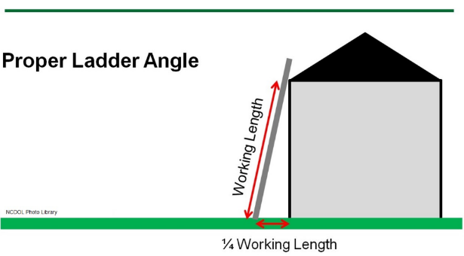
Ladder Use
1926.1053(b)(5)(i)
Non-self-supporting ladders must be at an angle…. ¼ of working length from the foot to the top support – equates to a 4:1 ratio

Slide 27
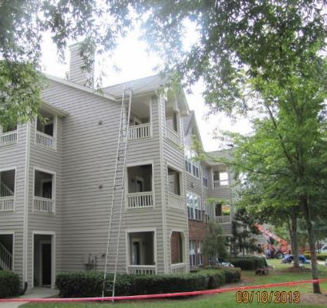
Ladder Use
1926.1053(b)(6)
Ladders must be used only on stable and level surfaces unless secured to prevent accidental displacement
NCDOL Photo Library

Slide 28
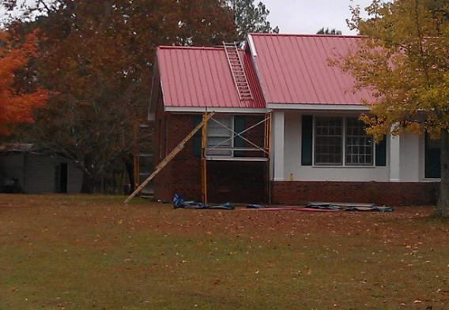
Ladder Use
1926.1053(b)(4)
Ladders must be used only for the purpose for which they were designed

Slide 29
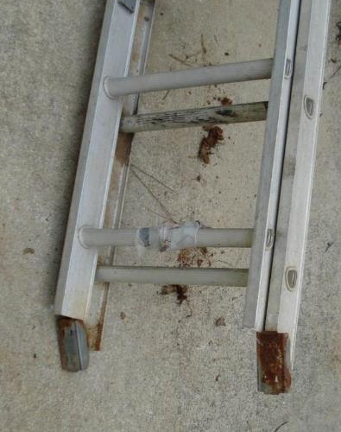
Ladder Use
1926.1053(b)(7)-(8)
Ladders must not be used on slippery surfaces unless secured or provided with slip-resistant feet to prevent accidental displacement
NCDOL Photo Library

Slide 30
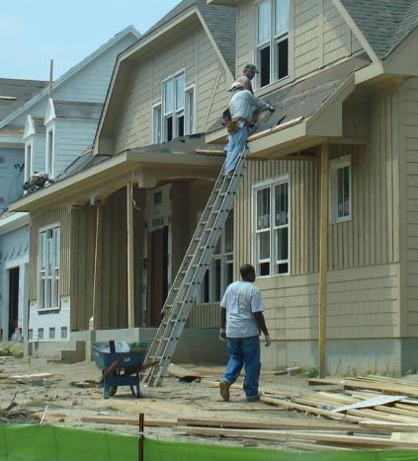
Ladder Use
1926.1053(b)(9)
Area around the top and bottom of ladders must be kept clear
NCDOL Photo Library

Slide 31
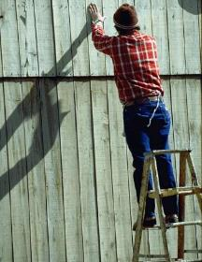
Ladder Use
1926.1053(b)(20)-(21)
When ascending or descending a ladder, the user must face the ladder
Employee must use at least one hand to grasp the ladder when progressing up and/or down the ladder
Improper Use
NCDOL Photo Library

Slide 32
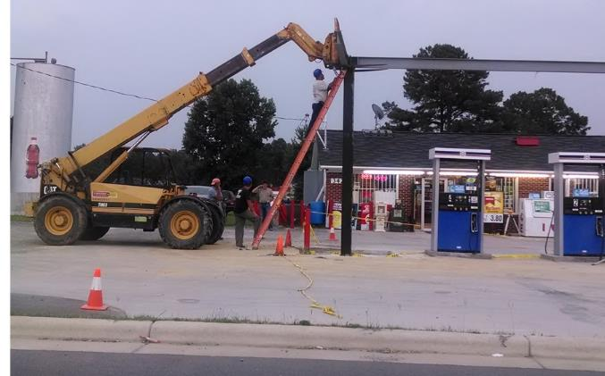
Ladder Use
1926.1053(b)
Is this correct?
NCDOL Photo Library

Slide 33
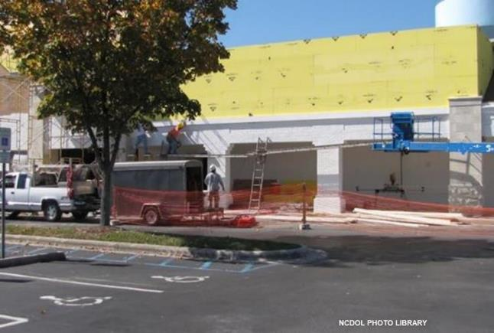
Ladder Use
Is this correct?

Slide 34
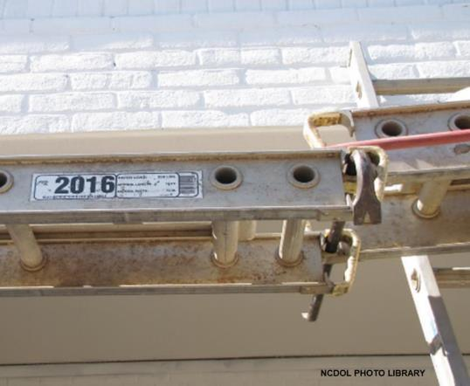
Ladder Use
Is this correct?

Slide 35
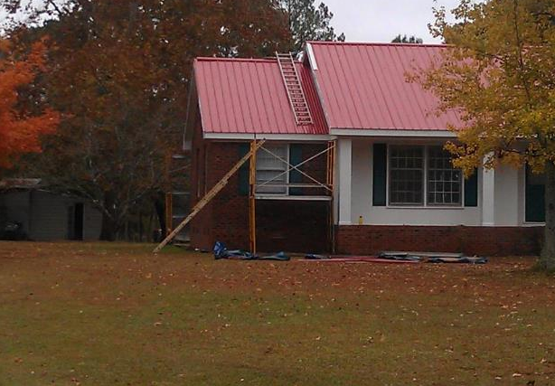
Ladder Use
1926.1053(b)
Is this correct?
NCDOL Photo Library

Slide 36
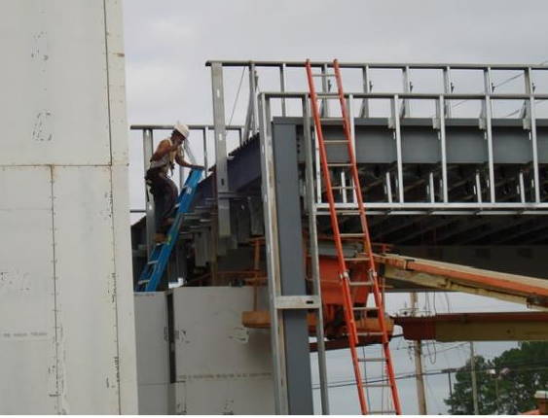
Ladder Use
1926.1053(b)
Is this correct?
NCDOL Photo Library
NCDOL Photo Library

Slide 37
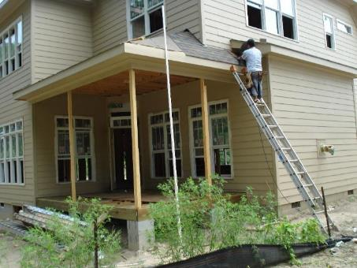
Ladder Use
1926.1053(b)(5)(i)
Non-self-supporting ladders must be at an angle … ¼ of working length from the foot to the top support – equates to a 4:1 ratio
NCDOL Photo Library

Slide 38
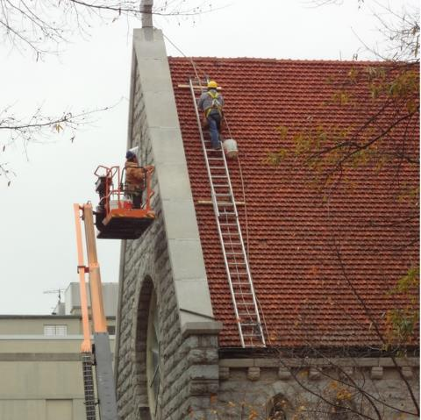
Ladder Use
Is this correct?
NCDOL Photo Library
NCDOL Photo Library

Slide 39
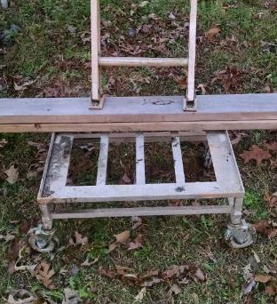
Ladder Use
1926.1053(b)(6)
Ladders must be used only on stable and level surfaces unless secured to prevent accidental displacement
NCDOL Photo Library

Slide 40
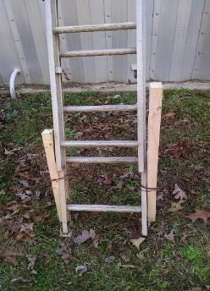
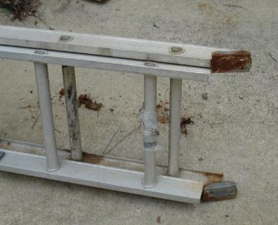
Ladder Use
1926.1053(b)(7)
Ladders must not be used on slippery surfaces unless secured or provided with slip-resistant feet to prevent accidental displacement
NCDOL Photo Library
NCDOL Photo Library
NCDOL Photo Library

Slide 41
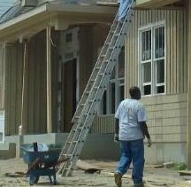
Ladder Use
1926.1053(b)(8)
Ladders placed in any location where they can be displaced by workplace activities or traffic, such as in passageways, doorways, or driveways must be secured to prevent accidental displacement, or a barricade must be used to keep the activities or traffic away from the ladder
NCDOL Photo Library
NCDOL Photo Library

Slide 42
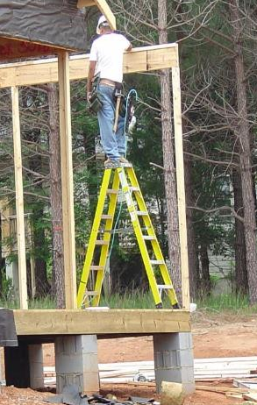
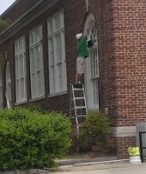
Ladder Use
1926.1053(b)(13)
Self-supporting top (top cap) or top step must not be used as a step
NCDOL Photo Library
NCDOL Photo Library

Slide 43

Ladder Use
1926.1053(b)
Can you identify the hazards?
NCDOL Photo Library

Slide 44
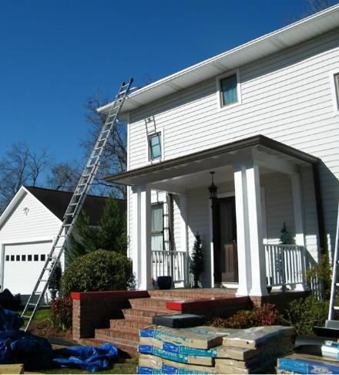
Ladder Use
1926.1053(b)
Is this correct?
NCDOL Photo Library

Slide 45
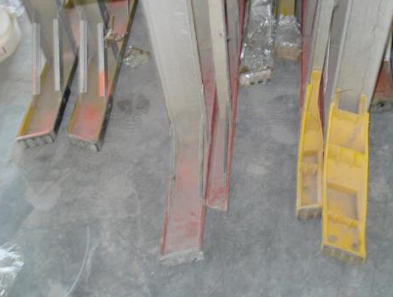
Ladder Inspection
1926.1053(b)(15)-(16)
Ladders must be inspected by a competent person
Portable ladders with structural defects must be tagged and withdrawn
from service until
repaired
NCDOL Photo Library

Slide 46
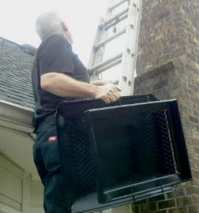
Ladder Safety
1926.1053(b)(20) – (21)
When ascending or descending a ladder, the user must face the ladder
Each employee must use at least one hand to grasp the ladder when progressing up and/or down the ladder
NCDOL Photo Library

Slide 47
Training
1926.1060
Employer must provide a training program for each employee using ladders and stairways
  Competent person
    Nature of fall hazards in the work area
    Correct procedures for erecting, maintaining, and disassembling the fall protection systems to be used;
    Proper construction, use, placement, and care in handling of all stairways and ladders; and
    Maximum intended load-carrying capacities of ladders used

Slide 48
1926 Subpart X
Appendix A
American National Standard Institute for ladders:
  ANSI A14.1-1982 – Portable Wood
  ANSI A14.2-1982 – Portable Metal
  ANSI A14.3-1984 – Fixed
  ANSI A14.4-1979 – Job-Made Ladders
  ANSI A14.5-1982 – Portable Reinforced Plastic

Slide 49
Summary
1926 Subpart X
In this course we discussed the following:
  Scope, application and definitions (1926.1050)
  General requirements (1926.1051)
  Stairways (1926.1052)
  Ladders (1926.1053)
  Training requirements (1926.1060)
  Appendix A [Non-Mandatory]

Slide 50
Thank You For Attending!
Final Questions?

