Slide 1
Respirable Crystalline Silica
29 CFR 1910.1053
Notes:
Revised 6/16/25
The information in this presentation is provided voluntarily by the N.C. Department of Labor, Education Training and Technical Assistance Bureau as a public service and is made available in good faith. This presentation is designed to assist trainers conducting OSHA outreach training for workers. Since workers are the target audience, this presentation emphasizes hazard identification, avoidance, and control – not standards. No attempt has been made to treat the topic exhaustively. It is essential that trainers tailor their presentations to the needs and understanding of their audience.
The information and advice provided on this Site and on Linked Sites is provided solely on the basis that users will be responsible for making their own assessment of the matters discussed herein and are advised to verify all relevant representations, statements, and information.
This presentation is not a substitute for any of the provisions of the Occupational Safety and Health Act of North Carolina or for any standards issued by the N.C. Department of Labor. Mention of trade names, commercial products, or organizations does not imply endorsement by the N.C. Department of Labor.

Slide 2
Objectives
1910.1053
In this course, we will discuss the following:
Respirable Crystalline Silica
Identification/Exposure Controls
New Regulatory Requirements

Slide 3
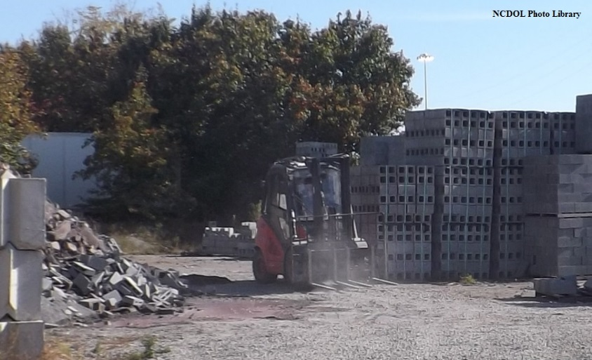
Industries
1910.1053
Foundries
Concrete products
Landscaping
Glass manufacturing
Refractory products
Cut stone and stone products

Slide 4
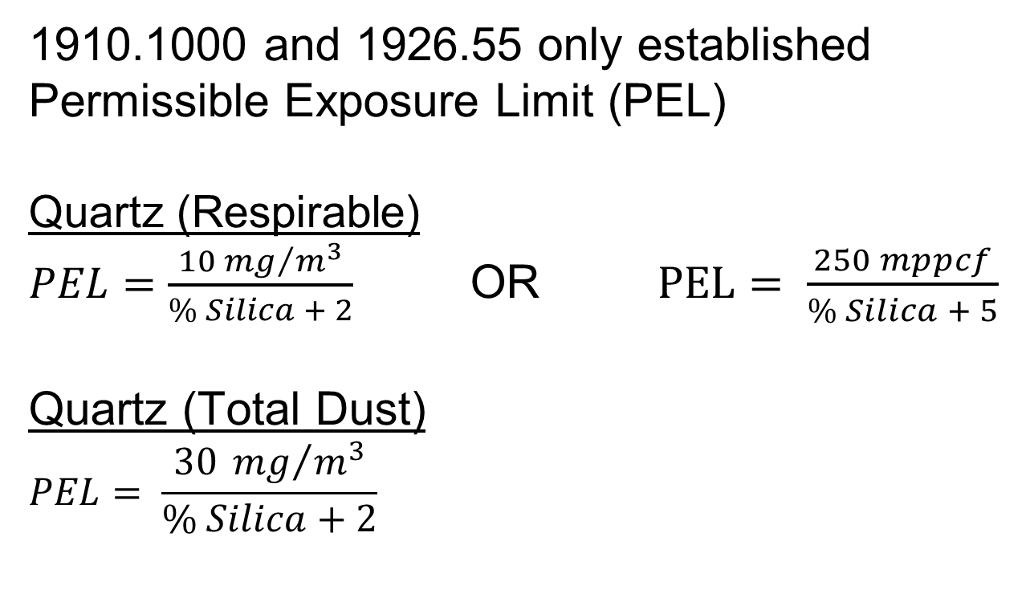
PEL (Prior to 2016)
1910.1053
1910.1000 and 1926.55 only established Permissible Exposure Limit (PEL)
Quartz (Respirable)
$PEL=\frac{10 {mg}/{m^{3}}}{\% Silica + 2}$ OR $PEL= \frac{250 mppcf}{\% Silica + 5}$
Quartz (Total Dust)
$$PEL= \frac{30 {mg}/{m^{3}}}{\% Silica+2}$$

Slide 5
PEL (Prior to 2016)
1910.1053
1910.1000 and 1926.55 only established Permissible Exposure Limit (PEL)
Quartz (Respirable)
$PEL=\frac{10 {mg}/{m^{3}}}{\% Silica + 2}$ OR $PEL= \frac{250 mppcf}{\% Silica + 5}$
Quartz (Total Dust)
$$PEL= \frac{30 {mg}/{m^{3}}}{\% Silica+2}$$

Slide 6
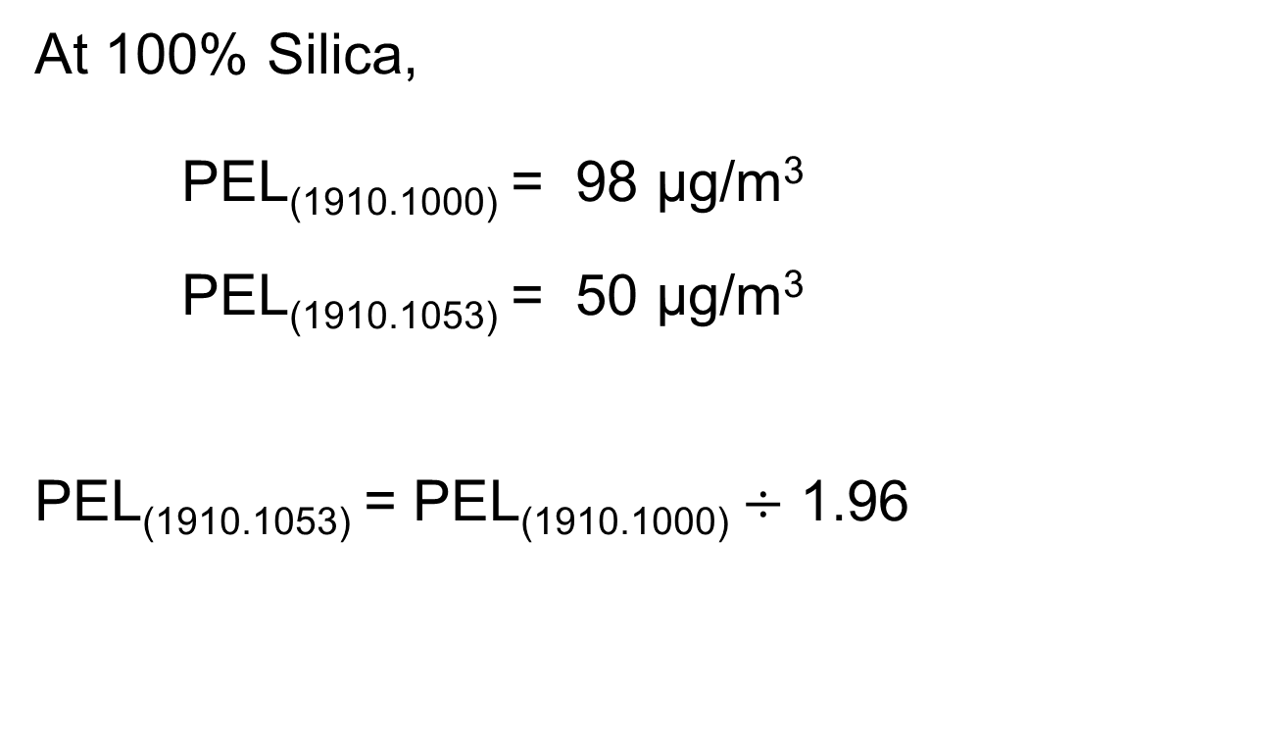
New PEL vs. Old PEL
1910.1053(c)
At 100% Silica,
PEL_{(1910.1000)} = 98 µg/m³
PEL_{(1910.1053)} = 50 µg/m³
PEL_{(1910.1053)} = PEL_{(1910.1000)} $÷$ 1.96

Slide 7
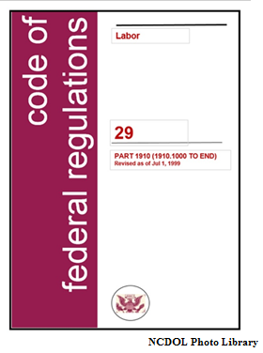
Published March 25, 2016
1910.1053
Sections
Scope and application
Definitions
Permissible exposure limit
Exposure assessment
Regulated areas
Methods of compliance
Respiratory protection
Housekeeping
Medical surveillance
Communication
Recordkeeping
Dates

Slide 8
Published March 25, 2016
1910.1053
Sections
(l) Dates
(b) Definitions
(a) Scope and application
(f) Methods of compliance
(d) Exposure assessment
(i) Medical surveillance
(k) Recordkeeping
(c) Permissible exposure limit
(g) Respiratory protection
(e) Regulated areas
(h) Housekeeping
(j) Communication

Slide 9
Published March 25, 2016
1910.1053
Sections
(l) Dates
(b) Definitions
(a) Scope and application
(f) Methods of compliance
(d) Exposure assessment
(i) Medical surveillance
(k) Recordkeeping
(c) Permissible exposure limit
(g) Respiratory protection
(e) Regulated areas
(h) Housekeeping
(j) Communication

Slide 10
Dates
1910.1053(l)
June 23, 2016 – Effective date
June 23, 2018 – All obligations of the standard commence, except medical surveillance

Slide 11
Dates
1910.1053(l)
Medical surveillance
  June 23, 2018 - Obligations for medical surveillance commence for employees exposed at or above the PEL (50µg/m³) for 30 or more days
  June 23, 2020 - Obligations for medical surveillance commence for employees exposure at or above the action level (25µg/m³) for 30 or more days

Slide 12
Dates
1910.1053(l)
Hydraulic fracturing operations in the oil and gas industry
  June 23, 2018 - All obligations but medical surveillance and engineering controls shall commence
  June 23, 2018 - Obligations for medical surveillance commence for employees exposed at or above the PEL (50µg/m³) for 30 or more days

Slide 13
Dates
1910.1053(l)
Hydraulic fracturing operations in the oil and gas industry
  June 23, 2020 - Obligations for medical surveillance commence for employees exposure at or above the action level (25µg/m³) for 30 or more days
  June 23, 2021 - Obligations for engineering controls commence

Slide 14
Definitions
1910.1053(b)
Action level [AL]
Assistant secretary
Director
Employee exposure
High-efficiency particulate air [HEPA] filter
Objective data
Physician or other licensed health care professional [PLHCP]
Regulated area
Respirable crystalline silica
Specialist

Slide 15
Definitions
1910.1053(b)
Action level [AL]
Assistant secretary
Director
Employee exposure
High-efficiency particulate air [HEPA] filter
Objective data
Physician or other licensed health care professional [PLHCP]
Regulated area
Respirable crystalline silica
Specialist

Slide 16
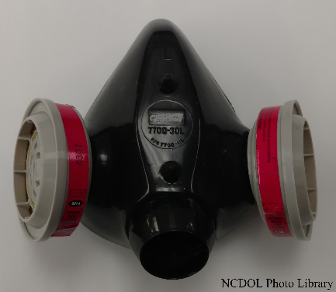
Employee Exposure
1910.1053(b)
The exposure to airborne respirable crystalline silica that would occur if the employee were not using a respirator.

Slide 17
Objective Data
1910.1053(b)
Information, such as air monitoring data from industry-wide surveys or calculations based on the composition of a substance, demonstrating employee exposure to respirable crystalline silica associated with a particular product or materials or a specific process, task, or activity.
The data must reflect workplace conditions closely resembling or with a higher exposure potential than the processes, types of material, control methods, work practices, and environmental conditions in the employer’s current operations.

Slide 18
Regulated Area
1910.1053(b)
An area, demarcated by the employer, where an employee’s exposure to airborne concentrations of respirable crystalline silica exceeds, or can reasonably be expected to exceed, the PEL.

Slide 19
Respirable Crystalline Silica
1910.1053(b)
Quartz, cristobalite, and/or tridymite contained in airborne particles that are determined to be respirable by a sampling device designed to meet the characteristics for respirable-particle-size-selective samplers specified in the International Organization for Standardization (ISO) 7708:1995.

Slide 20
Published March 25, 2016
1910.1053
Sections
(l) Dates
(b) Definitions
(a) Scope and application
(f) Methods of compliance
(d) Exposure assessment
(i) Medical surveillance
(k) Recordkeeping
(c) Permissible exposure limit
(g) Respiratory protection
(e) Regulated areas
(h) Housekeeping
(j) Communication

Slide 21
Published March 25, 2016
1910.1053
Sections
(l) Dates
(b) Definitions
(a) Scope and application
(f) Methods of compliance
(d) Exposure assessment
(i) Medical surveillance
(k) Recordkeeping
(c) Permissible exposure limit
(g) Respiratory protection
(e) Regulated areas
(h) Housekeeping
(j) Communication

Slide 22
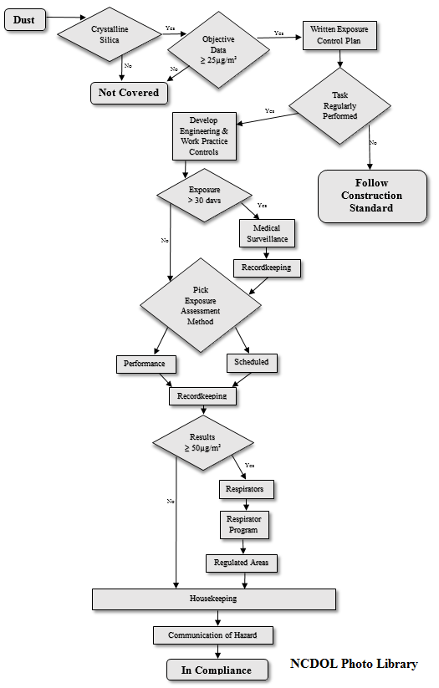
Silica Flow Chart
1910.1053
GENERAL INDUSTRY
(a) Scope and application
(f) Methods of compliance
(d) Exposure assessment
Green represents “MAYBE” (i) Medical surveillance
(k) Recordkeeping
(c) Permissible exposure limit
(g) Respiratory protection
(e) Regulated areas
(h) Housekeeping
(j) Communication

Slide 23
Scope and Application
1910.1053(a)(1)
This section applies to all occupational exposures to respirable crystalline silica, except:
  Construction Work as defined in 29 CFR 1910.12(b)
  Agricultural Operations covered in 29 CFR part 1928
  Exposures that result from the processing of sorptive clays

Slide 24
Scope and Application
1910.1053(a)(2)
This section applies to all occupational exposures to respirable crystalline silica, except:
  Where employer has objective data demonstrating that employee exposure will remain below 25 µg/m³ as an 8-hour time-weighted average (TWA) under any foreseeable conditions

Slide 25
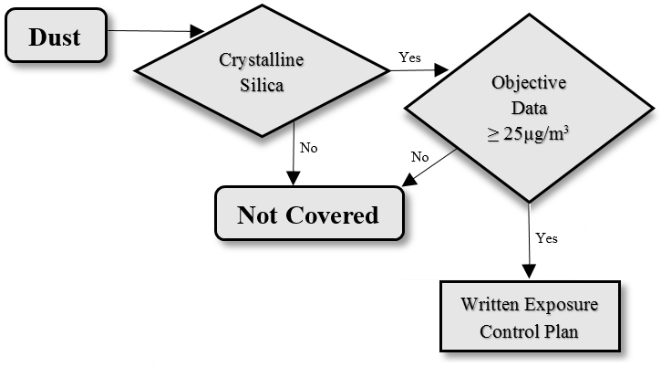
Scope and Application
1910.1053(a)

Slide 26
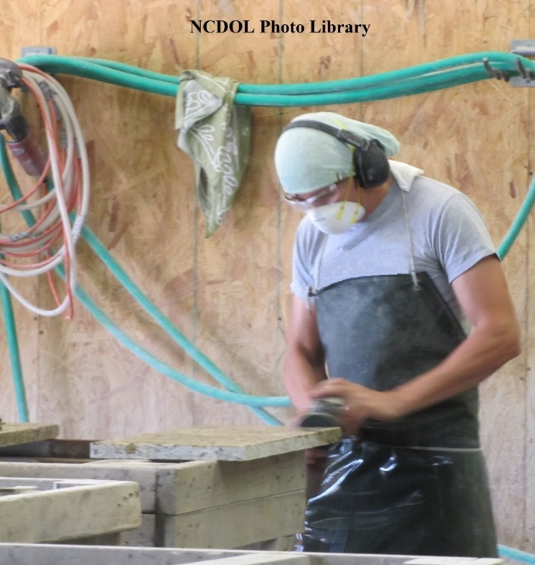
Scope and Application
1910.1053(a)
Exposure to silica results from performing activities that results in dust generation
Examples:
  Chipping
  Cutting
  Sawing
  Drilling
  Grinding
  Sanding
  Crushing

Slide 27
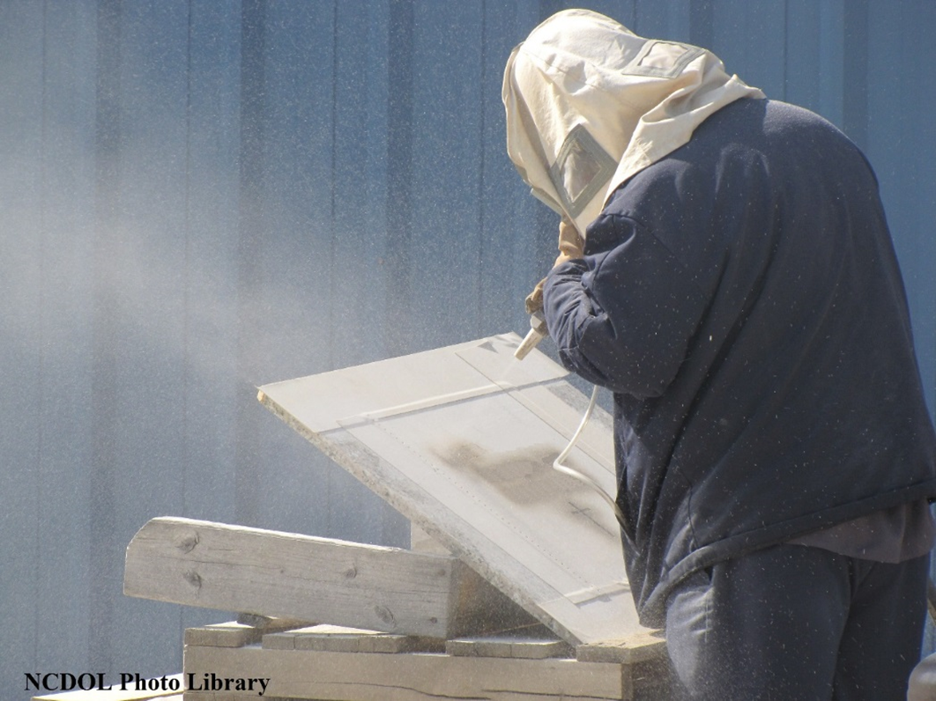
Dust

Slide 28
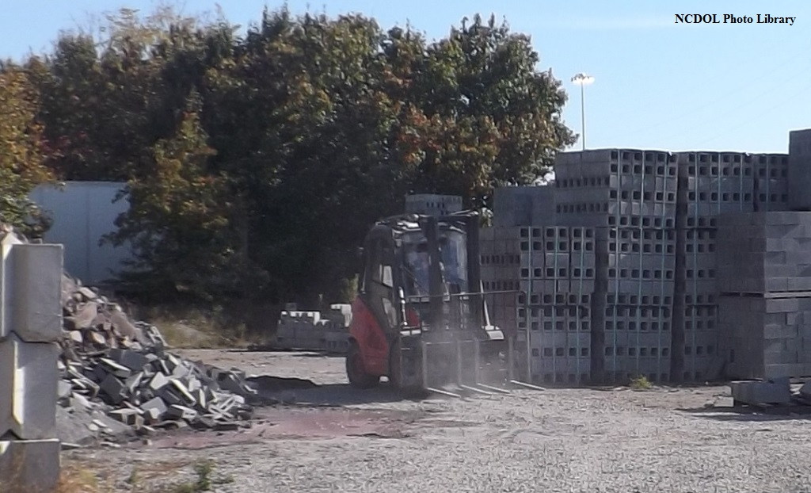
Dust

Slide 29
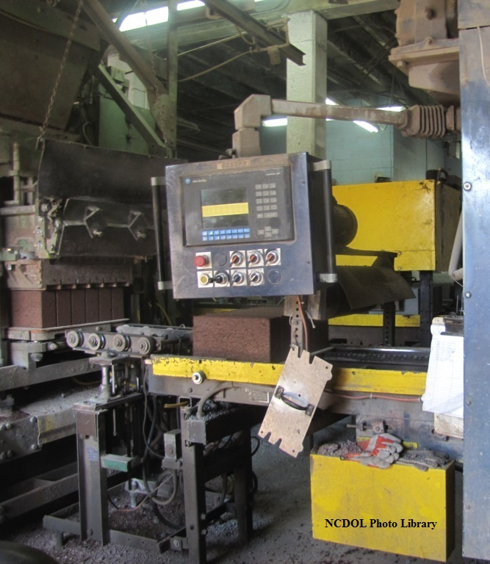
Dust

Slide 30

Dust

Slide 31
Scope and Application
1910.1053(a)

Slide 32
Crystalline Silica?

Slide 33
Crystalline Silica?

Slide 34
Crystalline Silica?

Slide 35
Crystalline Silica?

Slide 36
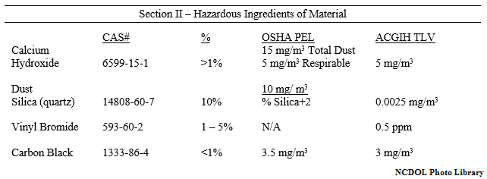
Presence of Crystalline Silica?
MSDS – Material Safety Data Sheet

Slide 37
Presence of Crystalline Silica?
MSDS – Material Safety Data Sheet

Slide 38
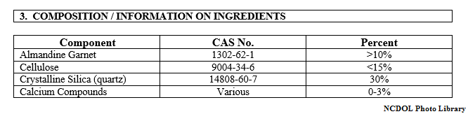
Presence of Crystalline Silica?
SDS – Safety Data Sheet

Slide 39
Presence of Crystalline Silica?
SDS – Safety Data Sheet

Slide 40
Scope and Application
1910.1053(a)

Slide 41
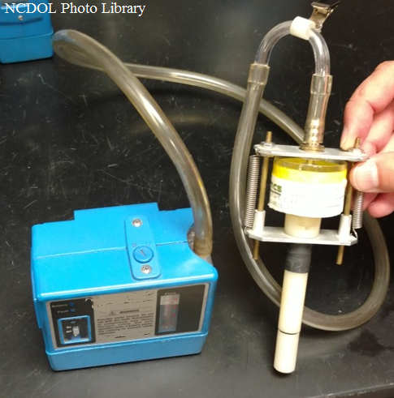
Crystalline Silica < 25µg/m³?
Objective data
Air monitoring from industry-wide surveys or calculations
Associated with a particular product or materials or specific process, task or activity
Reflect workplace conditions closely or higher exposure potential of current operations

Slide 42
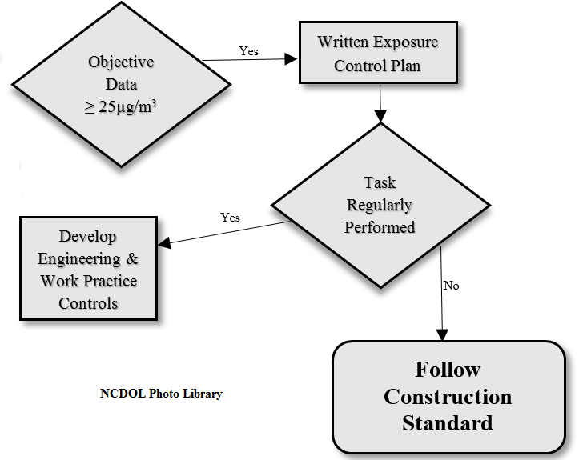
Exposure Control Plan
1910.1053(f)(2)

Slide 43
Exposure Control Plan
1910.1053(f)(2)
Purpose:
  To minimize or eliminate exposure to silica
Contains information on the following:
  Task description
  Description of the controls (engineering controls, work practices, personal protective equipment)
  Housekeeping measures
Updated annually

Slide 44
Exposure Control Plan
1910.1053(f)(2)

Slide 45
Scope and Application
1910.1053(a)(3)
This section applies to all occupational exposures to respirable crystalline silica, except:
  If the employer complies with 29 CFR 1926.1153; and
    Task performed is indistinguishable from a construction task listed on Table 1 in paragraph (c) of 29 CFR 1926.1153; and
    Task will not be performed regularly in the same environment and conditions

Slide 46
Scope and Application
1910.1053(a)(3)
This section applies to all occupational exposures to respirable crystalline silica, except:
  If the employer complies with 29 CFR 1926.1153; and
    Task performed is indistinguishable from a construction task listed on Table 1 in paragraph (c) of 29 CFR 1926.1153; and
    Task will not be performed regularly in the same environment and conditions

Slide 47
Silica Flow Chart
1910.1053

Slide 48
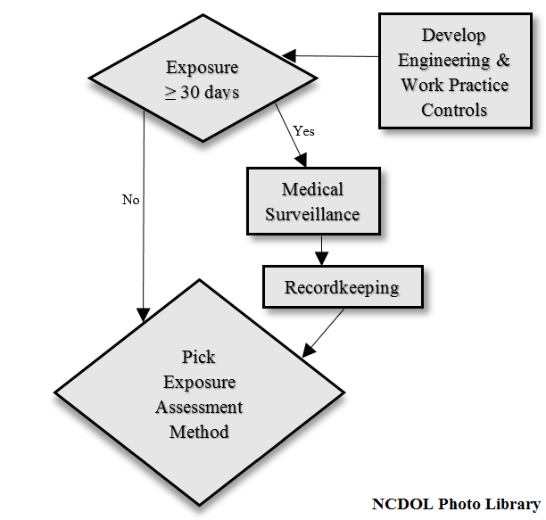
Silica Flow Chart
1910.1053

Slide 49
Medical Surveillance
1910.1053(i)(2)
Initial (baseline) medical examination
  Made available within 30 days after initial assignment, unless the employee received a medical examination that meets the requirements of this section within the last three (3) years

Slide 50
Medical Surveillance
1910.1053(i)(4)
Information provided to the PLHCP by the employer:
  Employee’s former, current, and anticipated
    Description of job duties
    Exposure to crystalline silica
  Description of any personal protective equipment (PPE) used or to be used
    Including when and for how long
  Previous medical examinations (including previous employment and current employer controlled)

Slide 51
Medical Surveillance
1910.1053(i)(3)
Periodic medical examination
  At least every three (3) years, or more frequently if recommended by the PLHCP

Slide 52
Medical Surveillance
1910.1053(i)(2)
Content of medical examinations
  Medical and work history
  Physical examination (emphasis on respiratory system)
  Chest X-ray
  Pulmonary function test
  Latent tuberculosis (TB) test (initial examination only)
  Other tests deemed necessary by the PLHCP

Slide 53
Medical Opinion: Employee
1910.1053(i)(5)
PLHCP’s written medical opinion
  Receive a written medical report within 30 days after the medical examination
Report includes the results of the medical examination
  Recommendations for limitations on respirator use
  Recommendations for limitations on silica exposure
  Recommendations for further evaluation/treatment
  Examination by a specialist

Slide 54
Medical Opinion: Employer
1910.1053(i)(6)
PLHCP’s written medical opinion (30 days)
  Date of examination
  A statement explaining examination met the requirements
  An opinion that describes limitations on respirator use
If employee provides written authorization, then the employer also receives:
  Any recommended limitations on the employee’s exposure to respirable crystalline silica
  Examination by a specialist

Slide 55
Silica Flow Chart
1910.1053

Slide 56
Recordkeeping
1910.1053(k)(3)
Medical surveillance
  Shall make and maintain an accurate record for each employee covered by medical surveillance
  Record shall include:
    Name and social security number
    Copy of PLHCP’s specialists’ written medical opinions, and
    Copy of information provided to the PLHCPs and specialists
  Employer shall ensure medical records are maintained and made available in accordance with 29 CFR 1910.1020

Slide 57
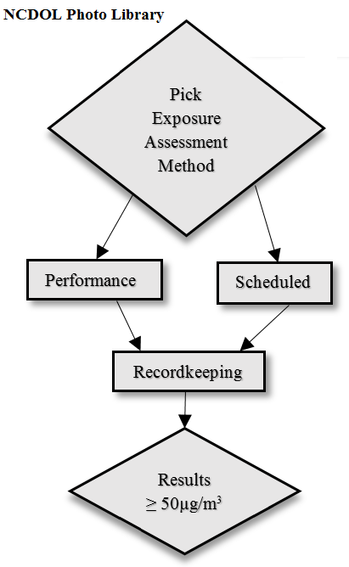
Silica Flow Chart
1910.1053

Slide 58
Exposure Assessment
1910.1053(d)(1)
Shall assess exposure of each employee who is or may reasonably be expected to be exposed to respirable crystalline silica at or above the action limit
Performance vs. scheduled monitoring

Slide 59
Exposure Assessment
1910.1053(d)(2)
Performance option
  Employer shall assess the 8-hour TWA exposure for each employee on the basis of any combination of air monitoring data or objective data sufficient to accurately characterize employee exposures to respirable crystalline silica
  Burden is on the employer to show that the data complies with the requirements

Slide 60
Exposure Assessment
1910.1053(d)(3)
Scheduled monitoring option
  Shall perform initial monitoring to assess the 8-hour TWA exposure for each employee on the basis of one or more personal breathing zone air samples that reflect the exposures of employees
    On each shift
    For each job classification
    In each work area

Slide 61
Exposure Assessment
1910.1053(d)(3)
Scheduled monitoring option
  Initial monitoring
    < Action level (25 µg/m³)
      Monitoring may be discontinued

Slide 62
Exposure Assessment
1910.1053(d)(3)
Most recent monitoring
  ≥ Action level (25 µg/m³) but < PEL (50 µg/m³
    Repeat monitoring within six (6) months
  > PEL
    Repeat monitoring within three (3) months
  < Action level (25 µg/m³)
    Repeat monitoring within six (6) months of the most recent
    monitoring until two (2) consecutive measurements, taken
    seven (7) or more days apart, are < action level (25
    µg/m³), at which time the monitoring may be discontinued

Slide 63
Exposure Reassessment
1910.1053(d)(4)
Required whenever a change in the production, process, control equipment, personnel, or work practices may reasonable be expected to result in new or additional exposures at or above the action level
OR
When the employer has any reason to believe that new or additional exposures at or above the action level have occurred

Slide 64
Employee Notification
1910.1053(d)(6)
Within fifteen (15) working days after completing an exposure assessment
Notification of assessment by either:
  Individually notifying each affected employee in writing of the results of that assessment, or
  Posting the results in an appropriate location accessible to all affected employees
Whenever an exposure assessment indicates employee exposure above the PEL (50 µg/m³), the employer shall describe in the written notification corrective actions being taken to reduce employee exposure to or below the PEL

Slide 65
Recordkeeping
1910.1053(k)(1)
Air monitoring
  Employer shall make and maintain an accurate record of all exposure measurements taken to assess employee and/or objective data relied upon to determine exposure to respirable crystalline silica
  Exposure records must be maintained and made available to employees, in accordance with 29 CFR 1910.1020

Slide 66
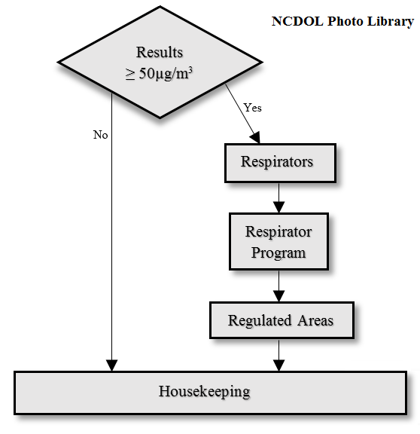
Silica Flow Chart
1910.1053

Slide 67
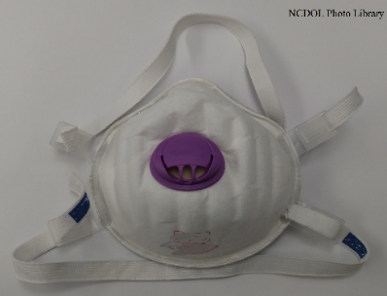
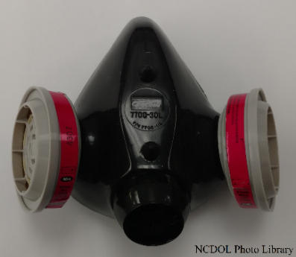
Respiratory Protection
1910.1053(g)(2)
Where required by paragraph (g) or 29 CFR 1926.1153, Table 1, employer must provide each employee an appropriate respirator that complies with the requirements of this paragraph and 29 CFR 1910.134
  Written Respiratory Protection Program
  Medical evaluation
  Fit testing
  Training
    Proper use
    Limitations/capabilities
    Maintenance/care/storage

Slide 68
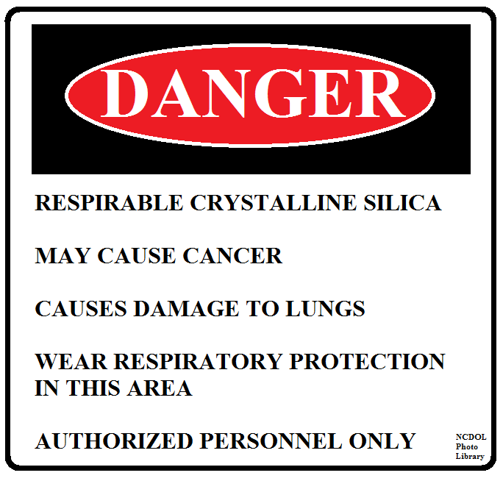
Regulated Areas
1910.1053(e)
Airborne concentrations above PEL
Demarcation
  Create boundaries to restrict access to regulated areas
  Post signs at all entrances
Access
  Only authorized persons
  Designated representative to observe monitoring
  OSHA personnel or other regulators
  Respirators provided, worn and enforced

Slide 69
Silica Flow Chart
1910.1053

Slide 70
Housekeeping
1910.1053(h)(1)
Activities that could contribute to silica exposure are prohibited:
  Dry sweeping or dry brushing
  Compressed air to clean surfaces or cloths

Slide 71
Housekeeping
1910.1053(h)(2)
Allowed activities:
  Wet sweeping
  Vacuuming (HEPA-filter)
  Compressed air when used in conjunction with a ventilation system that effectively captures the dust cloud created
  Other methods that minimize the likelihood of exposure
  No alternative method is feasible
    Dry sweeping or dry brushing
    Compressed air

Slide 72
Housekeeping
1910.1053(h)(2)
Allowed activities:
  Wet sweeping
  Vacuuming (HEPA-filter)
  Compressed air when used in conjunction with a ventilation system that effectively captures the dust cloud created
  Other methods that minimize the likelihood of exposure
  No alternative method is feasible
    Dry sweeping or dry brushing
    Compressed air

Slide 73
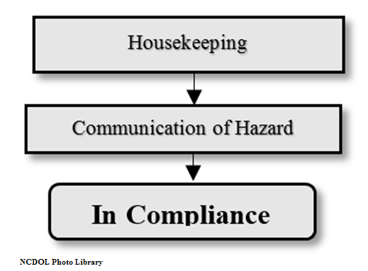
Silica Flow Chart
1910.1053

Slide 74
Communication
1910.1053(j)(1) & (j)(3)
Employee training
  Exposure to respirable crystalline silica
    Associated health hazards
    Specific tasks in the working environment
    Controls that minimize or eliminate exposure
  Explanation of the silica standard
  Purpose and description of the Medical Surveillance Program

Slide 75
Communication
1910.1053(j)(1) & (j)(3)
Hazard communication standard (HCS)
  Address
    Cancer, lung effects, immune system effects, and kidney effects
  Safety data sheets
  Labels
  Signs

Slide 76
Communication
1910.1053(j)(2)
Signs are required to be posted at all entrances to regulated areas
Must bear the following legend:
  Danger
  Respirable crystalline silica
  May cause cancer
  Causes damage to lungs
  Wear respiratory protection in this area
  Authorized personnel only

Slide 77
Communication
1910.1053(j)(2)

Slide 78
Review
1910.1053
Exposure to respirable crystalline silica has been linked to:
  Silicosis
  Lung cancer
  Chronic obstructive pulmonary disease
  Kidney disease

Slide 79
Silica Flow Chart
1910.1053
GENERAL INDUSTRY
(a) Scope and application
(f) Methods of compliance
(d) Exposure assessment
Green represents “MAYBE” (i) Medical surveillance
(k) Recordkeeping
(c) Permissible exposure limit
(g) Respiratory protection
(e) Regulated areas
(h) Housekeeping
(j) Communication

Slide 80
Summary
1910.1053
Respirable Crystalline Silica
Identification/Exposure Controls
New Regulatory Requirements

Slide 81
Thank You For Attending!
Final Questions?

