Slide 1
Respirable Crystalline Silica
29 CFR 1926.1153
Presented by:
Notes:
Revised 6/16/25
The information in this presentation is provided voluntarily by the N.C. Department of Labor, Education Training and Technical Assistance Bureau as a public service and is made available in good faith. This presentation is designed to assist trainers conducting OSHA outreach training for workers. Since workers are the target audience, this presentation emphasizes hazard identification, avoidance, and control – not standards. No attempt has been made to treat the topic exhaustively. It is essential that trainers tailor their presentations to the needs and understanding of their audience.
The information and advice provided on this Site and on Linked Sites is provided solely on the basis that users will be responsible for making their own assessment of the matters discussed herein and are advised to verify all relevant representations, statements, and information.
This presentation is not a substitute for any of the provisions of the Occupational Safety and Health Act of North Carolina or for any standards issued by the N.C. Department of Labor. Mention of trade names, commercial products, or organizations does not imply endorsement by the N.C. Department of Labor.

Slide 2
Objectives
1926.1153
In this course, we will discuss:
Respirable crystalline silica – what it is, sources and health effects
Identification/exposure controls – silica producing work processes and how to control it
New OSHA regulatory requirements

Slide 3
What is Crystalline Silica?
Crystalline silica is a basic component of soil, sand, granite, and many other minerals
Quartz is the most common form
Cristobalite and Tridymite are two other forms
Respirable size particles generated when workers chip, cut, drill, or grind materials that contain crystalline silica

Slide 4
Hazards of Crystalline Silica
Exposure to respirable crystalline silica has been linked to:
Silicosis
Lung cancer
Chronic obstructive pulmonary disease
Kidney disease

Slide 5
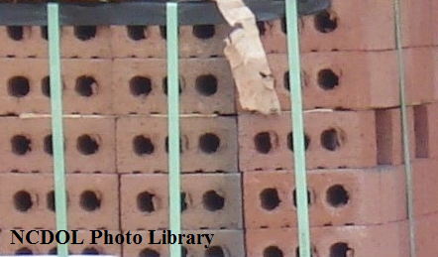
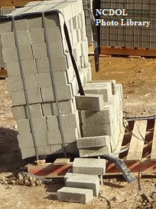
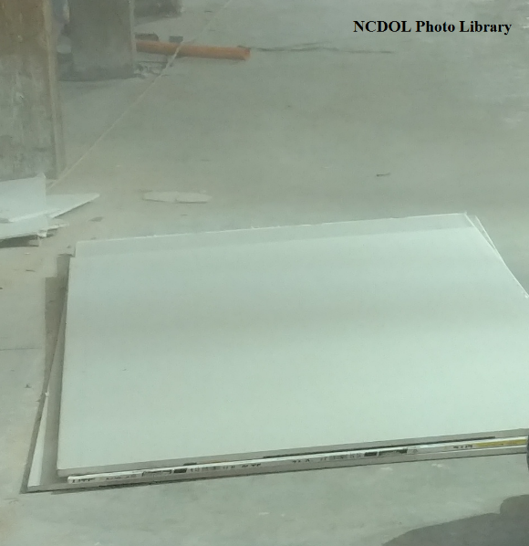
Some Common Products
Fiber cement board
Sand
Brick
Block
Concrete
Drywall

Slide 6
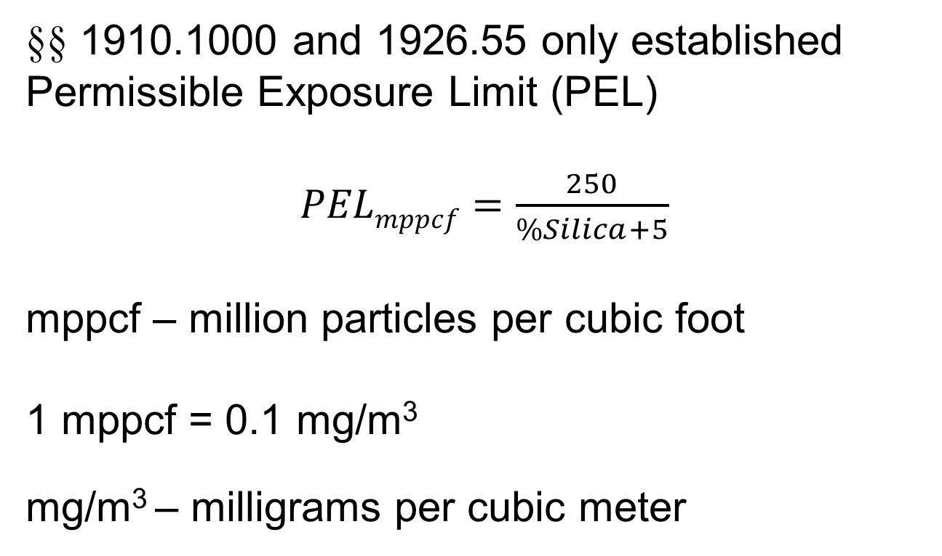
Previously
§§ 1910.1000 and 1926.55 only established Permissible Exposure Limit (PEL)
$PELmppcf=\frac{250}{\%Silica+5}$
mppcf – million particles per cubic foot
1 mppcf = 0.1 mg/m³
mg/m³ – milligrams per cubic meter

Slide 7
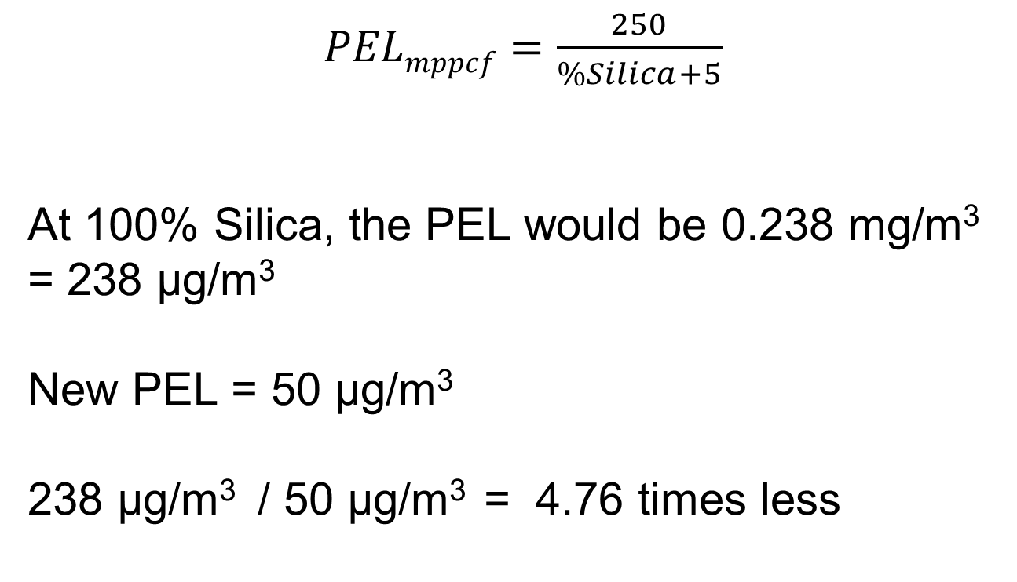
Old PEL Versus New PEL
$PELmppcf=\frac{250}{\%Silica+5}$
At 100% Silica, the PEL would be 0.238 mg/m³ = 238 µg/m³
New PEL = 50 µg/m³
238 µg/m³ / 50 µg/m³ = 4.76 times less

Slide 8
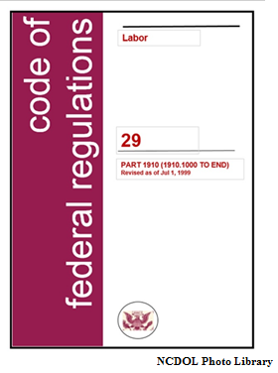
Published March 25, 2016
1926.1153
Sections
Scope and application
Definitions
Specified exposure control methods
Alternative exposure control methods
Respiratory protection
Housekeeping
Written exposure control plan
Medical surveillance
Communication of respirable crystalline silica hazards
Recordkeeping
Dates

Slide 9
Published March 25, 2016
1926.1153
Sections
(k) Dates
(b) Definitions
(a) Scope and application
(g) Written exposure control plan
(c) Specified exposure control methods
(d) Alternative exposure control methods
(e) Respiratory protection
(h) Medical surveillance
(j) Recordkeeping
(f) Housekeeping
(i) Communication of respirable crystalline silica hazards

Slide 10
Published March 25, 2016
1926.1153
Sections
(k) Dates
(b) Definitions
(a) Scope and application
(g) Written exposure control plan
(c) Specified exposure control methods
(d) Alternative exposure control methods
(e) Respiratory protection
(h) Medical surveillance
(j) Recordkeeping
(f) Housekeeping
(i) Communication of respirable crystalline silica hazards

Slide 11
Dates
1926.1153
Became effective June 23, 2016
All obligations of this section shall commence June 23, 2017, except requirements for methods of sample analysis in paragraph (d)(2)(v)
Requirements for methods of sample analysis in paragraph (d)(2)(v) of this section commence June 23, 2018

Slide 12
Definitions
1926.1153(b)
Action level
Assistant secretary
Director
Competent person
Employee exposure
High-efficiency particulate air [HEPA] filter
Objective data
Physician or other licensed health care professional
Respirable crystalline silica
Specialist

Slide 13
Definitions
1926.1153(b)
Action level
Assistant secretary
Director
Competent person
Employee exposure
High-efficiency particulate air [HEPA] filter
Objective data
Physician or other licensed health care professional
Respirable crystalline silica
Specialist

Slide 14
Competent Person
1926.1153(b)
An individual who is:
Capable of identifying existing and foreseeable respirable crystalline silica hazards in the workplace, and
Has authorization to take prompt corrective measures to eliminate or minimize them
Competent person must have the knowledge and ability necessary to fulfill the responsibilities set forth paragraph (g) of this section

Slide 15
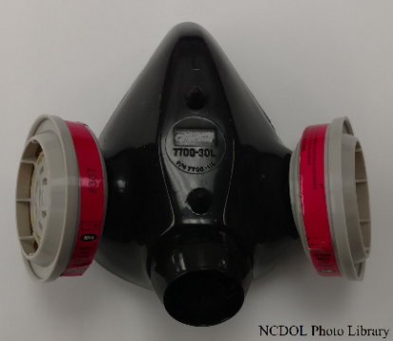
Employee Exposure
1926.1153(b)
Exposure to airborne respirable crystalline silica that would occur if the employee were not using a respirator

Slide 16
Respirable Crystalline Silica
1926.1153(b)
Quartz, cristobalite, and/or tridymite contained in airborne particles that are determined to be respirable by a sampling device designed to meet the characteristics for respirable-particle-size-selective samplers specified in the International Organization for Standardization (ISO) 7708:1995

Slide 17
Published March 25, 2016
1926.1153
Sections
(k) Dates
(b) Definitions
(a) Scope and application
(g) Written exposure control plan
(c) Specified exposure control methods
(d) Alternative exposure control methods
(e) Respiratory protection
(h) Medical surveillance
(j) Recordkeeping
(f) Housekeeping
(i) Communication of respirable crystalline silica hazards

Slide 18
Published March 25, 2016
1926.1153
Sections
(k) Dates
(b) Definitions
(a) Scope and application
(g) Written exposure control plan
(c) Specified exposure control methods
(d) Alternative exposure control methods
(e) Respiratory protection
(h) Medical surveillance
(j) Recordkeeping
(f) Housekeeping
(i) Communication of respirable crystalline silica hazards

Slide 19
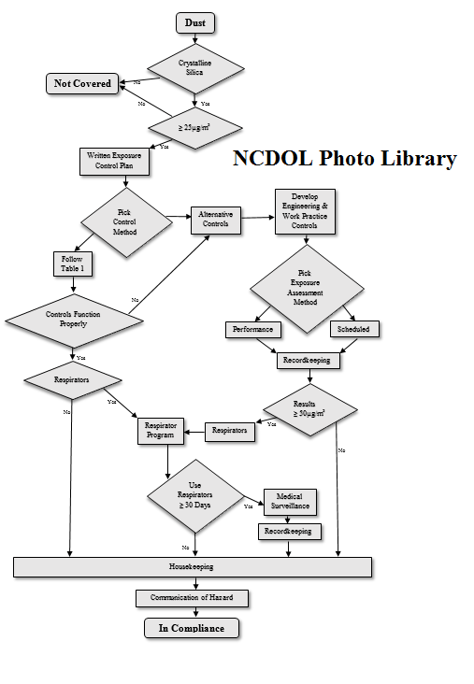
Silica Flow Chart
1926.1153
(a) Scope and application
(g) Written exposure control plan
(c) Specified exposure control methods
OR
(d) Alternative exposure control methods
Maybe
(e) Respiratory protection
(h) Medical surveillance
(j) Recordkeeping
(f) Housekeeping
(i) Communication

Slide 20
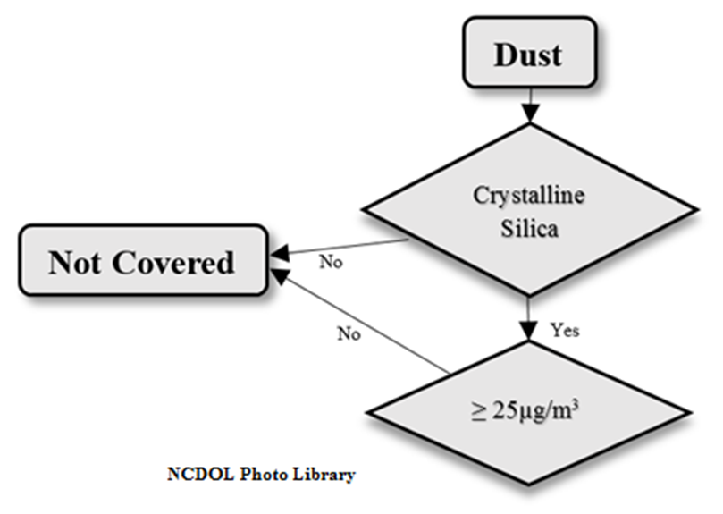
Scope and Application
1926.1153(a)
Applies to all occupational exposure to respirable crystalline silica in construction work, except where employee exposure will remain below 25 micrograms per cubic meter (µg/m³)

Slide 21
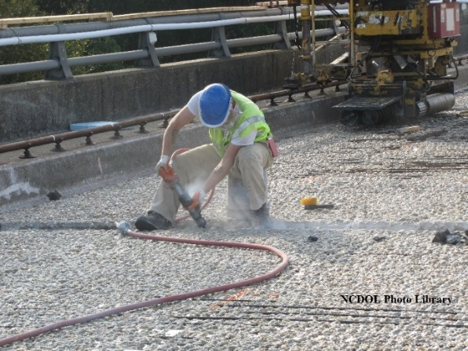
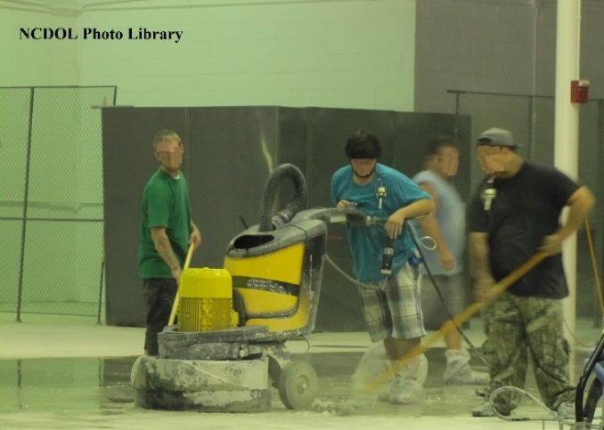
Exposure
Exposure to Silica begins with performing an activity that results in dust generation examples:
  Chipping
  Cutting
  Sawing
  Drilling
  Grinding
  Sanding
  Crushing

Slide 22
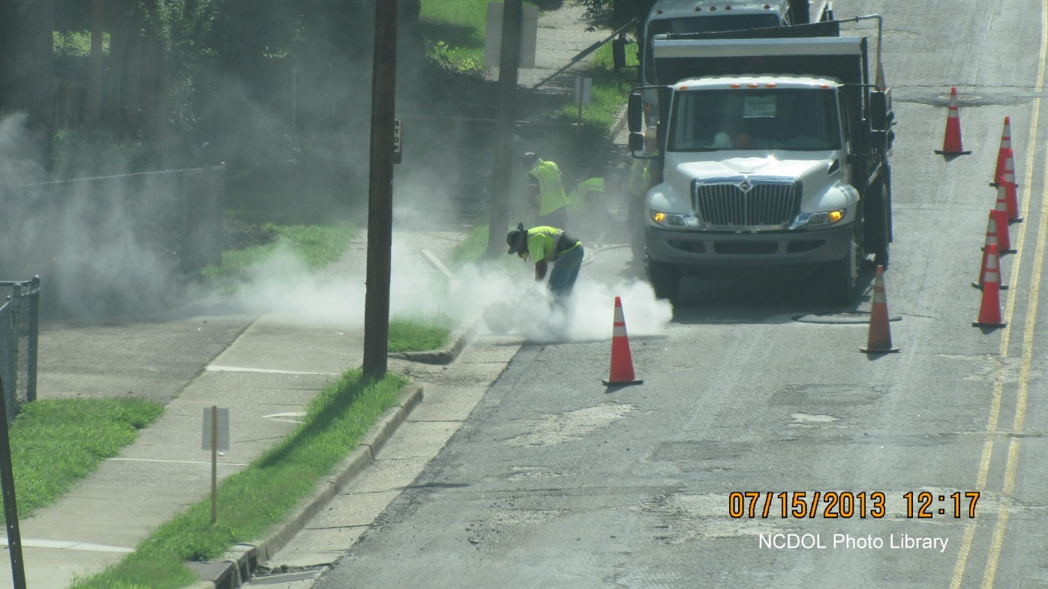
Dust

Slide 23
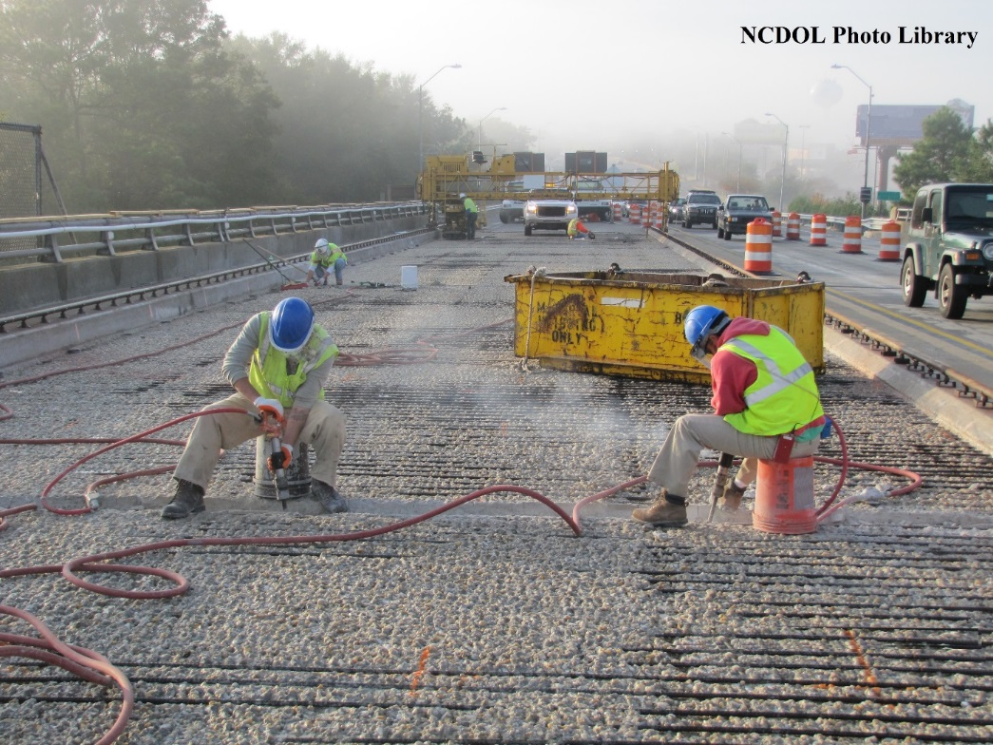
Dust

Slide 24
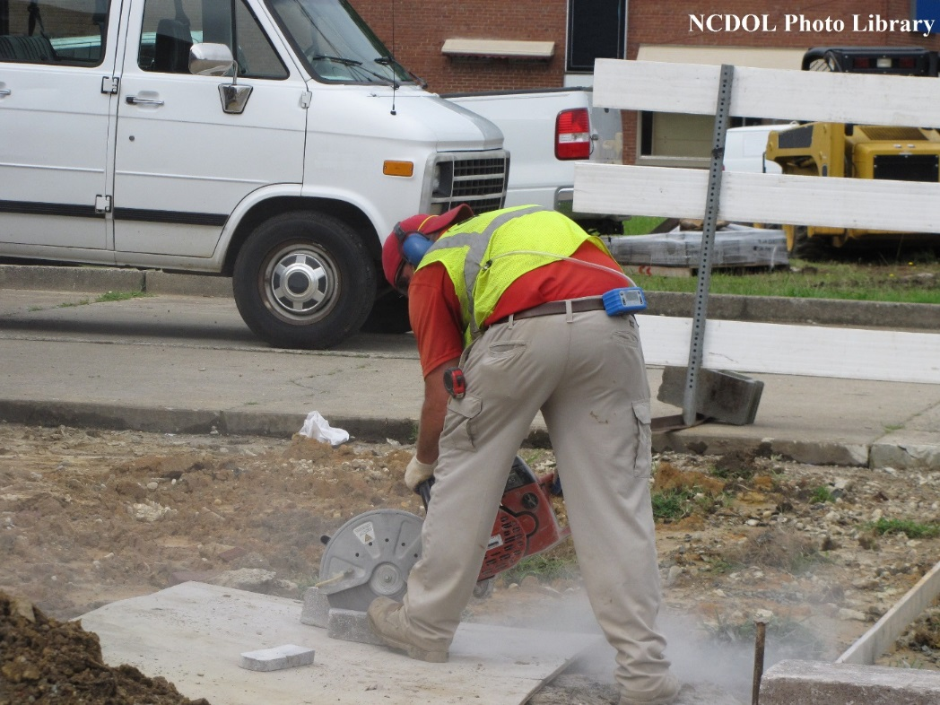
Dust

Slide 25
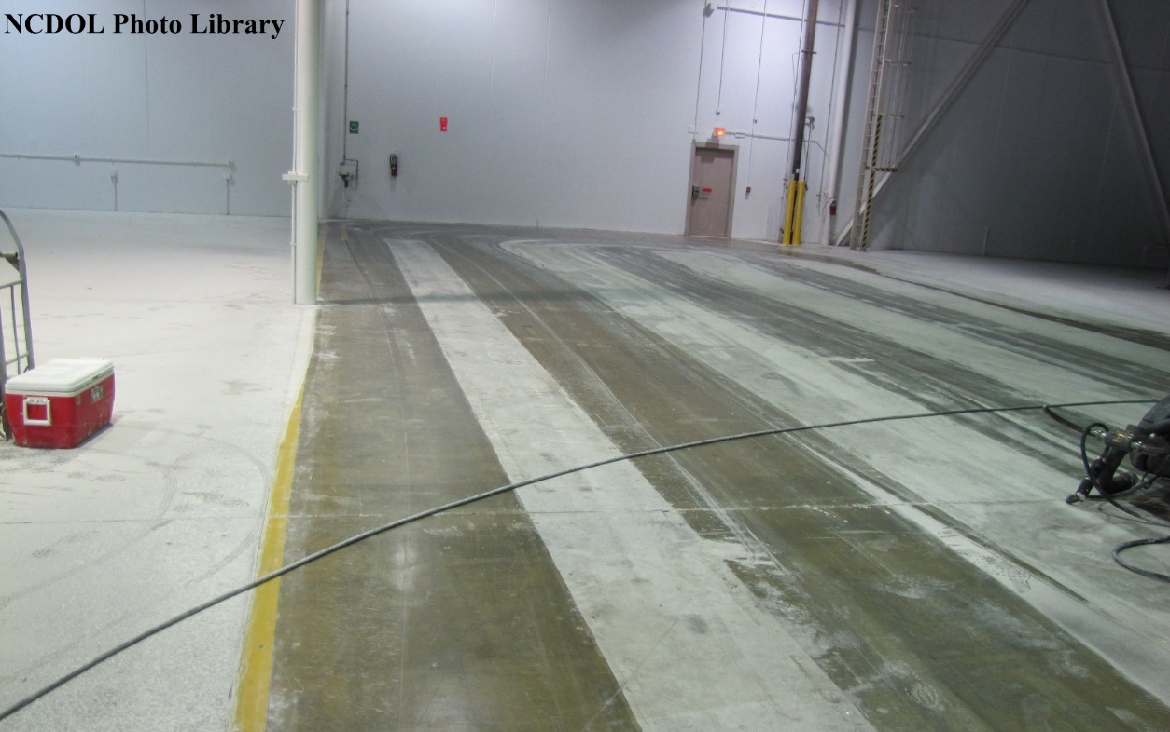
Dust

Slide 26
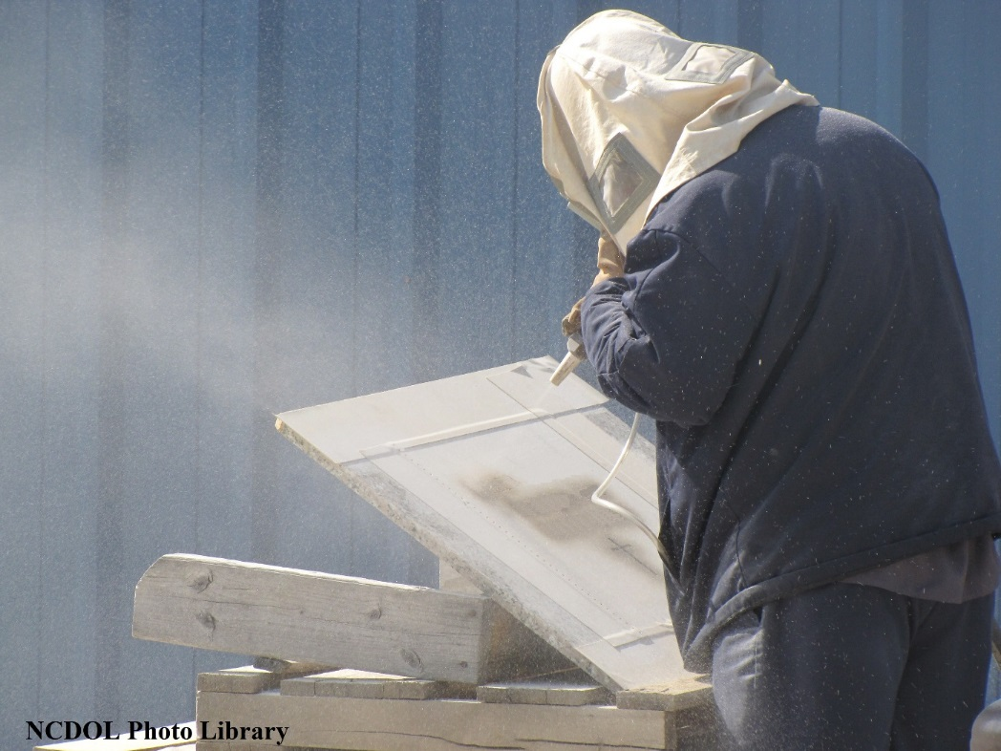
Dust

Slide 27

Scope and Application
1926.1153(a)

Slide 28
Crystalline Silica?

Slide 29
Crystalline Silica?

Slide 30
Crystalline Silica?

Slide 31
Crystalline Silica?

Slide 32
Crystalline Silica?

Slide 33
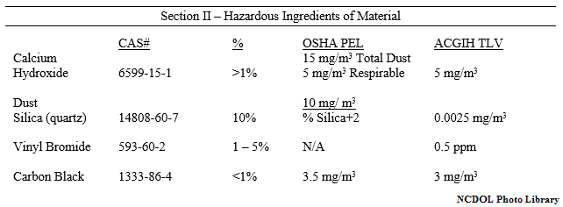
Presence of Crystalline Silica?
MSDS – Material Safety Data Sheet

Slide 34
Presence of Crystalline Silica?
MSDS – Material Safety Data Sheet

Slide 35
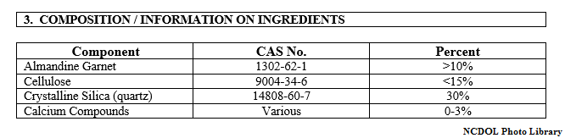
Presence of Crystalline Silica?
SDS – Safety Data Sheet

Slide 36
Presence of Crystalline Silica?
SDS – Safety Data Sheet

Slide 37
Scope and Application
1926.1153(a)

Slide 38
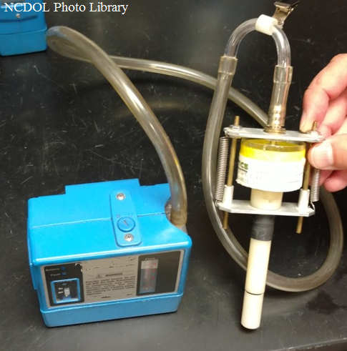
Crystalline Silica ≥ 25µg/m³
1926.1153(d)(2)(i)
Under any foreseeable conditions
Sample

Slide 39
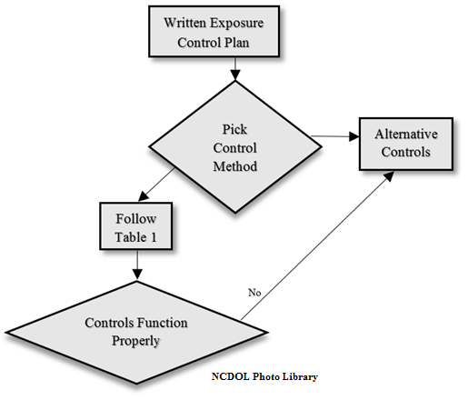
Written Exposure Control Plan
1926.1153(g)

Slide 40
Written Exposure Control Plan
1926.1153(g)(1)
Develop and implement a written exposure control plan to minimize or eliminate exposure to silica, which contains information on the following:
Task description
Description of the controls (engineering controls, work practices, personal protective equipment)
Housekeeping measures
Designates a competent person who will make frequent and regular inspections of the job sites, materials, and equipment to implement the written exposure control plan

Slide 41
Written Exposure Control Plan
1926.1153(g)(1)
Develop and implement a written exposure control plan to minimize or eliminate exposure to silica, which contains information on the following:
Procedures used to restrict access to work areas, when necessary, to minimize the number of employees exposed

Slide 42
Written Exposure Control Plan
1926.1153(g)(2)-(3)
Must be reviewed and evaluated at least annually and update when necessary
Must be readily available for examination and copying, upon request, to:
  Each employee covered by this section
  Designated employee representatives
  Assistant Secretary, and
  Director (of NIOSH)

Slide 43
Written Exposure Control Plan
1926.1153(g)

Slide 44
Specified Exposure Control Methods
1926.1153(c)(1)
Table 1 – Specified Exposure Control Methods; when working with materials containing crystalline silica
Lists 18 tasks with engineering and work practice control methods, and respirator requirements

Slide 45
Table 1 – Tasks
1926.1153(c)(1)
Stationary masonry saws
Handheld power saws (any blade diameter)
Handheld power saws for cutting fiber-cement board (with blade diameter of 8 inches or less)
Handheld grinders for uses other than mortar removal
Walk-behind milling machines and floor grinders
Small drivable milling machines (less than half-lane)

Slide 46
Table 1 – Tasks
1926.1153(c)(1)
Walk-behind saws
Drivable saws
Rig-mounted core saws or drills
Handheld and stand-mounted drills (including impact and rotary hammer drills)
Dowel drilling rigs for concrete
Handheld grinders for mortar removal
Large drivable milling machines (half-lane and larger)
Crushing machines
Vehicle-mounted drilling rigs for rock and concrete
Jackhammers and handheld powered chipping tools

Slide 47
Table 1 – Tasks
1926.1153(c)(1)
Heavy equipment and utility vehicles for tasks such as grading and excavating but not including:
  Demolishing, abrading, or fracturing silica-containing materials
Heavy equipment and utility vehicles used to abrade or fracture silica-containing materials or used during demolition activities involving silica-containing materials

Slide 48
Table 1 – Example 1
1926.1153(c)(1)
Equipment/Task | Engineering and work Practice control methods | Required respiratory protection and minimum assigned protection factor (APF)
 |  | ≤4 hours/shift | >4 hours/shift
Stationary masonry saws | Use saw equipped with integrated water delivery system that continuously feeds water to the blade | None. | None.

Slide 49
Table 1 – Example 2
1926.1153(c)(1)
Equipment/Task | Engineering and work Practice control methods | Required respiratory protection and minimum assigned protection factor (APF)
 |  | ≤4 hours/shift | >4 hours/shift
Handheld power saws (any blade diameter) | Use saw equipped with integrated water delivery system that continuously feeds water to the blade. Operate and maintain tool in accordance with manufacturer’s instructions to minimize dust emissions: -When used outdoors……………………… -When used indoors or in an enclosed area.. | None….……… APF 10.……… | APF 10. APF 10.

Slide 50
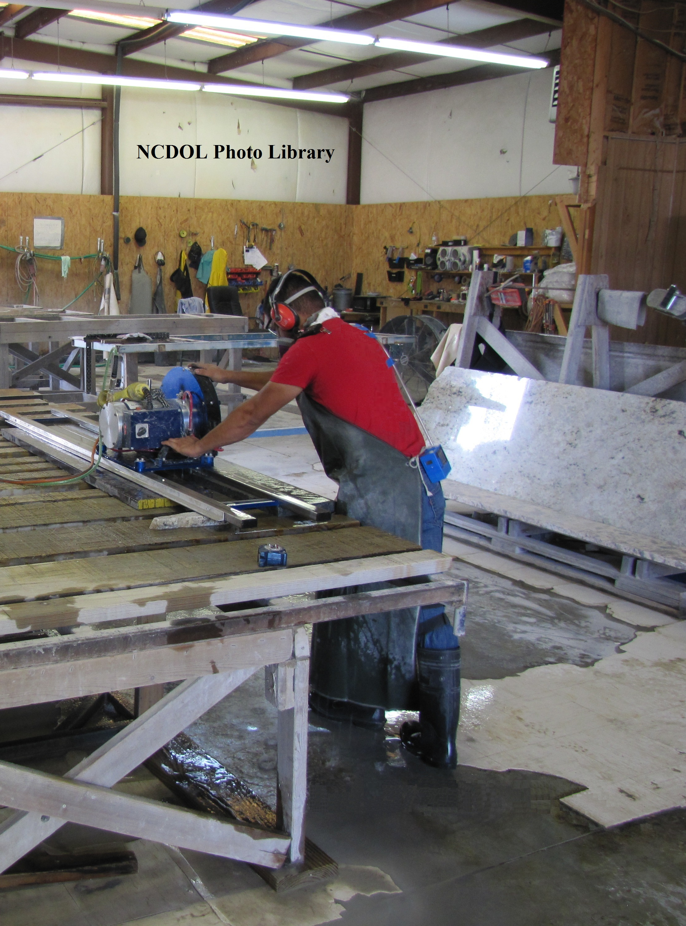
Example 2

Slide 51
Table 1 – Example 3
1926.1153(c)(1)
Equipment/Task | Engineering and work Practice control methods | Required respiratory protection and minimum assigned protection factor (APF)
 |  | ≤4 hours/shift | >4 hours/shift
Walk-behind saws | Use saw equipped with integrated water delivery system that continuously feeds water to the blade. Operate and maintain tool in accordance with manufacturer’s instructions to minimize dust emissions: -When used outdoors ………………………... -When used indoors or in an enclosed area ..... | None……….. APF 10 ……. | None. APF 10.

Slide 52
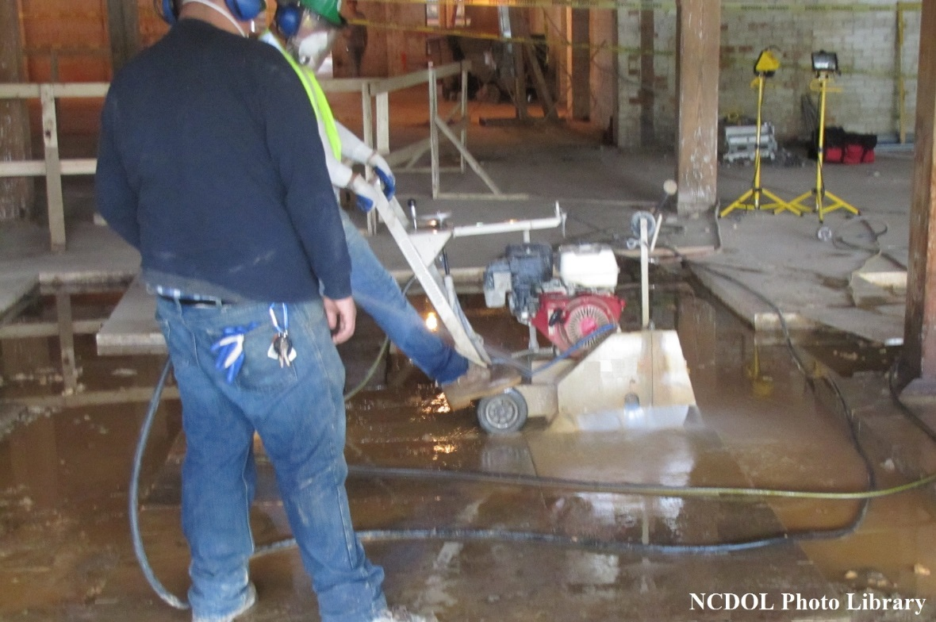
Example 3

Slide 53
Table 1 – Example 4
1926.1153(c)(1)
Equipment/Task | Engineering and work Practice control methods | Required respiratory protection and minimum assigned protection factor (APF)
 |  | ≤4 hours/shift | >4 hours/shift
Handheld and stand-mounted drills (including impact and rotary hammer drills). | Use drill equipped with commercially available shroud or cowling with dust collection system Operate and maintain tool in accordance with manufacturer’s instructions to minimize dust emissions. Dust collector must provide the air flow recommended by the tool manufacturer, or greater, and have a filter with 99% or greater efficiency and a filter-cleaning mechanism. Use a HEPA-filtered vacuum when cleaning holes | None. | None.

Slide 54
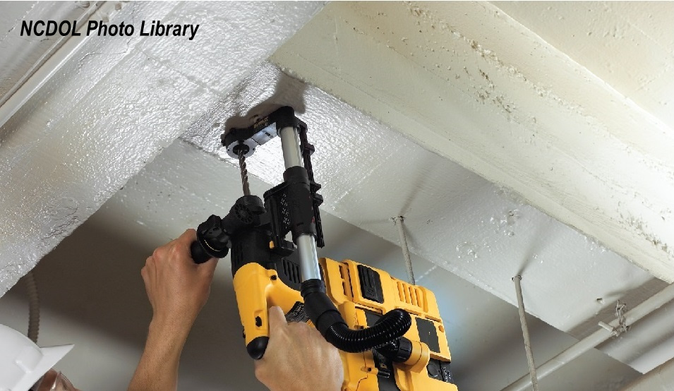
Example 4

Slide 55
Table 1 – Example 5
1926.1153(c)(1)
Equipment/Task | Engineering and work Practice control methods | Required respiratory protection and minimum assigned protection factor (APF)
 |  | ≤4 hours/shift | >4 hours/shift
Jackhammers and handheld powered chipping tools | Use tool with water delivery system that supplies a continuous stream or spray of water at the point of impact: -When used outdoors……………………………… -When used indoors or in an enclosed area……….. OR | None……….. APF 10…….. | APF 10. APF 10.

Slide 56
Table 1 – Example 5
1926.1153(c)(1)
Equipment/Task | Engineering and work Practice control methods | Required respiratory protection and minimum assigned protection factor (APF)
 |  | ≤4 hours/shift | >4 hours/shift
Jackhammers and handheld powered chipping tools | Use tool equipped with commercially available shroud and dust collection system. Operate and maintain tool in accordance with manufacturer’s instructions to minimize dust emissions Dust collector must provide the air flow recommended by the tool manufacturer, or greater, and have a filter with 99% or greater efficiency and a filter-cleaning mechanism -When used outdoors……………………………….. -When used indoors or in an enclosed area………… | None……… APF 10…… | APF 10. APF 10.

Slide 57
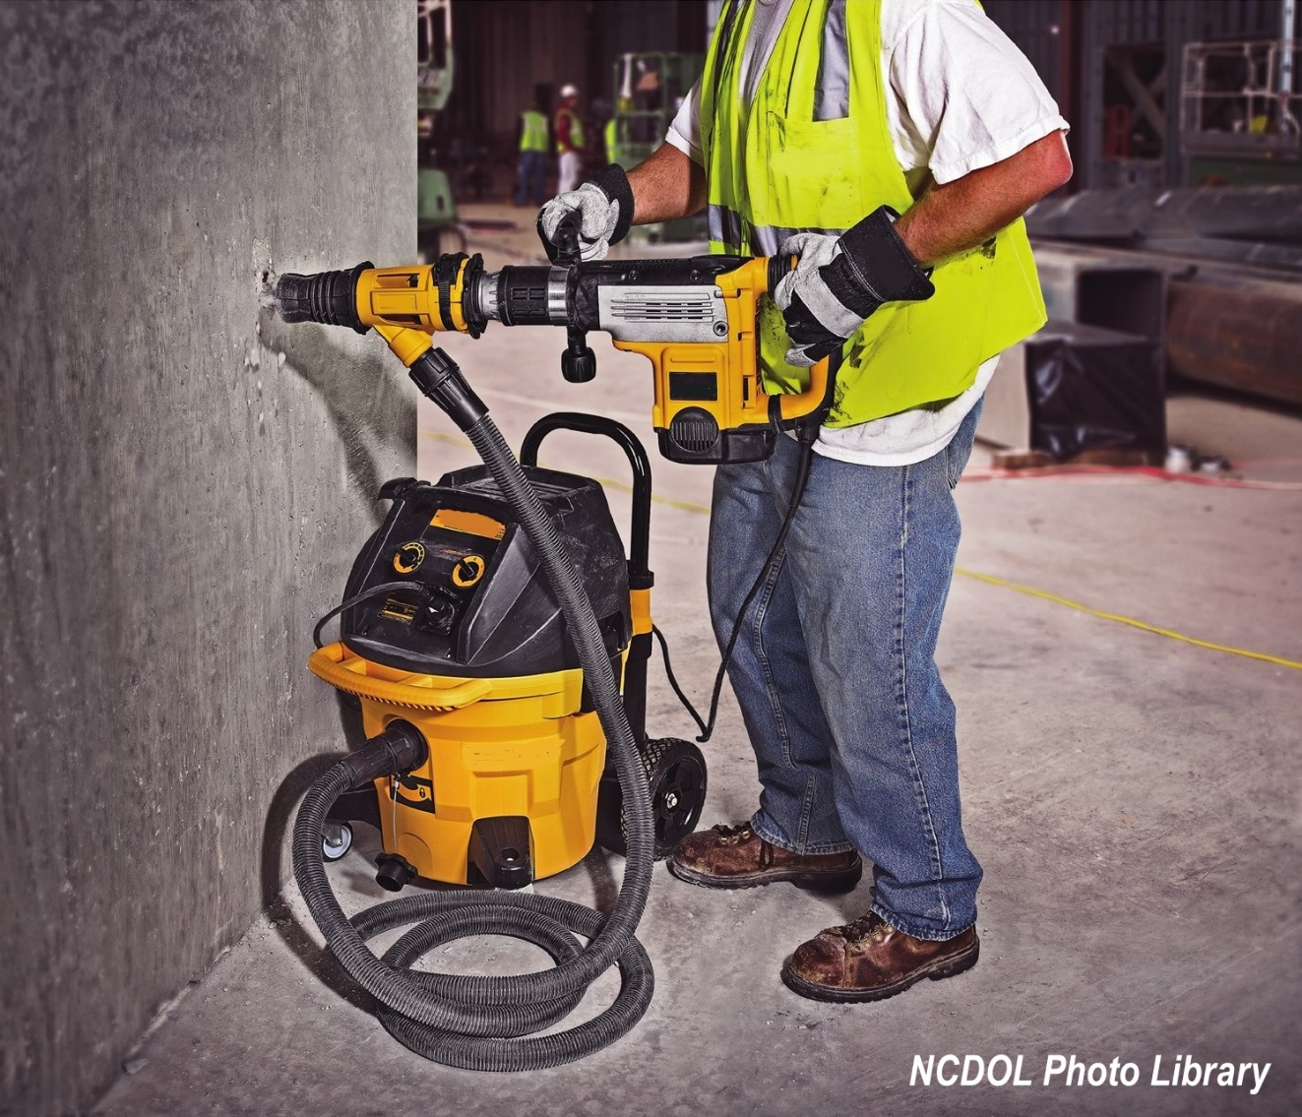
Example 5

Slide 58
Table 1 – Example 6
1926.1153(c)(1)
Equipment/Task | Engineering and work Practice control methods | Required respiratory protection and minimum assigned protection factor (APF)
 |  | ≤4 hours/shift | >4 hours/shift
Handheld grinders for mortar removal | Use grinder equipped with commercially available shroud and dust collection system Operate and maintain tool in accordance with manufacturer’s instructions to minimize dust emissions Dust collector must provide 25 cubic feet per minute (cfm) or greater of airflow per inch of wheel diameter and have a filter with 99% or greater efficiency and a cyclonic pre-separator or filter-cleaning mechanism | APF 10. | APF 25.

Slide 59
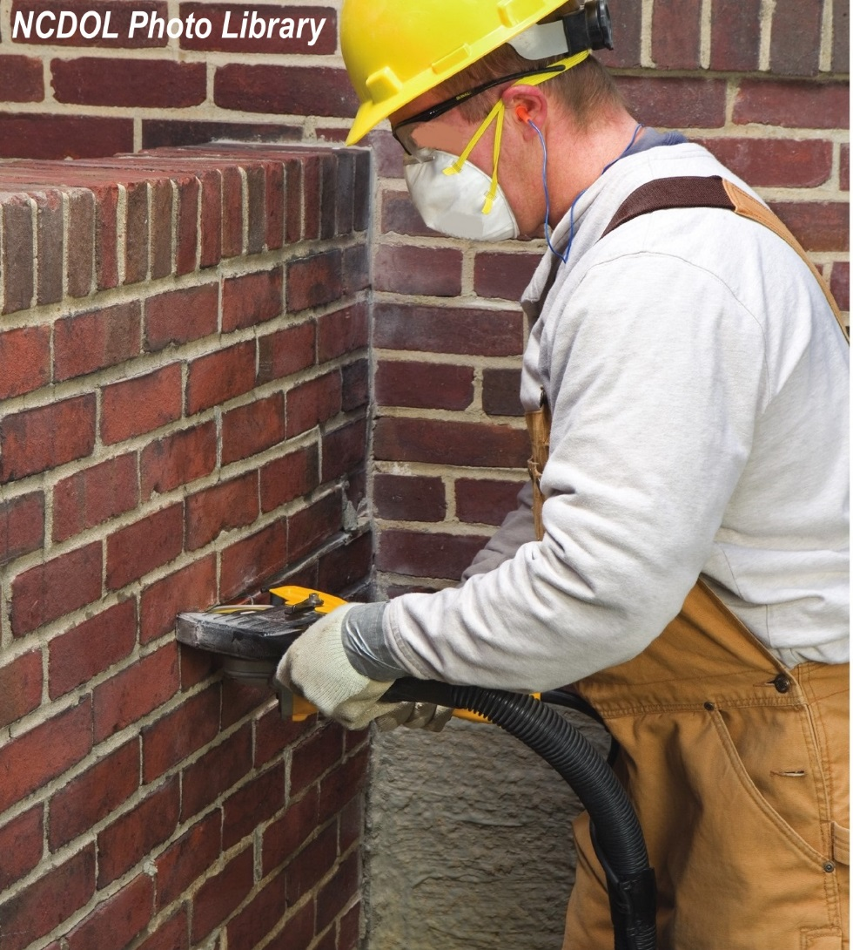
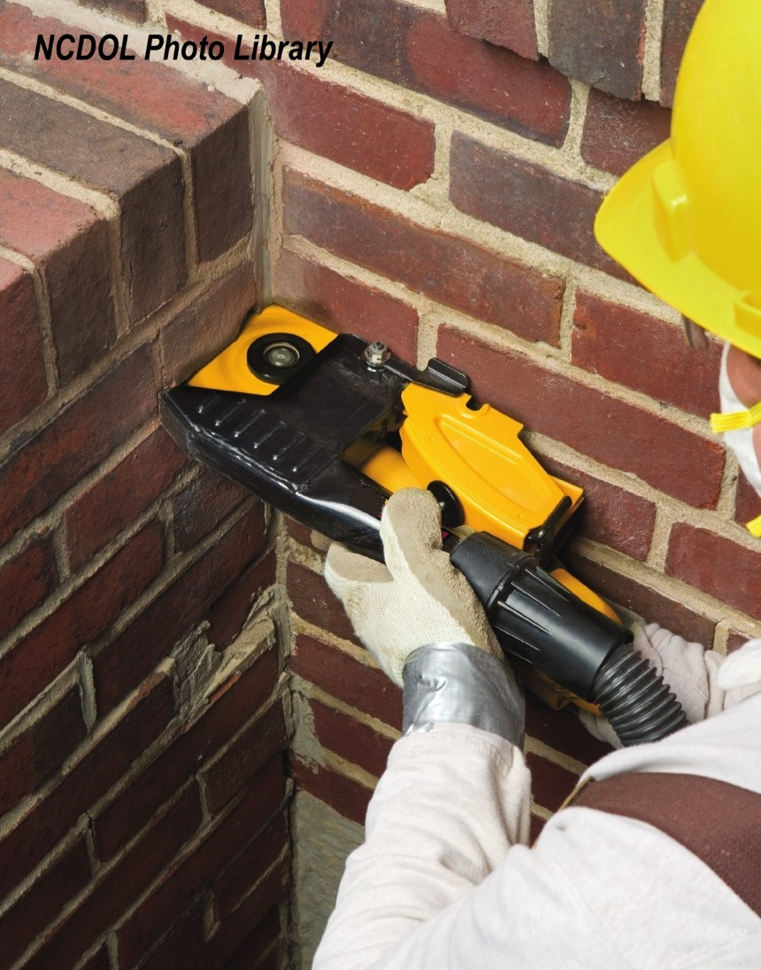
Example 6

Slide 60
Table 1 – Example 7
1926.1153(c)(1)
Equipment/Task | Engineering and work Practice control methods | Required respiratory protection and minimum assigned protection factor (APF)
 |  | ≤4 hours/shift | >4 hours/shift
Handheld grinders for uses other than mortar removal | For tasks performed outdoors only: Use grinder equipped with integrated water delivery system that continuously feeds water to the grinding surface Operate and maintain tool in accordance with manufacturer’s instructions to minimize dust emissions. OR | None. | None.

Slide 61
Table 1 – Example 7
1926.1153
Equipment/Task | Engineering and work Practice control methods | Required respiratory protection and minimum assigned protection factor (APF)
 |  | ≤4 hours/shift | >4 hours/shift
Handheld grinders for uses other than mortar removal | Use grinder equipped with commercially available shroud and dust collection system Operate and maintain tool in accordance with manufacturer’s instructions to minimize dust emissions Dust collector must provide 25 cubic feet per minute (cfm) or greater of airflow per inch of wheel diameter and have a filter with 99% or greater efficiency and a cyclonic pre-separator or filter-cleaning mechanism -When used outdoors……………………………... -When used indoors or in an enclosed area………. | None………. None………. | None. APF 10.

Slide 62
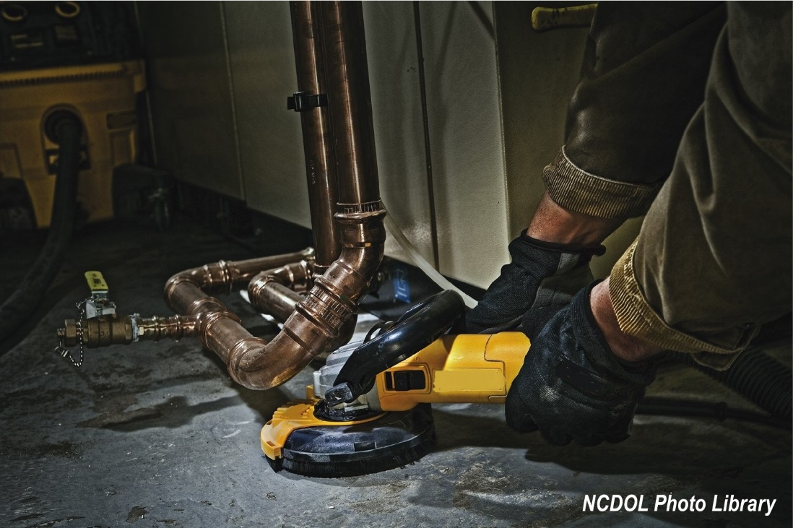
Example 7

Slide 63
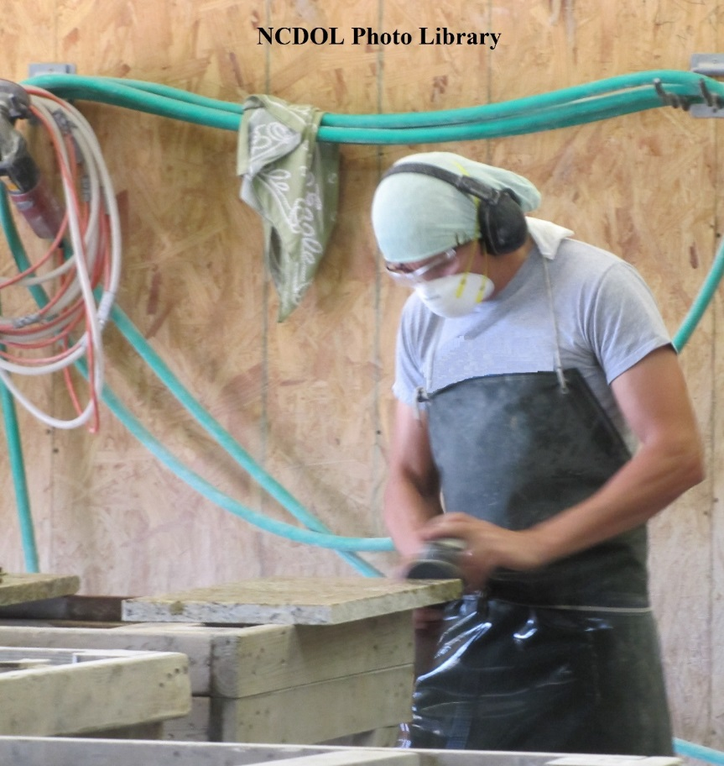
Example 7

Slide 64
Table 1 – Example 8
1926.1153(c)(1)
Equipment/Task | Engineering and work Practice control methods | Required respiratory protection and minimum assigned protection factor (APF)
 |  | ≤4 hours/shift | >4 hours/shift
Walk-behind milling machines and floor grinders. | Use machine equipped with integrated water delivery system that continuously feeds water to the cutting surface. Operate and maintain tool in accordance with manufacturer’s instructions to minimize dust emissions OR | None. | None.

Slide 65
Table 1 – Example 8
1926.1153(c)(1)
Equipment/Task | Engineering and work Practice control methods | Required respiratory protection and minimum assigned protection factor (APF)
 |  | ≤4 hours/shift | >4 hours/shift
Walk-behind milling machines and floor grinders. | Use machine equipped with dust collection system recommended by the manufacturer Operate and maintain tool in accordance with manufacturer’s instructions to minimize dust emissions Dust collector must provide the air flow recommended by the manufacturer, or greater, and have a filter with 99% or greater efficiency and a filter-cleaning mechanism When used indoors or in an enclosed area, use a HEPA-filtered vacuum to remove loose dust in between passes. | None. | None.

Slide 66
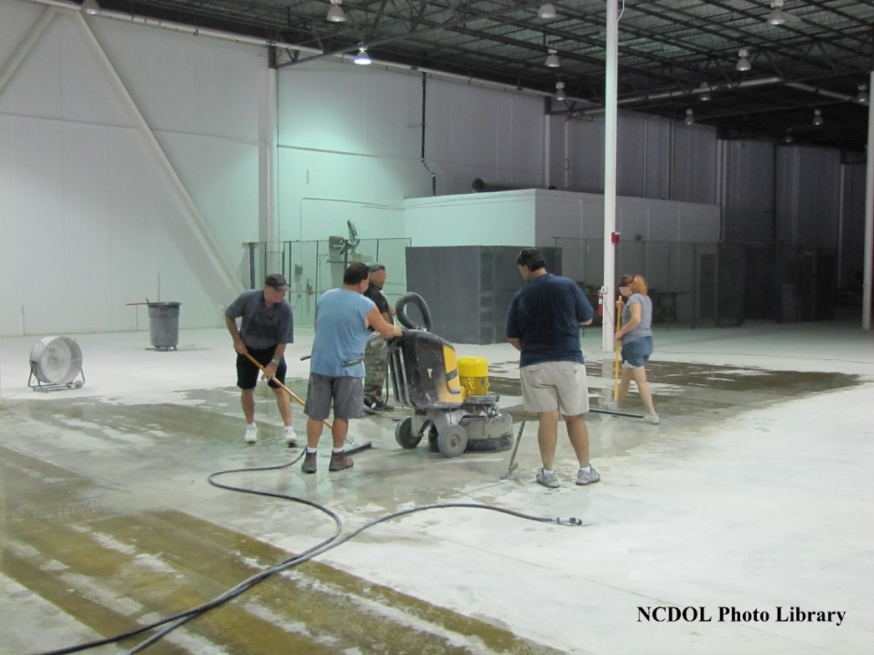
Example 8

Slide 67
Specified Exposure Control Methods
1926.1153(c)
Where an employee performs more than one task on Table 1 during the course of a shift, and the total duration of all tasks combined is more than four hours, the required respiratory protection for each task is the respiratory protection specified for more than four hours per shift.

Slide 68
Specified Exposure Control Methods
1926.1153(c)
If the total duration of all tasks on Table 1 combined is less than four hours, the required respiratory protection for each task is the respiratory protection specified for less than four hours per shift.

Slide 69
Specified Exposure Control Methods
1926.1153(c)
For each employee engaged in a task identified on Table 1, the employer shall fully and properly implement the engineering controls, work practices, and respiratory protection specified for the task on Table 1.

Slide 70
Specified Exposure Control Methods
1926.1153(c)
When implementing the control measures specified in Table 1, each employer shall:
For tasks performed indoors or in enclosed areas, provide a means of exhaust as needed to minimize the accumulation of visible airborne dust
For tasks performed using wet methods, apply water at flow rates sufficient to minimize release of visible dust

Slide 71
Specified Exposure Control Methods
1926.1153(c)
When controls are fully and properly implemented according to Table 1
  Do not have to comply with PEL
  Do not have to conduct exposure assessments for employees engaged in those tasks

Slide 72
Alternative Control Methods
1926.1153(d)
For tasks not listed in Table 1
or
where the employer does not fully and properly implement the engineering controls, work practices, and respiratory protection described in Table 1

Slide 73
Written Exposure Control Plan
1926.1153(g)

Slide 74
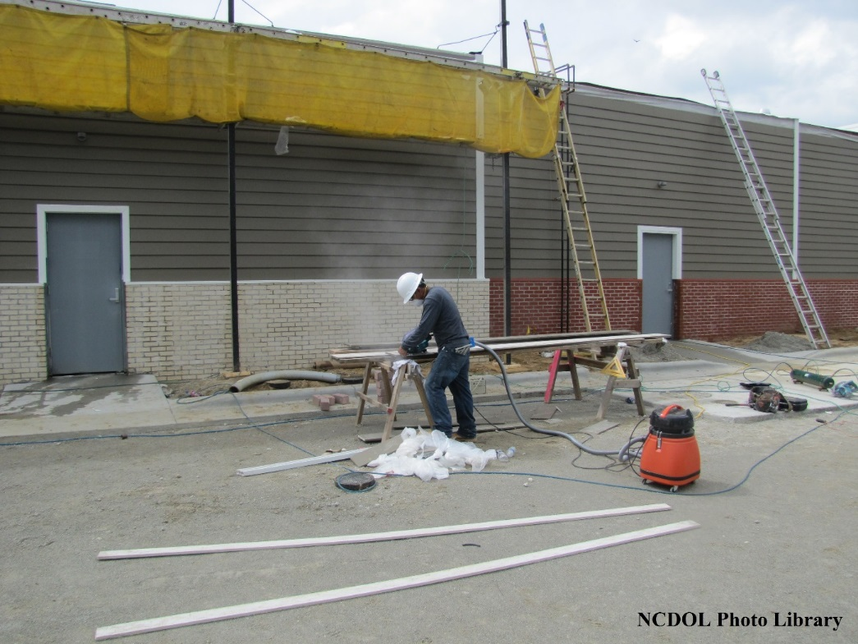
Controls Not Functioning Properly

Slide 75
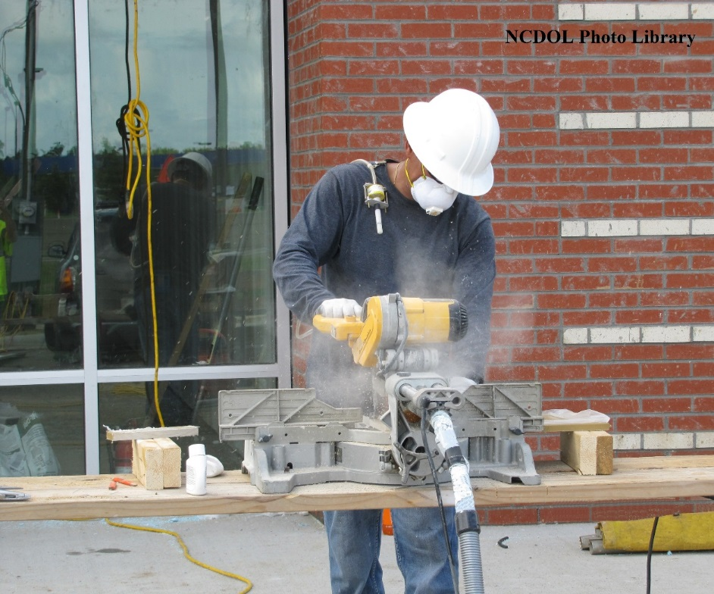
Controls Not Functioning Properly

Slide 76
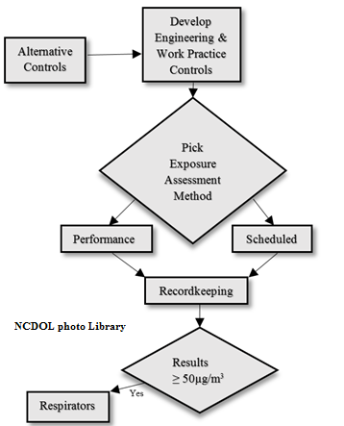
Alternative Control Methods
1926.1153(d)

Slide 77
Alternative Control Methods
1926.1153(d)
Permissible Exposure Limit (PEL)
Employer shall ensure that no employee is exposed to an airborne concentration of respirable crystalline silica in excess of
50 µg/m³, calculated as an 8-hour
Time Weighted Average (TWA)

Slide 78
Alternative Control Methods
1926.1153(d)
Engineering and work practice controls
Shall be used to reduce and maintain employee exposure to respirable crystalline silica to or below the PEL, unless the employer can demonstrate that such controls are not feasible
Wherever feasible engineering and work practice controls are not sufficient to reduce employee exposure to or below the PEL
  Must be used to reduce employee exposure to the lowest feasible level, and
  Supplement with the use of respiratory protection

Slide 79
Alternative Control Methods
1926.1153(d)
Engineering and work practice controls
Shall be used to reduce and maintain employee exposure to respirable crystalline silica to or below the PEL, unless the employer can demonstrate that such controls are not feasible
Wherever feasible engineering and work practice controls are not sufficient to reduce employee exposure to or below the PEL
  Must be used to reduce employee exposure to the lowest feasible level, and
  Supplement with the use of respiratory protection

Slide 80
Alternative Control Methods
1926.1153(d)

Slide 81
Alternative Control Methods
1926.1153(d)
Exposure assessment - assess the exposure of each employee who is or may reasonably be expected to be exposed to respirable crystalline silica at or above the action level
(25 µg/m³)
  Performance Option
  Scheduled Option

Slide 82
Scheduled Option
1926.1153(d)(2)
Exposure assessment
Initial monitoring
  < Action Level (25 µg/m³)
    Monitoring may be discontinued

Slide 83
Scheduled Option
1926.1153(d)(2)
Most recent monitoring
  ≥ AL (25 µg/m³) but < the PEL (50 µg/m³)
    Repeat monitoring within six (6) months
  > PEL
    Repeat monitoring within three (3) months
  < AL (25 µg/m³)
    Repeat such monitoring within six (6) months
    of the most recent monitoring until two (2) consecutive
    measurements, taken seven (7) or more days apart,
    are < AL (25 µg/m³), at which time the monitoring
    maybe discontinued

Slide 84
Alternative Control Methods
1926.1153(d)(2)(vi)
Employee notification of assessment results
Within five (5) working days after completing an exposure assessment
  Notify each affected employee in writing of the results of that assessment, or
  Post the results in an appropriate location accessible to all affected employees
Whenever an exposure assessment indicates that employee exposure is above the PEL (50 µg/m³), the employer shall describe in the written notification the corrective action being taken to reduce employee exposure to or below the PEL

Slide 85
Alternative Control Methods
1926.1153(d)(2)(iv)
Exposure reassessment
Whenever a change in the production, process, control equipment, personnel, or work practices may reasonable be expected to result in new or additional exposures at or above the action level
OR
When employer has reason to believe there are new or additional exposures at or above the action level have occurred

Slide 86
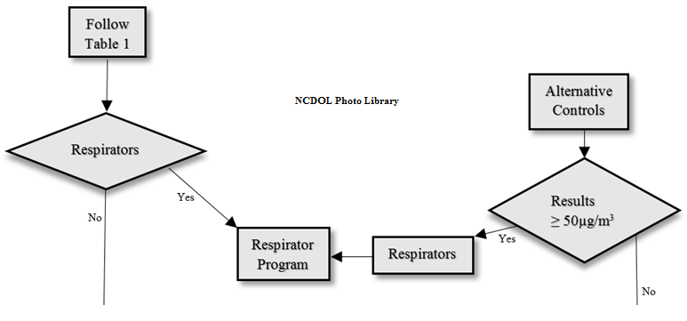
Respiratory Protection
1926.1153(e)

Slide 87
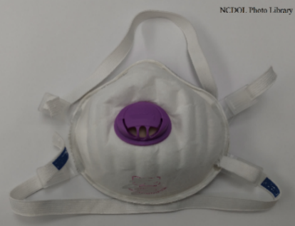
Respiratory Protection
1926.1153(e)
Where respiratory protection is required, the employer must provide each employee an appropriate respirator that complies with the requirements of paragraph (e) and 29 CFR 1910.134
Written Respiratory Protection Program
Medical evaluation
Fit testing
Training
  Proper use
    Limitations/capabilities
    Maintenance/care/storage

Slide 88
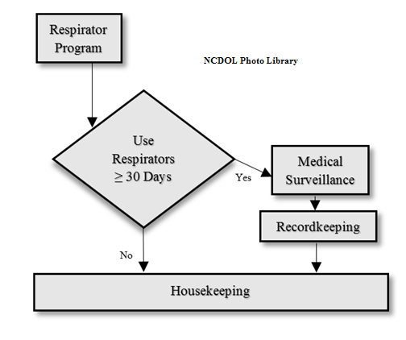
Medical Surveillance
1926.1153(h)

Slide 89
Medical Surveillance
1926.1153(h)(2)
Initial (baseline) examination
Must be made available within 30 days after initial assignment, unless
Employee received a medical examination that meets the requirements of this section within the last three (3) years

Slide 90
Medical Surveillance
1926.1153(h)(3)
Periodic examination
At least every three (3) years, or more frequently if recommended by the physician or other licensed health care professional (PLHCP)
Exam includes medical and work history, physical examination (emphasis on respiratory system), chest X-ray, pulmonary function test (PFT), and tuberculosis (TB) test

Slide 91
Medical Surveillance: Employee
1926.1153(h)(5)
PLHCP’s written medical opinion
Receive a written medical report within 30 days after the medical examination
Report includes the results of the medical examination:
Recommendations for limitations on respirator use
Recommendations for limitations on exposure to silica
Recommendations for further evaluation or treatment
Examination by a specialist

Slide 92
Medical Surveillance: Employer
1926.1153(h)(6)
PLHCP’s written medical opinion
Can only describe limitations on respirator use
If employee provides written authorization, then the employer also receives:
Any recommended limitations on the employee’s exposure to respirable crystalline silica
Recommendation for examination by a specialist

Slide 93
Recordkeeping
1926.1153(j)

Slide 94
Recordkeeping
1926.1153(j)(1)
Air monitoring
Employer shall make and maintain an accurate record of all exposure measurements taken to assess employee and/or objective data relied upon to determine exposure to respirable crystalline silica
All exposure records must be maintained and made available to employees, in accordance with 29 CFR 1910.1020

Slide 95
Recordkeeping
1926.1153(j)(3)
Medical Surveillance Program
Make and maintain an accurate record for each employee covered by medical surveillance
Medical records must be maintained and made available in accordance with 29 CFR 1910.1020

Slide 96
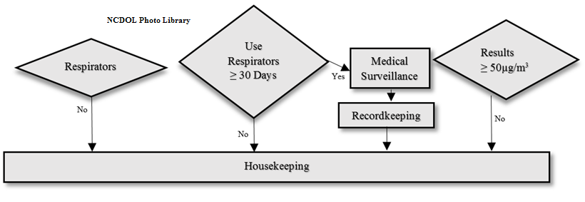
Housekeeping
1926.1153(f)

Slide 97
Housekeeping
1926.1153(f)(1)-(2)
Activities that could contribute to silica exposure are not allowed.
Dry sweeping or dry brushing
Compressed air to clean surfaces or cloths

Slide 98
Housekeeping
1926.1153(f)(1)
Approved activities
Wet sweeping
Vacuuming (HEPA-filter)
Compressed air when used in conjunction with a ventilation system that effectively captures the dust cloud created
Other methods that minimize the likelihood of exposure
No alternative method is feasible
  Dry sweeping or dry brushing
  Compressed air

Slide 99
Housekeeping
1926.1153(f)(1)
Approved activities
Wet sweeping
Vacuuming (HEPA-filter)
Compressed air when used in conjunction with a ventilation system that effectively captures the dust cloud created
Other methods that minimize the likelihood of exposure
No alternative method is feasible
  Dry sweeping or dry brushing
  Compressed air

Slide 100
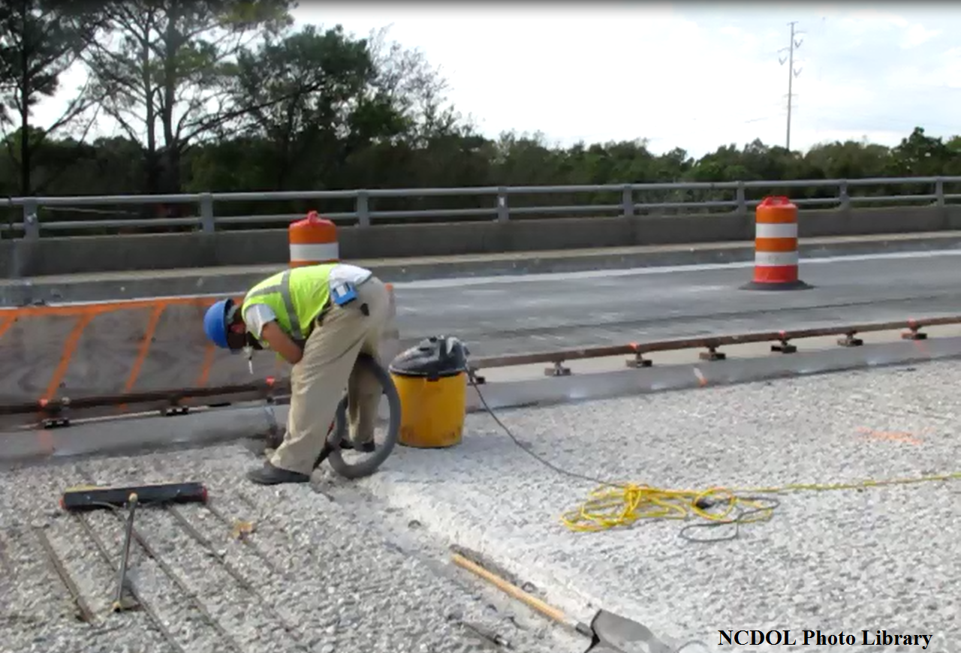
Vacuuming Without a Filter

Slide 101
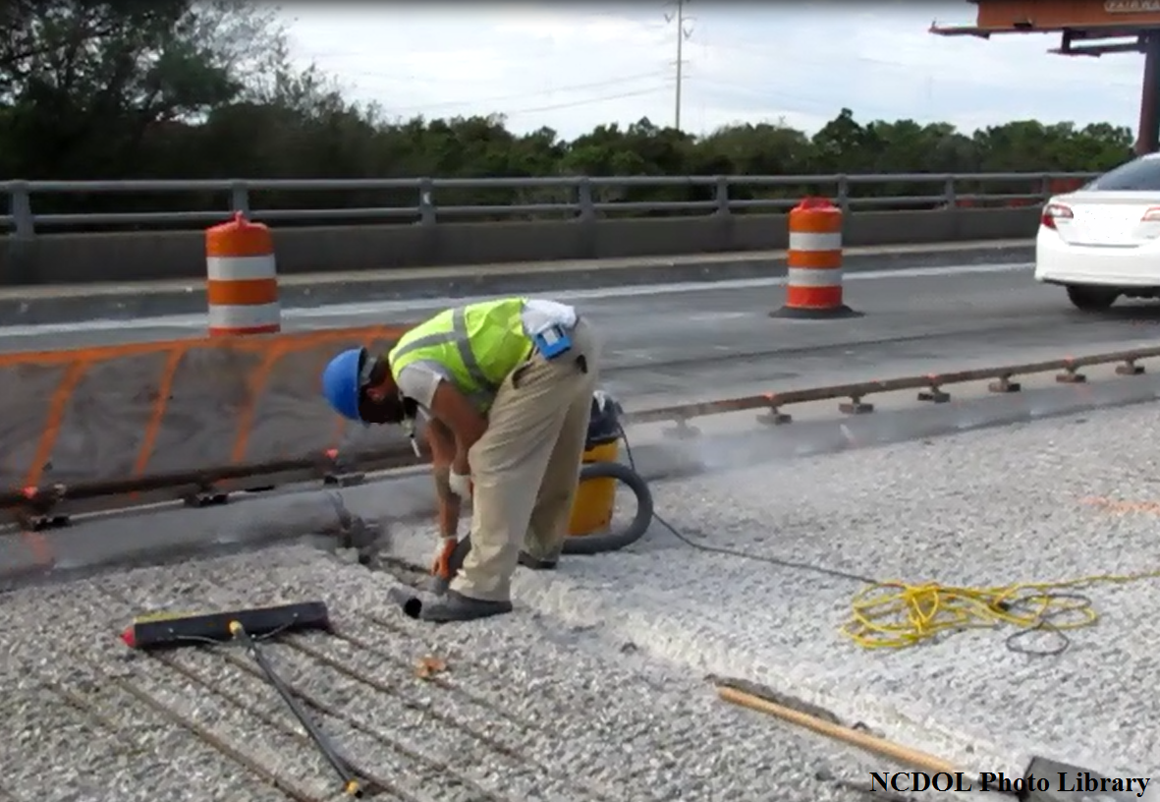
Vacuuming Without a Filter

Slide 102
Vacuuming Without a Filter

Slide 103
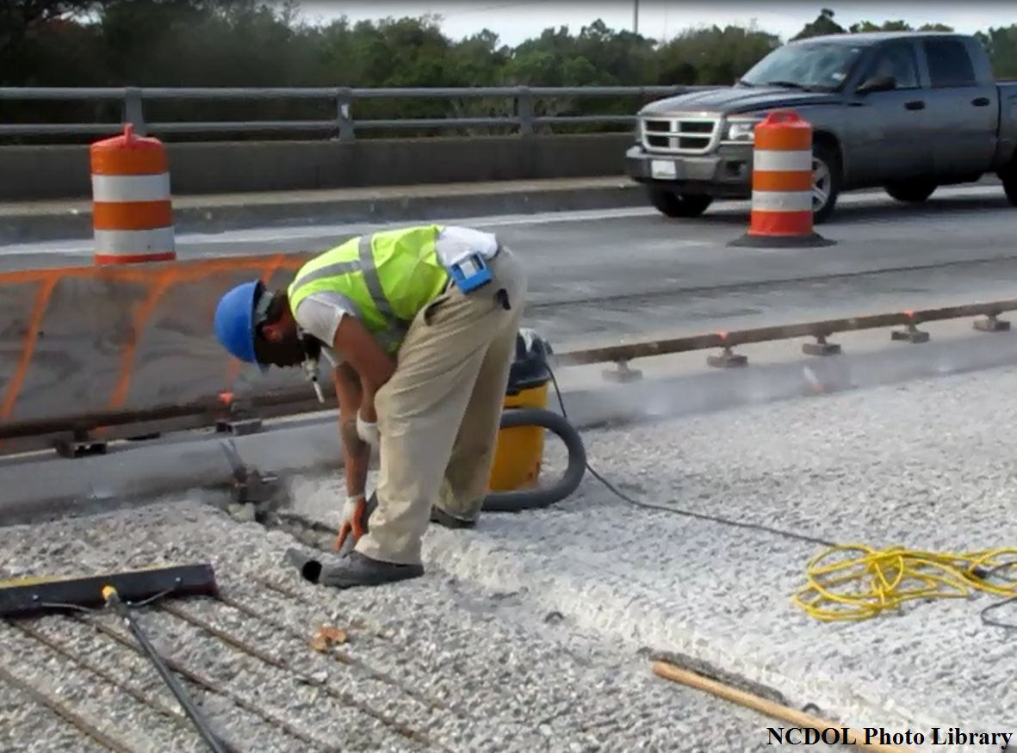
Vacuuming Without a Filter

Slide 104
Vacuuming Without a Filter

Slide 105
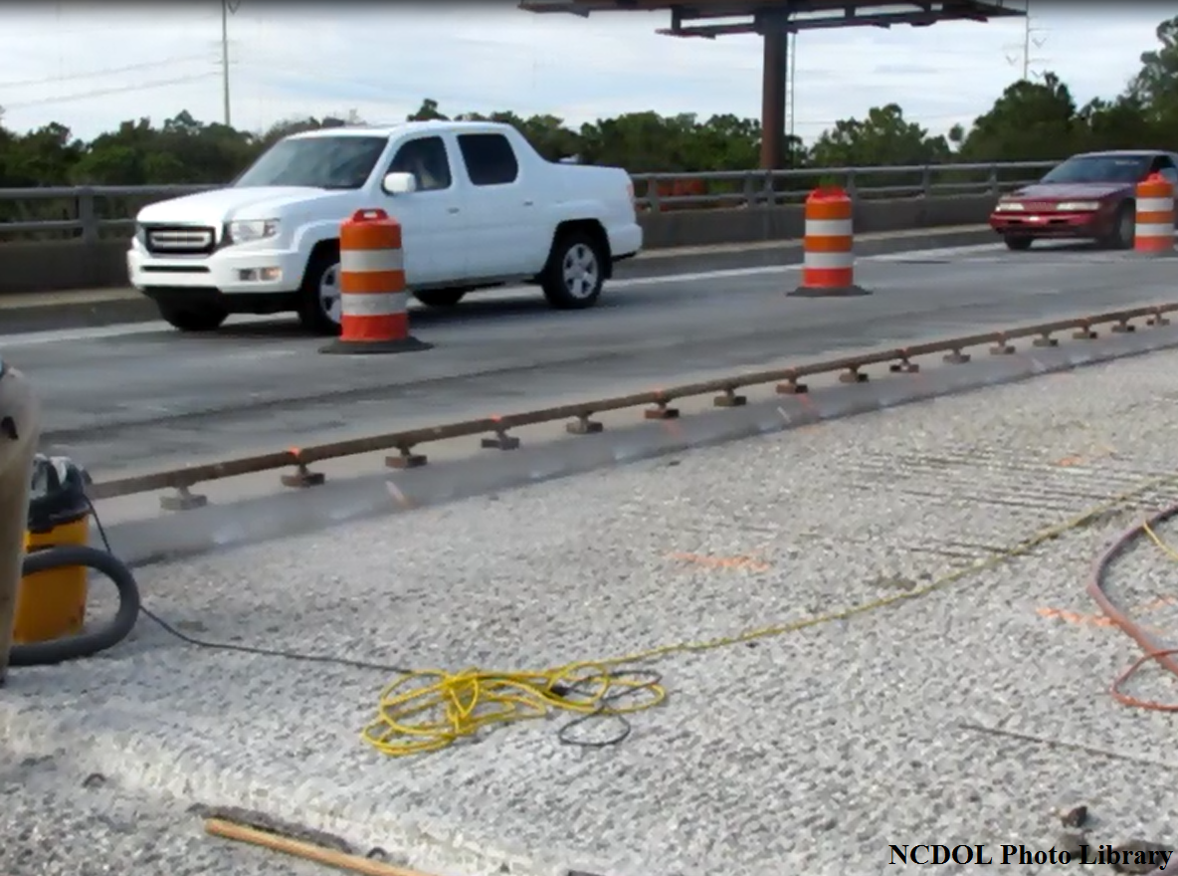
Vacuuming Without a Filter

Slide 106
Vacuuming Without a Filter

Slide 107
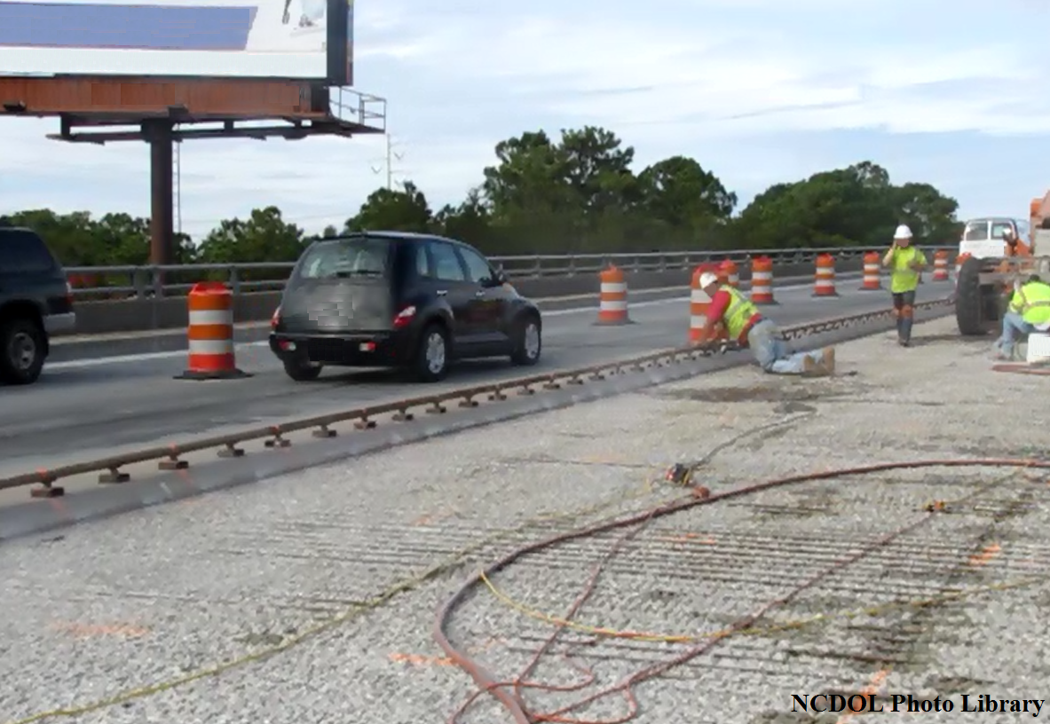
Vacuuming Without a Filter

Slide 108
Vacuuming Without a Filter

Slide 109
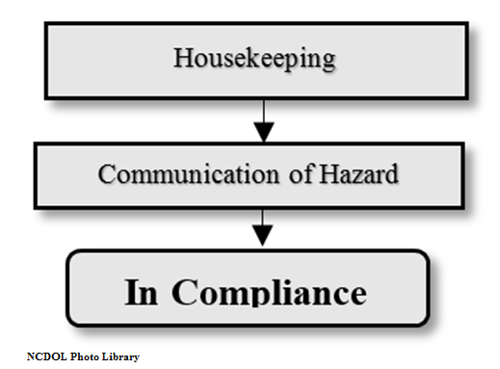
Communication
1926.1153(i)

Slide 110
Communication
1926.1153(i)(1)
Hazard Communication Standard (HCS)
  Address: Cancer, lung effects, immune system effects, and kidney effects
  Safety Data Sheets (SDS)
  Labels

Slide 111
Employee Information/Training
1926.1153(i)(2)
Exposure to respirable crystalline silica
  Associated health hazards
  Specific Tasks in the working environment
  Controls that minimize or eliminate exposure
Explanation of the silica standard
Identify the competent person
Purpose and a description of the medical surveillance program

Slide 112
Review
1926.1153
Exposure to respirable crystalline silica has been linked to:
Silicosis
Lung cancer
Chronic obstructive pulmonary disease
Kidney disease

Slide 113
Silica Flow Chart
1926.1153
(a) Scope and application
(g) Written exposure control plan
(c) Specified exposure control methods
OR
(d) Alternative exposure control methods
Maybe
(e) Respiratory protection
(h) Medical surveillance
(j) Recordkeeping
(f) Housekeeping
(i) Communication

Slide 114
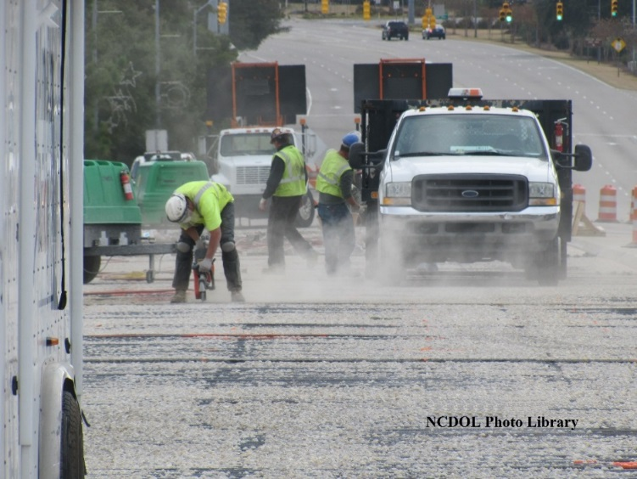
Review
Dust generation and exposure
Material composition
Who is your competent person?
Protect yourself!

Slide 115
Summary
Respirable crystalline silica – what it is, sources and health effects
Identification/exposure controls – silica producing work processes and how to control it
New OSHA regulatory requirements

Slide 116
Thank You For Attending!
Final Questions?

