Slide 1
Scaffolds
29 CFR 1926 – Subpart L
Presented by:
Notes:
Revised 6/15/25
The information in this presentation is provided voluntarily by the N.C. Department of Labor, Education Training and Technical Assistance Bureau as a public service and is made available in good faith. This presentation is designed to assist trainers conducting OSHA outreach training for workers. Since workers are the target audience, this presentation emphasizes hazard identification, avoidance, and control – not standards. No attempt has been made to treat the topic exhaustively. It is essential that trainers tailor their presentations to the needs and understanding of their audience.
The information and advice provided on this Site and on Linked Sites is provided solely on the basis that users will be responsible for making their own assessment of the matters discussed herein and are advised to verify all relevant representations, statements, and information.
This presentation is not a substitute for any of the provisions of the Occupational Safety and Health Act of North Carolina or for any standards issued by the N.C. Department of Labor. Mention of trade names, commercial products, or organizations does not imply endorsement by the N.C. Department of Labor.

Slide 2
Objectives
At the end of this course, students will be able to:
  Familiarize themselves with OSHA’s minimum requirements for scaffolds
  Recognize safe design, setup, and use of scaffolds
  Identify common scaffolding hazards
  Identify common abatement methods for scaffolding hazards

Slide 3
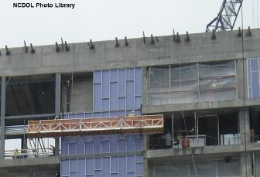
Scaffolds
1926.450 - Scope, application and definitions applicable to this subpart
1926.451 - General requirements
1926.452 - Additional requirements applicable to specific types of scaffolds
1926.453 - Aerial lifts
1926.454 - Training requirements

Slide 4
Scaffolds
29 CFR 1926 Subpart L - Appendices
Appendix A - Scaffold Specifications
Appendix B - (Reserved) Criteria for Determining the Feasibility of Providing Safe Access and Fall Protection for Scaffold Erectors and Dismantlers
Appendix C - List of National Consensus Standards
Appendix D - List of Training Topics for Scaffold Erectors and Dismantlers
Appendix E - Drawings and Illustrations
Note: These appendices are non-mandatory.

Slide 5
Scope and Application
1926.450(a)
Covers all scaffolds used in workplaces
  Two categories for scaffolds
    Supported
    Suspended
Aerial lifts are covered in 1926.453
Does not apply to crane or derrick
suspended personnel platforms, which are covered by 1926.1431(a)-(e)

Slide 6
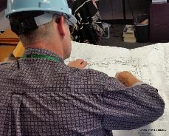
General Requirements
1926.451(a)(6)
Designed by qualified person
Constructed and loaded in accordance with that design
Appendix A (non-mandatory)
provides guidelines to assist in
complying with requirements

Slide 7
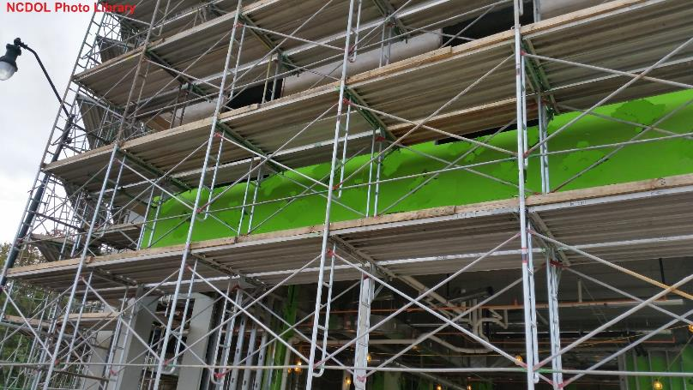
What makes this a good scaffold set up?

Slide 8
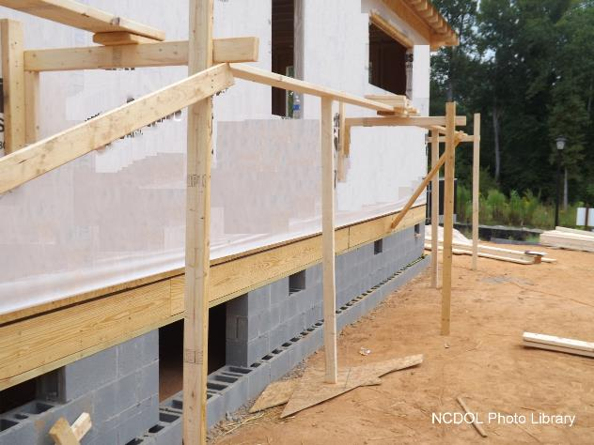
What is wrong with this scaffold set up?

Slide 9
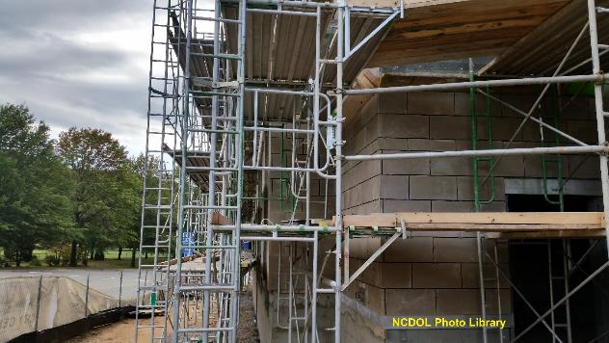
General Requirements
1926.451(a)(1)
Scaffold and scaffold components must support own weight and 4 times the maximum intended load.
  Includes personnel, equipment, and supply loads.

Slide 10
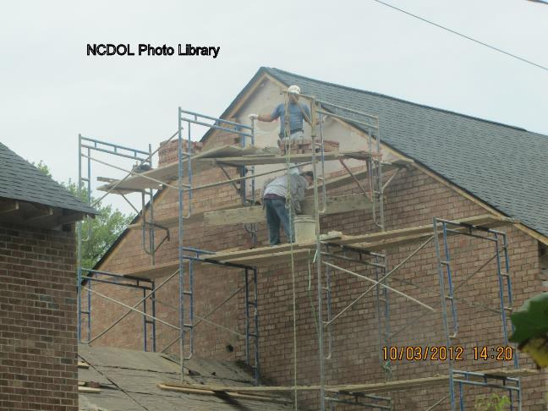
What are the hazards in this picture?

Slide 11
Scaffold Platform Construction
1926.451(b)(1)
Platforms on working levels of scaffolds must be fully planked or decked between front uprights and the guardrail supports.

Slide 12
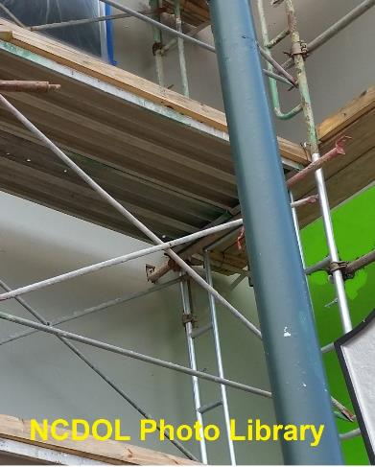
Scaffold Platform Construction
1926.451(b)(1)(i)-(ii)
No more than 1” space between adjacent units, and between platform and uprights.
Where necessary [e.g., to fit around uprights] maximum opening of 9½”.

Slide 13
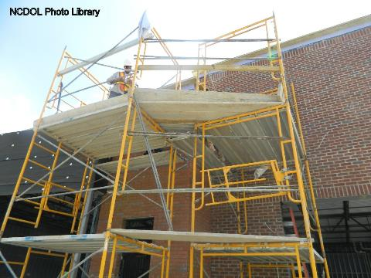
Scaffold Platform Construction
1926.451(b)(2)
Platforms used solely as walkways or performing scaffold erection or dismantling must be at least 18” wide.

Slide 14
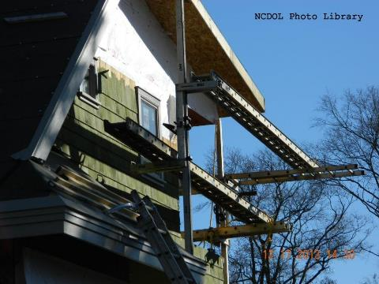
Scaffold Platform Construction
1926.451(b)(2)(i)
The following scaffold platforms must be at least 12” wide:
  Ladder jack
  Top plate bracket
  Roof bracket
  Pump jack scaffold

Slide 15
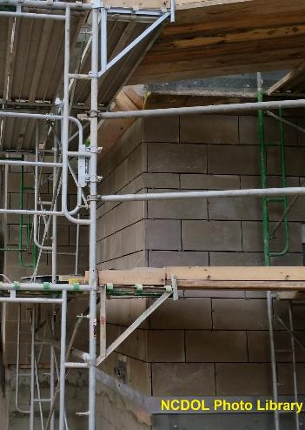
Scaffold Platform Construction
1926.451(b)(3)
Front edge of all platforms:
  No more than 14” from the face of the work
Exception:
  Maximum distance – 3” for outrigger scaffolds
  Maximum distance – 18” for plastering and lathing operations

Slide 16
Scaffold Platform Construction
1926.451(b)(4), (b)(5)(i)-(ii)
End of platform must extend over support at least 6”, unless cleated or restrained.
Platforms 10’ or shorter not to extend more than 12” over support.
Platforms more than 10’ not to extend more than 18” over support.
Plank
cleated

Slide 17
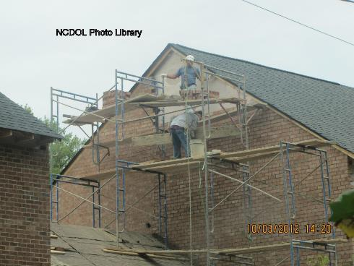
Scaffold Platform Construction
1926.451(b)(6)
Each abutted end of scaffold planks must rest on a separate support surface.

Slide 18

Scaffold Platform Construction
1926.451(b)(7)
When overlapping multiple platforms, overlap must occur only over supports and not less than 12” unless restrained to prevent movement.

Slide 19
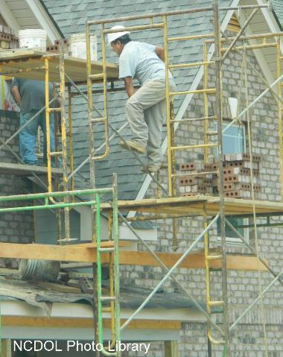
Scaffold Platform Construction
1926.451(b)(10)
Scaffold components must not be intermixed unless compatible and integrity maintained.
No modifications of mixed scaffold components unless approved by a competent person.

Slide 20
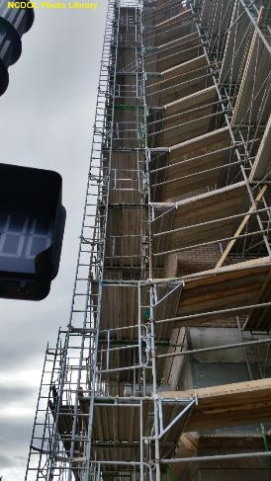
Criteria for Supported Scaffolds
1926.451(c)(1)
Height to base width ratio of more than 4:1, must be restrained from tipping by:
  Guying
  Tying
  Bracing, or
  Equivalent

Slide 21

Criteria for Supported Scaffolds
1926.451(c)(1)(ii)
Guys, ties, and braces must be installed per manufacturer’s recommendations or at the closest horizontal member to the 4:1 height.
  Vertically every 20’ – 3’ or less in width
  Vertically every 26’ – more than 3’ wide
  Each end and horizontal intervals not to exceed 30’

Slide 22
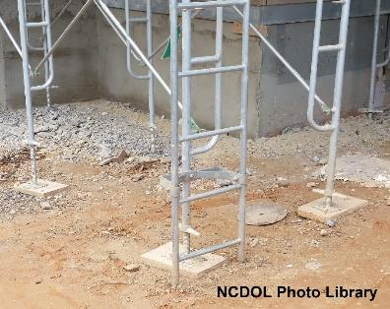
Criteria for Supported Scaffolds
1926.451(c)(2)
Poles, legs, posts, frames, and uprights must bear on base plates and mud sills or other adequate firm foundation.
Concrete slab is a firm
foundation and does
not require mud sills.

Slide 23
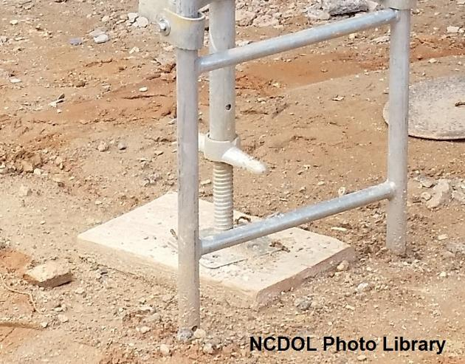
Criteria for Supported Scaffolds
1926.451(c)(2)

Slide 24
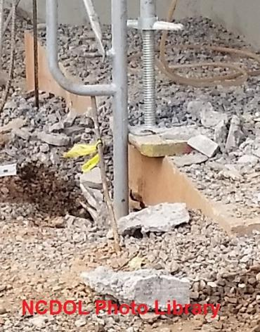
Criteria for Supported Scaffolds
1926.451(c)(2)(ii)
Unstable objects must not be used to support scaffolds or platform units.

Slide 25

Criteria for Supported Scaffolds
1926.451(c)(2)(ii)

Slide 26
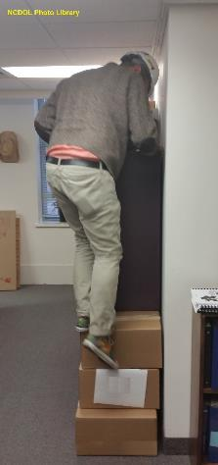
Criteria for Supported Scaffolds
1926.451(c)(2)(iii)
Unstable objects must not be used as working platforms.

Slide 27
Criteria for Supported Scaffolds
1926.451(c)(2)(iv)-(v)
Front-end loaders and similar equipment must not be used to support scaffold platforms unless designed by manufacturer.
Forklifts used to support scaffold platform must have entire platform attached to forks.
Forklift not to be moved horizontally while platform is occupied.

Slide 28

Criteria for Supported Scaffolds
1926.451(c)(3)
Poles, legs, posts, frames, and uprights must be plumb and braced to prevent swaying and displacement.

Slide 29
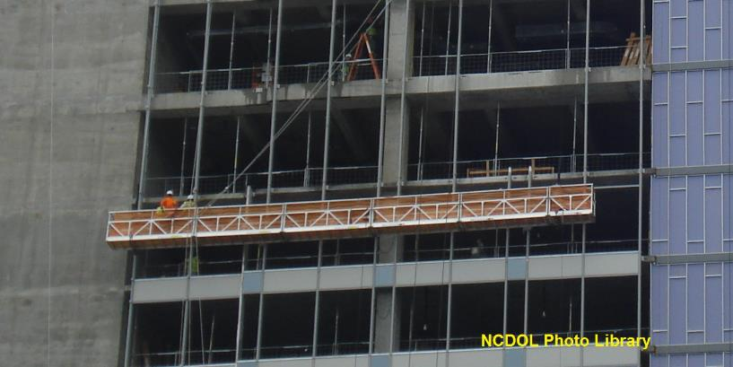
Criteria for Suspended Scaffolds
1926.451(d)

Slide 30
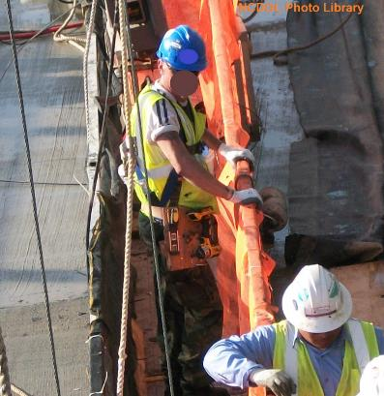
Criteria for Suspended Scaffolds
1926.451(d)(1)
All suspension scaffold support devices such as outrigger beams, cornice hooks, parapet clamps, etc., shall rest on surfaces capable of supporting at least 4 times the imposed load from the scaffold.
Life Line

Slide 31
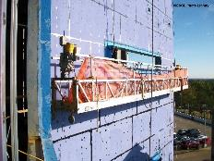
Criteria for Suspended Scaffolds
1926.451(d)(3)(iii)-(v)
Only use counterweights specifically designed for the system in use.
Counterweights must be secured by mechanical means to outrigger beams to prevent accidental displacement.
Do not remove counterweights until final disassembly.

Slide 32
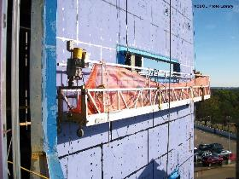
Criteria for Suspended Scaffolds
1926.451(d)(3)(vii)-(x)
Tiebacks must be:
  Equivalent strength to suspension ropes
  Secured to structurally sound anchorage on building
  Installed perpendicular to face of building or structure

Slide 33
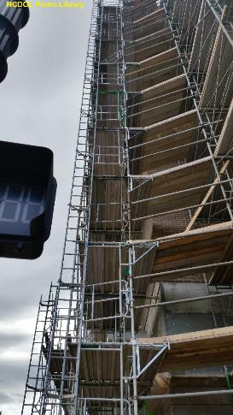
Scaffold Access
1926.451(e)(1)-(6)
Safe access must be provided to scaffold platforms.
  Portable ladders
  Hook-on ladders
  Stair towers
  Attachable ladders
  Stairway-type ladders
  Integral prefabricated scaffold access

Slide 34
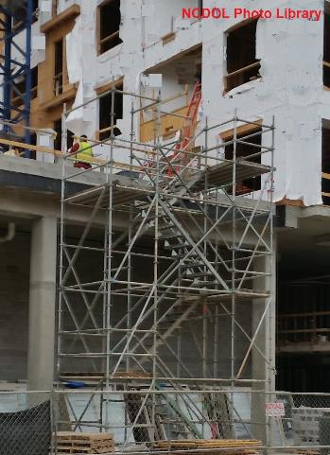
Scaffold Access
1926.451(e)(4)
Scaffold stairway/towers
  Stairrail – toprail and midrail
  Stairrails – 28”-37” from surface of tread
  Landing platform – at least 18” wide by 18” long at each level
  Stairway must be at least 18” wide
  Treads and landings – slip-resistant surfaces

Slide 35
Scaffold Access
1926.451(e)(6)
Integral prefabricated scaffold access frames
  Designed and constructed for use as ladder rungs
  Rung length of at least 8”
  Uniformly spaced within each frame section

Slide 36
Scaffold Access
1926.451(e)(6)
  Maximum spacing between rungs of 16 ¾”
  Have rest platforms at 35’ maximum vertical intervals on all supported scaffolds more than 35’ high
  Not to be used as a work platform if less than 11 ½”, unless using fall protection

Slide 37
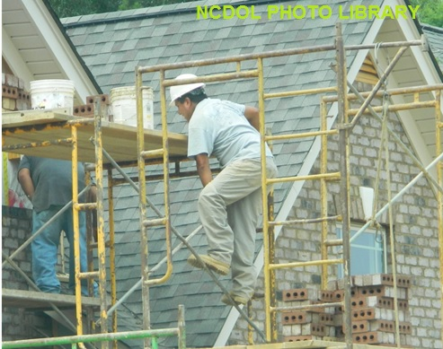
Scaffold Access
1926.451(e)(9)(iv)
Cross bracing on tubular welded frame scaffolds must not be used as means of access or egress.

Slide 38
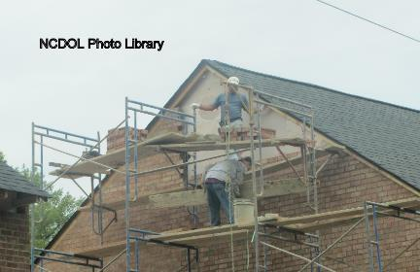
Scaffold Use
1926.451(f)(1-4)
Scaffold and scaffold components must not be overloaded.
Inspected for defects by competent person.
Immediately replaced,
repaired, or removed
from service if found
damaged.

Slide 39
Scaffold Use
1926.451(f)(7-13)
Erected, moved, dismantled, or altered only under supervision of competent person
No work on snow, ice covered platforms
Tag lines on swinging loads
Protect suspension ropes from heat, acid, or
corrosive substances
No work during storms or high winds
No debris allowed to accumulate on platforms

Slide 40
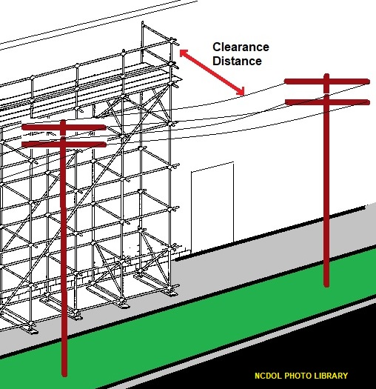
Scaffold Use
1926.451(f)(6)
Clearance between scaffolds and power lines:
  Insulated lines
    Less than 300 volts – 3’
    300 volts to 50 kV – 10’
    More than 50 kV – 10’ + 0.4” for each 1 kV over 50 kV
  Uninsulated lines
    Less than 50 kV – 10’
    More than 50 kV – 10’ + 0.4” for each 1 kV over 50 kV

Slide 41
Fall Protection
1926.451(g)
Fall protection (Personal Fall Arrest System (PFAS) or guardrails)
  1926.451(g)(1)(i-vi)
    PFAS and guardrails on suspension scaffolds
  1926.451(g)(2)
    PFAS required for erectors and dismantlers where feasible
  1926.451(g)(4)(ii)
    Toprails 38”- 45” high
  1926.451(g)(4)(iv)
    Midrails midway between toprail and platform surface
  1926.451(g)(4)(xv)
    Use cross-bracing in lieu of toprails or midrails in some cases

Slide 42
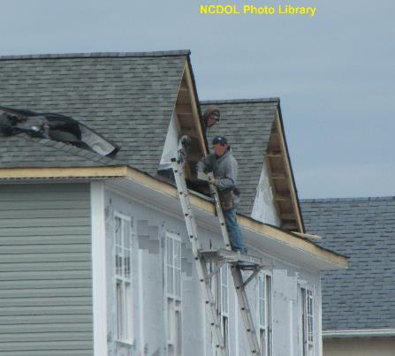
Fall Protection
1926.451(g)(1)
Employees on scaffold more than 10’ above a lower level must be protected from falling to that lower level.

Slide 43
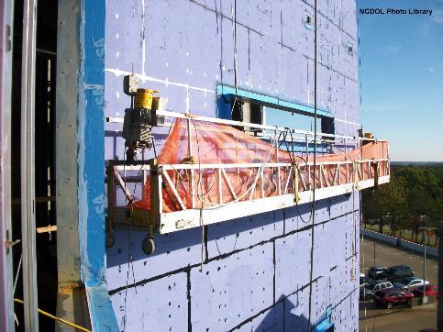
Fall Protection
1926.451(g)(1)(ii)
Employees on single-point or two-point adjustable suspension scaffold must be protected by both a personal fall arrest system and guardrail system.

Slide 44
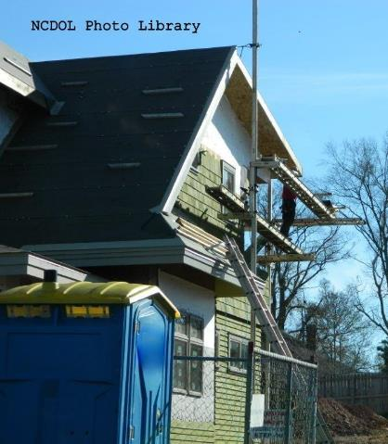
Fall Protection
1926.451(g)(2)
Employers must provide fall protection if feasible and does not create a greater hazard.
Competent person must determine:
  Feasibility and safety of providing fall protection during erecting and dismantling supported scaffold.

Slide 45
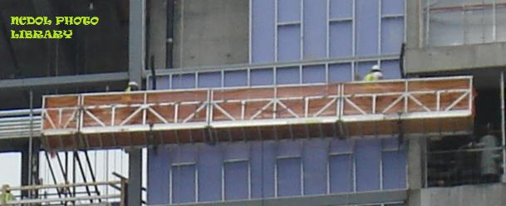
Fall Protection
1926.451(g)(4)
1926.451(g)(4) - Guardrail systems that comply with Appendix A meet these requirements
1926.451(g)(4)(i) - Guardrail systems must be installed along all open sides and ends of platforms
1926.451(g)(4)(xiii) - Steel or plastic banding must not be used as a toprail or midrail

Slide 46
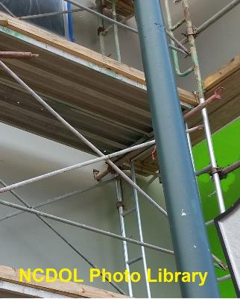
Fall Protection
1926.451(g)(4)(xv)
Crossbracing may be used in place of the top or midrail when the crossing point of the braces is between:
  38”- 48” above work platform
  for toprail
  20”- 30” above work platform
  for midrail

Slide 47

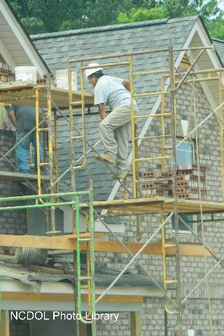
Which is good? Which is bad and ugly?

Slide 48

Falling Object Protection
1926.451(h)(1)
Hardhats are required for employees on scaffolds.

Slide 49
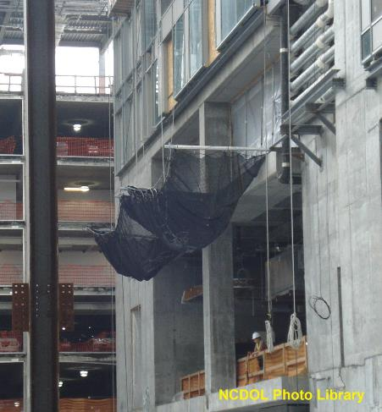
Falling Object Protection
1926.451(h)(1)
Erection of debris nets protect workers below from falling hand tools, debris, and other small objects.

Slide 50
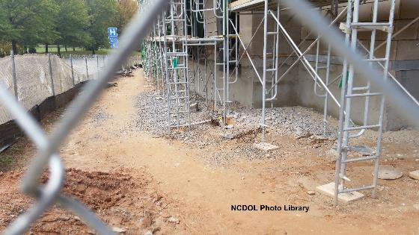
Falling Object Protection
1926.451(h)(2)(i)
Area below the scaffold to which objects can fall must be barricaded.
Employees must not be permitted to enter the hazard area.

Slide 51
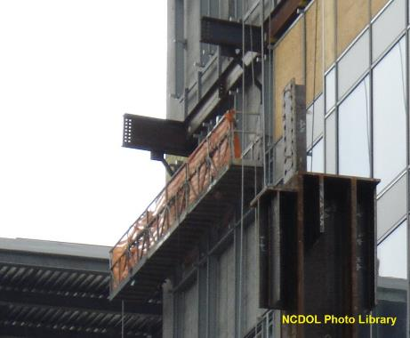
Fall Protection
1926.451(h)(2)(iii)
Where tools, material, or equipment is piled higher than top edge of toe board, paneling or screening extending from the toe board to the top of guardrail
must be installed.

Slide 52

Falling Object Protection
1926.451(h)(4)(ii)
Toe board must be erected along edge of platform to prevent tools, materials, or equipment falling from scaffold.
  Minimum height – 3½”
  Securely fastened

Slide 53
Pole Scaffold
1926.452(a)(1)-(8)
Pole scaffolds are an older type of supported scaffold in which every structural component, including uprights, braces and platforms are made of wood.
Runners extend over minimum of 2 poles.
Bearers extend minimum of 3” over outside edges of runners.
Bearers and runners not spliced between poles.
Since they are scratch built and seldom re-useable, they are rarely used today.

Slide 54
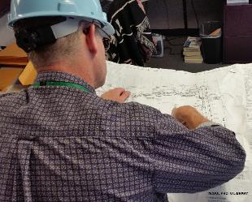
Pole Scaffold
1926.452(a)(10)
Pole scaffolds over 60’ in height must be designed by registered professional engineer.
  Must be constructed and loaded in accordance with that design.
  Non-mandatory Appendix A can be used to comply with design and loading requirements for scaffolds under 60 feet in height.

Slide 55
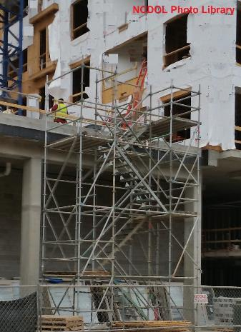
Tube and Coupler Scaffolds
1926.452(b)(10)
Tube and coupler scaffolds over 125 feet in height must be designed by a registered professional engineer.
  Must be constructed and loaded in accordance with such design.
  Non-mandatory Appendix A can be used to comply with design and loading requirements for scaffolds under 125 feet in height.

Slide 56

Fabricated Frame Scaffolds
1926.452(c)(6)
Scaffolds over 125 feet in height above base plates must be designed by a registered professional engineer.
Must be constructed and loaded in accordance with such design.

Slide 57
Bricklayers Square Scaffold
1926.452(e)
These are scaffolds often made of wood used primarily for masonry.
Shall not exceed three tiers in height and shall be so constructed and arranged that one square rests directly above the other.
Upper tiers shall stand on a continuous row of planks laid across the next lower tier and shall be nailed down or otherwise secured to prevent displacement.

Slide 58
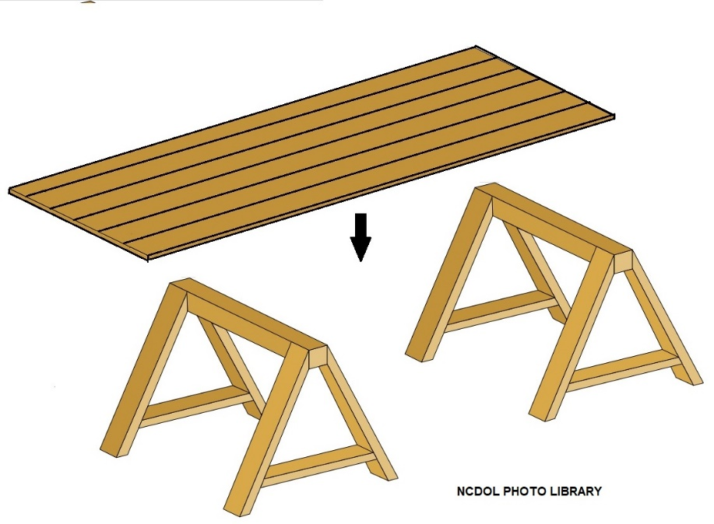
Horse Scaffold
1926.452(f)(1)-(2)
Scaffolds must not be constructed or arranged more than two tiers or 10 feet, whichever is less.
Each horse must be placed directly over the horse in the tier below.

Slide 59
Form Scaffolds
1926.452(g)(1)
Each bracket, except those for wooden bracket-form scaffolds, must be attached to the supporting formwork or structure by one or more of the following:
  Nails
  A metal stud attachment device
  Welding
  Hooking over a secured structural supporting member

Slide 60

Roof Bracket Scaffold
1926.452(h)(1)
Scaffold must be constructed to fit pitch of roof.
Must provide a level support for platform.
Platform must be at least 12” wide.

Slide 61
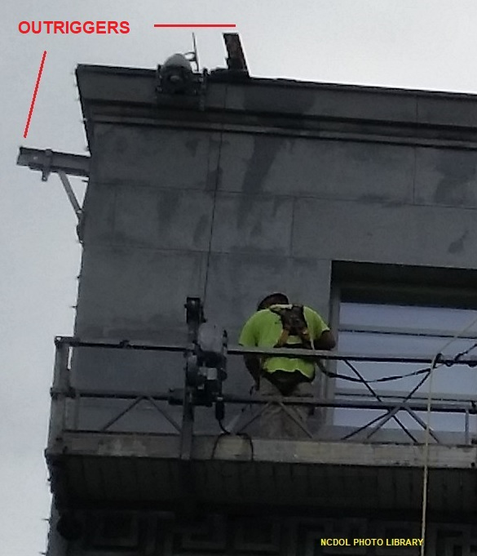
Outrigger Scaffold
1926.452(i)(4)-(6)
Outrigger beams must be secured in place to prevent movement and securely braced at the fulcrum point to prevent tipping.
Entire supporting structure shall be securely braced to prevent any horizontal movement.

Slide 62
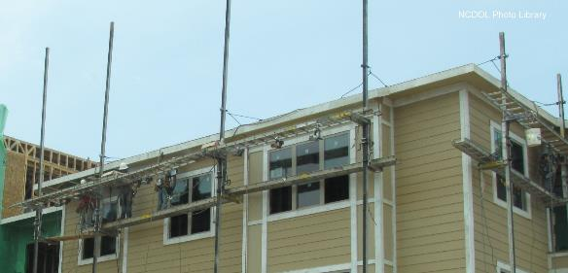
Pump Jack Scaffold
1926.452(j)(2)
Poles must be secured to structure by rigid triangular bracing or equivalent – bottom, top, and other points as necessary.
Supported scaffold poles must bear on firm foundation.

Slide 63
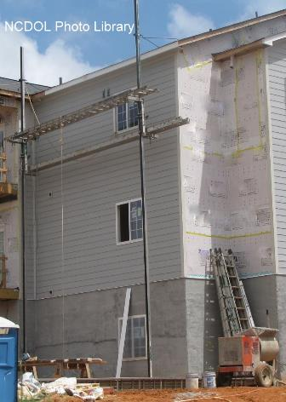
Pump Jack Scaffold
1926.452(j)(4)
Work benches must not be used as scaffold platforms.
  Is there safe access to this scaffold?
  Is there a fall protection violation?

Slide 64

Pump Jack Scaffold
1926.452(j)(5)
Wood poles must be properly constructed.
  Are the poles properly secured?
  Is there a fall protection issue?

Slide 65

Are there pump jack scaffold violations here?

Slide 66
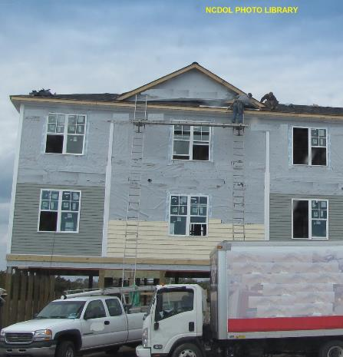
Ladder Jack Scaffold
1926.452(k)
Platforms must not exceed a height of 20 feet.
Ladders must meet requirements of Subpart X – Stairways and Ladders.
Ladders must be placed, fastened, or equipped with devices to prevent slipping.
Platforms must not be bridged one to another.
Platform must be at least 12” wide.
Bridged Platform
Over 20 feet ?

Slide 67
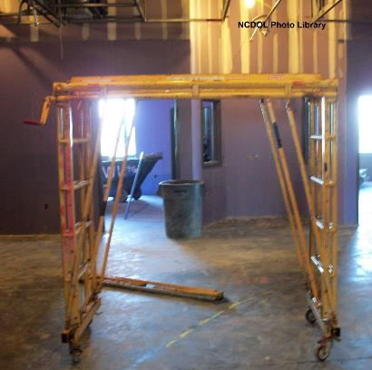
Mobile Scaffolds
1926.452(w)
Scaffolds must be properly braced.
Casters and wheel must be locked while in use.
Platforms must not extend out beyond base supports. – Unless outriggers are
used.
Caster stems and wheel stems must be pinned.

Slide 68
Mobile Scaffolds
1926.452(w)
Employees must not ride on scaffolds unless:
  Surface is within 3 degrees of level.
  Height to base ratio is 2:1 or less.
  Outrigger frames, when used, installed on both sides.
  Employees are not on any part of scaffold that extends beyond wheels or supports.

Slide 69
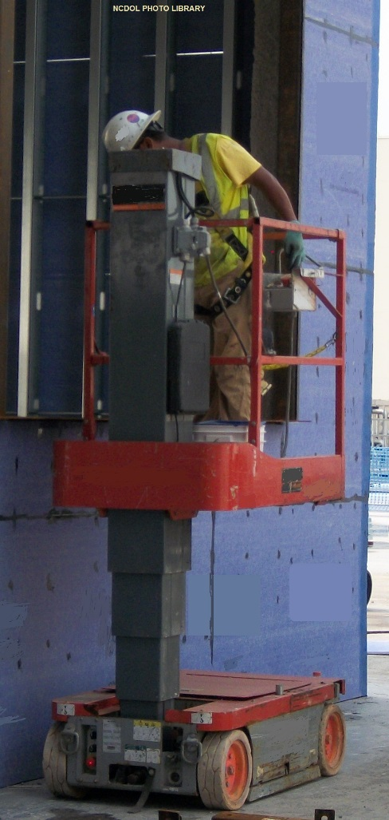
Mobile Scaffolds
1926.452(w)
Power systems used to propel mobile
scaffolds must be designed for such
use.
Forklifts, trucks, and similar motor
vehicles must not be used to propel
scaffolds.
  Unless scaffold is designed for such
  propulsion systems.

Slide 70
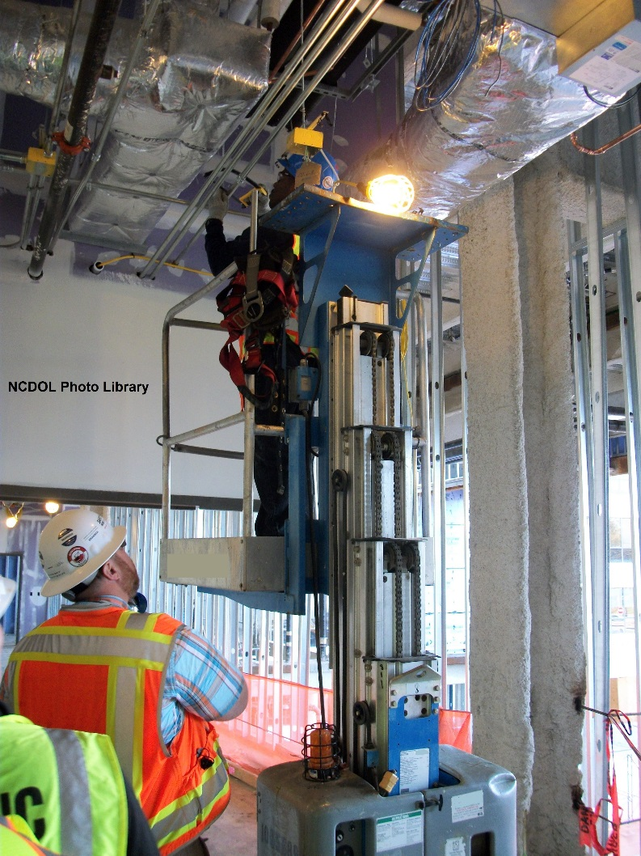
Other Types of Scaffolds
Window jack scaffolds
Chicken ladders
Step, platform, and trestle ladder scaffolds
Needle beam
Float (ship)
Catenary scaffold
Interior hung scaffold
Multi-level scaffold
Two-point (swing stage)

Slide 71
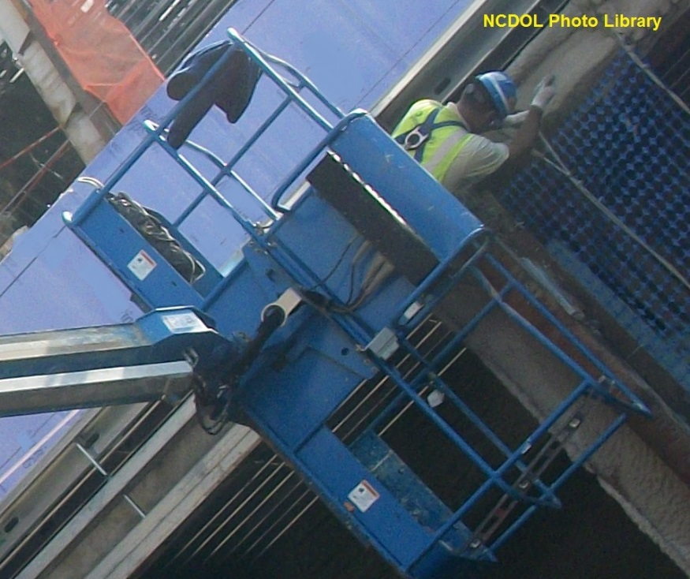
Aerial Lifts
1926.453(a)(1)
Aerial lifts include the following:
  Extensible boom
  platforms
  Aerial ladders
  Articulating boom
  platforms
  Vertical towers
  Combination of any
  such device

Slide 72
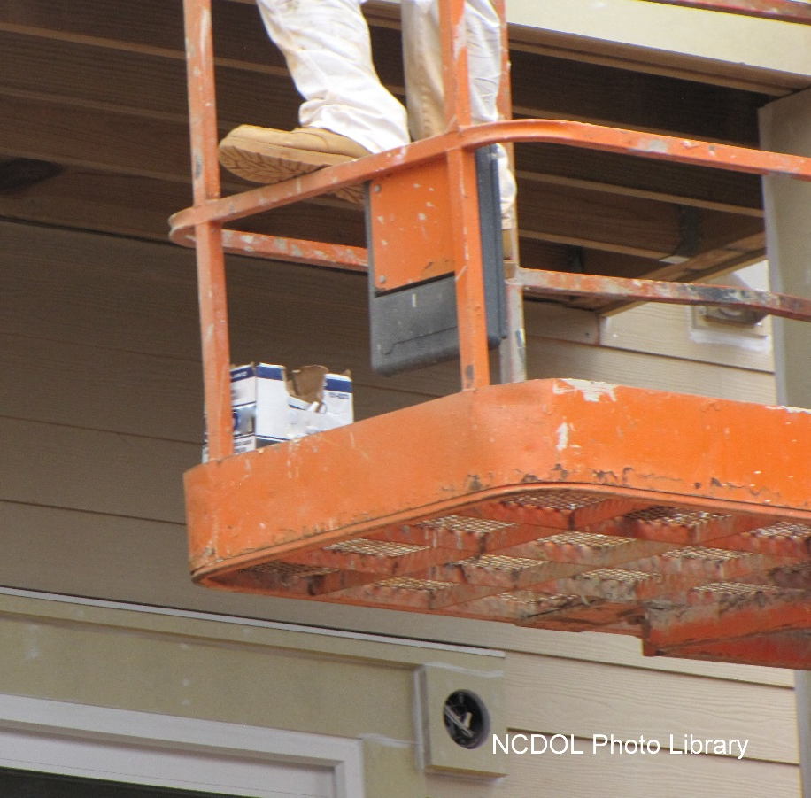
Aerial Lifts
1926.453(b)(2)
Extensible and articulating boom platforms:
  Lift controls tested each day prior to use.
  Only authorized personnel must operate.
  Belting off to adjacent pole, structure, etc. not permitted.
  Employees must always stand firmly on floor of basket.

Slide 73
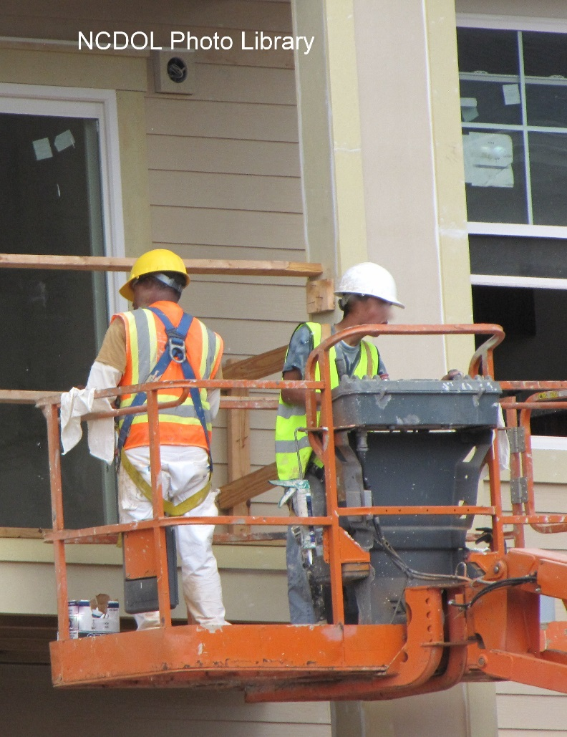
Aerial Lifts
1926.453(b)(2)
  Brakes must be set.
  When outrigger used – positioned on pads or solid surface.
  Boom and basket load limits not exceeded.
  Aerial lift must not be moved while in working position.
  Exception – Equipment specially designed for operation.

Slide 74
Aerial Lifts
1926.453(b)(2)
  Body belt must be worn, and lanyard attached to boom or basket.
    Body belts not acceptable as part of fall arrest system.
    Body belts are acceptable in a tethering or restraint system.

Slide 75
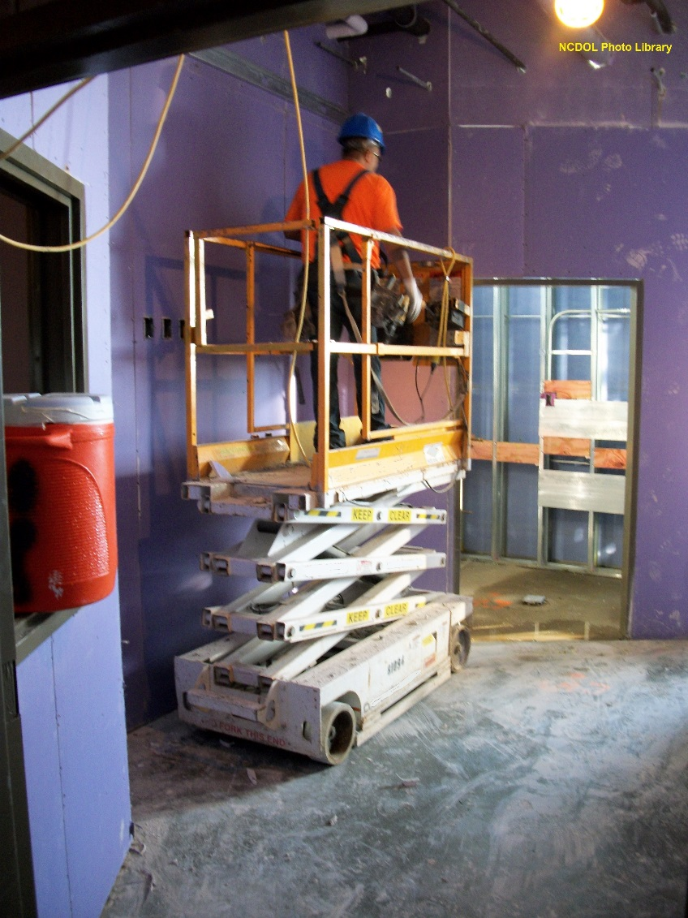
Scissor Lifts are Not Aerial Lifts
1926.453
Scissor lifts are not aerial lifts.
  Not covered under 1926.453
    Letter of interpretation – 8/1/00
  Scissor lifts meet the definition of a scaffold and must comply with requirements of a mobile scaffold.

Slide 76
Training Requirements
1926.454(a)
Trainer must be qualified in the subject matter.
Topics for employees who perform work on the scaffold:
  Nature of electrical, fall and falling object hazards
  Correct procedures for:
    Dealing with electrical hazards
    Erecting, maintaining, and disassembling fall protection systems
    Falling object protection systems being used
  Proper use of the scaffold and materials on scaffold
  Load capacities of scaffolds
  Requirements of this subpart

Slide 77
Training Requirements
1926.454(b)(2)
Employees that are involved in erecting, disassembling, moving, operating, repairing, maintaining, or inspecting a scaffold must be trained by a competent person.
Topics:
  Nature of scaffold hazards
  Correct procedures for erecting, disassembling, moving, operating, repairing, inspecting, and maintaining the type of scaffold in question
  Design criteria, maximum intended load-carrying capacity and intended use of the scaffold
  Other pertinent requirements of this subpart

Slide 78
Training Requirements
1926.454(c)
Retraining
  Employer has reason to believe that an employee lacks the skill or understanding needed for safe work involving the erection, use or dismantling of scaffolds.
  Where changes at the worksite present a new hazard.
  Where changes in the types of scaffolds, fall protection, falling object protection, or other equipment present a new hazard.
  Where inadequacies in an affected employee's work involving scaffolds indicate that the employee has not retained the requisite proficiency.

Slide 79

Summary
In this course, we discussed the following:
  OSHA’s minimum requirements for scaffolds
  Safe design, setup, and use of scaffolds
  Hazard identification
  Abatement methods
Notes:
79

Slide 80
Thank You For Attending!
Final Questions?

