Slide 1
Recordkeeping and Reporting
29 CFR 1904
Notes:
Revised 6/16/25
The information in this presentation is provided voluntarily by the N.C. Department of Labor, Education Training and Technical Assistance Bureau as a public service and is made available in good faith. This presentation is designed to assist trainers conducting OSHA outreach training for workers. Since workers are the target audience, this presentation emphasizes hazard identification, avoidance, and control – not standards. No attempt has been made to treat the topic exhaustively. It is essential that trainers tailor their presentations to the needs and understanding of their audience.
The information and advice provided on this Site and on Linked Sites is provided solely on the basis that users will be responsible for making their own assessment of the matters discussed herein and are advised to verify all relevant representations, statements, and information.
This presentation is not a substitute for any of the provisions of the Occupational Safety and Health Act of North Carolina or for any standards issued by the N.C. Department of Labor. Mention of trade names, commercial products, or organizations does not imply endorsement by the N.C. Department of Labor.

Slide 2
Objectives
At the conclusion of this course, students will be able to:
  Recognize who must comply with the standard
  Understand reporting requirements
  List criteria for recording
  Identify other issues related to recordkeeping
  Interpret Recordkeeping forms

Slide 3
Who Must Record?
1904.1
All employers in North Carolina except:
  Any employer with 10 or fewer employees for the previous calendar year.
  Any employer who is listed in the updated NAICS industry code list.
Exemptions above do not change employers’ reporting requirements.

Slide 4
Who Must Report?
1904 Subpart E
All employers must still report:
  All work-related fatalities within 8 hours.
  All work-related in-patient hospitalizations of one or more employees within 24 hours.
  All work-related amputations within 24 hours.
  All work-related losses of an eye within 24 hours.
All employers must participate in OSH surveys when requested.

Slide 5
Reporting Requirements
Subpart E
Four standards:
  1904.39: Reporting fatalities, one or more in-patient hospitalizations, amputations, and losses of an eye
  1904.40: Providing records to government representatives
  1904.41: Annual survey
  1904.42: Request from Bureau of Labor Statistics (BLS)

Slide 6
Reporting
1904.39(a)
To report a fatality, call OSH Division:
  1-800-625-2267 or 919-779-8560
  After hours, call State Capitol Police at 919-733-3333
Death/fatality of an employee(s)
  Report within 8 hours the death/fatality of any employee from a work-related incident.
  Employers do not have to report a fatality if it occurred more than 30 days after the work-related incident.

Slide 7
Reporting
1904.39(a)
To report an accident, contact OSH Division:
  1-800-625-2267 or 919-779-8560
  Online reporting form: https://www.labor.nc.gov/contact/report-workplace-accident
Employers must report within 24 hours
  Any work-related in-patient hospitalization of one or more employees, amputation, or eye loss

Slide 8
Reporting
1904.39(b)
Employers do not have to report:
  Any in-patient hospitalization, amputation or loss of an eye that occurs more than 24 hours after the work-related incident.
  Any in-patient hospitalization for diagnostic testing or observation only.

Slide 9
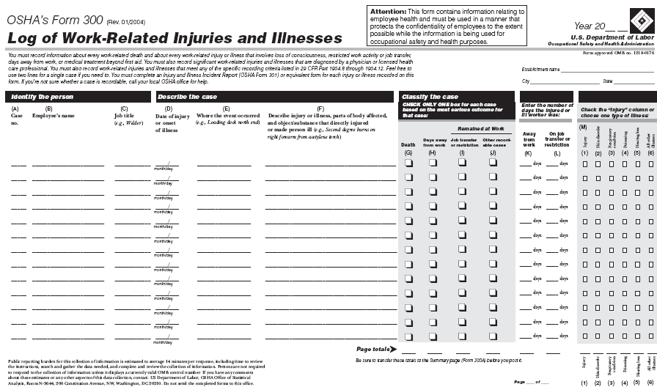
Reporting
1904.39(b)(3)-(4)
Not reportable—however still recordable if:
  Motor vehicle accident (except in a construction work zone)
  Commercial or public transportation accident
NCDOL Photo Library

Slide 10
What Is Recordable?
1904.7(a)
Fatality, injury, or illness
  Work-related
  New case
  Meets one or more of the general recording criteria
NCDOL Photo Library

Slide 11
Work-Related
1904.5
An event or exposure in a work environment that:
  Caused or contributed to the condition
  Significantly aggravated pre-existing condition
Work-relatedness presumed while on employer’s premises, except …

Slide 12
Non-Work Related
1904.5(b)
When injury or illness is solely a result of:
  Being present in the work environment as a member of the general public
  Voluntary participation in wellness, medical, fitness, or recreation program
  Eating, drinking, or preparing food
  Personal tasks outside of working hours

Slide 13
Non-Work Related
1904.5(b)
  Personal grooming, self-medication, or self-inflicted
  Motor vehicle accident in parking lot or company access road while commuting
  Common cold or flu
  Mental illness

Slide 14
New Case
1904.6(a)
A case is “new” if:
  No previous record of injury or illness of the same type, affecting same body part.
  All signs and symptoms of a previous injury had disappeared, and the work environment caused a reappearance.
  Advice of a physician or other licensed health care professional can be followed to determine new or old.

Slide 15
General Recording Criteria
1904.7(a)
Death
Days away from work
Restricted work or transfer to another job
Medical treatment beyond first aid
Loss of consciousness
Diagnosed as a significant injury or illness

Slide 16
Death
1904.7
Record decedent's details into columns (A) through (G) of 300 log.
  No other entries are required on the log for a death.
Follow all reporting guidelines.

Slide 17
Days Away From Work
1904.7(b)(3)
Do not count the day of injury.
Do count calendar days not business days.
  180-day cap
You may estimate days if end of year and update amount later.
The count stops when employee leaves company for reasons other than the injury.
  If the employee leaves due to the injury, the days must be recorded.

Slide 18
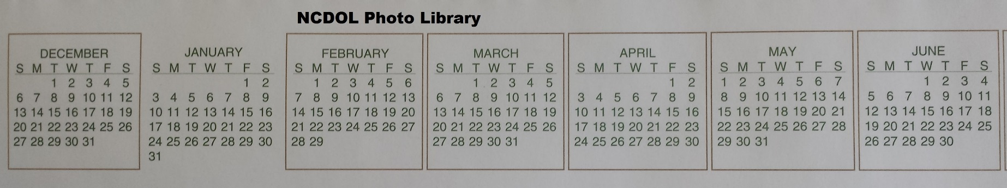
Restricted Work
1904.7(b)(4)
If the employer or a physician keeps employee from performing one or more “routine functions” or from working a full workday.
  Counted same as days away from work.
    Not to exceed 180 days.
Restrictions Begin
Restrictions Lifted

Slide 19
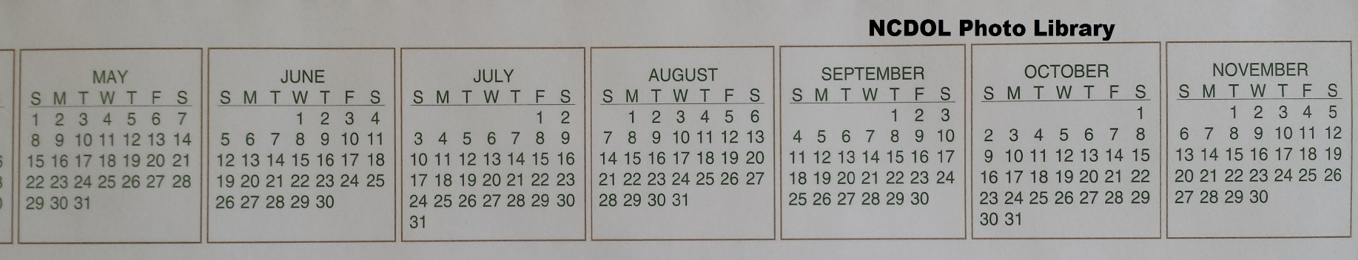
Transfer to Another Job
1904.7(b)(4)
If the employer or a physician assigns an
employee to another job for part of a day or
a full day.
  Counted same as days away from work.
    Not to exceed 180 days.
Transfer of Job
Begins Ends

Slide 20
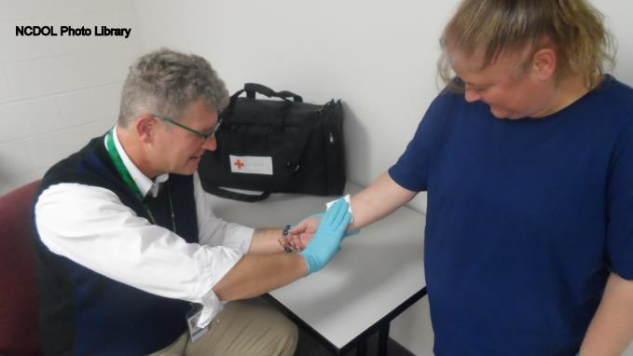
Medical Treatment
1904.7(b)(5)
Management and care of patient to combat
disease or disorder
Does not include:
  Observation or counseling
  Diagnostic procedures
  First aid procedures

Slide 21
First Aid
1904.7(b)(5)(ii)
The standard provides a specific list of first aid procedures. If not on the list, it is considered medical treatment.
Special cases
  An over-the-counter drug prescribed by a physician at prescription strength is medical treatment.
  Oxygen administered only for precautionary reasons is not medical treatment.

Slide 22
Loss of Consciousness
1904.7(b)(6)
Must record complete loss of consciousness
  Must be work-related.
  Duration of time not a factor.
  Note: Disorientation, incoherency, or diminished level of awareness are not recordable.

Slide 23
Significant Injuries and Illnesses
1904.7(b)(7)
Some injuries and illnesses may seem to have no recording criteria for medical treatment or time lost (however they are still recordable if diagnosed by a physician).
  Examples: Cancers, all fractures or cracked bones (including teeth), and punctured ear drums
    Significant and always recordable

Slide 24
Specific Recording Criteria
1904.8 – Needlesticks and sharps injuries
1904.9 – Cases involving medical removal
1904.10 – Hearing loss
1904.11 – Work-related tuberculosis

Slide 25
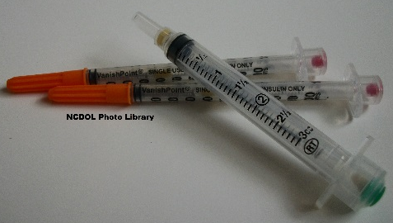
Needlesticks and Sharps Injuries
1904.8
Record exposure to blood or other potentially infectious material when:
  Results in diagnosis of a bloodborne illness or meets one or more of the general recording criteria.
Record needlesticks and sharps injuries when:
  Contaminated with another person’s blood or contaminated with other potentially infectious material
  (as defined by 29 CFR 1910.1030).

Slide 26
Cases with Medical Removal
1904.9
Recording cases involving medical removal of an employee.
  Record if employee was removed under the medical surveillance requirements of an OSHA standard.
    Enter each case as either involving days away from work or involving restricted work activity.
    If result of chemical exposure, enter case in “poisoning” column.
  Do not have to record if voluntarily removed by employer.

Slide 27
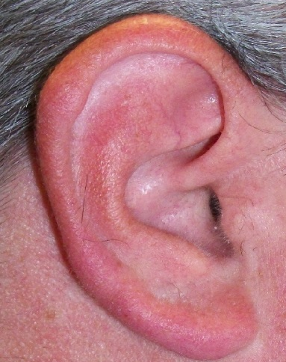
Hearing Loss
1904.10
Standard Threshold Shifts (STS)
  Record hearing loss when both:
    Work-related STS (10+ dB at 2-4K Hz)
    25 dB at or above audiometric zero
NCDOL photo library

Slide 28
Hearing Loss Recordability
1904.10(b)
Has the employee suffered a STS (an average 10 dB or more loss relative to the most current baseline audiogram averaged at 2000, 3000 and 4000 Hz) in one or both ears according to the General Industry noise standard, 1910.95?
YES
Is the employee’s overall hearing level at 25 dB or more above audiometric zero averaged at 2000, 3000 and 4000 Hz in the affected ear(s)?
YES
Is the hearing loss work-related?
YES
Record on the Form 300; check the “Hearing loss” column.

Slide 29
Hearing Loss Recordability
1904.10(b)
Has the employee suffered a STS (an average 10 dB or more loss relative to the most current baseline audiogram averaged at 2000, 3000 and 4000 Hz) in one or both ears according to the General Industry noise standard, 1910.95?
Is the employee’s overall hearing level at 25 dB or more above audiometric zero averaged at 2000, 3000 and 4000 Hz in the affected ear(s)?
No
Is the hearing loss work-related?
Do Not Record

Slide 30
Hearing Loss Recordability
1904.10(b)
 | 2K | 3K | 4K
Baseline hearing level | 10 | 5 | 10
 | 2K | 3K | 4K | Average
Year 1 hearing level | 20 | 15 | 20 | 18 dB
Shift from baseline | 10 | 10 | 10 | 10 dB
avg shift ≥ 10 dB, but avg level not ≥ 25 dB:
- NOT RECORDABLE
 | 2K | 3K | 4K | Average
Year 2 hearing level | 30 | 25 | 30 | 28 dB
Shift from baseline | 20 | 20 | 20 | 20 dB
avg shift ≥ 10 dB and avg level ≥ 25 dB:
- RECORDABLE

Slide 31
Work-Related Tuberculosis
1904.11
Work-related tuberculosis (TB) cases must be recorded when:
  Employee occupationally exposed to a known case of active TB in the workplace and subsequently develops TB infection as evidenced by positive skin test or diagnosis.
  TB cases may be lined-out when non-work-related contact can be proven.

Slide 32
Recordkeeping Forms
1904.29
Form 300 – Log of work-related injuries and illnesses
Form 300A – Summary of work-related injuries and illnesses
Form 301 – Injury and illness incident report

Slide 33
Form 300
1904.29
NCDOL Photo Library

Slide 34
Form 300 Columns A-E
1904.29
Case number
Employee’s name
Employee’s job title
Date of injury or onset of illness (month/day)
Where the event occurred

Slide 35
Form 300 Column F
1904.29
Describe injury, illness, cause and body part affected and enter a detailed description for each recordable injury or illness (be specific):
  Mechanism of injury (hammer, broken glass, vehicle, etc.)
  Part of body injured (left hand, right eye, forehead, etc.)
  How injury occurred (lifting boxes, assault, training, etc.)

Slide 36
Form 300 Columns G-J
1904.29
Make ONLY one entry in these columns with an X:
Death (if an employee death has occurred)
Days away, if incident involves missed workdays
Job transfer or restriction or if placed on limited duties
Mark if other than a death, lost time, transfer or
job restriction (example: “medical treatment only”)

Slide 37
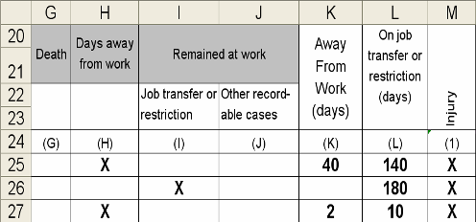
Form 300 Columns K-L
1904.29
Enter the total amount of days:
Total number of days away from work
Total number of job transfer or job restriction days
NCDOL Photo Library
Not to exceed 180 total
days in column K, L or
both columns combined
Notes:
(

Slide 38
Form 300 Column M
1904.29
Choose either injury or the type of illness in this section:
  Injury
  Skin disorder
  Respiratory condition
  Poisoning
  Hearing loss
  All other illnesses

Slide 39
Form 300
1904.29
A calendar year injury log form
  Must be kept up to date.
    Update within seven calendar days of a change or event.
  Retain for five years.
    Update (as changes occur) within seven calendar days.
  Must be provided to a government investigator upon request within four business hours (§1904.40).

Slide 40
Form 300A
1904.32
Summarizes information from Form 300
  Must be completed and signed by a company executive at the end of each calendar year.
  Post for employees to view from February 1 through April 30 of following calendar year.
  Retain with Form 300 and provide access for five full years.

Slide 41
Form 301
1904.29
An injury report form
  Must be completed within seven calendar days of the injury.
  Completed for each Form 300 entry.
  An equivalent form may be used.
    Example: NC Industrial Commission Form 19
  Retain and provide access for five years.

Slide 42
Privacy Case List
1904.29
Not an established form.
Must be used only with privacy concern cases
Enter “privacy case” instead of name on Form 300.
  A person’s job title on a Form 300 may reveal their identity.
Make a separate list with these names and case numbers.

Slide 43
Determining Privacy Concern Cases
An injury to an intimate body part or the reproductive system
A sexual assault
Mental illnesses
HIV infection, hepatitis, or tuberculosis
Needlesticks or sharps injuries
All illnesses upon employee request

Slide 44
Other Recordkeeping Issues
1904.35 – Employee involvement
1904.36 – Prohibition against discrimination
Other privacy issues

Slide 45
Summary
Students should now understand the requirements for the following:
  Reporting
  Recording
  Required forms
  Recording criteria
  Other requirements
  Employer responsibilities and employee involvement

Slide 46
Additional Information
NCDOL OSH Division
  Education, Training and Technical Assistance (ETTA)
    Toll free: 1-800-NC-LABOR or 1-800-625-2267
    Direct phone: 919-707-7876
  E-mail: ask.osh@labor.nc.gov
Federal OSHA website: www.osha.gov
  Search for “recordkeeping”

Slide 47
Thank You For Attending!
Final Questions?

