Slide 1
Powered Industrial Trucks
29 CFR 1910.178
:
Notes:
Revised 6/2025
The information in this presentation is provided voluntarily by the N.C. Department of Labor, Education, Training and Technical Assistance Bureau as a public service and is made available in good faith. This presentation is designed to assist trainers conducting OSHA outreach training for workers. Since workers are the target audience, this presentation emphasizes hazard identification, avoidance, and control – not standards. No attempt has been made to treat the topic exhaustively. It is essential that trainers tailor their presentations to the needs and understanding of their audience.
The information and advice provided on this Site and on Linked Sites is provided solely on the basis that users will be responsible for making their own assessment of the matters discussed herein and are advised to verify all relevant representations, statements, and information.
This presentation is not a substitute for any of the provisions of the Occupational Safety and Health Act of North Carolina or for any standards issued by the N.C. Department of Labor. Mention of trade names, commercial products, or organizations does not imply endorsement by the N.C. Department of Labor.

Slide 2
Objectives
1910.178
After this course, students will be able to:
  Be able to reference requirements for powered industrial trucks (PIT)
  Recognize safe operation of equipment
  Implement operator training and evaluation
  Identify common forklift hazards
  Familiarize themselves with abatement methods and procedures

Slide 3
Amputations Special Emphasis Program
Goal to reduce occupational exposures to amputations
Struck by and caught between injuries
  Lockout/tagout
  Machine guarding
Increase outreach to employers and employees
  Training events (Internal and external)
  Compliance inspections
  Consultation visits
  Publications
Amputations must be reported within 24 hours

Slide 4
General Requirements
1910.178(a)(1)
Covers safety requirements related to fire protection, design, maintenance, and use of:
  Fork trucks
  Tractors
  Platform lift trucks
  Motorized hand trucks
  Other specialized industrial trucks
….powered by electric motors or internal combustion engines

Slide 5
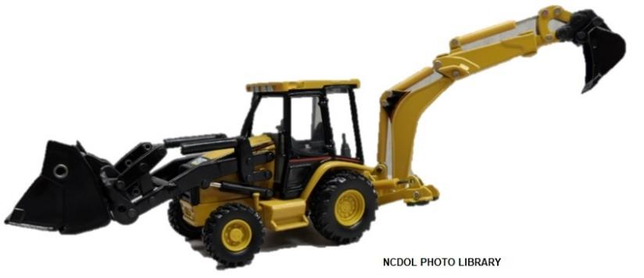
General Requirements
1910.178(a)(1)
Does not apply to:
  Compressed air or nonflammable compressed gas-operated industrial trucks
  Farm vehicles
  Vehicles intended primarily for earth moving or over-the-road hauling

Slide 6

General Requirements
1910.178(a)(2)-(3)
New PITs acquired and used by an employer shall meet the design requirements of:
  American National Standard for Powered Industrial Trucks, Part II, ANSI B56.1 – 1969’’, which is incorporated by reference as specified in § 1910.6
Approved trucks shall bear a label or some other identifying mark indicating approval by the testing laboratory

Slide 7
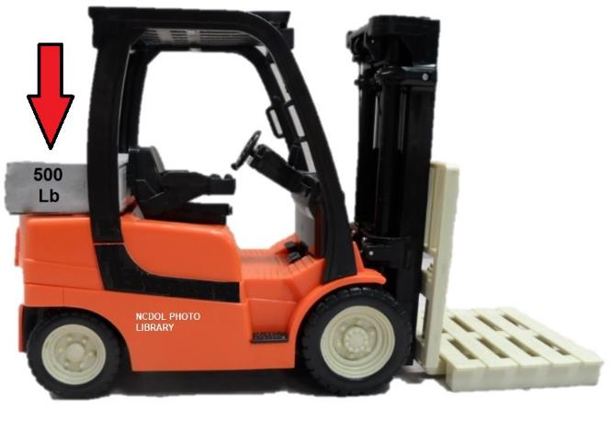
General Requirements
1910.178(a)(4)
Modifications and additions which affect capacity and safe operation must have prior written approval from manufacturer

Slide 8
General Requirements
1910.178(a)(5)
Trucks equipped with front-end attachments, other than factory installed must:
  Be marked to identify the attachments
  Show approximate weight of truck and attachment combination at maximum elevation with load laterally centered

Slide 9
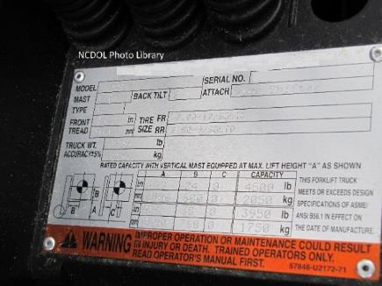
General Requirements
1910.178(a)(6)-(7)
All nameplates and markings in place and maintained in a legible condition
The term, “Approved truck or approved industrial truck” means:
  A truck that is listed or approved for fire safety purposes for the intended use by a national recognized testing laboratory

Slide 10
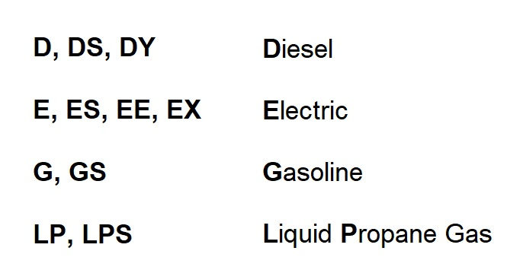
Designations
1910.178(b)(1)-(12)
Atmosphere or location classified as to whether it is hazardous or nonhazardous prior to the consideration of industrial trucks used

Slide 11
Designated Locations
1910.178(c)
Refer to Table N-1 in 1910.178 for the use of industrial trucks in various locations
Power-operated industrial trucks shall not be used in atmospheres containing hazardous concentrations:
  Gases or vapors
  Dusts

Slide 12
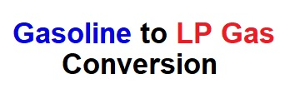
Converted Industrial Trucks
1910.178(d)
Industrial trucks approved for the use of gasoline may be converted to liquefied petroleum gas and it may be used in those locations where G, GS or LP, and LPS designated trucks have been specified

Slide 13
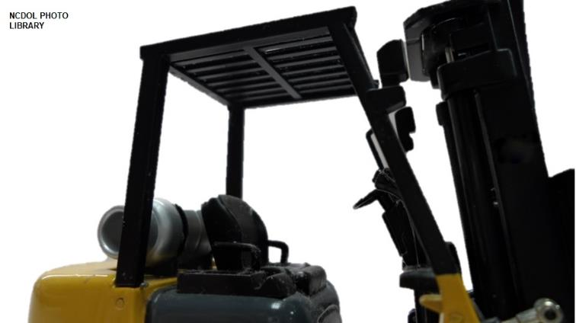
Safety Guards
1910.178(e)(1)
High lift rider trucks fitted with an overhead guard
  Overhead guard required unless operating conditions do not permit

Slide 14
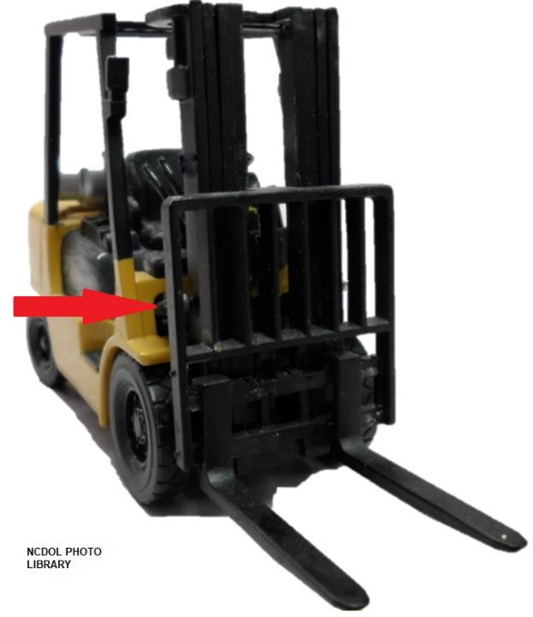
Safety Guards
1910.178(e)(2)
If the type of load presents a hazard, then user must equip fork truck with a vertical backrest extension manufactured in accordance with standard

Slide 15
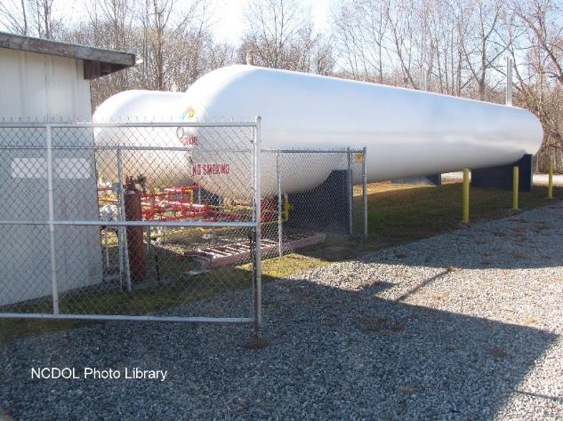
Fuel Handling and Storage
1910.178(f)(1)
Storage and handling of liquid fuels in accordance with NFPA Flammable and Combustible Liquids Code [NFPA No. 30-1969].
  Incorporated by reference as specified in §1910.6

Slide 16
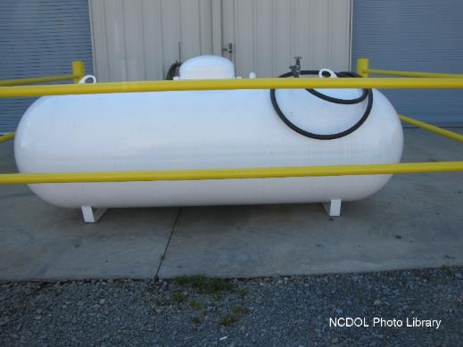
Fuel Handling and Storage
1910.178(f)(2)
Storage and handling of liquefied petroleum gas fuel in accordance with NFPA Storage and Handling of Liquefied Petroleum Gases [NFPA No. 58-1969]
  Incorporated by reference as specified in §1910.6

Slide 17
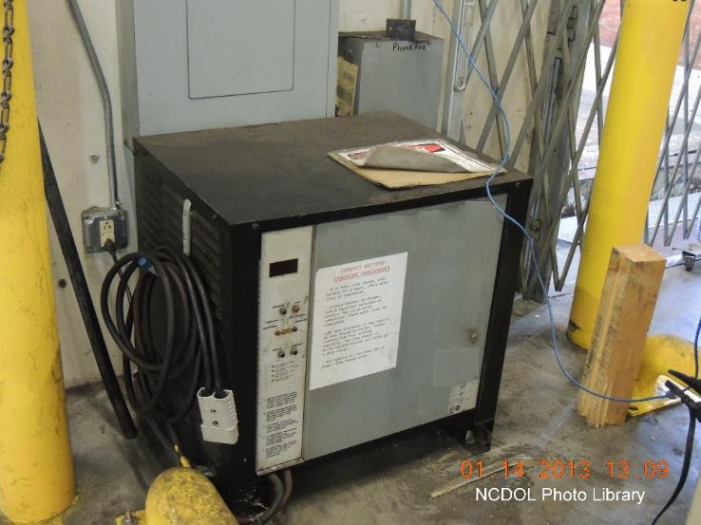
Changing/Charging Storage
1910.178(g)(1)
Battery charging installations located in areas designated for that purpose

Slide 18

Changing/Charging Storage
1910.178(g)(2)
Facilities provided for flushing and neutralizing spilled electrolyte
Facilities provided for protecting charging apparatus from damage by trucks

Slide 19
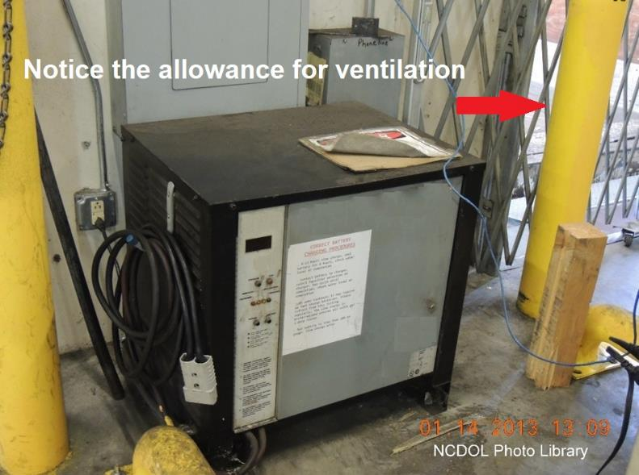
Changing/Charging Storage
1910.178(g)(2)
Facilities provided for adequate ventilation for dispersal of fumes from gassing batteries

Slide 20
Changing/Charging Storage
1910.178(g)(4)-(5)
Conveyor, overhead hoist, or equivalent material handling equipment provided for handling batteries
Reinstalled batteries properly positioned and secured

Slide 21
Changing/Charging Storage
1910.178(g)(6)-(9)
Carboy tilter or siphon provided for handling electrolyte
Acid poured into water; water must not be poured into acid
Trucks properly positioned and brake applied before attempting to change or charge batteries
When charging batteries, vent caps checked for proper functioning
Battery cover opened to dissipate heat

Slide 22
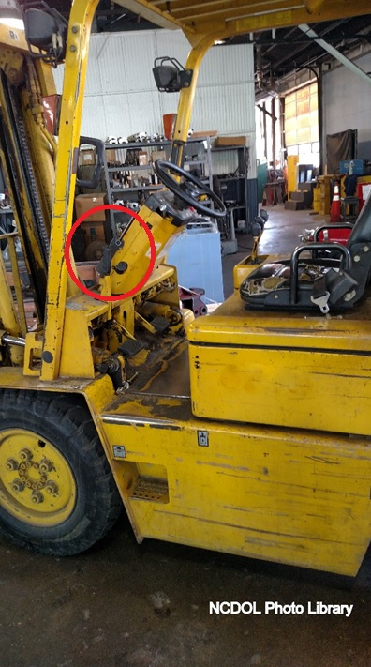
Changing/Charging Storage
1910.178(g)(8)
Trucks properly positioned and brake applied before attempting to change or charge batteries

Slide 23

Changing/Charging Storage
1910.178(g)(11)-(12)
Do Not Smoke in the charging area
Prevent open flames, sparks or electric arcs in charging area
Keep tools and other metallic objects away from the tops of uncovered batteries

Slide 24
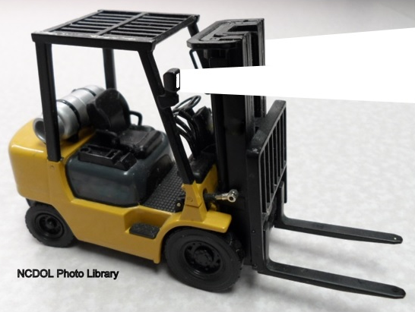
Lighting for Operating Areas
1910.178(h)(2)
Where general lighting is less than 2 lumens per square foot, auxiliary directional lighting provided on the truck

Slide 25

Noxious Gases and Fumes
1910.178(i)
Concentration levels of carbon monoxide gas created by powered industrial truck operations must not exceed the levels specified in 29 CFR 1910.1000
  Air contaminants/Carbon monoxide “CO”

Slide 26
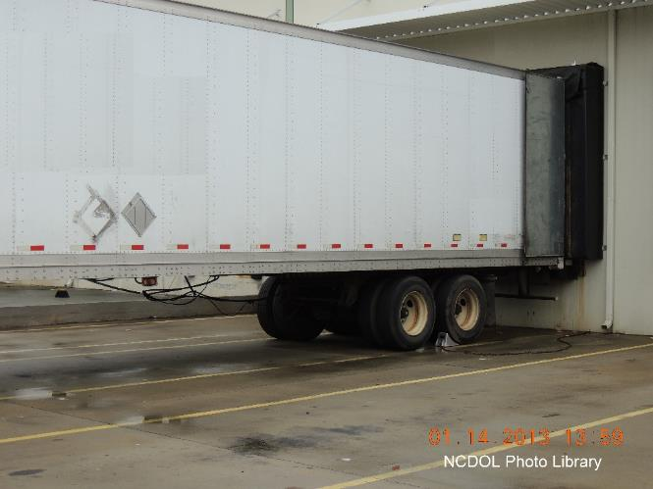
Trucks and Railroad Cars
1910.178(k)(1)
Brakes of highway trucks must be set, and wheel chocks placed under rear wheels while boarded with powered industrial trucks

Slide 27
Trucks and Railroad Cars
1910.178(k)(2),(4)
Loading and unloading railroad cars
  Wheel stops or other positive protection provided to prevent railroad cars from moving
  Setting the railroad car hand brake can also prevent car movement while dock boards or bridge plates are in position

Slide 28
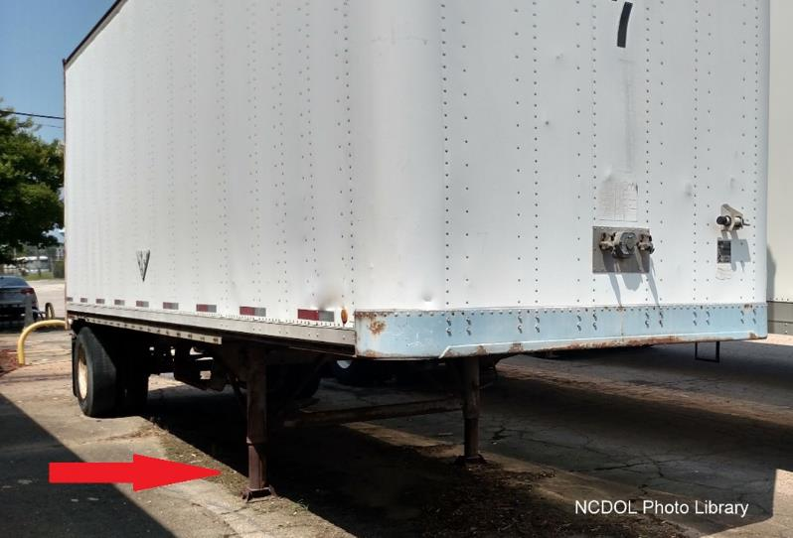
Trucks and Railroad Cars
1910.178(k)(3)
Fixed jacks may be necessary to support semi-trailer during loading or unloading when the trailer is not coupled to a tractor

Slide 29
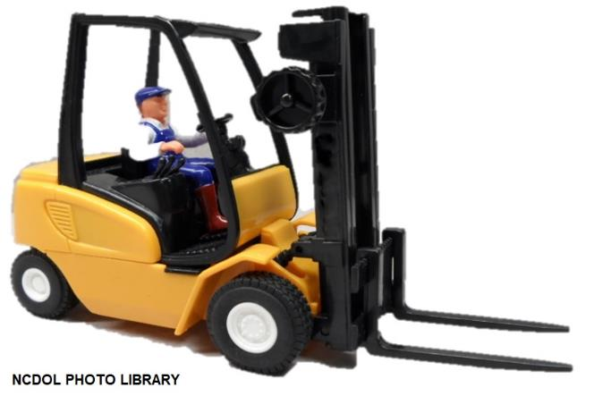
Operator Training
1910.178(l)(1)(i)
Employer shall ensure each powered industrial truck operator is competent to operate a powered industrial truck safely
  As demonstrated by successful completion of training and evaluation

Slide 30
Operator Training
1910.178(l)(2)
Trainees may only operate the truck:
  Under direct supervision of trainer
  Where such operation does not endanger the trainee or other employees

Slide 31
Operator Training
1910.178(l)(2)(ii)-(iii)
Training program must be combination of:
  Formal instruction such as:
    Lecture
    Discussion
    Interactive computer learning
    Video, written material
  Practical training exercises
  Evaluation
Operator training and evaluation
  Conducted by person with knowledge, training, and experience

Slide 32
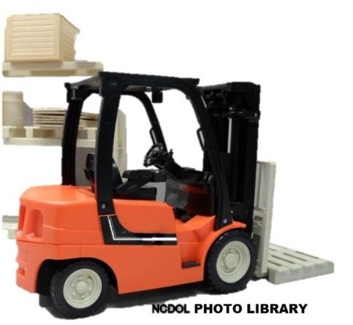
Operator Training
1910.178(l)(3)
Training program content (for initial training)
  Truck-related topics
  Workplace-related topics
  Requirements of 1910.178

Slide 33
Operator Training
1910.178(l)(3)(i)
Truck-related topics
  Differences from automobile
  Operating instructions, warnings and precautions
  Controls and instrumentation
  Engine or motor operation
  Steering and maneuvering
  Visibility

Slide 34
Operator Training
1910.178(l)(3)(i)
  Fork and attachment adaptation, operation, use
  Vehicle capacity and stability
  Vehicle inspection and maintenance that the operator will be required to perform
  Refueling/charging/recharging batteries
  Operating limitations
  Other instructions

Slide 35
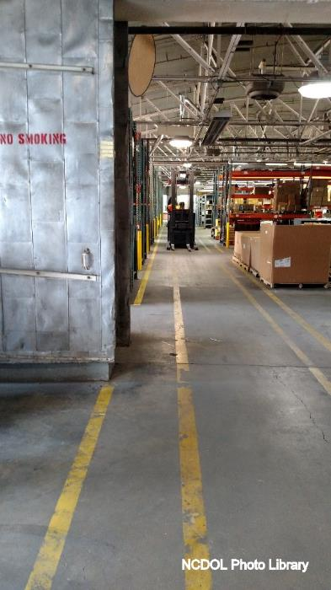
Operator Training
1910.178(l)(3)(ii)
Workplace-related topics
  Surface conditions
  Composition and stability of loads
  Pedestrian traffic
  Narrow aisles and restricted areas
  Load manipulation, stacking, unstacking

Slide 36
Operator Training
1910.178(l)(3)(ii)
  Operating in hazardous (classified) locations
  Operating on ramps and sloped surfaces
  Potentially hazardous environmental conditions
  Operating in closed environments or other areas where poor ventilation or maintenance could cause carbon monoxide or diesel exhaust buildup

Slide 37
Operator Training
1910.178(l)(4)(ii)
Refresher training and evaluation
  Operator observed operating vehicle in unsafe manner
  Involved in accident or near-miss incident
  Evaluation reveals not operating truck safely
  Assigned to different type of truck
  Conditions in workplace change

Slide 38
Operator Training
1910.178(l)(5)
Avoidance of duplicative training
  If an operator has previously received training in a topic specified in paragraph (l)(3) of this section, and such training is appropriate

Slide 39
Operator Training
1910.178(l)(6)
Employer must certify that each operator has been trained and evaluated
Certification must include:
  Name of operator
  Date of training
  Date of evaluation
  Identity of trainer

Slide 40
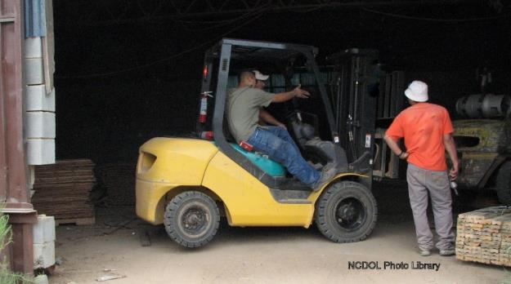
Truck Operations
1910.178(m)(1)-(4)
Trucks not driven up to anyone standing in front of a bench or other fixed object
No person allowed to stand or pass under the elevated portion of any truck, whether loaded or empty

Slide 41

Truck Operations
1910.178(m)(1)-(4)
Unauthorized personnel not permitted to ride
  A safe place to ride provided where riding of trucks is authorized
Employer shall prohibit arms or legs from being placed between the uprights of the mast or outside running lines of truck

Slide 42
Truck Operations
1910.178(m)(5)(i)(ii)
When a powered industrial truck is left unattended, out of view, 25ft or > away
  Load engaging means fully lowered
  Controls neutralized
  Power shut off and brakes set
  Wheels blocked if truck is parked on an incline

Slide 43
Truck Operations
1910.178(m)(5)(iii)
When operator is dismounted and within 25 feet of the truck still in his view, the load engaging means shall be:
  Fully lowered
  Controls neutralized
  Brakes set to prevent movement
  Wheels blocked if truck parked on incline

Slide 44
Truck Operations
1910.178(m)(6)
A safe distance maintained from the edge of ramps or platforms while on any elevated dock, or platform or freight car
Forklifts are not to be used to open or close freight doors

Slide 45
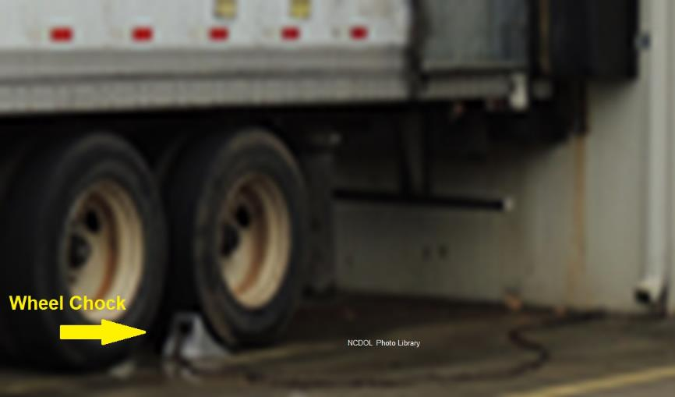
Truck Operations
1910.178(m)(7)
Brakes set and wheel blocks in place to prevent movement of trucks, trailers, or railroad cars while loading or unloading

Slide 46
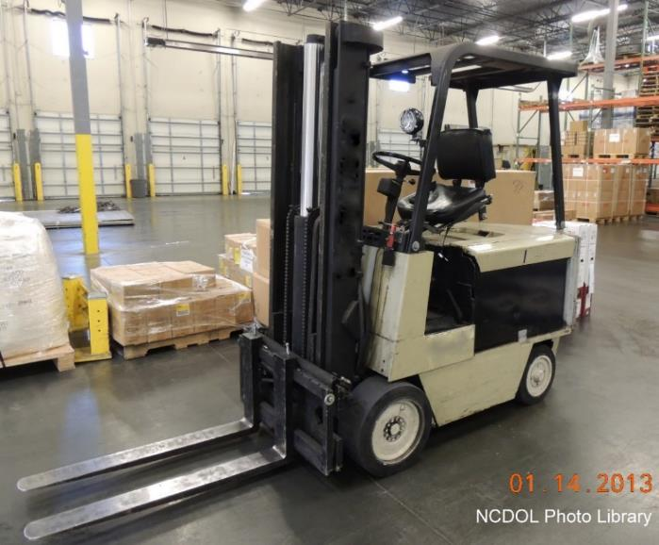
Truck Operations
1910.178(m)(8)
Sufficient headroom under overhead installations, lights, pipes, sprinkler system, etc.

Slide 47
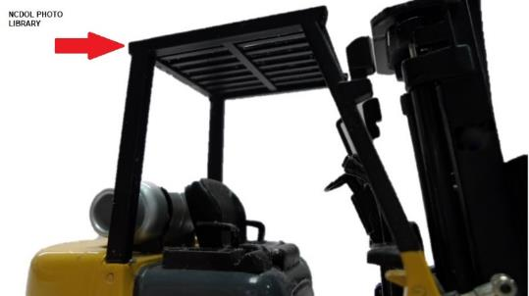
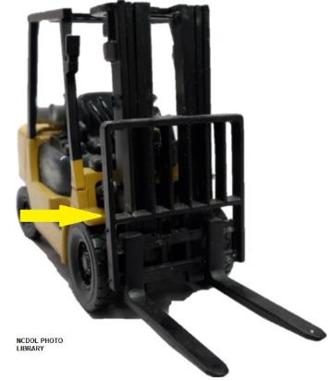
Truck Operations
1910.178(m)(9)-(10)
Overhead guard used as protection against falling objects
Load backrest extension used when necessary

Slide 48
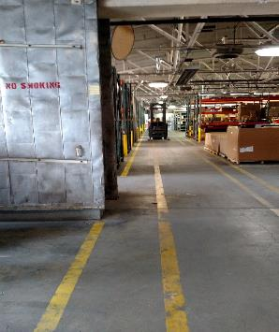
Truck Operations
1910.178(m)(14)
Fire aisles, access to stairways, and fire equipment shall be kept clear
NCDOL Photo Library

Slide 49
Traveling
1910.178(n)(1)-(3)
All traffic regulations observed, including authorized plant speed limits
Safe distances maintained
  Approximately three truck lengths
Right of way
  Ambulances, fire trucks, etc.
Watch for intersections, blind spots or other dangerous locations

Slide 50
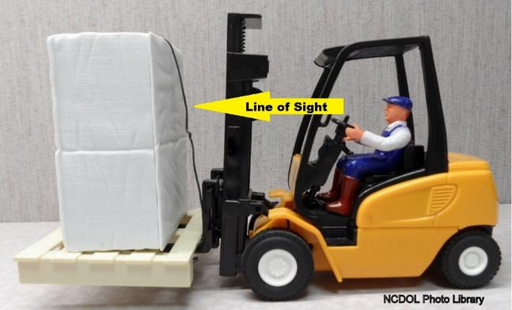
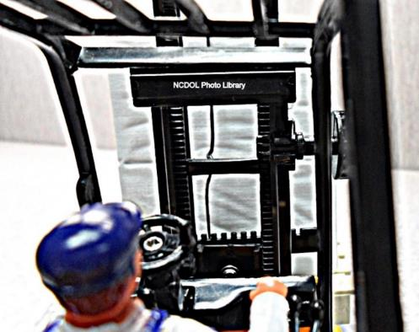
Traveling
1910.178(n)(4)
Drivers must slow down, sound horn at cross aisles and other locations where vision is obstructed
  If load obstructs forward view, then travel with load trailing

Slide 51

Traveling
1910.178(n)(5)-(6)
Railroad tracks crossed diagonally wherever possible
Keep a clear view of the path of travel

Slide 52
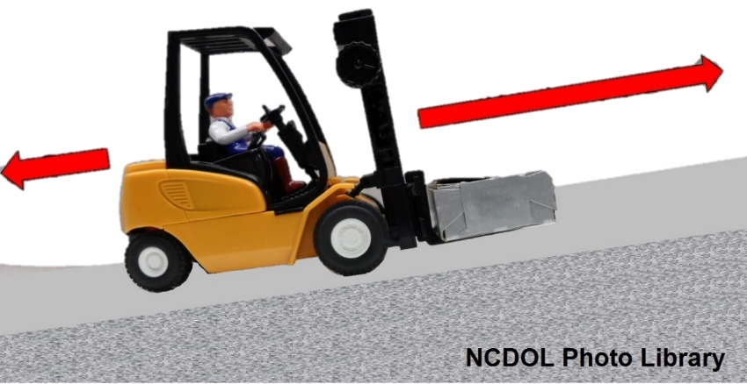
Traveling
1910.178(n)(7)
When ascending or descending grades in excess of 10 percent, loaded trucks driven with the load upgrade
Never turn a forklift on a grade

Slide 53
Traveling
1910.178(n)(11)
Dock boards or bridge plates properly secured before being driven over
Potential hazards
  While entering and leaving truck trailers or railroad cars:
    Falling off loading dock
    Moving trucks or railroad cars during loading and unloading
    Slipping or inadequate dockboards

Slide 54
Traveling
1910.178(n)(12)-(13)
Elevators approached slowly and squarely
  Once on the elevator:
    Controls neutralized
    Power shut off
    Brakes set
Motorized hand trucks enter elevators or other confined areas with load end forward

Slide 55
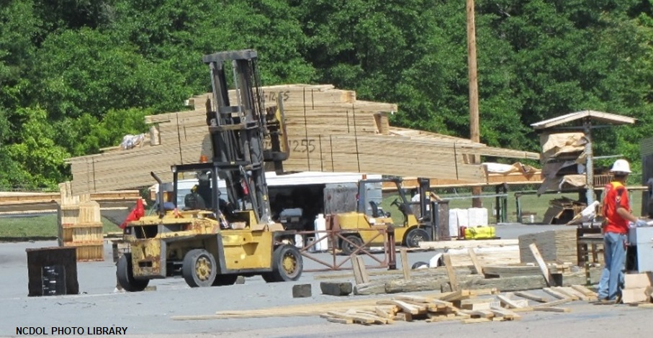
Traveling
1910.178(n)(14)-(15)
Avoid running over loose objects on roadway surfaces
Watch speed and how you negotiate turns

Slide 56
Loading
1910.178(o)(1)
Only stable or safely arranged loads shall be handled
  Exercise caution when handling off-center loads

Slide 57

Loading
1910.178(o)(2)
Only loads within the rated capacity of the truck must be handled

Slide 58
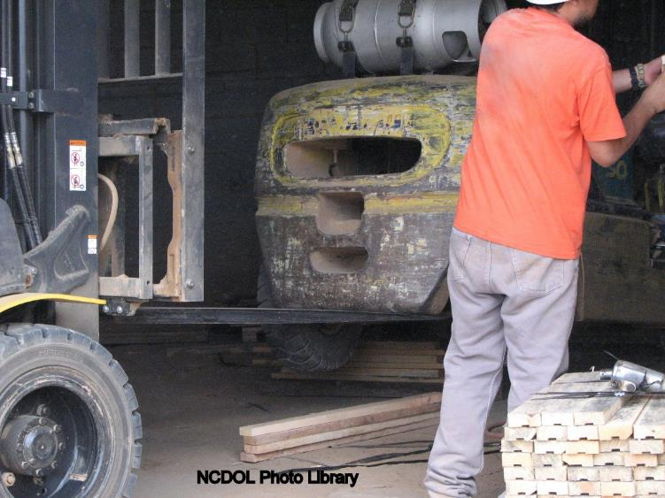
Loading
1910.178(o)(2)
Only loads within the rated capacity of the truck must be handled

Slide 59
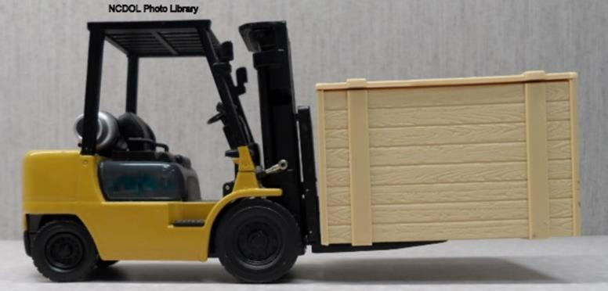
Loading
1910.178(o)(3) & (5)
Long or high (including multiple-tiered) loads which may affect capacity must be adjusted
On all grades, the load and load engaging means shall be tilted back if applicable, and raised only as far as necessary to clear the road surface

Slide 60
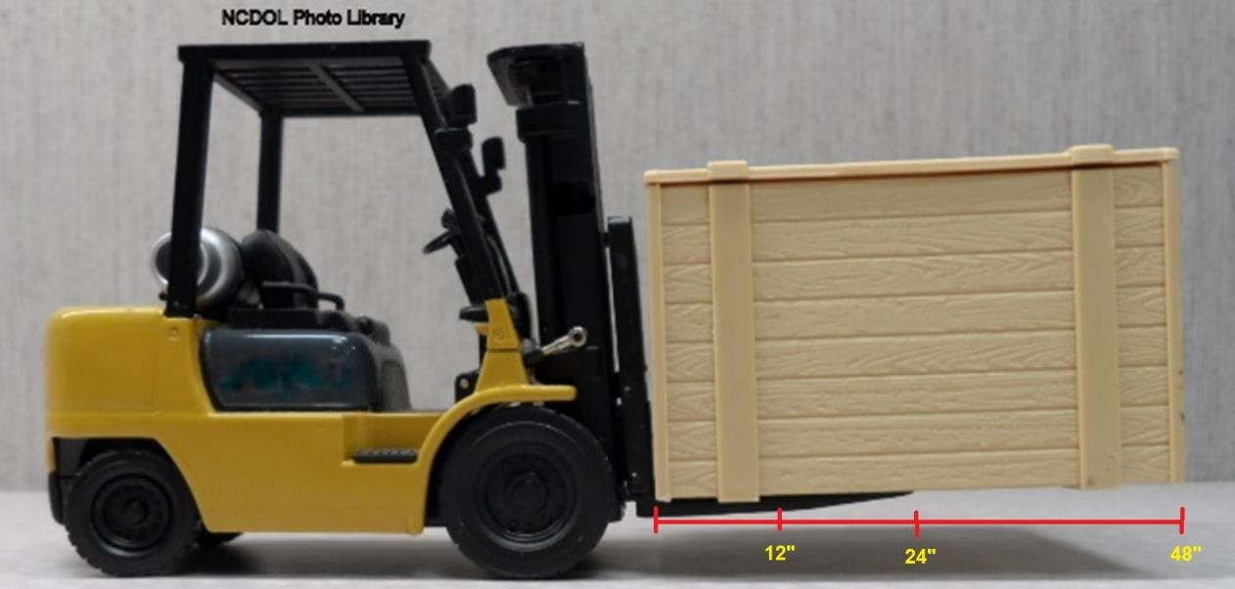
Loading
1910.178(o)(3) & (5)
Based on the length of this crate, could tilts and capacity be an issue with this load?

Slide 61
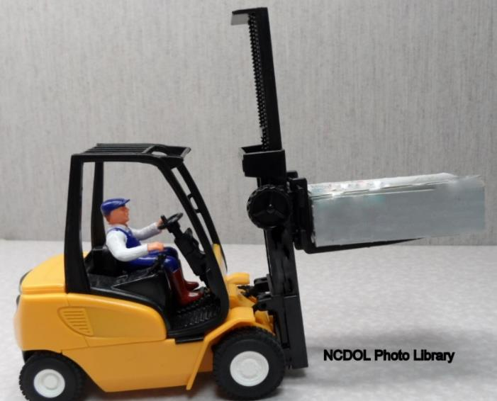
Loading
1910.178(o)(6)
Use extreme care when tilting the load forward or backward, particularly when high tiering
Tilting forward with load engaging means elevated prohibited except to pick up a load

Slide 62
Truck Operation
1910.178(p)(1)-(5)
Take truck out of service if it needs repair, is defective, or is unsafe to operate
Do not fill fuel tank while the engine is running
Clean up any spillage before starting truck
Do not operate if fuel is leaking from vehicle
Do not use open flames to check battery or fuel levels

Slide 63
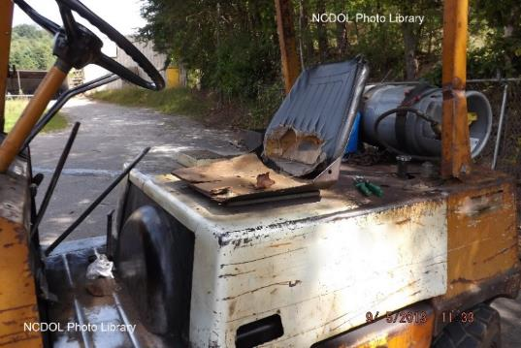
Truck Maintenance
1910.178(q)(1)-(3)
Trucks not in safe operating condition removed from service
Repairs to fuel and ignition systems conducted only in locations designated for such repairs
Repairs made by authorized personnel

Slide 64
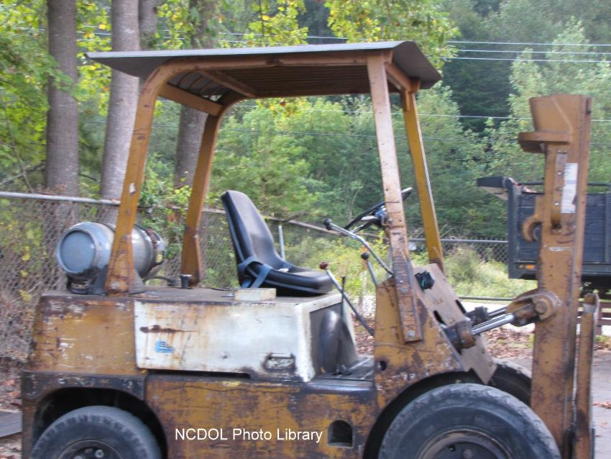
Truck Maintenance
1910.178(q)(1)-(3)
Abatement photo showing owner corrections

Slide 65
Truck Maintenance
1910.178(q)(4)-(6)
Prior to repairs to electrical system, disconnect battery
Parts replaced only by equivalent type of part from manufacturer
Trucks not altered so that relative positions of various parts are different from what they were when originally received from manufacturer

Slide 66
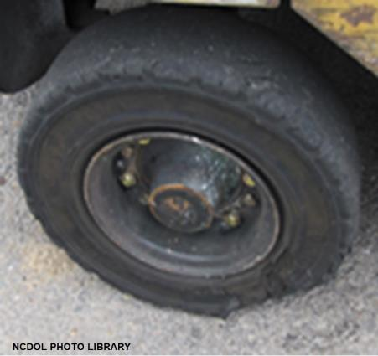
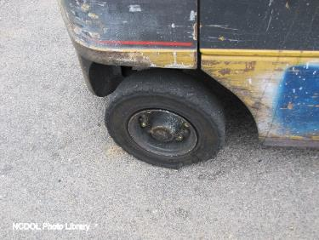
Truck Maintenance
1910.178(q)(7)
Trucks examined before being placed in service
Must not be placed in service if any condition adversely affects safety of vehicle
Examination made at least daily

Slide 67
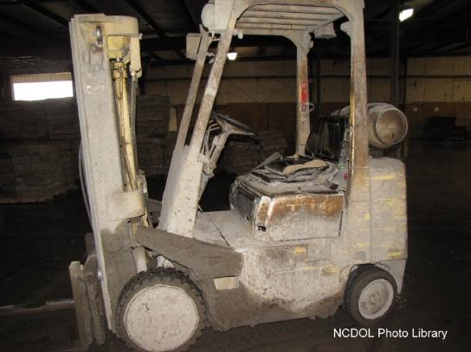
Truck Maintenance
1910.178(q)(8)-(10)
Mufflers inspected as required
Vehicle removed from service when temperature of parts indicates overheating
Industrial trucks kept in a clean condition
  Free of lint, excess oil and grease

Slide 68
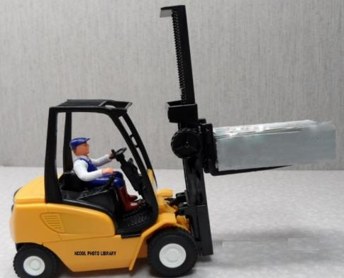
Forklift Tip overs or Rollovers
Two basic types of tip overs:
  A forward or longitudinal tip
  A lateral or side tip
Procedure to follow varies on the type of tip over and the class of forklift
What would happen if this driver turned suddenly turned sharply?

Slide 69
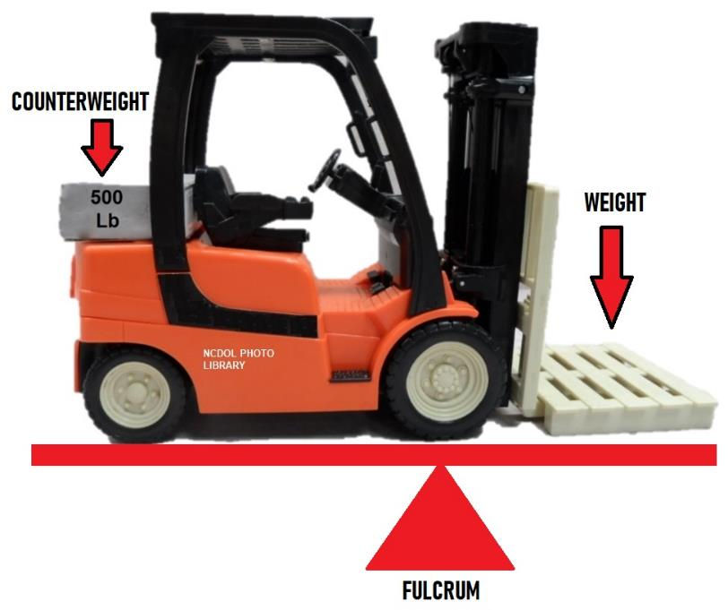
Stability
Forward wheels are the fulcrum

Slide 70
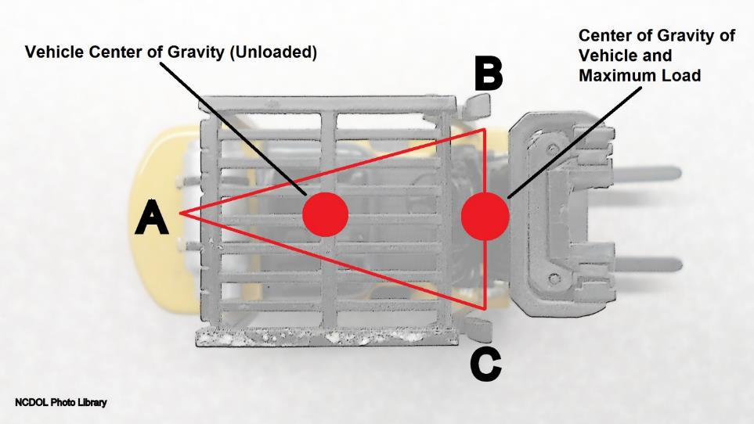
Stability Triangle
Counterbalanced powered industrial trucks
  Vehicle is supported at three points

Slide 71
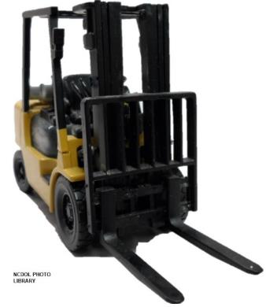
Summary
In this course, we covered:
  Minimum general requirements for powered industrial trucks (PIT)
  Safe operation of equipment
  Operator training and evaluation
  Hazard identification
  Abatement methods and procedures

Slide 72
Thank You For Attending!
Final Questions?

