Slide 1
Personal Protective Equipment
General Industry - Subpart I
29 CFR 1910.132
29 CFR 1910.132
29 CFR 1910.133
29 CFR 1910.135
29 CFR 1910.136
29 CFR 1910.137
29 CFR 1910.138
29 CFR 1910.140
Notes:
Revised 6/16/25
The information in this presentation is provided voluntarily by the N.C. Department of Labor, Education Training and Technical Assistance Bureau as a public service and is made available in good faith. This presentation is designed to assist trainers conducting OSHA outreach training for workers. Since workers are the target audience, this presentation emphasizes hazard identification, avoidance, and control – not standards. No attempt has been made to treat the topic exhaustively. It is essential that trainers tailor their presentations to the needs and understanding of their audience.
The information and advice provided on this Site and on Linked Sites is provided solely on the basis that users will be responsible for making their own assessment of the matters discussed herein and are advised to verify all relevant representations, statements, and information.
This presentation is not a substitute for any of the provisions of the Occupational Safety and Health Act of North Carolina or for any standards issued by the N.C. Department of Labor. Mention of trade names, commercial products, or organizations does not imply endorsement by the N.C. Department of Labor.

Slide 2
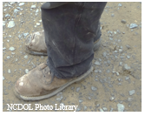
Objectives
At the end of the course, students will be able to:
Understand general provisions of the standards.
Recognize basic hazard categories.
Identify hazard sources and personal protective equipment (PPE).

Slide 3
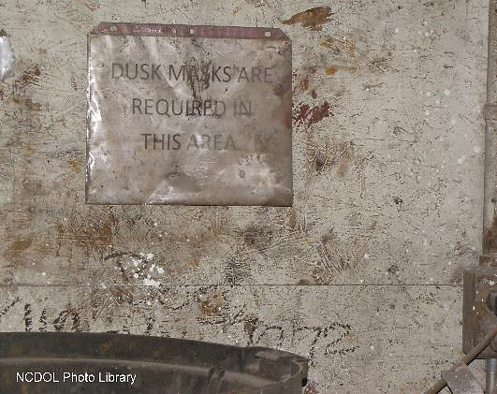
What is PPE?
Equipment worn to minimize exposure to hazards that cause serious workplace injuries and illnesses.
  PPE examples include hard hats, goggles, gloves and hearing protection.
  Should be a temporary measure.
?
NCDOL Photo Library

Slide 4
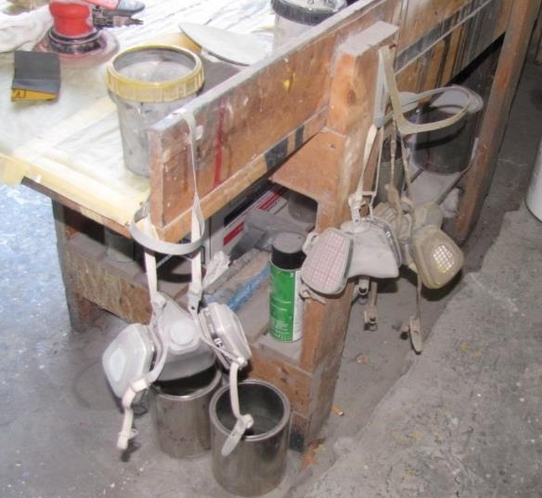
Personal Protective Equipment
1910.132(a)
General requirements
  Application
    Protective equipment, including personal protective equipment shall be provided, used, and maintained in a sanitary and reliable condition.
NCDOL Photo Library
NCDOL Photo Library

Slide 5
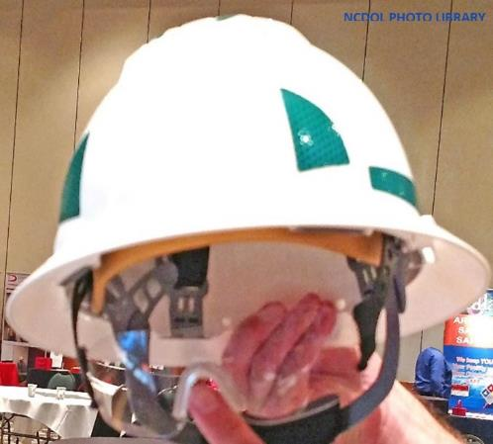
Employee-Owned Equipment
1910.132(b)
Where employees provide their own protective equipment, employer shall be responsible to assure its adequacy, including proper maintenance and sanitation.

Slide 6
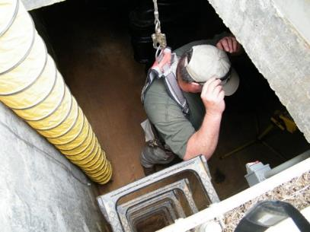
PPE Design
1910.132(c)
All personal protective equipment shall be of safe design and construction for the work to be performed.
NCDOL Photo Library
NCDOL Photo Library

Slide 7
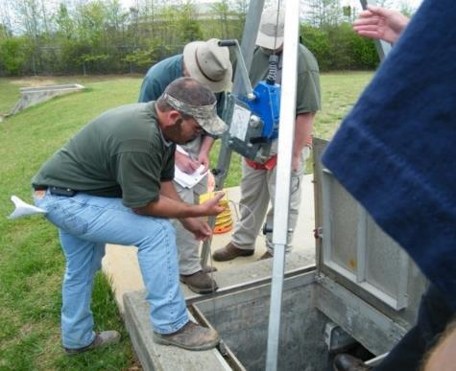
Hazard Assessment
1910.132(d)
Requirement
  Employer must select PPE based on the assessment and require employees to use them,
  Select PPE that properly fits each affected employee, and
  Communicate selection
  decisions to employees.
NCDOL Photo Library
NCDOL Photo Library
NCDOL Photo Library

Slide 8
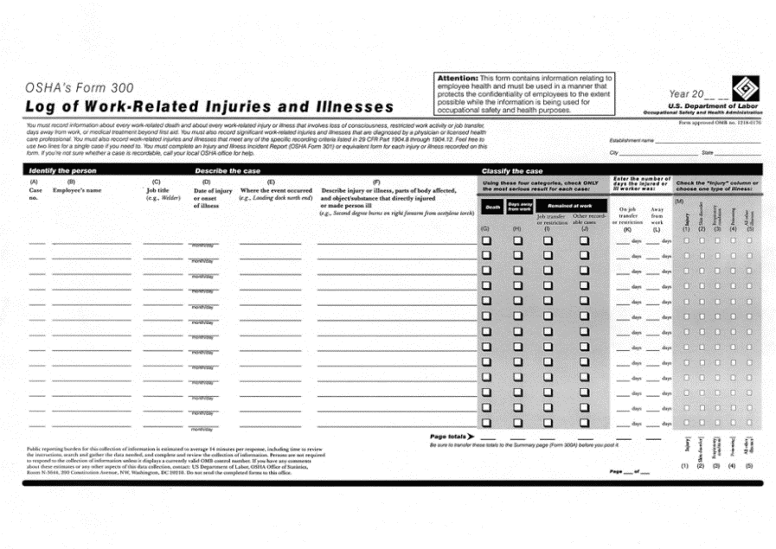
Hazard Assessment Process
1910.132(d)
Review injury/illness logs
Use recommendations on Safety Data Sheets
Review other records
NCDOL Photo Library

Slide 9
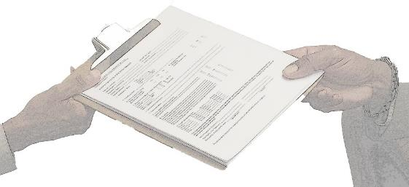
Hazard Assessment Process
1910.132(d)
Must be job and area based
Requires written certification identifying the document as such including:
  Workplace evaluated
  Person certifying that the evaluation
  Date of hazard assessment
NCDOL Photo Library

Slide 10
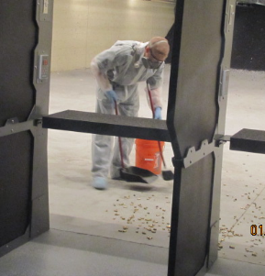
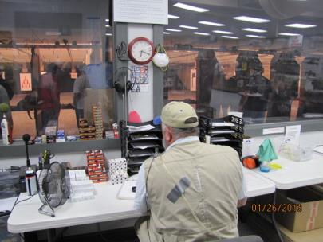
Hazard Assessment Process
1910.132(d)
Walk around
Hazard control
PPE selection
NCDOL Photo Library
NCDOL Photo Library

Slide 11
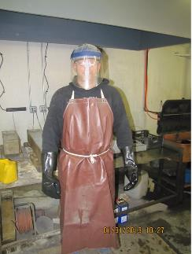
Basic Hazard Categories
Impact
Penetration
Compression
Chemical
Heat and cold or wet
Electrical shock
NCDOL Photo Library

Slide 12
Basic Hazard Categories
Electrical arc
Air contaminants (dusts, mists and fumes)
Light radiation
Falls
NCDOL Photo Library

Slide 13
Training
1910.132(f)
Training subjects:
  What PPE is required
  When PPE is required
  How to don, doff, adjust and wear PPE
  Limitations of PPE
  How to maintain and clean PPE
  When to replace PPE

Slide 14
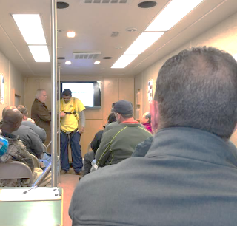
Training
1910.132(f)
Employee must demonstrate knowledge and skill.
Retrain when necessary.
NCDOL Photo Library

Slide 15
PPE Payment
1910.132(h)
Employer must pay for all PPE used in the workplace, except:
  Non-specialty safety-toe footwear and non-specialty prescription safety eyewear provided the employer allows it to be worn off the jobsite.
  Built-in metatarsals (as long as the employer provides another type of metatarsal protection when required).
  Logging boots
  Everyday work clothing and ordinary clothing, skin creams, used solely for protection from weather.

Slide 16

PPE Payment
1910.132(h)
Employer must pay for replacement PPE unless it is lost or intentionally damaged.
If the employer provides adequate and appropriate PPE, but the employee prefers a different type, the employer does not have to pay for it.
NCDOL Photo
NCDOL Photo Library

Slide 17
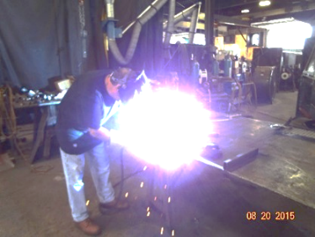
Eye and Face Protection
1910.133(a)(1)
General requirements
  Employer shall ensure that each affected employee used appropriate eye or face protection when exposed to eye or face hazards.
    Flying particles
    Molten metals
    Liquid chemicals
    Acids or caustic liquids
    Chemical gases or vapors
    Other potentially injurious light
    radiation
NCDOL Photo Library

Slide 18
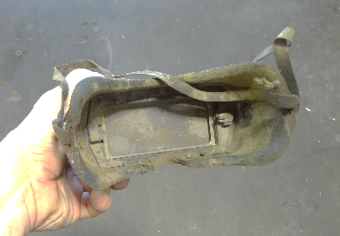
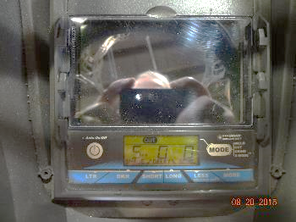
Eye and Face Protection
1910.133(a)(5)
General requirements
  Employer shall ensure that each affected employee uses equipment with filter lenses that have a shade number appropriate for the work being performed for protection from injurious light radiation.
  Appropriate shade numbers for various operations are listed in standard.
NCDOL Photo Library
NCDOL Photo Library

Slide 19
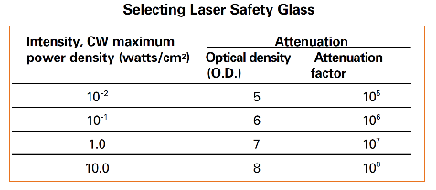
Eye and Face Protection
General Duty Clause
Laser light radiation can be extremely dangerous to the unprotected eye and direct or reflected beams can cause permanent eye damage.
  Laser retinal burns can be painless, so it is essential that all personnel in or around laser operations wear appropriate eye protection.
NCDOL Photo Library

Slide 20
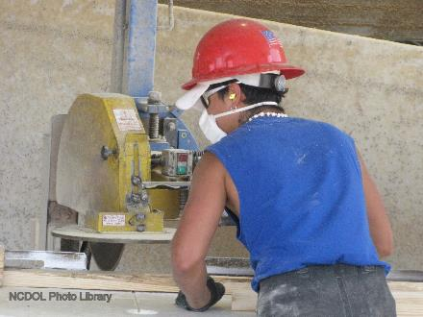
Eye and Face Protection
1910.133(a)(2)
Employer shall ensure that each affected employee uses eye protection that provides side protection when there is a hazard of flying objects.

Slide 21
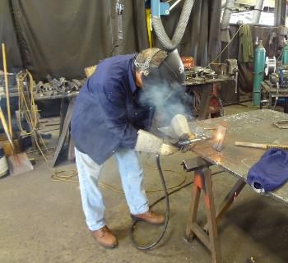
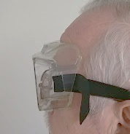
Eye and Face Protection
1910.133(a)(3)
Employer shall ensure:
  Each affected employee who wears prescription lenses while engaged in operations that involve eye hazards, wears eye protection that incorporates the prescription in its design, or
  Wears eye protection that can
  be worn over the prescription
  lenses.
NCDOL Photo Library
NCDOL Photo Library

Slide 22
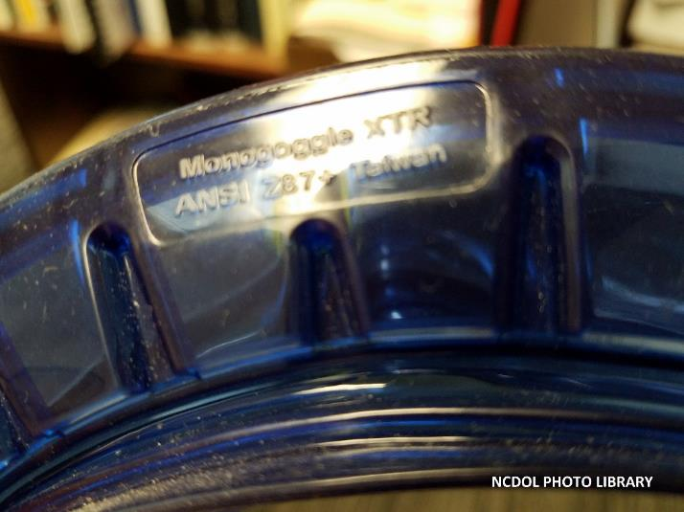
Eye and Face Protection
1910.133(b)
Criteria for protective eye and face devices
  ANSI Z87.1-2010
  ANSI Z87.1-2003
  ANSI Z87.1-1989 (R-1998)

Slide 23
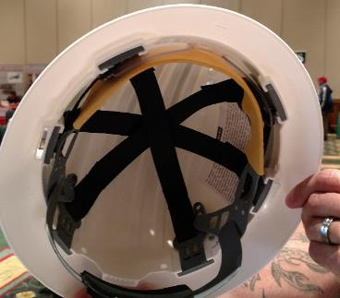
Head Protection
1910.135(a)(1)
General requirements
  Employer shall ensure that each affected employee wears a protective helmet when working in areas where there is a potential for injuries to the head from falling objects.
Built In - Eye Protection
NCDOL Photo Library

Slide 24
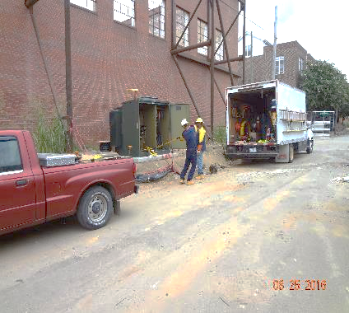
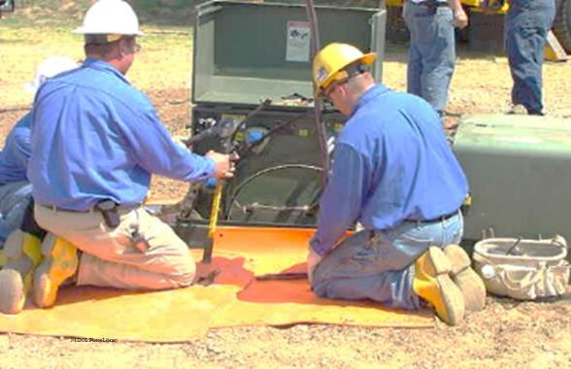
Head Protection
1910.135(a)(2)
Employer shall ensure that a protective helmet designed to reduce electrical shock hazard.
  Affected employee when near exposed electrical conductors.
NCDOL Photo Library
NCDOL Photo Library

Slide 25
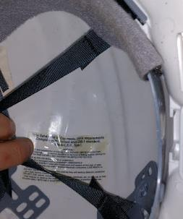
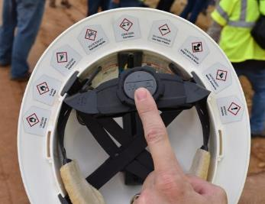
Head Protection
1910.135(b)(1)-(2)
Criteria for head protection
  ANSI Z89.1-2009
  ANSI Z89.1-2003
  ANSI Z89.1-1997
NCDOL Photo Library
NCDOL Photo Library

Slide 26
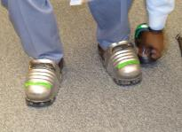
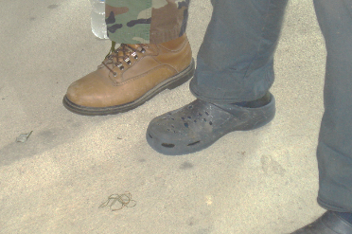
Foot Protection
1910.136(a)
General requirements
  Employer shall ensure that each affected employee uses protective footwear.
    In areas where there is a danger of foot injuries
    Objects piercing the sole
    Electrical hazards
      (Static discharge or Shock)
NCDOL Photo Library
NCDOL Photo Library

Slide 27
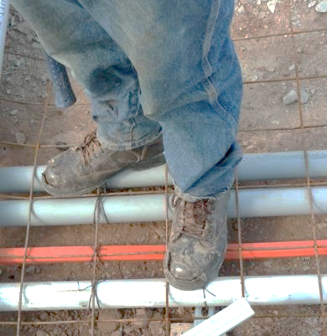
Foot Protection
1910.136(b)(1)-(2)
Criteria for protective footwear
  ANSI Z41-1999
  ANSI Z41-1991
  ASTM F2412-2005
  and F2413-2005
NCDOL Photo Library

Slide 28
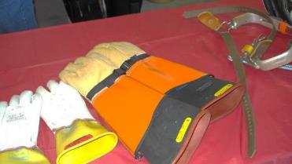
Electrical Protective Equipment
1910.137
General requirements
  Employers shall select and require employees to use appropriate hand protection.
    Equipment shall be capable of withstanding the ac proof-test voltage specified in Table I-1 or the dc proof-test voltage specified in Table I-2.
    Table I-1-AC Proof-Test
    Table I-2DC Proof-Test
    Table I-3-Glove Test
NCDOL Photo Library

Slide 29
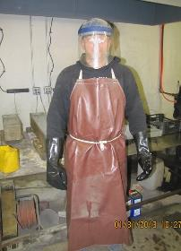

Hand Protection
1910.138(a)
General requirements
  Employers shall select and require employees to use appropriate hand protection.
    Skin absorption
    Cuts and lacerations
    Temperature extremes
    Abrasions
    Burns
NCDOL Photo Library
NCDOL Photo Library
NCDOL Photo Library
NCDOL Photo Library

Slide 30
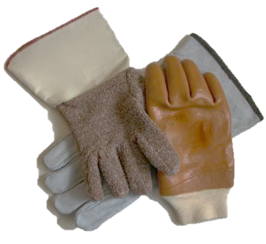
Hand Protection
1910.138(b)
Selection
  Employers shall base the selection of the appropriate hand protection on an evaluation of the performance characteristics.
    Hand protection relative to the task(s) to be performed.
      Conditions present, duration of use, and hazards identified.
NCDOL Photo Library

Slide 31
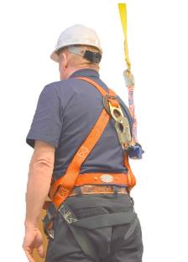
Personal Fall Protection Systems
1910.140(a)
General requirements
  Employer must ensure that personal fall protection systems meet the following requirements.
    Personal fall arrest systems and positioning systems
NCDOL Photo Library
NCDOL Photo Library

Slide 32
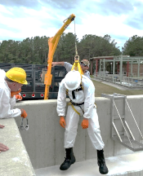
Personal Fall Protection Systems
1910.140(c)
Employers must ensure that personal fall protection systems must meet this standard.
  When vertical lifelines are used, each employee must be attached to a separate lifeline.
  Lanyards and vertical lifelines
  must have a minimum breaking
  strength of 5,000 pounds.
  Competent person or qualified
  person must inspect each knot in
  a lanyard or vertical lifeline to
  ensure that it meets requirements.
NCDOL Photo Library

Slide 33
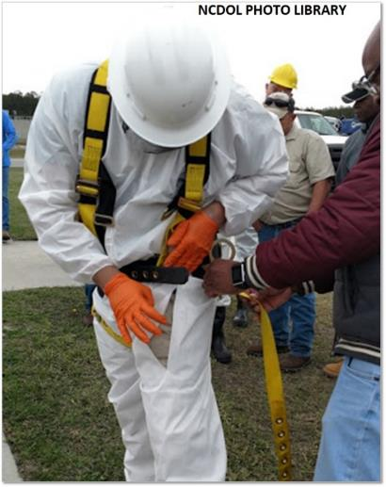
Personal Fall Arrest Systems
1910.140(d)
System performance criteria
  Limit the maximum arresting force on the employee to 1,800 pounds.
  Bring the employee to a complete stop and limit the maximum deceleration distance the employee travels to 3.5 feet.
  Have sufficient strength to withstand twice the potential impact energy of the employee free falling a distance of 6 feet.

Slide 34
Personal Fall Arrest Systems
1910.140(d)
System performance criteria
  Personal fall arrest systems are rigged in such a manner that the employee cannot free fall more than 6 feet (1.8 m) or contact a lower level.
  Body belts are prohibited as part of a personal fall arrest system.

Slide 35
Positioning Systems
1910.140(e)
System performance requirements
  All positioning systems must be capable of withstanding, without failure.
    Drop test consisting of a 4-foot (1.2-m) drop of a 250-pound (113-kg) weight
      Except window cleaners' positioning systems

Slide 36
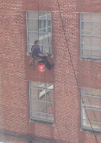
Positioning Systems
1910.140(e)
System performance criteria
  Window cleaners' positioning systems
    Be capable of withstanding without failure a drop test consisting of a 6-foot (1.8-m) drop of a 250-pound (113-kg) weight.
    Limit the initial arresting force on the falling employee to not more than 2,000 pounds (8.9 kN), and
    With a duration not exceeding 2 milliseconds and any subsequent arresting forces to not more than 1,000 pounds (4.5 kN).
NCDOL Photo Library

Slide 37
Positioning Systems
1910.140(e)
Lineman’s body belt and pole strap systems
  Electrical requirements: Dielectric test of 819.7 volts, AC, per centimeter (25,000 volts per foot) for 3 minutes without visible deterioration.
    A leakage test of 98.4 volts, AC, per centimeter (3,000 volts per foot) with a leakage current of no more than 1 mA; and
    A flammability test in accordance with Table I-7.
Table I-7 – Flammability Test
Test Method | Criteria for Passing Test
Vertically suspend a 19.7-inch (500-mm) length of strapping supporting a 220.5-lb (100-kg) weight; | Any flames on the positioning strap must self-extinguish. The positioning strap must continue to support the 220.5-lb (100kg) mass.
2. Use a butane or propane burner with a 3-inch (76-mm) flame;
3. Direct the flame to an edge of the strapping at a distance of 1 inch (25-mm);
4. Remove the flame after 5 seconds; and
5. Wait for any flames on the positioning strap to stop burning.
NCDOL Photo Library

Slide 38
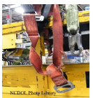
Summary
In this course, we covered the following:
General provisions of the standard
Basic hazard categories
Identification of hazard sources and personal protective equipment (PPE)

Slide 39

Thank You For Attending!
Final Questions?

