Slide 1
Personal Protective Equipment
Construction Industry – Subpart E
29 CFR 1926.95 - 1926.106
Notes:
Revised 6/16/25
The information in this presentation is provided voluntarily by the N.C. Department of Labor, Education Training and Technical Assistance Bureau as a public service and is made available in good faith. This presentation is designed to assist trainers conducting OSHA outreach training for workers. Since workers are the target audience, this presentation emphasizes hazard identification, avoidance, and control – not standards. No attempt has been made to treat the topic exhaustively. It is essential that trainers tailor their presentations to the needs and understanding of their audience.
The information and advice provided on this Site and on Linked Sites is provided solely on the basis that users will be responsible for making their own assessment of the matters discussed herein and are advised to verify all relevant representations, statements, and information.
This presentation is not a substitute for any of the provisions of the Occupational Safety and Health Act of North Carolina or for any standards issued by the N.C. Department of Labor. Mention of trade names, commercial products, or organizations does not imply endorsement by the N.C. Department of Labor.

Slide 2
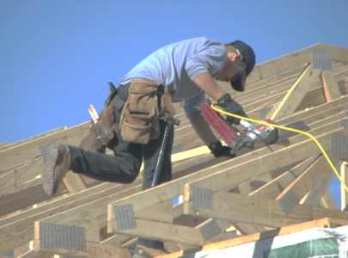
Objectives
After this course, students will:
Understand general provisions of the standard
Recognize basic hazard categories
Be able to identify hazard sources and personal protective equipment (PPE)
NCDOL Photo Library

Slide 3
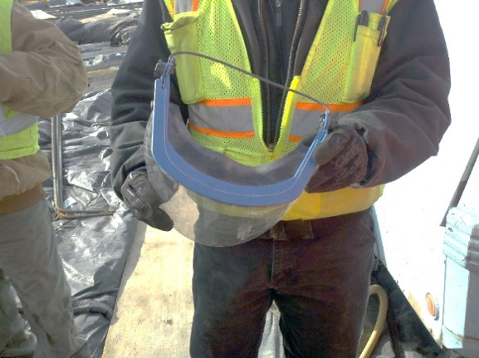
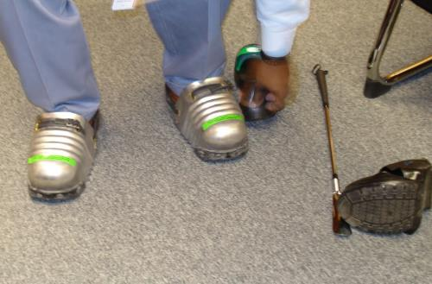
What is PPE?
Equipment that creates a barrier against workplace hazards
Examples include hard hats, goggles, gloves and hearing protection
A temporary measure
NCDOL Photo Library
NCDOL Photo Library
NCDOL Photo Library

Slide 4
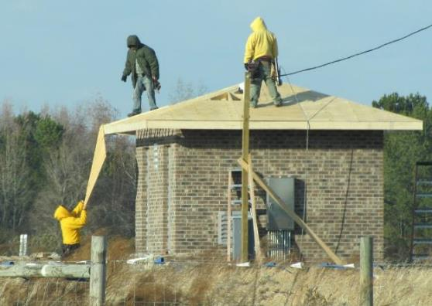
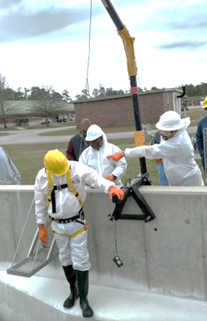
General Requirements
Personal protective equipment
  Establish and supervise programs for the education and training of employers and employees in the recognition, avoidance and prevention of unsafe conditions in employments covered by the act
NCDOL Photo Library
No fall protection used
NCDOL Photo Library
NCDOL Photo Library

Slide 5
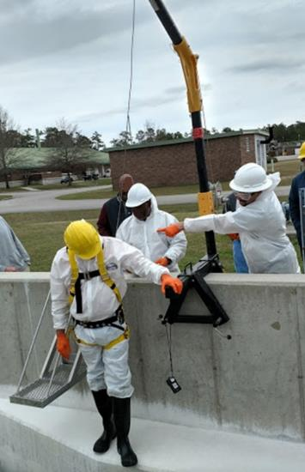
General Safety and Health Provisions
1926.28(a)
Personal protective equipment
  Employer is responsible for requiring the wearing of appropriate PPE in all operations where there is an exposure to hazardous conditions
NCDOL Photo Library
NCDOL Photo Library

Slide 6
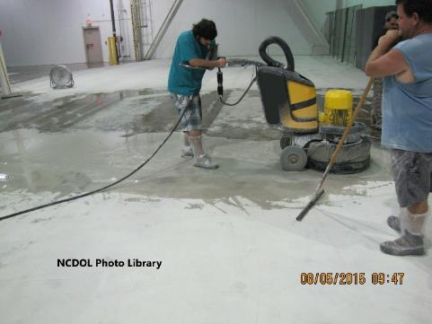
General Safety and Health Provisions
1926.21(b)(3)
Personal protective equipment
  Employees required to handle or use poisons, caustics, and other harmful substances shall be instructed regarding the safe handling and use, and be made aware of the potential hazards, personal hygiene, and personal protective measures required
NCDOL Photo Library
NCDOL Photo Library
NCDOL Photo Library

Slide 7
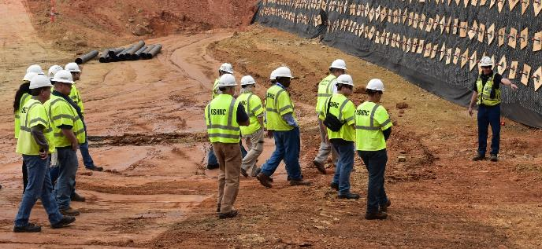
Training
1926.21(a)-(b)
Employer shall instruct each employee in the recognition and avoidance of unsafe conditions and the regulations applicable to his work environment to control or eliminate any hazards or other exposure to illness or injury
NCDOL Photo Library

Slide 8
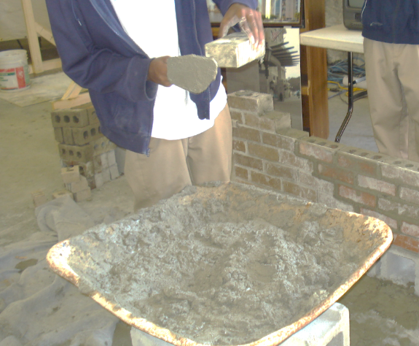
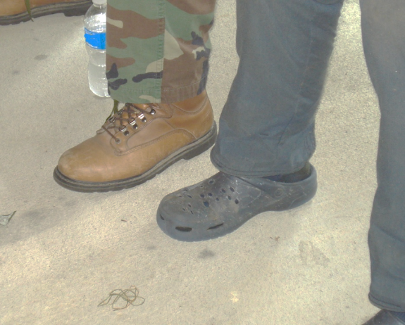
Criteria for PPE
1926.95(a)
Protective equipment, including PPE for eyes, face, head, and extremities shall be provided, used, and maintained in a sanitary and reliable condition
No PPE !
Not PPE !
NCDOL Photo Library
LOI Masons
NCDOL Photo Library

Slide 9
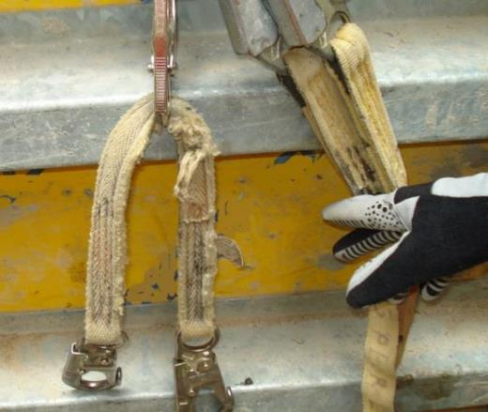
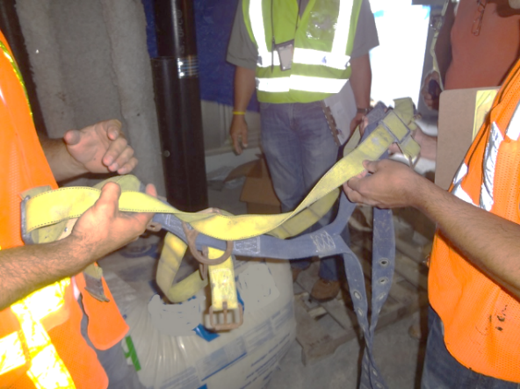
Criteria for PPE
1926.95(b)
Employee-owned equipment
  Where employees provide their own protective equipment, the employer shall be responsible to assure its adequacy, including proper maintenance, and sanitation of such equipment
NCDOL Photo Library
NCDOL Photo Library

Slide 10
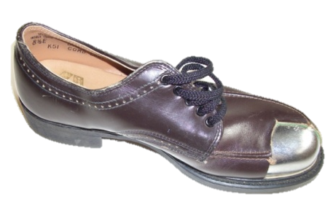
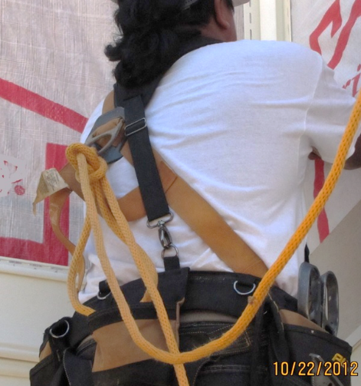
Criteria for PPE
1926.95(c)
Design
  All personal protective equipment shall be of safe design and construction for work to be performed
NCDOL Photo Library
Not correct
NCDOL Photo Library

Slide 11

Payment for PPE
1926.95(d)(2)-(5)
Except as noted, the protective equipment used to comply with this part shall be provided by the employer at no cost to employees
Exception:
  Everyday clothing, such as long-sleeve shirts, long pants, street shoes, and normal work boots
NC DOL Photo Library

Slide 12
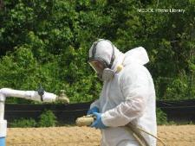
Training Documentation
Employers should prepare a record which contains the identity of the employee, the date of training, and the means used to verify that the employee understood the training
  Some construction standards require documentation/ certification of PPE training including:
    HAZWOPER (1926.65)
    Fall Protection (1926.503)
    Confined Spaces in Construction (1926.1207)
    Many Health Standards (Subpart D, Subpart Z)

Slide 13
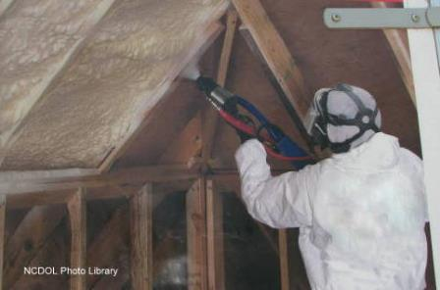
Basic Hazard Categories
Impact
Penetration
Compression
Chemical
Electrical shock
Electrical arc
Harmful dust
Light radiation
Falls
Heat

Slide 14
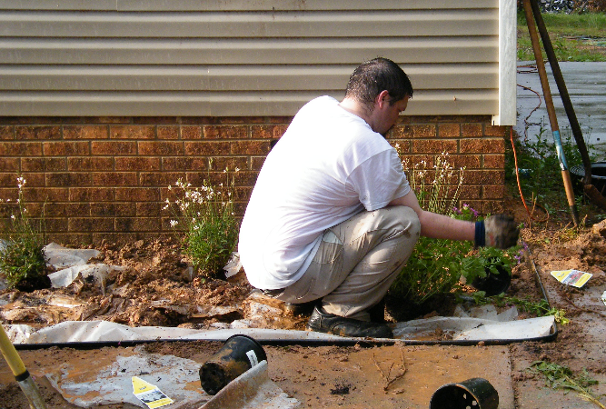
Hazard Sources
Motion
Temperature
Chemical exposure
Light radiation
Elevation
Sharp objects
Rolling/pinching
Electrical hazards
Workplace layout
Worker location
NCDOL Photo Library
NCDOL Photo Library

Slide 15
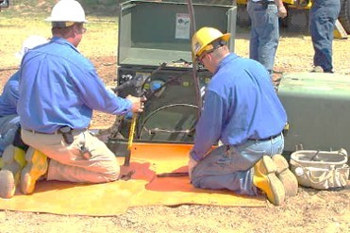
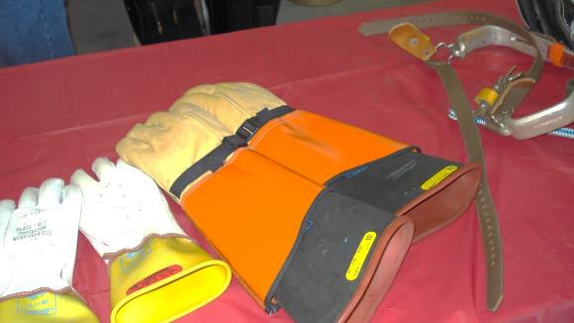
Electrical Protection
1926.97
Electrical protective equipment shall be maintained in a safe, reliable condition
  Rubber insulating blankets, matting, covers, line hose, gloves, and sleeves
Rating of gloves - Stamped - Class Protection “0”
NCDOL Photo Library
LOI Head Protection
NCDOL Photo Library

Slide 16
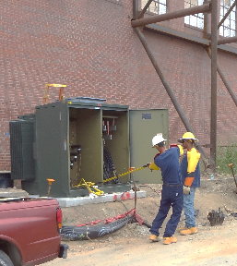
Electrical Protection
1926.97(c)(1)
Design requirements for specific types of electrical protective equipment
  Electrical protective equipment shall be maintained in a safe, reliable condition
  Must conform to those listed in Table E-4
Glove and arm protection
NCDOL Photo Library
LOI Head Protection
NCDOL Photo Library

Slide 17
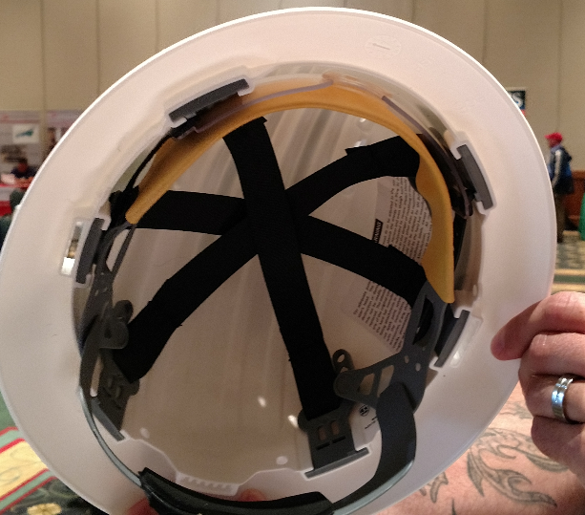
Head Protection
1926.100(a)
Employees working in areas where there is a possible danger of head injury from impact, or from falling or flying objects, or from electrical shock and burns, shall be protected by helmets
Built-in eye protection
LOI Head Protection
NCDOL Photo Library

Slide 18
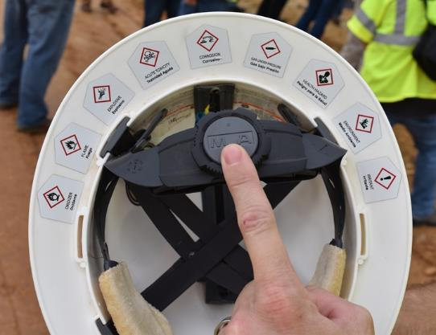
Head Protection
1926.100(b)
Helmets for protection of employees against impact and penetration of falling and flying objects shall meet specification in any of the following consensus standards:
  American National Standards Institute (ANSI) Z89.1-2009
  ANSI Z89.1-2003
  ANSI Z89.1-1997
NCDOL Photo Library

Slide 19
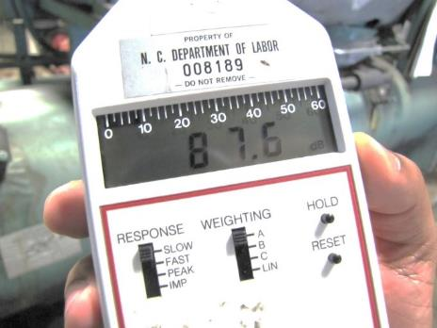
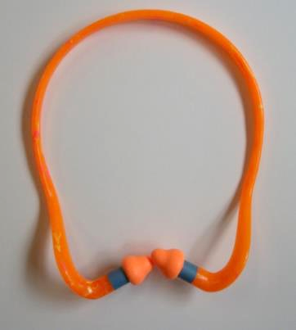
Hearing Protection
1926.101(a)
Wherever it is not feasible to reduce noise levels or duration of exposure to those specified in 29 CFR 1926.52, Table D-2, Permissible Noise Exposures, ear protection devices shall be provided and used
NCDOL Photo Library
NCDOL Photo Library

Slide 20
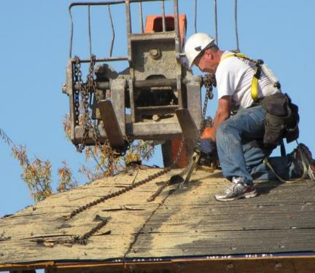
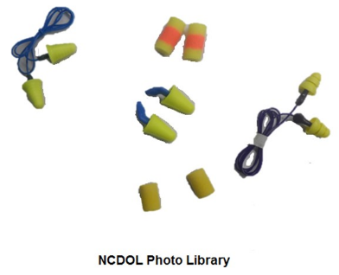
Hearing Protection
1926.101(b)-(c)
Ear protection devices inserted in the ear shall be fitted or determined individually by a competent person
Plain cotton is not an acceptable protective device
NCDOL Photo Library
No eye, ear or face protection
NCDOL Photo Library

Slide 21
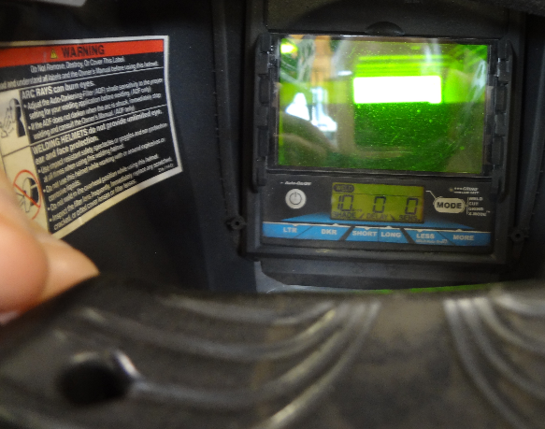
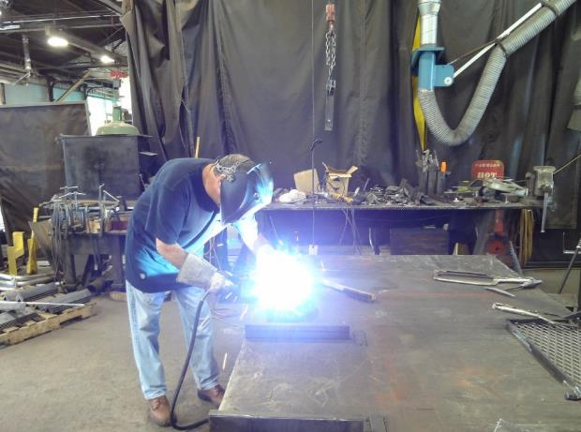
Eye and Face Protection
1926.102(a)(1)
Employees shall be provided with eye and face protection equipment when machines or operations present potential eye or face injury from physical, chemical, or radiation agents
NCDOL Photo Library
NCDOL Photo Library

Slide 22
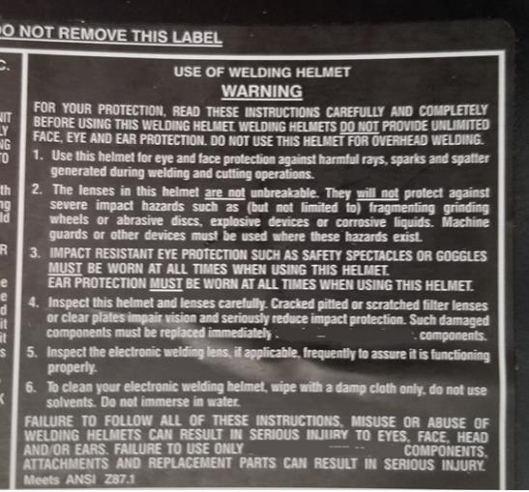
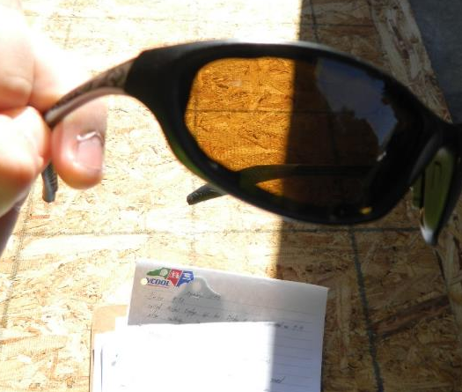
Eye and Face Protection
1926.102(a)(2)
Eye and face protection equipment must meet:
  ANSI Z87.1, Occupational and Educational Personal Eye and Face Protection Devices
NCDOL Photo Library
NCDOL Photo Library

Slide 23
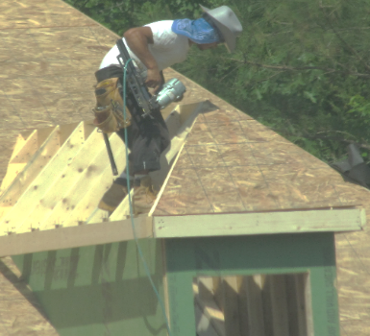
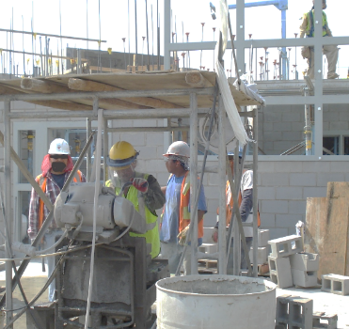
Eye and Face Protection
1926.102(a)(3)
When employee vision requires the use of prescription lenses while needing eye protection, the employee shall either:
  Wear prescription safety glasses
  Wear protective safety goggles or Over the Glass (OTG) safety glasses over their normal prescription glasses, or
  Wear PPE that integrates prescription lenses into the design (such as with spectacle kits in full face respirators)
NCDOL Photo Library
NCDOL Photo Library
NCDOL Photo Library
NCDOL Photo Library

Slide 24
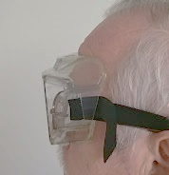
Eye and Face Protection
1926.102(a)(5)(i)-(vi)
Protective safety eyewear shall:
  Provide adequate protection against specific hazards
  Be reasonably comfortable under working conditions
  Fit snugly and not interfere with movement
  Be durable
  Capable of being disinfected
  Easily cleanable
NCDOL Photo Library
NCDOL Photo Library

Slide 25
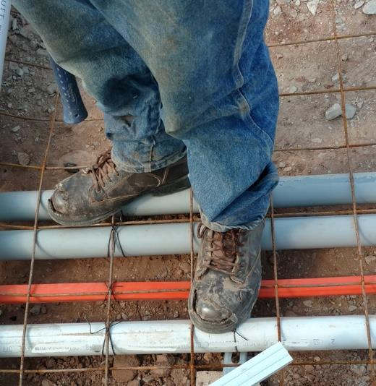
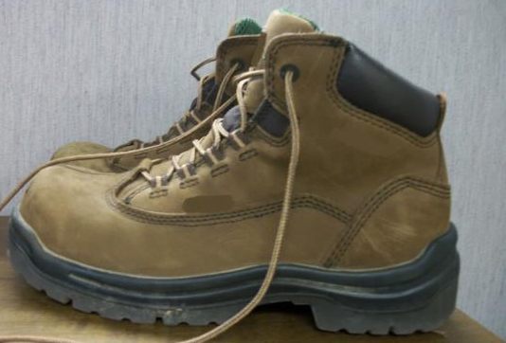
Foot Protection
1926.96
Safety-toe footwear for employees shall meet requirements and specifications in ANSI Z41.1-1967, Men’s Safety-Toe Footwear
NCDOL Photo Library
NCDOL Photo Library

Slide 26
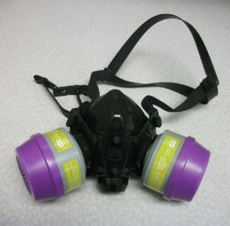
Respiratory Protection
1926.103
Identical to 29 CFR 1910.134
  Written program
  Medical evaluation
  Fit testing
  Selection and use
  Maintenance and care
  Training
  Program evaluation
  Recordkeeping
NCDOL Photo Library

Slide 27
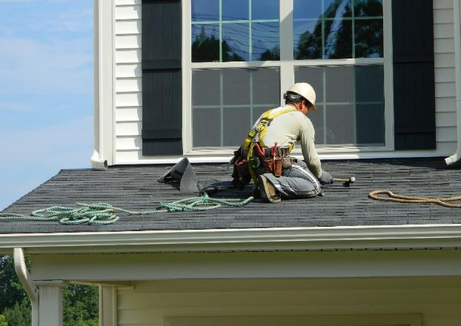
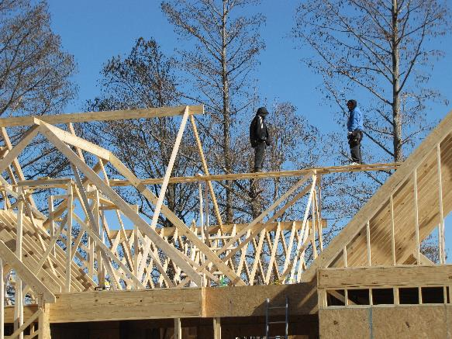
Safety Belts, Lifelines, Lanyards
1926.104(b)
Lifelines shall be secured above the point of operation to an anchorage or structural member
Minimum dead weight of 5,400 pounds
NCDOL Photo Library
NCDOL Photo Library

Slide 28
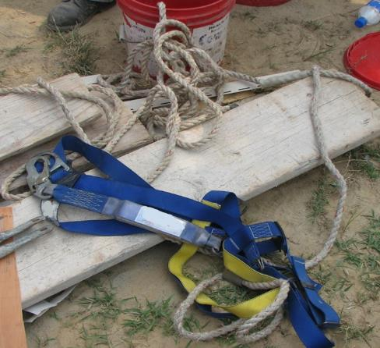
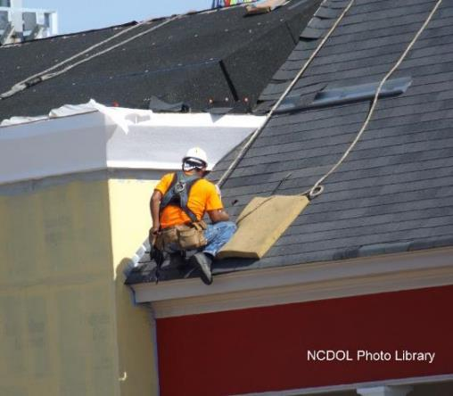
Safety Belts, Lifelines, Lanyards
1926.104(d)
Safety belts and lanyard shall be a minimum of ½-inch nylon, or equivalent
  A fall no greater than 6 feet
Nominal breaking strength of 5,400 pounds
NCDOL Photo Library

Slide 29
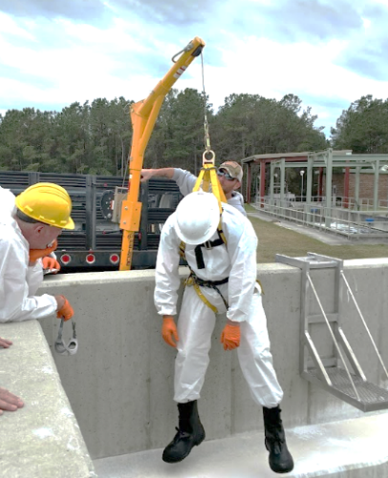
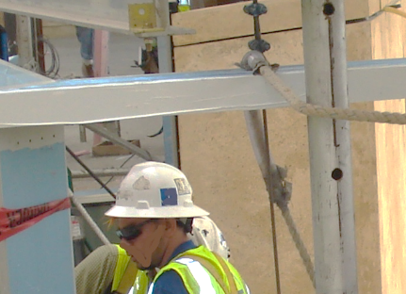
Safety Belts, Lifelines, Lanyards
1926.104(e)
All safety belts and lanyard hardware shall be drop forged or pressed steel, cadmium plated in accordance with Type 1, Class B plating specified in Federal Specification QQ-P-416
Surface shall be smooth and
free of sharp edges
NCDOL Photo Library
NCDOL Photo Library

Slide 30
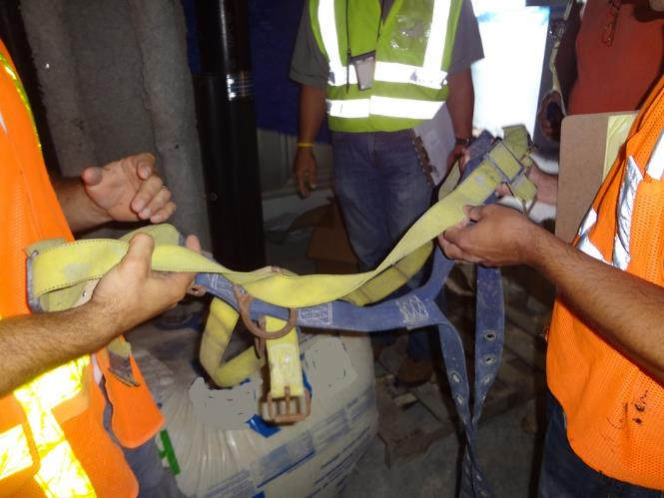
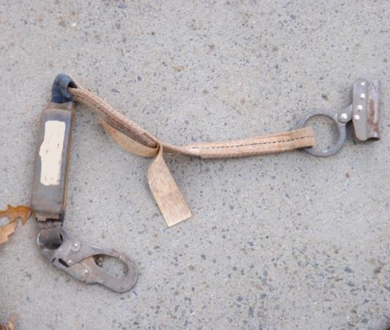
Safety Belts, Lifelines, Lanyards
1926.104(f)
All safety belts and lanyard hardware, except rivets, shall be capable of withstanding a tensile loading of 4,000 pounds without cracking, breaking, or taking a permanent deformation
NCDOL Photo Library
NCDOL Photo Library

Slide 31
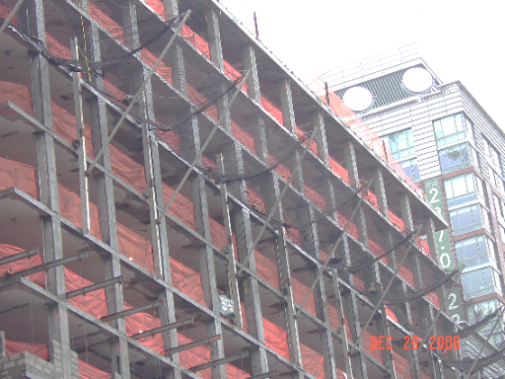
Safety Nets
1926.105(a)-(b)
Safety nets shall be provided when workplaces are more than 25 feet above ground, water surface, or other surfaces where use of ladders, scaffolds, catch platforms, temporary floors, safety lines, or safety belts are impractical
Where safety net protection
is required by this part,
operations shall not be
undertaken until net is in
place and has been tested
NCDOL Photo Library

Slide 32
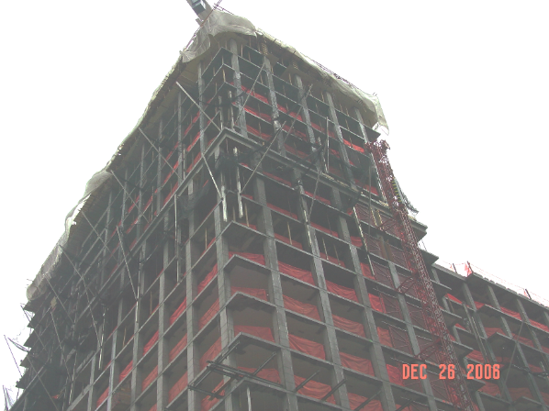
Safety Nets
1926.105(c)
Nets shall extend 8 feet beyond edge of the work surface where employees are exposed and shall be installed as close under the work surface as practical
  It is intended that only one level of nets be required for bridge construction
NCDOL Photo Library

Slide 33
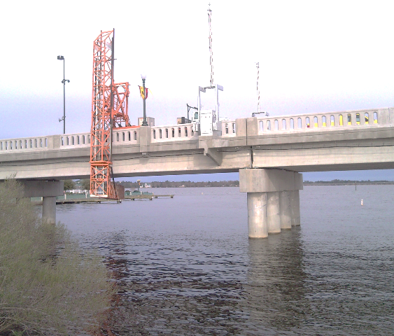
Working Over or Near Water
1926.106(a)-(d)
Life jacket or buoyant work vests must be U.S. Coast Guard approved
  Prior to and after each use, buoyant work vests or life preservers shall be inspected for defects
  Ring buoys shall be provided for rescue operations
  Lifesaving skiff shall be
  immediately available
NCDOL Photo Library

Slide 34

Summary
In this course, we covered the following:
General provisions of the standard
Basic hazard categories
Identification of hazard sources and personal protective equipment (PPE)
NCDOL Photo Library

Slide 35
Thank You For Attending!
Final Questions?
1-800-NC-LABOR
(1-800-625-2267)
www.labor.nc.gov

