Slide 1
N.C. Department of Labor
OSH Division
Multi-Employer Worksites
Notes:
Revised 06/16/25
The information in this presentation is provided voluntarily by the N.C. Department of Labor, Education Training and Technical Assistance Bureau as a public service and is made available in good faith. This presentation is designed to assist trainers conducting OSHA outreach training for workers. Since workers are the target audience, this presentation emphasizes hazard identification, avoidance, and control – not standards. No attempt has been made to treat the topic exhaustively. It is essential that trainers tailor their presentations to the needs and understanding of their audience.
The information and advice provided on this Site and on Linked Sites is provided solely on the basis that users will be responsible for making their own assessment of the matters discussed herein and are advised to verify all relevant representations, statements, and information.
This presentation is not a substitute for any of the provisions of the Occupational Safety and Health Act of North Carolina or for any standards issued by the N.C. Department of Labor. Mention of trade names, commercial products, or organizations does not imply endorsement by the N.C. Department of Labor.

Slide 2
Objectives
At the end of this course, students will be able to:
  Distinguish between a creating, correcting, controlling, and exposing employer.
  Recognize the responsibility as a creating, correcting, or controlling employer versus an exposing employer.
  Discuss the applicable rules governing OSH citing employers who do not have their employees exposed to the hazard.
NCDOL Photo Library
NCDOL Photo Library

Slide 3
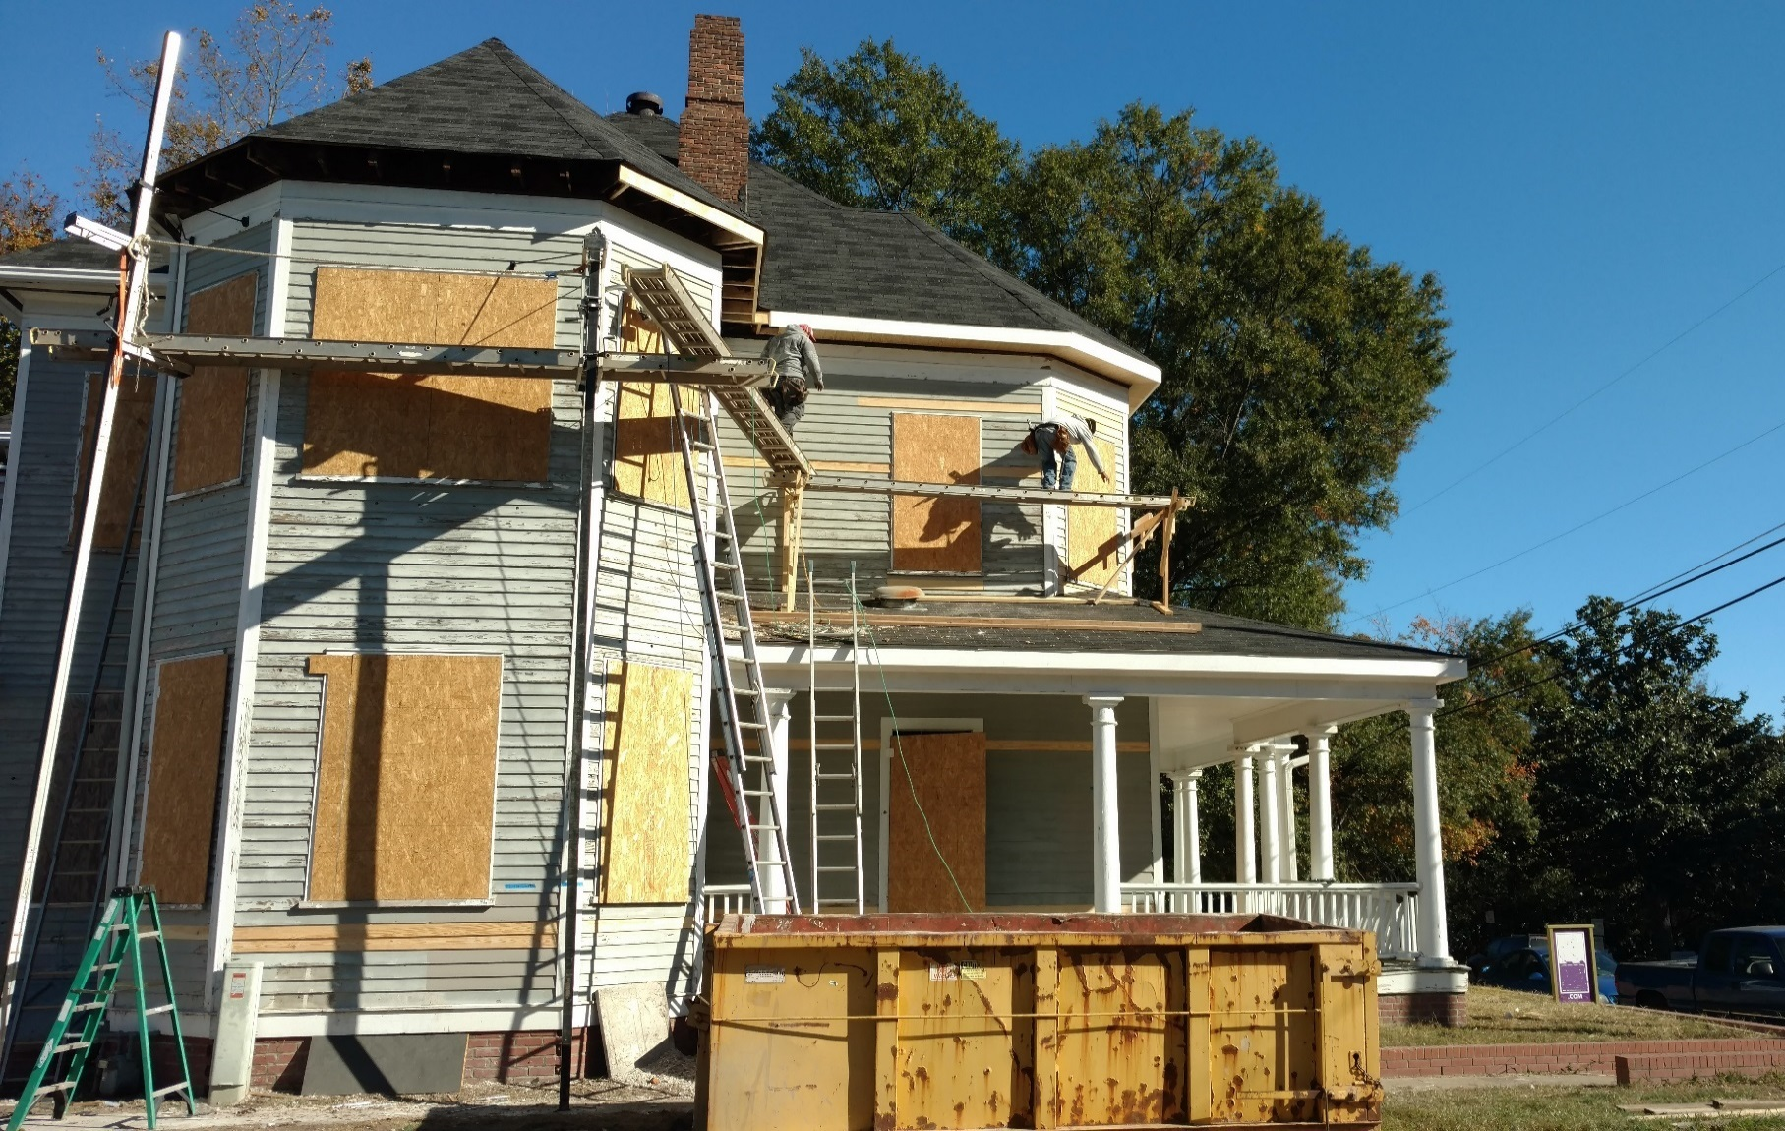
Spot the site condition for knowledge
Guardrail?
NCDOL Photo Library

Slide 4
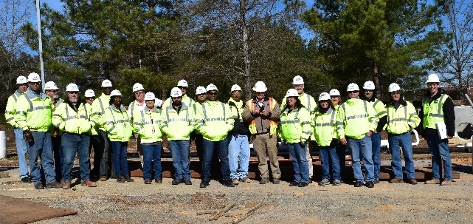
Cited Employer’s “Knowledge”
Every cited employer must have knowledge
  Actual knowledge of the condition, or
  Potential knowledge of the condition.
    Employer exercised reasonable diligence if:
      1926.20(b)(1) – Accident prevention programs
      1926.20(b)(2) – Jobsite inspections
      1926.20(b)(3) – Prohibit the use of unsafe tools
      1926.21(b)(4) – Safety training
NCDOL Photo Library

Slide 5
NC Field Operations Manual (FOM)
In addition to the exposing employer, the following employers can be cited:
  The creating employer,
  The controlling employer, and/or
  The correcting employer.
NCDOL Photo Library

Slide 6
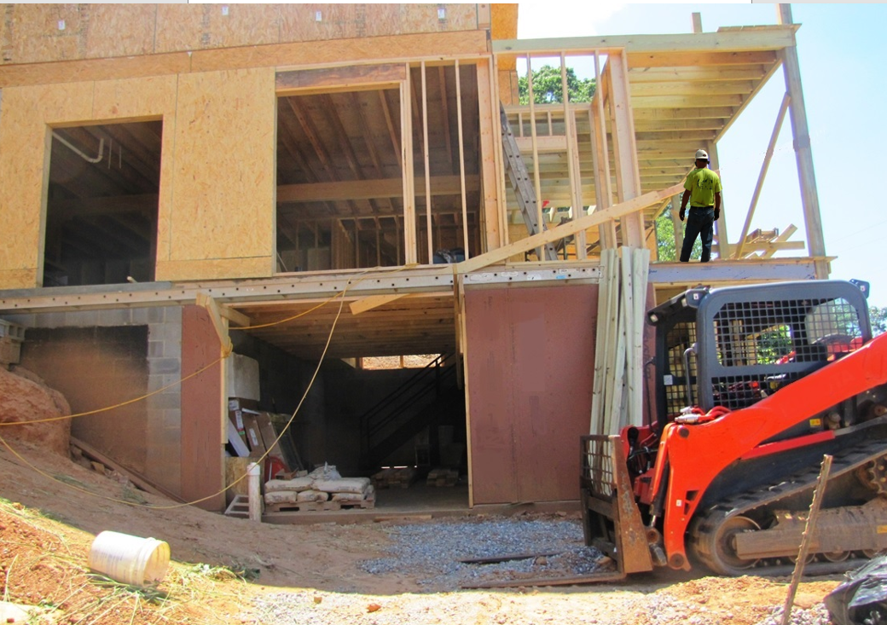
What is the hazard?
NCDOL Photo Library

Slide 7
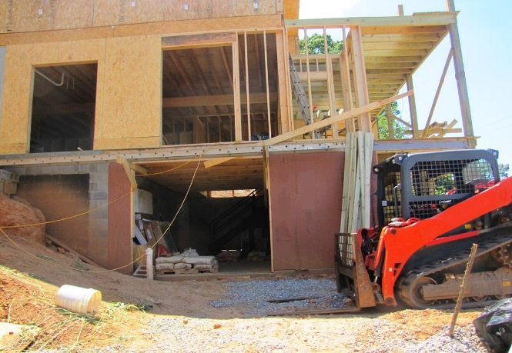
Controlling Employer
Employer who is responsible, by contract or through actual practice, for safety and health conditions on the worksite (i.e., employer who has the authority for ensuring that the hazardous condition is corrected).
  Example: By your lack of action for replacement of guardrails on a work order, employees are exposed to a fall of 6 feet or more above a lower level.
NCDOL Photo Library

Slide 8

Controlling Employer
NCDOL Photo Library

Slide 9
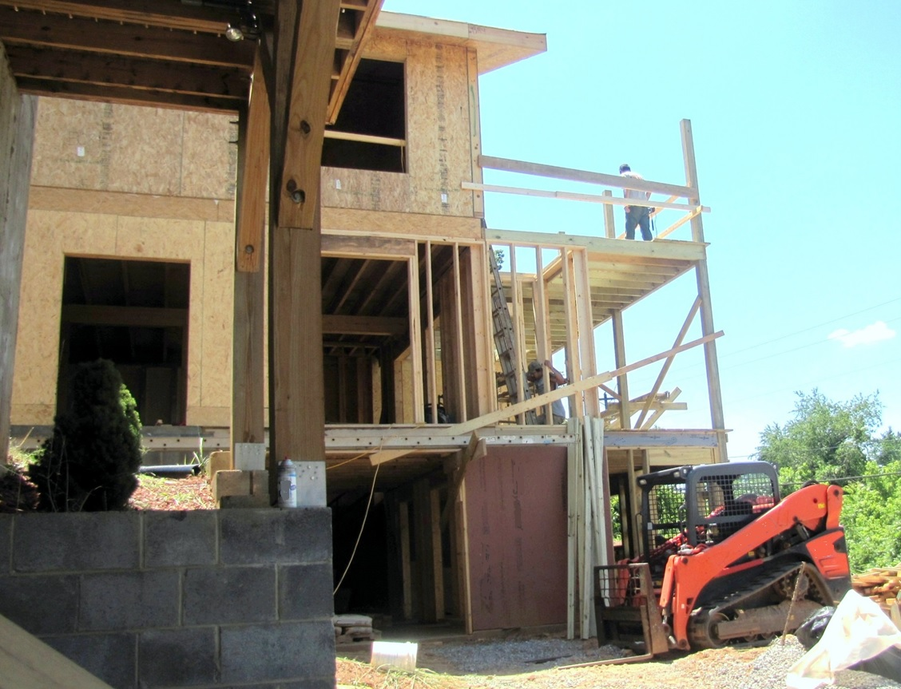
Controlling Employer
NCDOL Photo Library

Slide 10
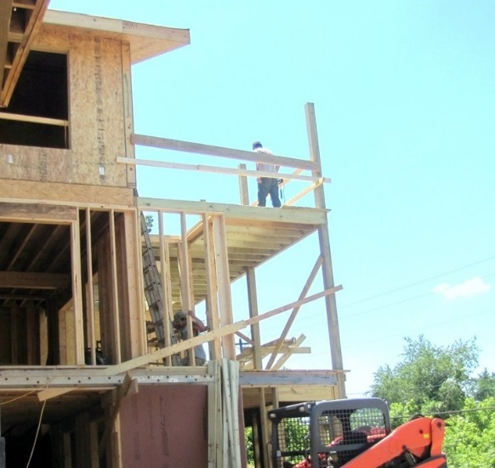
Correcting Employer
Employer who has the responsibility for actually correcting the hazard.
  Example: By your lack of replacing the guardrails, an employee is exposed to a fall of 6 feet or more above a lower level.
  Correcting employer may have no employees exposed.
NCDOL Photo Library

Slide 11

Correcting Employer
NCDOL Photo Library

Slide 12
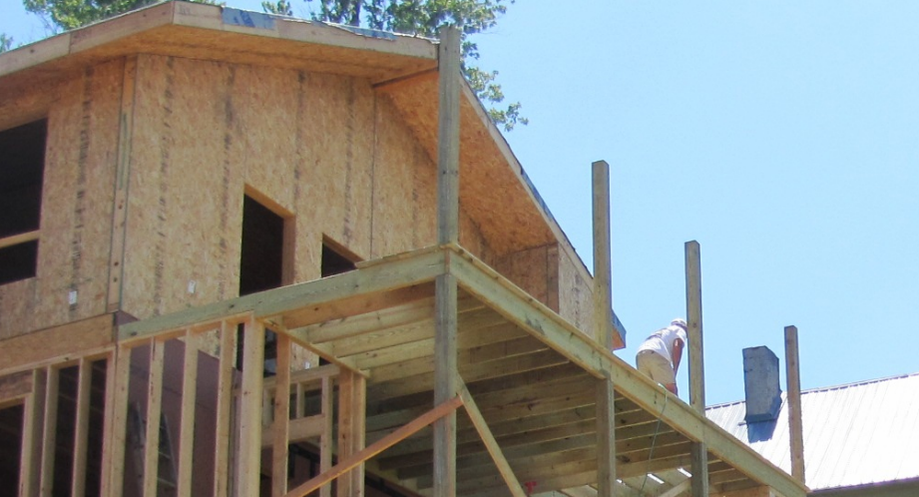
Creating Employer
Employer that caused a hazardous condition that violates an OSHA standard.
  Example: By your lack of authorizing the placement of guardrails that were not installed during construction can expose your employees to a fall of 6 feet or more above a lower level.
  .
  Creating employer may have no employees exposed.
NCDOL Photo Library

Slide 13
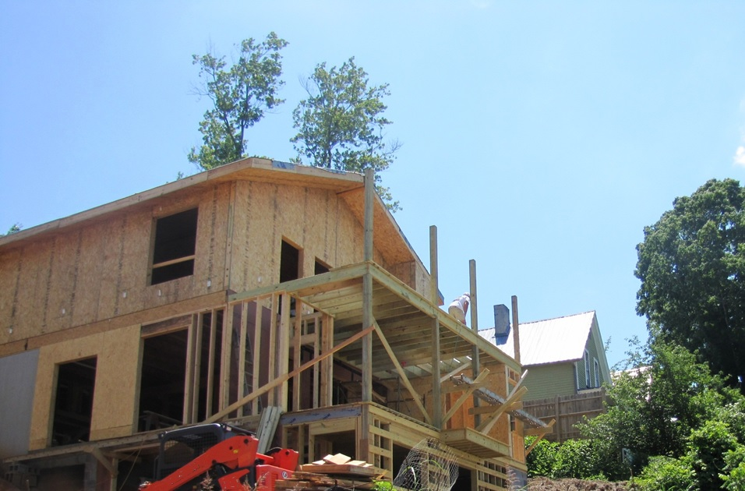
Creating Employer
NCDOL Photo Library

Slide 14
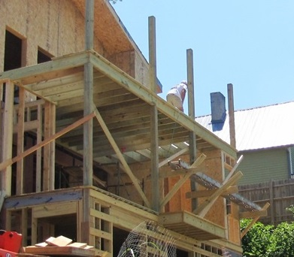
Exposing Employer
An employer whose own employees are exposed to the hazard.
  Example: Your employee may be exposed to a fall while building the upper decks which is more than 6 feet above a lower level with unprotected sides or edges; prohibited by 1926.501(b)(1).
    Exposing employer is the employer most frequently cited on an inspection.
NCDOL Photo Library

Slide 15
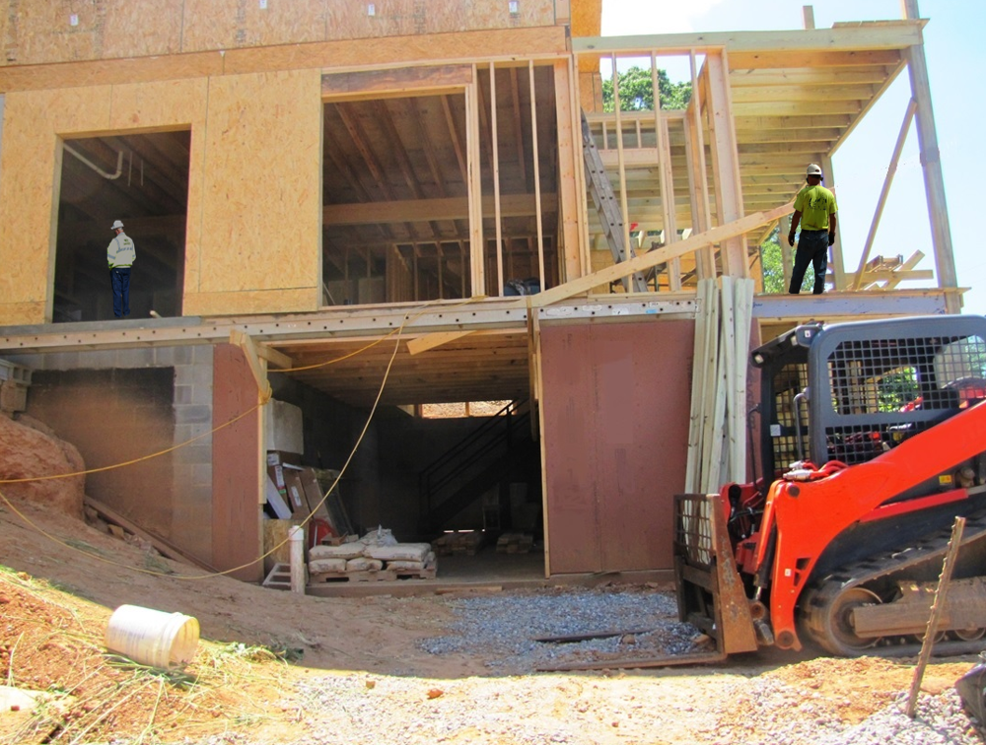
Exposing Employer
Plumber
Carpenter
NCDOL Photo Library

Slide 16


Legitimate Defense for Exposing Employer
Employer did not create the hazard.
Employer did not have responsibility or authority to have the hazard corrected.
Employer did not have the ability to correct or remove the hazard.
Electrical Contractor
NCDOL Photo Library

Slide 17
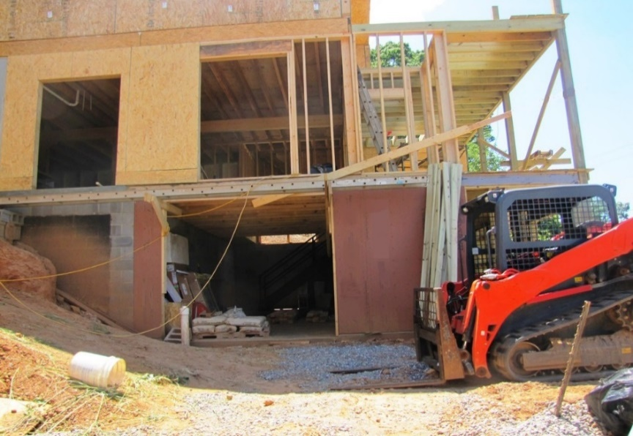
Legitimate Defense for Exposing Employer
Employer can demonstrate that controlling, creating, and/or correcting employers were notified of the hazard.
Employer has instructed their employees to recognize the hazard and how to avoid it.
Electrical Contractor
NCDOL Photo Library

Slide 18
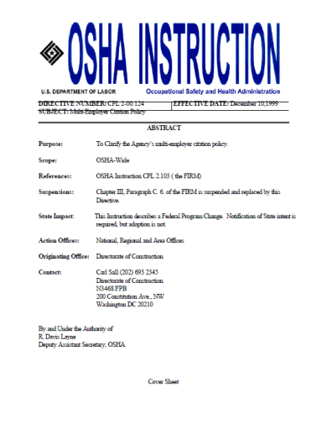
Can a Non-Exposing Employer be Cited?
Cited employer must have knowledge.
  Potential or actual knowledge
Under the General Duty Clause (GDC)
  Only employers whose own employees are exposed will be cited under GDC.
Reliance on CPL 2-00.124 guidance
  Simultaneous employer roles
NCDOL Photo Library

Slide 19

Can a Non-Exposing Employer be Cited?
Judgment of the CSHO: Did the employer…
  Conduct periodic inspections?
  Implement effective system(s) for correcting hazards?
  Enforce the other employer’s compliance with safety and health requirements?
NCDOL Photo Library

Slide 20
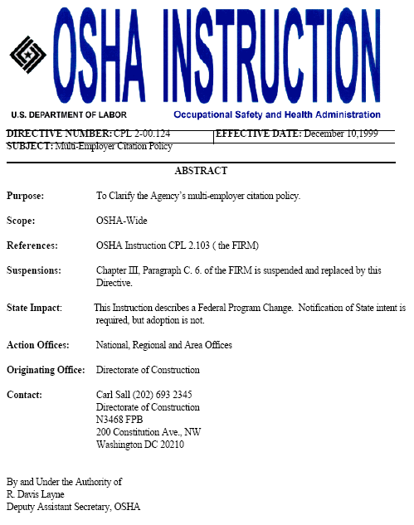
Multi-Employer Citation Policy
CPL 2-0.124 – December 10, 1999
  Established clearer guidance
  Established a two-step determination process
NCDOL Photo Library

Slide 21
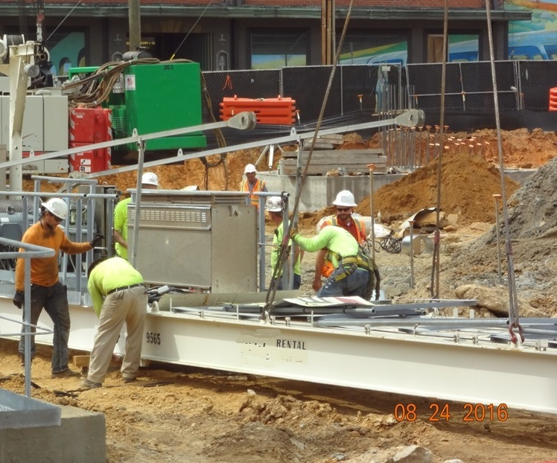
Multi-Employer Worksites
Two-step determination process
  Determine if the employer is creating, exposing, correcting or controlling.
  Determine if the employer’s actions are sufficient to meet OSHA requirements.
    Especially exposing employer
NCDOL Photo Library

Slide 22
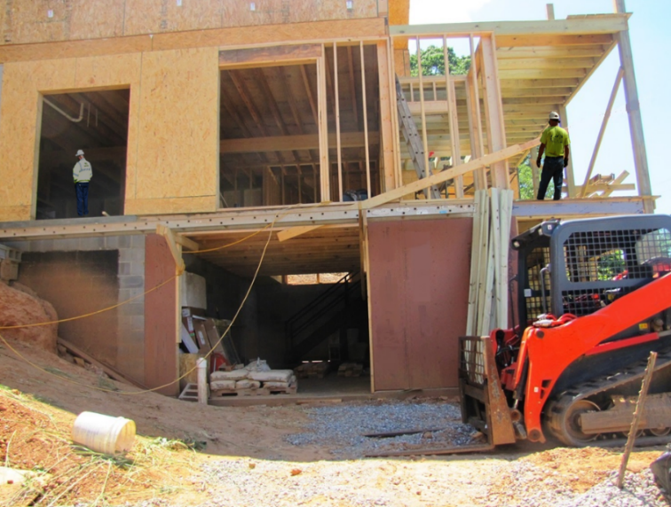
Multi-Employer Worksites
Creating employer
  Caused the hazardous condition
  Can be cited even if none of their own employees are exposed to the hazardous conditions
  If employer had knowledge
Carpenter
NCDOL Photo Library

Slide 23
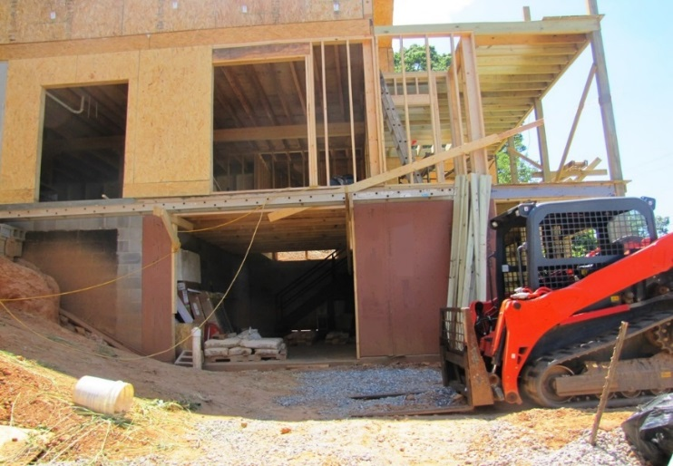

Multi-Employer Worksites
Exposing employer
  Own employees exposed
  Failed to take steps to protect their employees
    Asked the creating/correcting/controlling employer to correct the hazard.
    Informed their own employees of the hazard.
    Provided alternative protection.
Electrical Contractor
NCDOL Photo Library

Slide 24
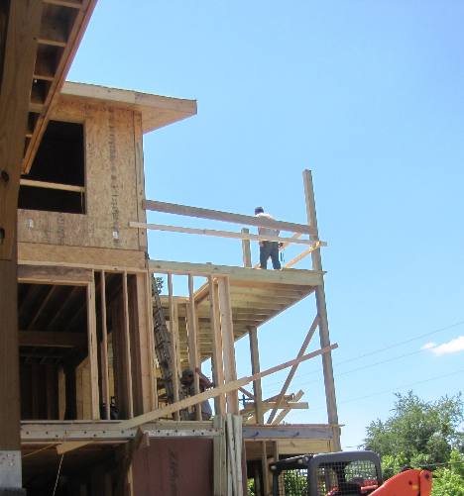
Multi-Employer Worksites
Correcting employer
  Responsible for correcting the hazard
  Can be cited even if none of their own employees are exposed to the hazardous condition
  If employer had knowledge
Carpenter Contractor
Knowledge
or
Potential Knowledge!
NCDOL Photo Library
NCDOL Photo Library

Slide 25
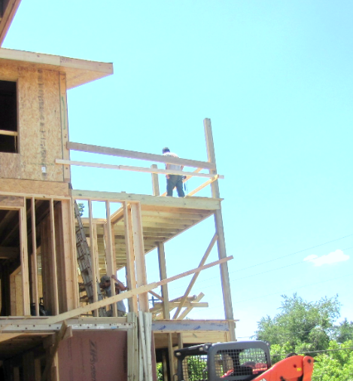
Multi-Employer Worksites
Controlling employer
  General supervision and authority at the worksite
  Power to correct hazards
  Power to require other employers to correct hazards
  Exercises reasonable care to prevent and detect hazards
NCDOL Photo Library

Slide 26

Multi-Employer Worksites
Controlling employers
  Evaluation of “reasonable care”
  Periodic and effective project inspections
  Implemented an effective system for hazard correction
  Enforces other controlled employers’ safety and health requirements
  Follow-up inspections to ensure hazard is corrected
    29 CFR 1926.20(b)(2), The employer shall provide for
  frequent and regular inspections of the job sites,
  materials, and equipment to be made by
  competent persons designated by the employers.
NCDOL Photo Library

Slide 27
Summary
In this course, we:
  Distinguished between the creating, correcting, controlling, and exposing employers.
  Recognized the responsibility as a creating, correcting, or controlling employer versus an exposing employer.
  Discussed the applicable rules governing OSH citing employers who do not have their employees exposed to the hazard.

Slide 28
Thank You For Attending!
Final Questions?

