Slide 1
Materials Handling and Storage
29 CFR 1910.176 - Handling Materials – General
29 CFR 1910.184 - Slings
Notes:
Rev 06/25
The information in this presentation is provided voluntarily by the N.C. Department of Labor, Education Training and Technical Assistance Bureau as a public service and is made available in good faith. This presentation is designed to assist trainers conducting OSHA outreach training for workers. Since workers are the target audience, this presentation emphasizes hazard identification, avoidance, and control – not standards. No attempt has been made to treat the topic exhaustively. It is essential that trainers tailor their presentations to the needs and understanding of their audience.
The information and advice provided on this Site and on Linked Sites is provided solely on the basis that users will be responsible for making their own assessment of the matters discussed herein and are advised to verify all relevant representations, statements, and information.
This presentation is not a substitute for any of the provisions of the Occupational Safety and Health Act of North Carolina or for any standards issued by the N.C. Department of Labor. Mention of trade names, commercial products, or organizations does not imply endorsement by the N.C. Department of Labor.

Slide 2
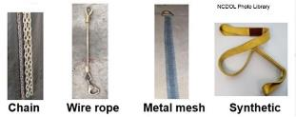
Objectives
After this course, students will be able to:
  Identify general material handling requirements.
    Secure storage, housekeeping, clearance limits, rolling railroad cars and guarding.
  Summarize sling requirements
    Scope, definitions, safe operating practices, inspections, alloy chain slings, wire rope slings, metal mesh slings, natural and synthetic fiber rope slings and synthetic web slings.

Slide 3
Amputations Special Emphasis Program
Goal to reduce occupational exposures to amputations.
Struck by and caught between injuries.
  Lockout/tagout
  Machine guarding
Increase outreach to employers and employees.
  Training events (Internal and external)
  Compliance inspections
  Consultation visits
  Publications
Amputations must be reported within 24 hours.

Slide 4
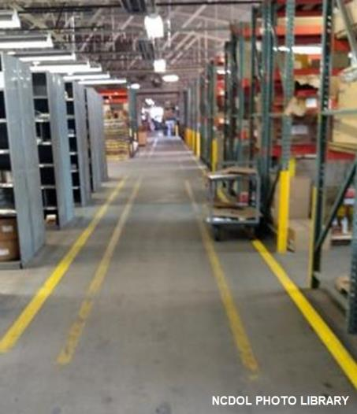
Handling Materials
1910.176(a)
General
  Where mechanical equipment is used, sufficient safe clearances shall be maintained.
    Aisles
    Loading docks
    Through doorways
    Turns of passage

Slide 5
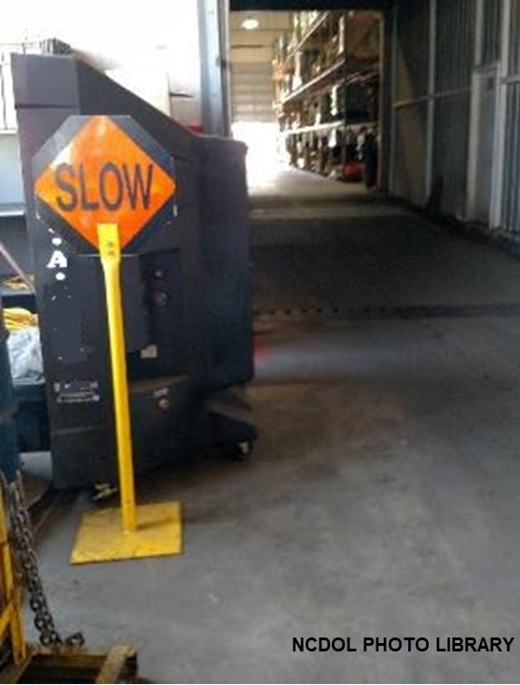
Handling Materials
1910.176(a)
General
  Aisles and passageways shall be kept clear and in good repair.
Notes:
5

Slide 6
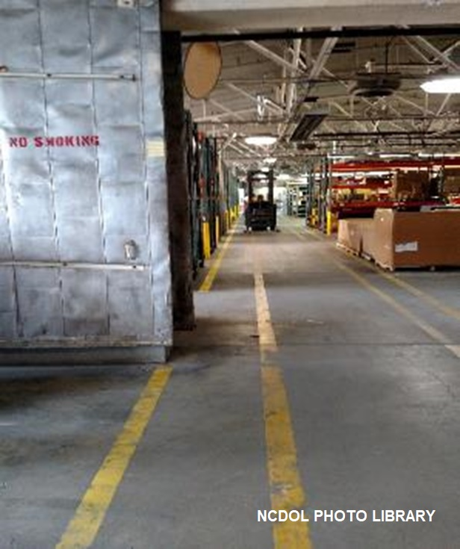
Handling Materials
1910.176(a)
General
  Permanent aisles and passageways shall be marked.

Slide 7
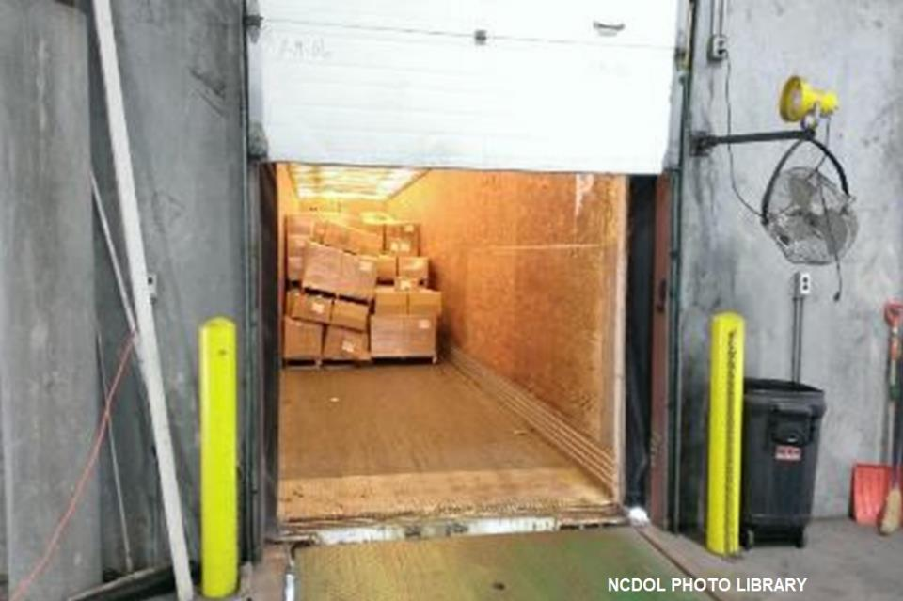
Secure Storage
1910.176(b)
Storage of material shall not create a hazard.
Notes:
7

Slide 8
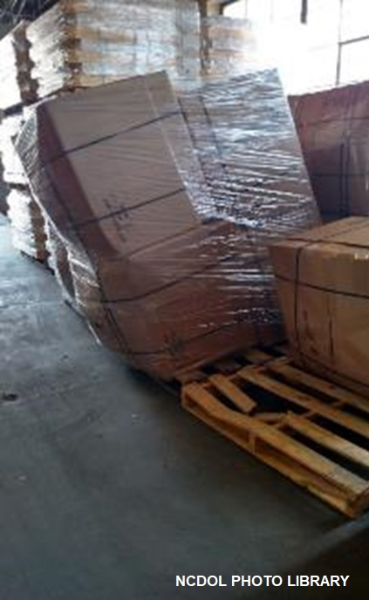
Secure Storage
1910.176(b)
Bags, containers, bundles, etc., stored in tiers
  Stacked, blocked, interlocked
  Limited in height so that they are stable
  Secure against sliding or collapse

Slide 9
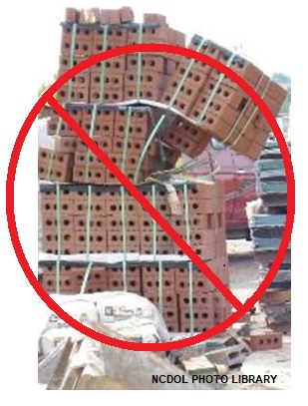
Secure Storage
1910.176(b)

Slide 10
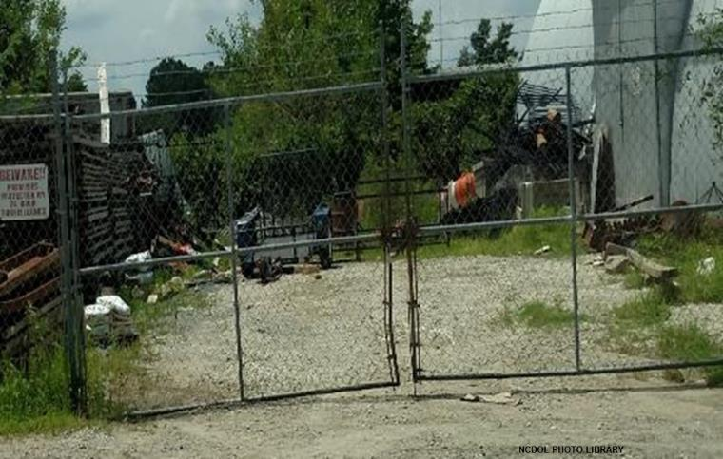
Housekeeping
1910.176(c)
Storage areas kept free from accumulation of materials that create hazards from:
  Tripping
  Fire
  Explosion
  Pest harborage
Notes:
10

Slide 11
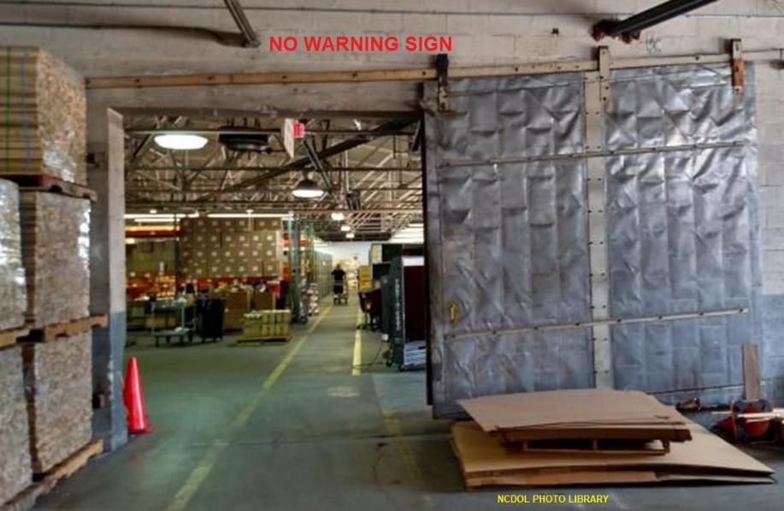
Clearance Limits
1910.176(e)
Clearance signs to warn of clearance limits shall be provided.

Slide 12
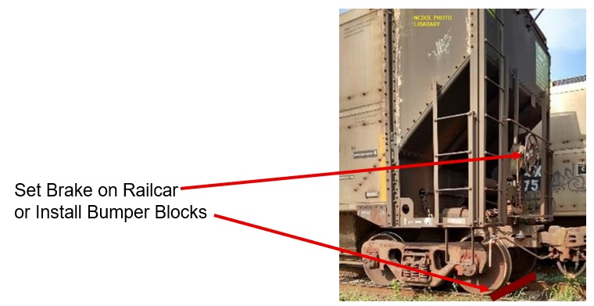
Rolling Railroad Cars 1910.176(f)
Derail and/or bumper blocks provided on spur railroad tracks:
  Where a rolling car could contact other cars being worked.
  Enter a building, work or
  traffic area.

Slide 13
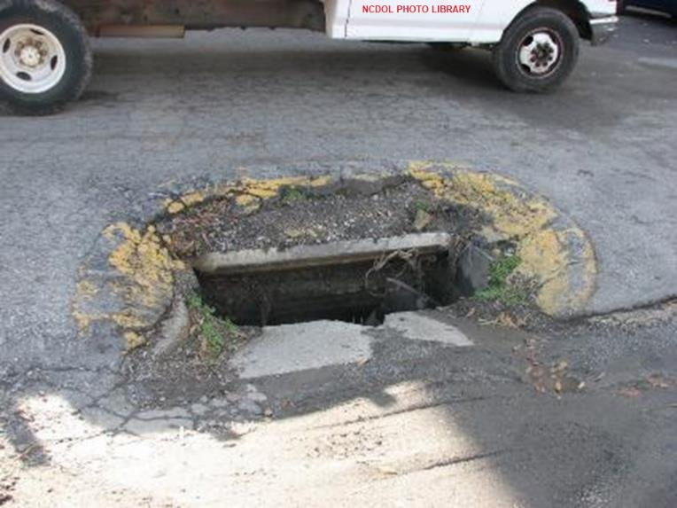
Guarding 1910.176(g)
Covers and/or guardrails provided to protect personnel from the hazards of open pits, tanks, vats, ditches, etc.

Slide 14
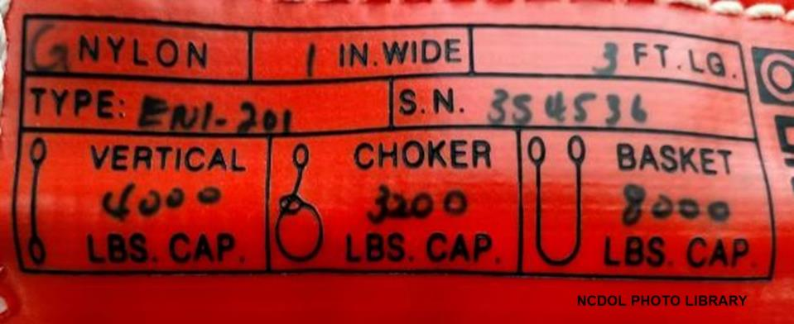
Slings
1910.184(a)
Scope
  Applies to slings used in conjunction with other material handling equipment for the movement of material by hoisting, in employments covered by 29 CFR Part 1910.
Notes:
14

Slide 15
Rigging Equipment Slings
1910.184(a)
Types of slings covered are those made from alloy steel chain, wire rope, metal mesh, natural or synthetic fiber rope and synthetic web.
Notes:
15

Slide 16
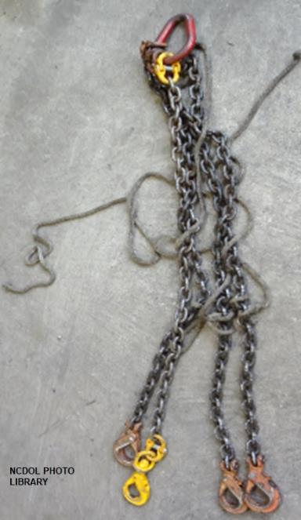
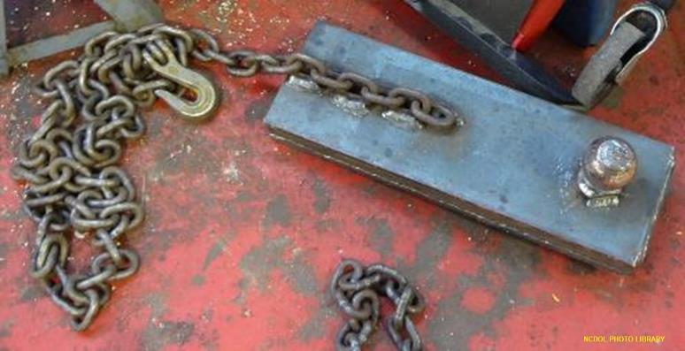
Safe Operating Practices
1910.184(c)
Slings shall not be shortened with knots or bolts or other makeshift devices.
Sling legs shall not be kinked.

Slide 17
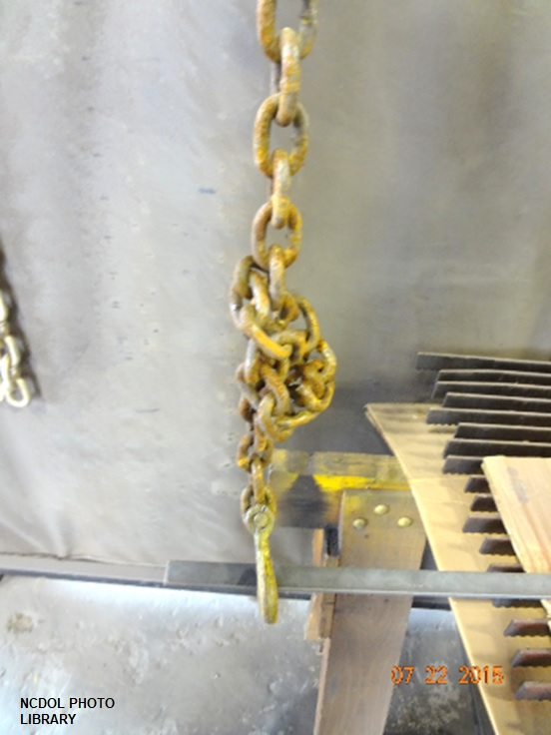
Safe Operating Practices
1910.184(c)
Slings shall not be loaded in excess of their rated capacities.
Slings that are damaged or defective shall not be used.

Slide 18
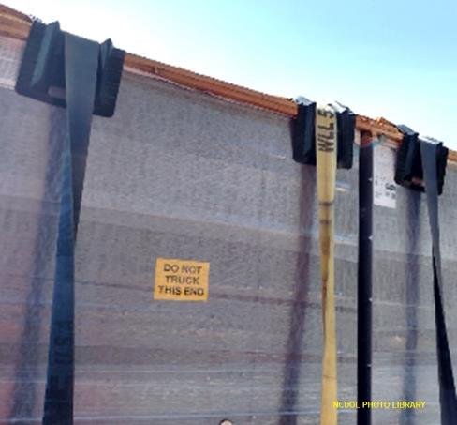
Safe Operating Practices
1910.184(c)
Slings shall be padded or protected from the sharp edges of their loads.
Hands or fingers shall not be placed between the sling and its load while the sling is being tightened around the load.

Slide 19
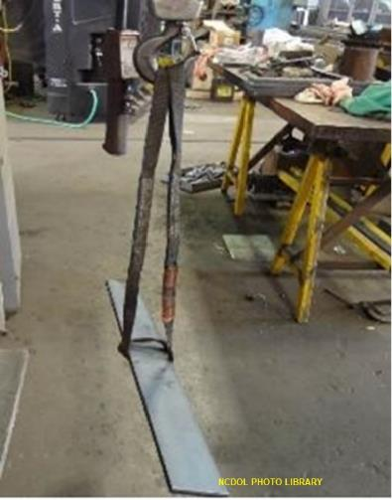
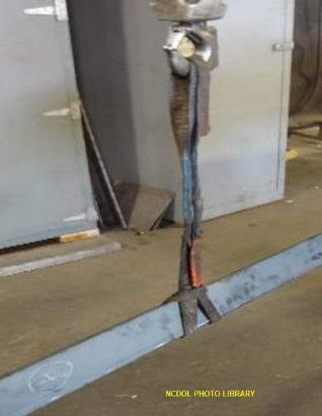
Safe Operating Practices
1910.184(c)
Slings used in a basket hitch shall have the loads balanced to prevent slippage.
Slings shall be securely attached to their loads.
Wrong
Correct

Slide 20
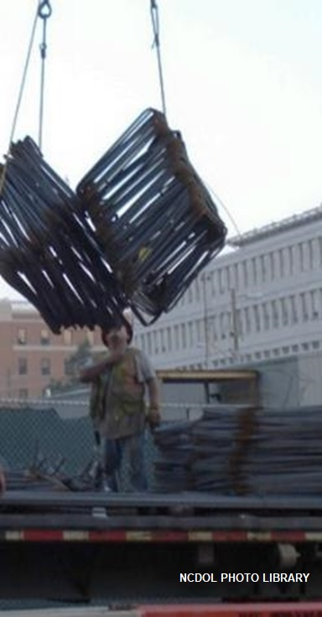
Safe Operating Practices
1910.184(c)
Suspended loads shall be kept clear of all obstructions.
Employees shall be kept clear of loads about to be lifted and of suspended loads.

Slide 21
Safe Operating Practices
1910.184(c)
Shock loading is prohibited.
A sling shall not be pulled from under a load when the load is resting on the sling.
Three factors determine the magnitude of the shock load:
  Weight of the object.
  Speed that the object is traveling before it starts to decelerate.
  Rate of deceleration (the stopping distance).

Slide 22
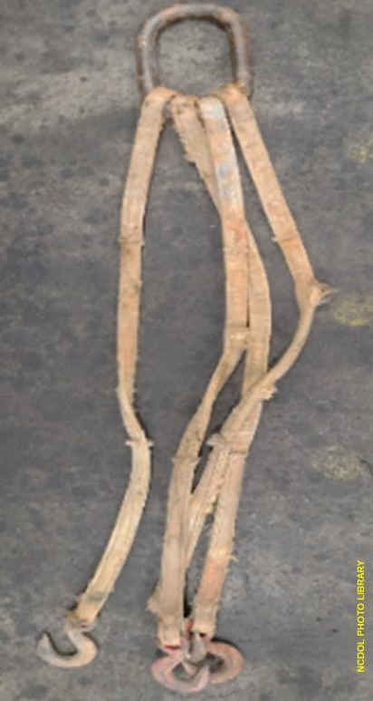
Inspections
1910.184(d)
Before being used, sling and all fastenings and attachment points inspected for damage or defects by a competent person.
Additional inspections performed as conditions warrant.
Damaged or defective slings
immediately removed from
service.

Slide 23
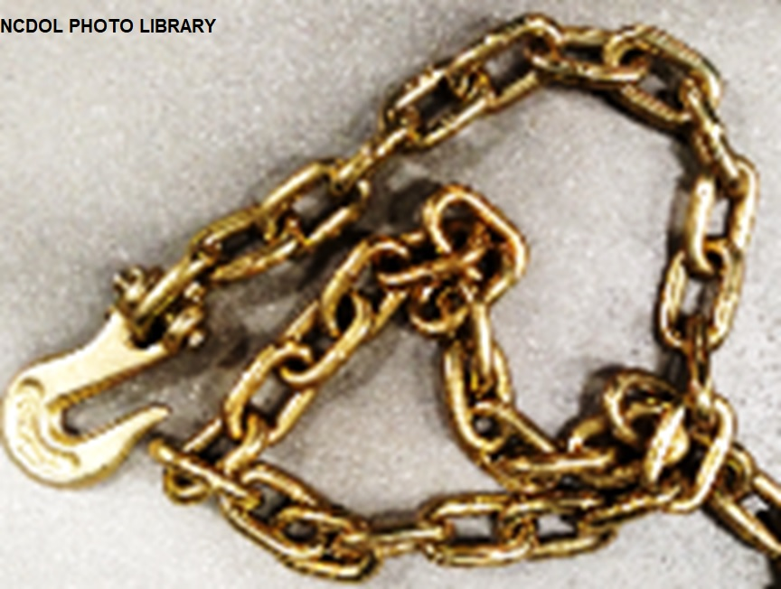
Alloy Steel Chain Grades
Grade 70 is transport chain manufactured in heat-treated carbon steel.
  Grade 70 chain is embossed with 7, 70 or 700.

Slide 24
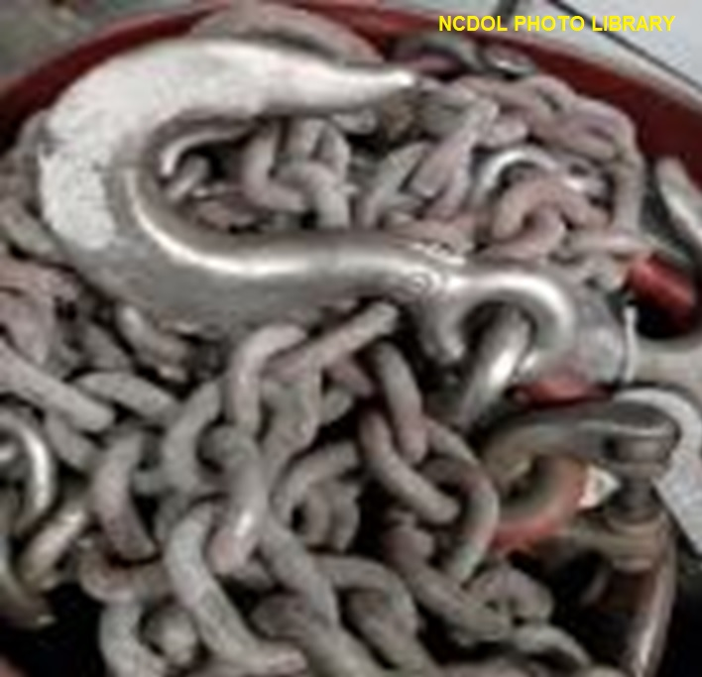
Alloy Steel Chain Grades
Grade 80 chain is a heat-treated steel chain with a high strength to weight ratio.
  Grade 80 chain is embossed with 8, 80 or 800 for identification purposes.

Slide 25
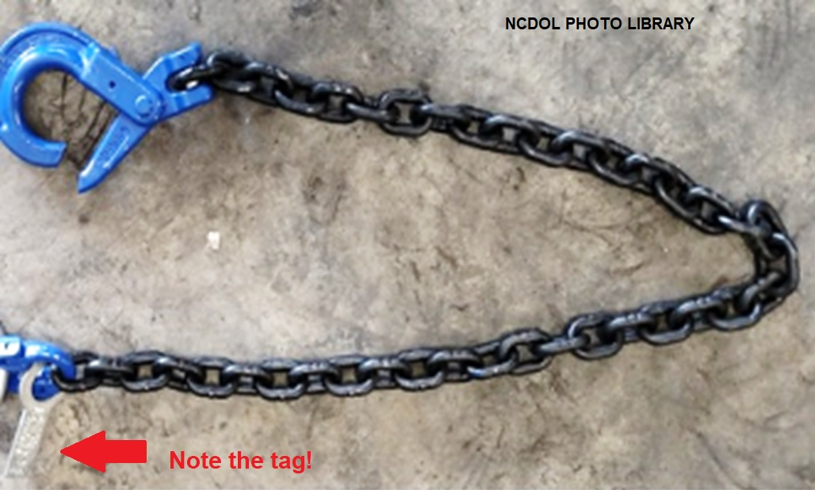
Alloy Steel Chain Grades
Grade 100 chain is a newer product and is becoming increasingly popular as a replacement for grade 80 chain.
  Grade 100 chain is embossed with 10, 100 or 1,000.

Slide 26
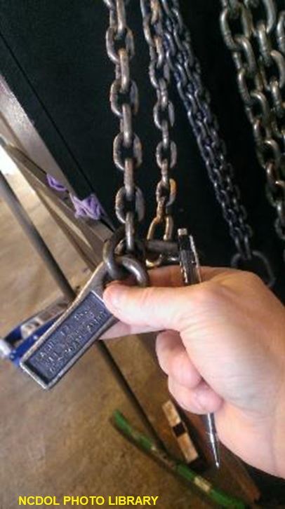
Sling Identification
1910.184(e)(1)
Alloy chain slings have permanently affixed durable identification stating:
  Size, grade, rated capacity,
  and reach
Notes:
26

Slide 27
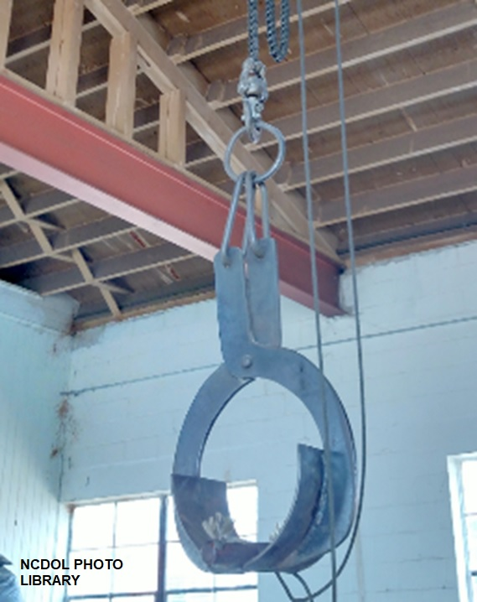
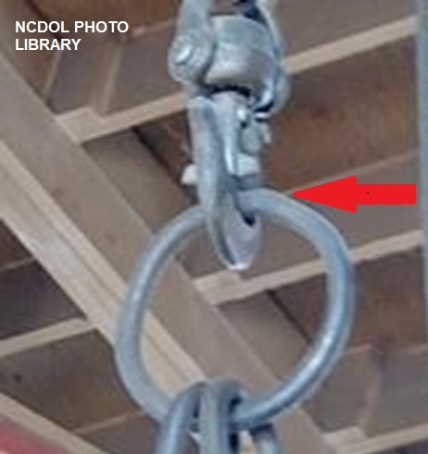
Attachments
1910.184(e)(2)
Hooks, rings, oblong links, or other attachments, when used with alloy steel chains must have a rated capacity at least equal to that of the chain.
Makeshift link or fasteners shall not be used.
Notes:
27

Slide 28
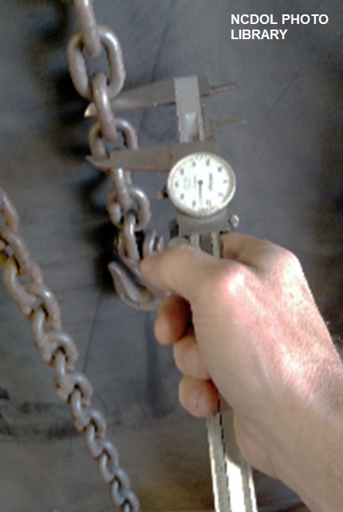
Inspections
1910.184(e)(3)(i)
In addition to the inspection required, a thorough periodic inspection shall be made on a regular basis:
  Frequency of sling use
  Severity of service conditions
  Nature of lifts being made
  Experience gained on service
  life of slings
  At least once every 12 months
Notes:
28

Slide 29
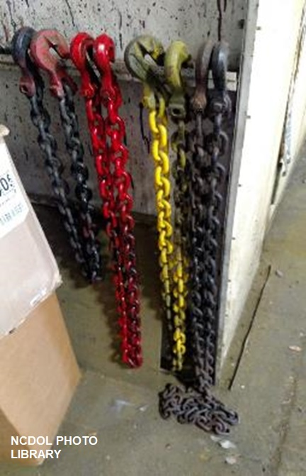
Alloy Steel Chains
1910.184(e)(3)(ii)
A record of the most recent month in which the alloy steel chain sling was thoroughly inspected must be maintained.
  Record must be available for
  examination.
Notes:
29

Slide 30
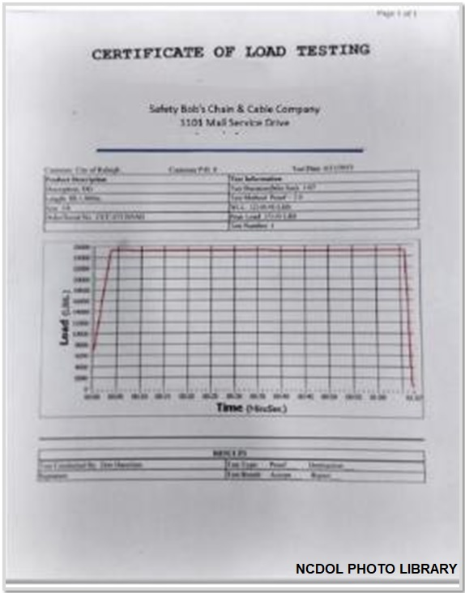

Proof Testing
1910.184(e)(4)
Employer shall retain a certificate of the proof test and shall make it available for examination.

Slide 31
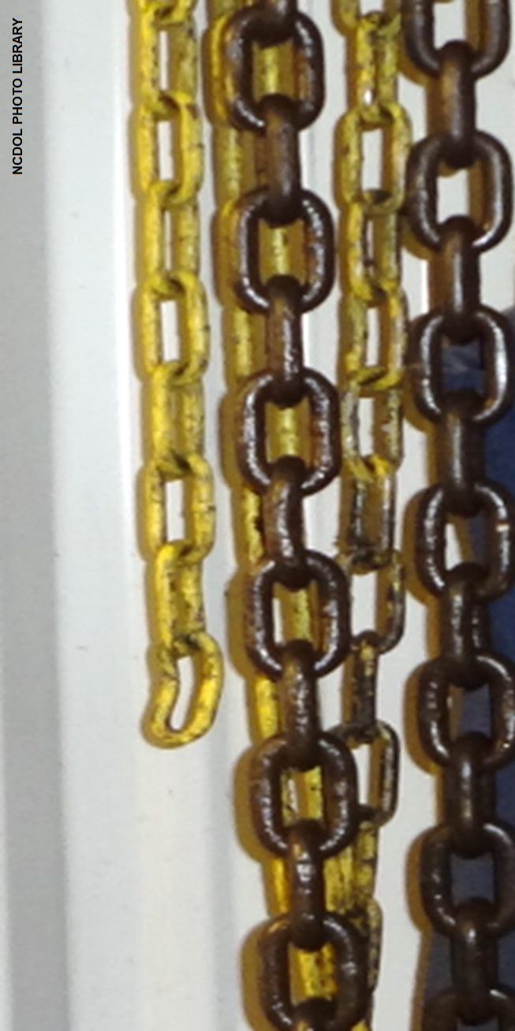
Repairing and Reconditioning
1910.184(e)(7)(i)-(ii)
Worn or damaged alloy steel chain slings or attachments shall not be used until repaired.
Mechanical couplings links or low carbon steel repair links shall not be used to repair broken links of chain.
Notes:
31

Slide 32
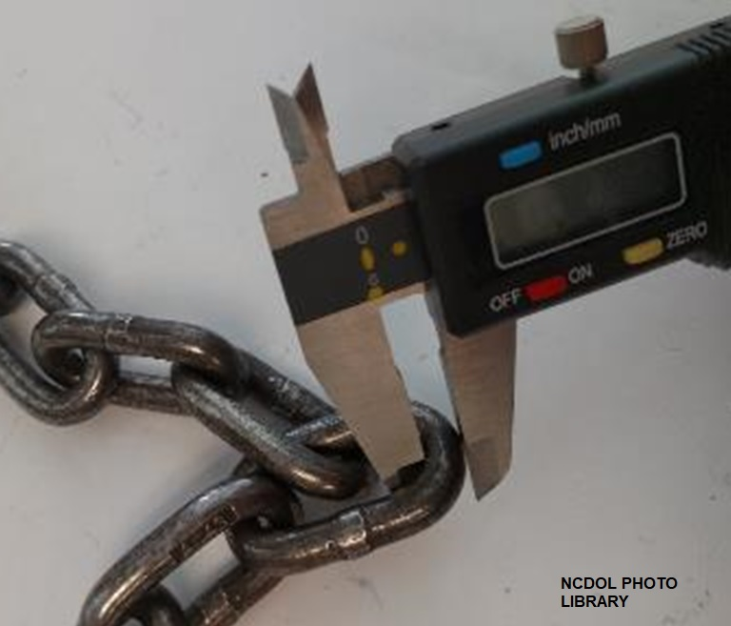
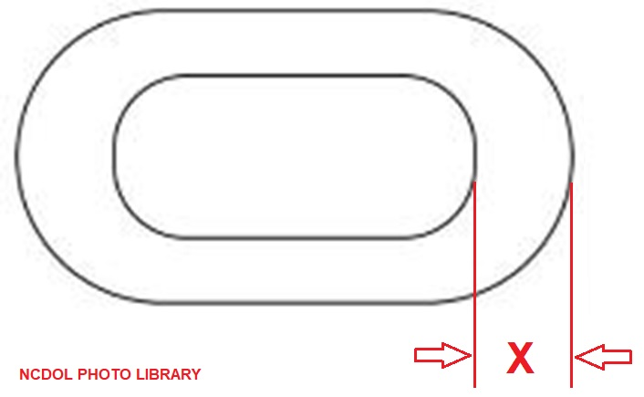
Effect of Wear
1910.184(e)(8)
If chain size at any point of any link is less than that stated in Table N-184-1:
  Sling removed from service.
Notes:
32

Slide 33
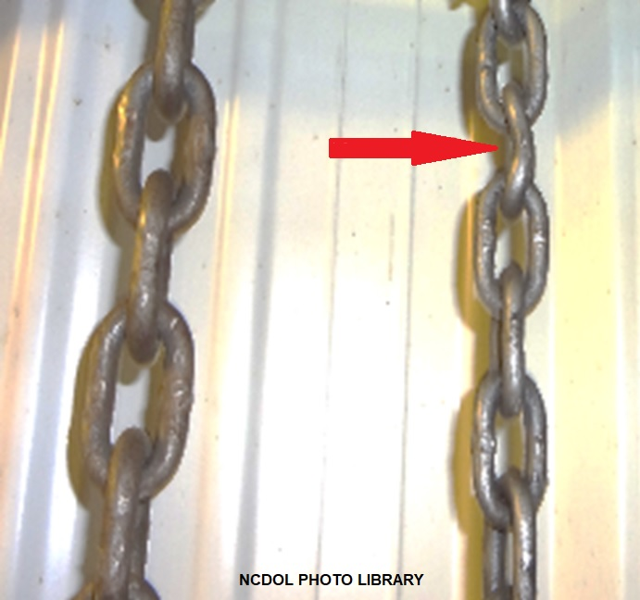
Deformed Attachments
1910.184(e)(9)(i)-(ii)
Remove from service if alloy steel chain slings have cracked or deformed master links, coupling links or other components
Notes:
33

Slide 34
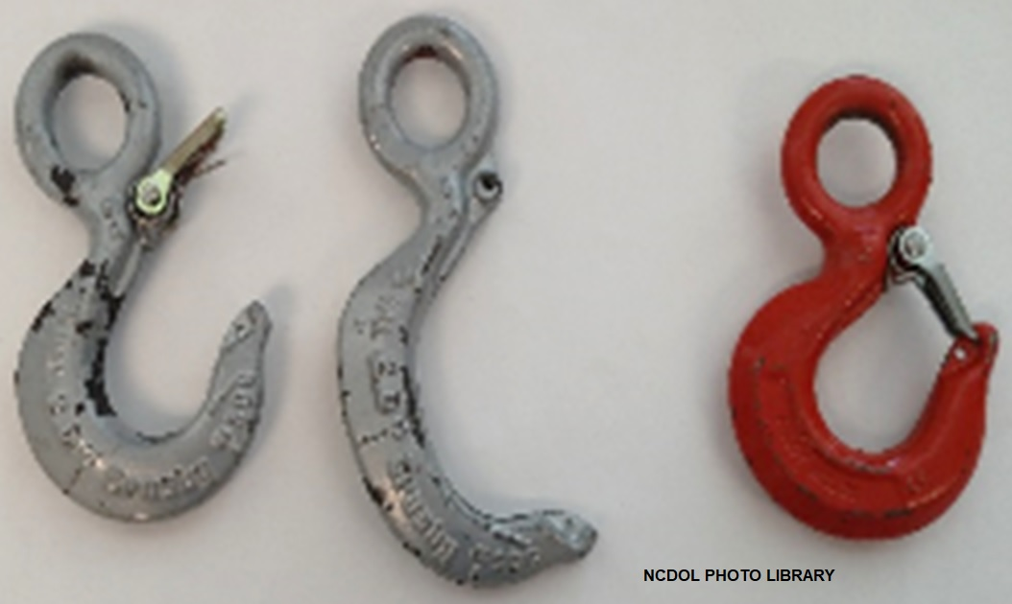
Deformed Attachments
1910.184(e)(9)(i)-(ii)
Remove from service if the hook is cracked, has been opened more than 15% of the normal throat opening measured at the narrowest point, or twisted more than 10 degrees from the plane of the unbent hook.
Notes:
34

Slide 35
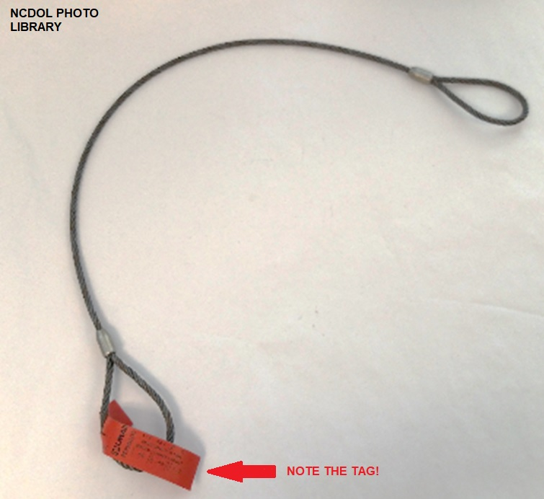
Wire Rope Slings
1910.184(f)(1)
Use only slings with permanently affixed and legible identification markings by manufacturer.
  Recommended safe working load
  Angle which it is based
  Number of legs
Notes:
35

Slide 36
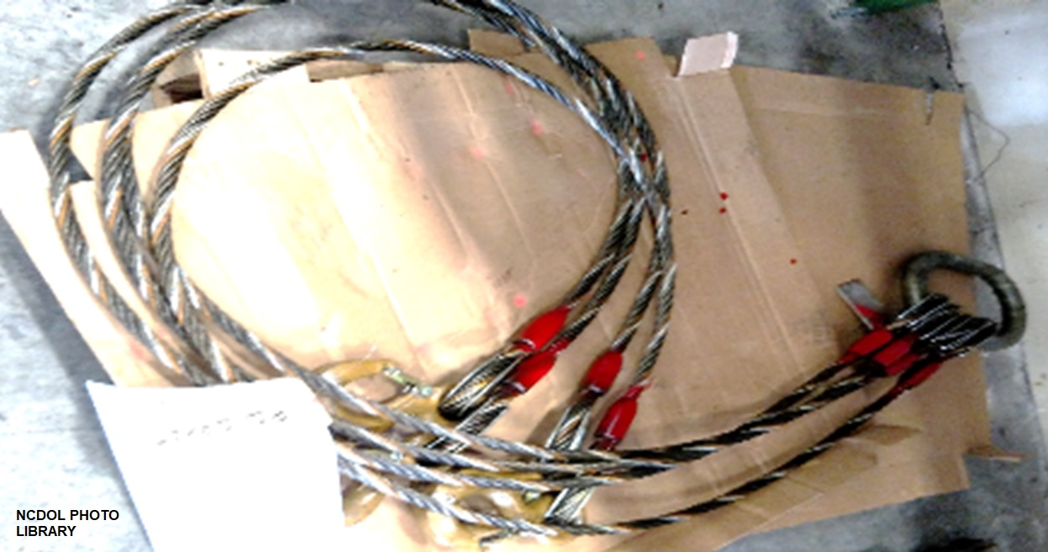
Minimum Sling Lengths
1910.184(f)(2)
Cable laid and 6x19 and 6x37 slings
  Minimum clear length of wire rope 10 times the component rope diameter between splices, sleeves or end fittings.
Notes:
36

Slide 37
Minimum Sling Lengths
1910.184(f)(2)
Braided slings shall have a minimum clear length of wire rope 40 times the component rope diameter between the loops or end fittings.
Notes:
37

Slide 38
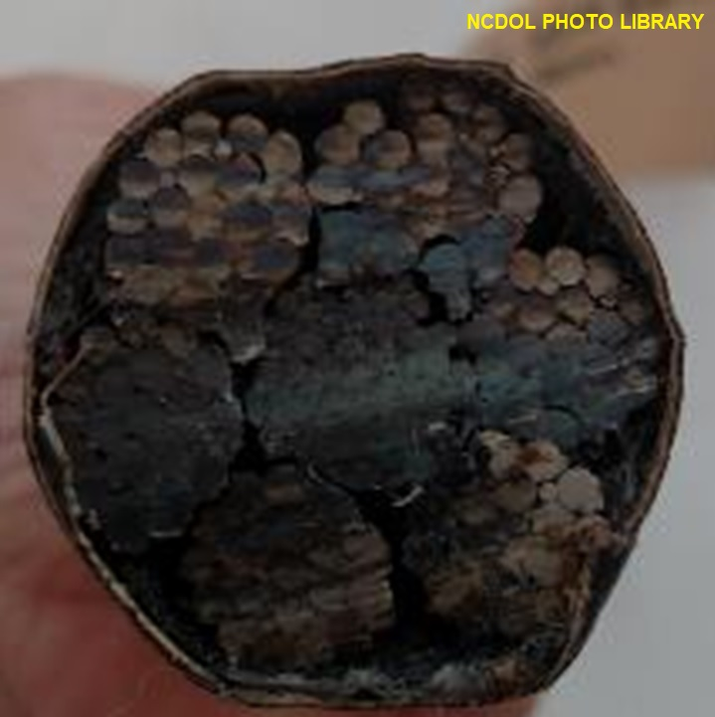
Safe Operating Temperatures
1910.184(f)(3)
Fiber core wire rope slings of all grades
  Permanently removed from service if exposed to temperatures in excess of 200 degrees F.
Non-fiber core wire rope slings of any grade
  When used at temperatures above 400 degrees F or below minus 60 degrees F.
    Recommendations of the sling manufacturer
    regarding use at that temperature followed.
Notes:
38

Slide 39
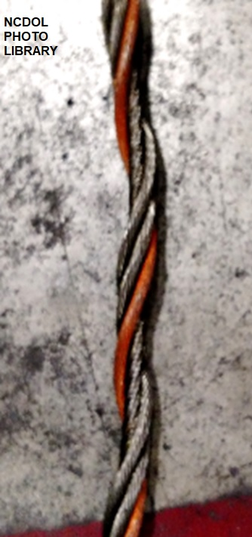
Removal From Service
1910.184(f)(5)
Ten randomly distributed broken wires in one rope lay, or five broken wires in one strand in one rope lay
Wear or scraping of one-third the original diameter of outside individual wires
Kinking, crushing, bird caging
Attachments cracked, deformed, worn
Evidence of heat
Corrosion
Notes:
39

Slide 40
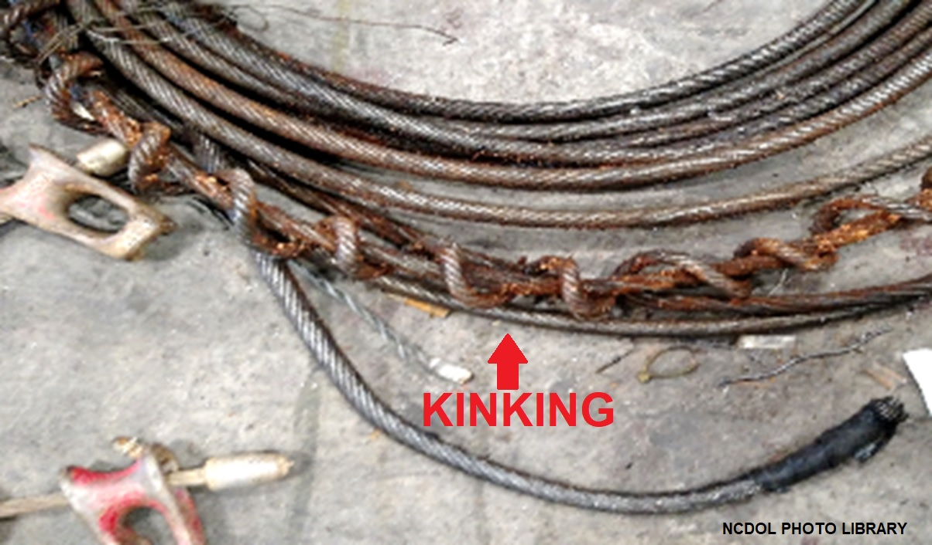
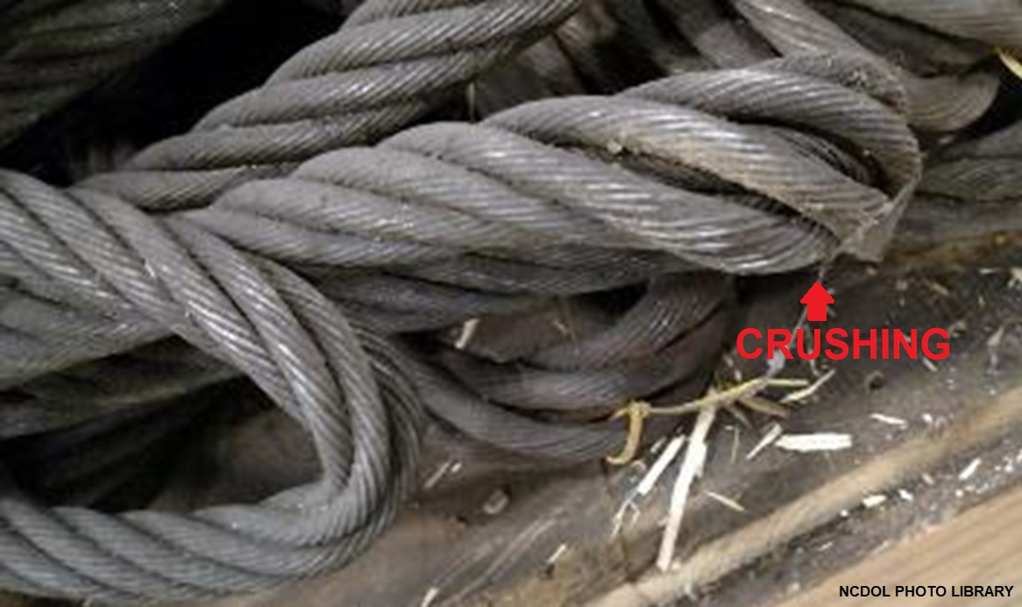
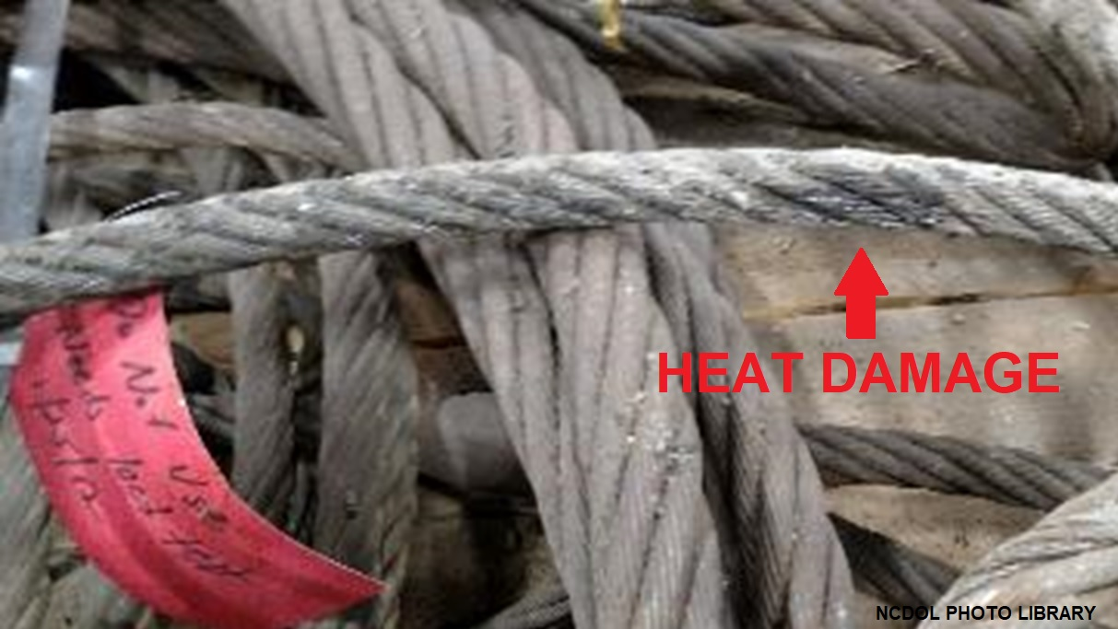
Removal From Service
1910.184(f)(5)
Notes:
40

Slide 41
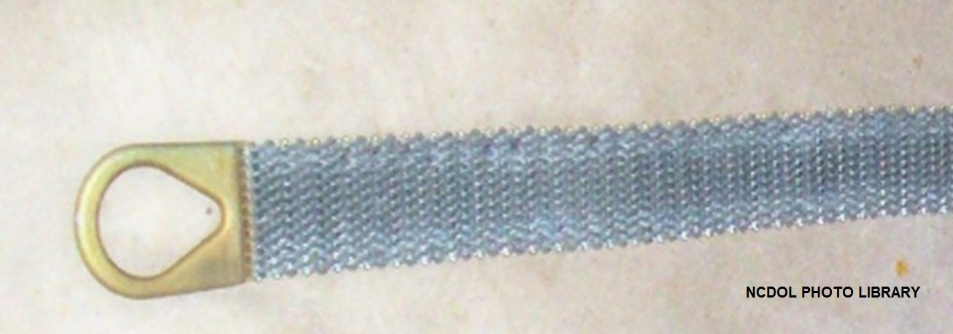
Metal Mesh Slings
1910.184(g)(1)-(2)
Metal mesh slings have permanent markings securely attached indicating it’s rated capacity for vertical basket and choker hitch loadings.
Handles have a rated capacity at least equal to the metal fabric and exhibit no deformation after proof testing.
Notes:
41

Slide 42
Repairs
1910.184(g)(8)
Metal mesh slings which are repaired:
  Not used unless repaired by a metal mesh sling manufacturer or equivalent entity.
Once repaired:
  Sling permanently marked or tagged,
  or a written record maintained, to
  indicate the date and nature of the
  repairs and the person or organization
  that performed the repairs.
  Records of repairs made available
  for examination.
Notes:
42

Slide 43
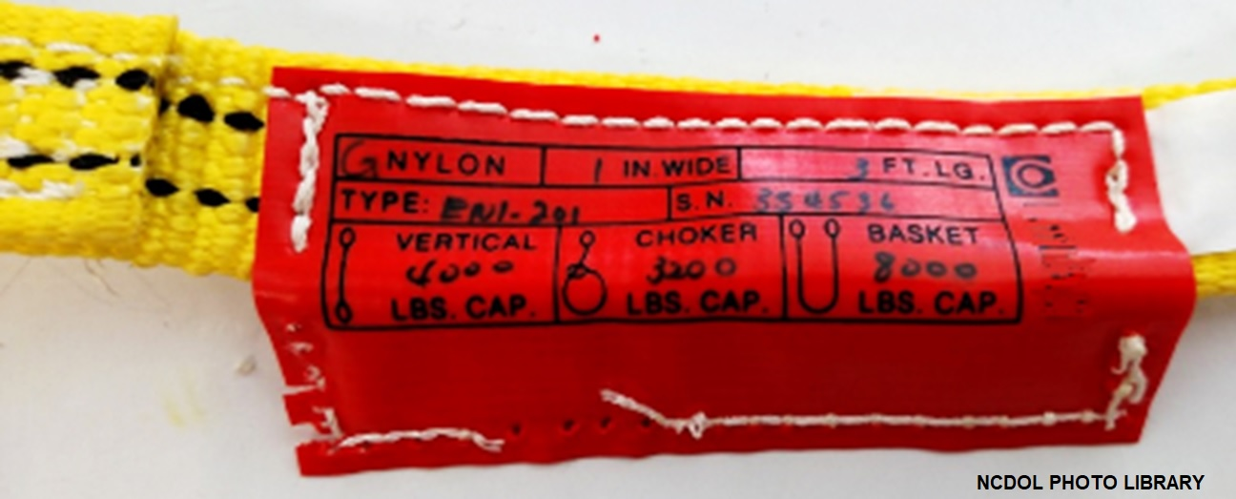
Natural and Synthetic Fiber Rope
1910.184(h)(1)
Natural and synthetic fiber rope slings have permanently affixed and legible identification markings.
  State rated capacity for types of hitches
  Angle upon which it is based
  Type of fiber material
  Number of legs if more than one
Notes:
43

Slide 44
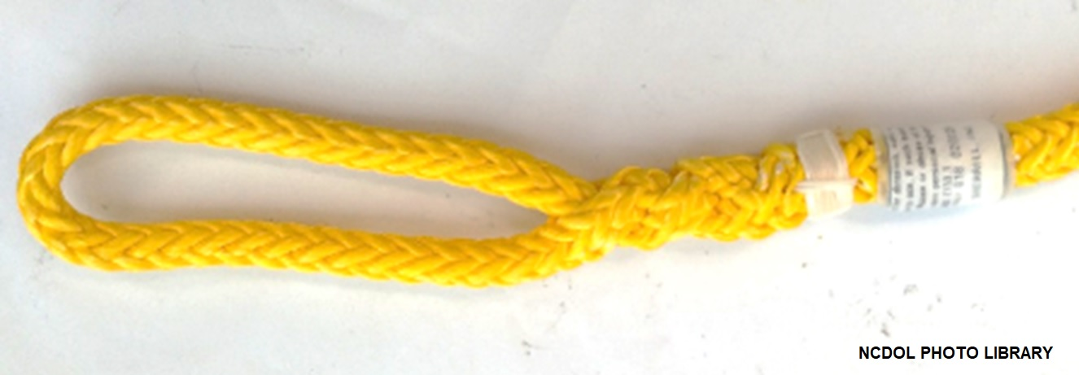
Splicing
1910.184(h)(3)
Spliced fiber rope slings shall not be used unless they have been spliced in accordance with the following minimum requirements and in accordance with any additional recommendations of the manufacturer:
  In manila rope, eye splices shall consist of at least three full tucks, and short splices shall consist of at least six full tucks, three on each side of the splice center line.
Notes:
44

Slide 45
Splicing
1910.184(h)(3)
In synthetic fiber rope, eye splices shall consist of at least four full tucks, and short splices shall consist of at least eight full tucks, four on each side of the center line.
Strand end tails not trimmed flush with the surface of the rope immediately adjacent to the full tucks.
Fiber rope slings have a minimum clear length of rope between eye splices equal to 10 times the rope diameter.
Notes:
45

Slide 46
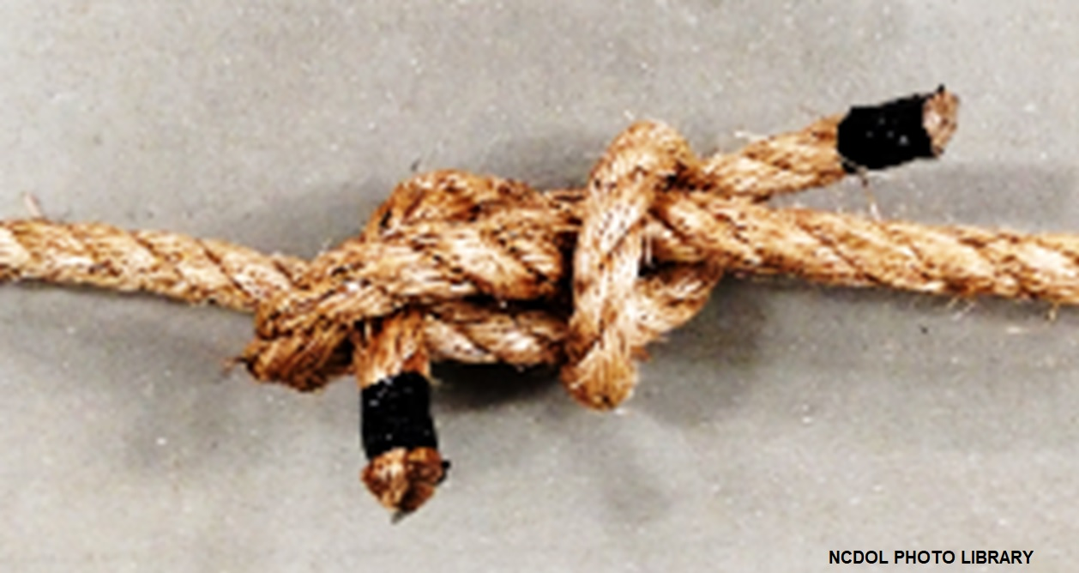
Splicing
1910.184(h)(3)
Knots shall not be used in lieu of splices.
Clamps not designed specifically for fiber ropes shall not be used for splicing.
For all eye splices, the eye shall be of such size to provide an included angle of not greater than 60 degrees at the splice when the eye is placed over the load or support.
NCDOL Photo Library
Notes:
46

Slide 47
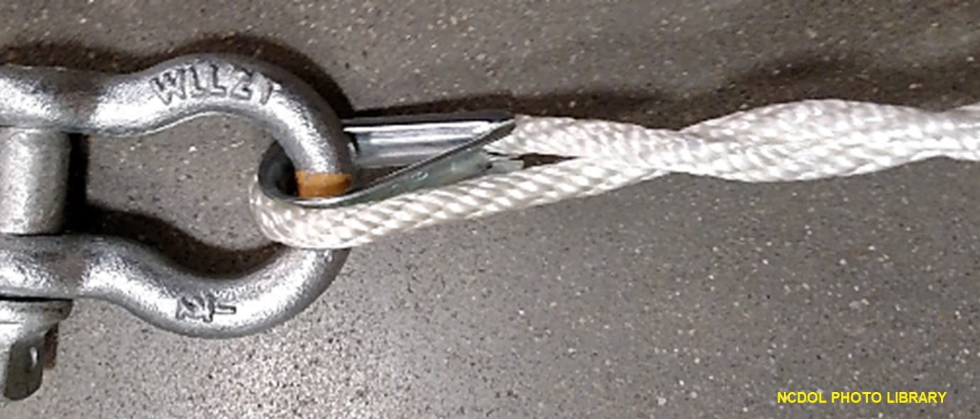
End Attachments
1910.184(h)(4)
Fiber rope slings not used if end attachments in contact with the rope have sharp edges or projections.
Notes:
47

Slide 48
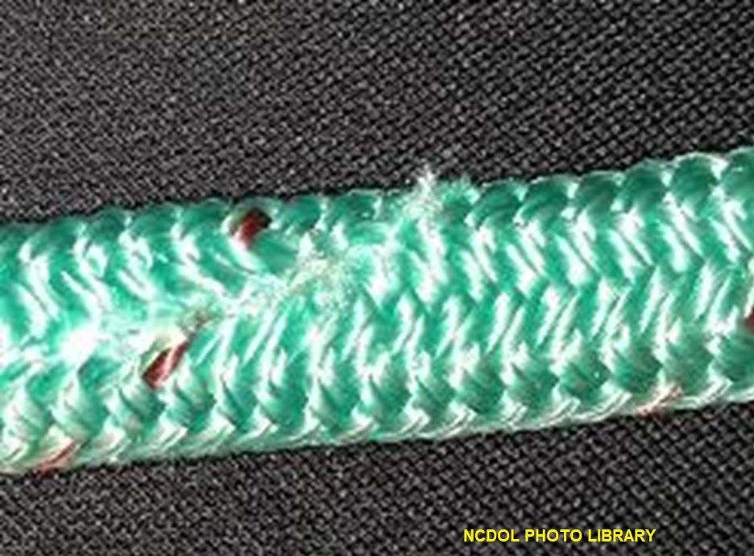
Removal From Service
1910.184(h)(5)
Natural and synthetic fiber rope slings immediately removed from service if any of the following conditions are present:
  Abnormal wear
  Powdered fiber between strands
  Variations in the size or roundness of strands
  Broken or cut fibers
  Discoloration or rotting
  Distortion of hardware in the sling
Notes:
48

Slide 49
Repairs
1910.184(h)(6)
Only fiber rope slings made from new rope shall be used.
Use of repaired or reconditioned fiber rope slings is prohibited.
Notes:
49

Slide 50
Identification and Webbing
1910.184(i)(1)-(2)
Sling identification
  Each sling marked or coded to show the rated capacities for each type of hitch and type of synthetic web material.
Webbing
  Synthetic webbing of uniform thickness and width and selvage edges shall not be split from the webbing's width.
Notes:
50

Slide 51
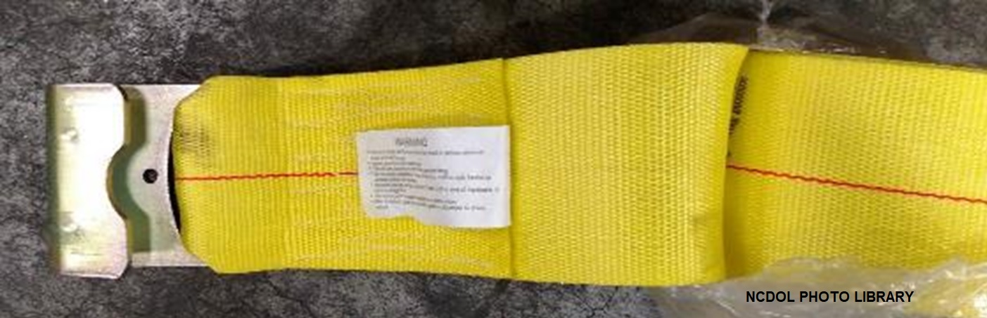
Fittings
1910.184(i)(3)
Of a minimum breaking strength at least equal to that of the sling.
Free of all sharp edges that could in any way damage the webbing.

Slide 52
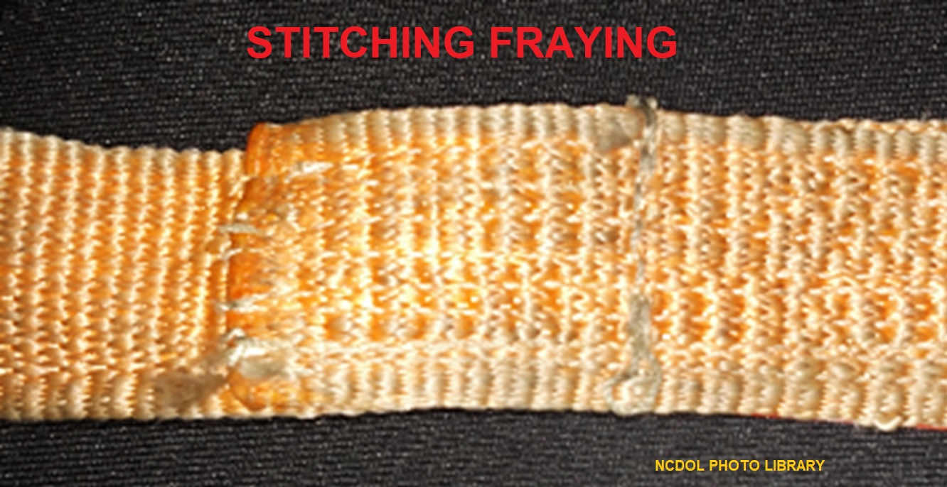
Attachment of End Fittings
1910.184(i)(4)
Stitching shall be the only method used to attach end fittings to webbing and to form eyes.
Thread shall be in an even pattern and contain a sufficient number of stitches to develop the full breaking strength of the sling.
Notes:
52

Slide 53
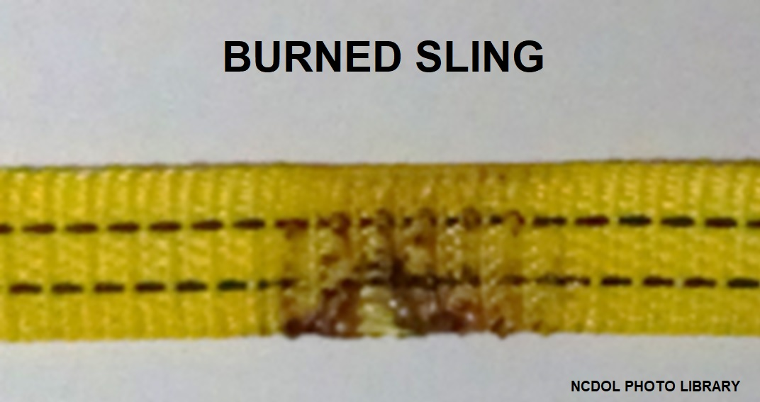
Environmental Conditions
1910.184(i)(6)
When synthetic web slings are used, the following precautions shall be taken:
  Nylon web slings not used where fumes, vapors, sprays, mists or liquids of acids or phenolics are present.
  Polyester and polypropylene web slings not used where fumes, vapors, sprays, mists or liquids of caustics are present.
  Web slings with aluminum fittings not used where fumes, vapors, sprays, mists or liquids of caustics are present.
Notes:
53

Slide 54
Safe Operating Temperatures
1910.184(i)(7)
Synthetic web slings of polyester and nylon not used at temperatures in excess of 180 degrees F.
Polypropylene web slings not used at temperatures in excess of 200 degrees F.
Notes:
54

Slide 55

Repairs
1910.184(i)(8)
Synthetic web slings repaired by sling manufacturer or equivalent entity.
Each repaired sling proof tested by the manufacturer or equivalent entity.
  Twice the rated capacity prior to its return to service.
  Retain a certificate of the proof test.
Notes:
55

Slide 56

Removal From Service
1910.184(i)(9)
Synthetic web slings immediately removed from service if any of the following conditions are present:
  Acid or caustic burns
  Melting or charring of any part of the sling surface
  Snags, punctures, tears or cuts
  Broken or worn stitches
  Distortion of fittings
Notes:
56

Slide 57
Summary
In this course, we covered:
  General material handling requirements
    Secure storage, housekeeping, clearance limits, rolling railroad cars and guarding.
  Sling requirements
    Scope, definitions, safe operating practices, inspections, alloy chain slings, wire rope slings, metal mesh slings, natural and synthetic fiber rope slings and synthetic web slings
.

Slide 58
Thank You For Attending!
Final Questions?

