Slide 1
Materials Handling, Storage, Use and Disposal
29 CFR 1926 – Subpart H
Notes:
Revised 6/16/25
The information in this presentation is provided voluntarily by the N.C. Department of Labor, Education Training and Technical Assistance Bureau as a public service and is made available in good faith. This presentation is designed to assist trainers conducting OSHA outreach training for workers. Since workers are the target audience, this presentation emphasizes hazard identification, avoidance, and control – not standards. No attempt has been made to treat the topic exhaustively. It is essential that trainers tailor their presentations to the needs and understanding of their audience.
The information and advice provided on this Site and on Linked Sites is provided solely on the basis that users will be responsible for making their own assessment of the matters discussed herein and are advised to verify all relevant representations, statements, and information.
This presentation is not a substitute for any of the provisions of the Occupational Safety and Health Act of North Carolina or for any standards issued by the N.C. Department of Labor. Mention of trade names, commercial products, or organizations does not imply endorsement by the N.C. Department of Labor.

Slide 2
Objectives
At the end of this course, students will be able to:
  Discuss minimum OSHA requirements for material handling, storage and equipment
  Identify safe storage of materials
  Recognize proper use of rigging equipment
  Identify hazards and abatement methods
Notes:
2

Slide 3
Amputations Special Emphasis Program
Goal to reduce occupational exposures to amputations
Struck by and caught between injuries
  Lockout/tagout
  Machine guarding
Increase outreach to employers and employees
  Training Events (Internal and external)
  Compliance Inspections
  Consultation Visits
  Publications
Amputations must be reported within 24 hours

Slide 4
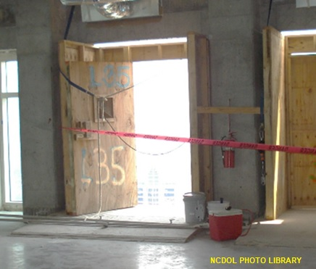
Materials Storage
1926.250(b)(1)
In buildings under construction, materials must not be placed within 6 feet of a hoistway or floor opening.
Notes:
4

Slide 5
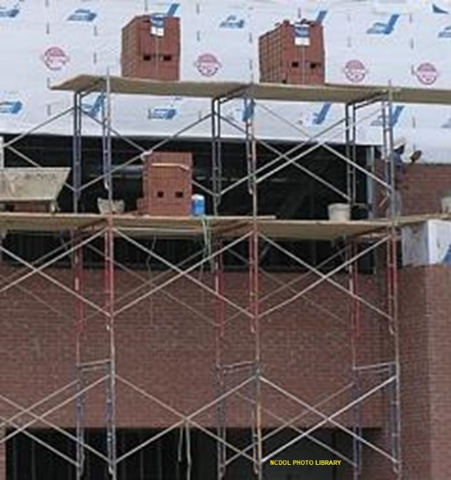
Materials Storage
1926.250(b)(2)–(5)
Use personal fall arrest equipment when working on stored material in silos, hoppers, tanks, and similar storage areas.
Non-compatible materials shall be segregated in storage.
Materials shall not be stored on
scaffolds or runways except for
immediate operations.

Slide 6
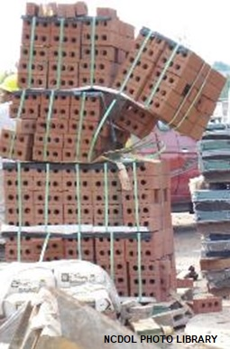
Materials Storage
1926.250(b)(6)
Stack bricks in a manner that will keep them from falling.
Do not stack higher than 7 feet.
Taper back loose brick stacks
after 4 feet.
Notes:
6

Slide 7
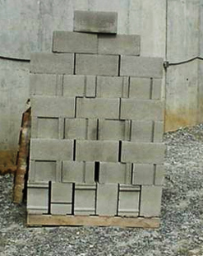
Materials Storage
1926.250(b)(7)
When masonry blocks are stacked higher than 6 feet.
  Stack shall be tapered back one-half block per tier above the 6-foot level.
NCDOL Photo Library

Slide 8
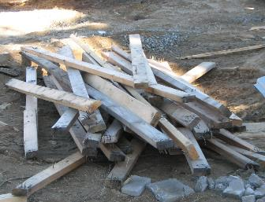
Materials Storage
1926.250(b)(8)
Storage of lumber
  Remove nails before stacking.
  Stacked level and on sills.
  Stack lumber so that it is stable and self-supporting.
  Piles not to exceed 20 feet.
    16 feet if handled manually.
NCDOL Photo Library
Notes:
8

Slide 9
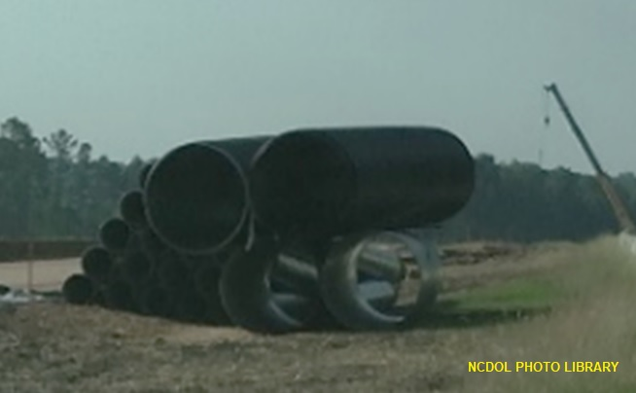
Materials Storage
1926.250(b)(9)
Structural steel, pipe, bar stock, etc., unless racked, must be stacked and blocked to prevent spreading or tilting.
NCDOL Photo Library
Notes:
9

Slide 10
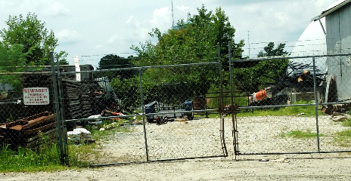
Housekeeping
1926.250(c)
Storage areas must be kept free from accumulation of materials that create hazards from:
  Tripping
  Fire
  Explosion
  Pest harborage
NCDOL Photo Library
Notes:
10

Slide 11
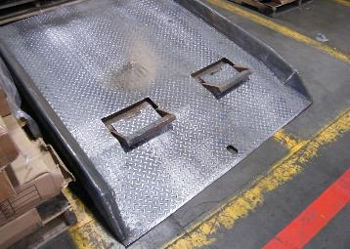
Dockboards
1926.250(d)
Dockboards must be strong enough to carry imposed load.
  Portable dockboards must be properly secured in position.
  Provided with handholds, or other effective means, to permit safe handling.
NCDOL Photo Library
Notes:
11

Slide 12
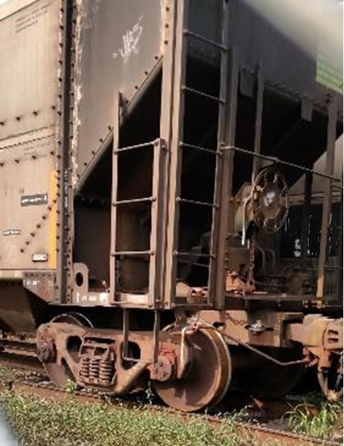
Dockboards
1926.250(d)(4)
Positive protection must be provided to prevent railroad cars from moving during loading or unloading operations.
NCDOL Photo Library
Notes:
12

Slide 13
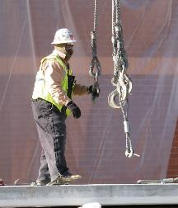
Rigging Equipment
1926.251(a)(1)
Rigging equipment for material handling shall be inspected prior to use on each shift and as necessary during its use to ensure that it is safe.
Defective rigging equipment shall be removed from service.
NCDOL Photo Library

Slide 14
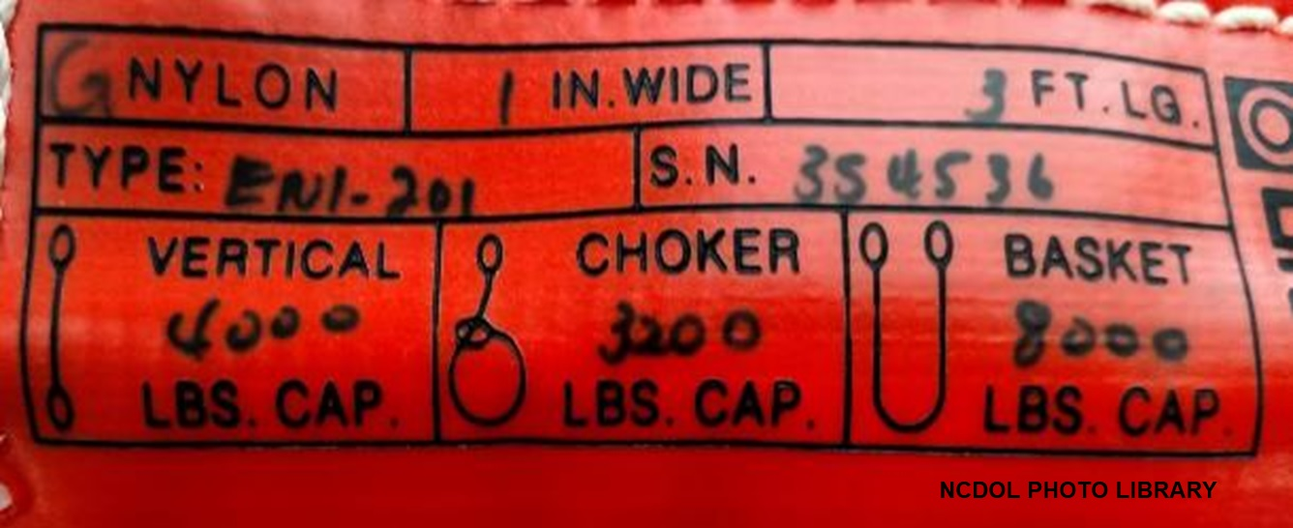
Rigging Equipment
1926.251(a)(2)
Sling configurations in construction rigging make a difference in loading.
  Vertical, choker, and basket hitches
Notes:
14

Slide 15
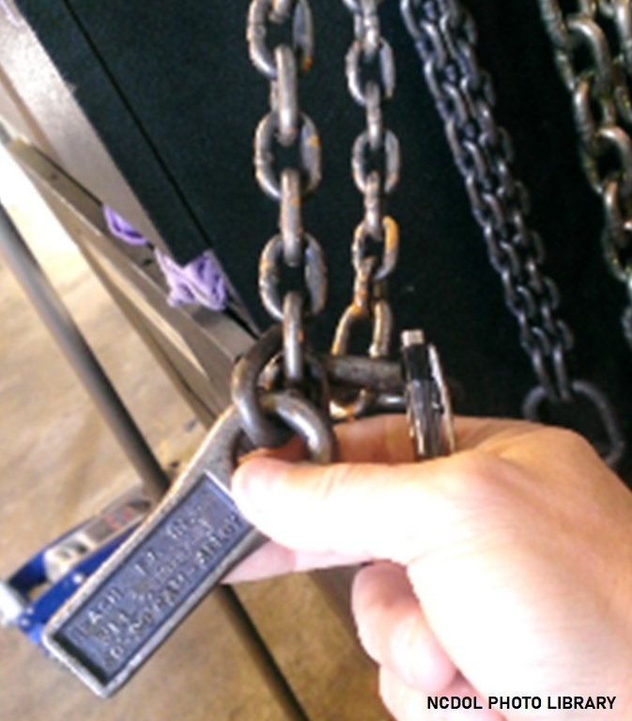
Rigging Equipment
1926.251(a)(2)
General
  Rigging equipment shall not be loaded in excess of its recommended safe working load as prescribed on the identification marking by the manufacturer.
Notes:
15

Slide 16
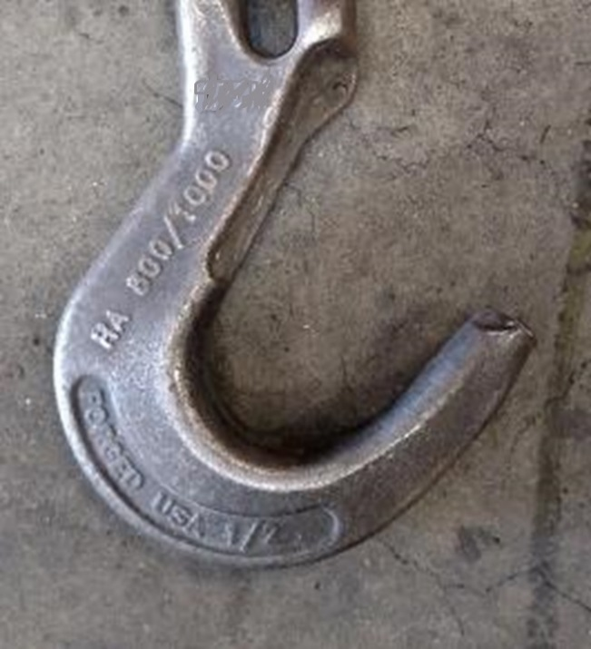
Rigging Equipment
1926.251(a)(3)-(4)
Rigging equipment removed from work area so as not to present a hazard to employees when not in use.
Custom design grabs, hooks,
clamps, or other lifting
accessories shall be marked
to indicate the safe working
loads.
NCDOL Photo Library
NCDOL Photo Library

Slide 17
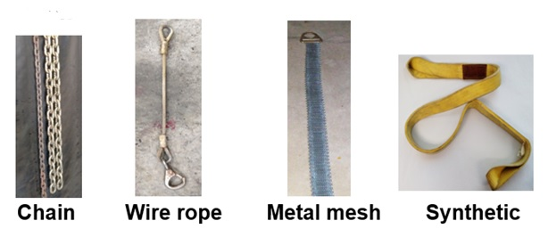
Rigging Equipment - Slings
1926.250(a)(5)
Types of slings covered are those made from alloy steel chain, wire rope, metal mesh, natural or synthetic fiber rope, and synthetic web.
NCDOL Photo Library
Notes:
17

Slide 18
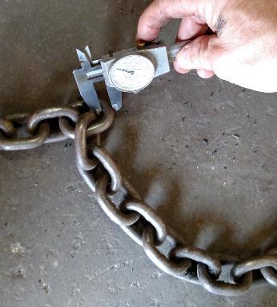
Rigging Equipment Inspections
1926.251(a)(6)
Inspections
  Equipment must be
  inspected prior to
  use and each shift.
    Also, as necessary during its use.
  Damaged or defective
  equipment must be
  removed from service.
NCDOL Photo Library
Notes:
18

Slide 19
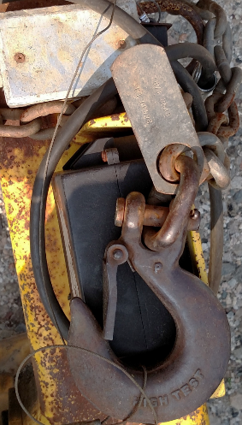
Alloy Steel Chains
1926.251(b)(1)
Chain slings must have permanently affixed durable
identification. stating
  Size, grade, rated capacity,
  and sling manufacturer
NCDOL Photo Library
Notes:
19

Slide 20
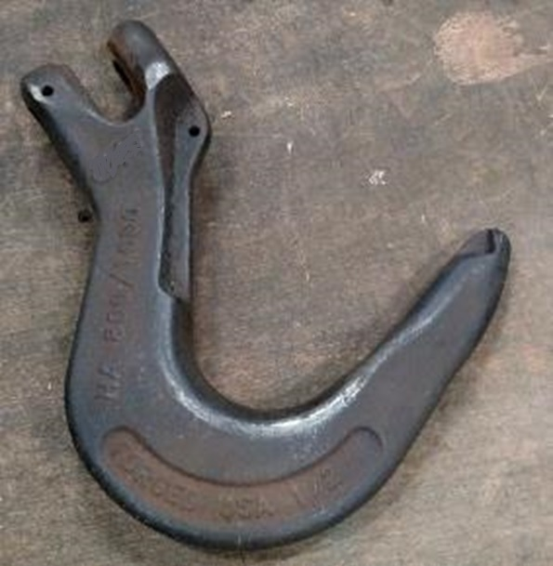
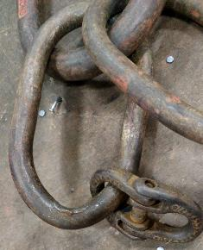
Alloy Steel Chains
1926.251(b)(2)
Hooks, rings, oblong links, or other attachments, when used with alloy steel chains, must have a rated capacity at least equal to that of the chain.
NCDOL Photo Library
NCDOL Photo Library
Notes:
20

Slide 21
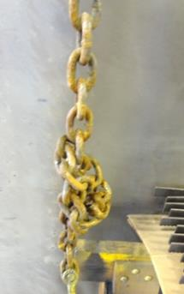
Alloy Steel Chains
1926.251(b)(3)
Job or shop hooks and links, or makeshift fasteners, formed from bolts, rods, etc., or other such attachments, shall not be used.
  Kinked or knotted chains must
  not be used for lifting.
  Chains must not be shortened by
  bolting, wiring or knotting.
NCDOL Photo Library
Notes:
21

Slide 22
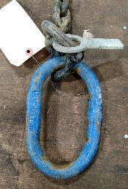
Alloy Steel Chains
1926.251(b)(4)
Employers must not use alloy steel-chain slings with loads in excess of the rated capacities (i.e., working load limits) indicated on the sling by permanently affixed and legible identification markings prescribed by the manufacturer.
NCDOL Photo Library
Notes:
22

Slide 23
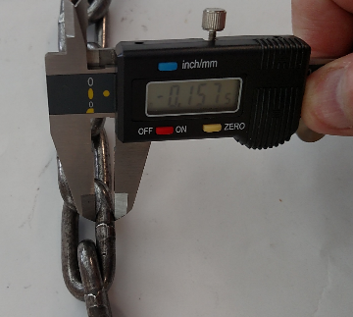
Alloy Steel Chains
1926.251(b)(5)
Chains must be removed from service when maximum allowable wear is reached at any point of any link.
Table H-1: Maximum Allowable Wear at any Point of Link
Chain size, inches | Maximum allowable wear, inches
¼ | ³/64
³/8 | ⁵/64
½ | ⁷/64
⁵/8 | ⁹/64
¾ | ⁵/32
⁷/8 | ¹¹/64
1 | ³/16
1 ¹/8 | ⁷/32
1 ¼ | ¼
1 ³/8 | ⁹/32
1 ½ | ⁵/16
1 ¾ | ¹¹/32
NCDOL Photo Library
Notes:
23

Slide 24
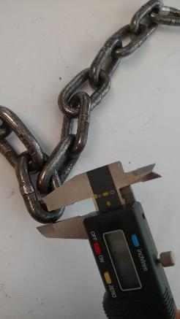
Alloy Steel Chains
1926.251(b)(6)(i)
A thorough periodic inspection of slings must be made on a regular basis.
  At least annually
Inspection determined on the
basis of:
  Frequency of sling use
  Severity of service conditions
  Nature of lifts being made
  Experience gained on service life of slings
NCDOL Photo Library
Notes:
24

Slide 25
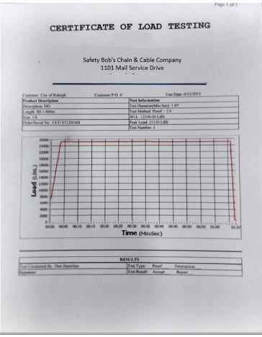
Alloy Steel Chains
1926.251(b)(6)(ii)
A record of the most recent month in which the chain sling was thoroughly inspected must be maintained.
Record must be available for examination.
NCDOL Photo Library
Notes:
25

Slide 26
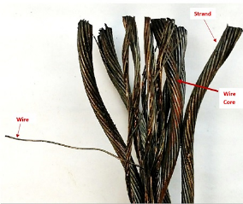
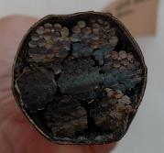
Wire Rope Slings
1926.251(c)
Considerations when selecting wire rope
  Strength
  Flexibility or resistance to bending fatigue
  Resistance to abrasion
  Resistance to crushing
  Resistance to rotation
  Resistance to corrosion
NCDOL Photo Library
NCDOL Photo Library
Notes:
26

Slide 27
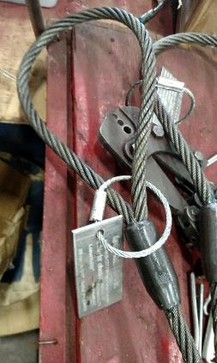
Wire Rope Slings
1926.251(c)(4)(i)
Eye splices made in any wire rope must have at least three full tucks.
  However, this requirement shall not operate to preclude the use of another form of splice or connection which can be shown to be as efficient, and which is not otherwise prohibited.
NCDOL Photo Library
Notes:
27

Slide 28
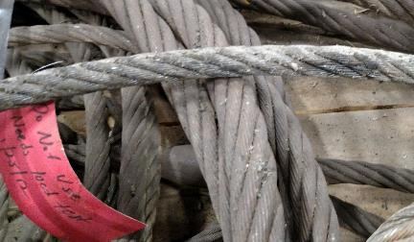
Wire Rope Slings
1926.251(c)(4)(iv)
Wire rope must not be used, if in any length of eight diameters:
  Total number of visible broken wires exceed 10% of the total number of wires.
  Rope shows excessive wear, corrosion, or defect.
NCDOL Photo Library
Notes:
28

Slide 29
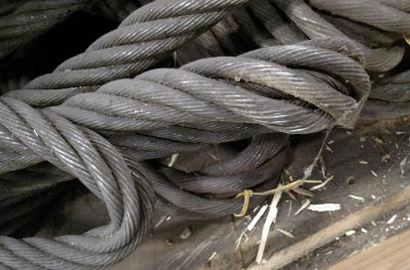
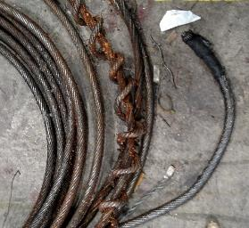
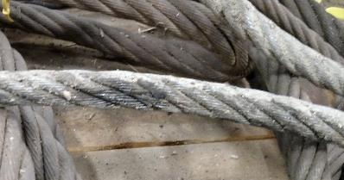
Wire Rope Slings
1926.251(c)(4)(iv)
NCDOL Photo Library
NCDOL Photo Library
Kinking
Crushing
Heat Damage
NCDOL Photo Library
Notes:
29

Slide 30
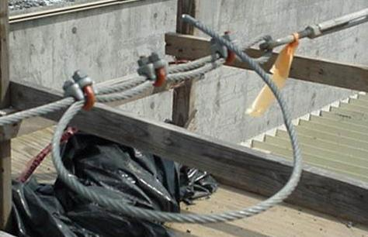
Wire Rope Slings
1926.251(c)(5)(i)
When using U-bolt wire rope clips to form eyes, ensure the “U” section is in contact with the dead end of the rope.
NCDOL Photo Library
Correct Method
Notes:
30

Slide 31
Natural/Synthetic Fiber Rope Slings
1926.251(d)(1)/(7)
Do not exceed the rated capacities indicated on the sling.
Use rope slings that have permanently affixed and legible identification markings that state the rated capacity for the type(s) of hitch(es) used and the angle upon which it is based, type of fiber material, and the number of legs (if more than one).

Slide 32
Synthetic Web Slings
1926.251(e)
Synthetic web sling markings
  Slings must be marked or coded to show:
    Name or trademark of manufacturer
    Rated capacities for the type of hitch
    Type of material
Notes:
32

Slide 33
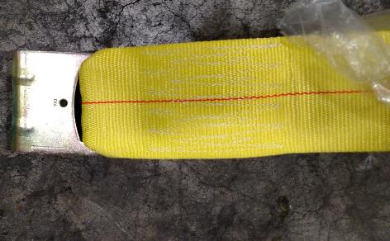
Synthetic Web Slings
1926.251(e)(4)
Synthetic web sling fittings
  Fittings must have a breaking strength at least equal to that of the sling.
  Fittings must be free of sharp edges.
NCDOL Photo Library
Notes:
33

Slide 34
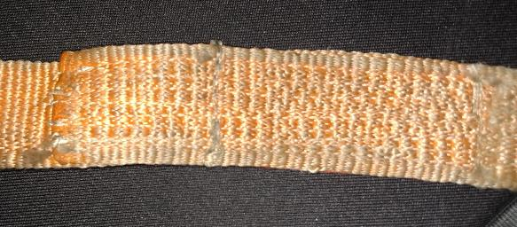
Synthetic Web Slings
1926.251(e)(5)
Stitching is the only method allowed to attach end fittings to webbing or to form eyes.
Stitching
NCDOL Photo Library
Notes:
34

Slide 35
Environmental Conditions
1926.251(e)(6)-(7)
Chemicals
  Nylon web slings shall not be used where fumes, vapors, sprays, mists or liquids of acids or phenolics are present.
  Polyester or polypropylene web slings, or web slings with aluminum fittings shall not be used where fumes, vapors, sprays, mists or liquids of caustics are present.
Heat
  Synthetic web slings of polyester and nylon shall not be used in excess of 180 degrees Fahrenheit (F) (82 degrees Celsius (C)).
  Polypropylene web slings shall not be used at temperatures in excess of 200 degrees F (93.33 degrees C).
Notes:
35

Slide 36
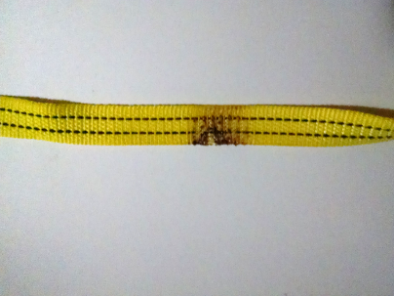
Synthetic Web Slings
1926.251(e)(8)
Remove from service if any of the following conditions are present:
  Acid or caustic burns
  Melting or charring of
  any part
  Snags, punctures, tears or cuts
  Broken or worn stitches
  Distortion of fittings
NCDOL Photo Library
Heat Damage
Notes:
36

Slide 37
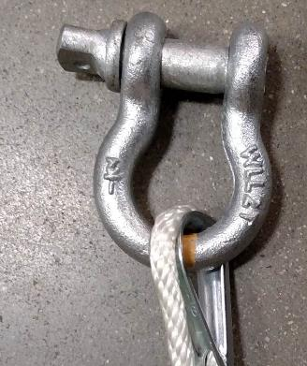
Shackles and Hooks
1926.251(f)(1)
Do not use shackles with loads that exceed the rated capacity (as indicated on the shackle).
NCDOL Photo Library
Notes:
37

Slide 38
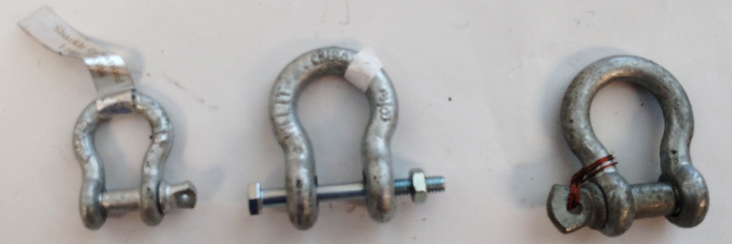
Shackles and Hooks
1926.251(f)
NCDOL Photo Library
Right
Wrong
Notes:
38

Slide 39
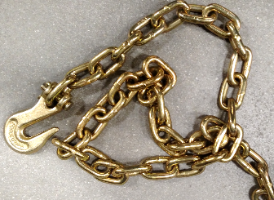
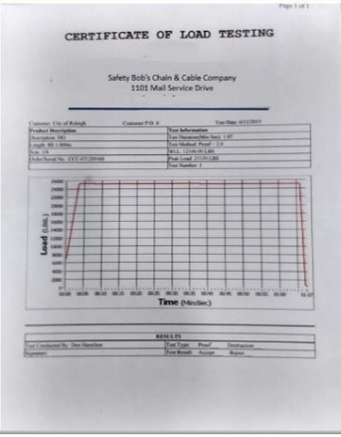
Shackles and Hooks
1926.251(f)(2)
Follow manufacturer’s recommendations in determining safe working load (SWL).
  If manufacturer’s SWL is not available:
    Must be tested to the intended SWL before they are initially put into use.
    Employer must keep a record
    of the dates and test results.
NCDOL Photo Library
NCDOL Photo Library
Notes:
39

Slide 40
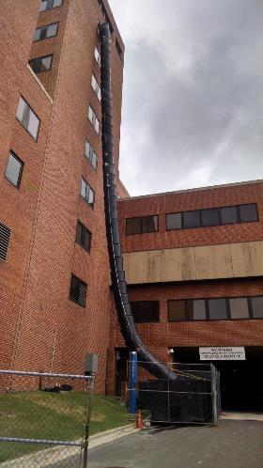
Disposal of Waste Materials
1926.252(a)
An enclosed chute must
be used when dropping
material more than 20 feet
outside of a building.
NCDOL Photo Library
Notes:
40

Slide 41
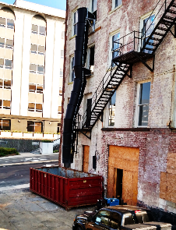
Disposal of Waste Materials
1926.252(b)
When debris is dropped through holes in floors without the use of chutes:
  Area must be enclosed with barricades.
  Warning signs must be posted at each level.
Employees were dropping debris from these areas
NCDOL Photo Library
Notes:
41

Slide 42

Disposal of Waste Materials
1926.252(c)-(e)
All scrap lumber, waste material, and rubbish must be removed from the immediate work area as work progresses.
Disposal of waste material or debris by burning shall comply with local fire regulations.
All solvent waste, oily rags, and
flammable liquids must be kept
in fire resistant, covered containers
until removed from worksite.
NCDOL Photo Library
Notes:
42

Slide 43
Summary
In this course, we discussed:
  Minimum requirements for material handling, storage and equipment
  Safe storage of materials
  Proper use of rigging equipment
  Hazards and abatement methods

Slide 44
Thank You For Attending!
Final Questions?

