Slide 1
Control of Hazardous Energy (Lockout/Tagout)
29 CFR 1910.147
Notes:
Revised 06/2025
The information in this presentation is provided voluntarily by the N.C. Department of Labor, Education, Training and Technical Assistance Bureau as a public service and is made available in good faith. This presentation is designed to assist trainers conducting OSHA outreach training for workers. Since workers are the target audience, this presentation emphasizes hazard identification, avoidance, and control – not standards. No attempt has been made to treat the topic exhaustively. It is essential that trainers tailor their presentations to the needs and understanding of their audience.
The information and advice provided on this Site and on Linked Sites is provided solely on the basis that users will be responsible for making their own assessment of the matters discussed herein and are advised to verify all relevant representations, statements, and information.
This presentation is not a substitute for any of the provisions of the Occupational Safety and Health Act of North Carolina or for any standards issued by the N.C. Department of Labor. Mention of trade names, commercial products, or organizations does not imply endorsement by the N.C. Department of Labor.
NCDOL References:
HAZARDOUS ENERGY CONTROL (Lockout/Tagout)
CPL 02-00-147 Control of Hazardous Energy
CPL 02-01-043 Slide-locks-Control of Hazardous Energy
CFR 106 Lockout/Tagout
CFR 106A Lockout/Tagout

Slide 2
Objectives
After this course, students will be able to:
  Understand the need for energy control procedures
  Identify methods of lockout/tagout
  Identify the employer’s responsibilities
  Identify the employee training needs
  Understand how to handle group lockout/tagout, outside contractors, and shift changes

Slide 3
Amputations Special Emphasis Program
Goal to reduce occupational exposures to amputations
Struck by and caught between injuries
  Lockout/tagout
  Machine guarding
Increase outreach to employers and employees
  Training events (Internal and external)
  Compliance Inspections
  Consultation Visits
  Publications
Amputations must be reported within 24 hours

Slide 4
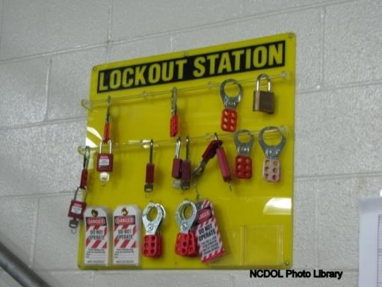
Lockout/Tagout
1910.147
Technically known as the “Control of Hazardous Energy”
  Control of unexpected energization or start-up of machines or equipment, or release of stored energy that could cause injury to employees

Slide 5
Scope
1910.147(a)(1)
Covers the servicing and/or maintenance of machines or equipment where the unexpected start-up or release of stored energy could cause injury
  Installation and set-up
  Adjustment or maintenance
  Inspection
  Modification
  Routine service

Slide 6
Scope
1910.147(a)(1)
Does not cover
  Construction, agriculture, maritime
  Installations under exclusive control of the electric utilities for power generation, transmission and distribution
  Exposure to electrical hazards from work on, near, or with conductors or equipment in electric-utilization installations
  Oil and gas drilling and servicing

Slide 7
Application
1910.147(a)(2)
Servicing and/or maintenance which takes place during normal production operations is covered only if:
  Employee is required to remove or bypass a guard or other safety device; or
  Employee is required to place any part of his/her body into the point of operation or where an associated danger zone exists during a machine operation.

Slide 8
Application
1910.147(a)(2)
Exception
  Minor tool changes and adjustments, and other minor servicing activities, which take place during normal production operations, are not covered if they are:
    Routine,
    Repetitive, and
    Integral to the use of the equipment for production
    provided that the work is performed using alternative measures which provide effective protection

Slide 9
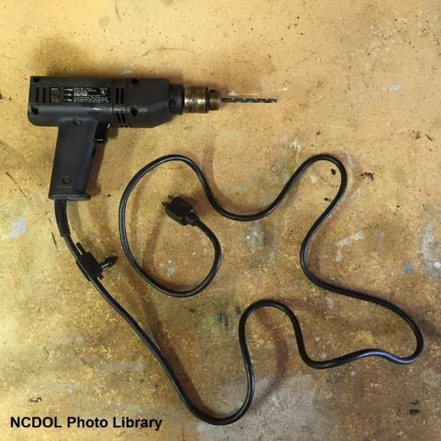
Application
1910.147(a)(2)
Does not cover:
  Normal production operations
  Work on cord and plug connected equipment where plug is under exclusive control of employee performing servicing/maintenance
  Hot tap operations, under special conditions

Slide 10
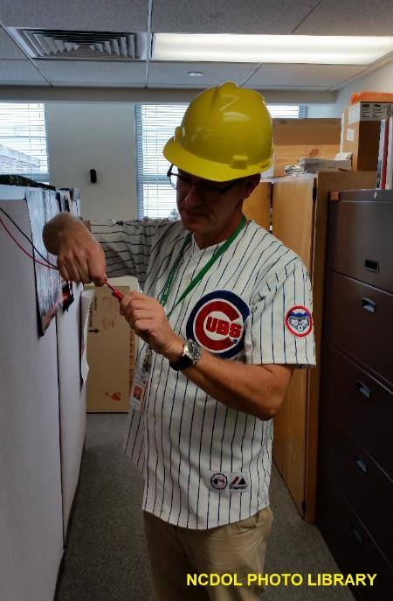
Definitions
1910.147(b)
Authorized employee
  An employee who locks out or tags out machines or equipment to perform servicing or maintenance on that machine or equipment
  Lockout or tagout is used by these employees for their own protection

Slide 11
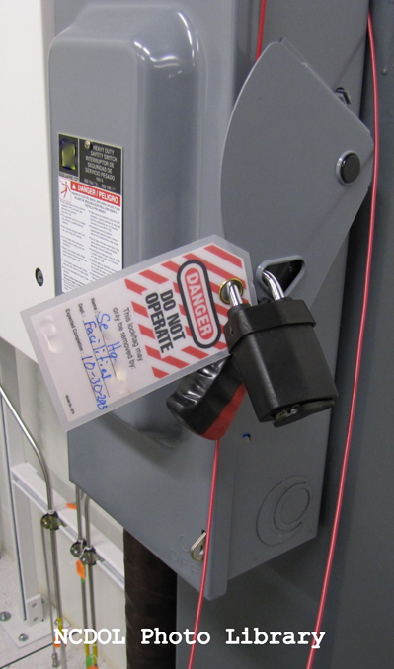
Definitions
1910.147(b)
Affected employee
  An employee who performs the duties of his or her job on equipment or in an area in which the energy control procedure is implemented and servicing or maintenance operations are performed

Slide 12
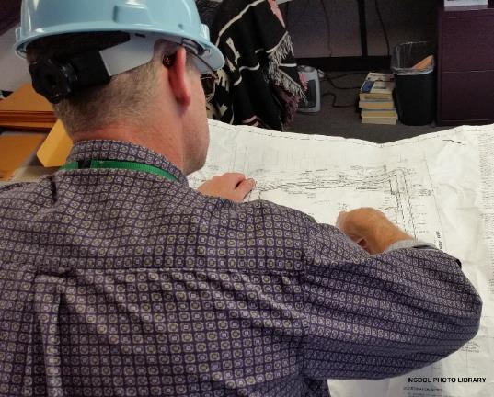
Other Employees
1910.147(c)(7)
Other employees
  Other employees whose work operations are, or may be, in an area where energy control procedures may be utilized

Slide 13
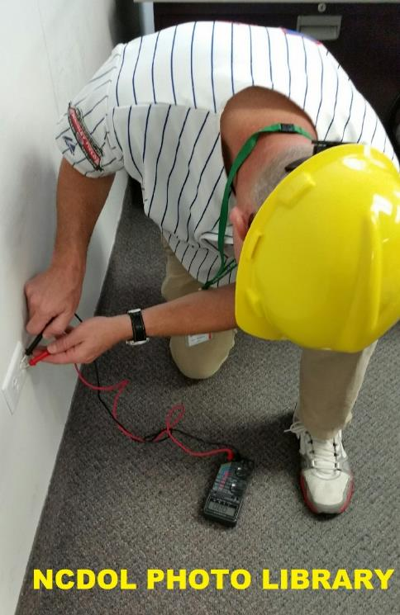
Definitions
1910.147(b)
Energy source
  Mechanical
  Hydraulic
  Chemical
  Pneumatic
  Electrical
  Thermal

Slide 14
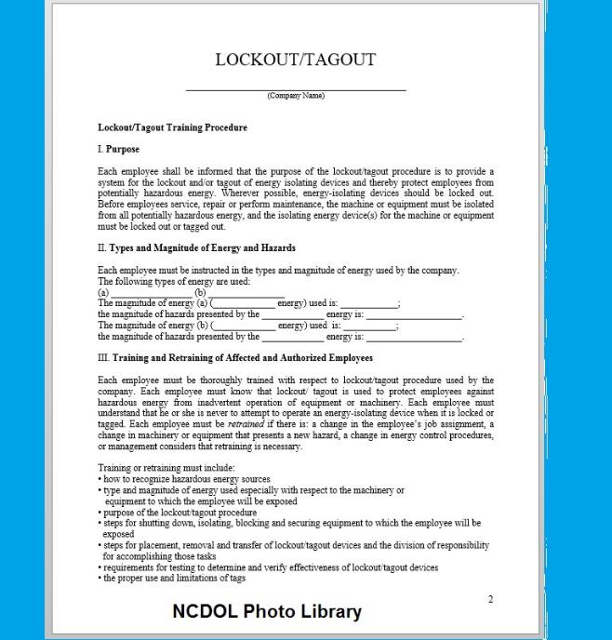
Energy Control Program
1910.147(c)(1)
The employer shall establish a program consisting of:
  Energy control procedures
  Employee training
  Periodic inspections

Slide 15

Energy Control Program
1910.147(c)(2)
If an energy isolating device is not capable of being locked out, the employer’s energy control program shall utilize a “tagout system”.

Slide 16
Energy Control Program
1910.147(c)(3)
When a tagout device is used on an energy isolating device which is capable of being locked out
  Tagout device shall be attached at the same location
  Must provide equivalent safety

Slide 17
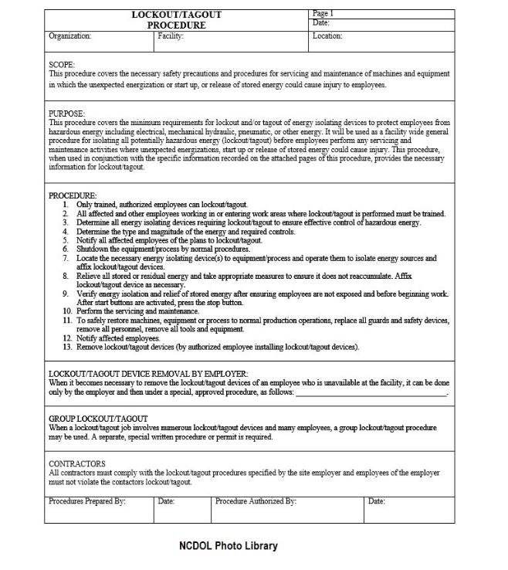
Energy Control Procedure
1910.147(c)(4)
Procedures
  Shall be developed, documented and utilized for the control of potentially hazardous energy
  Shall clearly and specifically outline techniques to be utilized to control hazardous energy

Slide 18
Energy Control Procedure
1910.147(c)(4)
Energy control (LOTO) procedure
  Statement of intended use of procedure
  Steps for shutting down, isolating, blocking and securing machines or equipment to control hazardous energy
  Steps for the placement, removal and transfer of lockout devices or tagout devices and the responsibility for them, and
  Requirements for testing machine/equipment to determine and verify effectiveness of LOTO devices and other energy control measures

Slide 19
Procedure Exception
1910.147(c)(4)
    Machine/equipment has no potential for stored/residual energy after shut down
    Machine/equipment has a single energy source (readily identified and isolated
    The isolation and locking out of energy source will completely de-energize/deactivate the machine/equipment
    Machine/equipment is isolated from that energy source and locked out during servicing or maintenance

Slide 20
Procedure Exception
1910.147(c)(4)
    Lockout device is under the exclusive control of the authorized employee performing the servicing or maintenance
    Servicing/maintenance does not create hazards for other employees; and
    Employer has had no accidents involving the unexpected activation/re-energization of the machine/equipment during servicing/maintenance

Slide 21
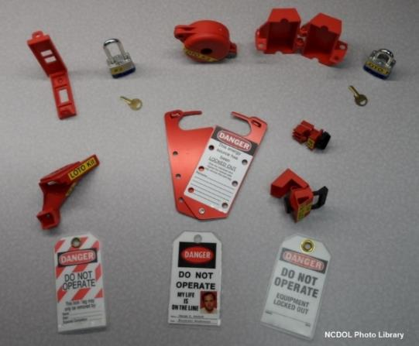
Materials and Hardware
1910.147(c)(5)
Provided by employer
Singularly identified
Only device(s) used
Not used for other purposes

Slide 22
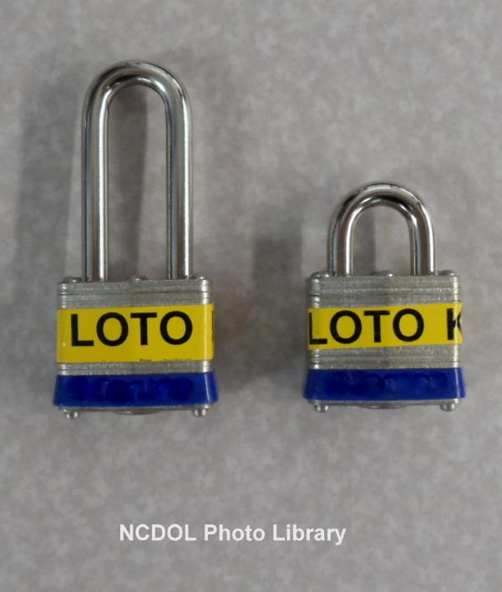
Materials and Hardware
1910.147(c)(5)
Durable
Standardized
Substantial
Identifiable

Slide 23

Types of Devices

Slide 24
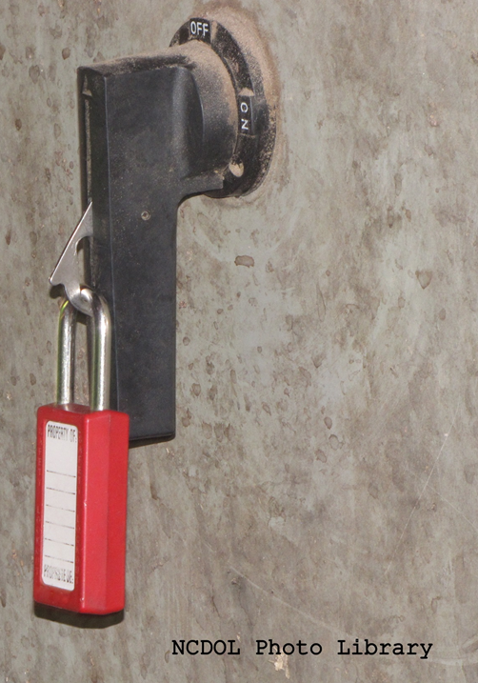
Is this lockout identifiable?
1910.147(c)(5)
Based on the photo, it is not.

Slide 25
Periodic Inspection
1910.147(c)(6)
Conducted at least annually to ensure procedure and requirements are followed
Performed by authorized employee other than the one(s) using the procedure
Designed to correct identified deficiencies or inadequacies
Employer shall certify that periodic inspection has been performed

Slide 26
Periodic Inspection
1910.147(c)(6)
Lockout inspection
  Must review each authorized employee’s responsibilities under the energy control procedure
Tagout inspection
  Must review each authorized and affected employee’s responsibilities under the energy control procedure, and
  Additional training requirements of 1910.147(c)(7)(ii)

Slide 27
Training and Communication
1910.147(c)(7)
Authorized employee
  Recognition of hazardous energy sources
  Type and magnitude of energy in workplace
  Methods and means for energy isolation and control
Affected employee
  Purpose and use of the energy control procedure

Slide 28
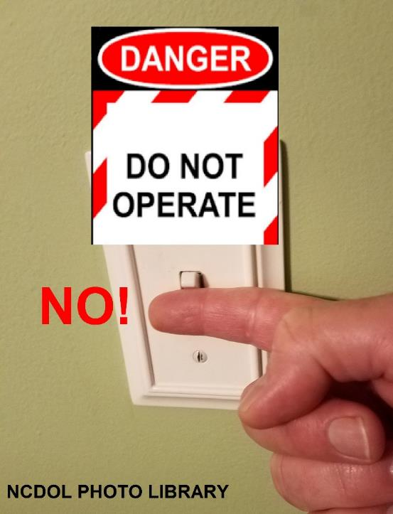
Training and Communication
1910.147(c)(7)
All other employees
  Procedures for energy control
  Prohibition of restarting or reenergizing machines that are locked or tagged out

Slide 29

Training and Communication
1910.147(c)(7)
Tagout system limitations
  Warning devices only; do not provide physical restraint
  Must not be removed/bypassed/ignored
  Must be legible and understandable
  Must withstand environmental conditions
  May evoke false sense of security
  Must be securely attached

Slide 30
Training and Communication
1910.147(c)(7)
Retraining for authorized and affected employees
  Change in job assignments
  Change in machines, equipment or processes that present new hazards
  Change in energy control procedures
  Whenever periodic inspections reveal, or employer has reason to believe, there are deviations in employee knowledge or use of procedures

Slide 31
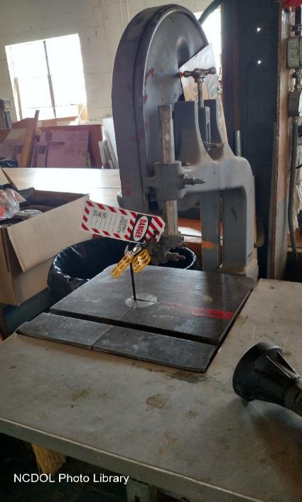
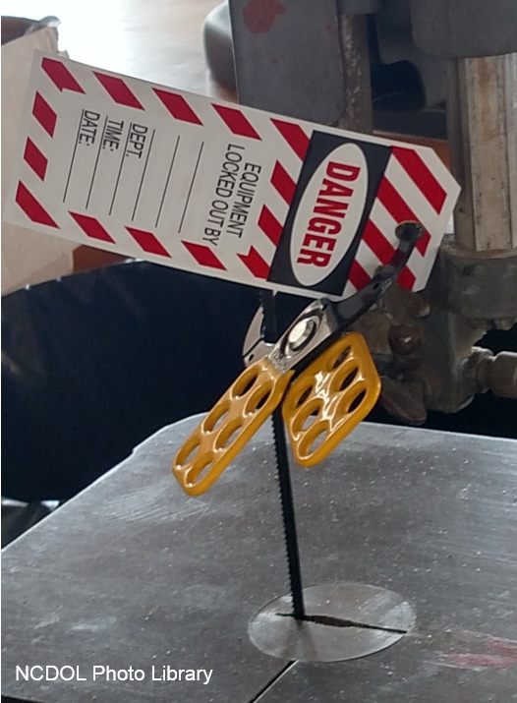
Is this a proper lockout?
NO
Why?

Slide 32
Energy Isolation
1910.147(c)(8)
Lockout or tagout shall be performed only by the authorized employees who are performing the servicing or maintenance

Slide 33
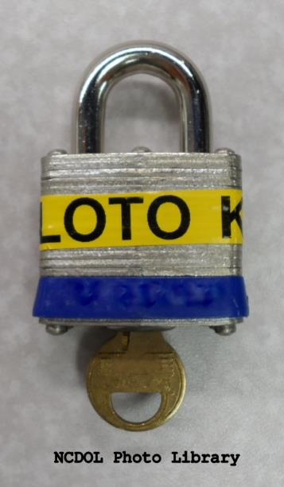
Notification of Employees
1910.147(c)(9)
Affected employees shall be notified by the employer or authorized employee of the application and removal of LOTO devices
Notification given before controls are applied, and after they are removed from the machine or equipment

Slide 34
Application of Control
1910.147(d)
Application of control
  Preparation for shutdown
  Machine or equipment shutdown
  Machine or equipment isolation
  LOTO device application
  Release of stored energy
  Verification of isolation

Slide 35
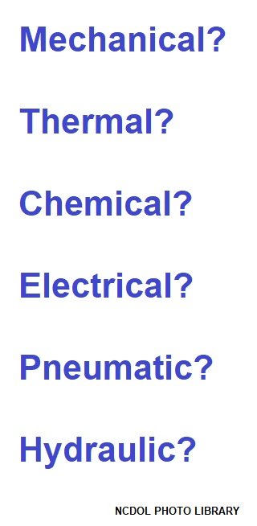
Preparation for Shutdown
1910.147(d)(1)
Know the types and amounts of energy
Know the hazards of the energy
Know method or means to control energy

Slide 36
Machine/Equipment Shutdown
1910.147(d)(2)
Turn off or shut down using established procedures
Utilize orderly shutdown to avoid additional or increased hazard(s) to employees as a result of the equipment stoppage

Slide 37
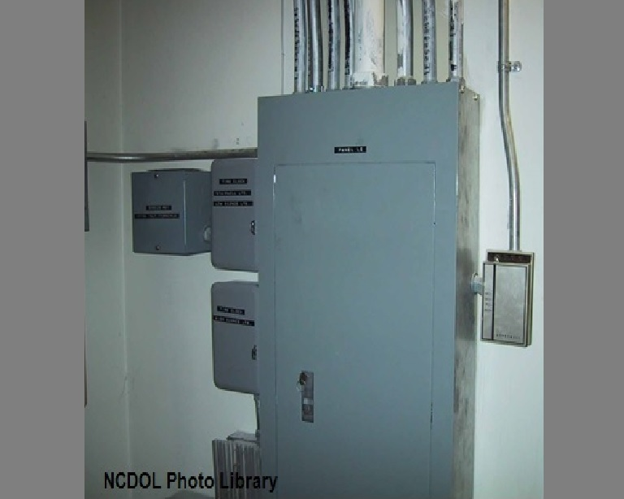
Machine/Equipment Isolation
1910.147(d)(3)
All energy isolating devices needed to control energy shall be physically located to isolate the machine or equipment from the energy source(s)

Slide 38
Lockout/Tagout Application
1910.147(d)(4)
Devices shall be affixed to each energy isolating device by authorized employees
Lockout devices shall be affixed in a manner that will hold the energy isolating devices in a “safe” or “off” position
Tagout devices shall be affixed in a manner indicating that the operation or movement of energy isolating devices from the “safe” or “off” position is prohibited

Slide 39
Release of Stored Energy
1910.147(d)(5)
After application of device, all potentially hazardous stored or residual energy shall be relieved, disconnected, restrained, and otherwise rendered safe

Slide 40
Verification of Isolation
1910.147(d)(6)
Prior to starting work on machines or equipment that have been locked out/tagged out
  Authorized employee shall verify that isolation and de-energization of the machine or equipment have been accomplished

Slide 41
Release from Control
1910.147(e)
Release from LOTO
  Inspection of machine or equipment work area
  Location of employees
  LOTO device removal

Slide 42
Inspection of Work Area
1910.147(e)
Before LOTO devices are removed and energy restored
  Work area inspected to ensure that nonessential items have been removed and to ensure that machine or equipment components are operationally intact
  Work area shall be checked to ensure that all employees have been safely positioned or removed
  Affected employees notified that LOTO devices are removed

Slide 43
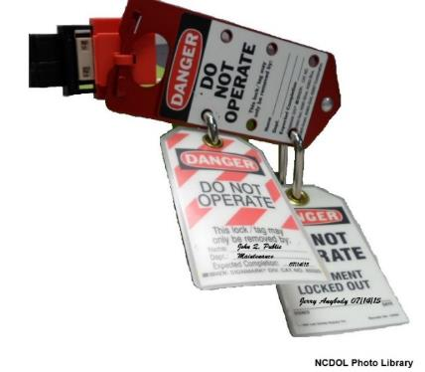
LOTO Device Removal
1910.147(e)(3)
Each LOTO device shall be removed from each energy isolating device by the employee who applied the device
  Exception: When authorized employee who applied the LOTO device is not available, device may be removed under the direction of the employer

Slide 44
LOTO Device Removal
1910.147(e)(3)
Employer removal of LOTO device
  Specific procedure shall include:
    Verification by employer that authorized employee who applied device is not at the facility
    Making all reasonable efforts to contact authorized employee to inform them that LOTO device has been removed, and
    Ensuring that authorized employee has this knowledge before they resume work at facility

Slide 45
Testing/Positioning Machines
1910.147(f)
When LOTO devices must temporarily be removed for testing/positioning:
  Clear machine or equipment of tools and materials
  Remove employees from area
  Remove lockout/tagout device
  Energize and proceed with testing or positioning
  Deenergize and reapply energy control measures

Slide 46
Outside Personnel
1910.147(f)(2)
Contractors and the on-site employer must exchange lockout/tagout information
On-site employees must understand and comply with rules used by the contractor

Slide 47

Group Lockout/Tagout
1910.147(f)(3)
When servicing and/or maintenance is performed by a group, they shall utilize a procedure which affords employee protection equivalent to a personal LOTO device

Slide 48
Group Lockout/Tagout
1910.147(f)(3)
Primary responsibility is vested in an authorized employee
Authorized employee must ascertain exposure status of group members
If more than one crew is involved, a coordinator shall be designated
Each authorized employee shall use a personal LOTO device and remove device when they stop working on machine/equipment

Slide 49
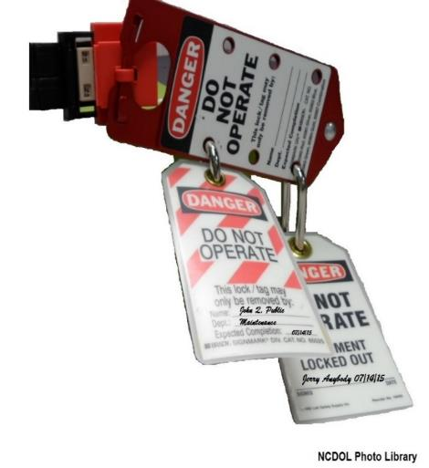
Shift/Personnel Changes
1910.147(f)(4)
Specific procedures used during shift/personnel changes to ensure the continuity of LOTO protection
  To minimize exposures from the unexpected energization or start-up of the machine/ equipment, or release of stored energy

Slide 50

Sample LOTO Program
Appendix A
Typical minimal lockout procedures
  A non-mandatory guideline to assist employers and employees in complying with the requirements of this section

Slide 51
Summary
In this course, we covered:
  The need for energy control procedures
  Methods of lockout/tagout procedures
  Employer’s responsibilities
  Employee training needs
  Inspection requirements

Slide 52
Thank You For Attending!
Final Questions?

