Slide 1
Introduction to the
N.C. Department of Labor
OSH Division
Understanding OSH in N.C.
Notes:
Revised 6/16/25
The information in this presentation is provided voluntarily by the N.C. Department of Labor, Education Training and Technical Assistance Bureau as a public service and is made available in good faith. This presentation is designed to assist trainers conducting OSHA outreach training for workers. Since workers are the target audience, this presentation emphasizes hazard identification, avoidance, and control – not standards. No attempt has been made to treat the topic exhaustively. It is essential that trainers tailor their presentations to the needs and understanding of their audience.
The information and advice provided on this Site and on Linked Sites is provided solely on the basis that users will be responsible for making their own assessment of the matters discussed herein and are advised to verify all relevant representations, statements, and information.
This presentation is not a substitute for any of the provisions of the Occupational Safety and Health Act of North Carolina or for any standards issued by the N.C. Department of Labor. Mention of trade names, commercial products, or organizations does not imply endorsement by the N.C. Department of Labor.

Slide 2
Objectives
At the end of the course students will be able to:
  Understand the Occupational Safety and Health Act and subparts
  Know the OSH Division and its various bureaus
    Functions of each bureau
    How each bureau can assist you
  Look for the standards that employers must follow in North Carolina

Slide 3
Occupational Safety and Health Act
Williams - Steiger Occupational Safety and Health Act of 1970 (OSHA) is a federal law enacted to protect workers.
  Enacted into law on December 29, 1970
  Also referred to as Public Law §91-596
    Passed by 91st Congress and signed by President Nixon

Slide 4
North Carolina is a State OSHA Plan
Under Section 18 of the Occupational Safety and Health Act
  (b) Any State which, at any time, desires to assume responsibility for development and enforcement therein of occupational safety and health standards relating to any occupational safety or health issue with respect to which a Federal standard has been promulgated under section 6 shall submit a State plan for the development of such standards and their enforcement.
Notes:
.

Slide 5
North Carolina State Plan
NCGS 95-126
Occupational Safety and Health Act of North Carolina was signed into law in 1973.
  Must be “as effective as” Federal OSHA.
  Monitored by Federal OSHA.
Majority of the standards are adopted verbatim from Federal OSHA.
Any state desiring Federal OSHA approval for private sector occupational safety and health program must also cover its state and local government workers.

Slide 6

Rules and Standards
North Carolina General Statute (NCGS)
North Carolina Administrative Code (NCAC)
Code of Federal Regulation (CFR)

Slide 7
North Carolina General Statutes
North Carolina OSH Act
  General Duty Clause
  Inspections (Right to enter/right to inspect)
  Employer/employee rights and responsibilities
Safety and Health Programs and Committees Act
Right to Know Act
Migrant Housing Act
Notes:
Besides the North Carolina OSH Act (Article 16), parts of which we will discuss on the next few slides, the OSH Division enforces the Safety and Health Programs and Committees Act, Right to Know Act, and Migrant Housing Act.

Slide 8
North Carolina OSH Act
NCGS 95-129(1)
General Duty Clause
  Each employer shall furnish to each of his employee's conditions of employment, and
  A place of employment which are free from recognized hazards that are causing or are likely to cause death or serious physical harm to his employees.

Slide 9
North Carolina OSH Act
NCGS 95-129(1)
The employer failed to keep the workplace free of a hazard to which employees of that employer were exposed and:
  The hazard was recognized in the industry,
  The hazard was causing or likely to cause death or serious physical harm, and
  There was a feasible and useful method to correct the hazard.
Notes:
The hazard be can feasibly be corrected.

Slide 10
North Carolina OSH Act
NCGS 95-129(1)
Key points
  Consensus standards; ANSI, NFPA, NEC
  Manufacturer’s use and maintenance
  Industry knowledge/best practice
General duty provisions shall be used only where there is no OSHA standard that applies to the particular hazard involved
  i.e.; ergonomics, heat stress, indoor air quality

Slide 11

North Carolina OSH Act
NCGS 95-136
Inspections
  Right to enter without delay and at any reasonable
  time.
  Right to inspect and investigate during regular
  working hours.

Slide 12
North Carolina OSH Act
NCGS 95-129
Rights and responsibilities
  Employers
    Furnish employees with safe and healthy working conditions.
    Comply with occupational safety and health standards.
    May participate in hearings on proposed standards.
    Entitled to review any citation.

Slide 13
North Carolina OSH Act
NCGS 95-130
Rights and responsibilities
  Employees
    Must comply with the standards.
    Obtain training from their employer on any chemicals or other hazardous materials they may be exposed to or working with, such as bloodborne pathogens.
    Receive information about OSHA standards, job hazards, worker injuries, and workers' rights from their employer.

Slide 14
North Carolina OSH Act (cont.)
NCGS 95-130
    Request that a dangerous condition or OSHA violation is corrected by their employer.
    File complaint to OSHA of a violation or serious hazard in the workplace and to have their name withheld from their employer.
    Be involved in any OSHA inspection, find out the results of the inspection, and if necessary, appeal the final action.
    File complaint to OSHA without possibility of retaliation or other discriminatory acts by their employer.

Slide 15
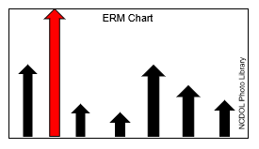
Safety & Health Programs & Committees Act
NCGS 95-251/252
Requires written safety and health programs and safety committees in workplaces with high experience rate modifiers (1.5 or higher).
OSH notifies employers who must comply with this legislation.

Slide 16
Right To Know Act
NCGS 95-173 through 221
Requires employers who manufacture, process, use, store, or produce hazardous chemicals to compile and maintain a Hazardous Substance List (NCGS 95-191).
  Copy provided to Fire Chief
  Updated at least annually

Slide 17

Migrant Housing Act
NCGS 95–222 through 229
Requires housing provided to migrant agricultural laborers be registered with and inspected by the State.
  Responsibility is handled by the Agricultural Safety and Health (ASH) Bureau of the N.C. Department of Labor.

Slide 18
North Carolina Administrative Code
Title 13 (Labor) – Chapter 7 (OSH)
  Subchapter A – General Rules and Operational Procedures
  Subchapter F – Standards
  Subchapter G – Handling of Antineoplastic Agents
Takes precedence over the Federal Regulations
Incorporates the CFR

Slide 19
Code of Federal Regulations
29 CFR 1904 – Recordkeeping
29 CFR 1910 – General Industry
29 CFR 1915 – Shipyards*
29 CFR 1917 – Marine Terminals*
29 CFR 1926 – Construction
29 CFR 1928 – Agriculture
    * Applies only to the Public Sector
Notes:
*

Slide 20
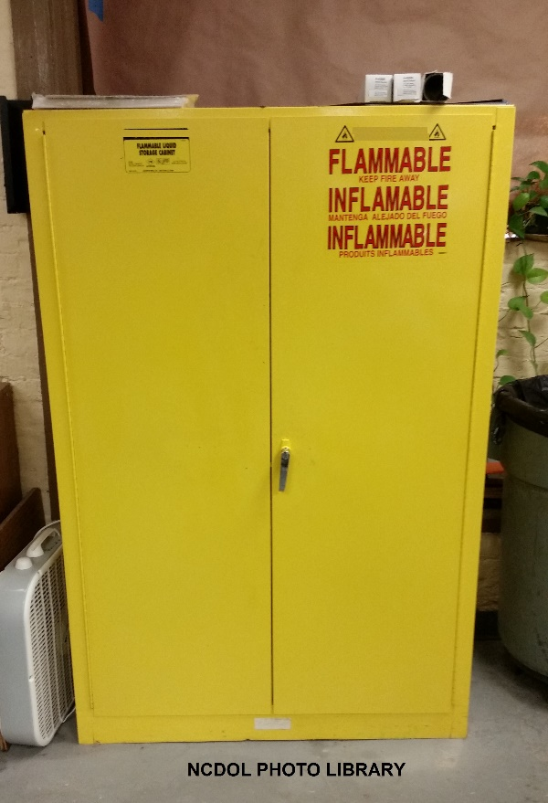
State - Specific Standards
General Industry
  Hazardous materials
Maritime (Public Sector only)
Blasting and Use of Explosives
Communication Towers
Handling of Antineoplastic Agents

Slide 21
State - Specific Standards
Construction
  General Safety and Health Provisions
    Personal protective equipment (PPE)
  Occupational Health and Environmental Controls
    Nonionizing radiation
  Personal protective and life saving equipment
  Steel erection
  Toxic and Hazardous Substances
    Bloodborne pathogens

Slide 22
North Carolina Department of Labor
OSH
Division
Consultative
Services
Bureau
Education,
Training
and
Technical
Assistance
Bureau
Agricultural
Safety
and
Health
Bureau
Planning,
Statistics
and
Information
Management
Bureau
East
and West
Compliance
Bureaus
NCDOL Photo Library

Slide 23
Consultative Services
On-site Consultation
  Safety and health surveys
  Technical assistance
  Safety and health program assessment and assistance
  Hazard identification
  Air sampling and analysis
  Noise measurements
Photo courtesy of Rodgers Builders
NCDOL Photo Library

Slide 24
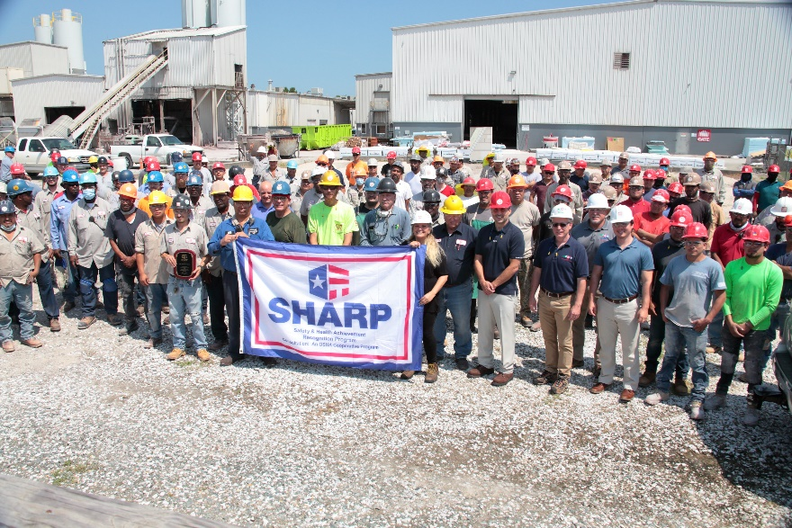
Consultative Services
Safety and Health Achievement Recognition Program (SHARP)
Partnerships
Photo courtesy of Rodgers Builders
NCDOL Photo Library

Slide 25
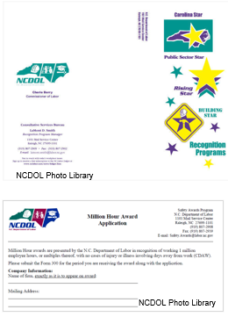
Education, Training and Technical Assistance
Recognition Programs
  Safety Awards
  Carolina Star Programs
    Carolina Star
    Rising Star
    Building Star
    Public Sector
Alliances

Slide 26
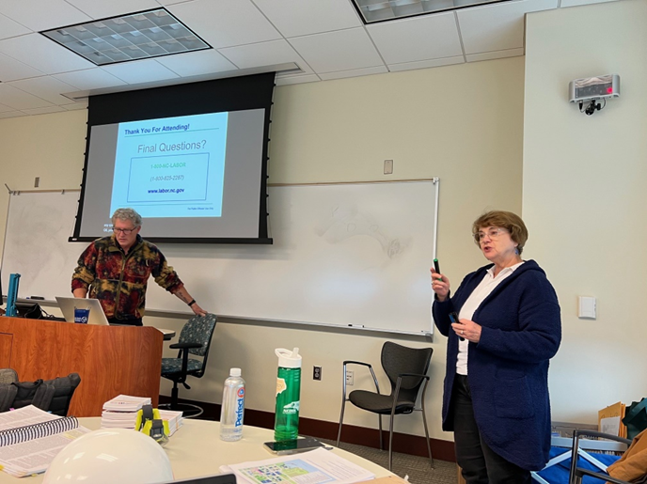
Education, Training and Technical Assistance
Education and Training
  Safety and health workshops
  Speaker’s bureau
  Webinars
  Display booths
  Training calendar
NCDOL Photo Library
NCDOL Photo Library

Slide 27
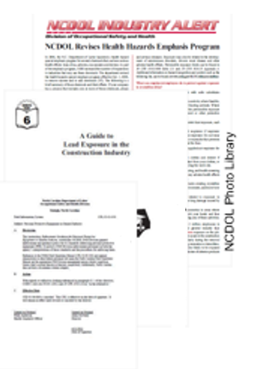
Education, Training and Technical Assistance
Technical Assistance
  Federal standards review for state adoption
  Coordinate State - specific rulemaking activities
  Interpretation assistance
  Variance applications
  Publications (English and Spanish)

Slide 28
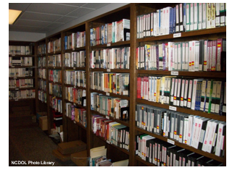
Education, Training and Technical Assistance
Library
  Provide research assistance (e.g., consensus standards)
  Loan videos, DVDs and publications
  On-line catalog
  Streaming video service

Slide 29

Agricultural Safety and Health
Conduct inspections in agricultural workplaces
  Complaint, fatality, and referral
  Conduct pre-occupancy inspections of migrant housing
Bilingual outreach program
ASH publications
Gold Star Grower Housing Program

Slide 30
Planning, Statistics and Information Management
OSH Compliance inspection targeting system
Coordinate OSH Division strategic planning
Manage OSH Compliance and ASH inspection targeting system
Case file management (disclose Compliance, ASH, and Employment Discrimination files, archive Compliance/ASH files)
Compile/analyze OSH Division statistical data

Slide 31
East and West Compliance
Enforcement of the OSH standards
  Conduct safety and health compliance inspections
  Recommend the issuance of citations and penalties
  Ensure the completion of abatements and/or corrective actions
  Manage the OSH Complaint Desk

Slide 32
Contact Information and Resources
NCDOL web site: www.labor.nc.gov
Federal OSHA web site: www.osha.gov
ETTA: 919-707-7876
Consultative Services: 919-707-7846
NCDOL toll-free: 1-800-NC-LABOR (1-800-625-2267)
Complaint/Referral/Fatality: 919-779-8560

Slide 33
Summary
In this course, we discussed the:
  Occupational Safety and Health Act
  OSH Division function and its various bureaus
  Standards that employers must follow in North Carolina and where to find them

Slide 34
Understanding the Code of Federal Regulations (CFR)
General Industry (29 CFR 1910)
Notes:
Revised: 12/2023
The information in this presentation is provided voluntarily by the N.C. Department of Labor, Education Training and Technical Assistance Bureau as a public service and is made available in good faith. This presentation is designed to assist trainers conducting OSHA outreach training for workers. Since workers are the target audience, this presentation emphasizes hazard identification, avoidance, and control – not standards. No attempt has been made to treat the topic exhaustively. It is essential that trainers tailor their presentations to the needs and understanding of their audience.
The information and advice provided on this Site and on Linked Sites is provided solely on the basis that users will be responsible for making their own assessment of the matters discussed herein and are advised to verify all relevant representations, statements, and information.
This presentation is not a substitute for any of the provisions of the Occupational Safety and Health Act of North Carolina or for any standards issued by the N.C. Department of Labor. Mention of trade names, commercial products, or organizations does not imply endorsement by the N.C. Department of Labor.

Slide 35
Objectives
Show how to read the standards
Define vertical and horizontal standards
Practice finding standards

Slide 36
Reading the Code of Federal Regulations
Do you know what these numbers and letters represent?
  29 CFR 1910.184(i)(3)(ii)
  29 (Title)
    CFR (Code of Federal Regulations)
      1910 (Part)
        184 (i)(3)(ii) (Section)

Slide 37

Federal Government
Statutes
Code
Title
Subtitle
Chapter
Part
Subpart
Section (standard)

Slide 38
Code of Federal Regulations
Occupational Safety and Health
  29 CFR 1904 – Recordkeeping
  29 CFR 1910 – General Industry
  29 CFR 1915 – Shipyards
  29 CFR 1917 – Marine Terminals
  29 CFR 1926 – Construction
  29 CFR 1928 – Agriculture

Slide 39
Types of Standards
Standards can be described as being:
  Horizontal
  or
  Vertical
NCDOL Photo Library
Relevant to all industries
Relevant to only a particular industry
NCDOL Photo Library

Slide 40
Consensus Standards
CFR 1910.6
Incorporated by Reference
  American Conference of Governmental Industrial Hygienists (ACGIH)
  American Society of Agricultural Engineers (ASAE)
  American National Standards Institute (ANSI)
  American Society of Mechanical Engineers (ASME)
  American Society for Testing and Materials (ASTM)
  American Welding Society (AWS)
  Department of Commerce (U.S. Government)
  National Fire Protection Association (NFPA)

Slide 41
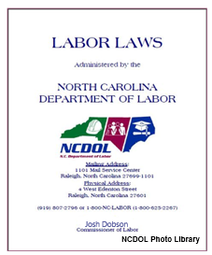
Other Useful Information
North Carolina Administrative Code (NCAC)
Addendum
Letters of interpretation
Index

Slide 42

Let’s Work On Examples

Slide 43
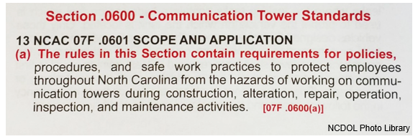
Standards Look-up
Practice finding the Communication Tower Standards specific to North Carolina: Section 13 NCAC 07F.0600
  On which page is this located in your standards book?

Slide 44
Standards Look-up
Practice finding the standard for Recording and Reporting Occupational Injuries and Illnesses: 29 CFR 1904
  On which page is this located in your standards book?
Which standard contains the recordability decision tree?
Which standard outlines the requirements for reporting fatalities and multiple hospitalization incidents to OSHA?
1904.4(b)(2)
1904.39

Slide 45
Questions
Are headlights required on forklifts?
As part of the hazard communication training requirements:
  When must training be conducted?
  What topics must be covered?
Who must review lockout/tagout procedures?
Who is responsible for paying for personal protective equipment?
1910.178(h)(2)
1910.1200(h)(1)
1910.1200(h)(2) - (3)
1910.147(c)(6)(i)
1910.132(h)

Slide 46
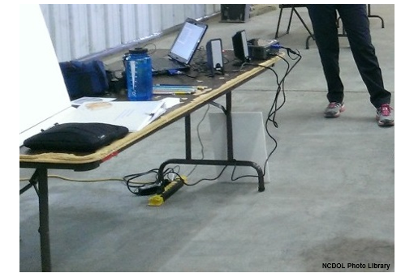
Which standard addresses this hazard?
Standard violated:

Slide 47
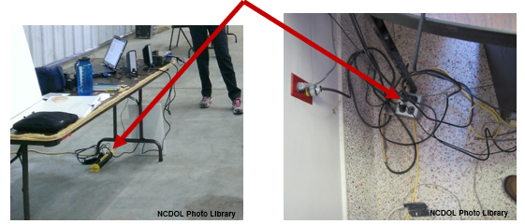
Which standard addresses this hazard?
Standard violated:
  1910.305(a)(2)(ii)
    Temporary wiring shall be removed immediately upon completion of the project or purpose for which the wiring was installed

Slide 48
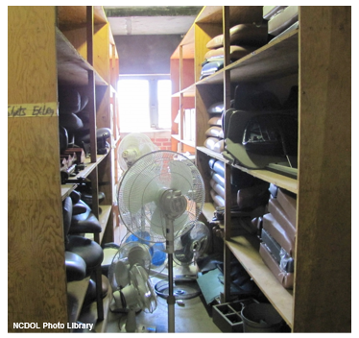
Which standard addresses this hazard?
Standard violated:

Slide 49
Which standard addresses this hazard?
Standard violated:
  1910.22(a)(1)
    All places of employment shall be kept clean and orderly

Slide 50
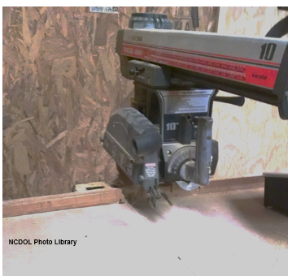
Which standard addresses this hazard?
Standard violated:

Slide 51
Which standard addresses this hazard?
Standard violated:
  1910.213(h)(1)
    Lower portion of blade must be guarded on both sides

Slide 52
Summary
In this course we discussed:
  How to read the standards
  Vertical and horizontal standards definitions
  Practice finding standards

Slide 53
Thank You For Attending!
Final Questions?

