Slide 1
Understanding the OSHA Inspection Process
Notes:
Revised 06/25
The information in this presentation is provided voluntarily by the N.C. Department of Labor, Education Training and Technical Assistance Bureau as a public service and is made available in good faith. This presentation is designed to assist trainers conducting OSHA outreach training for workers. Since workers are the target audience, this presentation emphasizes hazard identification, avoidance, and control – not standards. No attempt has been made to treat the topic exhaustively. It is essential that trainers tailor their presentations to the needs and understanding of their audience.
The information and advice provided on this Site and on Linked Sites is provided solely on the basis that users will be responsible for making their own assessment of the matters discussed herein and are advised to verify all relevant representations, statements, and information.
This presentation is not a substitute for any of the provisions of the Occupational Safety and Health Act of North Carolina or for any standards issued by the N.C. Department of Labor. Mention of trade names, commercial products, or organizations does not imply endorsement by the N.C. Department of Labor.

Slide 2
Objectives
At the end of this course, students will be able to:
  Understand different inspection types
  Identify what generates an inspection
  Understand the procedures involved as a compliance inspection
  Describe the rights and responsibilities of employers and employees
  Understand the post-inspection process

Slide 3
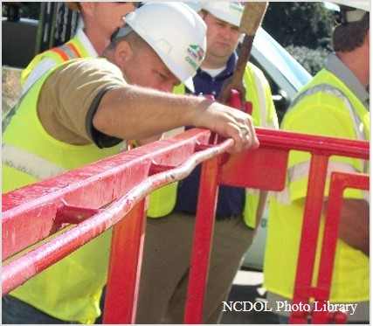
Inspection Types/Priorities
Imminent danger
Fatality/catastrophe
Complaints
Referrals
Follow-up
Programmed

Slide 4
Programmed
Special Emphasis Programs (SEP)
  Amputations
  Construction
  Logging/Arboriculture
  Long Term Care
  Health Hazards (e.g., lead, beryllium, silica, hexavalent chromium, isocyanates)
  Food Manufacturing
  Warehousing, Storage, and Related Product Distribution Industries

Slide 5
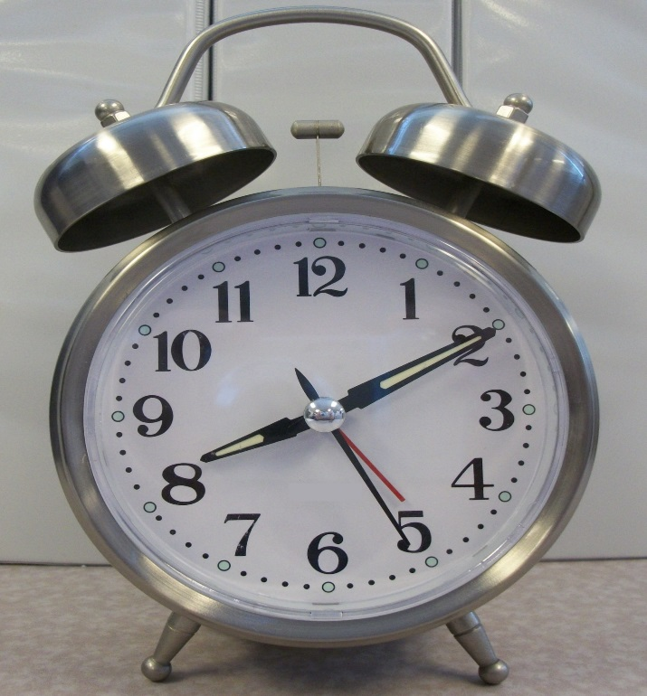
Workplace Entry
Normal working hours
Credentials
Refusal
Interference
Special situations
  Inspect on 2nd/3rd shift
  Security clearance
  Sampling
NCDOL Photo Library

Slide 6
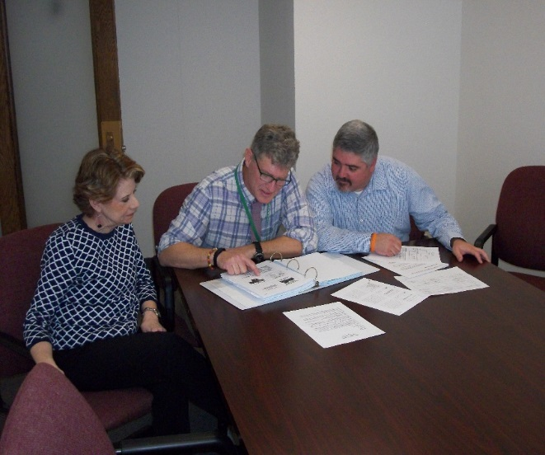
Opening Conference
Purpose and scope
Records inspection
Walk around representatives
Trade secrets
NCDOL Photo Library

Slide 7
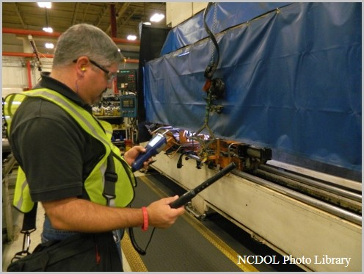
Walk Around Inspection
Plain view hazards
Program evaluation
Safety/health inspection
Interviews
Photographs
Nova Development

Slide 8
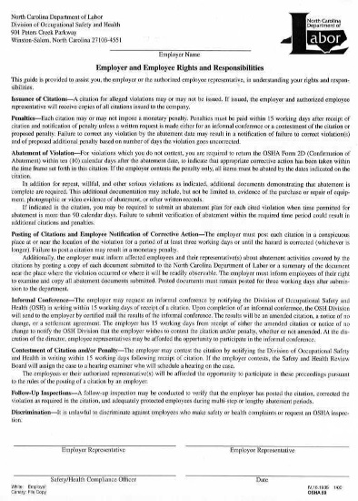
Closing Conference
Discuss findings and potential alleged violations
Employer and employee rights and responsibilities
  Form 59
NCDOL Photo Library
Nova Development

Slide 9

After the Inspection
Citations or in-compliance
Abatement
Violation types
Penalties
Informal conference
Contestment
Discrimination
NCDOL Photo Library

Slide 10
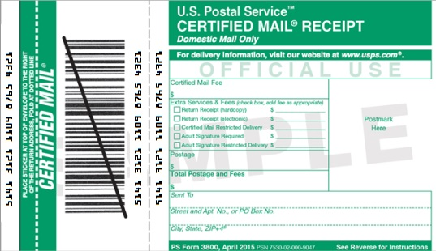
Citations
Issuance
  Received by certified mail
Posting
  Three days or until the hazards are abated, whichever is longer

Slide 11
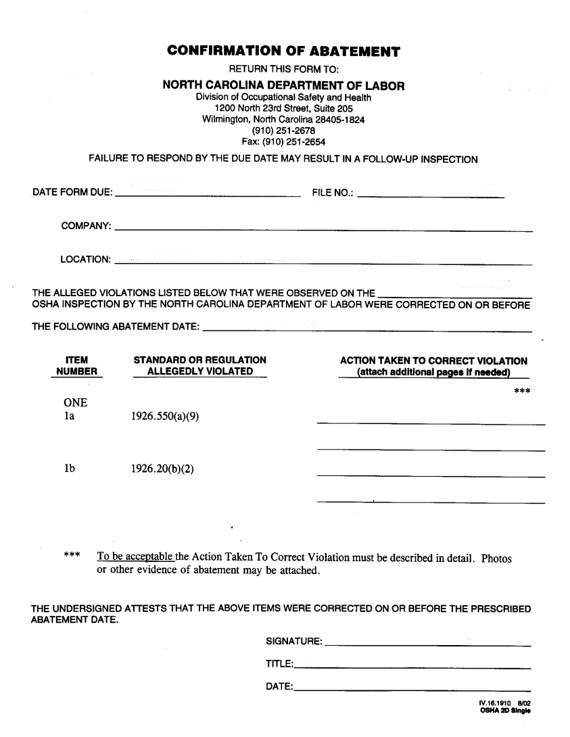
Abatement
Date - extension
OSHA Form 2D
Follow-up inspection
NCDOL Photo Library

Slide 12
Violations
Types of violations
  Serious
    “Deemed to exist in the place of employment if there is substantial probability that death or serious physical harm could result.…”
  Non-serious
    “Situations where the accident or illness that would be most likely to result from a hazardous condition would probably not cause death or serious physical harm....”

Slide 13
Violations
  Willful
    When evidence shows either an intentional violation of the act or plain indifference to its requirements.
  Criminal-Willful
    Employer willfully violates any standard which causes death of an employee and is found guilty.
  Repeat
    Employer has been cited previously for a substantially similar condition.
  Failure to Abate
    Employer has not corrected a previously cited violation which has become final order.

Slide 14
Hazard Assessments
Severity
  Most likely an injury or illness resulting from exposure
Probability
    Number of employees exposed
    Frequency and duration of exposure
    Employee distance from the hazard
    Other factors

Slide 15
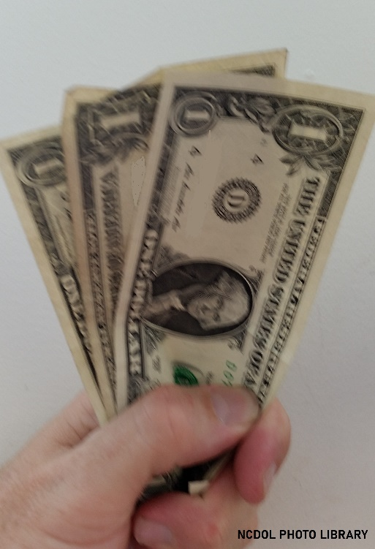
Maximum Penalties
Willful – $165,514
Repeat – $165,514 (x2, x5, x10)
Serious – $16,550 (*exception)
Failure to Abate – $16,550/day
Non-serious – May have monetary value

Slide 16
Penalty Adjustment Factors
Size (# of Employees) | 251+ | 176-250 | 131-175 | 91-130 | 56-90 | 26-55 | 1-25
 | 0% | 20% | 30% | 40% | 50% | 60% | 70%
History |  |  |  | 10%
Safety and Health Programs |  |  |  | 0%, 10%, 25%, 40%
Notes:
16

Slide 17
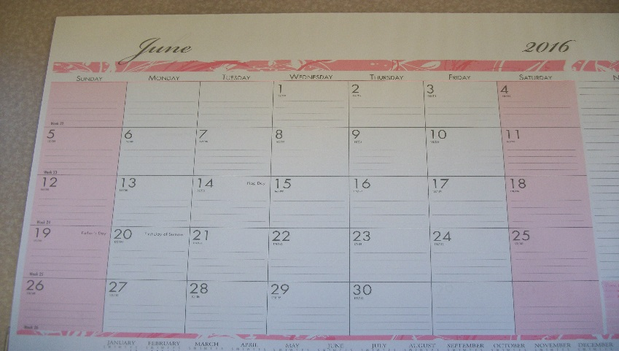
Informal Conference
Time frame
Post request
Settlement agreement - posted
Notice of amended citations
Notice of no change
NCDOL Photo Library

Slide 18
Contestment
Any part of citation
Written
Time frame
Administrative Law Judge
OSH Review Commission
NCDOL Photo Library

Slide 19
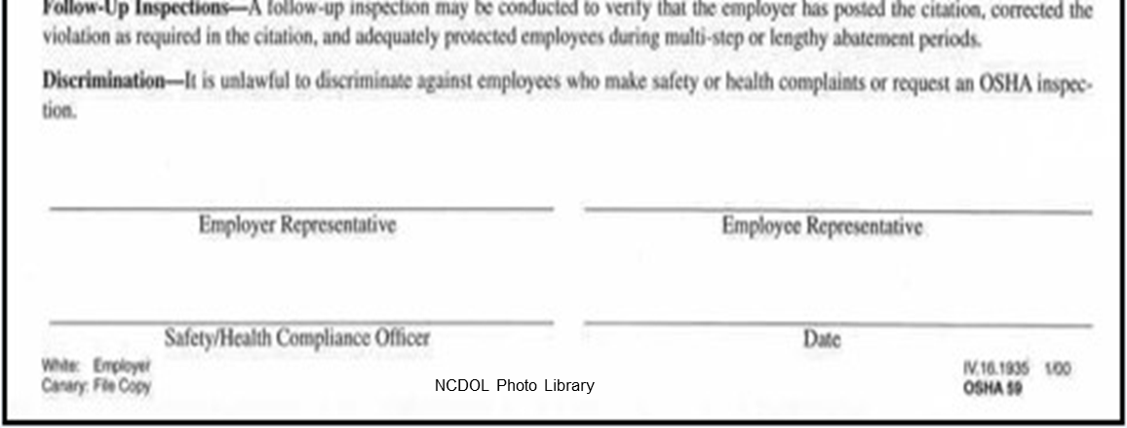
Discrimination
It is unlawful to discriminate against employees who file safety or health complaints or request an OSHA inspection.
NCDOL Photo Library

Slide 20
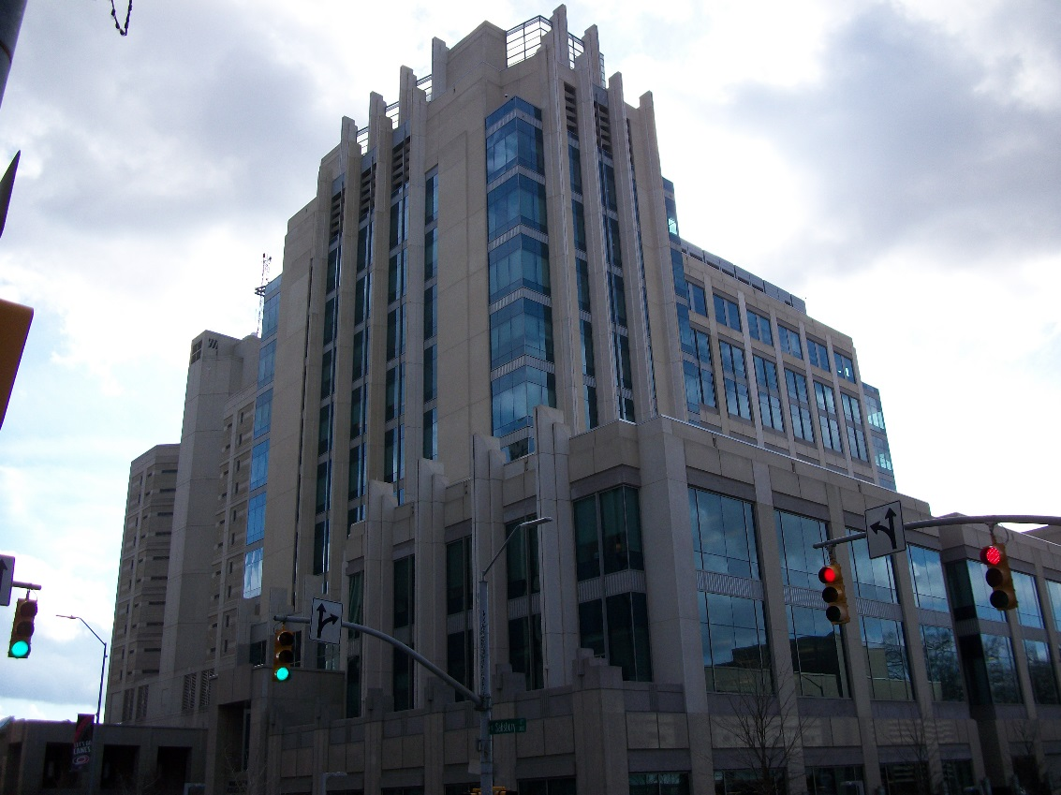
Other Issues
Criminal penalties
Wake Co. Justice Center
NCDOL Photo Library
Notes:
20

Slide 21
Summary
In this course, we discussed:
  Inspection types
  What generates an inspection
  Procedures of a compliance inspection
  Rights and responsibilities of employers and employees
  What happens after an inspection
Wake Co. Justice Center
NCDOL Photo Library
Notes:
21

Slide 22
Thank You For Attending!
Final Questions?

