Slide 1
Heat Stress
Notes:
Revised 06/16/25
The information in this presentation is provided voluntarily by the N.C. Department of Labor, Education, Training and Technical Assistance Bureau as a public service and is made available in good faith. This presentation is designed to assist trainers conducting OSHA outreach training for workers. Since workers are the target audience, this presentation emphasizes hazard identification, avoidance, and control – not standards. No attempt has been made to treat the topic exhaustively. It is essential that trainers tailor their presentations to the needs and understanding of their audience.
The information and advice provided on this Site and on Linked Sites is to provided solely on the basis that users will be responsible for making their own assessment of the matters discussed herein and are advised to verify all relevant representations, statements, and information.
This presentation is not a substitute for any of the provisions of the Occupational Safety and Health Act of North Carolina or for any standards issued by the N.C. Department of Labor. Mention of trade names, commercial products, or organizations does not imply endorsement by the N.C. Department of Labor.

Slide 2
Objectives
At the end of this course, students will be able to:
  Recognize heat stress hazards and how to prevent them.
  Understand heat disorders and health effects.
  Discuss the hierarchy of controls for heat stress hazards and heat environments.
Notes:
2

Slide 3
Heat Stress Poll
How many of you work in extreme heat conditions or supervise those that do?
How many of you have ever had a job working in extreme heat conditions?
Is heat stress only a concern for outdoor workers?
Can heat stress lead to a fatality?
Notes:
3

Slide 4
The “Perfect Storm” for Heat Stress
Dark heavy tight wool, nylon or polyester clothing
Working in direct sunlight
No water provided
Heavy physical work (such as using an ax or shovel)
High heat index (>115º F)
No breaks
No hat
Long workday
Worker not acclimated
NCDOL Photo Library
Notes:
4

Slide 5
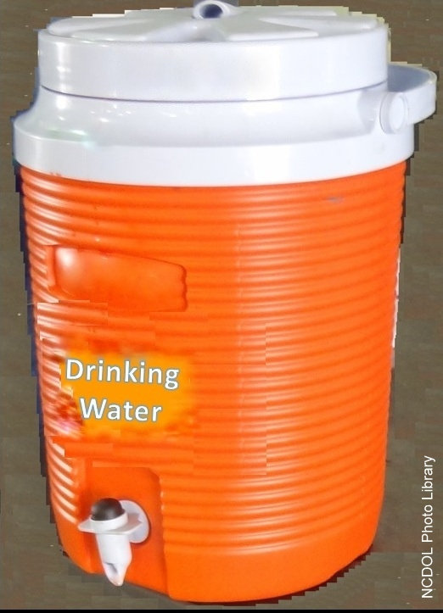
Provide Water
Adequate supply of potable water
2 - 4 cups per hour per worker
50º - 60º F
Marked container (e.g., “Drinking Water”)
Closed container
No shared container (e.g., cup, dipper, bottle)
Notes:
5

Slide 6
Definitions
Heat stress
  Sum of environmental and metabolic heat loads on an individual minus the heat loss to the environment, primarily through evaporation.
Heat strain
  Overall physiological response resulting from heat stress.
NCDOL Photo Library
Notes:
6

Slide 7
The Four Environmental Factors
Temperature
  Ambient air temperature
Humidity
  Amount of moisture in the air
Radiant heat
  Such as from the sun or a furnace
Air velocity
  Circulating air
NCDOL Photo Library

Slide 8
Causal Factors
Age, weight, degree of physical fitness
Degree of acclimatization, metabolism
Use of alcohol or drugs
A variety of medical conditions such as hypertension all affect a person’s sensitivity to heat
NCDOL Photo Library
Notes:
8

Slide 9
Causal Factors
Prior heat injury predisposes an individual to additional injury.
Type of clothing worn must be considered.
Fabrics ?
Colors ?
Notes:
9

Slide 10
The Heat Index
Heat Index | Risk Level | Protective Measures
Less than 91° F | Lower (caution) | Basic heat safety and planning
91° F to 103° F | Moderate | Implement precautions and heighten awareness
103° F to 115° F | High | Additional precautions to protect workers
Greater than 115° F | Very high to extreme | Triggers even more aggressive protective measures
NCDOL Photo Library

Slide 11
Heat Disorders and Health Effects
Heat rash
Heat cramps
Heat exhaustion
Heat stroke
NCDOL Photo Library
Notes:
11

Slide 12
Cal/OSHA Heat Illness Study
Half of the workers suffered heat illnesses on the first day of work.
80% of the workers had been on the job for four or fewer days.
NCDOL Photo Library
https://www.dir.ca.gov/DOSH/heatillnessinvestigations-2005.pdf
Notes:
12

Slide 13
Heat Rash
Most common problem in hot work environments.
Symptoms
  Prickly heat is manifested as red papules and usually appears in areas where the clothing is restrictive.
  Sweat cannot freely evaporate from the skin and sweat ducts become plugged.
NCDOL Photo Library
Notes:
13

Slide 14
Heat Rash
Prevention
  Prevented by breathable clothing and thorough cleansing of the skin.
Treatment
  Treated by keeping skin dry, use of cooled sleeping quarters, and calamine lotion.
NCDOL Photo Library
Notes:
14

Slide 15
Heat Cramps
May result after excessive water loss, sweating, and dehydration.
Symptoms
  Shriveled skin, sunken eyes, dry mouth, and tongue
  Severe pain and cramps in legs and abdomen, fainting or dizziness, weakness, profuse sweating, and headaches
Treatment
  Increase fluid intake, provide rest, and move to a cool place.
NCDOL Photo Library
Notes:
15

Slide 16
Heat Exhaustion
Blood moves toward outer body to remove heat.
  Blood pools in the skin leaving less for the brain.
Symptoms
  Fatigue, headache, dizziness, profuse sweating, rapid pulse, thirst, loss of appetite, nausea, vomiting, and fainting
NCDOL Photo Library
Notes:
16

Slide 17
Heat Exhaustion
Treatment
  Get to the shade, cool off, increase fluids; use cold wet towels or ice; use a fan; elevate legs above heart; loosen clothing; don’t give any liquids containing alcohol or caffeine.
  If condition worsens, seek medical attention immediately.
  If left untreated, heat exhaustion can
  lead to HEAT STROKE.
NCDOL Photo Library
Notes:
17

Slide 18
Heat Stroke
A medical emergency and a life-threatening condition caused by the failure of the heat-regulating mechanisms of the body due to high heat and humidity.
Core temperature rises, and body stops sweating
NCDOL Photo Library
Notes:
18

Slide 19
Heat Stroke
Symptoms
  Skin is hot, dry, and flushed; rapid pulse; confusion; nausea; convulsions; abnormally high body temperature (e.g., rectal temp. > 105.8° F); unconsciousness.
Treatment
  Move to cooler location, loosen clothing, immerse in cool water, wrap in wet sheets, and apply cold compresses to the head, neck and groin.
  SEEK MEDICAL ATTENTION IMMEDIATELY
NCDOL Photo Library
Notes:
19

Slide 20
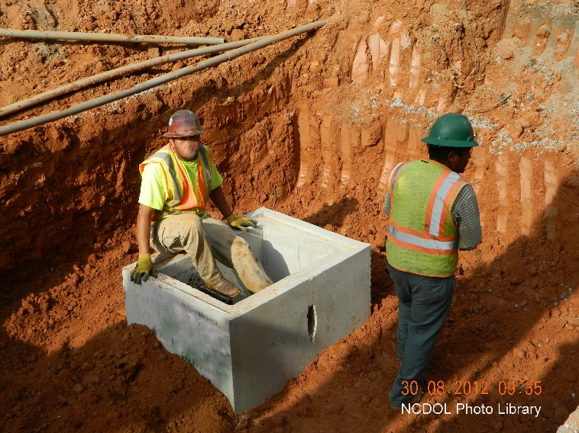
Heat Fatalities – What were workers doing? ₁
Asbestos remediation
Weed trimming
Drywall finishing
Steel connection
General construction
Recycling conveyor line
Carrying mail
Ship cleanup operation
Bulldozer operation
Oil and gas well drilling
1 – Source: OSHA Heat Fatalities Map (2008-2014)
Notes:
20

Slide 21

Heat Fatalities – What were workers doing?
Working on a roof
Digging trenches
Outside painting
Residential framing
Cutting down trees
Installing synthetic turf
Highway construction
Repairing roof
Collecting garbage
Harvesting cantaloupes
1 – Source: OSHA Heat Fatalities Map (2008-2014)
Notes:
21

Slide 22
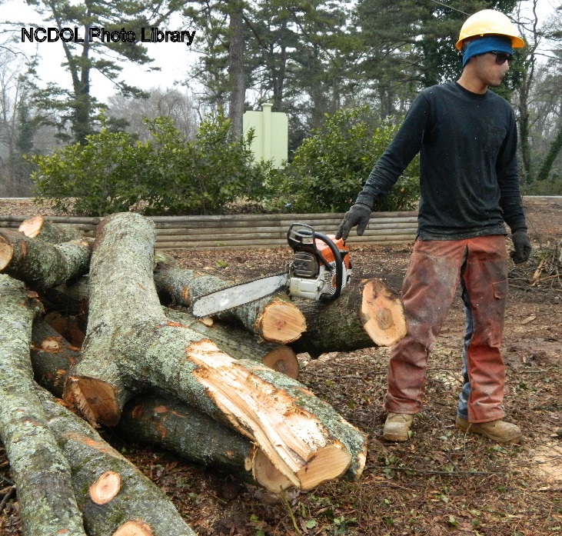
Heat Fatalities – What were workers doing?
Catering an outdoor event
Harvesting pistachios
Working at a golf course
Landscaper
Changing a tractor tire
Laying brick
Fighting a fire
Cutting trees
Paving
Repairing air conditioning units
1 – Source: OSHA Heat Fatalities Map (2008-2014)
Notes:
22

Slide 23
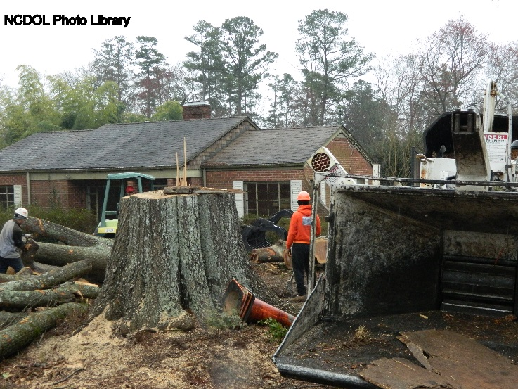
Heat Fatalities – What were workers doing?
Picking strawberries
Cleaning up a construction jobsite
Installing a swimming pool
Mowing grass
Pouring concrete
Pruning trees
Shoveling soil
Priming tobacco
Erecting rental tents
1 – Source: OSHA Heat Fatalities Map (2008-2014)
Notes:
23

Slide 24
Citations for Heat Stress?
Heat stress hazards are cited using the “General Duty Clause”.
General Duty Clause
  Each employer will furnish to each of his employee’s conditions of employment and a place of employment that are free from recognized hazards that are causing or are likely to cause death or serious physical harm to his employees.
OSHA Compliance

Slide 25
The “General Duty Clause”
NCGS 95-129(1)
The employer failed to keep the workplace free of a hazard to which employees of that employer were exposed and:
  The hazard was recognized in the industry;
  The hazard was causing or likely to cause death or serious physical harm; and
  There was a feasible and useful method to correct the hazard.
OSHA Compliance

Slide 26
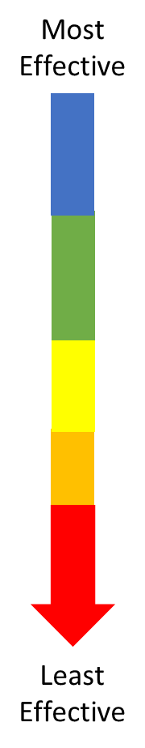
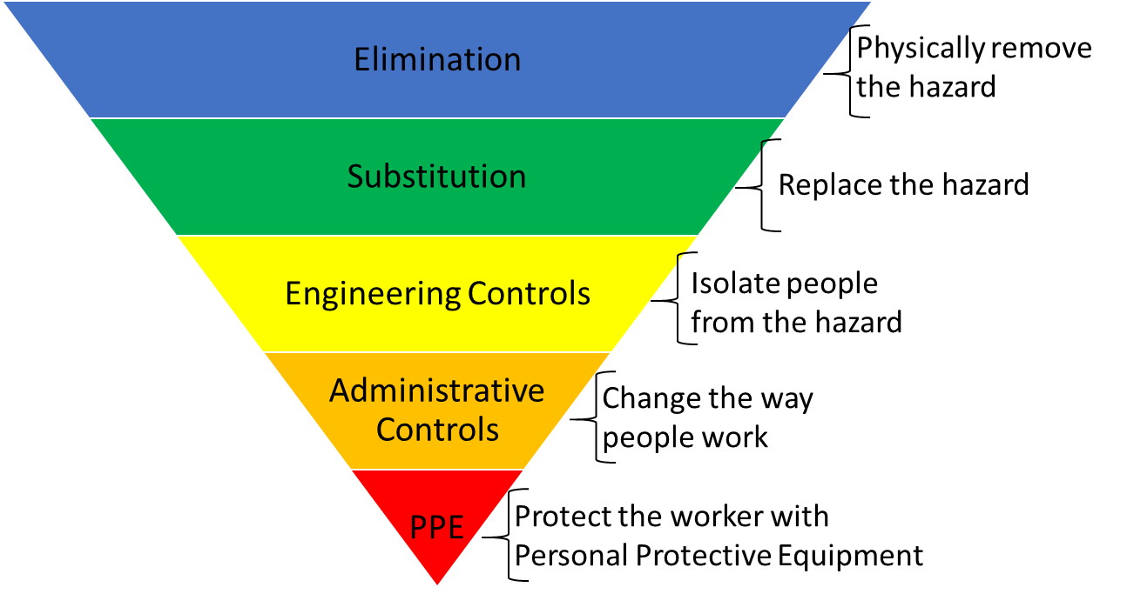
Hierarchy of Controls
NCDOL Photo Library

Slide 27
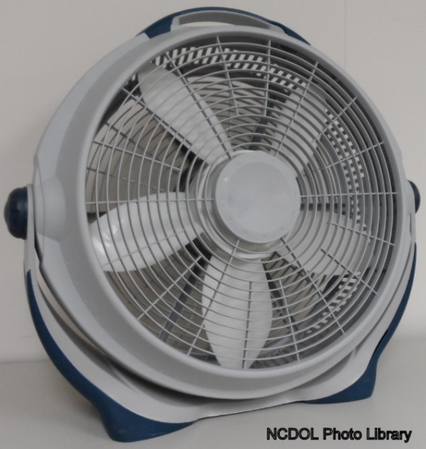
Engineering Controls
General ventilation
Air treatment
  Air cooling
  Air conditioning
Local air cooling
Convection
Heat conduction
Radiant heat sources
  Shielding
  Insulation and surface modification
Notes:
27

Slide 28
Work Practice Controls
  Perform work activities during cooler periods of the day
  Minimize activity in hot area
Slow down the work pace
  Reduce the number and duration of exposures
  Wear proper clothing
Provide recovery areas
Work rate
  The fastest way to decrease the rate of heat production is to decrease the work rate.
Notes:
28

Slide 29
Personal Protective Equipment
Reflective clothing
Auxiliary body cooling
  Ice vests
  Wetted clothing (low humidity)
  Water-cooled garments (hoods, vests and “long johns”)
  Circulating air (vortex tubes, compressed air)
NCDOL Photo Library
Notes:
29

Slide 30
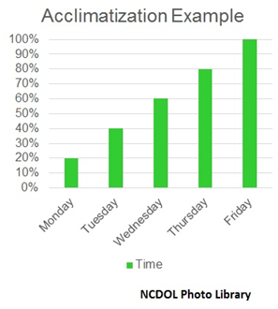
Acclimatization
Successive heat exposures of at least one hour per day.
Initially, 20% exposure for the first day, followed by 20% per day increase in exposure over the next four days.
Notes:
30

Slide 31
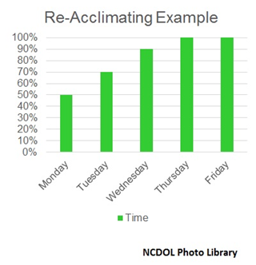
Re-Acclimating
After long absences
  50% exposure on day back
  20% per day increase for the next 2 days
  Final 10% on the 3rd day
Notes:
31

Slide 32

Work Monitoring Programs
Personal monitoring
  Heart rate
  Recovery heart rate
  Oral temperature
  Extent of body water loss
Notes:
32

Slide 33
Training
Knowledge of hazards
Predisposing factors (e.g., age, medications)
Signs and symptoms
PPE
First-aid
Health effects of heat-related illness
NCDOL Photo Library
Notes:
33

Slide 34
Bottom Line
Excessive heat in the work environment can lead to:
  Serious physical harm and/or death
The keys are:
  Recognition of the hazards
  Preventive measures
NCDOL Photo Library
Notes:
34

Slide 35
Action Items for Affected Employers
A heat illness prevention program
A heat acclimatization program
Access to an adequate supply of potable water
Means for employees to cool off (e.g., shaded areas, air-conditioned rooms, vehicles, fans)
Adequate number of rest periods
Appropriate protective clothing such as cooling vests
Heat stress training
First aid training (e.g., recognition, treatment of heat illnesses

Slide 36
Summary
In this course, we discussed the following:
  Heat stress hazards and how to prevent them
  Heat disorders and health effects
  Hierarchy of controls for heat stress hazards and heat environments

Slide 37

Thank You For Attending!
Final Questions?

