Slide 1
Food Manufacturing Special Emphasis Program
NAICS 311
:
Notes:
Revised: 06/23/2025
The information in this presentation is provided voluntarily by the N.C. Department of Labor, Education Training and Technical Assistance Bureau as a public service and is made available in good faith. This presentation is designed to assist trainers conducting OSHA outreach training for workers. Since workers are the target audience, this presentation emphasizes hazard identification, avoidance, and control – not standards. No attempt has been made to treat the topic exhaustively. It is essential that trainers tailor their presentations to the needs and understanding of their audience.
The information and advice provided on this Site and on Linked Sites is provided solely on the basis that users will be responsible for making their own assessment of the matters discussed herein and are advised to verify all relevant representations, statements, and information.
This presentation is not a substitute for any of the provisions of the Occupational Safety and Health Act of North Carolina or for any standards issued by the N.C. Department of Labor. Mention of trade names, commercial products, or organizations does not imply endorsement by the N.C. Department of Labor.

Slide 2
Objectives
At the end of this course, students will understand:
  Purpose of a Food Manufacturing Special Emphasis Program (SEP).
  What this program means for North Carolina employers.
  Areas of focus when an inspection occurs.

Slide 3
Why a Food Manufacturing SEP?
Employees exposed to production machinery.
Production jobs typically require no prior training and education.
Production levels are not sensitive to economic conditions.
Injury/illness rates higher than other sectors.

Slide 4
Food Manufacturing
Industry groups:
NAICS 3111 Animal Food Mfg. | NAICS 3112 Grain and Oilseed Milling | NAICS 3113 Sugar and Confectionery Mfg. | NAICS 3114 Fruit and Vegetable Preserving and Specialty Food Mfg.
NAICS 3115 Dairy Product Mfg. | NAICS 3116 Animal Slaughtering and Processing | NAICS 3117 Seafood Product Prep and Packaging | NAICS 3118 Bakeries and Tortilla Mfg.
NAICS - North American Industry Classification System

Slide 5
Bureau of Labor Statistics (BLS)
Non-Fatal Incidence Rates
2020 BLS Data | TRC Rate | DART Rate
NC - All Private Industry | 2.2 | 1.3
National - All Private Industry | 2.9 | 1.8
NC - Food Manufacturing NAICS 311 | 3.8 | 3.0
National - Food Manufacturing NAICS 311 | 3.8 | 3.0
Total Recordable Case – TRC
Days Away, Restricted or Transferred – DART

Slide 6
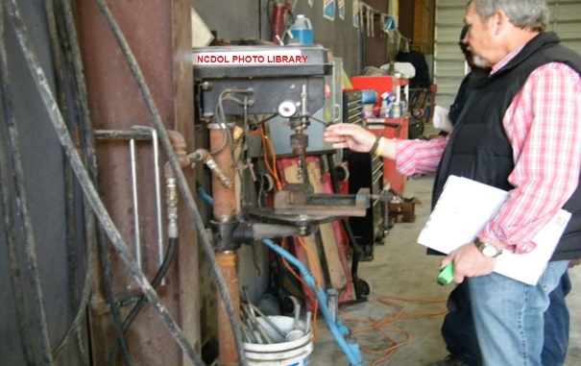
Inspection Types
Inspection assignments generated through:
  Fatalities
  Accidents
  Complaints and referrals
  General industry schedule criteria

Slide 7
Inspection Priority
Inspections are generated and assigned according to priority.
  Imminent Danger > Fatality/Catastrophe > Complaints/Referrals > Follow-up/Monitoring > SEP Programmed
Unprogrammed inspections can be expanded to cover the SEP.

Slide 8
Inspection Scope
OPN 140
Comprehensive Inspection
Operational Procedure Notice 140 – Food Manufacturing SEP Inspection
Complaint

Slide 9
Focus Areas of SEP Inspection
Process Safety Management (PSM)
OSHA Recordkeeping/Medical Records
Combustible Dust
Confined Spaces
Machine Guarding
Electrical Hazards
Lockout-Tagout (LOTO)
Ergonomics
Hazard Communication
Other Hazards

Slide 10
Machine Guarding
Focus Areas:

Slide 11
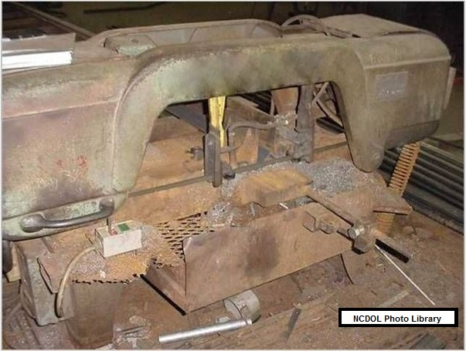
Machine Guarding 1910.212(a)(1)
Guarding provided to protect employees from hazards created by:
  Point of operation
  Ingoing nip points
  Rotating parts
  Flying chips and sparks
Does this saw comply
with the requirement?

Slide 12
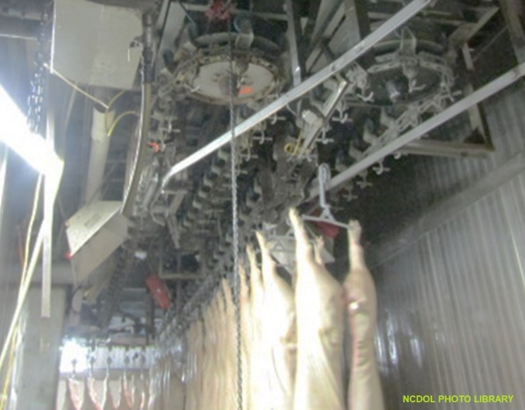
Work Environment
1910 Subpart O
Work often places employees in close proximity to moving equipment and systems.
Employee's access moving machinery to:
  Assist product flow,
  Clear blockages or spills, and
  Carry out cleaning duties.
Machine guarding required at the point of operation

Slide 13
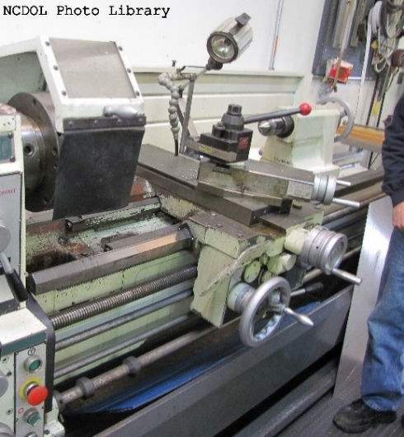
General Requirements 1910.212(a)(3)
Machine guarding required at the point of operation.
Special hand-tools must be used when entering danger zone.
  Supplemental protection only

Slide 14
Potential Hazard
1910 Subpart O
Conveyors - Dangerous and deadly if insufficient guarding and if safety procedures are not enforced.
  Examples:
    Materials placed correctly on conveyor.
    Employees trained to protect/safeguard hands.
    No long or loose clothing, hair, jewelry.

Slide 15
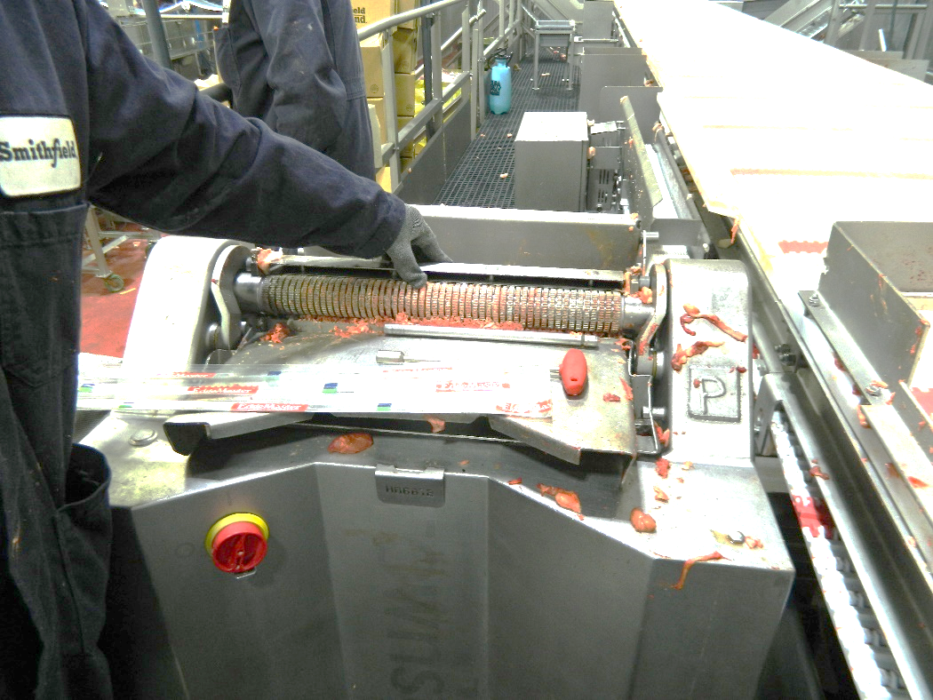
Potential Hazard
1910 Subpart O
Membrane skinners
  No guarding
  Severe damage and amputations can occur
NCDOL Photo Library

Slide 16
Potential Hazard
1910.212(a)(3)(ii)
Overriding or circumventing guards
  Ensure guarding doesn’t hinder production.
  Ensure guarding can’t be circumvented.
1910.212(a)(3)(ii) …The guarding device shall be in conformity with any appropriate standards therefor, or, in the absence of applicable specific standards, shall be so designed and constructed as to prevent the operator from having any part of his body in the danger zone during the operating cycle.

Slide 17
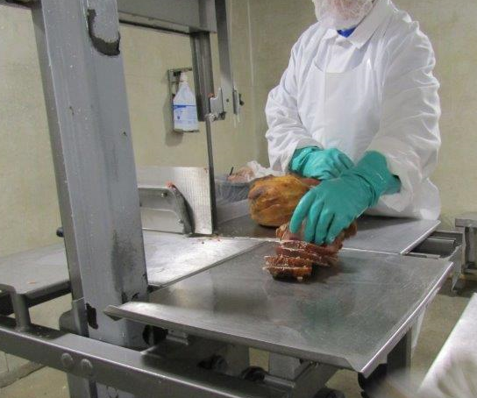
Example Violation
1910.212(a)(3)(ii)
Insufficient guarding/guarding not properly adjusted to cover the open blade.
  Exposing employees' hands to hazard
NCDOL Photo Library

Slide 18
Machine Guarding – Big Picture
Ensure effective barriers, covers, etc. are in place where needed.
Use LOTO when guarding must be circumvented.
Ensuring machine guarding reduces injuries.
Effective employee training.

Slide 19
Electrical and Lockout/Tagout
Focus Areas:

Slide 20
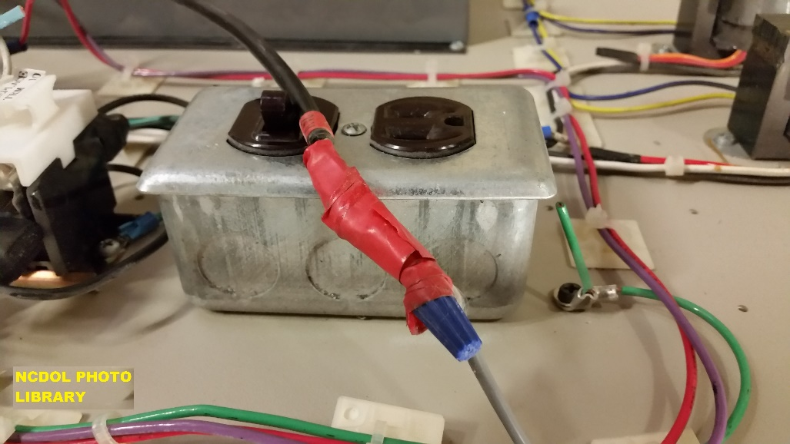
Electrical
General Requirements
1910.303(b)(1)
Examination installation, and use of equipment
  Electrical equipment must be free from recognized hazards:
    Cables exposed to sharp edges
    Splices
    Bare conductors

Slide 21
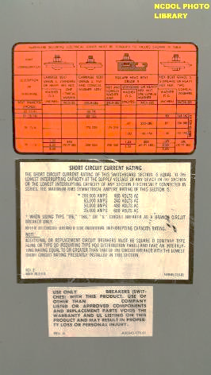
Electrical
General Requirements
1910.303(b)(2)
Installation and use
  Listed or labeled equipment shall be installed and used in accordance with its listing and labeling.

Slide 22
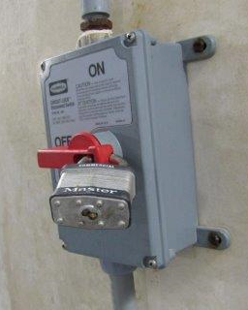
LOTO - Scope
1910.147(a)(1)
Covers the servicing and/or maintenance of machines or equipment where the unexpected start-up or release of stored energy could cause injury.
  Installation and set-up
  Adjustment or maintenance
  Inspection
  Modification
  Routine service
NCDOL Photo Library

Slide 23
LOTO - Application
1910.147(a)(2)
Normal production operations are not covered.
HOWEVER, servicing and/or maintenance tasks during production are covered if:
  Employee removes/bypasses guard or other safety device
  Employee is required to place any part of his/her body into the point of operation, or
  Where an associated danger zone exists during a machine operation.

Slide 24
LOTO - Application
1910.147(a)(2)
Exception
  Minor tool changes and adjustments, and other minor servicing activities, which take place during normal production operations, are not covered if they are:
    Routine,
    Repetitive, and
    Integral to the use of the equipment for production
Provided that the work is performed using alternative measures which provide effective protection.

Slide 25
Energy Control Procedure
1910.147(c)(4)
Energy control (LOTO) procedure
  Statement of intended use of procedure.
  Steps for shutting down, isolating, blocking and securing machines or equipment to control hazardous energy.
  Steps for the placement, removal and transfer of lockout devices or tagout devices and the responsibility for them, and
  Requirements for testing machine/equipment to determine and verify effectiveness of LOTO devices and other energy control measures.

Slide 26
Example Violation
1910.332(b)(2)
Lack of effective training
  Common violation
  Examples:
    Employees, who were not qualified persons, were not trained in and familiar with any electrically related safety practices not specifically addressed by 29 CFR 1910.331 through 29 CFR 1910.335, but which were necessary for their safety.
    Employee was working from a ladder on a light fixture and experienced an electrical shock.

Slide 27
Hazard Communication
Focus Areas:

Slide 28
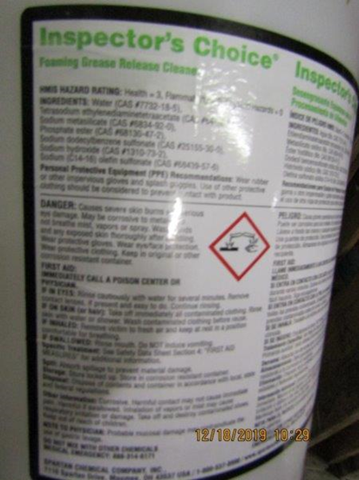
Hazard Communication
Specific chemical hazards can include:
  Ammonia
  Chlorine
  Carbon dioxide
  Hydrogen peroxide
  Peracetic acid
NCDOL Photo Library

Slide 29
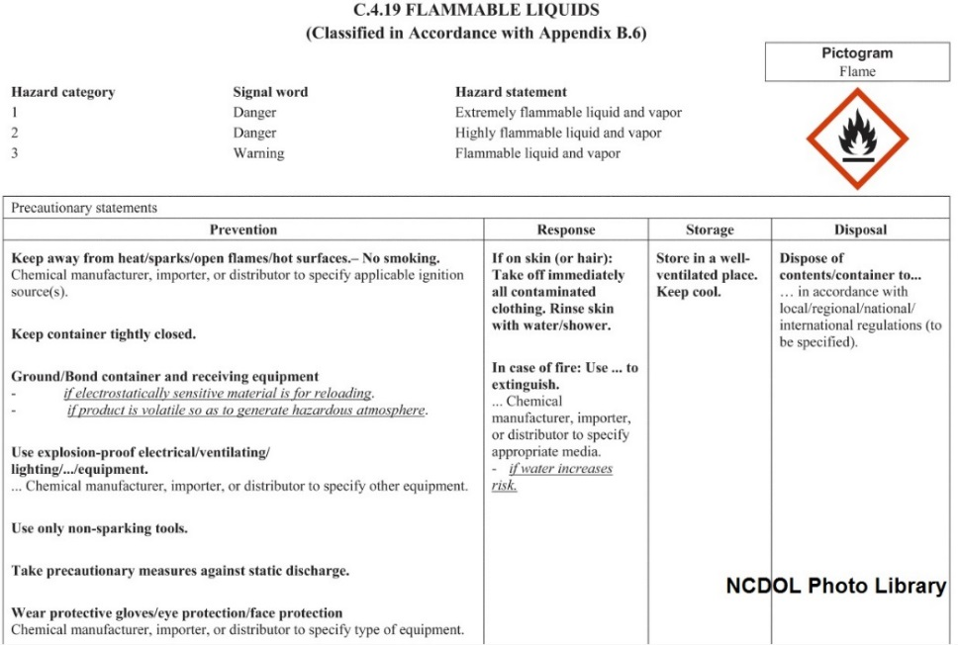
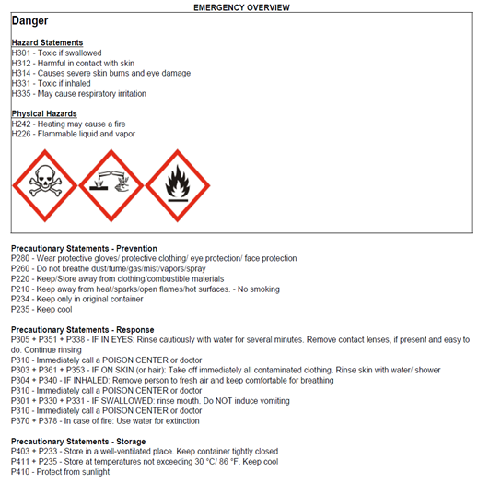
Key Elements of HazCom
1910.1200
Hazard classification
Written program
Labeling
Safety data sheets (SDS)
Employee training

Slide 30
Information and Training
1910.1200(h)
Training topic requirements
  How to recognize a chemical presence or release
  Types of hazards chemicals present
  Hazards not otherwise classified (HNOC)
  How to protect themselves
  Parts hazard communication program:
    An explanation of the labeling system
    Safety data sheets
    How employees can obtain/use the appropriate hazard information

Slide 31
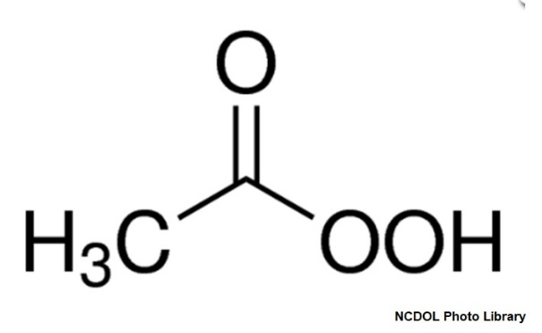
Hazard Example
Peracetic acid (PAA)
  Strong vinegar smell
  Irritating above 1 part per million (ppm)
  Corrosive and damaging to eyes and skin
  Respiratory irritant
  Level of hazard dependent on concentration

Slide 32
Confined Space
Focus Areas:

Slide 33
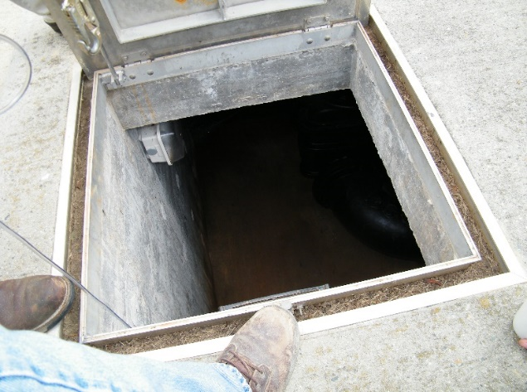
Confined Space
1910.146
Many manufacturing sites contain permit-required confined spaces.
  Food manufacturing facilities often have a large number of confined spaces, such as silos, tanks, mixing vats and storage bins, which creates risks when maintenance is needed.
NCDOL Photo Library

Slide 34
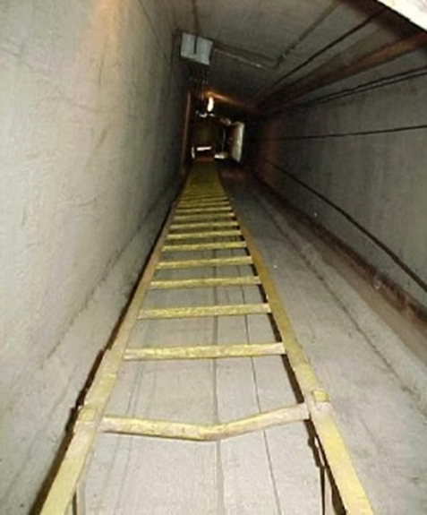
Example Confined Spaces
1910.146
Storage tanks
Process vessels
Boilers
Ducts
Utility vaults
Pipelines
Equipment and machinery
Open top spaces (>4 feet)
NCDOL Photo Library

Slide 35
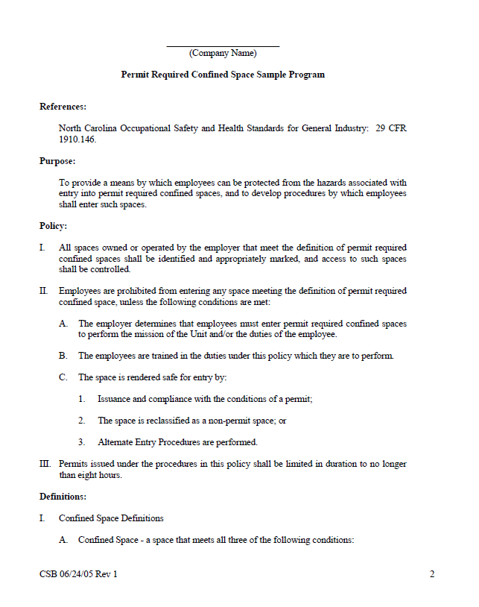
Written Permit Space Program
1910.146(c)(4)
If employees enter permit spaces, employer shall develop and implement a written permit space program.
NCDOL Photo Library

Slide 36
Combustible Dust
Focus Areas:

Slide 37
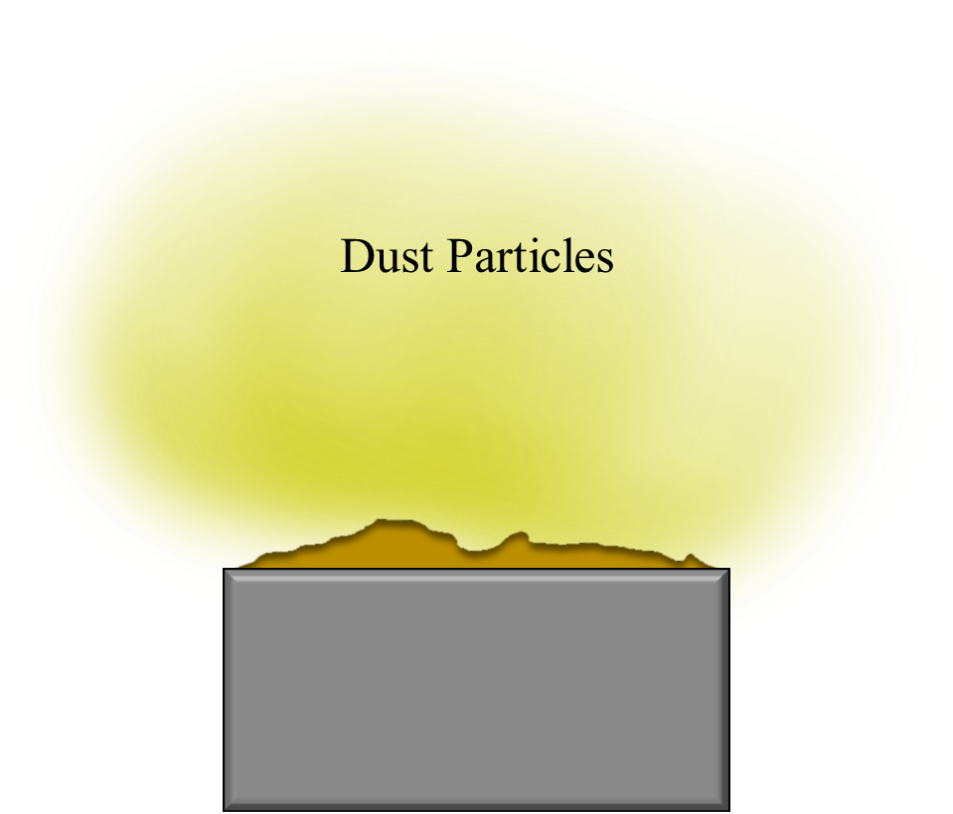
Combustible Dust
CPL 03-00-008
Combustible dust is a risk factor in the manufacturing of numerous food product segments, such as:
    Bakery
    Cookie and cracker
    Snack food
    Blends/mixes
    Cereal
    Spices

Slide 38
Combustible Dust
CPL 03-00-008
Any fine material that can catch fire and explode when mixed with air. Can be from:
  Most solid organic materials…
  Examples include sugar, starch, spices, flour
Can pass through a U.S. No. 40 Standard Sieve
  420 µm or smaller in diameter

Slide 39
Combustible Dust
CPL 03-00-008
Multiple standards can apply:
  1910.22, Walking - Working Surfaces
    Must maintain sanitary conditions
  1910.38, Emergency Action Plans
  1910.94, Ventilation
  1910.146, Permit - Required Confined Spaces
  1910 Subpart L – Fire Protection
    For example: 1910.157, Portable Fire Extinguishers
  1910.307, Hazardous (classified) Locations
  1910.1200, Hazard Communication

Slide 40
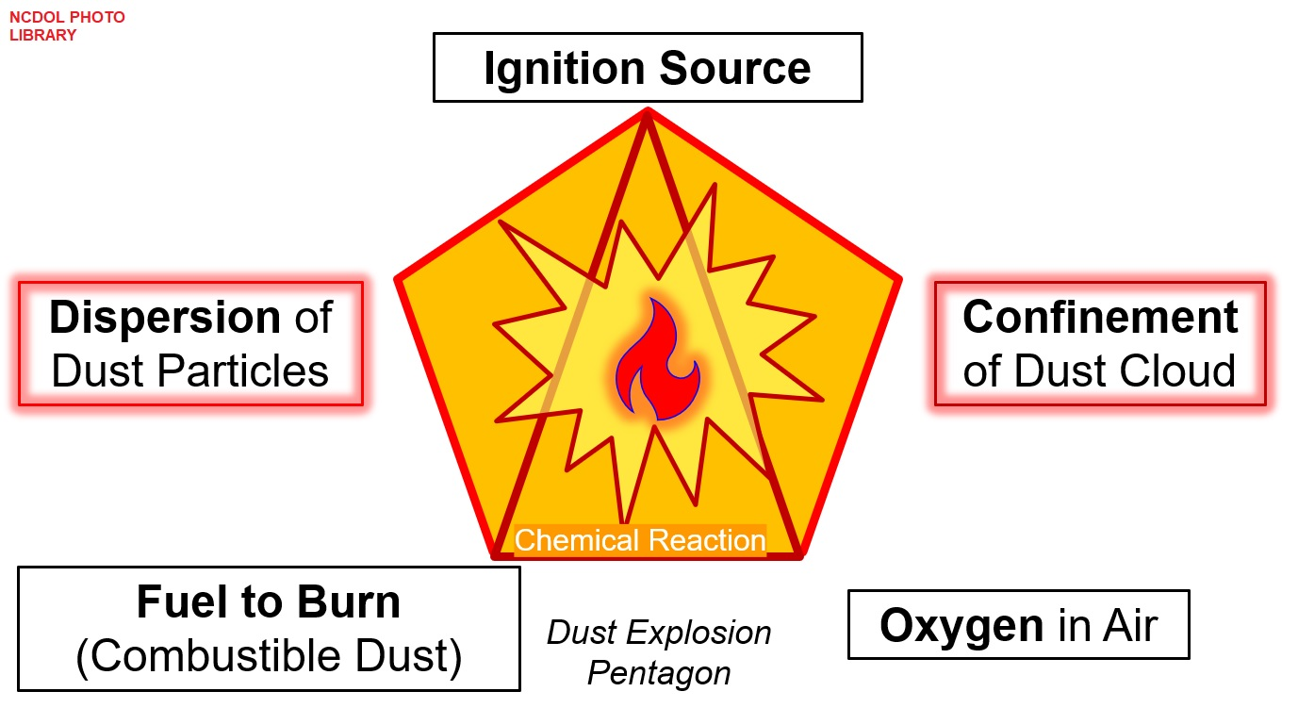
Elements of a Dust Explosion

Slide 41
Combustible Dust
CPL 03-00-008
If combustible dust hazard are not controlled the results can be disastrous:
Dust explosions have been linked to numerous fatal accidents.
Between 1980 and 2005, the U.S. Chemical Safety Board investigated 281 combustible dust incidents that killed 119 workers and injured 718 others.
Example: 2/7/2008 - Imperial Sugar Refinery
  Large accumulations of sugar dust
  14 deaths, 38 injured

Slide 42
Ergonomics
Focus Areas:

Slide 43
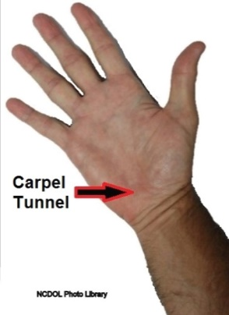
Ergonomics
NCGS 95-129(1)
Definition
  Ergonomics is defined as the science related to man and his work, embodying the anatomic, physiologic, and mechanical principles affecting the efficient use of human energy.
Injury examples
  Carpal tunnel syndrome; tendinitis; rotator
  cuff injuries (a shoulder problem); epicondylitis
  (an elbow problem); trigger finger; muscle
  strains and lower back injuries.

Slide 44
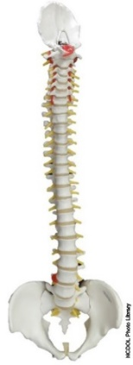
Ergonomic Program Elements
Management commitment
Employee involvement
Training
Workplace analysis
Prevention and control measures
Medical management
Program evaluation

Slide 45
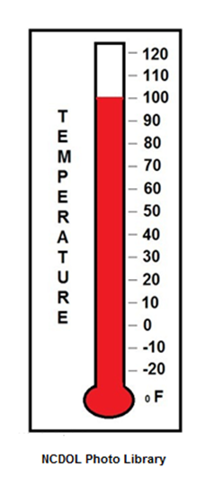
Movement/Environmental Stressors
Repetitive motions: Frequent and rapid muscular contractions
Static postures: In one position for long periods, reduces blood flow
Movement: Affected by work pace and task variety
Temperature: Psychological effects, hot, cold
Vibration: Damage small blood vessels and nerves

Slide 46
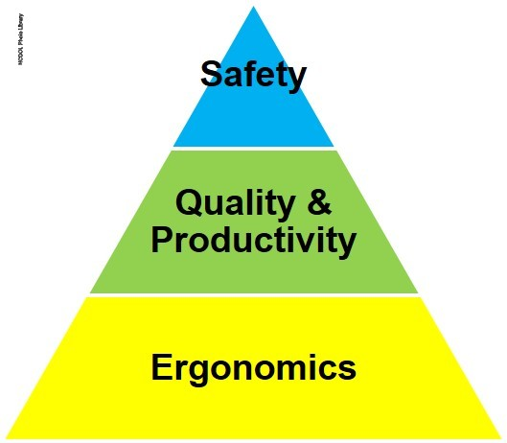
Workplace Problems and Losses
Increased discomfort, pain, injury or illness
Workers’ compensation costs
Lost or restricted work time
Short- or long-term disability
Increased absenteeism
Greater turnover
Low morale
Decreased productivity and/or quality

Slide 47
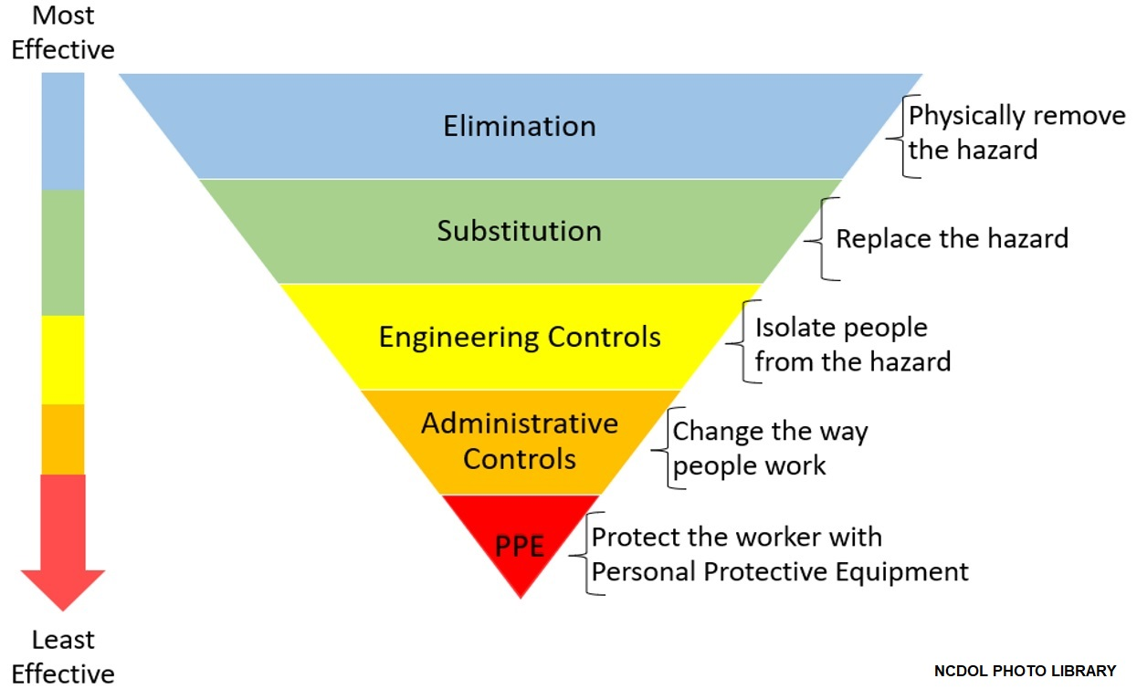
Hierarchy of Controls

Slide 48
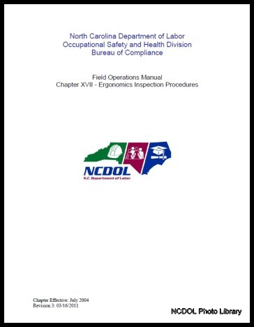
NCDOL OSH Division Perspective
North Carolina employers can be cited for ergonomic violations without an OSHA ergonomic standard.
Field Operations Manual (FOM) Chapter XVII
  Phase 1
  Phase 2
  Phase 3
Current citations are issued under the
General Duty Clause.

Slide 49
Recordkeeping
Focus Areas:

Slide 50
Recordkeeping – OPN 140
29 CFR 1904
Federal OSHA statistics have identified under-reporting of recordable cases in Food Manufacturing

Slide 51
Who Must Record?
1904.1
All employers in North Carolina except:
  Any employer with 10 or fewer employees for the previous calendar year.
  Any employer who is listed in the updated NAICS industry code list.
Exemptions above do not change employers’ reporting requirements.

Slide 52
General Recording Criteria
1904.7(a)
Death
Days away from work
Restricted work or transfer to another job
Medical treatment beyond first aid
Loss of consciousness
Diagnosed as a significant injury or illness

Slide 53
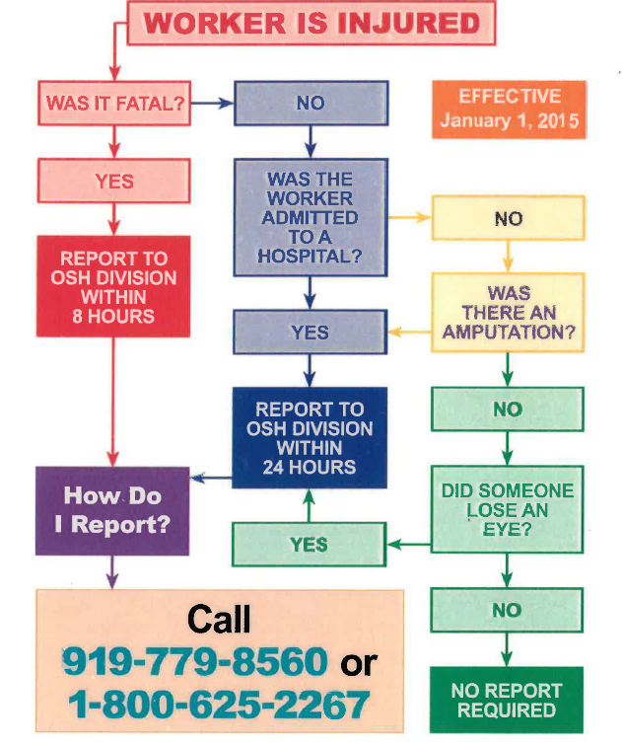
Reporting Requirements
1904.39
Fatalities
  8 hours
Hospitalizations
  24 hours
Amputations
  24 hours
Loss of eye
  24 hours

Slide 54
Respiratory Protection
Focus Areas:

Slide 55
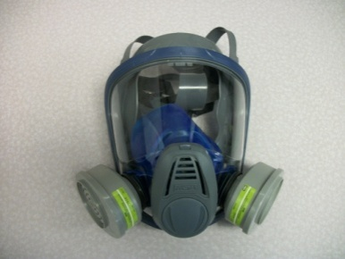
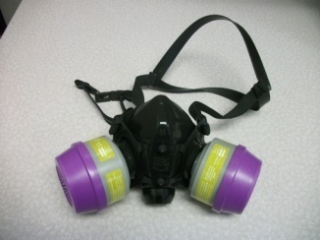
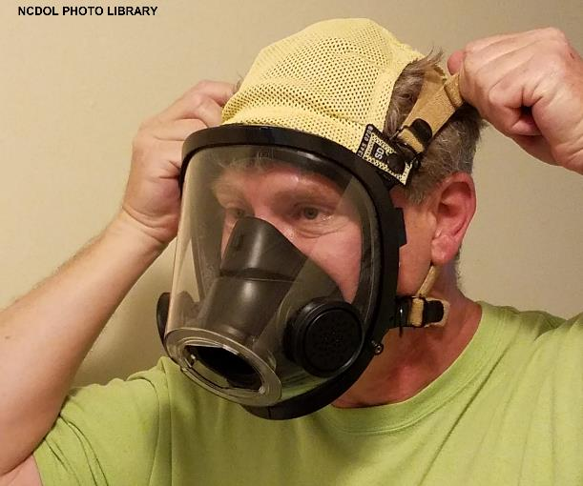
Respirators
1910.134
Food manufacturing industry employees can be exposed to a variety of respiratory irritants and hazards.
NCDOL Photo Library
NCDOL Photo Library

Slide 56
Written Program
1910.134(c)(1)
Written program must contain procedures for:
  Selecting respirators
  Medical evaluations
  Fit testing
  Respirator use
  Respirator maintenance
  Ensuring adequate breathing air for supplied air respirator (SAR)
  Employee training
  Program evaluation
Program must be worksite-specific.

Slide 57
Training and Information
1910.134(k)(3)-(5)
Required:
  Prior to requiring the employee to use a respirator
  Annually
  When changes in workplace render previous training obsolete
  Employee use demonstrates
  inadequate training
  Any other situation arises in which
  retraining appears necessary

Slide 58
Training Topics
1910.134(k)(1)
Why the respirator is necessary and how improper fit, usage, or maintenance can compromise the protective effect of the respirator.
Limitations and capabilities of the respirator.
How to effectively use the respirator in emergencies.

Slide 59
Training Topics
1910.134(k)(1)
How to inspect, don, doff, use, perform seal checks.
Maintenance and storage procedures.
How to recognize medical signs and symptoms that may limit or prevent the effective use of respirators.
General requirements of the standard.

Slide 60
When is Fit Testing Required?
1910.134(f)
Before initial use
Annually, thereafter
When facial features change, such as with weight gain or loss, use of dentures
Note: Employees wearing tight-fitting face-pieces must not be fit tested if they have facial hair. *

Slide 61
Bloodborne Pathogens
Focus Areas:

Slide 62
Exposure Control Plan
1910.1030(c)(1)(ii)
Written plan designed to eliminate or minimize employee exposure that contains:
  Exposure determination
  Schedule and method of implementing paragraphs
  (d) through (h) of the standard
  Procedures for evaluating circumstances surrounding an exposure incident
  Must be reviewed at least annually

Slide 63
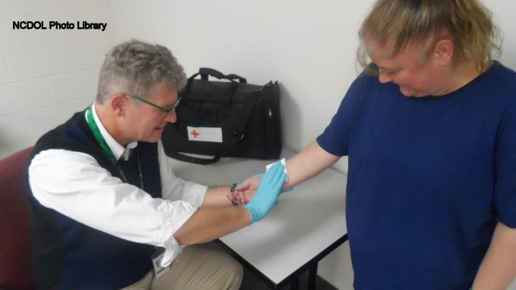
Potential Occupational Exposure
In food manufacturing potential exposures typically occur through:
  Onsite nurse/medical staff
  Employees required to perform collateral 1st aid duties

Slide 64

Example Violations
Serious: 1910.1030(c)(2)(i)(A)
  Bloodborne pathogens exposure determination did not include a list of all job classifications in which all employees in those job classifications had occupational exposure.
NC Photo Library

Slide 65
Process Safety Management
Focus Areas:

Slide 66
Process Safety Management
1910.119
1910.119 – Process Safety Management
  Applies to facilities with large refrigeration units or freezer processes.
  Processes which involves chemicals at or above specified Threshold Quantities (TQ), Appendix A.
Main purpose:
  To proactively identify, evaluate, and mitigate or prevent highly hazardous chemical releases.
Requires a written plan of action/program and employee consultation.

Slide 67
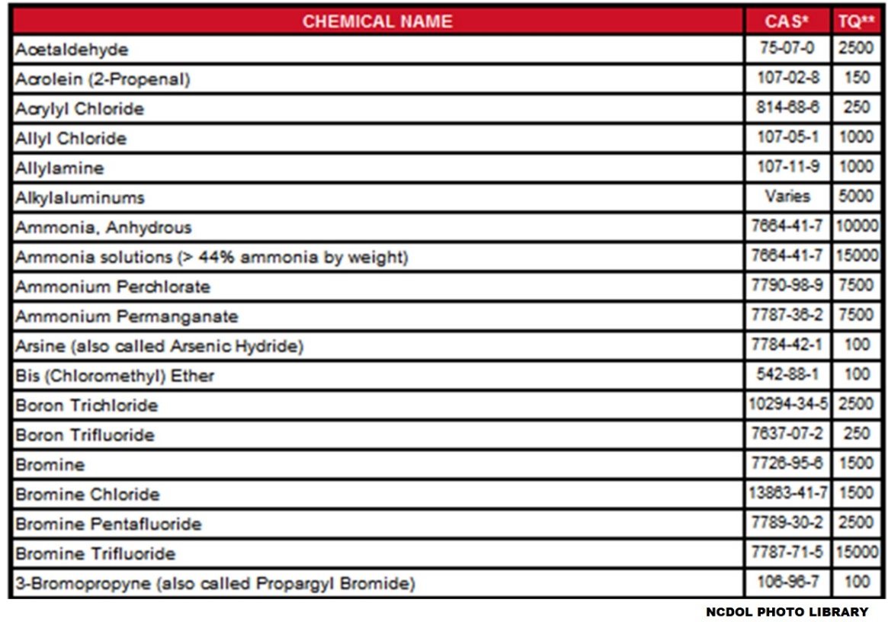
List of Hazardous Chemicals Appendix A
Most common products above threshold quantities:
  Anhydrous ammonia (10,000 Ibs. TQ)
  Chlorine (1,500 Ibs. TQ)

Slide 68
PSM: 14 Elements of Compliance
Employee Participation
Process Safety Information
Process Hazard Analysis
Operating Procedures
Training
Contractors
Pre-Startup Safety Review

Slide 69
PSM: 14 Elements of Compliance
Mechanical integrity
Hot Work Permit
Management of Change
Incident Investigation
Emergency Planning and Audits
Compliance Audits
Trade Secrets

Slide 70
Occupational Noise
Focus Areas:

Slide 71
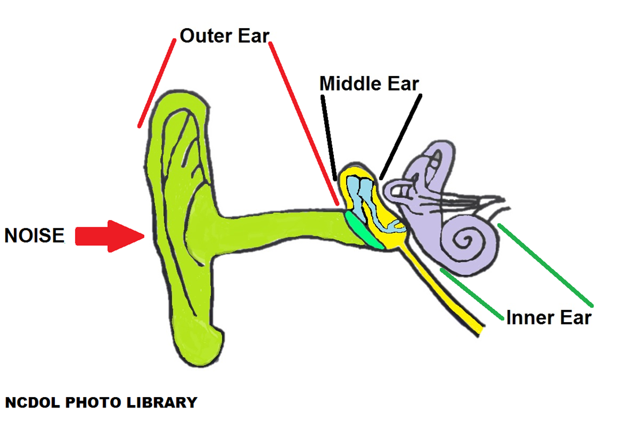
Occupational Noise
Noise hazards in food manufacturing
  Machinery, processes, and equipment produce high noise levels

Slide 72
Permissible Exposure Level
1910.95(b)
No employee shall be exposed above the permissible exposure level (PEL)
  PEL = 90 decibels on the A scale (dBA) for 8-hour time-weighted average (TWA)
  Action level (AL) – 85 dBA – 8-hour TWA
Feasible engineering and administrative controls are required before personal protective equipment (PPE) can be used.

Slide 73
Example Noise Hazard
1910.95(d)(1)
When employees are exposed to high noise serious/permanent hearing loss can result.
  1910.95(d)(1)
  When information indicates that any employee's exposure may equal or exceed an 8-hour time-weighted average of 85 decibels, the employer shall develop and implement a monitoring program.

Slide 74
Other Hazards
Focus Areas:

Slide 75
Other Hazards
29 CFR 1910
Personal protective equipment
  1910.132 - Hazard assessment and training
    Involve managers and workers
Example PPE in Food Manufacturing
  Cut resistant gloves/arm guards
  Chemical gloves
  Protective clothing and boots (slip resistant shoes)

Slide 76
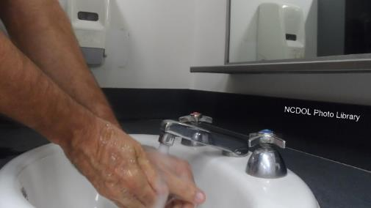
Other Hazards
1910.141
1910.141 – Sanitation
  Clean water to wash hands
  Adequate number of toilets
  Employees must have access to facilities in timely manner

Slide 77
Other Hazards
Thermal stressors:
  Can be found in various locations in the facility (Live-kill areas, boilers, etc.).
  Engineering/administrative controls in place, PPE assessed.
  Adequate supplies potable/drinkable water must be available for employees in a timely manner.
    Avoid heat stress injuries.

Slide 78
Other Hazards
Biological/zoonotic disease hazards:
  Medical record/OSHA 300 log evaluations
  Employer’s efforts to control hazards/prevent exposure will be assessed.
Example: Brucellosis
  Bacterium found in infected cattle or swine.
  Workers can contract via inhalation or direct bodily contact with infected blood or tissue.

Slide 79
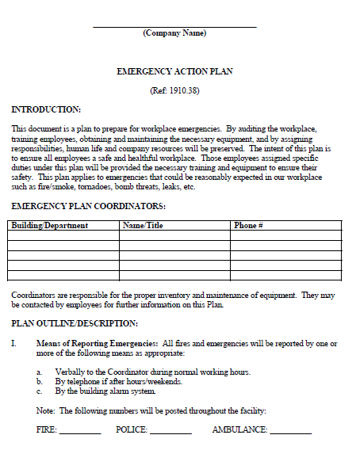
Other Hazards
Emergency Action Plan (EAP)
  1910.38 - Essential due to chemicals used in food manufacturing

Slide 80
Summary
During this course, we covered:
  Food Manufacturing Special Emphasis Program
  Implications for N.C. employers
  Compliance focus areas during an inspection

Slide 81

Thank You For Attending!
Final Questions?

