Slide 1
Collateral First Aid Requirements
Presented by:
Notes:
Revised: 08/28/18
The information in this presentation is provided voluntarily as a public service by the N.C. Department of Labor, Education Training and Technical Assistance Bureau and is made available in good faith. This presentation is designed to assist trainers conducting OSHA outreach training for workers. Since workers are the target audience, this presentation emphasizes hazard identification, avoidance, and control – not standards. No attempt has been made to treat the topic exhaustively. It is essential that trainers tailor their presentations to the needs and understanding of their audience.
The information and advice provided on this Site and on Linked Sites is provided solely on the basis that users will be responsible for making their own assessment of the matters discussed herein and are advised to verify all relevant representations, statements, and information.
This presentation is not a substitute for any of the provisions of the Occupational Safety and Health Act of North Carolina or for any standards issued by the N.C. Department of Labor. Mention of trade names, commercial products, or organizations does not imply endorsement by the N.C. Department of Labor.

Slide 2
Objectives
At the end of this course, students will:
Recognize the difference between collateral duty and primary duty
Be aware of requirements for first aid availability
Be able to explain how collateral and primary first aid duty relates to the bloodborne pathogens standard

Slide 3
Collateral Duty Vs. Primary Duty
Collateral duty:
Not your primary job assignment
You provide first aid, responding solely to injuries resulting from workplace incidents, generally at the location where the incident occurred.
Examples: teacher, camp counselor
Primary duty:
You are designated as a first aid provider and responsible to render first aid and medical assistance
Examples: emergency medical service personnel, lifeguard, plant nurse

Slide 4
Medical Services and First Aid
General Industry – 29 CFR 1910.151
Construction – 29 CFR 1926.50
Mancomm ©
NCDOL Photo Library

Slide 5
Medical Services and First Aid
1910.151
General Industry
Employer shall ensure the ready availability of medical personnel for advice and consultation on matters of plant health
In the absence of an infirmary, clinic, or hospital in near proximity to the workplace which is used for the treatment of all injured employees, a person or persons shall be adequately trained to render first aid
When required to have a person adequately trained to render first aid then adequate first aid supplies shall be readily available

Slide 6
Medical Services and First Aid
1926.50
Construction Industry
Provisions shall be made prior to commencement of the project for prompt medical attention in case of serious injury
Proper equipment for prompt transportation of the injured person to a physician or hospital, or a communication system for contacting necessary ambulance service, shall be provided

Slide 7
Medical Services and First Aid
1926.50
In the absence of an infirmary, clinic, hospital, or physician, that is reasonably accessible in terms of time and distance to the worksite, which is available for the treatment of injured employees, a person who has a valid certificate in first-aid training that can be verified by documentary evidence, shall be available at the worksite to render first aid
First aid supplies shall be easily accessible when required

Slide 8
Medical Services and First Aid
1926.50
In areas where 911 is not available, the telephone numbers of the physicians, hospitals, or ambulances shall be conspicuously posted

Slide 9
“In Near Proximity” “Reasonably Accessible”
1910.151/1926.50
Interpretation letters
1/16/2007
3/23/2007
OSHA has long interpreted the term “in near proximity” and “reasonably accessible” to mean that emergency care must be available within no more than 3-4 minutes from the workplace
OSHA does exercise discretion for particular cases
Possibility of serious work-related injuries is less likely
Up to 15 minutes may be reasonable

Slide 10
Other Standards With First Aid Requirements
General Industry
1910.120 – HAZWOPER
1910.266 – Logging
1910.269 – Electrical Power Generation, Transmission and Distribution
1910.421 – Commercial Diving, Pre-dive Procedures
State-specific
13 NCAC 7F.0605 – Communication Towers

Slide 11
Bloodborne Pathogens (BBP) Standard
1910.1030 – Scope and Application
Applies to all occupational exposure to blood or other potentially infectious materials as defined by paragraph (b)
13 NCAC 07F .0207 – Toxic and Hazardous Substances
Subpart Z – Toxic and Hazardous Substances – Incorporation of the existing standard for Bloodborne Pathogens, 29 CFR 1910.1030, excluding subparagraph (e) – HIV and HBV Research Laboratories and Production Facilities, into the Safety & Health Regulations for Construction (29 CFR 1926)

Slide 12
“Occupational Exposure”
1910.1030, 13 NCAC 07F .0207
General Industry – 1910.1030
Occupational Exposure means reasonably anticipated skin, eye, mucous membrane, or parenteral contact with blood or other potentially infectious materials that may result from the performance of an employee's duties
Construction – 13 NCAC 07F .0207
Occupational Exposure means reasonably anticipated skin, eye, mucous membrane, or parenteral contact with blood or other potentially infectious materials that may result from the performance of collateral first aid duties by an employee in the areas of construction, alteration, or repair, including painting and decorating

Slide 13
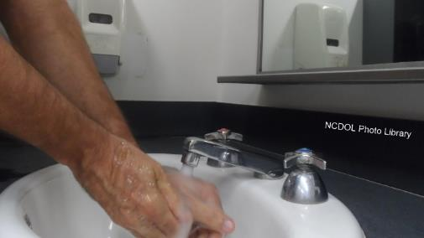
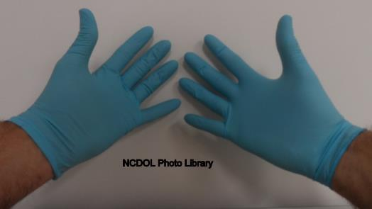
Highlights of BBP Standard
1910.1030
Use engineering controls
Enforce work practice controls
Provide personal protective equipment (PPE)
Offer Hepatitis B vaccination

Slide 14
Highlights of BBP Standard
1910.1030
Use labels and signs to communicate hazards
Provide information and training
Establish an exposure control plan (ECP)
Maintain employee medical and training records

Slide 15
Hepatitis B Vaccination
1910.1030(f)
Hepatitis B vaccine, post-exposure evaluation and follow-up, including prophylaxis, shall be:
Available to employees at a reasonable time and place and without cost
Performed by or under the supervision of a licensed physician or healthcare professional
Prophylaxis will be provided when medically indicated, as recommended by the U.S. Public Health Service (USPHS)
Notes:
15

Slide 16
No Cost to the Employee
1910.1030(f)
No out of pocket expense
Employer may not require employee to use his/her health care insurance to pay for series unless:
Employer pays all of the cost of health insurance,
and
No cost to employee in form of deductibles, co-payments, or other expenses
Notes:
16

Slide 17
Hepatitis B Vaccination
1910.1030(f)(2)(i)
Hepatitis B vaccine shall be made available:
After employee has received required training
Within 10 days of initial assignment to all employees with occupational exposure
Ensures employees receive appropriate medical follow-up after each specific exposure incident
Notes:
17

Slide 18
Hepatitis B Vaccination
1910.1030(f)(2)(i)
Exceptions
If the employee has previously completed the complete Hepatitis B vaccination series, or
Immunity is confirmed through antibody testing, or
The vaccine is contraindicated for medical reasons
Notes:
18

Slide 19
Hepatitis B Vaccination
1910.1030(f)(2)
Participation in prescreening not prerequisite for receiving Hepatitis B vaccination
Provided even if employee declines but later wants vaccination
Employee must sign statement when declining Hepatitis B vaccination
Hepatitis B vaccination booster doses must be available to employees if recommended by the USPHS
Notes:
19

Slide 20
Hepatitis B Vaccine Delay Option
Exemption only for collateral duty
Vaccine series can be provided post-exposure
Hepatitis B vaccine series must be made available within 24 hours of first aid incident
The following conditions must be met for the exemption:
Primary job assignment is not rendering first aid or other medical assistance, and
Any first aid rendered is only as a collateral duty, responding solely to injuries resulting from workplace incidents, generally at the location where the incident occurred

Slide 21
Hepatitis B Vaccine Delay Option
Employer’s ECP must specifically contain the following:
Provision for a reporting procedure that ensures that all first aid incidents involving the presence of blood or OPIM will be reported to the employer before the end of the work shift during which the incident occurred
Report must include names of all first aid providers who rendered assistance, regardless of whether PPE was used and must describe the first aid incident, including time and date
Description must include a determination of whether or not, in addition to the presence of blood or OPIM, an "exposure incident,” as defined by the standard, occurred.

Slide 22
Hepatitis B Vaccine Delay Option
This determination is necessary in order to ensure that the proper post-exposure evaluation, prophylaxis, and follow-up procedures required by paragraph (f)(3) – Post-exposure Evaluation and Follow-up – of the standard are made available immediately, whenever there has been an "exposure incident" as defined by the standard
A report that lists all such first aid incidents, that is readily available upon request, to all employees and to the Assistant Secretary
Provision for the bloodborne pathogens training program for designated first aiders to include the specifics of this reporting procedure

Slide 23
Hepatitis B Vaccine Delay Option
Provision for the full hepatitis B vaccination series to be made available as soon as possible, but in no event later than 24 hours, to all unvaccinated first aid providers who have rendered assistance in any situation involving the presence of blood or OPIM, regardless of whether or not a specific "exposure incident," as defined by the standard, has occurred
All these requirements must be met, otherwise it is a violation of 1910.1030(f)(2)(i)

Slide 24
Resources
Bloodborne Pathogens Standard - 29 CFR 1910.1030
Compliance Directive - CPL 02-02-069
Consultative Services - 919-707-7846
Education, Training and Technical Assistance - 919-707-7876
Web Sites
www.osha.gov
www.labor.nc.gov

Slide 25
Summary
In this course, we covered:
Difference between collateral duty and primary duty
Requirements for first aid availability
How collateral and primary first aid duty relates to the bloodborne pathogens standard

Slide 26
Thank You For Attending!
Final Questions?

