Slide 1
Fire Protection and Prevention
29 CFR 1926, Subpart F
Notes:
Revision Date: 06/25
The information in this presentation is provided voluntarily by the N.C. Department of Labor, Education Training and Technical Assistance Bureau as a public service and is made available in good faith. This presentation is designed to assist trainers conducting OSHA outreach training for workers. Since workers are the target audience, this presentation emphasizes hazard identification, avoidance, and control – not standards. No attempt has been made to treat the topic exhaustively. It is essential that trainers tailor their presentations to the needs and understanding of their audience.
The information and advice provided on this Site and on Linked Sites is provided solely on the basis that users will be responsible for making their own assessment of the matters discussed herein and are advised to verify all relevant representations, statements, and information.

Slide 2
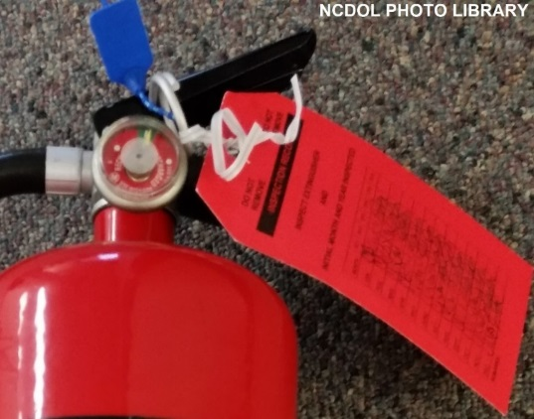
Objectives
1926, Subpart F
In this course we will discuss the following:
Employer responsibilities for the development of a fire protection program
Fire classifications
Fire extinguishers and small hose lines
Firefighting equipment

Slide 3
Objectives
1926, Subpart F
Ignition hazards
Temporary buildings
Open yard combustible material storage
Indoor material storage
Notes:
3

Slide 4
General Requirements
1926.150(a)(1)
Employer is responsible for
  Development of a fire protection program to be followed throughout all phases of the construction and demolition work
  Providing for the firefighting equipment as specified in this Subpart
  As fire hazards occur, there shall be no delay in providing the necessary equipment
Notes:
4

Slide 5
Types of Fires
1926.150 Table F-1
Fires are classified by the type of FUEL they burn
4 Types:
  A: Normal combustibles
  B: Flammable liquids
  C: Electrical
  D: Combustible metals
Notes:
5

Slide 6
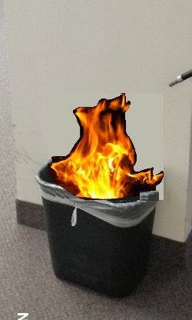
Fire Classifications
1926.150 Table F-1
Class A
  Normal combustibles
    Wood
    Paper
    Plastic
    Rags
Notes:
6

Slide 7
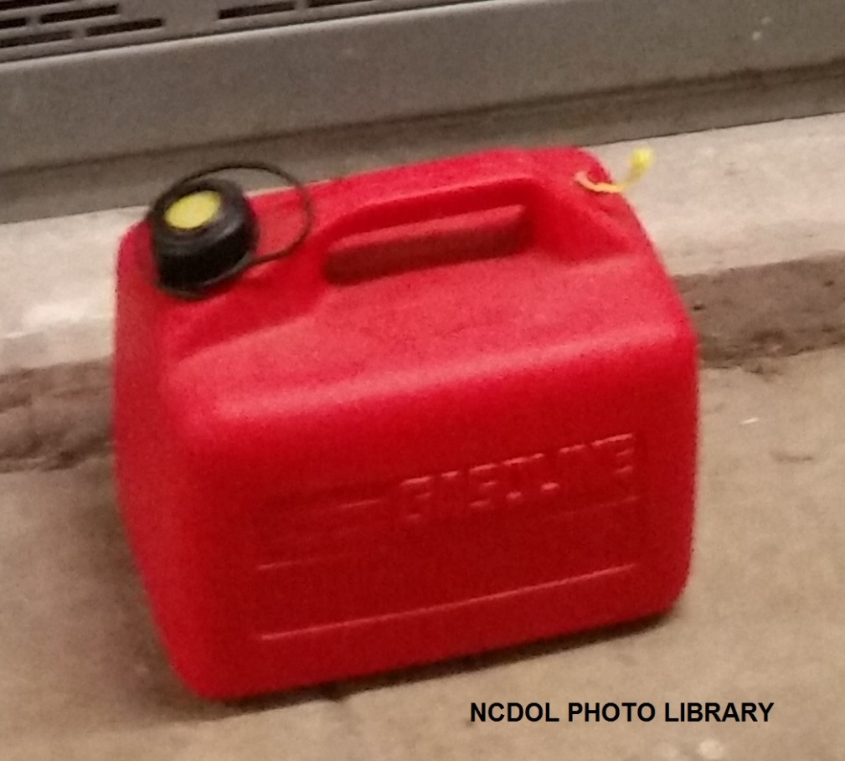
Fire Classifications
1926.150 Table F-1
Class B
  Flammable liquids
    Gasoline
    Oil
    Grease
    Paint
Notes:
7

Slide 8
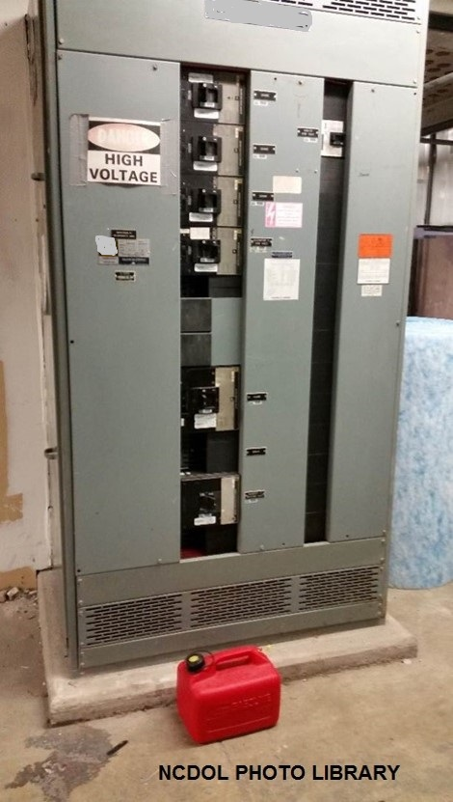
Fire Classifications
1926.150 Table F-1
Class C
  Electrical
    Electrical junctions
    Motors
    Generators
    Heaters
Notes:
8

Slide 9

Fire Classifications
1926.150 Table F-1
Class D
  Metals
    Potassium
    Sodium
    Aluminum
    Magnesium
Notes:
9

Slide 10
Water Supply
1926.150(b)
Water supply (temporary or permanent) required to properly operate firefighting equipment
  Must be of sufficient volume, duration and pressure
  To be made available as soon as combustible materials accumulate
Where underground water mains are to be provided, must be installed, completed and available for use as soon as practicable
Notes:
10

Slide 11
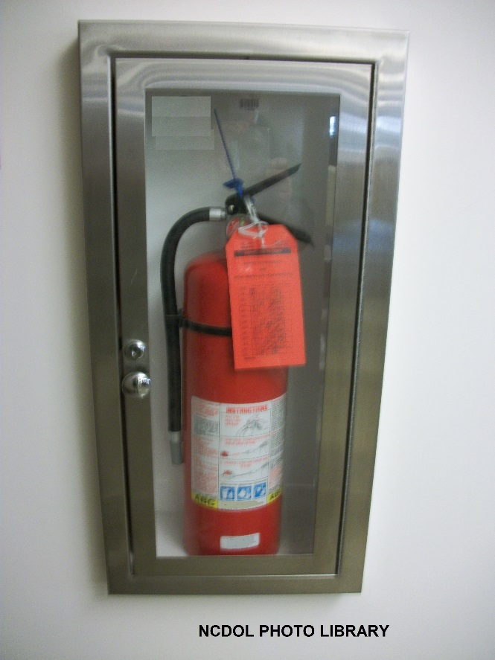
Firefighting Equipment
1926.150(c)(1)(i)
A fire extinguisher, rated not less than 2A, must be provided for each 3,000 square feet of the protected building area, or major fraction thereof
Travel distance from any point of the protected area to the nearest fire extinguisher must not exceed 100 feet
Notes:
11

Slide 12
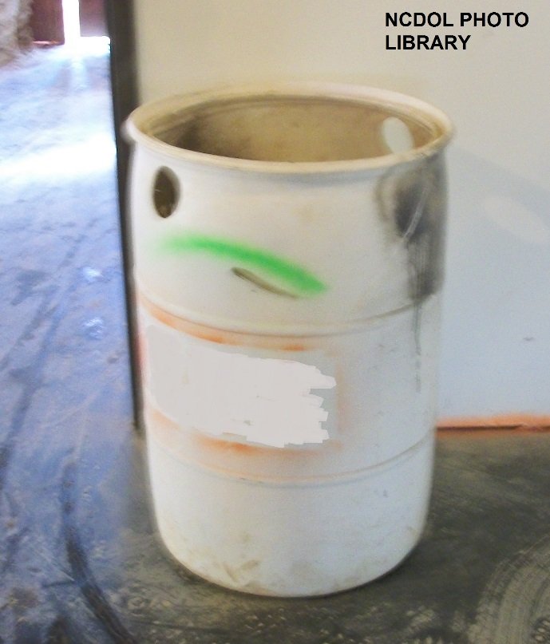
Firefighting Equipment
1926.150(c)(1)(ii)
One 55-gallon open drum of water with two fire pails may be substituted for a fire extinguisher having a 2A rating
Notes:
12

Slide 13
Firefighting Equipment
1926.150(c)(1)(iii)
A ½-inch diameter garden-type hose line, not to exceed 100 feet in length and equipped with a nozzle, may be substituted for a 2A-rated fire extinguisher, provided it’s capable of discharging a minimum of 5 gallons per minute with a minimum hose stream range of 30 feet horizontally
Garden-type hose lines shall be mounted on conventional racks or reels
Number and location of hose racks or reels shall be such that at least one hose stream can be applied to all points in the area
Notes:
13

Slide 14
Firefighting Equipment
1926.150(c)(1)(iv)-(v)
One or more fire extinguishers, rated not less than 2A, shall be provided on each floor
In multistory buildings, at least one fire extinguisher shall be located adjacent to stairway
Water devices used shall be protected from freezing
Notes:
14

Slide 15
Firefighting Equipment
1926.150(c)(1)(vi)
Fire extinguisher, rated not less than 10B, must be provided within 50 feet of wherever more than 5 gallons of flammable or combustible liquids or 5 pounds of flammable gas are being used on jobsite
Requirement does not apply to the integral fuel tanks of motor vehicles
Notes:
15

Slide 16
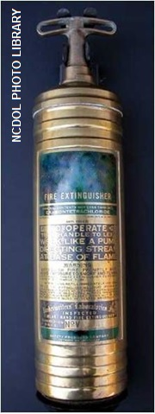
Firefighting Equipment
1926.150(c)(1)(vii)
Carbon tetrachloride and other toxic vaporizing liquid fire extinguishers are prohibited
Notes:
16

Slide 17
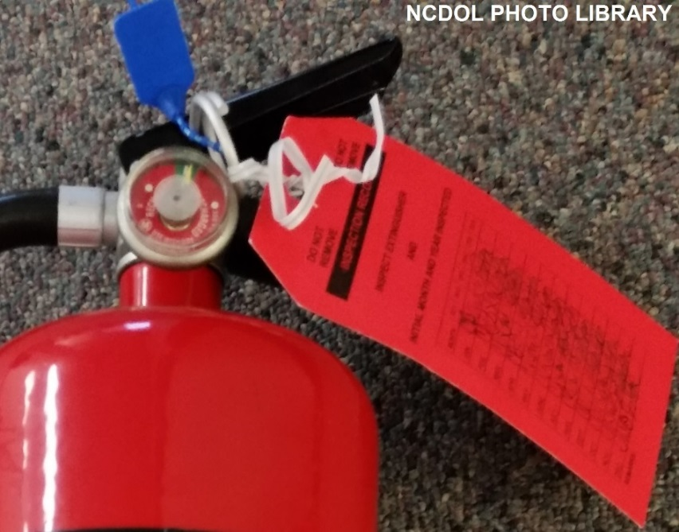
Firefighting Equipment
1926.150(c)(1)(viii)
Portable fire extinguishers shall be inspected periodically and maintained in accordance with “Maintenance and Use of Portable Fire Extinguishers, NFPA 10”
Notes:
17

Slide 18
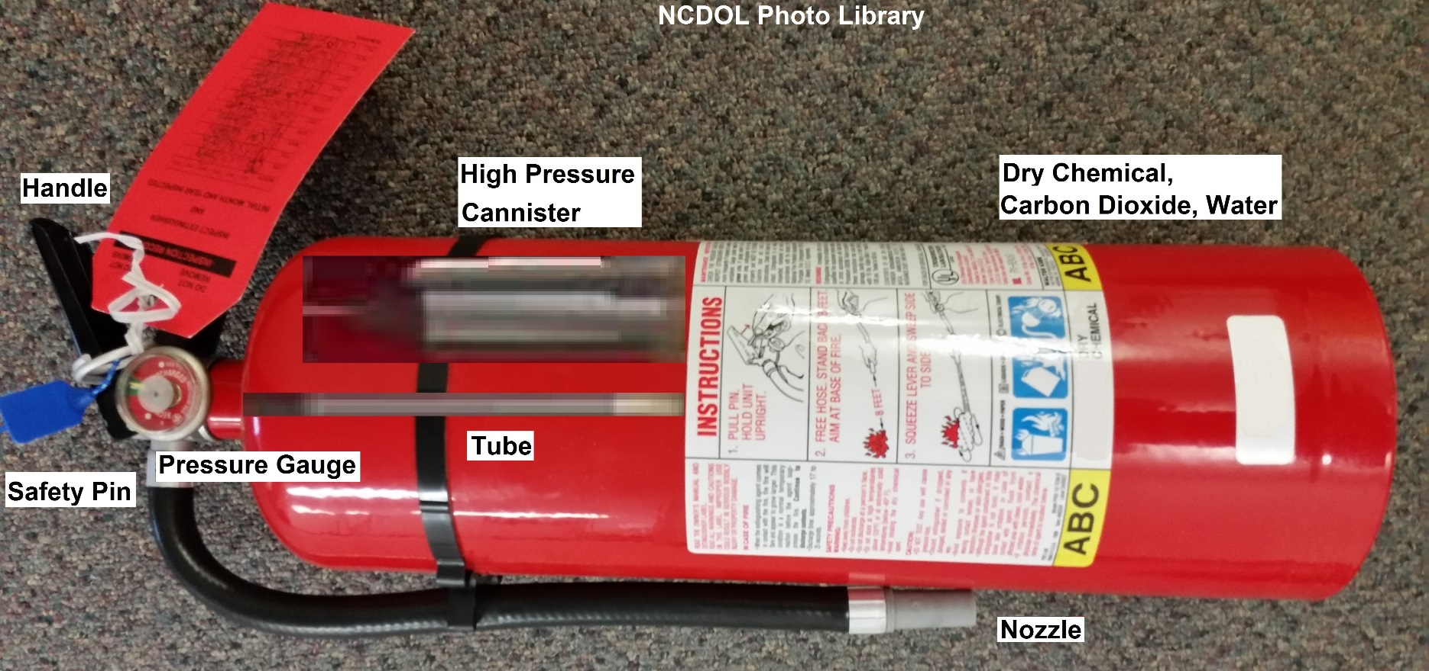
Fire Extinguishers
1926.150(c)(1)(viii)
How does it work?
Notes:
18

Slide 19
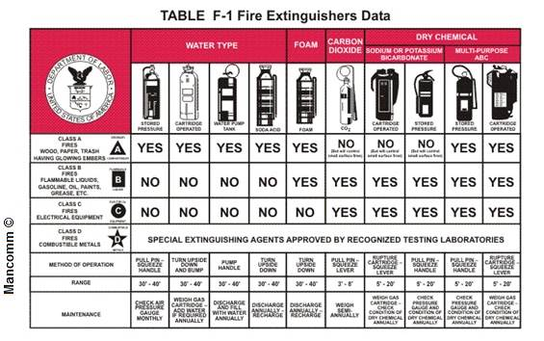
Fire Extinguishers
1926.150(c)(1)(x)
Types of fire extinguishers are classified by the type of fire on which they may be used
  Table F-1 provides a guide for selecting fire extinguishers
Notes:
19

Slide 20
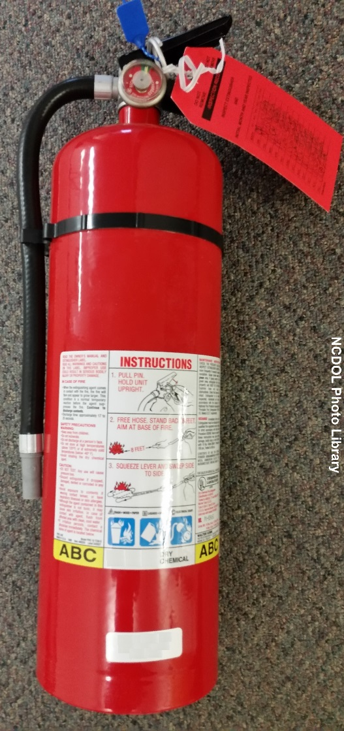
Types of Fire Extinguishers
1926.150(c)(1)
Class A
  Used on wood, paper, plastic
Class B
  Used on flammable liquids
Class C
  Used on electrical fires
Class D
  Used on metal fires
Notes:
20

Slide 21
Use of Fire Extinguishers
1926.150
Using a fire extinguisher
  Type (classification of fire)
  Correct extinguisher
Use the PASS system
Notes:
21

Slide 22
Use of Fire Extinguishers
1926.150
PASS
Pull
Aim
Squeeze
Sweep
Notes:
22

Slide 23
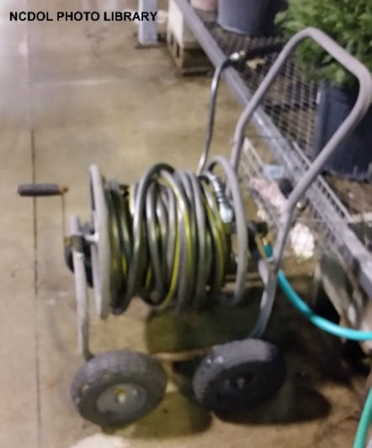
Firefighting Equipment
1926.150(c)(2)(i)
Fire hose and connections
  100 feet, or less, of 1½ -inch hose, with a nozzle capable of discharging water at 25 gallons or more per minute, may be substituted for a fire extinguisher rated not more than 2A in the designated area provided that the hose line can reach all points in the area
Notes:
23

Slide 24
Firefighting Equipment
1926.150(c)(2)(ii)-(iii)
If fire hose connections are not compatible with local firefighting equipment, the contractor must provide adapters, or equivalent, to permit connections
During demolition involving combustible materials, charged hose lines, supplied by hydrants, water tank trucks with pumps, or equivalent, must be made available
Notes:
24

Slide 25
Firefighting Equipment
1926.150(d)(1)(i)
Sprinkler protection
  If the facility being constructed includes the installation of automatic sprinkler protection, the installation shall closely follow the construction and be placed in service as soon as applicable laws permit following completion of each story
  During demolition or alterations, existing automatic sprinkler installations must be retained in service as long as reasonable
    Operation of sprinkler control valves is permitted only by properly authorized persons
Notes:
25

Slide 26
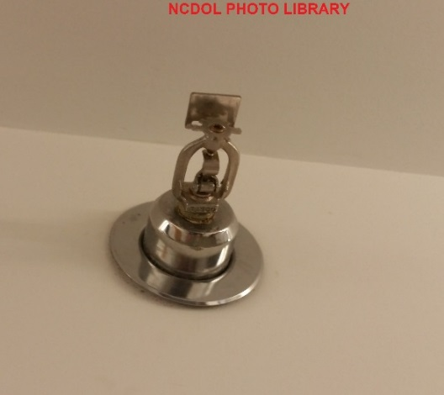
Firefighting Equipment
1926.150(d)(1)(ii)
  Modification of sprinkler systems to permit alterations or additional demolition should be expedited so that the automatic protection may be returned to service as quickly as possible
  Sprinkler control valves must be checked daily at close of work to ascertain that the protection is in service
Notes:
26

Slide 27
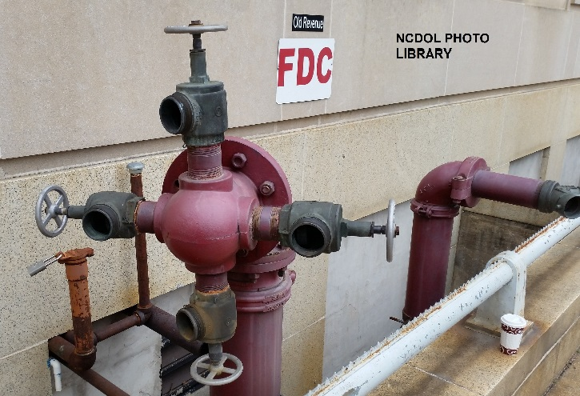
Firefighting Equipment
1926.150(d)(2)
Standpipes
  In all structures in which standpipes are required, or where standpipes exist in structures being altered, they shall be brought up as soon as applicable laws permit, and maintained as construction progresses
Notes:
27

Slide 28
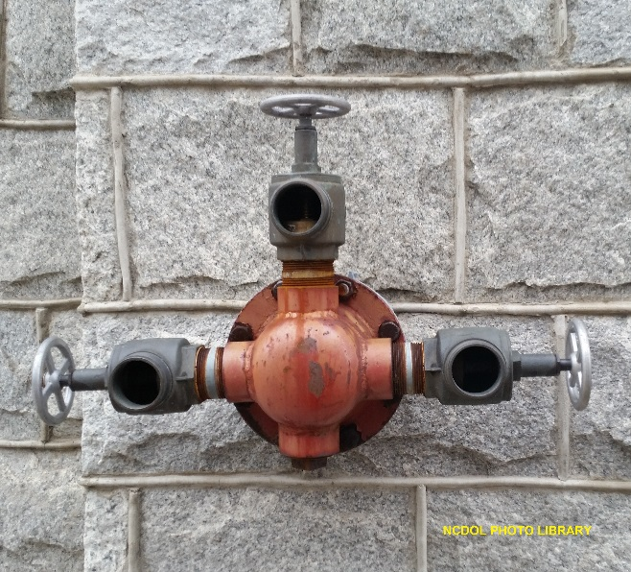
Firefighting Equipment
1926.150(d)(2)
  Standpipes must be provided with Siamese fire department connections on the outside of the structure, at the street level, which shall be conspicuously marked
  Must be at least one standard
  hose outlet at each floor
Notes:
28

Slide 29
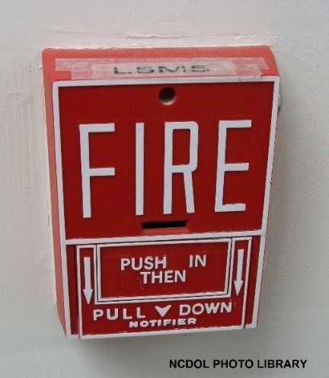
Fire Alarm Devices
1926.150(e)(1)-(2)
Alarm system, e.g., telephone system, siren, must be established by the employer whereby employees on site and local fire department can be alerted for an emergency
Alarm code and reporting instructions must be conspicuously posted at phones and at employee entrances
Notes:
29

Slide 30
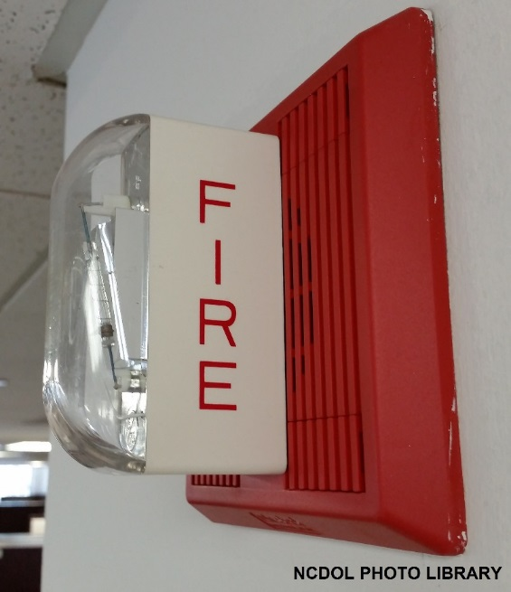
Fire Alarm Devices
1926.150(e)(1)
Audible alarms
  Bells
  Horns
  Sirens
Workplace announcement system
  Speakers used to play a live or recorded voice message
Notes:
30

Slide 31
Fire Cutoffs
1926.150(f)(1)-(2)
Fire walls and exit stairways, required for the completed buildings, must get construction priority
Fire doors, with automatic closing devices, must be hung on openings as soon as practicable
Fire cutoffs must be retained in buildings undergoing alterations or demolition until operations necessitate their removal
Notes:
31

Slide 32
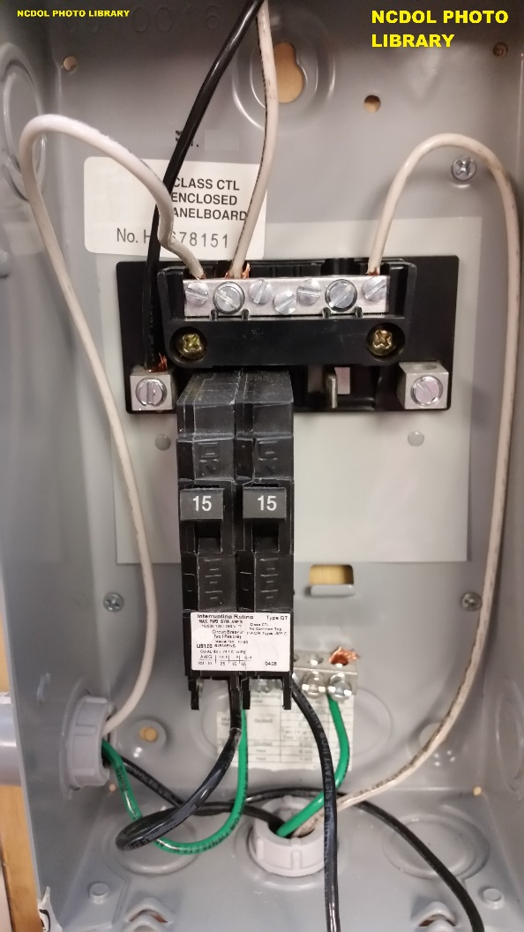
Ignition Hazards
1926.151(a)(1)
Electrical wiring and equipment for light, heat, or power purposes must be installed in compliance with the requirements of 29 CFR 1926 Subpart K, Electrical
Notes:
32

Slide 33
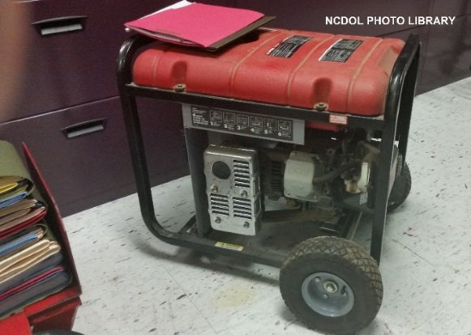
Ignition Hazards
1926.151(a)(2)
Internal combustion engine powered equipment must be located so that the exhausts are away from combustible materials
When the exhausts are piped outside the building under construction, a clearance of at least 6 inches must be maintained between the piping and combustible material
Notes:
33

Slide 34
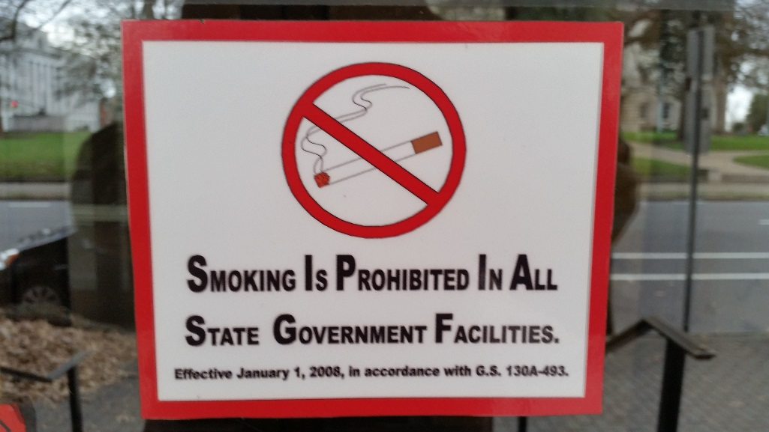
Ignition Hazards
1926.151(a)(3)
Smoking must be prohibited at or in the vicinity of operations which constitute a fire hazard
Conspicuously posted: “No Smoking or Open Flame”
Notes:
34

Slide 35
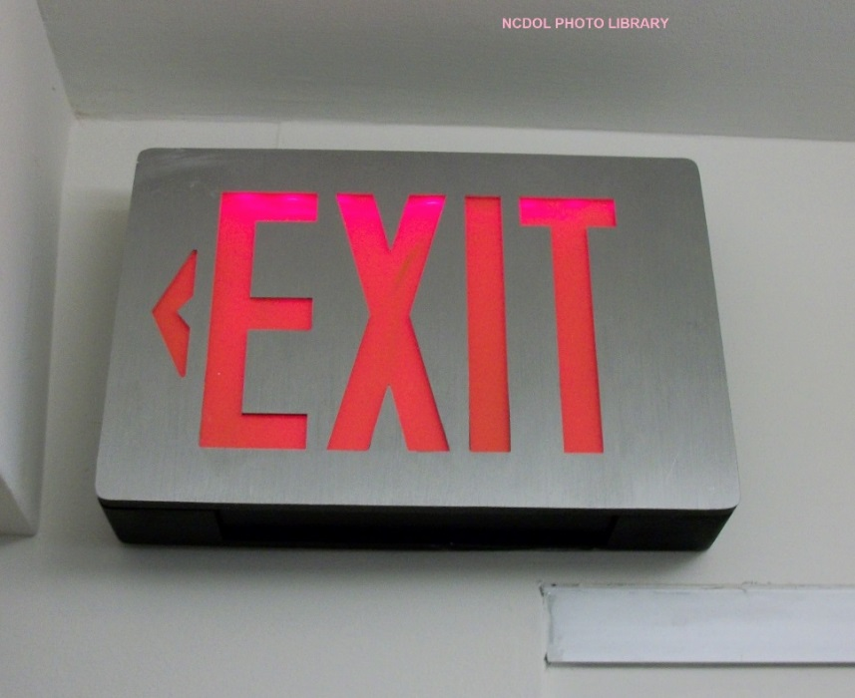
Temporary Buildings
1926.151(b)(1)
Cannot be erected where it will adversely affect any means of exit
Notes:
35

Slide 36
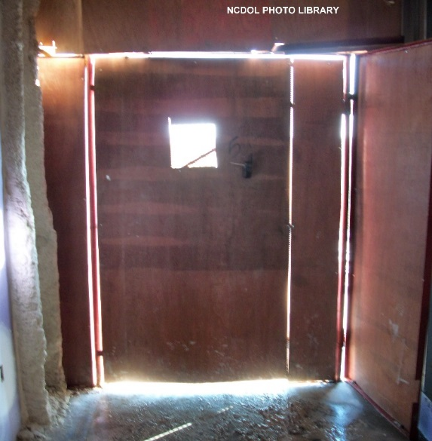
Temporary Buildings
1926.151(b)(2)
When located within another building or structure, must be of either noncombustible construction or of combustible construction having a fire resistance of not less than one hour
Notes:
36

Slide 37
Temporary Buildings
1926.151(b)(3)
Located other than inside another building
Not used for storage, handling, or use of flammable or combustible liquids, flammable gases, explosives, or blasting agents, or similar hazardous occupancies
Must be located at a distance of not less than 10 feet from another building or structure
Notes:
37

Slide 38
Temporary Buildings
1926.151(b)(3)
Groups of temporary buildings, not exceeding 2,000 square feet in aggregate
Must, for the purposes of 1926 Subpart F, be considered a single temporary building
Notes:
38

Slide 39
Open Yard Storage
1926.151(c)(1)-(2)
Combustible materials must be piled with due regard to the stability of piles and in no case higher than 20 feet
Driveways between and around combustible storage piles must be at least 15 feet wide and maintained free from accumulation of rubbish, equipment, or other articles or materials
Notes:
39

Slide 40
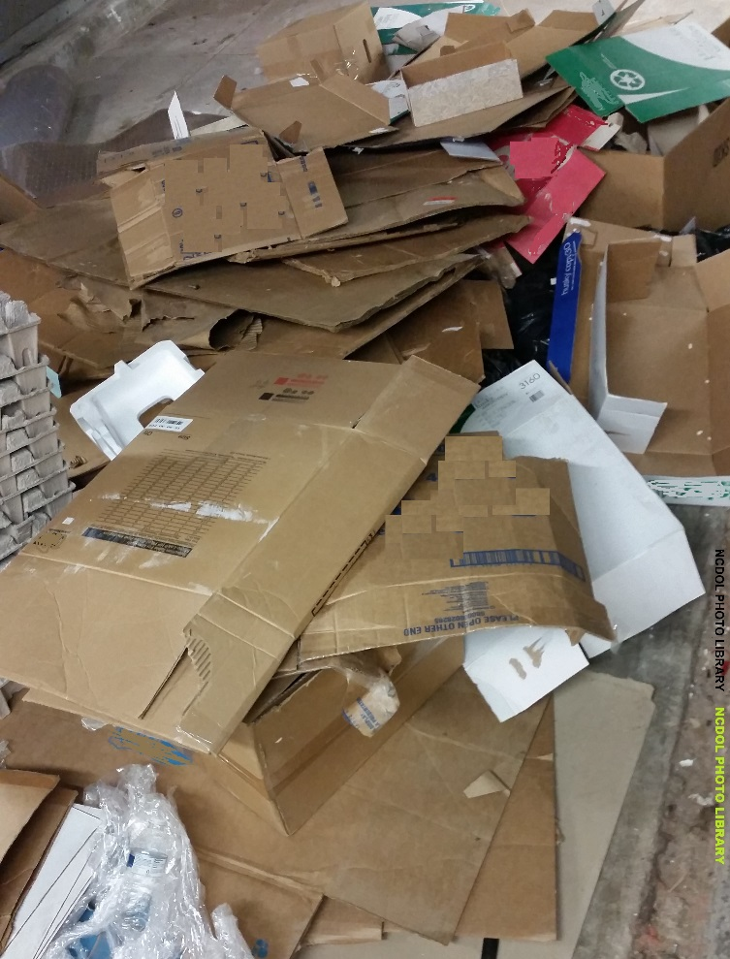
Open Yard Storage
1926.151(c)(3)-(4)
Entire storage site must be kept free from accumulation of unnecessary combustible materials
Weeds and grass must be kept down and regular procedure provided for periodic cleanup of entire area
When there is a danger of an underground fire, that land cannot be used for combustible or flammable storage
Notes:
40

Slide 41
Open Yard Storage
1926.151(c)(5)
Method of piling must be solid wherever possible and in orderly and regular piles.
No combustible material can be stored outdoors within 10 feet of a building or structure.
Notes:
41

Slide 42
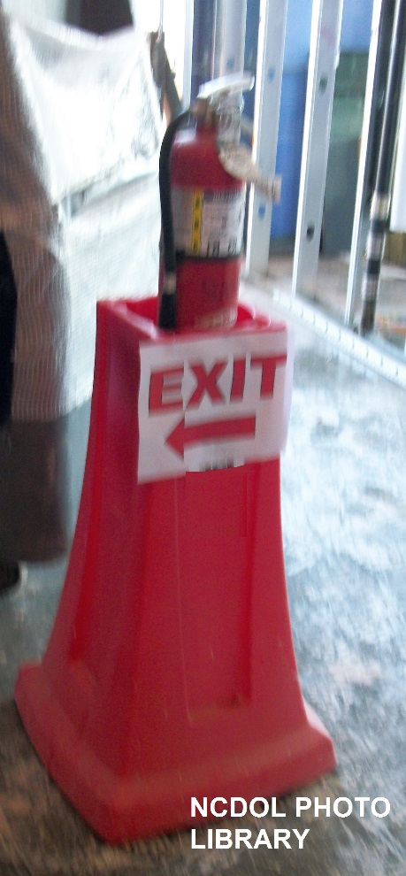
Open Yard Storage
1926.151(c)(6)
Suitable portable fire extinguishing equipment must be provided at convenient, conspicuously accessible locations in the yard area
Portable fire extinguishers, rated not less than 2A, must be placed so that maximum travel distance to the nearest unit does not exceed 100 feet
Notes:
42

Slide 43
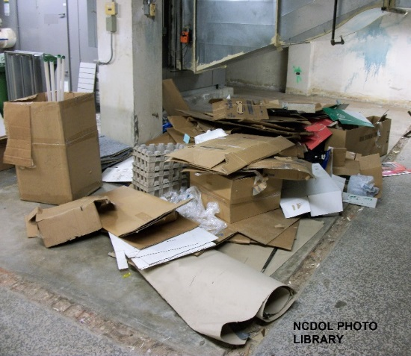
Indoor Storage
1926.151(d)(1)-(3)
Must not obstruct, or adversely affect, means of exit
All materials must be stored, handled, and piled with due regard to their fire characteristics
Noncompatible materials, which
may create a fire hazard, must
be segregated by a barrier
having a fire resistance of at
least one hour
Notes:
43

Slide 44
Indoor Storage
1926.151(d)(4)
Material must be piled to minimize the spread of fire internally and to permit convenient access for firefighting
Stable piling must be maintained at all times
Aisle space must be maintained to safely accommodate the widest vehicle that may be used within the building for firefighting purposes
Notes:
44

Slide 45
Indoor Storage
1926.151(d)(5)-(6)
Clearance of at least 36 inches must be maintained between the top level of the stored material and the sprinkler deflectors
Clearance must be maintained around lights and heating units to prevent ignition of combustible materials
Notes:
45

Slide 46

Indoor Storage
1926.151(d)(7)
A clearance of 24 inches must be maintained around the path of travel of fire doors
Material cannot be stored within 36 inches
of a fire door opening
Notes:
46

Slide 47
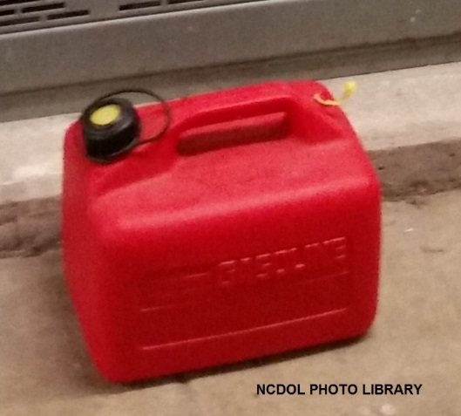
Flammable Liquids
1926.152(a)(1)-(2)
General requirements
  Only approved containers and portable tanks can be used for storage and handling of flammable liquids
  Flammable liquids cannot be stored in areas used for exits, stairways, or normally used for the safe passage of people

Slide 48
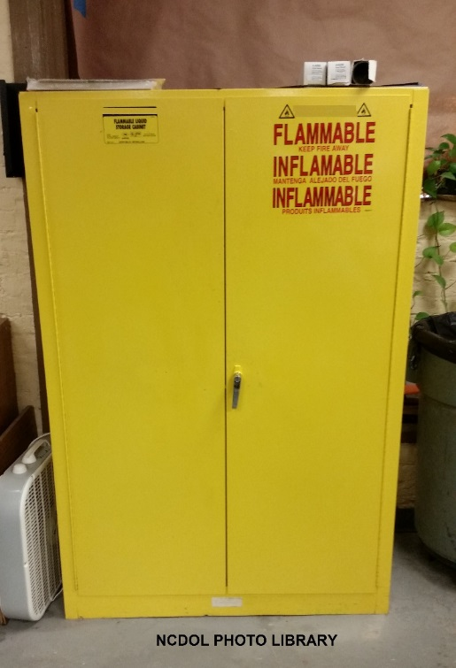
Flammable Liquids
1926.152(b)(1)
Indoor storage
  No more than 25 gallons of flammable liquids can be stored in a room outside of an approved storage cabinet
Notes:
48

Slide 49
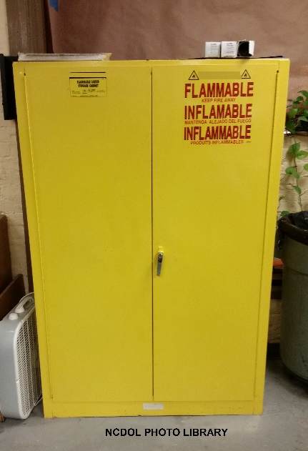
Flammable Liquids
1926.152(b)(2)
Indoor storage
  Quantities of flammable liquid in excess of 25 gallons must be stored in an acceptable or approved cabinet
  Cabinets must be labeled in
  conspicuous lettering,
  “Flammable—Keep Fire Away”
Notes:
49

Slide 50

Flammable Liquids
1926.152(b)(3)
Indoor storage
  Not more than 60 gallons of Category 1, 2 and/or 3 flammable liquids or 120 gallons of Category 4 flammable liquids can be stored in any one storage cabinet
  Not more than three such cabinets
  may be located in a single storage area
    Quantities in excess of this must be stored
    in an inside storage room

Slide 51
Flammable Liquids
1926.152(b)(4)
Indoor storage
  Constructed to meet the required fire-resistive rating for their use
  Room must have raised sills or ramps at least 4 inches in height
  Electrical wiring and equipment must be approved for Class I, Division 1, Hazardous Locations
  Provided with either a gravity or a mechanical exhausting system

Slide 52

Flammable Liquids
1926.152(b)(5)
Quantity
  Quantity of flammable liquids kept in the vicinity of spraying operations must be the minimum required for operations and should ordinarily not exceed a supply for 1 day or one shift

Slide 53

Flammable Liquids
1926.152
General requirements
Indoor storage
Storage outside buildings
Fire control
Dispensing liquids
Handling liquids at point of final use
Service and refueling areas
Tank storage
Notes:
53

Slide 54
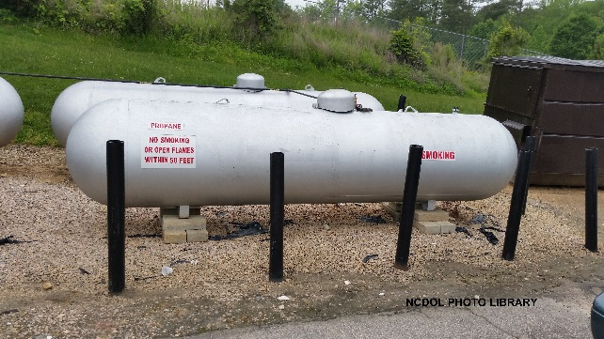
Liquefied Petroleum Gas
1926.153
Approval of equipment and systems
Welding on LP-gas containers prohibited
Safety devices
Dispensing
Requirements for appliances
Containers and regulating equipment
Storage of LP containers
Notes:
54

Slide 55
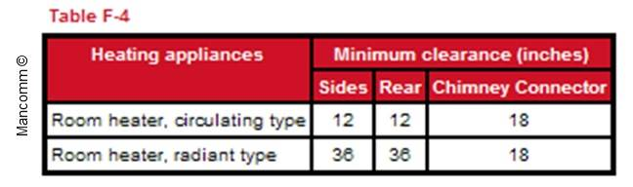
Temporary Heating Devices
1926.154
Ventilation
Clearance mounting
Stability
Solid fuel salamanders
Oil-fired heaters

Slide 56
Summary
1926, Subpart F
Employer responsibilities
Fire classifications
Fire extinguishers
Firefighting equipment
Ignition hazards
Temporary buildings
Open yard combustible material storage
Indoor material storage

Slide 57
Thank You For Attending!
Final Questions?

