Slide 1
Fire Protection – Portable Fire Extinguishers
29 CFR 1910.157
Presented by:
Notes:
Revised: 01/23/2018
The information in this presentation is provided voluntarily by the N.C. Department of Labor, Education Training and Technical Assistance Bureau as a public service and is made available in good faith. This presentation is designed to assist trainers conducting OSHA outreach training for workers. Since workers are the target audience, this presentation emphasizes hazard identification, avoidance, and control – not standards. No attempt has been made to treat the topic exhaustively. It is essential that trainers tailor their presentations to the needs and understanding of their audience.
The information and advice provided on this Site and on Linked Sites is provided solely on the basis that users will be responsible for making their own assessment of the matters discussed herein and are advised to verify all relevant representations, statements, and information.
This presentation is not a substitute for any of the provisions of the Occupational Safety and Health Act of North Carolina or for any standards issued by the N.C. Department of Labor. Mention of trade names, commercial products, or organizations does not imply endorsement by the N.C. Department of Labor.

Slide 2
Objectives
1910.157
In this course, we will discuss the following:
Scope and application
Exemptions
General requirements
Selection
Inspection and maintenance
Training

Slide 3
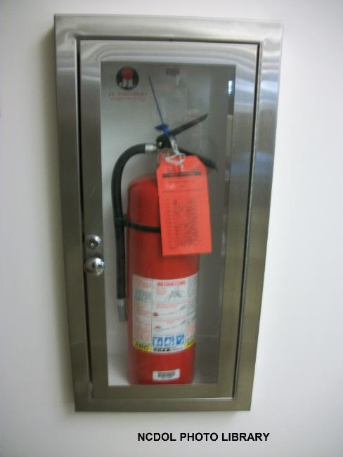
Scope and Application
1910.157(a)
Applies to the placement, use, maintenance, and testing of portable fire extinguishers provided for the use of employees

Slide 4
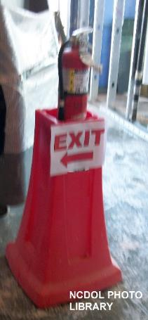
Exemptions
1910.157(b)(1)
Employer has established and implemented:
Written fire safety policy
Requires the immediate and total evacuation of employees
When extinguishers are not available
in the workplace, unless a specific
standard requires that a portable
fire extinguisher be provided

Slide 5
Exemptions
1910.157(b)(2)
Employer exempt from the distribution requirements in paragraph (d) if employer has established and implemented:
Emergency action plan that authorizes certain employees to use portable fire extinguishers
Requires the immediate evacuation of all other employees

Slide 6
General Requirements
1910.157(c)(1)
Employer shall:
Provide portable fire extinguishers
Mount, locate and identify them so they are readily accessible to employees without subjecting employees to possible injury

Slide 7
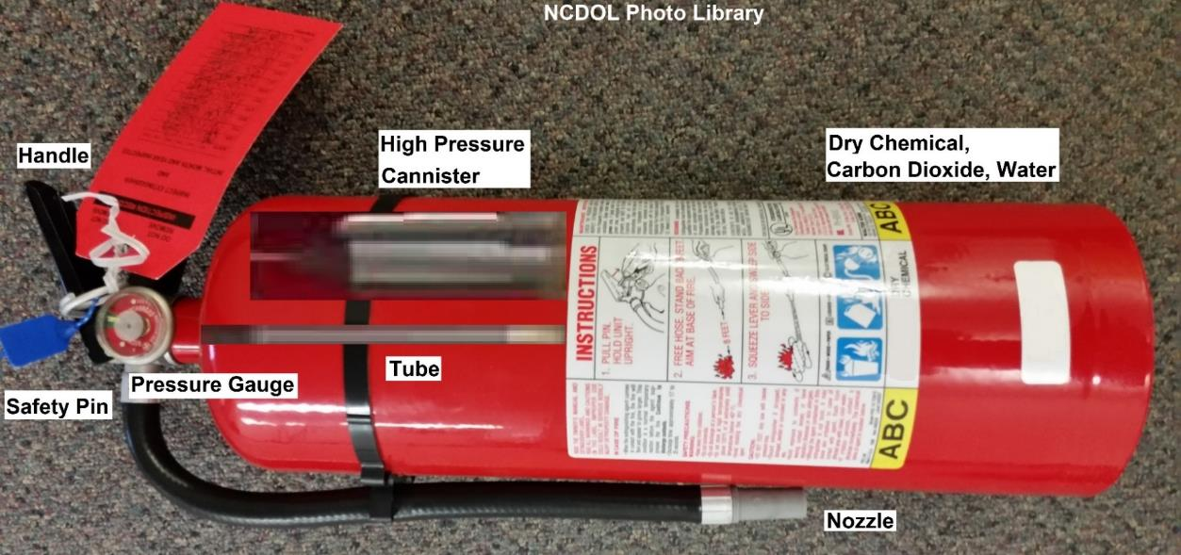
General Requirements
1910.157(c)(2)
Only approved portable fire extinguishers shall be used

Slide 8
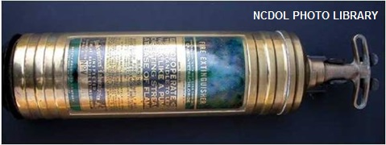
General Requirements
1910.157(c)(3)
Employer shall not provide or make available in the workplace portable fire extinguishers using:
Carbon tetrachloride, or
Chlorobromomethane extinguishing agents

Slide 9
General Requirements
1910.157(c)(4)
Employer shall assure:
Fire extinguishers are maintained in a fully charged and operable condition
Kept in their designated places at all times except during use

Slide 10
General Requirements
1910.157(c)(5)
Employer shall remove the following fire extinguishers from service (delisted by Underwriters Laboratories in 1969):
Soldered or riveted shell self-generating soda acid
Self-generating foam
Gas cartridge water type portable fire
extinguishers which operate by being
inverted

Slide 11
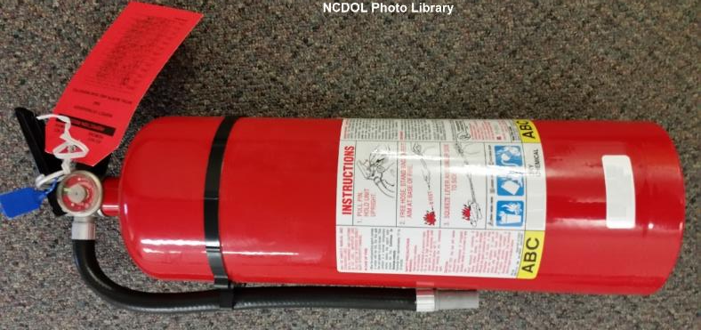
Selection and Distribution
1910.157(d)(1)
Portable fire extinguishers shall be provided for employee use
Selected and distributed based on the classes of anticipated workplace fires, size and degree of hazard

Slide 12
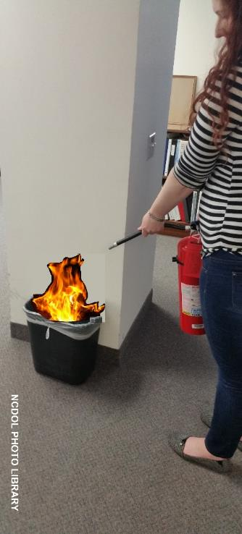
Selection and Distribution
1910.157(d)(2)
Employer shall distribute:
Class A fire extinguishers within a travel distance of 75 feet or less
Class A—Ordinary combustibles
Wood
Paper
Plastic
Cloth
Rubber

Slide 13
Selection and Distribution
1910.157(d)(3)
Employer may use:
Uniformly spaced standpipe systems or hose stations connected to a sprinkler system instead of Class A fire extinguishers
Systems must provide total coverage of area to be protected and employees must be trained annually in use

Slide 14
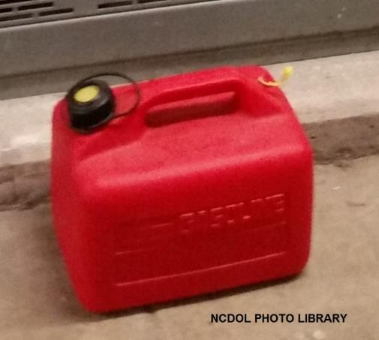
Selection and Distribution
1910.157(d)(4)
Employer shall distribute:
Class B fire extinguishers within a travel distance of 50 feet or less
Class B—Flammable liquids

Slide 15
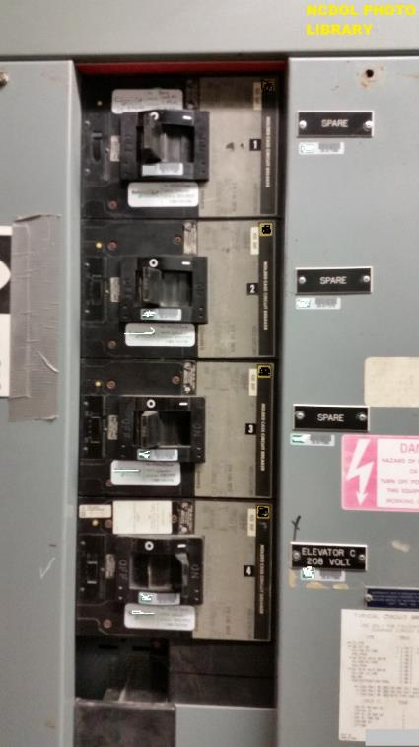
Selection and Distribution
1910.157(d)(5)
Employer shall distribute:
Class C fire extinguishers on the basis of the appropriate pattern for existing Class A or Class B hazards
Class C—Electrical fires

Slide 16
Selection and Distribution
1910.157(d)(6)
Employer shall distribute:
Class D fire extinguishers within a travel distance of 75 feet or less
Required in combustible metal areas where metal powders, flakes, and shavings are generated at least once every two weeks
Class D—Metals

Slide 17
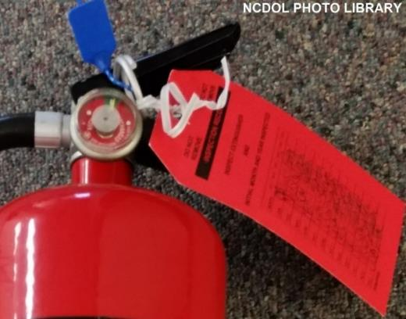
Inspection, Maintenance and Testing
1910.157(e)(1)-(2)
Employer shall be responsible for the inspection, maintenance and testing of all portable fire extinguishers in the workplace
Fire extinguishers or hose shall be visually inspected monthly

Slide 18
Inspection, Maintenance and Testing
1910.157(e)(3)
Employer shall:
Assure that fire extinguishers are subjected to an annual maintenance check
Record the annual maintenance date and retain record for one year
Record available to the Assistant
Secretary upon request

Slide 19
Inspection, Maintenance and Testing
1910.157(e)(4)
Dry chemical extinguishers require a 12-year hydrostatic test
Subjected to applicable maintenance procedures every 6 years
Exempted
Dry chemical extinguishers having non-refillable
disposable containers

Slide 20
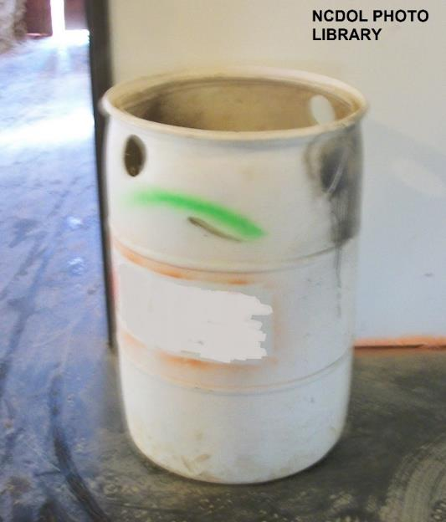
Inspection, Maintenance and Testing
1910.157(e)(5)
Employer shall assure that alternate equivalent protection is provided when portable fire extinguishers are removed from service for maintenance and recharging

Slide 21
Hydrostatic Testing
1910.157(f)(1)
Employer shall assure that hydrostatic testing is performed by trained persons with suitable testing equipment and facilities

Slide 22
Hydrostatic Testing
1910.157(f)(2)
Employer shall assure that portable extinguishers are hydrostatically tested at the intervals listed in Table L-1
Take this time to look up Table L-1
29 CFR 1910.157(f)(2) Table L-1
29 (Title)
CFR (Code of Federal Regulations)
1910 (Part)
157 (f)(2) Table L-1 (Section)
Table L-1

Slide 23
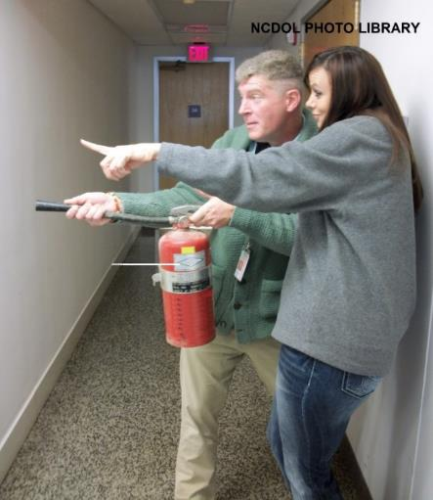
Training and Education
1910.157(g)(1)-(2)
Where employer has provided portable fire extinguishers for employee use
Employer shall provide
training on fire extinguisher
use and hazards involved
with incipient stage fire fighting
Initially and annually thereafter

Slide 24
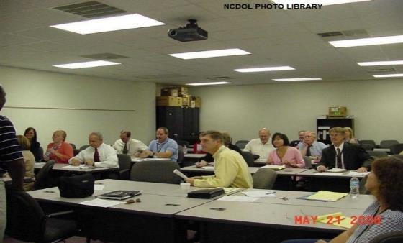
Training and Education
1910.157(g)(3)-(4)
Employees who have been designated to use fire fighting equipment as part of an emergency action plan
Employer shall provide training in use of appropriate equipment to designated group
Initially and annually thereafter

Slide 25
Summary
1910.157
In this course, we discussed:
Scope and application
Exemptions
General requirements
Selection
Inspection and maintenance
Training

Slide 26
Thank You For Attending!
Final Questions?

