Slide 1
Fall Protection in Construction
§1926 Subpart M
Presented by:
Notes:
Revised: May 2023
The information in this presentation is provided voluntarily by the N.C. Department of Labor, Education Training and Technical Assistance Bureau as a public service and is made available in good faith. This presentation is designed to assist trainers conducting OSHA outreach training for workers. Since workers are the target audience, this presentation emphasizes hazard identification, avoidance, and control – not standards. No attempt has been made to treat the topic exhaustively. It is essential that trainers tailor their presentations to the needs and understanding of their audience.
The information and advice provided on this Site and on Linked Sites is provided solely on the basis that users will be responsible for making their own assessment of the matters discussed herein and are advised to verify all relevant representations, statements, and information.
This presentation is not a substitute for any of the provisions of the Occupational Safety and Health Act of North Carolina or for any standards issued by the N.C. Department of Labor. Mention of trade names, commercial products, or organizations does not imply endorsement by the N.C. Department of Labor.

Slide 2
Objectives
After this course, students will:
Recognize fall hazards in construction
Understand Subpart M requirements
Be able to apply fall protection standards to construction
work sites

Slide 3
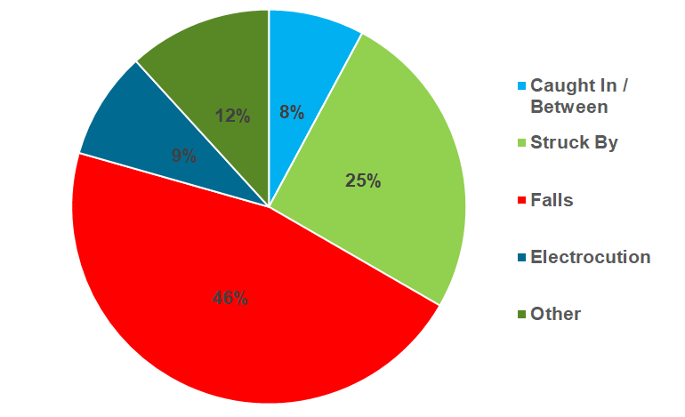
Falls= 46% of CY 2018-2022 Construction Fatalities in North Carolina

Slide 4
Subpart M – Fall Protection
1926.500-503
Exception
Covers all fall hazards except specific requirements
found in:
Subpart L – Scaffolds
Subpart R – Steel erection
Subpart S – Tunneling operations
Subpart V – Power transmission and distribution
Subpart X – Stairways and ladders
Subpart CC – Cranes and derricks
13 NCAC 07F .0605 – Communication towers

Slide 5
Subpart M – Fall Protection
1926.500(a)(1)
Exception
The provisions of this subpart do not apply when employees are making an inspection, investigation, or assessment of workplace conditions prior to the actual start of construction work or after all construction work has been completed

Slide 6
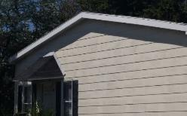
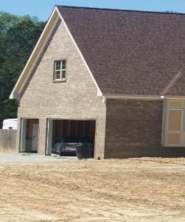
Fall Exposure: Then and now...
1969 Construction
Est. fall exposure
Drip edge = 11 feet
Roof peak = 16 feet
2008 Construction
Est. fall exposure
Drip edge = 23 feet
Roof peak = 38 feet
NCDOL Photo Library
NCDOL Photo Library

Slide 7
Fall Protection Requirements
Steel Erection
15′
Scaffolds
10′
Construction
6′
General Industry
4′

Slide 8
Duty to Have Fall Protection 1926.501(a)
Employer required to provide fall protection systems
Employer must determine if the walking/working surfaces on which its employees are to work have the strength and structural integrity to support employees safely

Slide 9
Fall Protection Required 1926.501(b)(1)-(15)
Unprotected sides, edges
Leading edges
Hoist areas
Holes
Formwork, reinforcing steel
Ramps, runways
Excavations
Dangerous equipment
Overhand bricklaying
Low-slope roofs
Steep roofs
Pre-cast concrete erection
Residential construction
Wall openings
Other walking and working surfaces

Slide 10
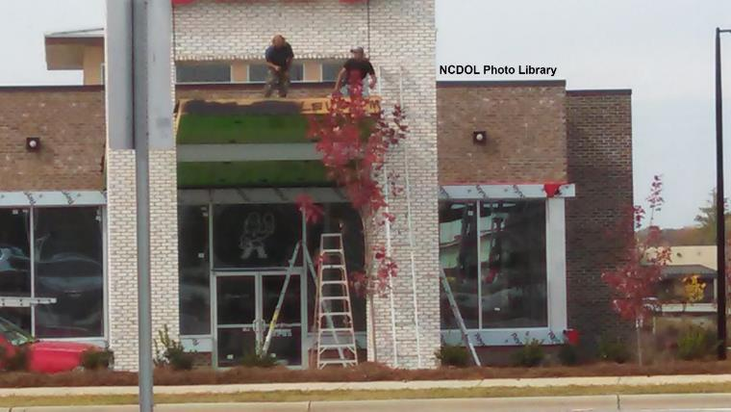
Fall Protection Required
1926.501(b)(1)
Unprotected sides and edges

Slide 11
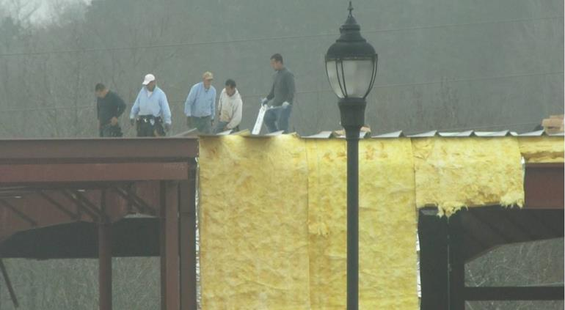
Fall Protection Required
1926.501(b)(2)
Leading edges
NCDOL Photo Library

Slide 12
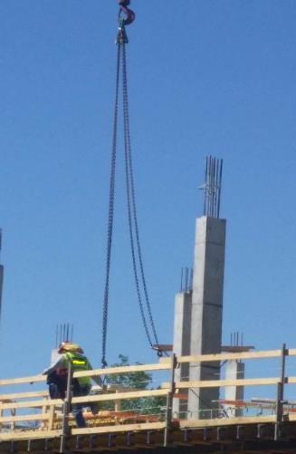
Fall Protection Required
1926.501(b)(3)
Hoist areas
NCDOL Photo Library

Slide 13
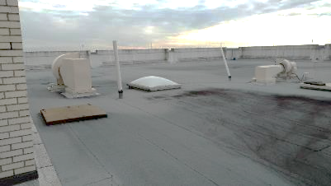
Fall Protection Required
1926.501(b)(4)
Holes
More than 6 feet above lower level
Includes skylights
NCDOL Photo Library
NCDOL Photo Library

Slide 14
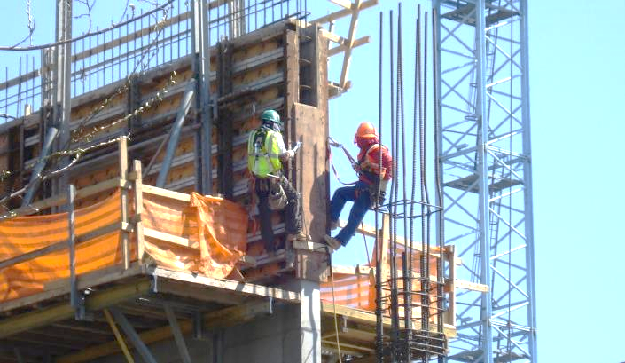
Fall Protection Required
1926.501(b)(5)
Formwork and reinforcing steel
NCDOL Photo Library

Slide 15
Fall Protection Required
1926.501(b)(6)
Ramps, runways, other walkways
NCDOL Photo Library

Slide 16
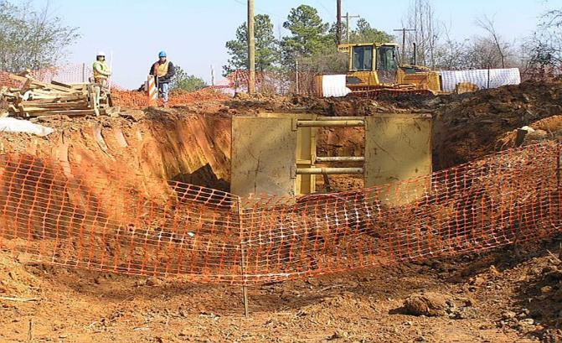
Fall Protection Required
1926.501(b)(7)
Excavations
NCDOL Photo Library

Slide 17
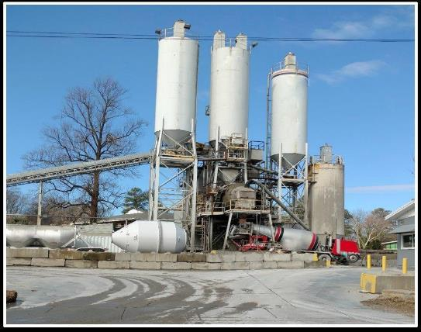
Fall Protection Required
1926.501(b)(8)
Dangerous equipment
NCDOL Photo Library

Slide 18
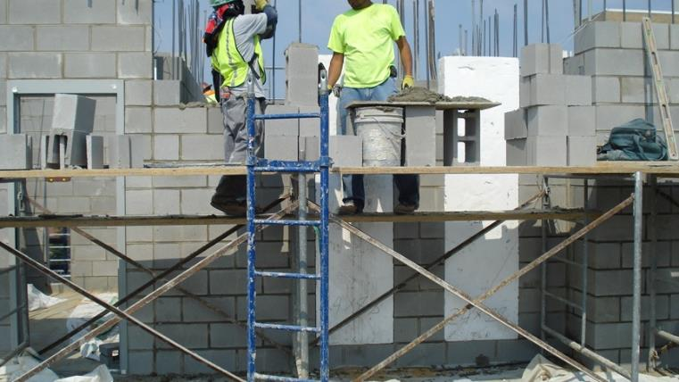
Fall Protection Required
1926.501(b)(9)
Overhand bricklaying
NCDOL Photo Library

Slide 19
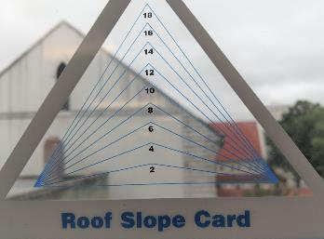
Fall Protection Required
1926.501(b)(10)-(11)
Low-slope roof
< 4/12 pitch
Steep roof
> 4/12 pitch
NCDOL Photo Library
NCDOL Photo Library

Slide 20
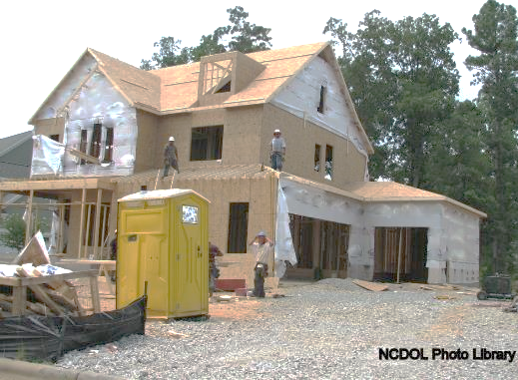
Fall Protection Required
1926.501(b)(13)
Residential construction
STD 03-11-002 for citation guidance

Slide 21
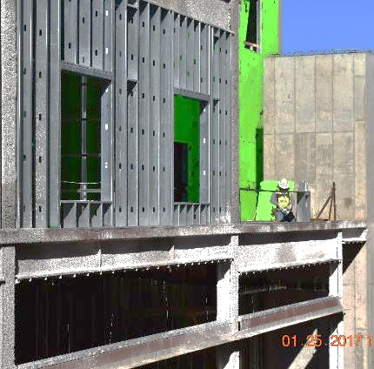
Fall Protection Required
1926.501(b)(14)
Wall openings

Slide 22
Falling Object
1926.501(c)
Each exposed employee must wear a hard hat
Employer must take steps to prevent employees from being hit by falling objects
Erect toe boards, screens, or guardrail systems
Erect a canopy structure
Barricade the area

Slide 23
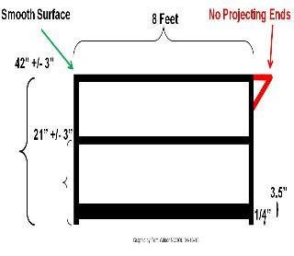
Protection from Falling Objects
1926.502(j)
Toeboards
When used as falling object protection, must be erected along the edge of the overhead walking/working surface
Withstand force of at least 50 pounds
Toeboards must be a minimum of 3½ inches in vertical height
NCDOL Photo Library

Slide 24
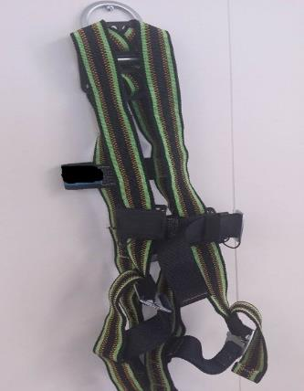
Methods of Fall Protection
1926.502(a)(1)
Conventional methods
Safety nets
Guardrails
Personal fall arrest systems
NCDOL Photo Library

Slide 25
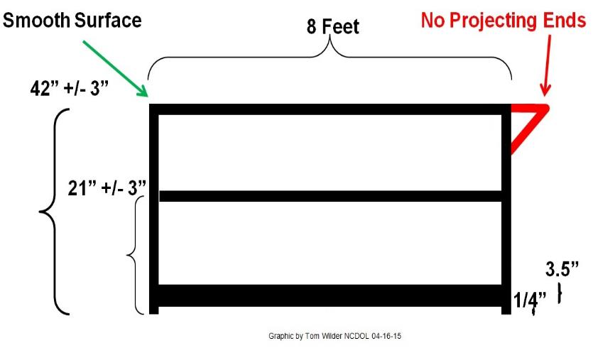
Guardrail System
1926.502(b)
NCDOL Photo Library

Slide 26
Safety Nets
1926.502(c)
Used for:
Bridges
Demolition of multi-story buildings
Rarely used in residential construction

Slide 27
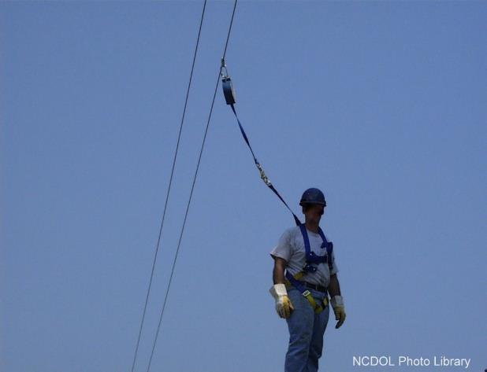
Personal Fall Arrest System (PFAS)
NCDOL Photo Library

Slide 28
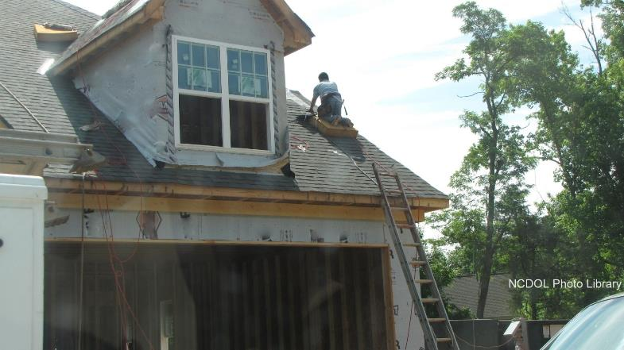
Personal Fall Arrest System
Is this correct?

Slide 29
Personal Fall Arrest System
1926.502(d)
D-Rings, snaphooks, lanyards, lifelines, anchorages rated @ 5,000 pounds
No free fall more than 6 feet; nor contact any lower level; 3.5 feet maximum deceleration
Provide for prompt rescue
Inspect prior to each use

Slide 30
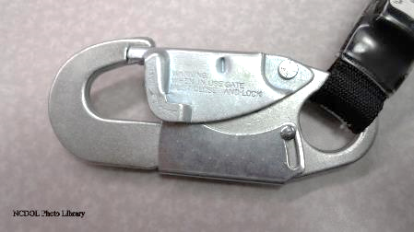
Personal Fall Arrest System
1926.502(d)
Body belts not allowed for fall arrest but may be used as a positioning device
Only locking type of snaphook can be used

Slide 31
Methods of Fall Protection
1926.502(f), (g), (h), (k)
Other acceptable methods
Used under certain circumstances
Warning lines
Control access zones (CAZ)
Safety monitor
Fall protection plan

Slide 32
Warning Lines
1926.502(f),1926.501(b)(10)
Used on low-sloped roofs < 4/12
Erect 6 feet from all edges
Need fall protection for last 6 feet
Used in combination with other systems
Developed by competent person

Slide 33
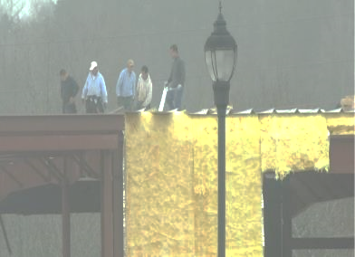
Controlled Access Zones
1926.502(g)
Used in:
Leading edge work
Overhand bricklaying
Pre-cast concrete
Only authorized persons
NCDOL Photo Library
NCDOL Photo Library

Slide 34
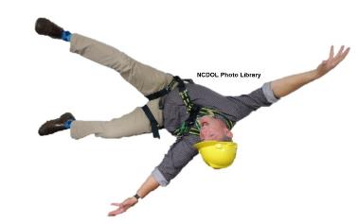
Safety Monitor System 1926.502(h)
Used on low-sloped roofs < 4/12
With roof widths < 50 feet, can use alone
Monitor must be competent person
No other responsibilities

Slide 35
Fall Protection Plan
1926.502(k)
Only for specific area or jobs
Leading edge work
Precast concrete erection work
Residential construction work
Used when conventional fall protection equipment is infeasible or creates a greater hazard
Designed by qualified person
Supervised by competent person

Slide 36
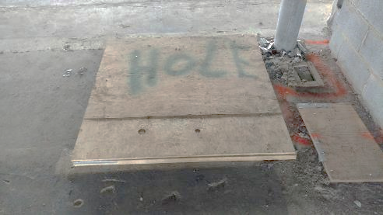
Covers for Holes
1926.502(i)
Covers must:
Withstand two times weight of expected load
Secured to prevent displacement
Marked “hole” or “cover” or color-coded
NCDOL Photo Library

Slide 37
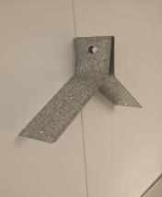
Personal Fall Arrest System 1926.502(d)
Anchorage Connectors
Harness
NCDOL Photo Library
NCDOL Photo Library
NCDOL Photo Library

Slide 38
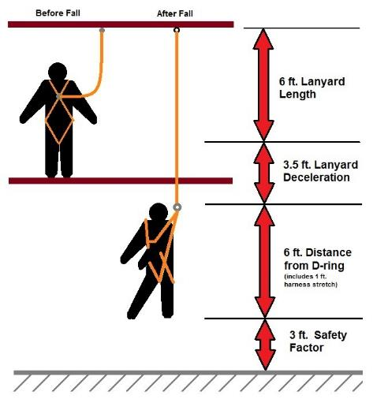
Personal Fall Arrest Systems
NCDOL Photo Library

Slide 39
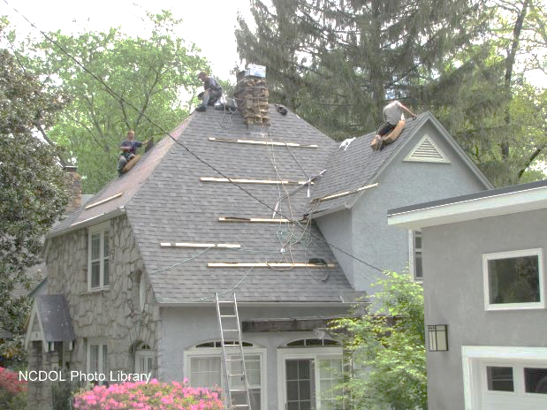
Personal Fall Arrest Systems
Is this correct?

Slide 40
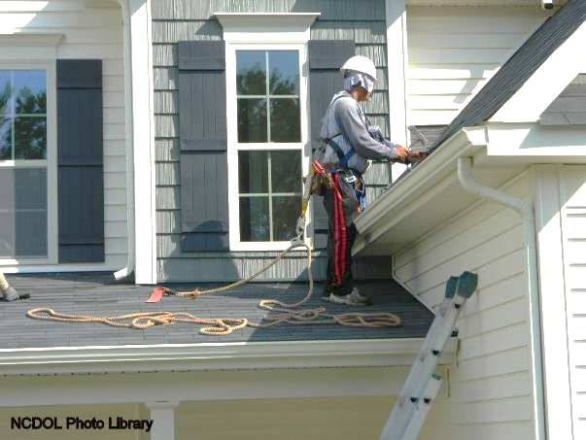
Personal Fall Arrest Systems
Is this correct?

Slide 41
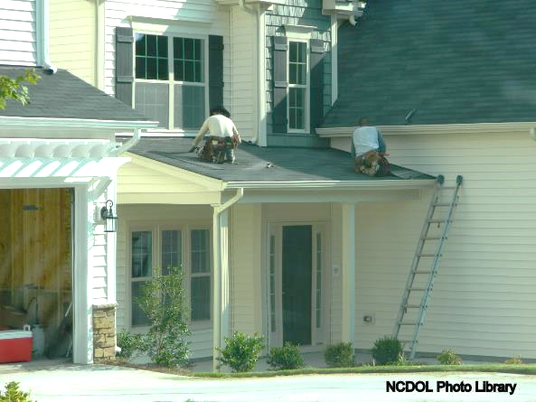
Personal Fall Arrest Systems
Is this correct?

Slide 42
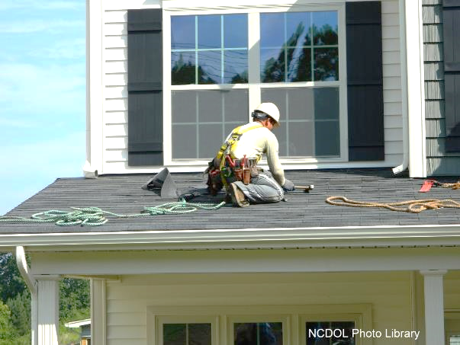
Personal Fall Arrest Systems
Is this correct?

Slide 43
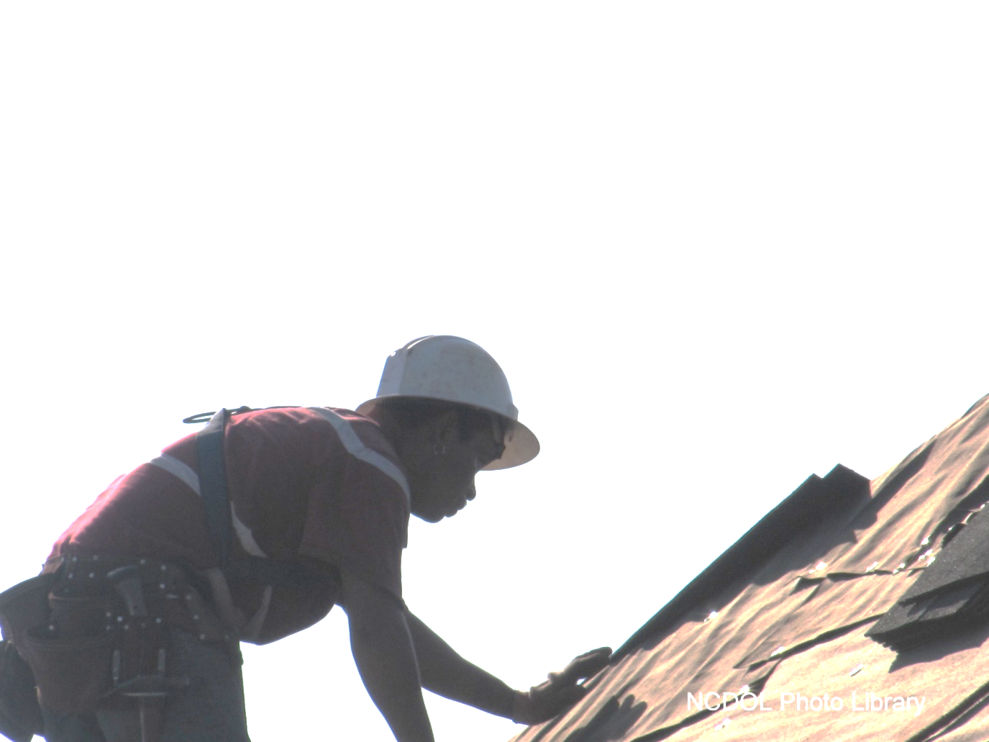
Personal Fall Arrest Systems
Is this correct?

Slide 44
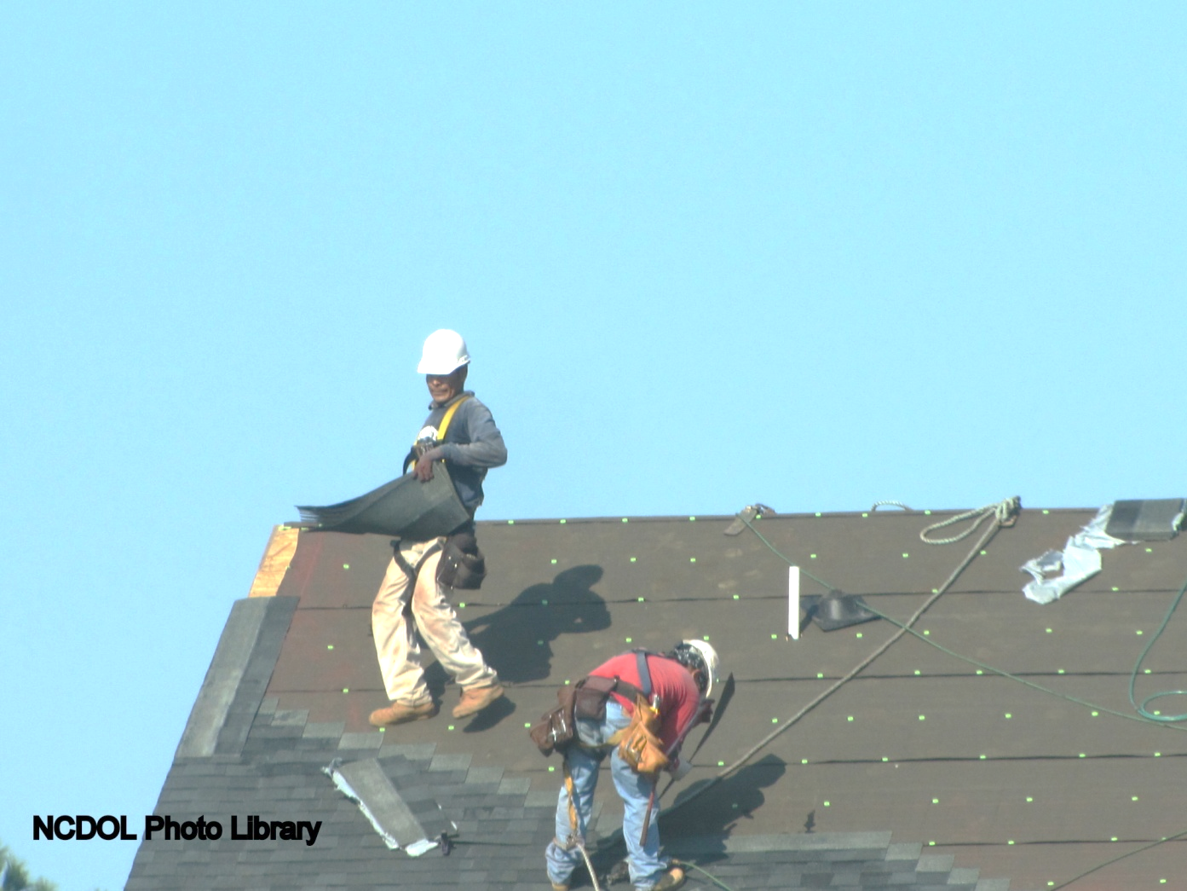
Personal Fall Arrest Systems
Is this correct?

Slide 45
Positioning Device System 1926.502(e)
Allows an employee to be supported on an elevated vertical surface
No more than 2 feet freefall
Inspected before each use
Safety belts okay for use

Slide 46
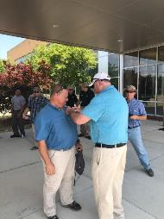
Training Requirements 1926.503
Employer must:
Provide a training program
Ensure each employee has been trained
Provide written certification of training
Retrain where necessary
NCDOL Photo Library

Slide 47
Summary
In this course, we discussed:
Fall hazards in construction
Subpart M requirements
Applying fall protection standards to construction sites

Slide 48
Thank You For Attending!
Final Questions?

