Slide 1
Exit Routes, Emergency Action Plans, and Fire Prevention Plans
1910 Subpart E
Notes:
Revision: 01/02/18
The information in this presentation is provided voluntarily by the N.C. Department of Labor, Education Training and Technical Assistance Bureau as a public service and is made available in good faith. This presentation is designed to assist trainers conducting OSHA outreach training for workers. Since workers are the target audience, this presentation emphasizes hazard identification, avoidance, and control – not standards. No attempt has been made to treat the topic exhaustively. It is essential that trainers tailor their presentations to the needs and understanding of their audience.
The information and advice provided on this Site and on Linked Sites is provided solely on the basis that users will be responsible for making their own assessment of the matters discussed herein and are advised to verify all relevant representations, statements, and information.
This presentation is not a substitute for any of the provisions of the Occupational Safety and Health Act of North Carolina or for any standards issued by the N.C. Department of Labor. Mention of trade names, commercial products, or organizations does not imply endorsement by the N.C. Department of Labor.

Slide 2

Objectives
1910 Subpart E
In this course, we will discuss the following:
Exit routes (means of egress)
Coverage and definitions
Design requirements
Operational features
Emergency action plan
Fire prevention plan
National Fire Protection Association (NFPA) 101

Slide 3

Means of Egress
1910.34(a)–(b)
Every employer is covered
Exit routes are covered
  Minimum requirements for exit routes to allow for the safe evacuation of employees during an emergency
  Also covers the minimum requirements for emergency action plans and fire prevention plans.

Slide 4
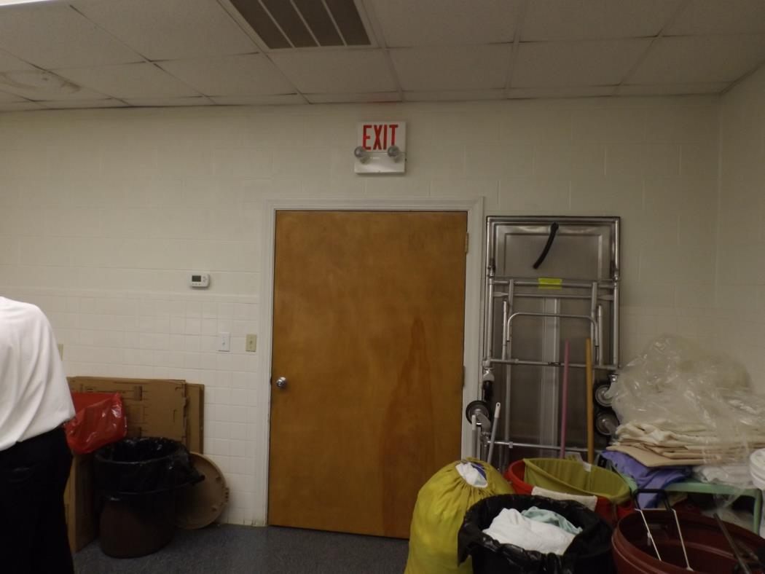
Means of Egress
1910.34
NCDOL Photo Library

Slide 5
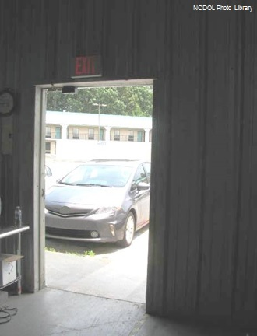
Definitions
NFPA 3.3.172
Egress
  Act or an instance of going from an enclosed place
  A means or place of going out; an exit
  Right or permission
  to go
NCDOL Photo Library

Slide 6
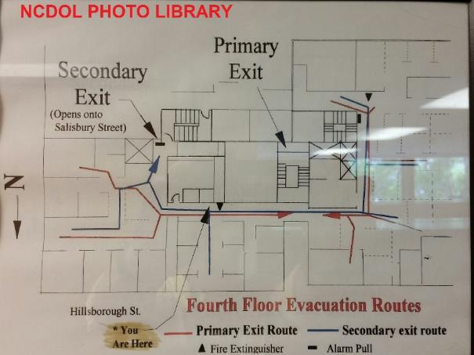
Definitions
1910.34(c)
Exit route
  A continuous and unobstructed path of exit travel from any point within a workplace to a place of safety (including refuge areas)

Slide 7
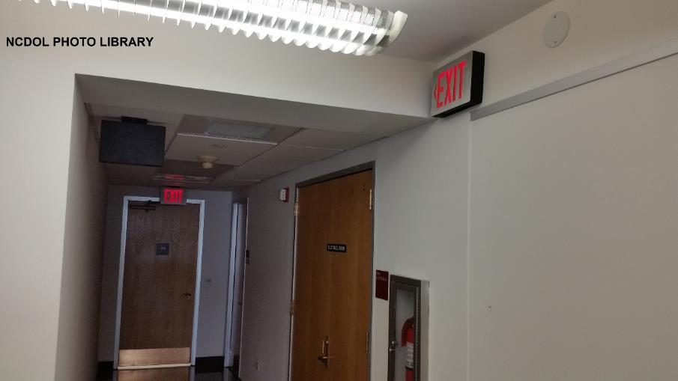
Definitions
1910.34(c)
Exit access
  That portion of a means of egress that leads to an exit

Slide 8
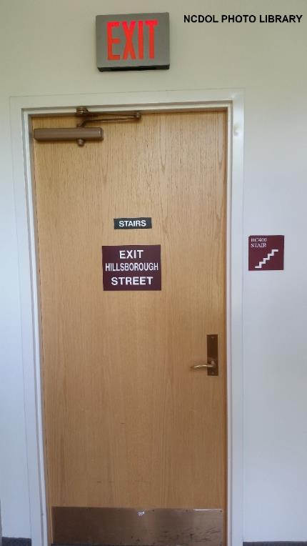
Definitions
1910.34(c)
Exit
  That portion of an exit route that is generally separated from other areas to provide a protected way of travel to the exit discharge

Slide 9
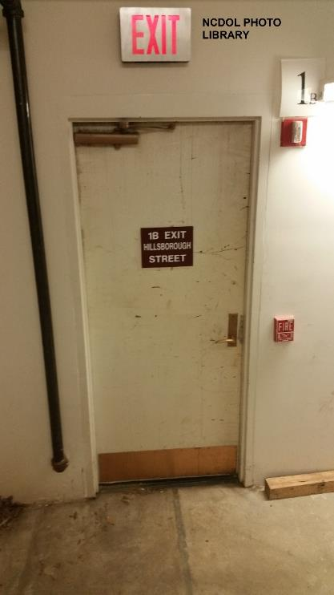
Definitions
1910.34(c)
Exit discharge
  Part of the exit route that leads directly outside or to a street, walkway, refuge area, public way, or open space with access to the outside

Slide 10
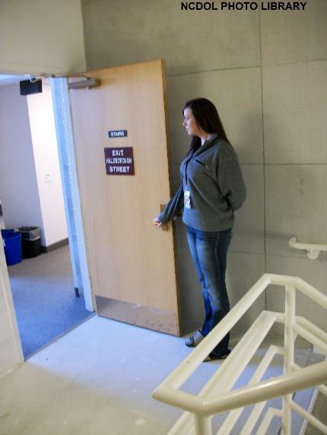
Design Basic Requirements
1910.36(a)(1)–(3)
Exit routes must be:
  Permanent
  Separated by fire resistant materials
  Openings into an exit must be limited

Slide 11
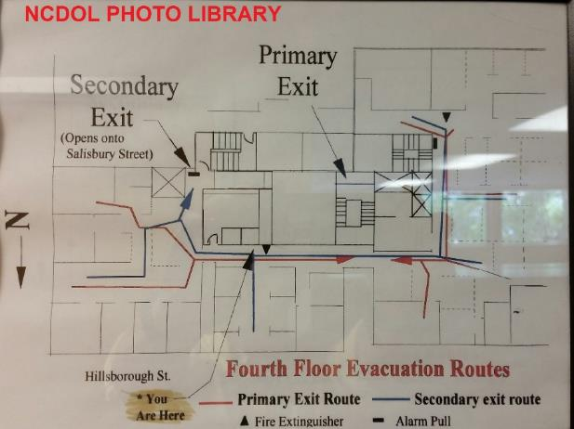
Exit Routes
1910.36(b)
The number of exit routes must be adequate.
  Two exit routes
  More than two exit routes
  A single exit route

Slide 12
Exit Discharge
1910.36(c)(1)–(3)
Each exit discharge must lead directly outside or to a street, walkway, refuge area, public way, or open space with access to the outside
The street, walkway, refuge area, public way, or open space to which an exit discharge leads must be large enough to accommodate the building occupants likely to use the exit route
Exit stairs that continue beyond the level… clearly indicate the direction of travel…”

Slide 13
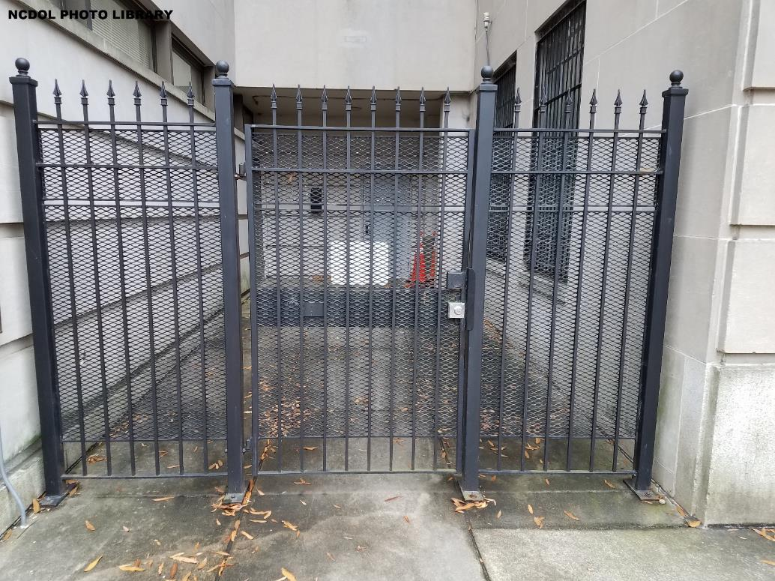
Exit Discharge
1910.36(c)(1)
Exit Door

Slide 14
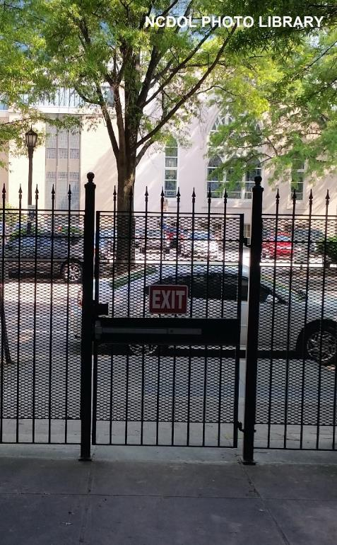
Exit Route Design
1910.36(d)–(h)
Must be:
  Unlocked and unrestricted
  Side-hinged
  Adequate capacity and height
  Must meet height and width requirements
  Outdoor exit route permitted

Slide 15
Unlocked and Unrestricted
1910.36(d)
Must be able to open door from inside without keys, tools, or special knowledge
  Panic bars that lock from the outside are permitted
Must be free of device or alarm that could restrict emergency use if device or alarm fails
May be locked from inside in mental, penal, or correctional facilities
  And only if supervisory personnel are continuously on duty and there is an emergency plan

Slide 16
Side-Hinged
1910.36(e)
Must be used to connect any room to an exit route
Door that connects any room to an exit route must swing out in direction of exit travel if room is designed to be occupied by more than 50 people or if room is a high hazard area

Slide 17
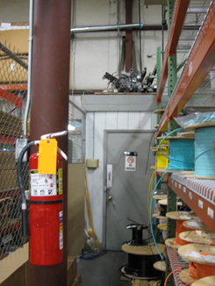
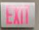
Adequate Capacity
1910.36(f)
Must support maximum permitted occupant load for each floor served
Capacity of exit route may not decrease in direction of exit route travel to exit discharge
  Note: Information regarding “occupant load” is located in NFPA 101-2009, Life Safety Code and in IFC-2009, International Fire Code.
NCDOL Photo Library

Slide 18
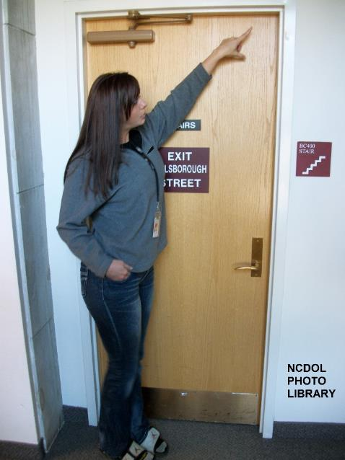
Minimum Height and Width
1910.36(g)
Ceiling of exit route must be at least seven feet six inches high
Exit access must be at least 28 inches wide at all points
Width must accommodate maximum permitted occupant load of each floor
Objects that project into exit route must not reduce width of exit route to less than
minimum width requirements

Slide 19
Outdoor Exit Route
1910.36(h)
Have guardrails to protect unenclosed sides if a fall hazard exists
Covered if snow or ice is likely to accumulate along route
Reasonably straight and have smooth, solid, substantially level walkways
Must not have a dead-end that is longer than 20 feet

Slide 20
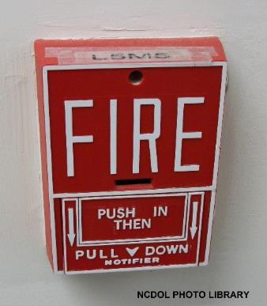
Exit Route Maintenance and Safeguards
1910.37(a)–(e)
Danger to employees minimized
Adequate and appropriate lighting and marking
Fire retardant properties maintained
Exit routes maintained during construction and repairs
Employee alarm system must be operable

Slide 21
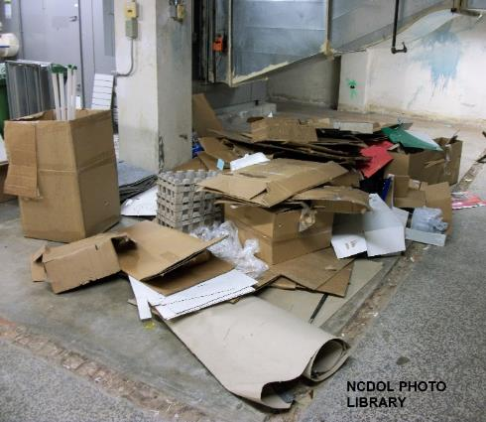
Danger to Employees Minimized
1910.37(a)
Kept free of explosive or highly flammable furnishings or other decorations
Arranged so employees will not travel toward a high hazard area
Must be free and unobstructed
Safeguards designed to protect employees during an emergency must be in proper working order at all times

Slide 22

Lighting and Marking
1910.37(b)(1)-(4)
Adequately lighted
Clearly visible and marked by a
sign reading “Exit”
Free of decorations or signs that obscure visibility of exit
If direction of travel to exit is not apparent, signs must be posted along exit access indicating direction of travel to nearest exit

Slide 23
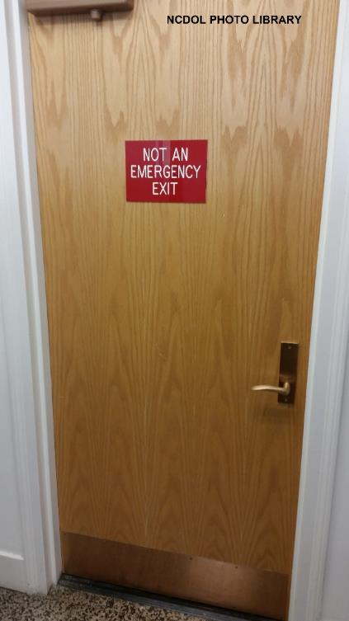
Lighting and Marking
1910.37(b)(5)
Each doorway or passage along exit access that could be mistaken for an exit must be marked “Not an Exit” or be identified by a sign indicating its actual use

Slide 24

Lighting and Marking
1910.37(b)(6)-(7)
Each exit sign must be illuminated by a reliable light source and be a distinct color
Must have the word “Exit” in plainly legible letters not less than six inches high, with the principal strokes of the letters in the word “Exit” not less than three-fourths of an inch wide

Slide 25
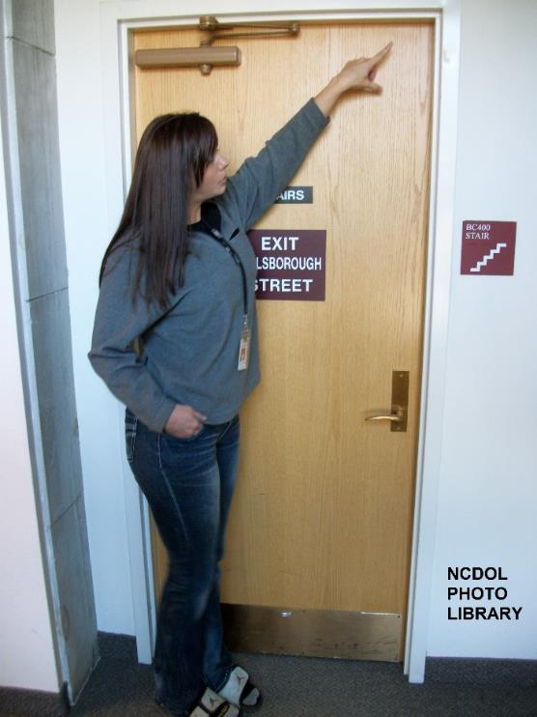
Fire Retardant Properties
1910.37(c)
Fire retardant paints or solutions must be renewed as often as necessary to maintain their fire retardant properties

Slide 26
Construction and Repairs
1910.37(d)
During new construction, employees must not occupy a workplace until exit routes are completed and ready for employee use
During repairs or alterations, employees must not occupy a workplace unless exit routes are available and existing fire protections are maintained, or until alternate fire protection is furnished
Employees must not be exposed to hazards of flammable or explosive substances or equipment used during construction, repairs, or alterations

Slide 27
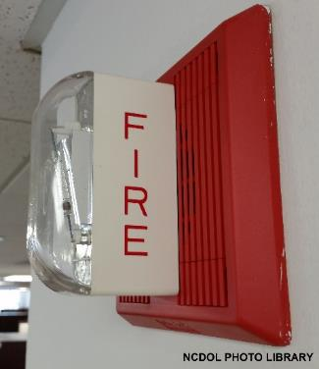
Operable Alarm System
1910.37(e)
Install and maintain an operable employee alarm system that has a distinctive signal to warn employees of fire or other emergencies, unless employees can promptly see or smell a fire or other hazard in time to provide adequate warning to them
Employee alarm system must
comply with § 1910.165

Slide 28
Psychological Hazards
Lack of information
Panic
Confusion

Slide 29

Physical Hazards
Fire
Toxic vapors
Threats
Storms
Other
Notes:
29

Slide 30
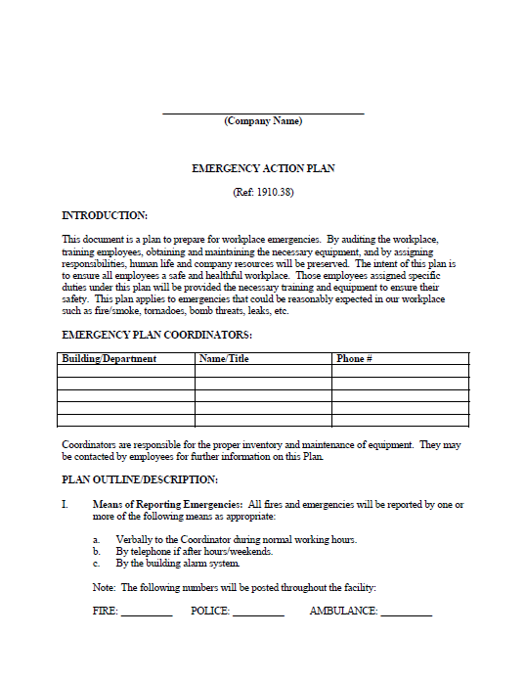
Emergency Action Plan
1910.38(a)–(b)
An employer must have an emergency action plan whenever an OSHA standard in this part requires one
An emergency action plan (EAP)
must be in writing kept at the
workplace and available to
employees when required
If an employer has 10 or fewer
employees, it may be communicated
verbally
NCDOL Photo Library

Slide 31
EAP Elements
1910.38(c)
Must have procedures for:
    Reporting a fire or other emergency
    Emergency evacuation
    Employees who operate critical operations
    Account for employee post evacuation
    Employees performing rescue or medical duties
    Name or job title of every employee who may be contacted about the EAP

Slide 32

Alarm System and Training
1910.38(d)–(f)
Maintained and distinctive sounds based on an emergency
Employer must designate and train employees for a safe and orderly evacuation
Employer must review EAP with employees:
  Development and/or initial hiring
  Job change
  Plan change

Slide 33
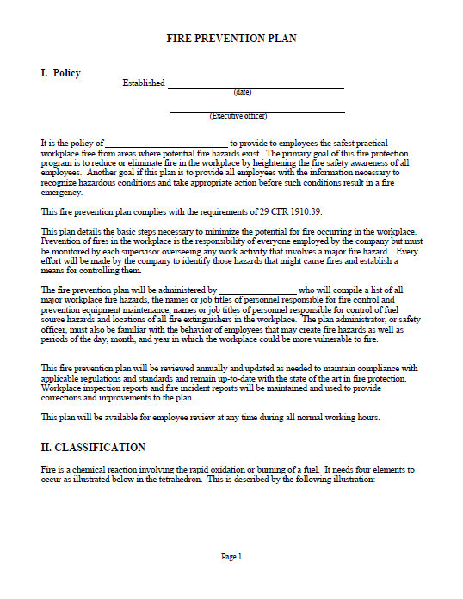
Fire Prevention Plan
1910.39(a)–(b)
An employer must have a fire prevention plan when an OSHA standard in this part requires one
A fire prevention plan must be
in writing, kept at the
workplace, and available to
employees for review
If an employer has 10 or
fewer employees, it may be
communicated verbally
NCDOL Photo Library

Slide 34

Fire Plan Elements
1910.39(c)
Must have procedures for:
  A list of all major fire hazards, proper handling and storage
  Accumulation controls for flammable and combustible waste materials
  Procedures for regular maintenance
  Name or job title of employees responsible maintaining equipment
  Name or job title of employees responsible
  for control of fuel source

Slide 35
Employee Information
1910.39(d)
An employer must inform employees upon initial assignment to a job of the fire hazards to which they are exposed
An employer must also review with each employee those parts of the fire prevention plan necessary for self-protection

Slide 36
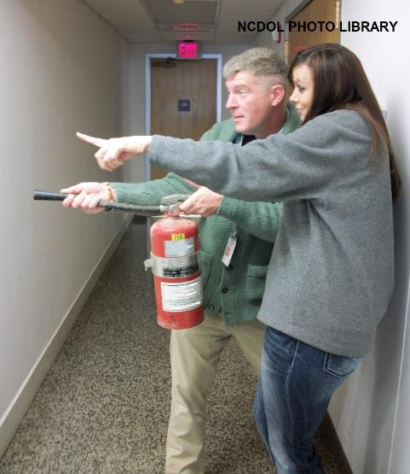
Exit Routes, Emergency Action Plans, and Fire Prevention Plans
1910 Subpart E Appendix
Non-mandatory guideline to assist employers in complying with the appropriate requirements
  Emergency action plan elements
  Emergency evacuation
  Emergency action plan training
  Fire prevention housekeeping
  Maintenance of equipment under
  fire prevention plan

Slide 37
Alternate Exit-Route Codes
1910.35
If an employer complies with the exit-route provisions of:
  NFPA 101, Life Safety Code, 2009
or
  International Fire Code, 2009
….then OSHA will deem in compliance with the OSHA standards

Slide 38
Summary
1910 Subpart E
Exit routes (means of egress)
Coverage and definitions
Design requirements
Operational features
Emergency action plan
Fire prevention plan
NFPA 101

Slide 39
Thank You For Attending!
Final Questions?

