Slide 1
Ergonomics Awareness
Notes:
Revised: 6/16/25
The information in this presentation is provided voluntarily by the N.C. Department of Labor’s Education, Training and Technical Assistance Bureau as a public service and is made available in good faith. This presentation is designed to assist trainers conducting OSHA outreach training for workers. Since workers are the target audience, this presentation emphasizes hazard identification, avoidance, and control – not standards. No attempt has been made to treat the topic exhaustively. It is essential that trainers tailor their presentations to the needs and understanding of their audience.
The information and advice provided on this site and on linked sites is provided solely on the basis that users will be responsible for making their own assessment of the matters discussed herein and are advised to verify all relevant representations, statements, and information.
This presentation is not a substitute for any of the provisions of the Occupational Safety and Health Act of North Carolina or for any standards issued by the N.C. Department of Labor. Mention of trade names, commercial products, or organizations does not imply endorsement by the N.C. Department of Labor.
NCDOL Resources:
ERGONOMICS
CPL 02-00-078 Regional Ergonomic Program
CPL 02-00-098 Case File Documentation for Videotapes and Audiotapes (Ergonomic inspections)
FOM Chapter 17 Ergonomic Inspection Procedures
MOU NCSU – Ergonomics Letter
OPN 132 – SEP: Long Term Care Facilities
OPN 140 – SEP: Food Manufacturing

Slide 2
Objectives
In this course, we will discuss the following:
  Definition of ergonomics
  Workplace problems, injuries and losses due to ergonomic issues
  Types, signs and symptoms, and risk factors of musculoskeletal disorders (MSDs)
  Common ergonomic stressors
  Techniques to combat these stressors
  NCDOL OSH Division perspective on ergonomics

Slide 3
Definitions
Ergonomics
  Greek derivation
    Ergo (work)
    Nomos (law)
  Interfacing man, machine and environment to optimize safety, productivity and comfort
  “Fitting the task to the human”

Slide 4
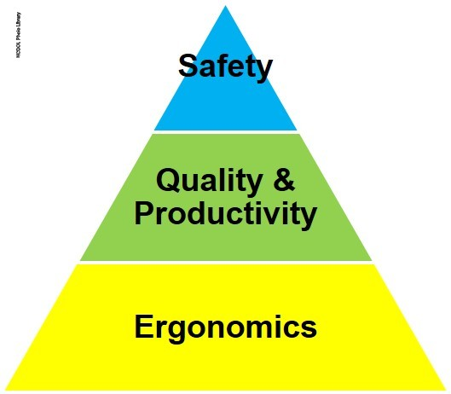
Workplace Problems and Losses
Increased discomfort, pain, injury or illness
Workers’ compensation costs
Lost or restricted work time
Short- or long-term disability
Increased absenteeism
Greater turnover
Low morale
Decreased productivity and/or quality

Slide 5
Musculoskeletal System
Bones - Provide structure, support and protection
Muscles - Expand and contract to move bones
Tendons - Connect muscle to bone
Ligaments - Connect bone to bone

Slide 6
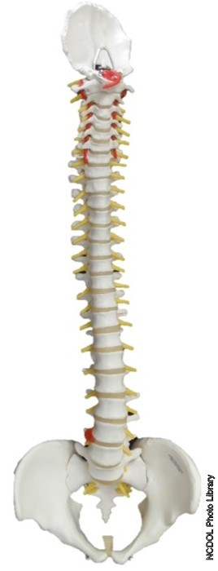
Musculoskeletal System
Cartilage - Provides cushioning and lubrication
Bursa - Fluid-filled sac that lubricates and cushions between points of friction
Vertebrae - Bones that make up the spine
Discs - Shock absorbers for the spine

Slide 7
Other Important Components
Arteries and veins
  Transport blood
    Deliver oxygen
    Remove waste
Nerves
  Provide tactility, sensation
  Provide feedback on pain and discomfort
  Determine which muscles to use
  Coordinate activities
NERVES
Arteries
Veins

Slide 8
Musculoskeletal Disorders (MSDs)
Damage or weakening of the musculoskeletal system
MSDs occur as an acute trauma or a cumulative trauma
Most common occupational problems include back strain and tendon disorders

Slide 9
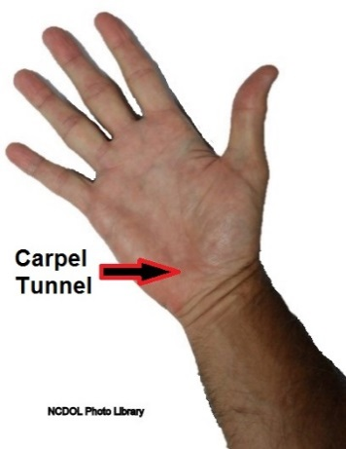
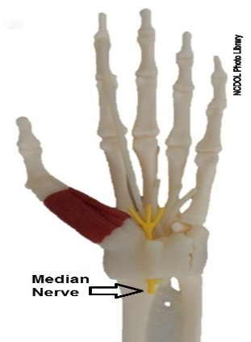
Common Musculoskeletal Disorders
Tendinitis
  Epicondylitis (“Tennis Elbow”)
  De Quervain’s tendinitis
Bursitis
Carpal tunnel syndrome
Tenosynovitis (“Trigger Finger”)
Thoracic outlet syndrome
Muscle strain

Slide 10
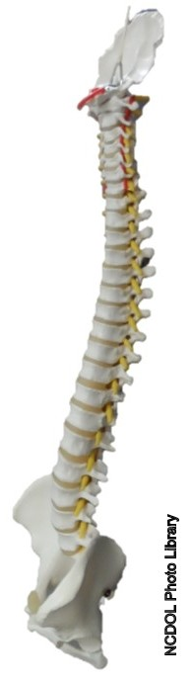
Types of Back Injuries
Ligament sprains
Muscle or tendon strains
Lumbar strain/sprain
Low back pain
Disc disorders

Slide 11
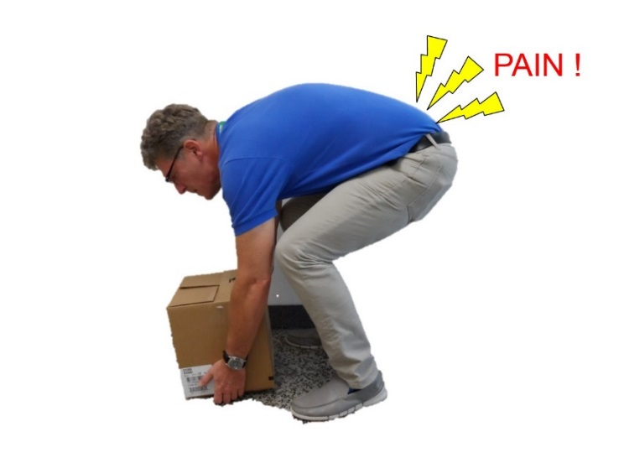
Signs and Symptoms of MSDs
Discomfort or pain
Numbness or tingling
Redness
Limited range of motion
Fullness, tightness or swelling
Weakness (trouble holding objects)
NCDOL Photo Library
Early reporting of symptoms and early treatment may resolve problems without lost work time, restricted activity or surgery.

Slide 12

Conservative Treatment
Anti-inflammatory medication (e.g., Ibuprofen)
Rest affected body part
Ice
Heat
Work accommodations
Physical therapy

Slide 13
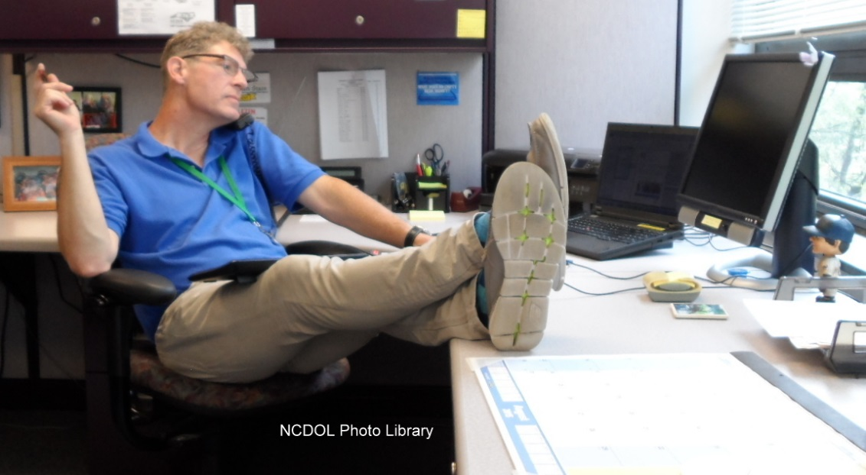
Ergonomic Stressors
Personal stressors
Force
Posture
Movement
  Repetitive
  Static
Environmental
Good or Bad Ergonomics?

Slide 14
Personal Stressors
Gender
Age
Smoking
Strength
Flexibility
Obesity
Diabetes
Lack of fitness
Body size and shape
Alcoholism
Recreational activities
Insufficient sleep
Insufficient recovery
Prior episode

Slide 15
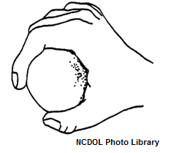

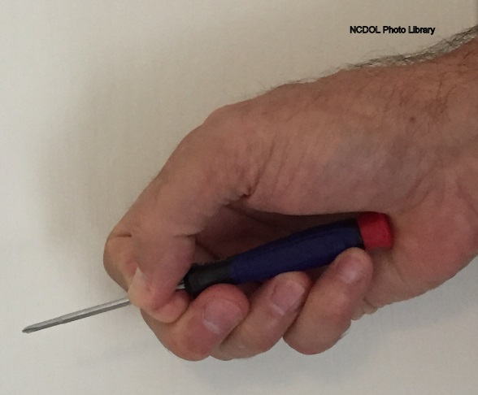
Force
Forces
  Lifting
  Lowering
  Pushing
  Pulling
  Contact force
Force is affected by:
  Object weight
  Friction (pushing and pulling)
  Tool shape and size

Slide 16
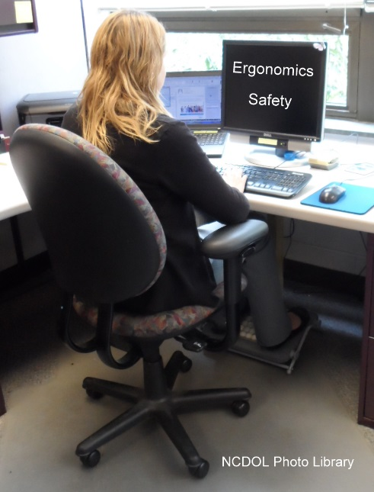
Posture
Neutral postures
  Strongest mechanical advantage
Awkward postures
  More prone to injury
Posture is affected by:
  Object shape and size
  Object placement and location
  Placement of workstation/equipment
  Tool shape

Slide 17
Neutral Posture
Standing with back straight
Sitting up straight
Arms to the side
Shoulders relaxed
Elbows in 90-degree bend
Wrists straight (“handshake” position)
Head facing straight forward

Slide 18
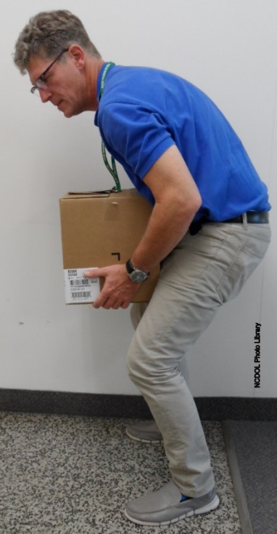
Proper Lifting Technique
Plan the lift and path
Check the weight of the load
Keep the load close to your body
Face the load, do not twist
Bend using your knees, not your back
Lift with your legs, not your back

Slide 19
Movement
Repetitive motions
  Frequent and rapid muscular contractions
  Limited recovery time
Static postures
  Holding one position for long periods of time
  Reduces blood flow
Movement is affected by:
  Work pace
  Task variety

Slide 20
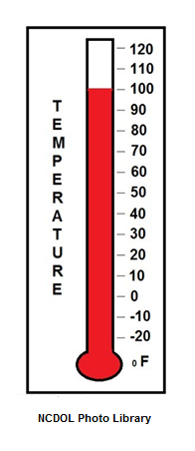
Environmental Stressors
Temperature
  Physiological effects
  Heat
  Cold
Vibration
  Can damage small blood vessels and nerves

Slide 21
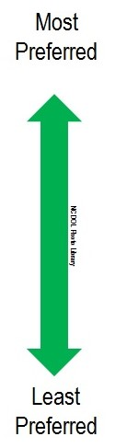
Controlling Stressors
Hierarchy of Controls
  Engineering Controls
    Eliminate hazard
    Physically change workstation
    Add equipment and tools
    Redesign products
  Administrative Controls
    Procedures to limit exposures to hazards
    Work rules and techniques
  Personal Protective Equipment (PPE)
    Are back belts and wrist braces PPE?

Slide 22

Controlling Stressors
Principles to consider when designing controls
  Reduce force
    Minimize weight that the employee must lift
    Reduce friction when pushing/pulling

Slide 23
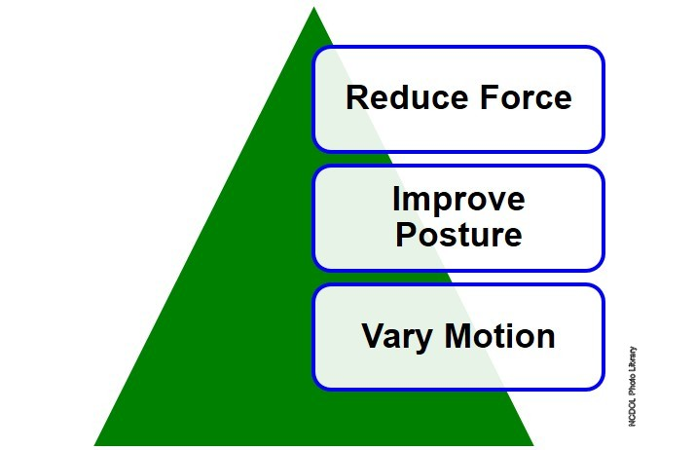
Controlling Stressors
Improve posture
  Reduce reach distances
  Choose appropriate tools
Vary motion
  Avoid long-term static postures
  Add variety to tasks
  Avoid repetitive motions
  Consider job rotation

Slide 24
Examples of Controls

Slide 25
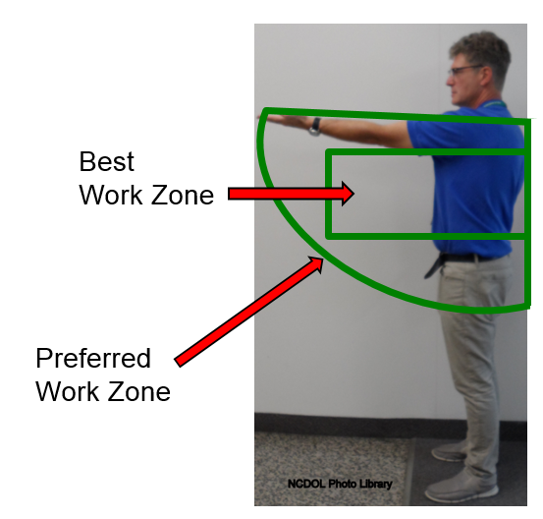
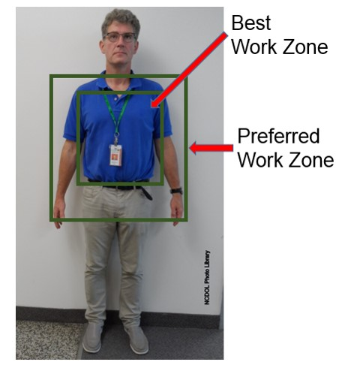
Workstation Design
Work within preferred work zones

Slide 26
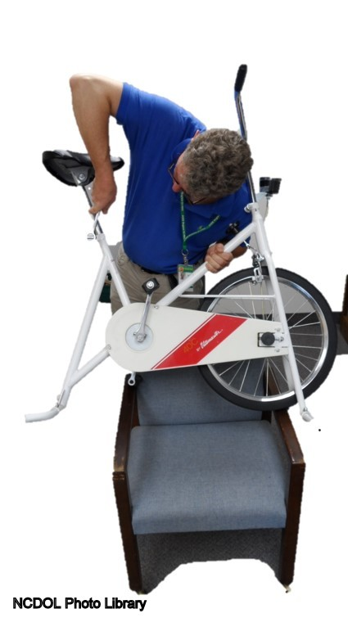
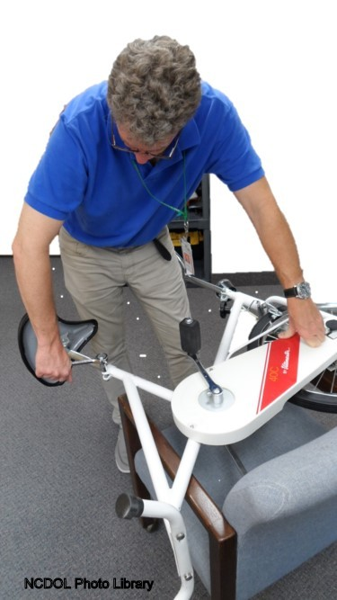
Workstation Design
Reposition the work height

Slide 27

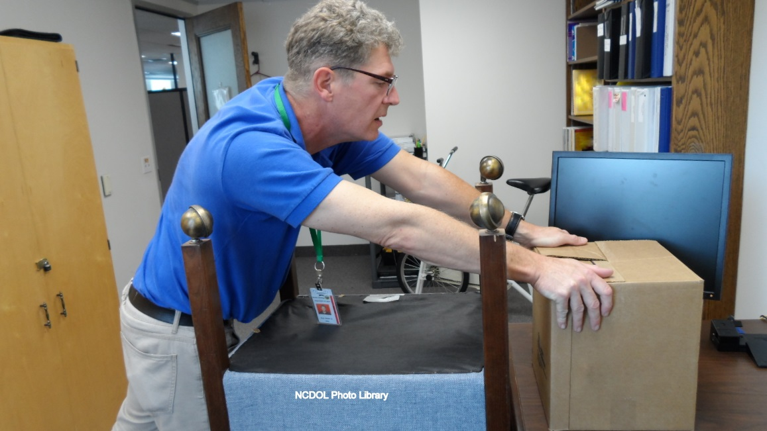
Workstation Design
Store heavier items within close reach

Slide 28
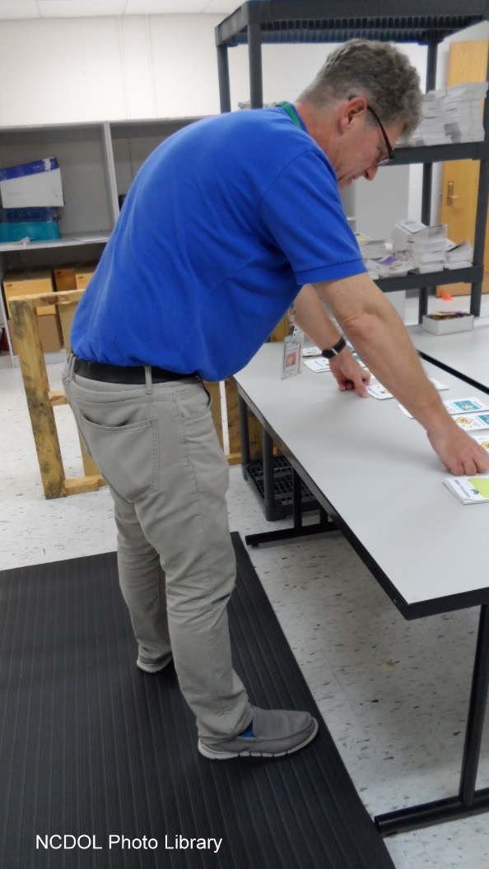
Workstation Design
Use anti-fatigue mats

Slide 29
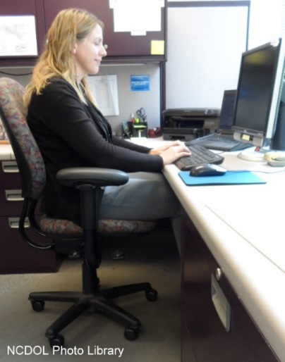
Workstation Design
Computer workstation and adjustable chair
  Position top of monitor at or just below eye level
  Keep head and neck balanced and in-line with torso
  Keep shoulders relaxed and lower back supported
Notes:
Photo by NCDOL Tom Wilder – Sara Steward 08-25-15
The worker is working at a workstation with an adjustable chair and footrest.
Many products, including office chairs, are advertised as being “ergonomic.” However, based on what we’ve covered so far, an item is really only ergonomic if it fits the specific worker and the specific task. When selecting an “ergonomic” office chair, it’s best to look for a chair that has adjustable features, so that it can fit many different users. Whenever possible, it’s always best to have the specific employee test the chair to make sure the adjustable features can adjust to fit that employee.
Look for the following adjustable features:
Seat pan height
Seat pan depth
Backrest height
Backrest angle
Backrest tension control
Arm rest height (angle and in/out positioning are also available)
The ultimate goal when setting up a computer workstation or adjusting a chair is to make sure that the worker can maintain neutral postures. The tips on the slide can help to remind employees about some of these concepts.

Slide 30

Workstation Design
  Keep elbows close to body
  Maintain wrists and hands in line with forearms
  Allow adequate room for keyboard and mouse
  Keep feet flat on the floor or use footrest

Slide 31
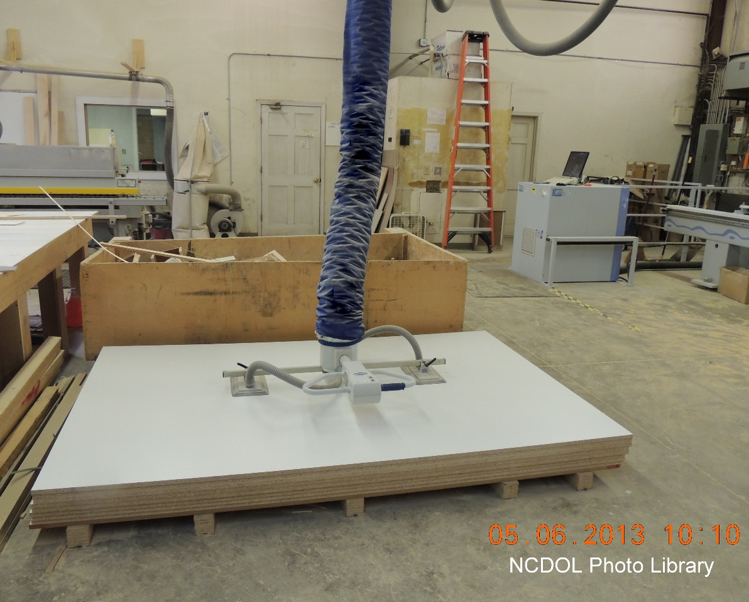
Manual Material Handling
Use vacuum lift assist

Slide 32

Manual Material Handling
Utilize two-person lift

Slide 33
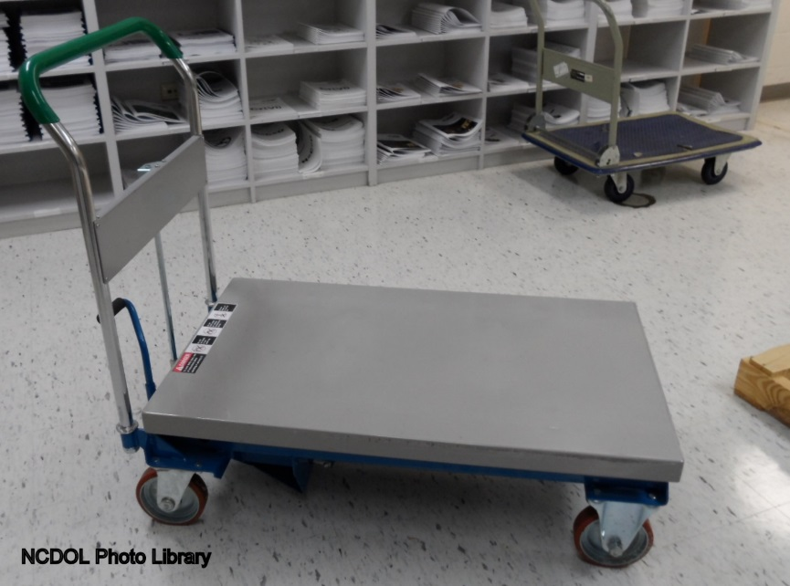
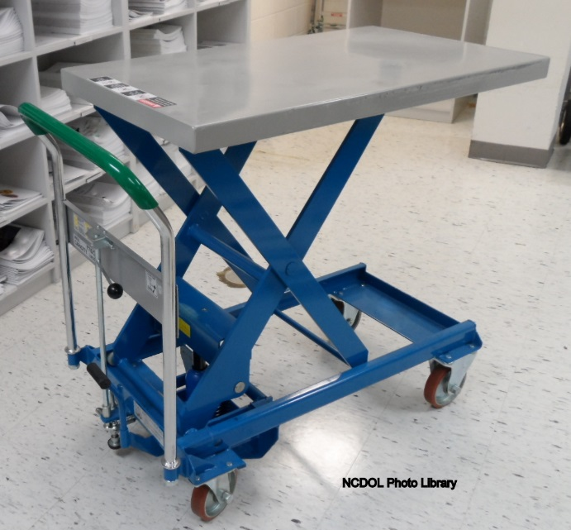
Manual Material Handling
Use carts
Move, reposition and lift up to 1750 pounds with this cart

Slide 34
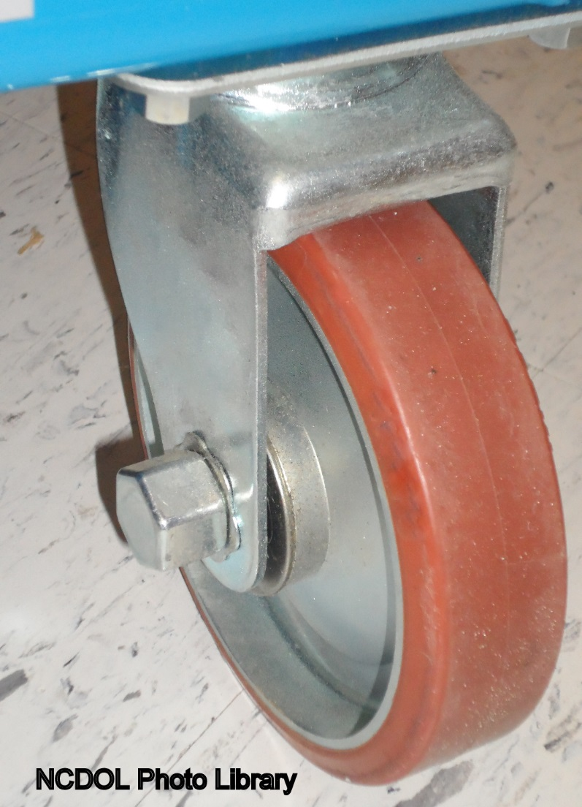
Manual Material Handling
Keep wheels well maintained

Slide 35

Hand Tools
Use power tools

Slide 36
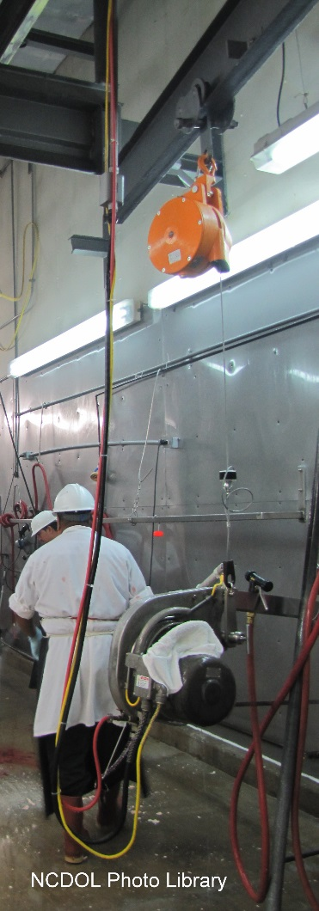
Hand Tools
Use tool balancers

Slide 37
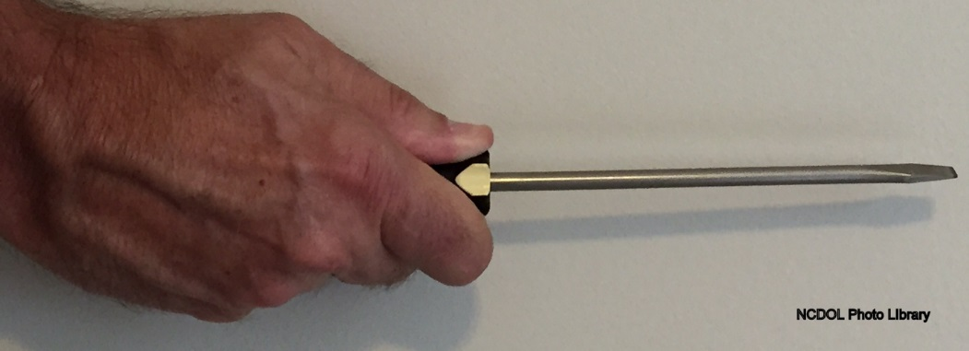
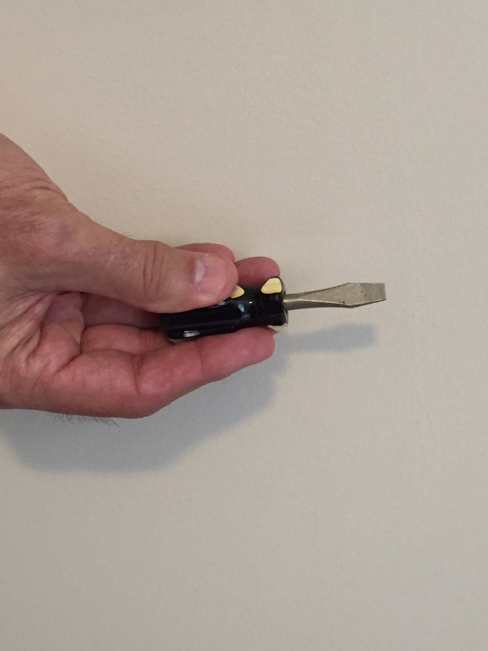
Hand Tools
Use power grip rather than pinch
Longer Screwdriver Handle
Shorter “Stubby” Screwdriver Handle
NCDOL Photo Library

Slide 38

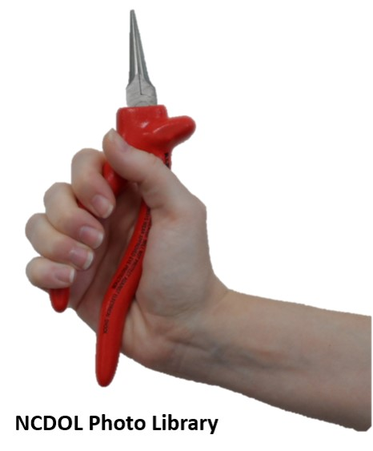


Hand Tools
Choose tool to maintain neutral postures
Notes:
.

Slide 39
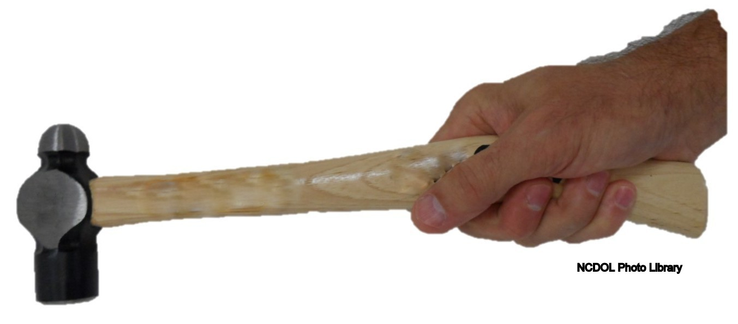
Hand Tools
Consider curved hammer with power grip hold

Slide 40
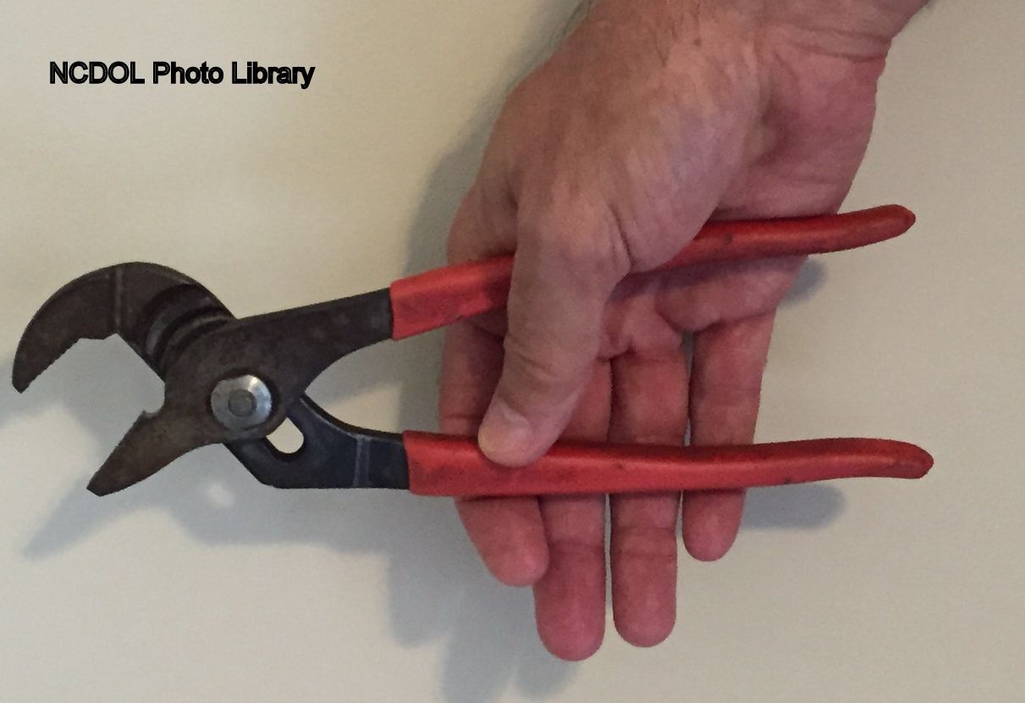
Hand Tools
Choose hand tools with longer handles

Slide 41
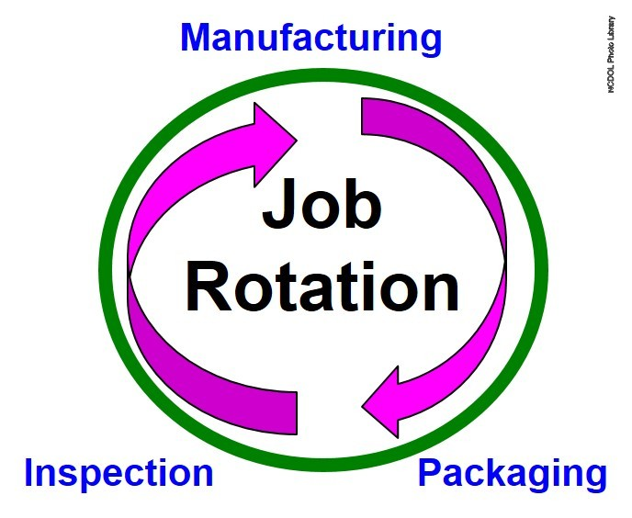
Administrative Controls
Implement job rotation
Implement work hardening

Slide 42

NCDOL OSH Division Perspective
North Carolina employers can be cited for ergonomic violations without an OSHA ergonomic standard
Field Operations Manual (FOM) Chapter XVII
  Phase 1
  Phase 2
  Phase 3
Current citations are issued under the General Duty Clause

Slide 43
General Duty Clause
The following criteria must be met:
  Employees must be exposed to a hazard
  Hazard must be likely to cause death or serious physical harm
  Hazard must be recognized in industry
  Must be a feasible way to abate the hazard

Slide 44
Special Emphasis Programs
Special Emphasis Programs in North Carolina with a focus on ergonomics:
  Long Term Care Facilities
  Food Manufacturing

Slide 45
Voluntary Guidelines
Utilize voluntary ergonomic guidelines
  Nursing homes
  Foundries
  Retail grocery stores
  Poultry processing
  Shipyards
  Meat packing
  Furniture industry (NCDOL)

Slide 46
Ergonomics Program Elements
Management commitment
Employee involvement
Training
Workplace analysis
Prevention and control measures
Medical management
Program evaluation

Slide 47
Available Industry-Specific eTools
Electrical contractors
Baggage handling
Beverage delivery
Computer workstations
Grocery warehousing
Hospitals
Nursing homes
Poultry processing
Printing
Sewing

Slide 48
Additional Resources
NCDOL
https://www.labor.nc.gov/ergonomics
Federal OSHA
http://www.osha.gov/SLTC/ergonomics/
NIOSH
http://www.cdc.gov/niosh/topics/ergonomics/

Slide 49
Summary
In this course, we discussed the following:
  Definition of ergonomics
  Workplace problems, injuries and losses due to ergonomic issues
  Types, signs and symptoms, and risk factors of musculoskeletal disorders)
  Common ergonomic stressors
  Techniques to combat these stressors
  NCDOL OSH Division perspective on ergonomics

Slide 50
Thank You For Attending!
Final Questions?

