Slide 1
Electrical Safety in General Industry
§1910 Subpart “S“
Notes:
Revised 06/2025
The information in this presentation is provided voluntarily by the N.C. Department of Labor, Education Training and Technical Assistance Bureau as a public service and is made available in good faith. This presentation is designed to assist trainers conducting OSHA outreach training for workers. Since workers are the target audience, this presentation emphasizes hazard identification, avoidance, and control – not standards. No attempt has been made to treat the topic exhaustively. It is essential that trainers tailor their presentations to the needs and understanding of their audience.
The information and advice provided on this Site and on Linked Sites is provided solely on the basis that users will be responsible for making their own assessment of the matters discussed herein and are advised to verify all relevant representations, statements, and information.
This presentation is not a substitute for any of the provisions of the Occupational Safety and Health Act of North Carolina or for any standards issued by the N.C. Department of Labor. Mention of trade names, commercial products, or organizations does not imply endorsement by the N.C. Department of Labor.

Slide 2
Objectives
At the end of this course, students will be able to:
  Identify common electrical hazards.
  Recognize electrical equipment defects/hazards.
  Familiarize themselves with the general requirements of the standard.
  Familiarize themselves wiring design and protection.
  Identify wiring methods, components, and equipment for general use.

Slide 3
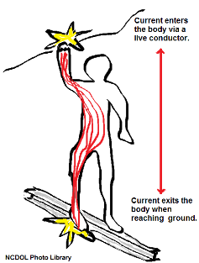
Electrical Hazards
Electric shock/electrocution occurs when current flows through the body causing damage.
Burns are caused by arc blast or hot conductors:
  Thermal
  Electrical
Indirect falls from ladders, scaffolds
or other walking - working surfaces.

Slide 4
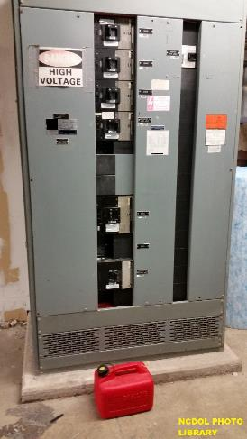
Electrical Hazards
Explosions are caused when electricity provides a source of ignition for an explosive mixture in the atmosphere.
Fires are caused by overloading circuits or excessive current flowing through faulty wiring; setting fire to insulation and surrounding materials.

Slide 5
Electrical Utilization Systems
1910.302(a)(1)
Scope and application
  Electrical installations and utilization equipment installed or used within or on buildings, structures and other premises:
    Yards
    Carnivals
    Parking and other lots
    Mobile homes
    Recreational vehicles
    Industrial substations
    Conductors that connect the installations to a supply of electricity
    Other outside conductors on the premises

Slide 6
Electrical Utilization Systems
1910.302(a)(2)
Not covered
  Installations in ships.
  Installations underground in mines.
  Installations of railways for generation exclusively for signaling and communication purposes.
  Installations of communication equipment under the exclusive control of communication utilities.
  Installations under the exclusive control of electric utilities for the purpose of communication or metering.

Slide 7
Extent of Application
1910.302(b)
Requirements are applicable to all installations, regardless of when they were designed or installed §§1910.302(b)(1).
Installations made after March 15, 1972, shall comply with the provisions of §§1910.302 through 1910.308, except paragraphs (b)(3) and (b)(4) of this section.
Requirements applicable to installations made after April 16, 1981, §§1910.302(b)(1) and §§1910.302(b)(3).
Requirements applicable to installations made after August 13, 2007, §§1910.302(b)(1), §§1910.302(b)(3) and §§1910.302(b)(4).

Slide 8
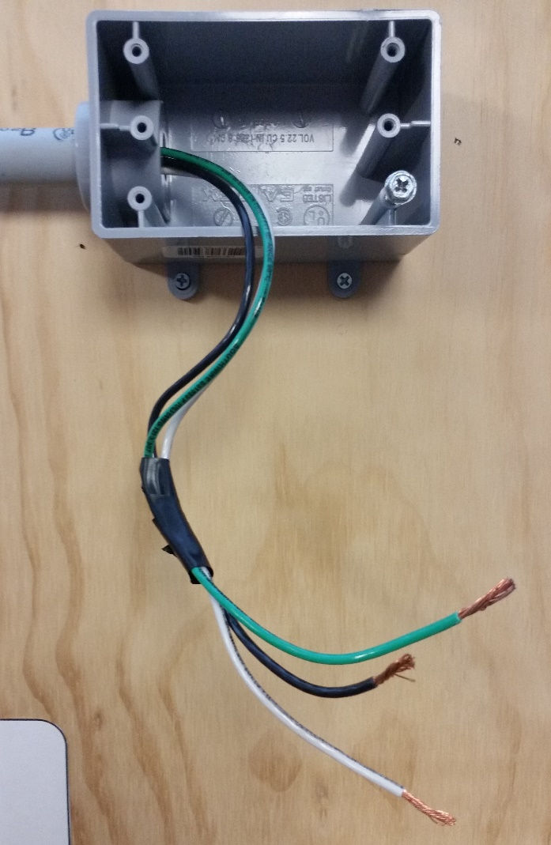
General Requirements
1910.303(b)(1)
Examination installation, and use of equipment
  Electrical equipment must be free from recognized hazards:
    Cables exposed to sharp edges
    Splices
    Bare conductors

Slide 9
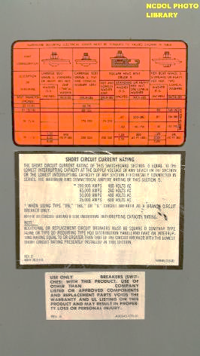
General Requirements
1910.303(b)(2)
Installation and use
  Listed or labeled equipment shall be installed and used in accordance with its listing and labeling.

Slide 10
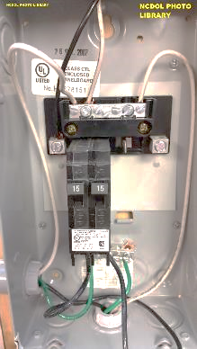
Nationally Recognized Testing Laboratories
Canadian Standards Association (CSA International)
Curtis-Straus LLC (CSL)
FM Approvals LLC (FM)
Intertek Testing Services NA, Inc. (ITSNA)
MET Laboratories, Inc. (MET)
Nemko North America, Inc. (NNA)
NSF International (NSF)
QPS Evaluation Services Inc.
SGS U.S. Testing Company, Inc. (SGSUS)
Southwest Research Institute (SWRI)
TUV SUD America, Inc. (TUVAM)
TUV SUD Product Services GmbH (TUVPSG)
TUV Rheinland of North America, Inc. (TUV)
Underwriters Laboratory Inc. (UL)

Slide 11
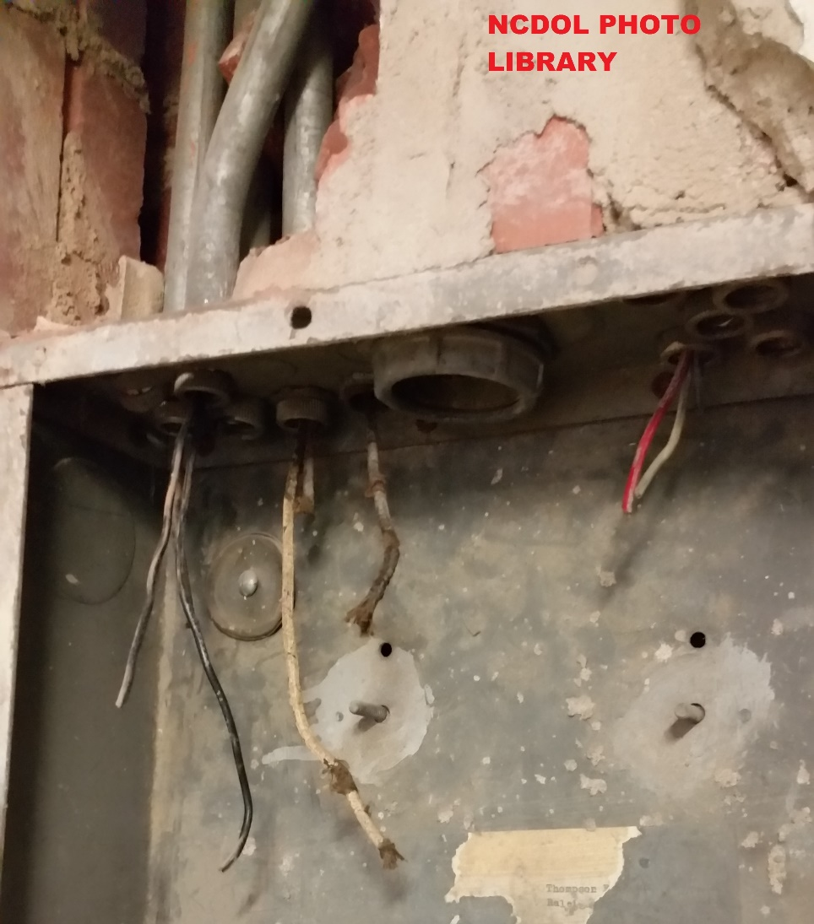
General Requirements
1910.303(b)(3)
Insulation integrity
  Completed wiring installations must be free from short circuits.

Slide 12
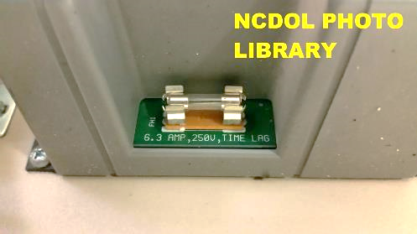
General Requirements
1910.303(b)(4)
Interrupting rating
  Sufficient for the nominal circuit voltage and current available.
Note: 6.3 AMP, 240 VOLT
TIME LAG FUSE

Slide 13
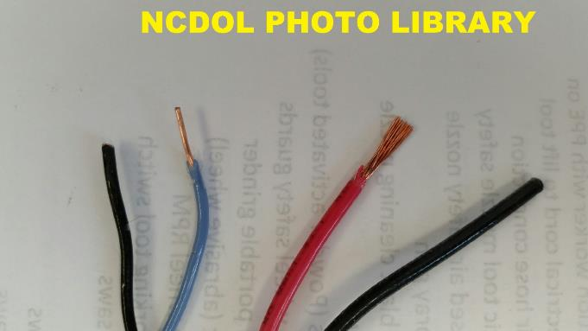
American Wire Gauge (AWG)
18 AWG solid
14 AWG stranded
Note: A larger gauge number indicates a smaller size wire.

Slide 14
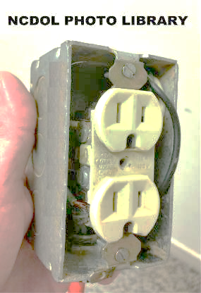
General Requirements
1910.303(b)(6)
Deteriorating agents
  Unless identified for use in the operating environment, no conductors or equipment shall be:
    Located in damp or wet locations.
    Exposed to agents that have a deteriorating effect on the conductors or equipment.
    Exposed to excessive temperatures.

Slide 15
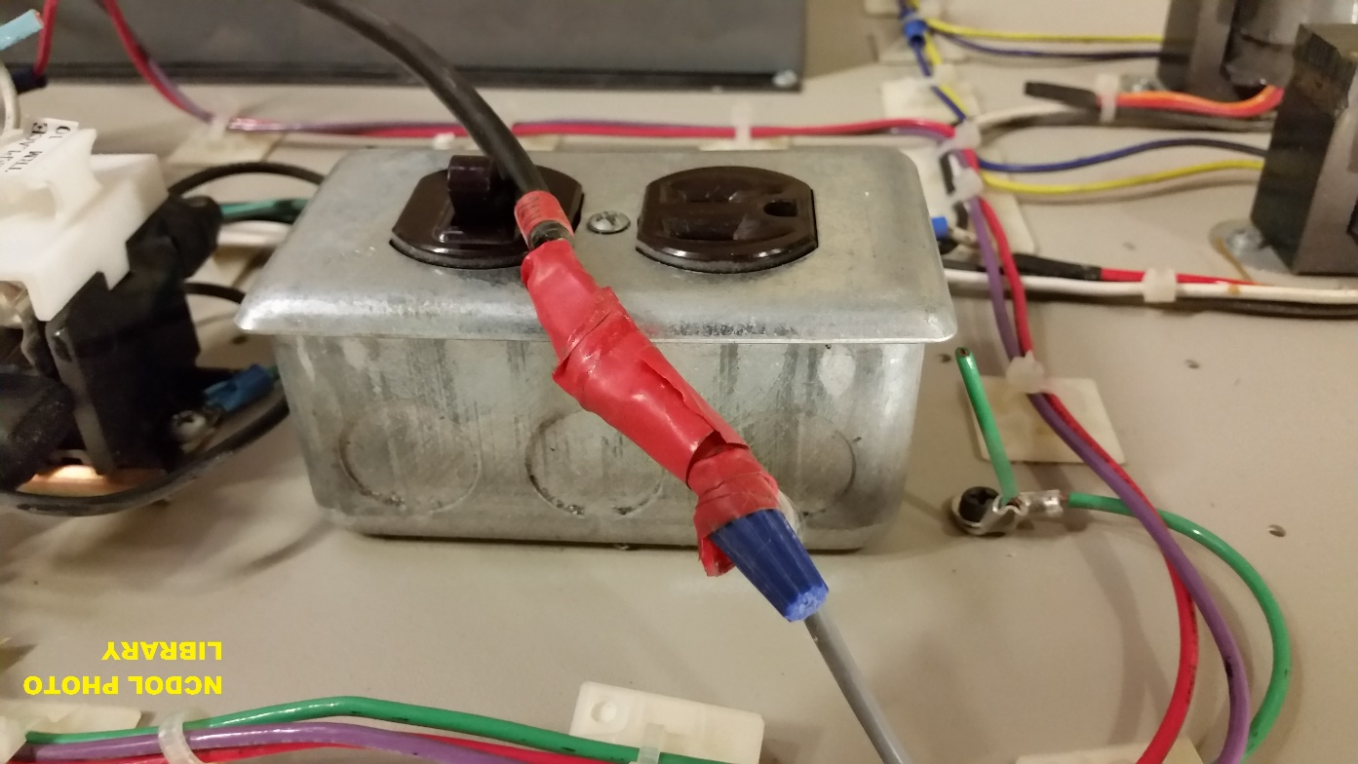
General Requirements
1910.303(b)(7)
Mechanical execution of work
  Equipment shall be installed in a neat workmanlike manner.

Slide 16
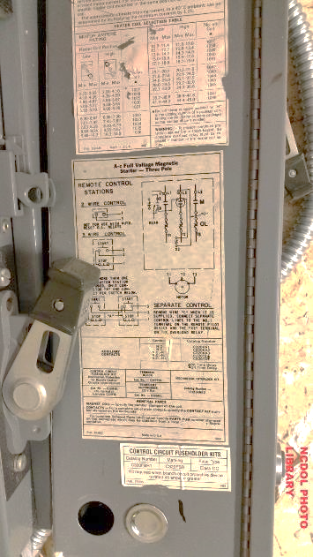
General Requirements
1910.303(b)(7)(i)
Unused openings shall be effectively closed to afford protection substantially equivalent to the wall of the equipment.

Slide 17
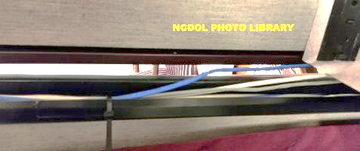
General Requirements
1910.303(b)(7)(ii)
Conductors shall be racked to provide ready and safe access in underground and subsurface for installation and maintenance.
NO!

Slide 18
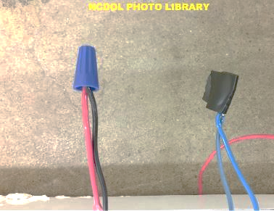
General Requirements
1910.303(c)(3)
Splices
  Splicing devices suitable for use
  Brazing, welding, or soldering
  Splices must be joined
  mechanically and electrically
  secure before soldering
YES NO

Slide 19
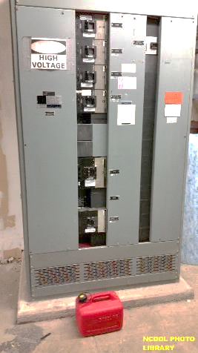
General Requirements
1910.303(d)
Arcing parts
  Parts of electric equipment that produce arcs, sparks, flames, or molten metal shall be enclosed or separated and isolated from all combustible material.

Slide 20
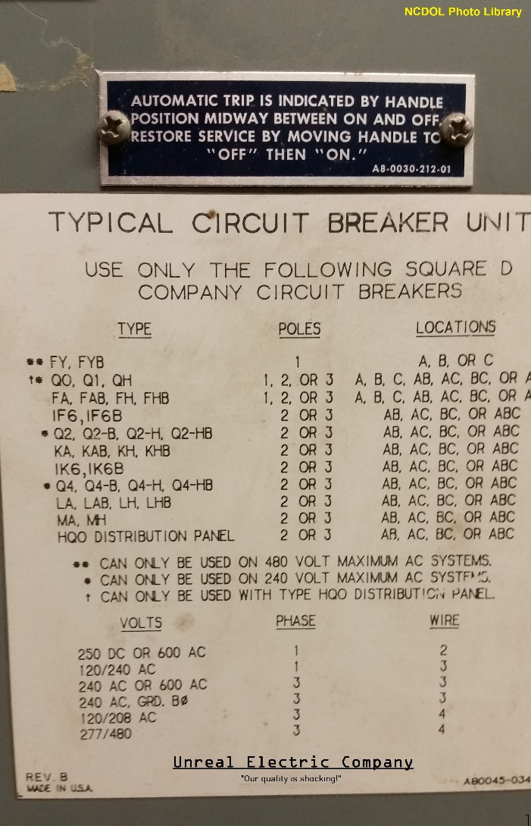
General Requirements
1910.303(e)
Markings
  Electrical equipment must have the manufacturer's name, trademark, or other descriptive marking.
  Must provide voltage, current, wattage, or other ratings, as necessary.
  Must have sufficient durability to withstand the environment involved.

Slide 21
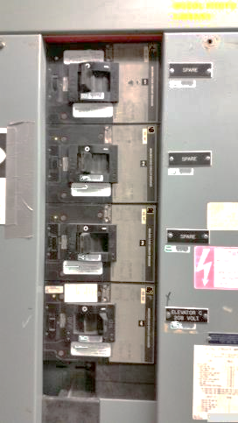
General Requirements
1910.303(f)(2)-(3)
Disconnecting means and circuits
  Each service, feeder, and branch circuit, at its disconnecting means or over-current device, must be legibly marked to indicate its purpose.
  Markings required shall be durable and withstand the environment involved.

Slide 22
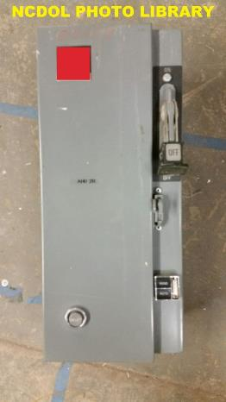
General Requirements
1910.303(f)(4)
Capable of accepting a lock
  Disconnecting means shall be capable of being locked in the open position.

Slide 23
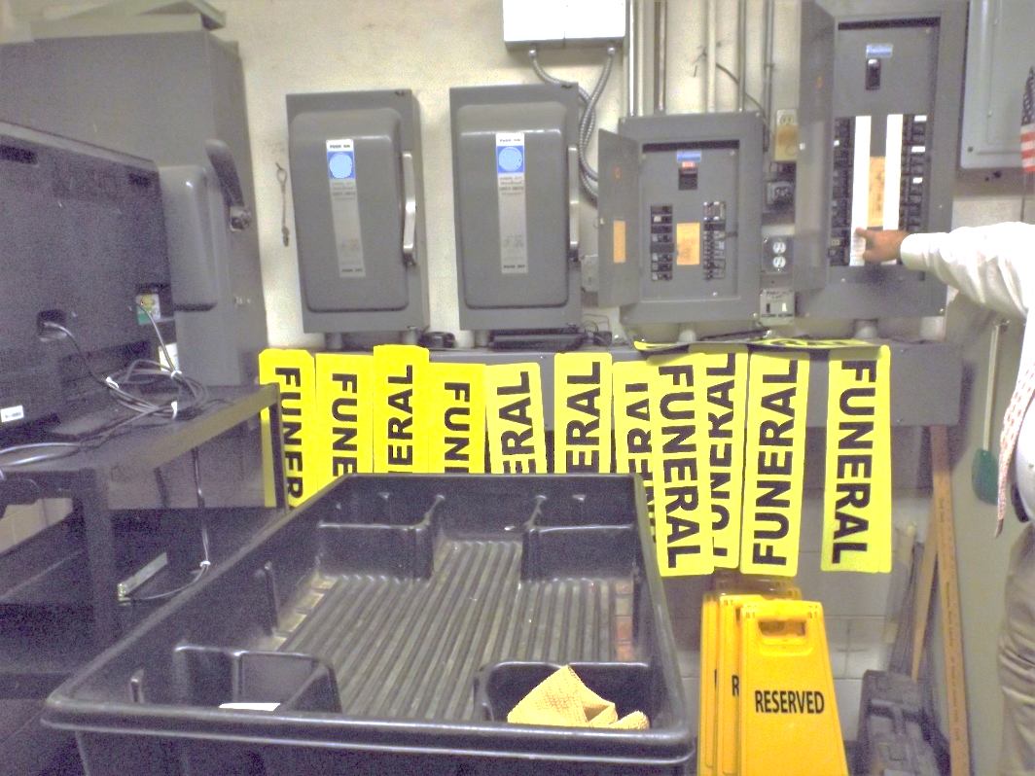
Space About Electrical Equipment
1910.303(g)(1)
Sufficient access and working space must be provided and maintained to permit ready and safe operation and maintenance of equipment.
NCDOL Photo Library

Slide 24
Space About Electrical Equipment
1910.303(g)(1)(i)(A)
TABLE S–1.— MINIMUM DEPTH OF CLEAR WORKING SPACE AT ELECTRIC EQUIPMENT, 600 V OR LESS
Nominal voltage to ground | Minimum clear distance for condition ^{2,3}
 | Condition A |  | Condition B |  | Condition C
 | m | ft | m | ft | m | ft
0 - 150 | ¹0.9 | ¹3.0 | ¹0.9 | ¹3.0 | 0.9 | 3.0
151 - 600 | ¹0.9 | ¹3.0 | 1.0 | 3.5 | 1.2 | 4.0
Condition A — Exposed live parts on one side and no live or grounded parts on the other side of the working space.
Condition B — Exposed live parts on one side and grounded parts on the other side.
Condition C — Exposed live parts on both sides of the workspace with the operator between.

Slide 25
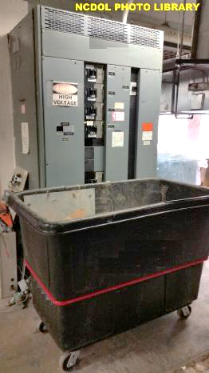
Space About Electrical Equipment
1910.303(g)(1)(i)(B)-(C)
Width of working space in front of the electric equipment shall be the width of the equipment or 762 mm (30 inches), whichever is greater.
Workspace shall be clear and extend from the grade, floor, or platform to the height required.
30” minimum

Slide 26

Guarding of Live Parts
1910.303(g)(2)(i)
Live parts of electric equipment operating at 50 volts or more must be guarded.

Slide 27
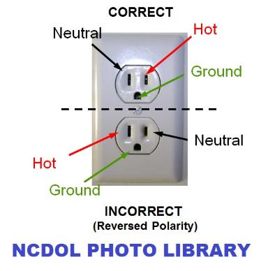
Wiring Design and Protection
1910.304(a)(2)
Polarity of connections
  No grounded conductor may be attached to any terminal or lead so as to reverse designated polarity.

Slide 28
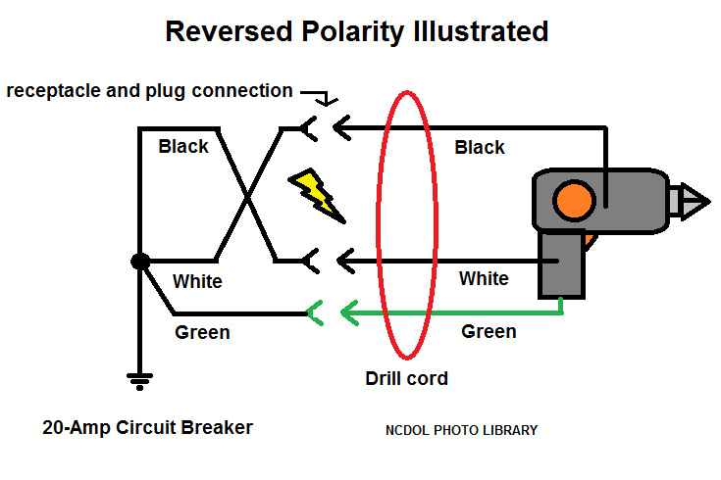
Wiring Design and Protection
1910.304(a)(2)

Slide 29
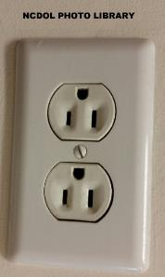
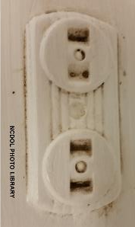
Receptacles and Cord Connectors
1910.304(b)(2)(i)
Receptacles installed on 15- and 20- ampere branch circuits shall be of the grounding type.
  Except as permitted for replacement receptacles in paragraph (b)(2)(iv).
Pre-1959
Post-1959

Slide 30
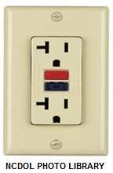
Receptacles and Cord Connectors
1910.304(b)(2)(iv)(C)(2)
A non-grounding - type receptacle may be replaced with a ‘‘GFCI Protected’’ type receptacle and shall be marked ‘‘GFCI Protected’’ and ‘‘No Equipment Ground”.
Equipment grounding conductor may not be connected to such grounding-type receptacles.
GFCI Protected
Note: Marked “GFCI Protected’’ and ‘‘No Equipment Ground”
Ground Fault Circuit Interrupter (GFCI)
No Equipment Ground

Slide 31
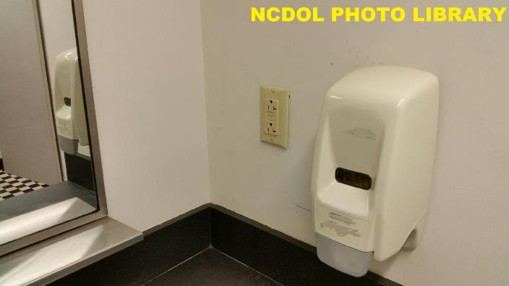
GFCI Protection for Personnel
1910.304(b)(3)(i)
All 125-volt receptacles installed in bathrooms or on rooftops shall have GFCI protection.

Slide 32
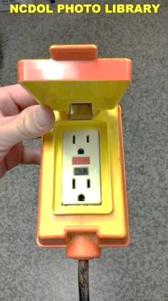
GFCI Protection for Personnel
1910.304(b)(3)(ii)(A)
Temporary wiring installations
  All 125-volt, single phase, 15 - 20 ampere, shall be GFCI protected during maintenance, remodeling or construction like activities.

Slide 33
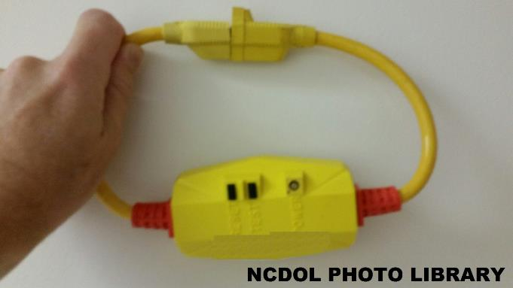
GFCI Protection for Personnel
1910.304(b)(3)(ii)(A)
Portable GFCI

Slide 34

GFCI Protection for Personnel
1910.304(b)(3)(ii)(A)
Note 2 to paragraph (b)(3)(ii)(A) of this section:
  Cord sets and devices incorporating the required GFCI that are connected to the receptacle closest to the source of power are acceptable forms of protection.

Slide 35

GFCI Protection for Personnel
1910.304(b)(3)(ii)(B)
Temporary wiring installations
  Receptacles other than 125-volt, single phase, 15-20 ampere, shall
  be GFCI protected.

Slide 36
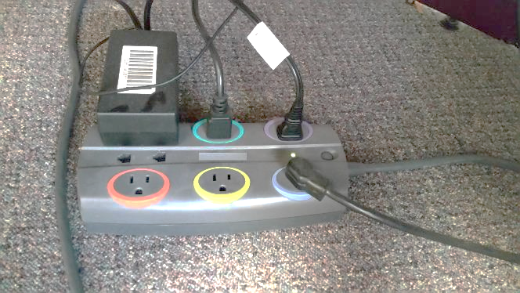
Outlet Devices
1910.304(b)(4)(ii)(B)
A receptacle shall not be overloaded:
  As specified in table S-4.
NCDOL Photo Library

Slide 37
Outlet Devices
1910.304(b)(4)(ii)(B)
Safety factor of 20%
TABLE S–4 — Maximum Cord- and Plug- Connected Load to Receptacle
Circuit rating (amperes) | Receptacle rating (amperes) | Maximum load (amperes)
15 or 20 | 15 | 12
20 | 20 | 16
30 | 30 | 24

Slide 38
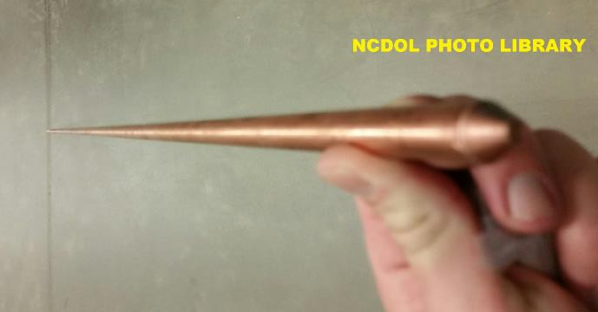
Grounding Connections
1910.304(g)(4)
A grounding electrode conductor shall be used.

Slide 39
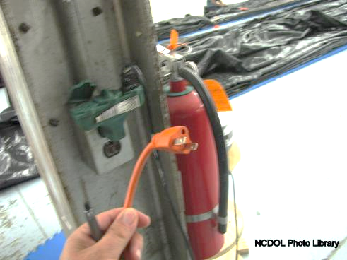
Grounding Path
1910.304(g)(5)
Path to ground from circuits
  Permanent,
  Continuous, and
  Effective.

Slide 40
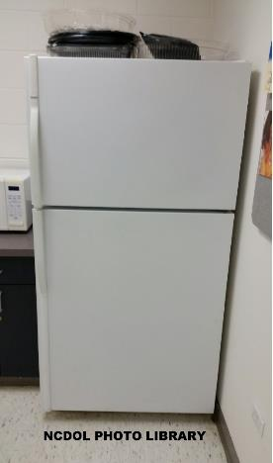
Grounding Path 1910.304(g)(6)(iii)
Frames of electric ranges
Wall-mounted ovens
Counter-mounted cooking units
Clothes dryers
Metal outlet or junction boxes
that are part of the circuit for
these appliances…
……shall be grounded.

Slide 41
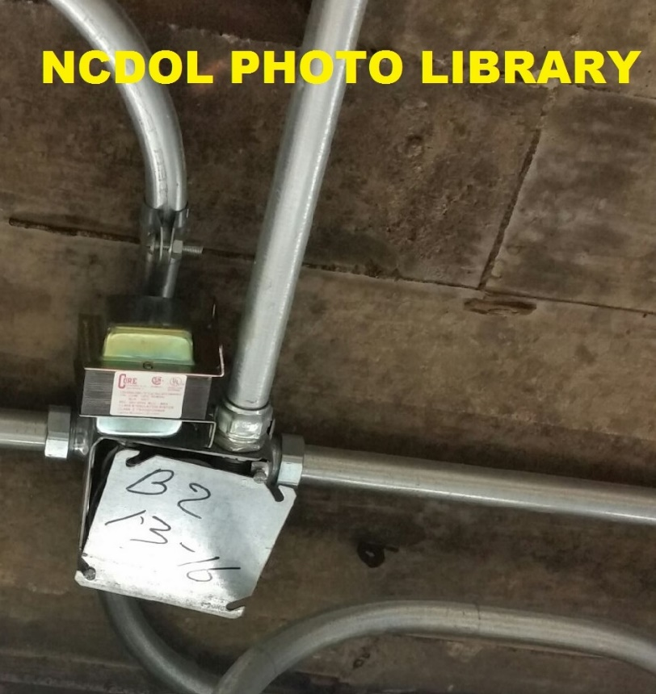
Wiring Methods, Components, and Equipment
1910.305(b)(1)
Cabinets, boxes, and fittings
  Conductors entering boxes, cabinets, or fittings shall be protected from abrasion.
  Openings through which conductors enter shall be
  effectively closed.
  Each cable shall be secured.

Slide 42
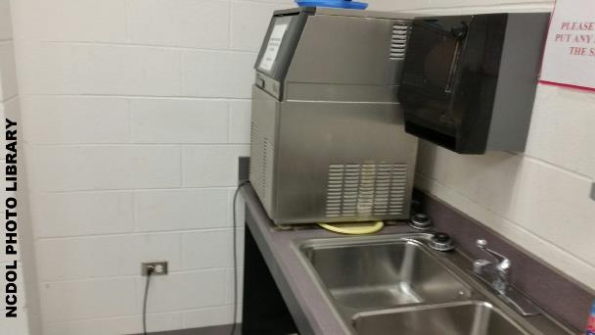
Wiring Methods, Components, and Equipment
1910.305(e)(1)
Enclosures for damp locations shall be installed so as to prevent moisture or water from entering and accumulating.

Slide 43
Wiring Methods, Components, and Equipment
1910.305(g)(1)(ii)
Flexible cords and cables can be used for:
  Pendants
  Wiring of fixtures
  Connection of portable lamps or appliances
  Portable and mobile signs
  Elevator cables
  Wiring of cranes and hoists
  Connection of stationary equipment
  Prevention of transmission of noise or vibration
  Appliances where the fastening means and mechanical connections are designed for maintenance or repair
  Data processing cables
  Connection of moving parts
  Temporary wiring

Slide 44
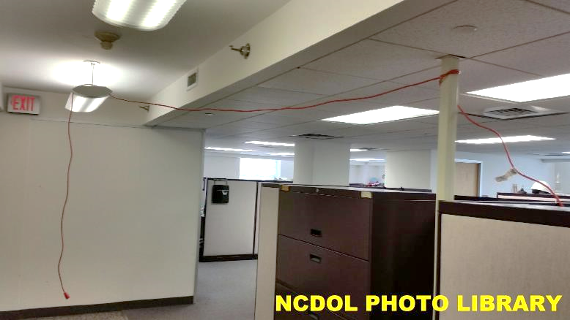
Wiring Methods, Components, and Equipment
1910.305(g)(1)(ii)
Can you use an extension cord for this?

Slide 45
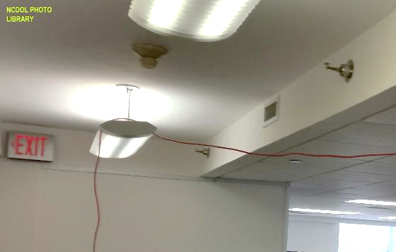
Wiring Methods, Components, and Equipment
1910.305(g)(1)(iv)(B)
Flexible cords and cables may not be used when run through holes in walls, ceilings or floors.

Slide 46
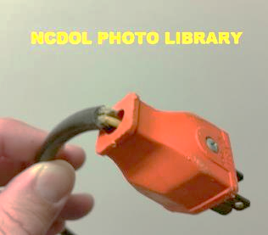
Wiring Methods, Components, and Equipment
1910.305(g)(2)(iii)
Flexible cords and cables must be connected to devices and fittings.
  Strain relief must be provided to prevent pull from being directly transmitted to joints or terminal screws.

Slide 47
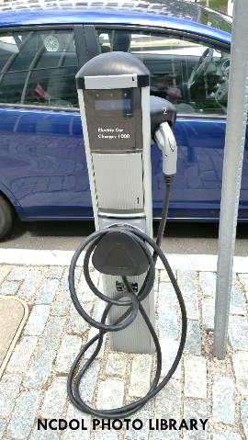
Wiring Methods, Components, and Equipment
1910.305(j)(2)(iv)
Wet or damp locations
  A receptacle installed in a wet or damp location shall be suitable for the location.

Slide 48
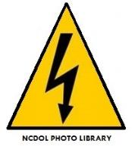
Summary
In this course, we discussed the following:
  Common electrical hazards
  Electrical equipment defects/hazards
  General requirements of the standard
  Wiring design and protection
  Wiring methods, components, and equipment for general use

Slide 49
Thank You For Attending!
Final Questions?

