Slide 1
Confined Spaces
29 CFR 1910.146
Notes:
Revised 06/16/25
The information in this presentation is provided voluntarily by the N.C. Department of Labor, Education Training and Technical Assistance Bureau as a public service and is made available in good faith. This presentation is designed to assist trainers conducting OSHA outreach training for workers. Since workers are the target audience, this presentation emphasizes hazard identification, avoidance, and control – not standards. No attempt has been made to treat the topic exhaustively. It is essential that trainers tailor their presentations to the needs and understanding of their audience.
The information and advice provided on this Site and on Linked Sites is provided solely on the basis that users will be responsible for making their own assessment of the matters discussed herein and are advised to verify all relevant representations, statements, and information.
This presentation is not a substitute for any of the provisions of the Occupational Safety and Health Act of North Carolina or for any standards issued by the N.C. Department of Labor. Mention of trade names, commercial products, or organizations does not imply endorsement by the N.C. Department of Labor.

Slide 2
Objectives
In this course, we will:
  Identify confined spaces in general industry
  Identify the difference between a confined space and a permit-required confined space
  Determine if a hazard exists within the confined space
  Discuss responsibilities for the entrant, attendant and entry supervisor
  Identify rescue options

Slide 3
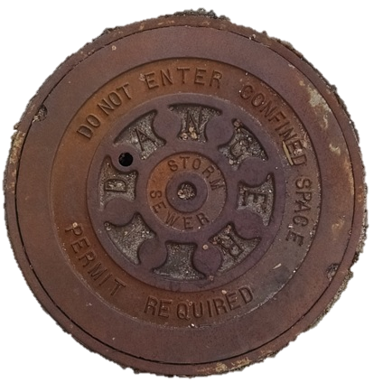
Confined Spaces
1910.146(a)
Permit-Required Confined Spaces Standard
  Contains requirements for practices and procedures to protect employees in general industry from the hazards of entry into permit-required confined spaces
    Does not apply to agriculture, construction, or shipyard employment
NCDOL Photo Library

Slide 4
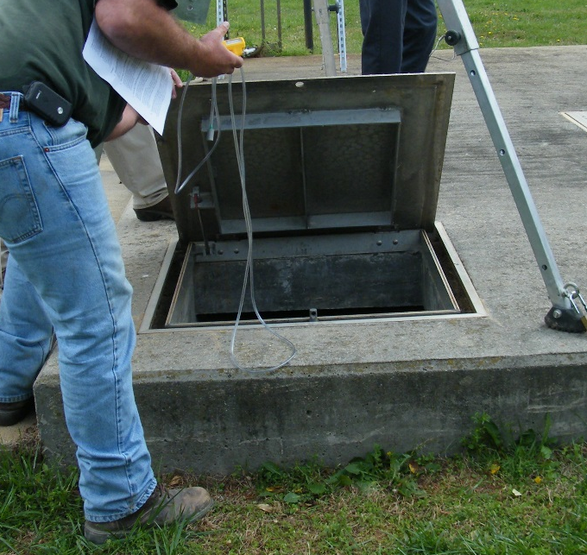
Definition of Confined Space
1910.146(b)
A space that:
  Is large enough and so configured that an employee can bodily enter and perform assigned work
  Has limited or restricted means for entry or exit; and
  Is not designed for continuous
  employee occupancy
NCDOL Photo Library

Slide 5
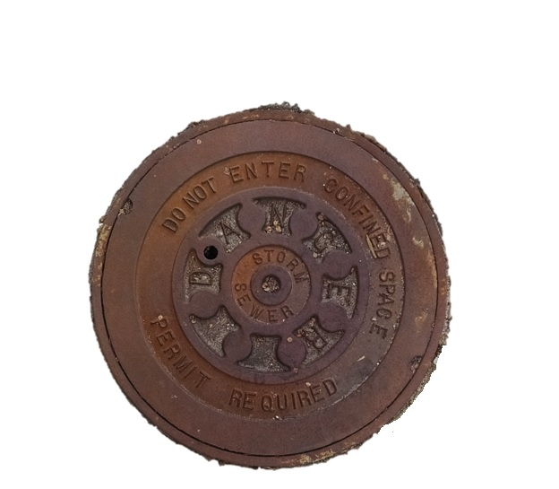
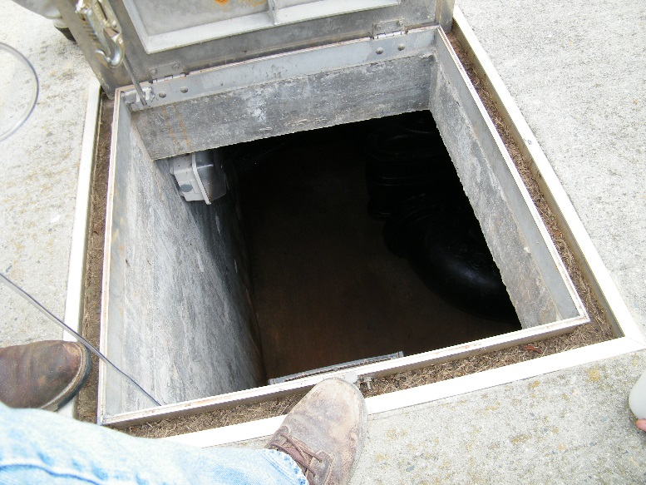
Confined Spaces
1910.146
Storage tanks
Manholes and sewers
Grain storage bins
Boilers
Ducts
Tank cars
NCDOL Photo Library
NCDOL Photo Library

Slide 6
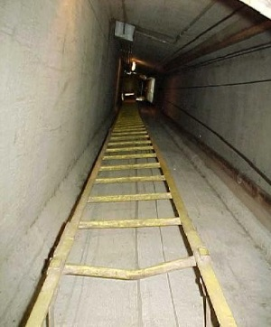
Confined Spaces
1910.146
Sewers
Utility vaults
Pipelines
Equipment and machinery
Tunnels
Open top spaces (>4 feet)
NCDOL Photo Library

Slide 7
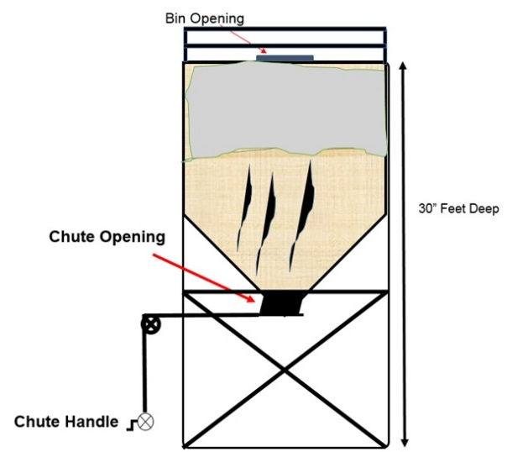

Permit-Required Confined Space
1910.146(b)
Permit-required confined space (permit space) means a confined space that has one or more of the following characteristics:
  Hazardous atmosphere
  Internal configuration (inwardly converging walls, sloping floors)
  Engulfment hazard
  Recognized serious safety
  or health hazard
NCDOL Photo Library

Slide 8

Confined Space Hazards
Oxygen-deficient/enriched atmospheres
Flammable atmospheres
Toxic atmospheres
General/physical (noise, entrapment, engulfment, temperature)
Mechanical (moving parts)
Electrical
NCDOL Photo Library

Slide 9
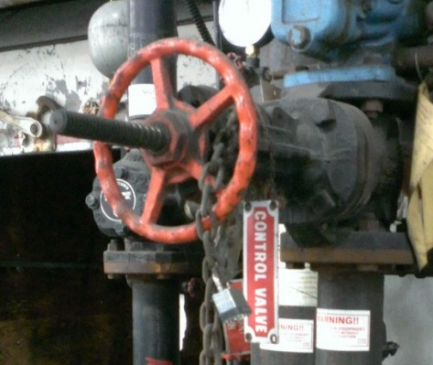
Controlling Confined Space Hazards
Locking out moving parts
De-energizing electrical parts or wiring
Blocking (blanking) steam pipes and product
in-feeding pipes
Draining or pumping out liquid contents
Air monitoring and ventilating
NCDOL Photo Library

Slide 10

Permit Space Entry
1910.146(c)(2)
If workplace contains permit spaces, employer shall inform exposed employees by posting signs or other equally effective means
NCDOL Photo Library

Slide 11
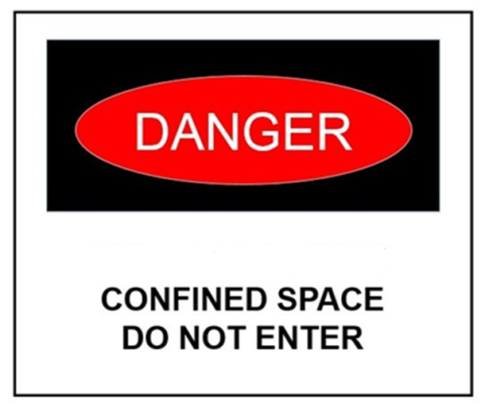
Permit Space Non-Entry
1910.146(c)(3)
If employer decides its employees will not enter permit spaces, employer shall take effective measures to prevent employees from entering permit spaces
NCDOL Photo Library

Slide 12
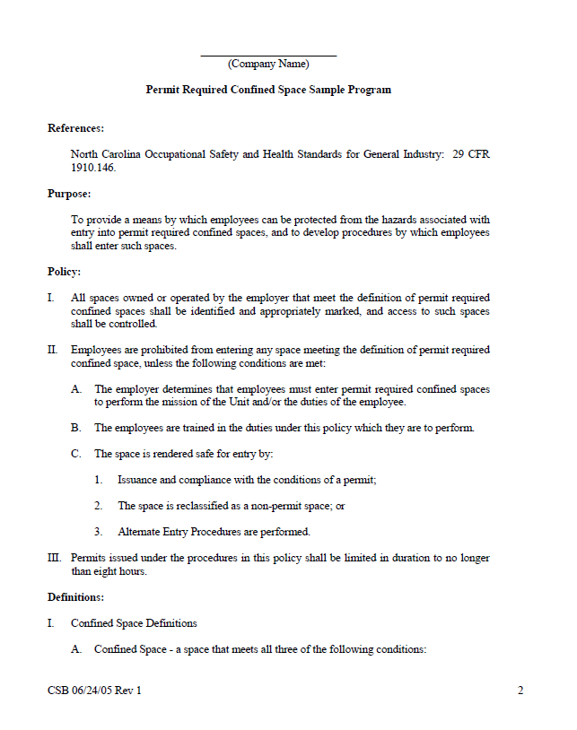
Written Permit Space Program
1910.146(c)(4)
If employees enter permit spaces, employer shall develop and implement a written permit space program
NCDOL Photo Library

Slide 13
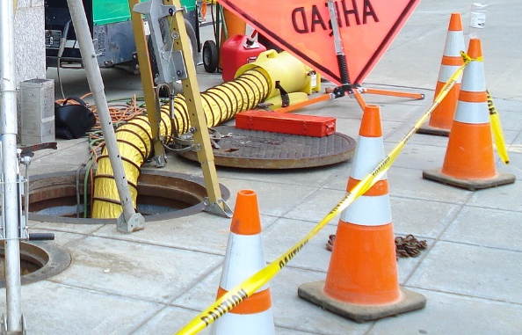
Written Permit Space Program
1910.146(d)
Provide measures and procedures:
  Prevent unauthorized entry
  Identify permit space hazards
  Ensure implementation for safe entry
  Provide, maintain and ensure proper use of equipment
  Evaluate permit space conditions
  Provide for at least one attendant
  Monitoring multiple spaces
NCDOL Photo Library

Slide 14
Written Permit Space Program
1910.146(d)
Method of designating the role(s) of each active person (attendants, entry supervisors, entrants)
For summoning rescue and other emergency operations
System for preparation, issuance, use and cancellation entry permit
System for concluding entry after entry completion
Coordination with multiple employers
System to review entry operations and permit space program

Slide 15
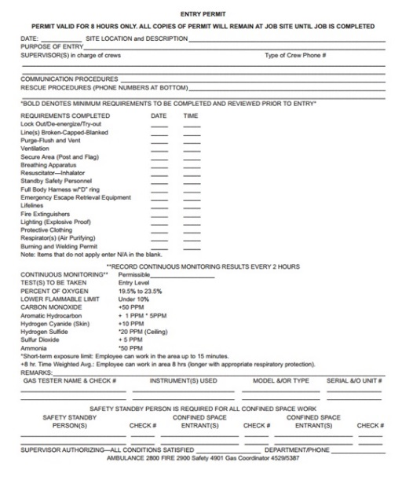
Confined Space Entry Hierarchy
No “permit” space
  Entry permitted only if no hazards exist or all hazards are eliminated without entry
Alternate entry procedures
  Only in spaces with
  controlled atmospheric hazards
Written permit system
  Required for any high hazard space
NCDOL Photo Library

Slide 16
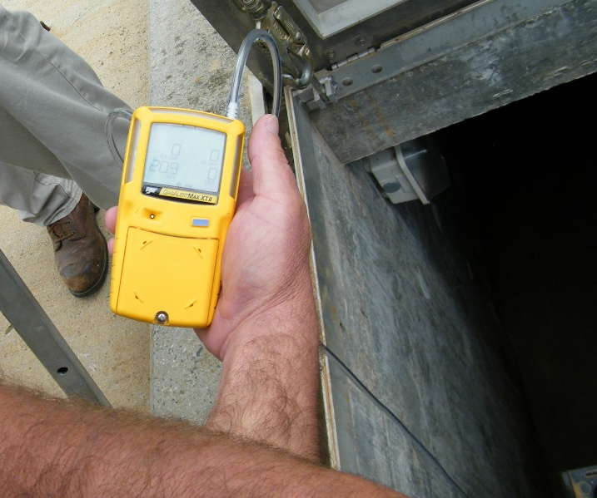
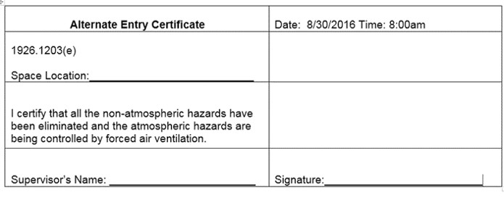
Alternate Entry Requirements
1910.146(c)(5)
Employees must be trained
Atmosphere tested before and during entry
Continuous forced air ventilation
If a hazardous atmosphere is detected, or ventilation stops, the space
must be promptly exited
NCDOL Photo Library
NCDOL Photo Library

Slide 17
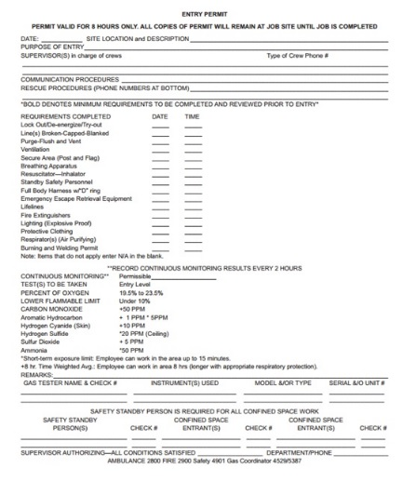
Permit System
1910.146(e)
Written procedure for preparing and issuing permits for entry and returning permit space to service
Requirements:
  Document completion of required measures
  Permit availability
  Supervisor signature
  Activity (job) duration
  Permit termination/cancellation (1 year)
NCDOL Photo Library

Slide 18
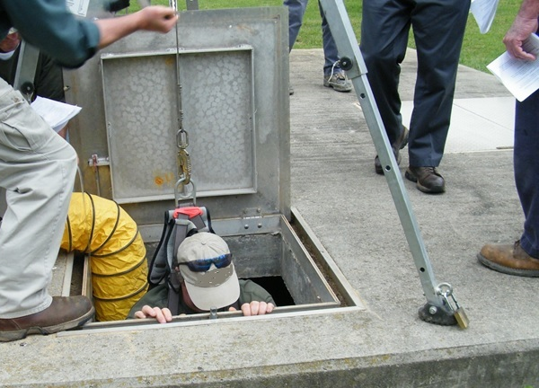
Entry Permit
1910.146(f)
Entry permit shall identify:
  Space to be entered
  Purpose of entry
  Date and duration
  Authorized entrants
  Personnel (attendant and supervisor)
  Hazards within the space
  Isolation of space
  Acceptable entry conditions
NCDOL Photo Library

Slide 19
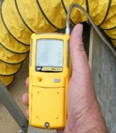
Entry Permit
1910.146(f)
Additional requirements
  Air monitoring test results
  Specifies safety equipment/PPE
  Methods used to control the hazards
  Communication procedures
  Rescue and emergency services
    Name and telephone number of the rescue service
NCDOL Photo Library

Slide 20
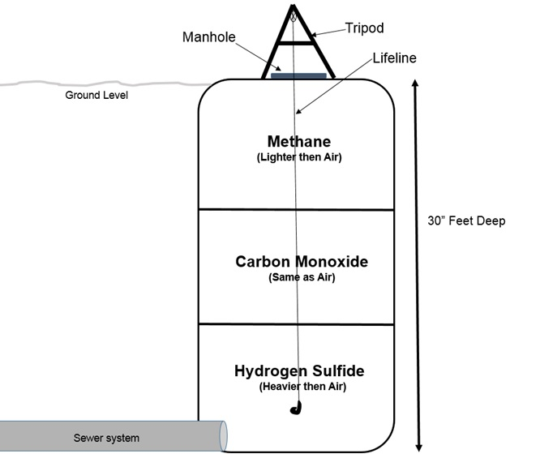

Air Monitoring and Ventilation
Before and during entry
Methane | 0.55
Ammonia | 0.59
Carbon Monoxide | 0.96
Nitrogen | 0.97
AIR 1.0
Hydrogen Sulfide | 1.2
Carbon Dioxide | 1.5
Gasoline | 3-4
Jet Fuel | 4.7
Lighter than
air gases
NCDOL Photo Library
Heavier than
air gases

Slide 21
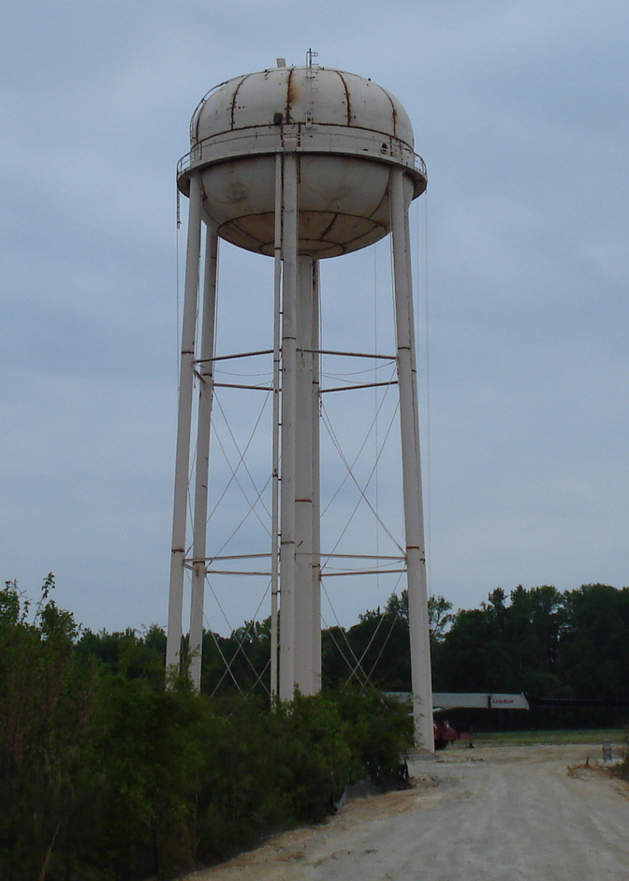
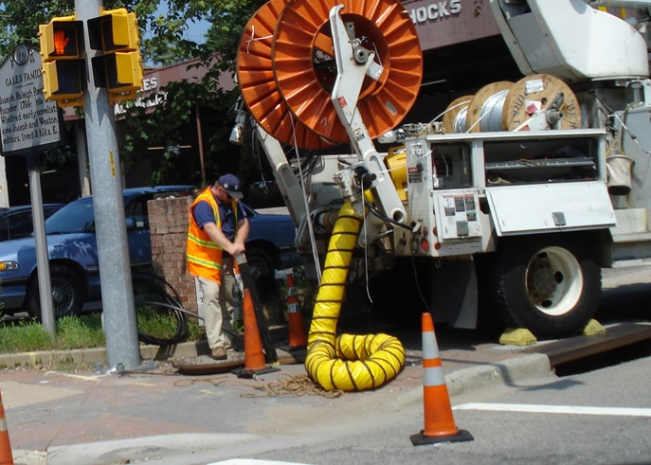
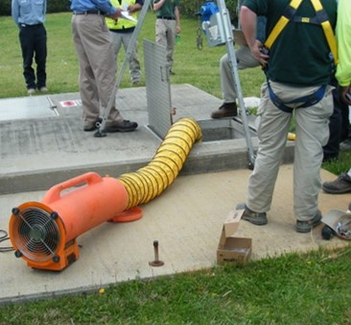
Air Monitoring and Ventilation
NCDOL Photo Library
NCDOL Photo Library
NCDOL Photo Library

Slide 22
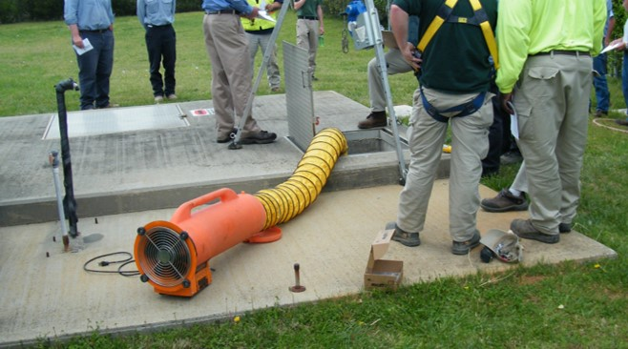
Duties Assigned
1910.146(h)-(j)
Authorized entrant: Employee(s) who enter into the permit space
Attendant: Individual stationed outside space who monitors entrant(s)
Entry supervisor: Person responsible for planning, authorizing, and terminating entry
NCDOL Photo Library

Slide 23
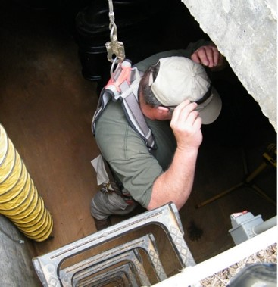
Authorized Entrant
1910.146(h)
Knowledge of hazards in permit space
Proper use of equipment
Communication methods
When to alert attendant
When to exit
NCDOL Photo Library

Slide 24
Attendants
1910.146(i)
Knowledge of hazards in permit space
Aware of behavioral effects of exposure
Maintains an accurate count of entrants
Remains outside permit space during operations
Communicates with entrants
Monitors activities inside and outside space
Summons rescue and emergency services

Slide 25
Attendants
1910.146(i)
Takes action when unauthorized persons approach permit space
Performs non-entry rescues
Performs no other duties that
might interfere with primary
duty
  To monitor and protect entrants
NCDOL Photo Library

Slide 26
Entry Supervisors
1910.146(j)
Knowledge of hazards in permit space
Verifies completion of all tests; procedures and equipment in place as specified by permit
Terminates and cancels permit as required
Verifies rescue services availability and operable summons capability
Removes unauthorized individuals
Ensures entry operations remain intact

Slide 27
Training
1910.146(g)
Training provided so all employees acquire the understanding, knowledge, and skills necessary for the safe performance of duties assigned
  Before first assigned to duties
  Before change in assigned duties
  When change in operations
  Employee proficiency
  Certification of training

Slide 28
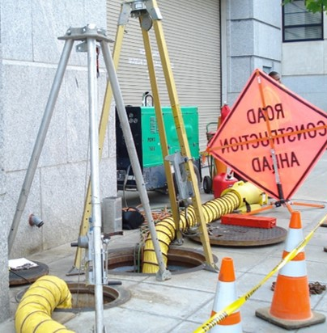
Rescue and Emergency Services
1910.146(k)
Entry rescue
  Use rescue and emergency services
  Use own employees
Non-entry rescue
  Entrants use retrieval systems or methods
NCDOL Photo Library

Slide 29
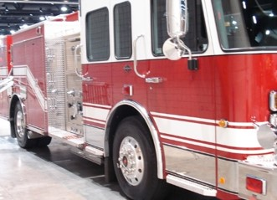
Rescue and Emergency Services
1910.146(k)(1)
Using rescue and emergency services
  Evaluate prospective services ability to perform the summons in a timely and proficient manner
  Identify the hazards in the space
  Practice mock rescues
NCDOL Photo Library

Slide 30
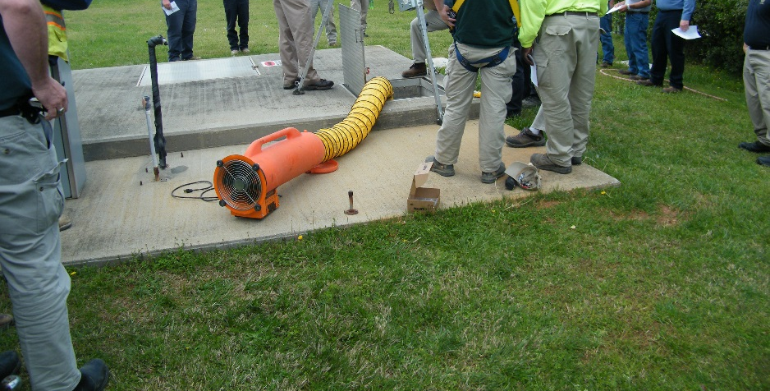
Rescue and Emergency Services
1910.146(k)(2)
Rescue using in-house employees
  Trained to perform assigned rescue duties
  Trained in basic first aid and CPR
  Practice rescue at least annually
    Note: If using air-supplying respirators, additional training is required per 29 CFR 1910.134 (Respiratory Protection)

Slide 31
Rescue and Emergency Services
1910.146(k)(3)
Non-entry rescue
  Retrieving an entrant from a confined space without going into the space
  Entrants must wear a chest or full body harness with retrieval line attached
NCDOL Photo Library

Slide 32
Additional Information
Appendices
A: Permit-required Confined Space Decision Flow Chart
B: Procedures for Atmospheric Testing
C: Examples of Permit-required Confined Space Programs
D: Sample Permits
E: Sewer System Entry
F: Non-Mandatory - Rescue Team or Rescue Service
Evaluation Criteria

Slide 33
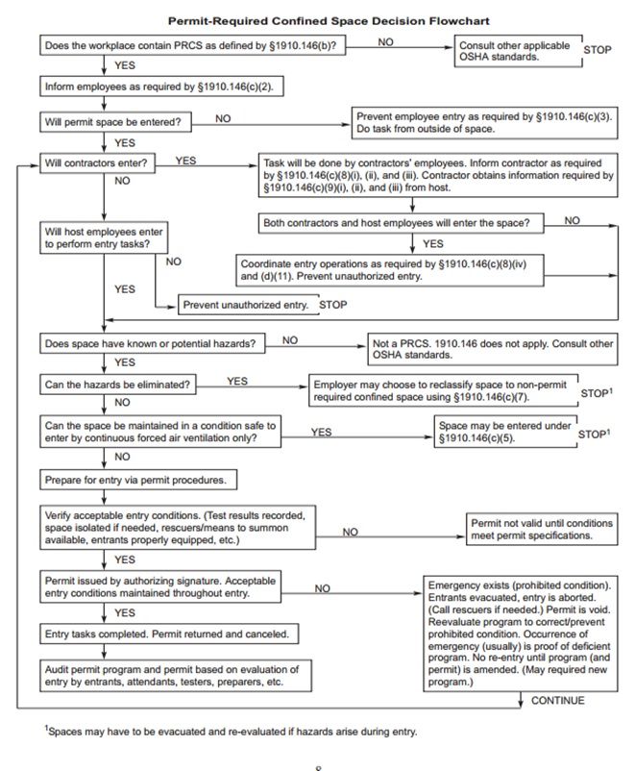
Permit Space Decision Making Tool
NCDOL Photo Library

Slide 34
Confined Spaces
1910.146
Storage tanks
Manholes and sewers
Grain storage bins
Boilers
Ducts
Tank cars
Utility vaults
Pipelines
Equipment and machinery
Tunnels
Open top spaces (>4 feet)
Sewers

Slide 35
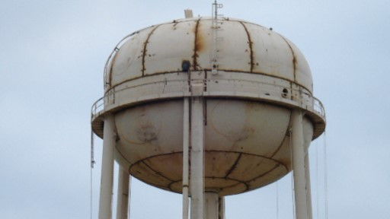
Is this a Confined Space?
NCDOL Photo Library

Slide 36
Is this a Confined Space?
NCDOL Photo Library

Slide 37
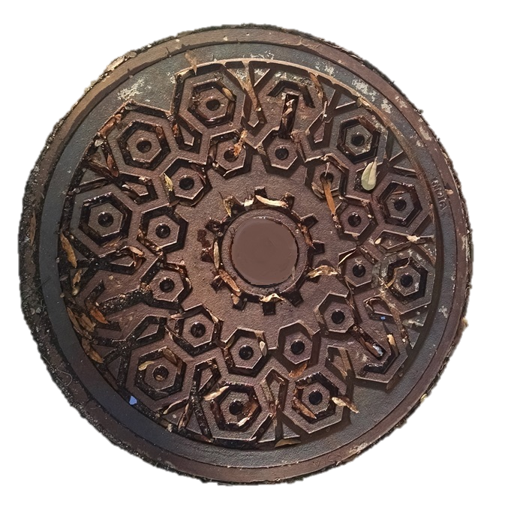
Is this a Confined Space?
NCDOL Photo Library

Slide 38
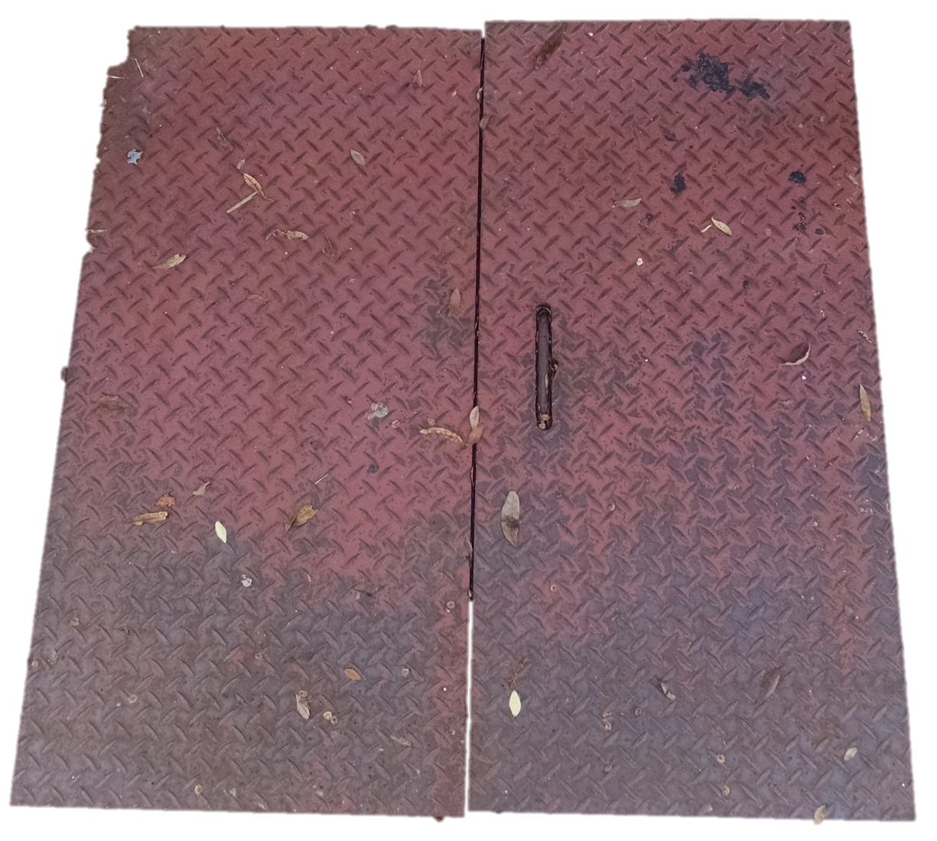
Is this a Confined Space?
NCDOL Photo Library

Slide 39
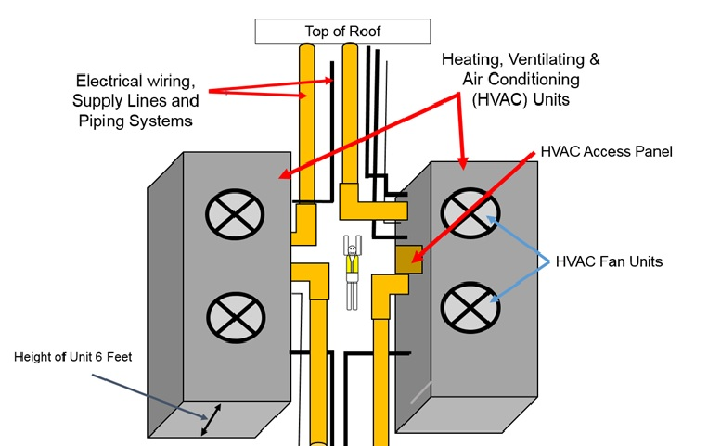
Is this a Confined Space?
Worker
NCDOL Photo Library

Slide 40
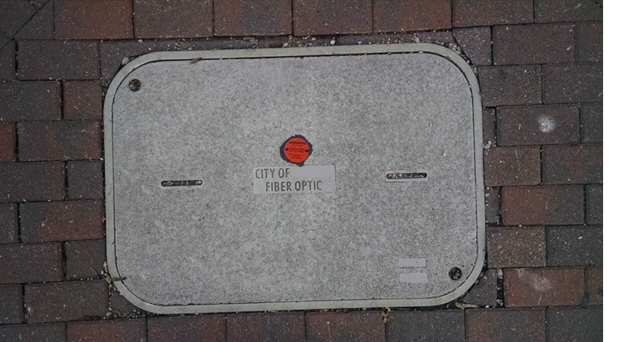
Is this a Confined Space?
NCDOL Photo Library
NCDOL Photo Library

Slide 41
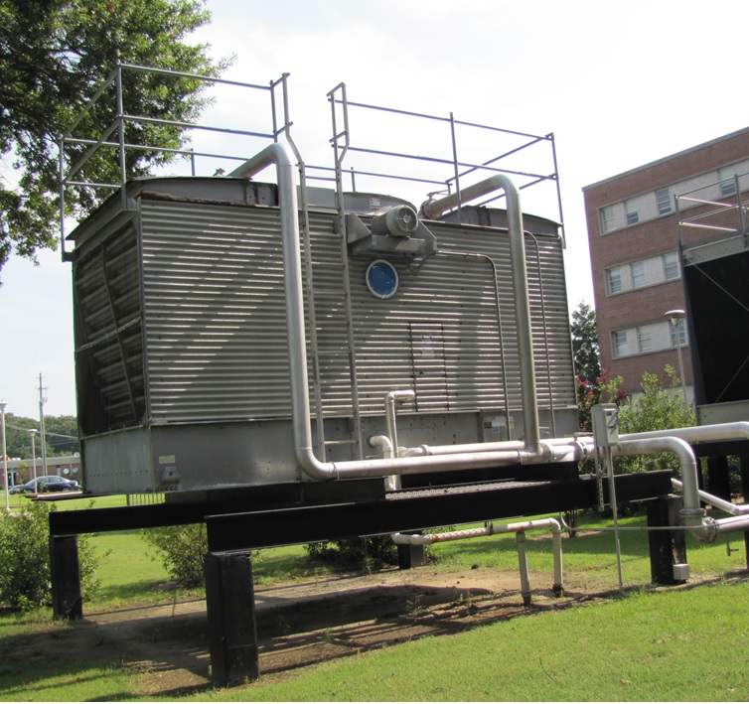
Is this a Confined Space?
NCDOL Photo Library

Slide 42
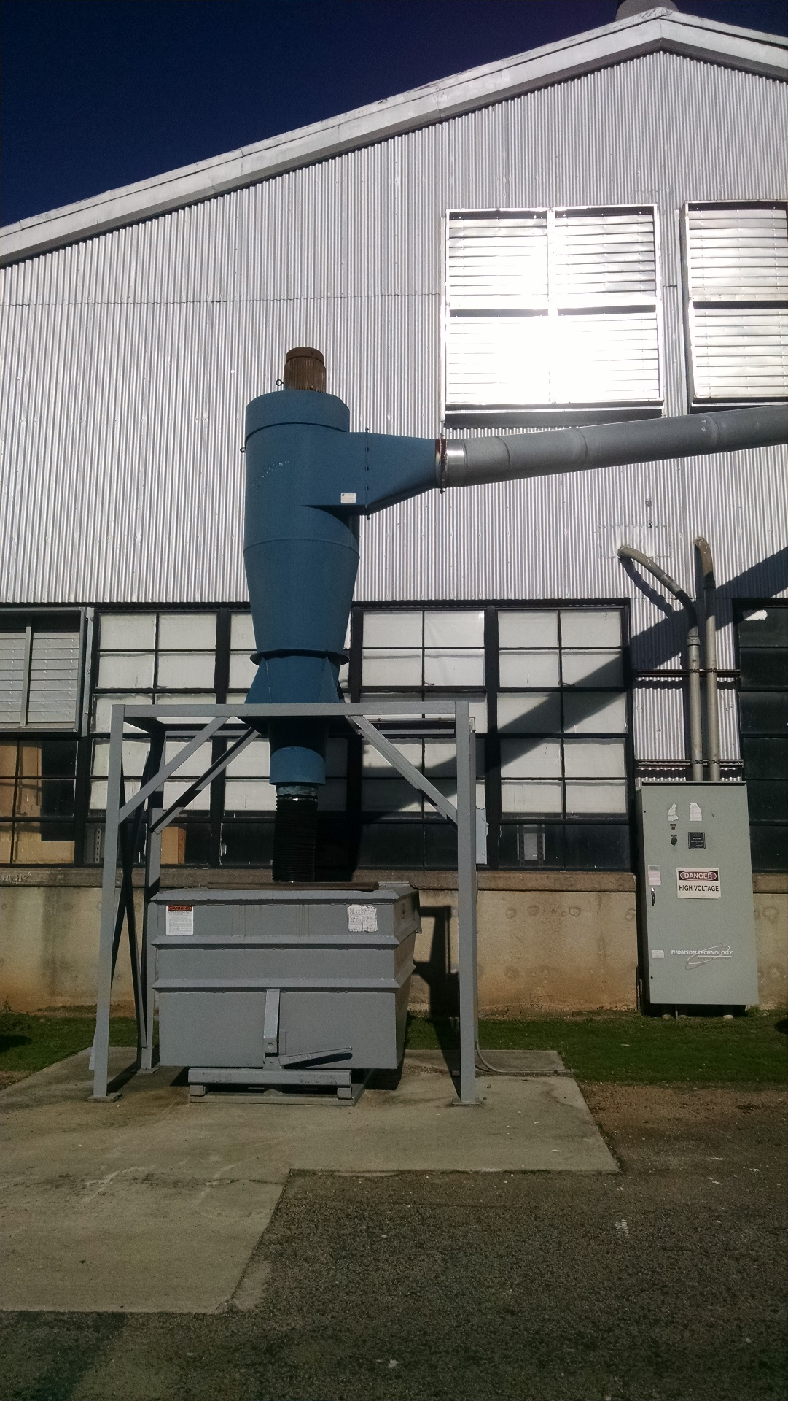
Is this a Confined Space?
NCDOL Photo Library

Slide 43
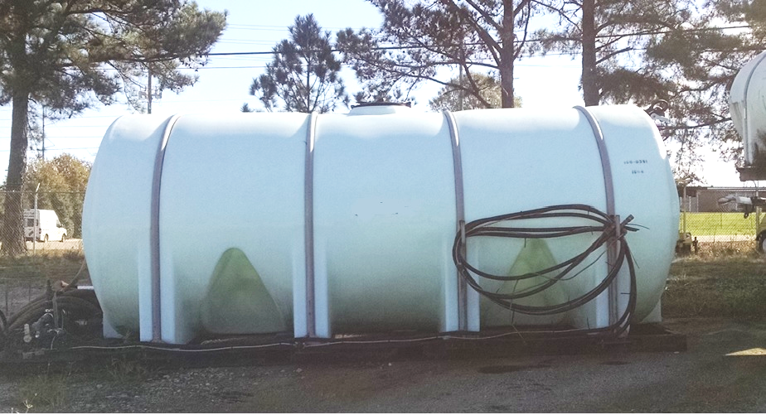
Is this a Confined Space?
18 Inch Opening
NCDOL Photo Library

Slide 44
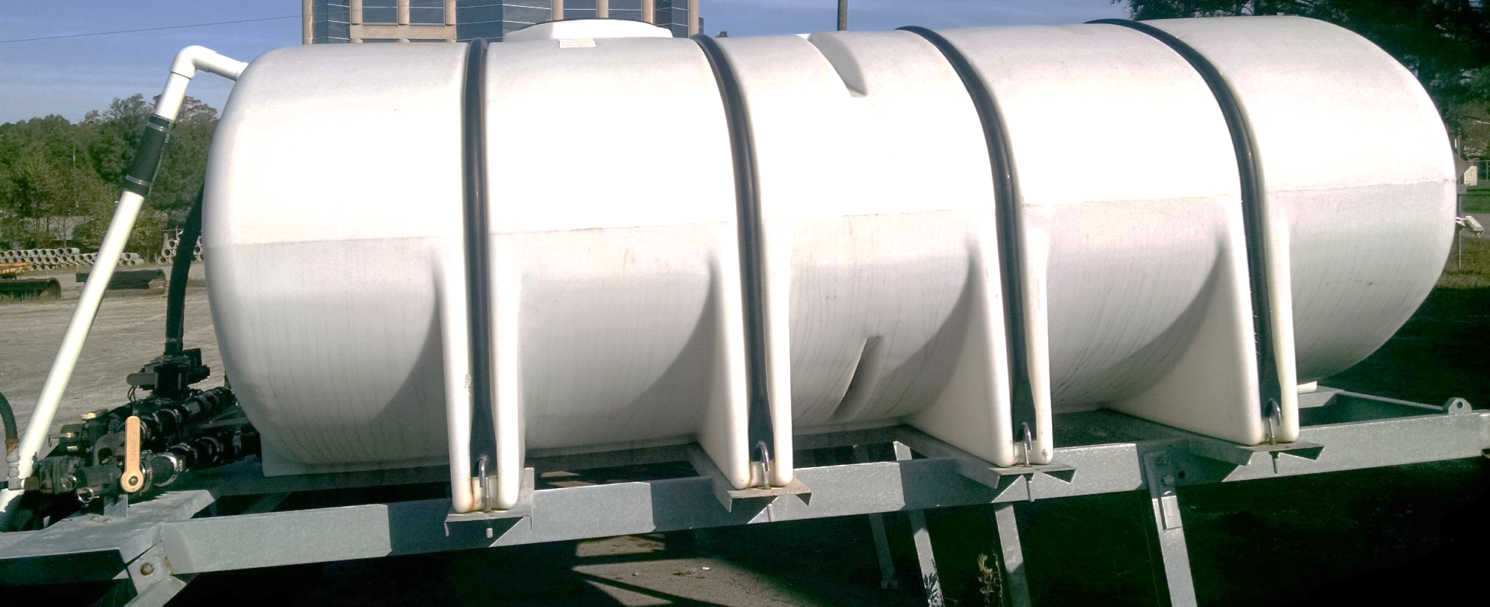
Is this a Confined Space?
11 Inch Opening
NCDOL Photo Library

Slide 45
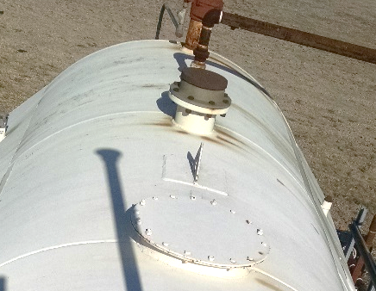
Is this a Confined Space?
NCDOL Photo Library

Slide 46
Summary
In this course, we discussed:
  Confined spaces in general industry
  The difference between a confined space and a permit-required confined space
  How to determine if a hazard exists within the confined space
  Responsibilities for the entrant, attendant and entry supervisor
  Rescue options

Slide 47

Thank You For Attending!
Final Questions?

