Slide 1
Confined Spaces in Construction
29 CFR 1926 – Subpart AA
Notes:
Revised 06/2025
The information in this presentation is provided voluntarily by the N.C. Department of Labor, Education Training and Technical Assistance Bureau as a public service and is made available in good faith. This presentation is designed to assist trainers conducting OSHA outreach training for workers. Since workers are the target audience, this presentation emphasizes hazard identification, avoidance, and control – not standards. No attempt has been made to treat the topic exhaustively. It is essential that trainers tailor their presentations to the needs and understanding of their audience.
The information and advice provided on this Site and on Linked Sites is provided solely on the basis that users will be responsible for making their own assessment of the matters discussed herein and are advised to verify all relevant representations, statements, and information.
This presentation is not a substitute for any of the provisions of the Occupational Safety and Health Act of North Carolina or for any standards issued by the N.C. Department of Labor. Mention of trade names, commercial products, or organizations does not imply endorsement by the N.C. Department of Labor.

Slide 2
Objectives
Subpart AA
At the end of this course, students will be able to:
  Define a confined space.
  Recognize the difference between a confined space and permit-required confined space.
  Understand methods used to determine if/when hazards exist within a confined space.
  Discuss entrant, attendant and entry supervisor responsibilities.
  List requirement for rescue and emergency services.

Slide 3
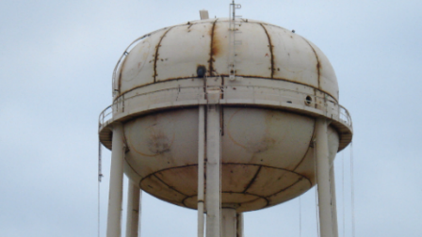
Scope
1926.1201(a)
Standard contains practices and procedures to protect workers engaged in construction activities at a worksite with one or more confined spaces.
If space meets definition of a confined space and contains recognized serious health or safety hazards, it is a permit-required confined space
  A space with no potential to have atmospheric hazards may be classified as a non-permit confined space only when all hazards are eliminated.
NCDOL Photo Library

Slide 4

Test Question
At what point does this become a confined space or permit-required confined space?
NCDOL Photo Library

Slide 5
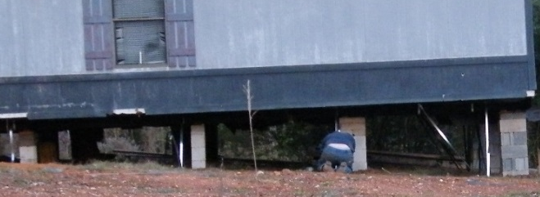
Enforcement
North Carolina has adopted the new OSHA Confined Spaces in Construction standards verbatim, with an effective date of October 2, 2015.
Subsequently, OSHA announced a delay of enforcement of some sections of the confined space standards for those employers engaged in residential construction work until January 8, 2016.
NCDOL Photo Library

Slide 6
Exceptions
1926.1201(b)
This standard does not apply to:
  Construction work regulated by 1926 Subpart P –Excavations.
  Construction work regulated by 1926 Subpart S -Underground Construction, Caissons, Cofferdams and Compressed Air.
  Construction work regulated by 1926 Subpart Y –Diving.

Slide 7
Exceptions
1926.1201(b)
1926 Subpart P - Excavations
  If there is a confined space within an excavation, such as a sewer pipe, and a worker enters the pipe to perform work, it is covered by Subpart AA.
  1926 Subpart S - Underground Construction, Caissons, Cofferdams and Compressed Air
  Work done in an underground space that does not involve altering the “structure” of the space is covered by Subpart AA (such as installing equipment).

Slide 8
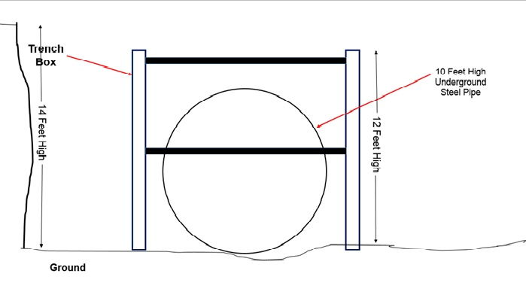
Discussion
NCDOL Photo Library

Slide 9
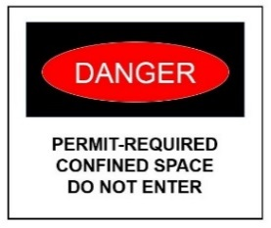
Definitions
1926.1202
Confined space
  A space that:
    Is large enough and so configured that an employee can bodily enter it;
    Has limited or restricted means for entry or exit, and
    Is not designed for continuous occupancy.
Confined spaces can present physical and atmospheric hazards that can be prevented if addressed prior to entering to perform work.
NCDOL Photo Library

Slide 10
Definitions
1926.1202
Competent person
  One who is capable of identifying existing and predictable hazards in the surroundings or working conditions which are unsanitary, hazardous, or dangerous to employees, and who has the authorization to take prompt corrective measures to eliminate them.

Slide 11
Definitions
1926.1202
Entry
  Action by which any part of a person passes through an opening into a permit-required confined space.
  Entry includes ensuing work activities in that space and is considered to have occurred as soon as any part of entrant’s body breaks the plane of an opening into the space, whether or not such action is intentional, or any work activities are actually performed in the space.

Slide 12
Definitions
1926.1202
Control
  Action taken to reduce level of any hazard inside a confined space using engineering methods (for example, by ventilation), and then using these methods to maintain the reduced hazard level.
    Also refers to engineering methods used for this purpose.
    Personal protective equipment is not considered a control.
Controlling contractor
  Employer that has overall responsibility for construction at worksite.

Slide 13
Definitions
1926.1202
Host employer
  Employer that owns or manages the property where construction work is taking place.
Monitor or monitoring
  Process used to identify and evaluate hazards after an authorized entrant enters space.
Early-warning system
  Method used to alert authorized entrants and attendants that an engulfment hazard may be developing.

Slide 14
Definitions
1926.1202
Physical hazard
  An existing or potential hazard that can cause death or serious physical damage.
    Examples include, but are not limited to:
      Explosives (as defined by 1926.914(n));
      Mechanical, electrical, hydraulic and pneumatic energy; radiation; temperature extremes; engulfment; noise; and inwardly converging surfaces.
    Includes chemicals that can cause death or serious physical damage through skin or eye contact (rather than through inhalation) .

Slide 15
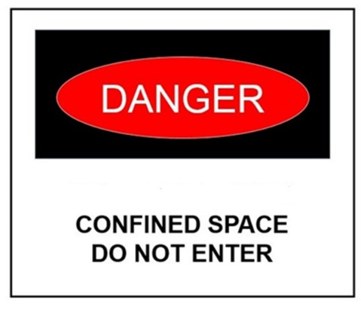
General Requirements
1926.1203(a)
Prior to work starting, a competent person must evaluate the worksite.
  Identify confined spaces, including permit spaces.
When there are changes in use or configuration to the non-permit space.
  Competent person must reevaluate the space and reclassify it, if necessary.
NCDOL Photo Library

Slide 16
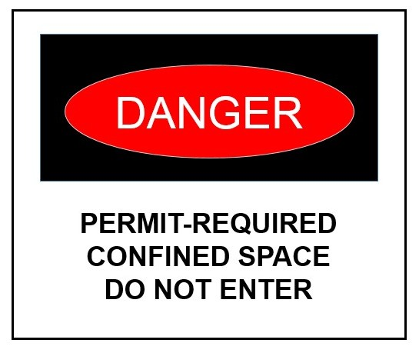
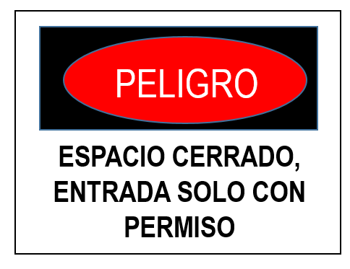
General Requirements
1926.1203(b)
Competent person must identify all permit spaces - those workers will enter, and those they will not enter.
All permit spaces must be posted/identified in some way.
NCDOL Photo Library

Slide 17
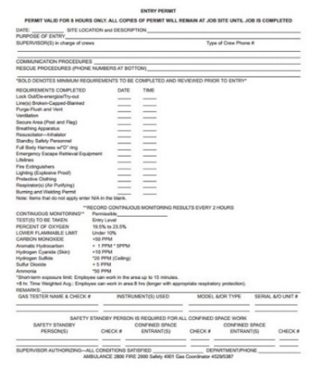
General Requirements
1926.1203(c)-(d)
If workers will not perform work in permit spaces.
  Employer must ensure that workers are prevented from entering permit spaces.
Employers who have determined that workers will perform work in permit spaces must develop a permit space program.
NCDOL Photo Library

Slide 18
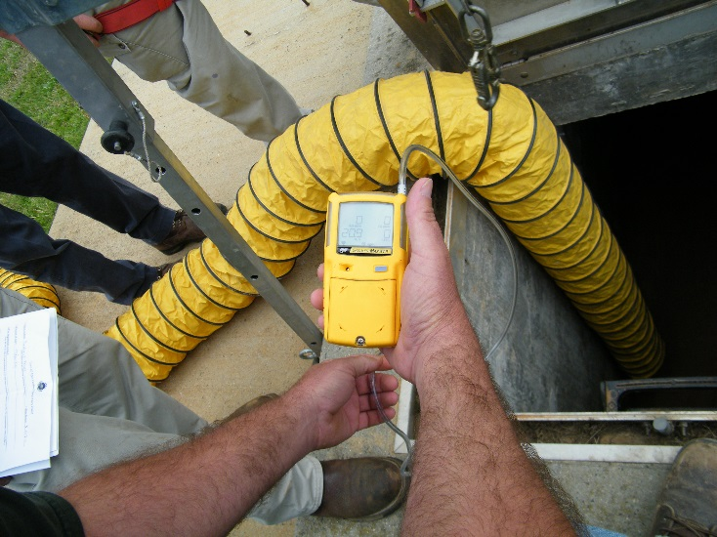
General Requirements
1926.1203(e)(1)(i)
Employers may use alternate procedures for entering a permit space when only hazard is actual or potential atmosphere.
  Must demonstrate that all physical hazards in the space are eliminated or isolated through engineering controls.
NCDOL Photo Library

Slide 19
General Requirements
1926.1203(e)(1)(ii)-(vi)
Employers must:
  Demonstrate that continuous forced air ventilation alone is sufficient to maintain that permit space safe for entry.
  Develop monitoring and inspection data.
  Document the determinations and supporting data and make them available to each employee who enters the permit space.
Permit space can be reclassified after all hazards within the space have been eliminated.

Slide 20
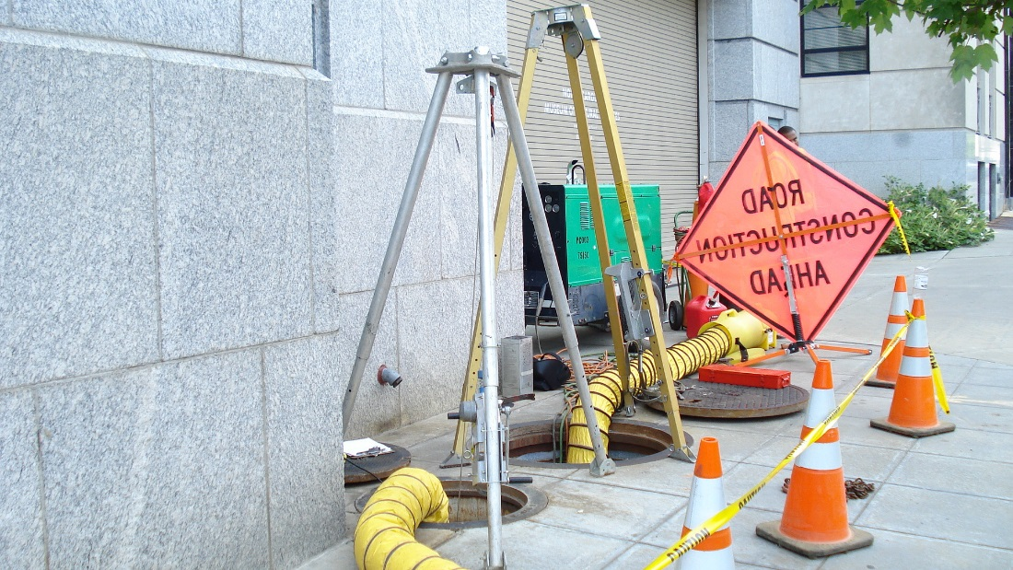
General Requirements
1926.1203(e)(2)(ii)
If entrance covers are removed, the opening must:
  Be immediately guarded by a railing or temporary cover or barrier to prevent an accidental fall through the opening.
  Protect each employee working in the space from foreign objects entering the space.
NCDOL Photo Library

Slide 21
General Requirements
1926.1203(e)(2)(v)(A)-(C)
Continuous forced air ventilation
  Employees must not enter the space until forced air ventilation has eliminated any hazardous atmosphere.
  Be so directed as to ventilate immediate areas where an employee is/will be present within the space and continue until all employees have left space.
  Air supply for forced air ventilation must be from a clean source and must not increase hazards in space.

Slide 22
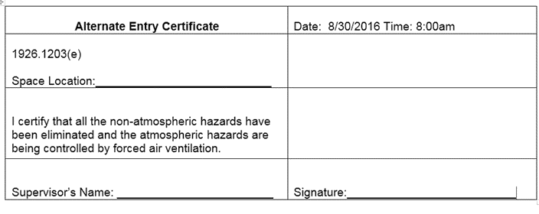
General Requirements
1926.1203(e)(2)(ix)
Employers who allow workers to enter a permit space using alternate entry procedures:
  Must verify that space is safe for entry with the following:
    Written certification that contains date,
    Location of space, and
    Signature of the person providing certification.
NCDOL Photo Library

Slide 23
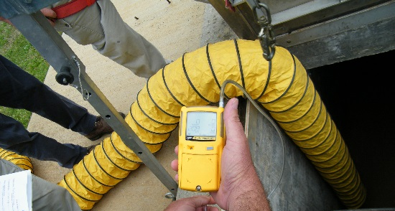
General Requirements
1926.1203(f)
When there are changes in use or configuration of a non-permit confined space that might increase hazards to entrants, or:
  Some indication that initial evaluation of space may not have been adequate.
Each entry employer must have a competent person reevaluate that space and, if necessary, reclassify it as a permit-required confined space.
NCDOL Photo Library

Slide 24
General Requirements
1926.1203(g)
A space classified by an employer as a permit-required confined space may only be reclassified as a non-permit confined space when a competent person determines that all applicable requirements have been met.
NCDOL Photo Library

Slide 25
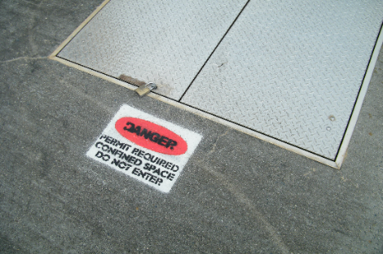
General Requirements
1926.1203(h)(1)
Permit space entry communication and coordination.
Before entry operations begin, host employer must provide the following information:
  Location of each known permit space.
  Hazards or potential hazards in each space or reason it is a permit space.
  Precautions that host employer or any previous controlling contractor or entry employer implemented for protection of employees in permit space.
NCDOL Photo Library

Slide 26
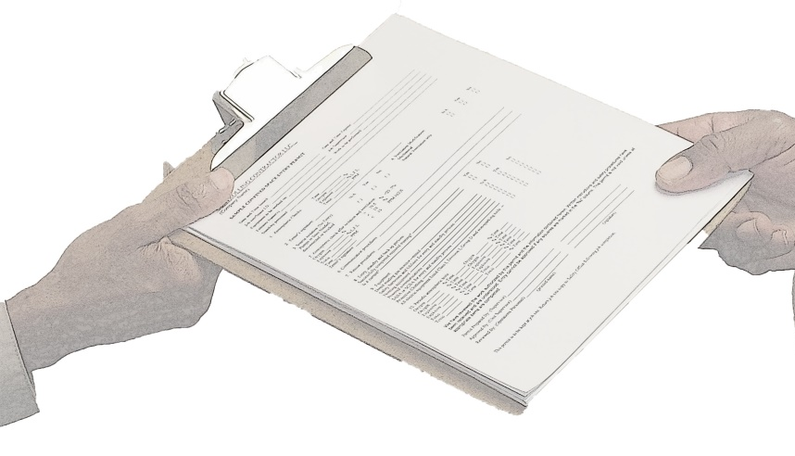
General Requirements
1926.1203(h)(2)(i)-(ii)
Before entry operations begin, controlling contractor must:
  Obtain host employer’s information about permit space hazards and previous entry operations, and
  Provide the following information to each entity entering a permit space and any other entity at worksite whose activities could foreseeably result in a hazard in permit space.
NCDOL Photo Library

Slide 27
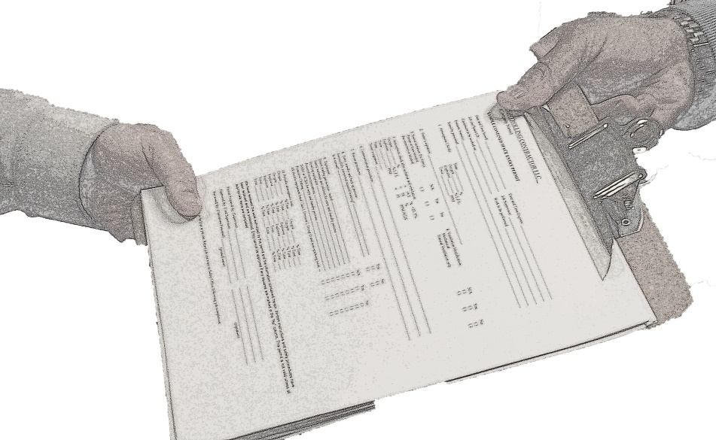
General Requirements
1926.1203(h)(2)(ii)(A)-(C)
  Information received from host employer.
  Any additional information the controlling contractor has about subjects (permit space location, hazards).
  Precautions host employer, controlling contractor, or other entry employers implemented for protection of employees in permit spaces.
NCDOL Photo Library

Slide 28
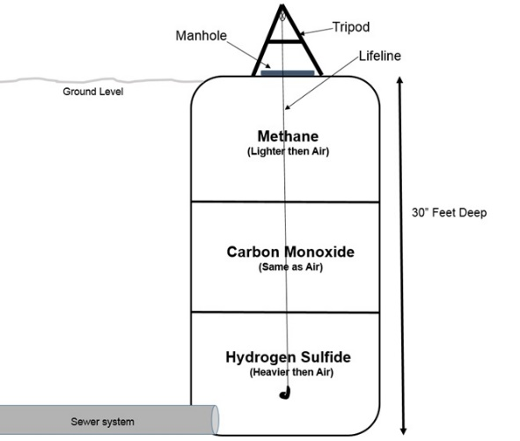
General Requirements
1926.1203(h)(3)(i)-(ii)
Before entry operations begin, each entry employer must:
  Obtain all controlling contractor’s information regarding permit space hazards and entry operations, and
  Inform controlling contractor of permit space program that entry employer will follow, including any hazards likely to be
  confronted or created in each permit space.
NCDOL Photo Library

Slide 29
General Requirements
1926.1203(h)(4)(i)-(ii)
Controlling contractor and entry employer(s) must coordinate entry operations when:
  More than one entity performs permit space entry at same time, or
  Permit space entry is performed at same time that any activities that could foreseeably result in a hazard in permit space are performed.

Slide 30
General Requirements
1926.1203(h)(5)
After entry operations, controlling contractor must debrief each entity that entered a permit space regarding the permit space program and any hazards confronted or created in permit space(s) during entry operations.
  Entry employer must inform controlling contractor in a timely manner of the permit space program and of any hazards confronted or created in permit space(s) during entry operations, and
  Controlling contractor must apprise host employer of information exchanged with entry entities.

Slide 31
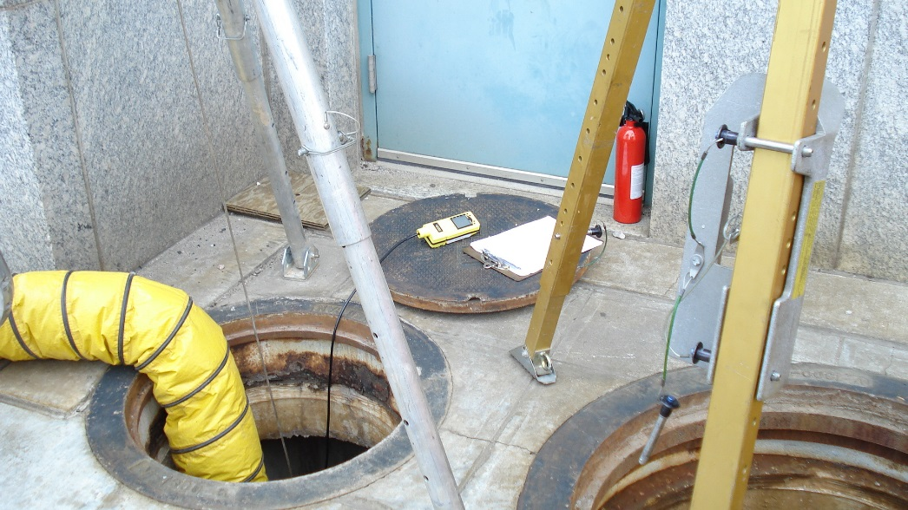
General Requirements
1926.1203(i)
If there is no controlling contractor present at worksite, requirements for, and role of, controlling contactors must be fulfilled by host employer or other employer who arranges to have employees of another employer perform work that involves permit space entry.
NCDOL Photo Library

Slide 32
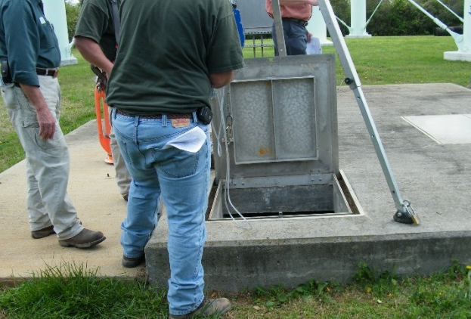
Confined Space Program
1926.1204(c)(1)-(8)
Each entry employer must:
  Implement measures necessary to prevent unauthorized entry.
  Identify and evaluate hazards of permit spaces before employees enter them.
  Develop and implement the means, procedures, and practices necessary for safe permit space entry operations.
NCDOL Photo Library

Slide 33
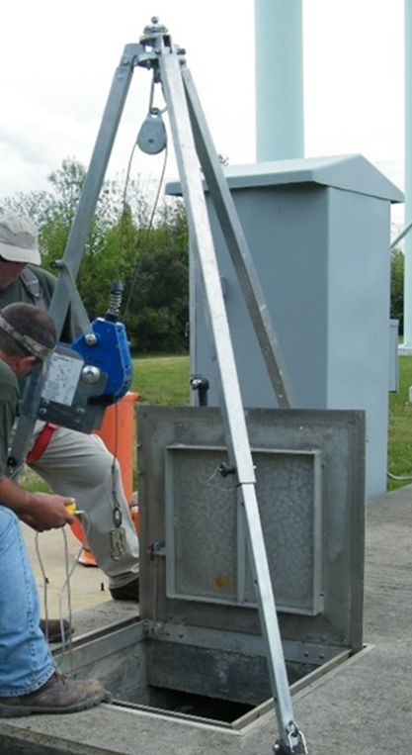
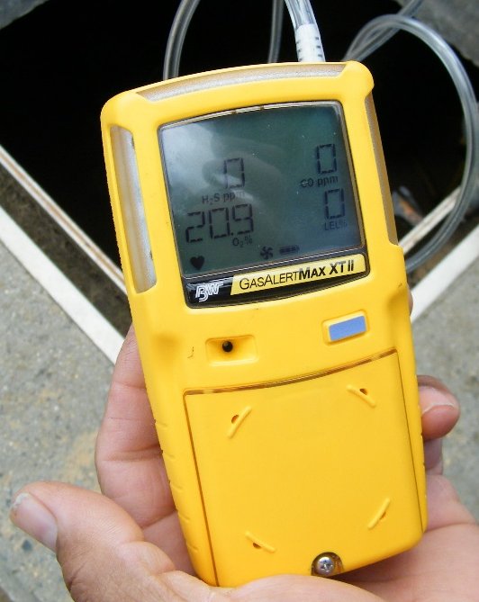
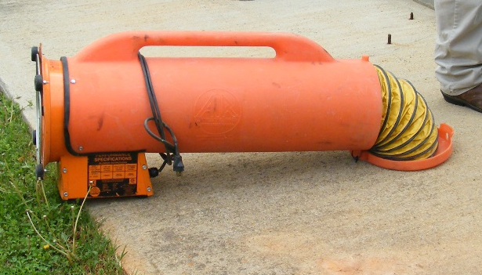
Employer Equipment
1926.1204(d)
Employers must provide equipment, at no cost to each employee, maintain that equipment properly, and ensure that each employee uses that equipment properly.
NCDOL Photo Library
NCDOL Photo Library
NCDOL Photo Library

Slide 34
Evaluate Permit Spaces
1926.1204(e)
Evaluate permit space conditions when entry operations are conducted.
Test conditions in permit space to determine if acceptable entry conditions exist before changes to space’s natural ventilation are made.

Slide 35
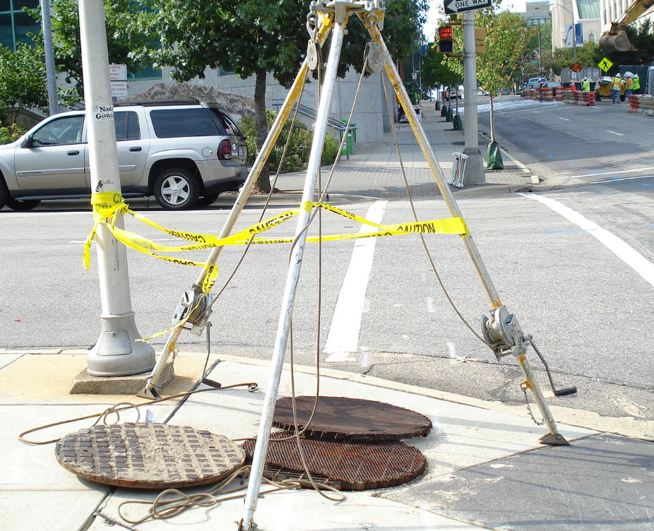
Attendant Responsibilities
1926.1204(f)
Provide at least one attendant outside permit space into which entry is authorized for duration of entry operations.
NCDOL Photo Library

Slide 36
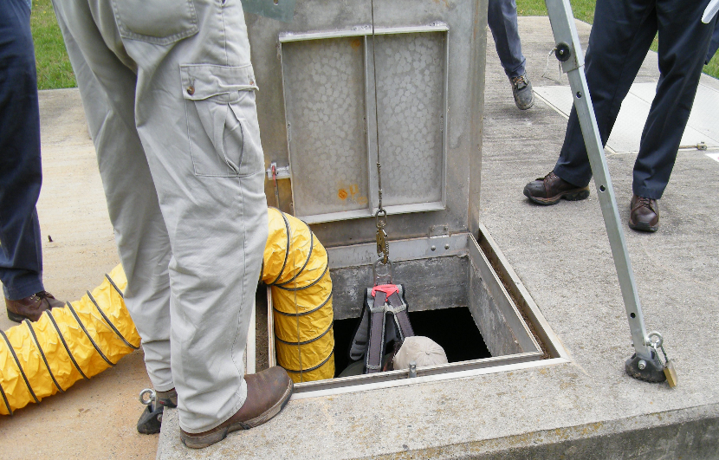
Attendant Responsibilities
1926.1204(g)
If multiple spaces are assigned to a single attendant, include in permit program, means and procedures to enable attendant to respond to an emergency affecting one or more of those permit spaces without distraction from attendant’s responsibilities.
NCDOL Photo Library

Slide 37
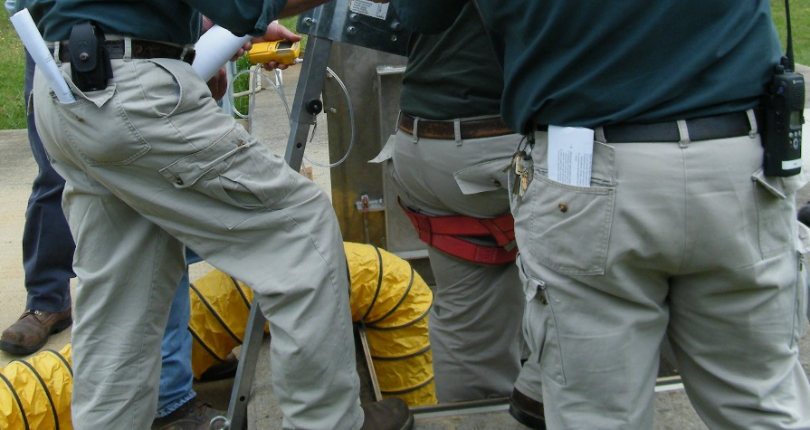
Responsibilities
1926.1204(h)
Designate each person who has active role (as, for example, authorized entrants, attendants, entry supervisors, or persons who test or monitor atmosphere in a permit space) in entry operations, identify duties of each such employee, and provide each such employee with required training.
NCDOL Photo Library

Slide 38
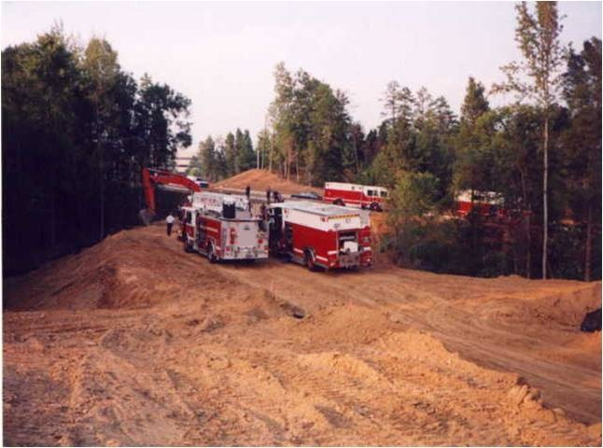
Procedures For Rescue
1926.1204(i)
Develop and implement procedures for summoning rescue and emergency services.
NCDOL Photo Library

Slide 39
Preparation
1926.1204(j)
Develop and implement a system for the preparation, issuance, use, and cancellation of entry permits including safe termination of entry operations under both planned and emergency conditions.
NCDOL Photo Library

Slide 40
Coordinate Entry Operations
1926.1204(k)
Develop and implement procedures to coordinate entry operations, in consultation with the controlling contractor.
  When employees of more than one employer are working simultaneously in a permit space, or
  Elsewhere on the worksite where their activities could foreseeably result in a hazard within confined space.

Slide 41
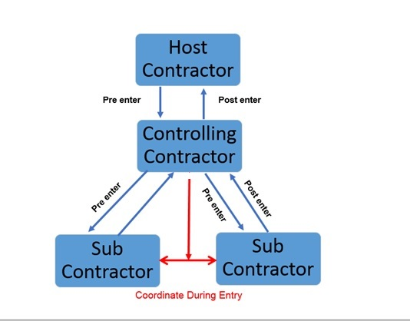
Flow Chart Coordination
NCDOL Photo Library

Slide 42
Closing Off or Canceling
1926.1204(l)
Requires an employer to develop and use procedures for terminating an entry permit and entry operations.
Canceled
NCDOL Photo Library

Slide 43
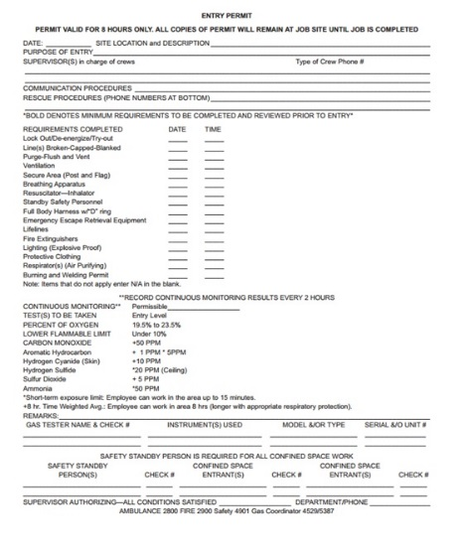
Review Entry Operations
1926.1204(m)
Review entry operations when measures taken under permit space program may not protect employees, and
  Revise program to correct deficiencies found to exist before subsequent entries are authorized.

Slide 44
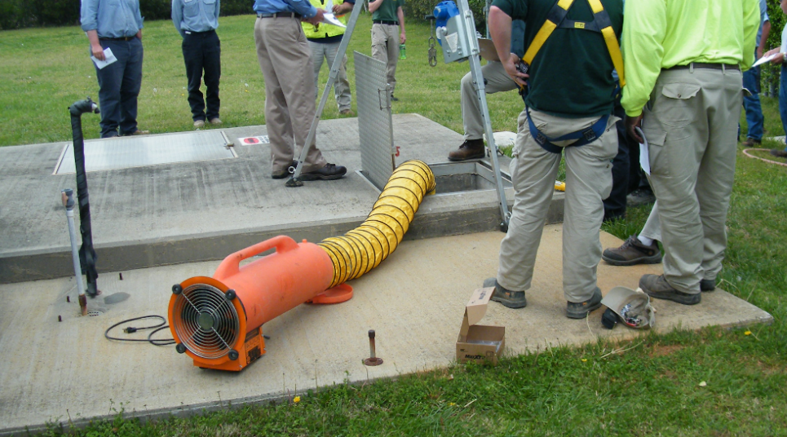
Permit Space Program
1926.1204(n)
Review permit space program
  Within one year after each entry using canceled permits, and
  Revise program as necessary to ensure that employees participating in entry operations are protected from permit space hazards.
NCDOL Photo Library

Slide 45
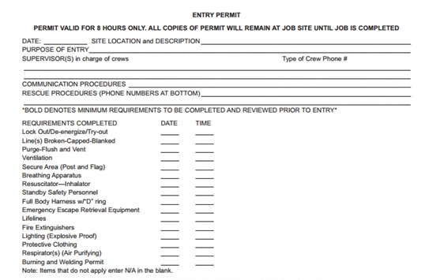
Permitting Process
1926.1205(a)-(d)
Before entry is authorized and begins:
  Each entry employer must document completion of measures required by preparing an entry permit.
  Entry supervisor identified on permit must sign entry permit to authorize entry.
  Duration of permit may not exceed time required to complete assigned task or job identified on permit.

Slide 46
Terminate Entry
1926.1205(e)(1)-(3)
Entry supervisor must terminate entry and cancel permit.
  Entry operations completed
  Condition not allowed under permit arises

Slide 47

Canceled Permits
1926.1205(f)
Entry supervisor must cancel entry permits when an assignment is completed or when new conditions exist.
  New conditions must be noted on canceled permit and later used in revising permit space program.
Standard requires employer to keep all canceled entry permits for at least one year.
Canceled
NCDOL Photo Library

Slide 48
Entry Permits
1926.1206(a)-(d)
Entry permit that documents compliance with the standard and authorizes entry to a permit space must identify:
  Permit space to be entered
  Purpose of entry
  Date and authorized duration of entry permit
  Authorized entrants by name or by other means
    Rosters or tracking systems

Slide 49
Entry Permits
1926.1206(e)-(i)
  Means of detecting an increase in atmospheric hazard levels if ventilation system stops working.
  Each person, by name, serving as an attendant.
  Individual, by name, serving as entry supervisor, and signature or initials of each entry supervisor who authorizes entry.
  Hazards of permit space.
  Measures used to isolate permit space and to eliminate or control permit space hazards before entry.

Slide 50
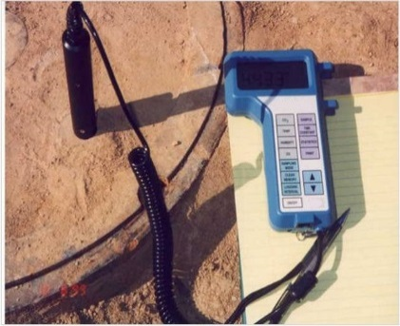
Entry Permits
1926.1206(j)-(m)
Acceptable entry conditions
  Results of tests and monitoring performed and accompanied by names or initials of testers and when they were performed.
  Rescue and emergency services to be summoned and means to summon them.
  Communication procedures used by authorized entrants and attendants to maintain contact during entry.
NCDOL Photo Library
NCDOL Photo Library

Slide 51
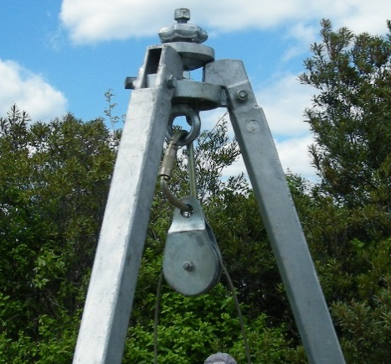

Entry Permits
1926.1206(n)-(o)
  Equipment, such as PPE, testing equipment, communications equipment, alarm systems, and rescue equipment, to be provided.
  Any other information, given the circumstances of the confined space, to ensure employee safety, and
  Any additional permits, such as for hot work, that have been issued to authorize work in permit space.
NCDOL Photo Library
NCDOL Photo Library
NCDOL Photo Library

Slide 52
Training
1926.1207(a)
Employer must provide training to each employee whose work is regulated by this standard.
  At no cost to employee.
  Ensure employee possesses understanding, knowledge, and skills necessary for safe performance of assigned duties.
Training must result in understanding hazards in permit space.
  Methods used to isolate, control, or protect employees from hazards.
  For employees not authorized to perform entry rescues, in dangers of attempting such rescues.

Slide 53
Training
1926.1207(b)(1)-(5)
Training provided to each affected employee:
  In a language and vocabulary that employee understands.
  Before employee is assigned duties.
  Before there is a change in assigned duties.
  Whenever a change in permit space entry operations that presents a hazard that an employee has not previously been trained, and
  Whenever there is evidence of a deviation from permit space entry procedures or inadequacies in employee’s knowledge or use of these procedures.

Slide 54
Training
1926.1207(c)-(d)
Training must establish employee proficiency in duties and must introduce new or revised procedures, as necessary.
Training records maintained:
  Must contain employee’s name, name of trainers, and training dates.
  Documentation must be available for inspection by employees and their authorized representatives, for period of time employee is employed by that employer.

Slide 55
Duties of Authorized Entrants
1926.1208(a)-(c)
Entry employer must ensure that all authorized entrants:
  Are familiar with and understand hazards that may be faced during entry, including information on the mode, signs or symptoms, and consequences of exposure.
  Properly use equipment.
  Communicate with attendant as necessary to enable attendant to assess entrant status and enable attendant to alert entrants of need to evacuate the space.

Slide 56
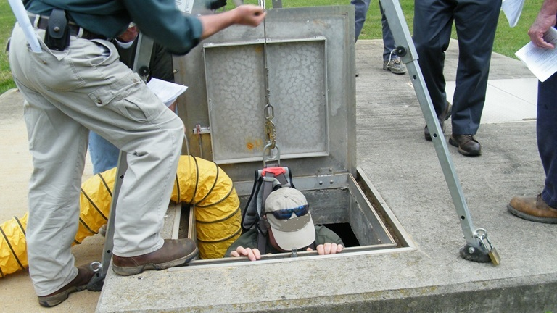
Duties of Authorized Entrants
1926.1208(d)
Alert attendant whenever:
  There is any warning sign or symptom of exposure to a dangerous situation, or
  Entrant detects a prohibited conditions.
NCDOL Photo Library

Slide 57
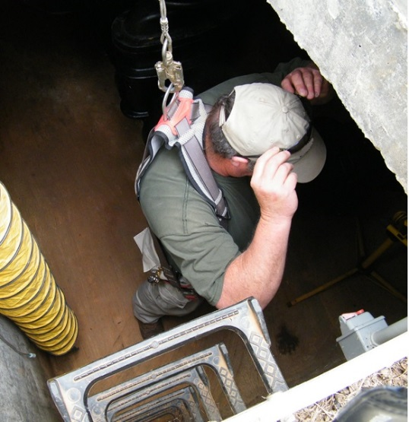
Duties of Authorized Entrants
1926.1208(e)
Exit from permit space as quickly as possible whenever:
  An order to evacuate is given by attendant or entry supervisor.
  There is a warning sign or symptom of exposure to a dangerous situation.
  Entrant detects a prohibited
  condition, or
  An evacuation alarm is activated.
NCDOL Photo Library

Slide 58

Duties of Attendants
1926.1209(a)-(c)
Entry employer must ensure each attendant:
  Is familiar with and understands hazards that may be faced during entry, including information on mode, signs or symptoms, and consequences of exposure.
  Is aware of possible behavioral effects of hazard exposure in authorized entrants.
  Continuously maintains an accurate count of authorized entrants in permit space and ensures
  that means used to identify authorized
  entrants accurately identifies who is in
  permit space.
Attendant
NCDOL Photo Library

Slide 59

Duties of Attendants
1926.1209(d)-(e)
Remains outside permit space during entry operations until relieved by another attendant.
Communicates with authorized entrants as necessary to assess entrant status and to alert entrants of need to evacuate space.
NCDOL Photo Library

Slide 60
Duties of Attendants
1926.1209(f)(1)-(f)(4)
Assesses activities and conditions inside and outside space to determine if it is safe for entrants to remain in space and orders authorized entrants to evacuate permit space immediately under any of the following conditions:
  If there is a prohibited condition.
  If behavioral effects of hazard exposure are apparent in an authorized entrant.
  If there is a situation outside space that could endanger authorized entrants, or
  If attendant cannot effectively and safely perform all required duties.

Slide 61
Duties of Attendants
1926.1209(g)
Summons rescue and other emergency services as soon as attendant determines that authorized entrants may need assistance to escape from permit space hazards.
NCDOL Photo Library

Slide 62
Duties of Attendants
1926.1209(h)(1)-(3)
Takes the following actions when unauthorized persons approach or enter a permit space while entry is underway:
  Warns unauthorized persons that they must stay away from permit space.
  Advises unauthorized persons that they must exit immediately if they have entered permit space, and
  Informs authorized entrants and entry supervisor if unauthorized persons have entered permit space.

Slide 63
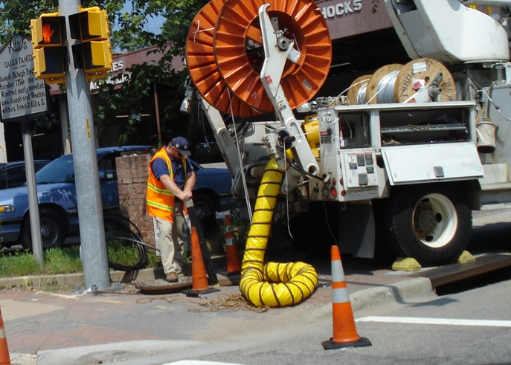
Duties of Attendants
1926.1209(i)-(j)
Performs non-entry rescues as specified by employer’s rescue procedure, and
Performs no duties that might interfere with attendant’s primary duty to assess and protect authorized entrants.
NCDOL Photo Library

Slide 64
Duties of Entry Supervisor
1926.1210(a)-(c)
Entry employer must ensure that each entry supervisor:
  Is familiar with and understands hazards that may be faced during entry, including information on mode, signs or symptoms, and consequences of exposure.
  Verifies, by checking that appropriate entries have been made on permit, and that all tests have been conducted and all procedures and equipment specified by permit are in place before endorsing permit and allowing entry to begin.
  Terminates entry and cancels or suspends permit as required.

Slide 65
Duties of Entry Supervisor
1926.1210(d)-(f)
Verifies that rescue services are available and means for summoning them are operable, and
  Employer will be notified as soon as services become unavailable.
Removes unauthorized individuals who enter or attempt to enter permit space during entry operations, and
  Determines, whenever responsibility for permit space entry operation is transferred, and
  At intervals dictated by hazards and operations performed within space, that entry operations remain consistent with entry permit and acceptable entry conditions are maintained.

Slide 66
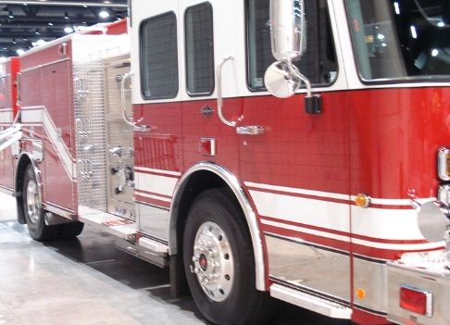
Rescue & Emergency Services
1926.1211(a)(1)-(2)
An employer who designates rescue and emergency services must:
  Evaluate a prospective rescuer’s ability to respond to a rescue summons in a timely manner, considering the hazard(s) identified.
  Evaluate a prospective rescue service’s ability, in terms of proficiency with rescue-related tasks and equipment, to function appropriately while rescuing entrants from the particular permit space or types of permit spaces identified.
NCDOL Photo Library

Slide 67
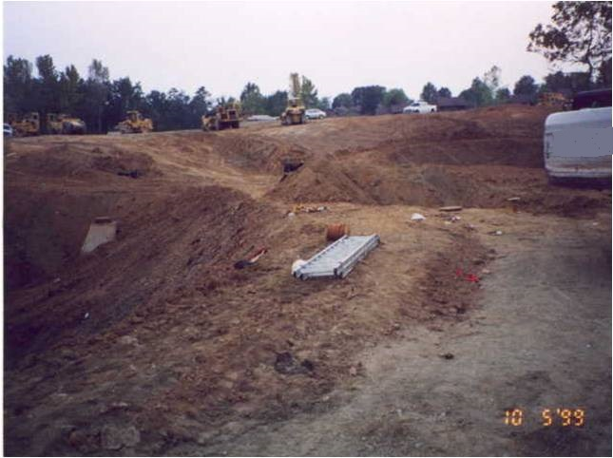
Rescue & Emergency Services
1926.1211(a)(3)(i)-(iii)
Select a rescue team or service from those evaluated that:
  Has capability to reach victim(s) within a time frame that is appropriate for permit space hazard(s) identified.
  Is equipped for, and proficient in, performing needed rescue services.
  Agrees to notify employer immediately in event that rescue service becomes unavailable.
Manhole
NCDOL Photo Library

Slide 68
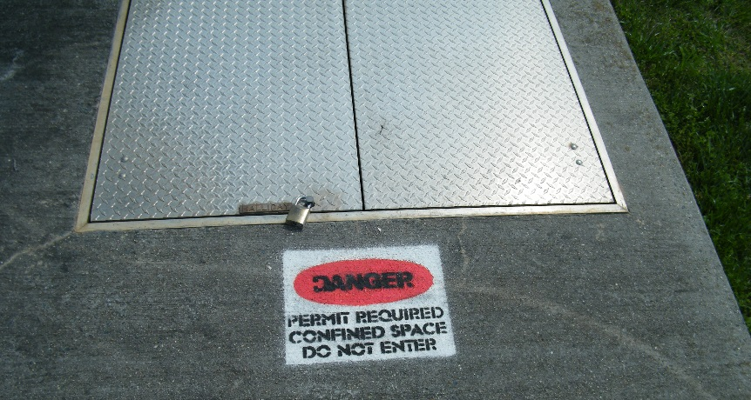
Rescue & Emergency Services
1926.1211(a)(4)-(5)
Inform each rescue team or service of hazards they may confront during rescue at site, and
Provide rescue team or service selected with access to all permit spaces from which rescue may be necessary so rescue team or service can develop appropriate rescue plans and practice rescue operations.
NCDOL Photo Library

Slide 69
Rescue & Emergency Services
1926.1211(b)(1)-(2)
An employer whose employees have been designated to provide permit space rescue and/or emergency services must provide all equipment and training at no cost to those employees and take following measures:
  PPE to all affected employees.
  Train all affected employees on rescue duties, and
  Establish proficiency.

Slide 70
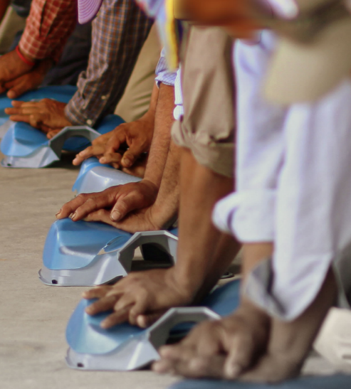
Rescue & Emergency Services
1926.1211(b)(3)
Train each affected employee in basic first aid and cardiopulmonary resuscitation (CPR).
Employer must ensure that at least one member of rescue team or service is available that holds a current certification in basic first aid and CPR.
NCDOL Photo Library

Slide 71
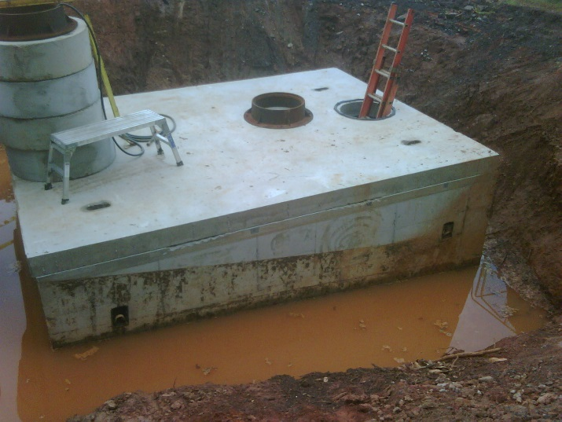
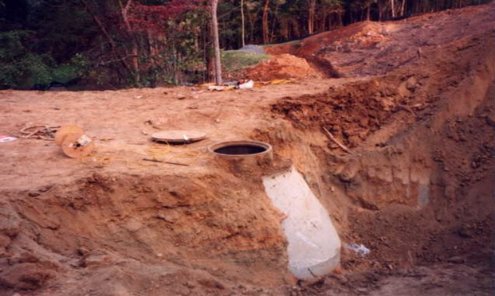
Rescue & Emergency Services
1926.1211(b)(4)
Ensure affected employees practice making permit space rescues before attempting an actual rescue, and at least once every 12 months.
  Representative permit spaces must, with respect to opening size, configuration, and accessibility, simulate types of permit spaces from which rescue is to be performed.
NCDOL Photo Library
NCDOL Photo Library

Slide 72
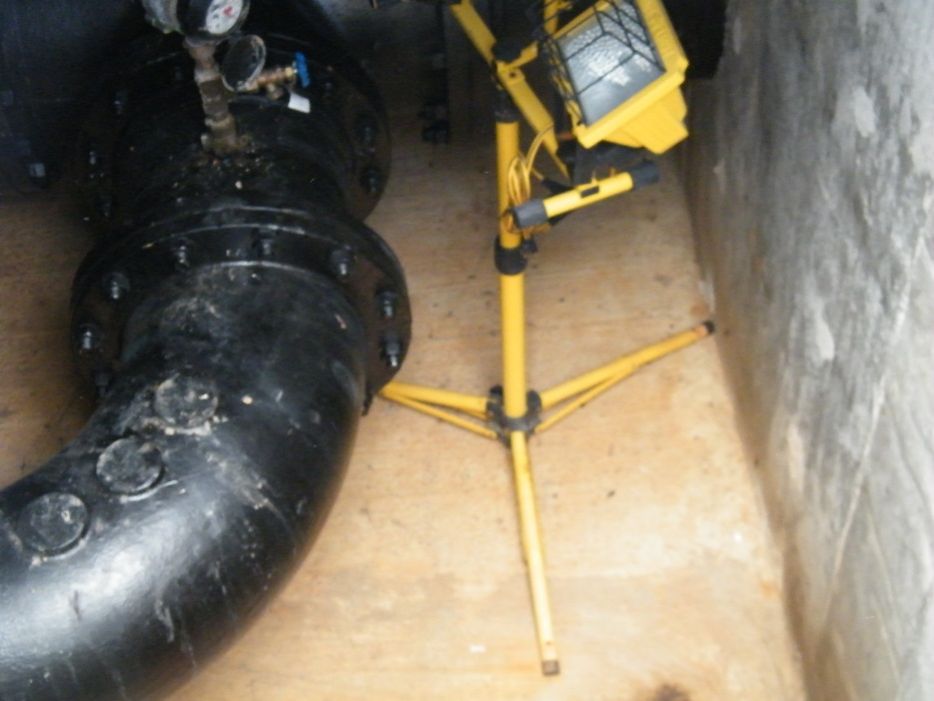
Rescue & Emergency Services
1926.1211(c)
Non-entry rescue is required unless retrieval equipment would increase overall risk of entry or would not contribute to rescue of entrant.
NCDOL Photo Library

Slide 73
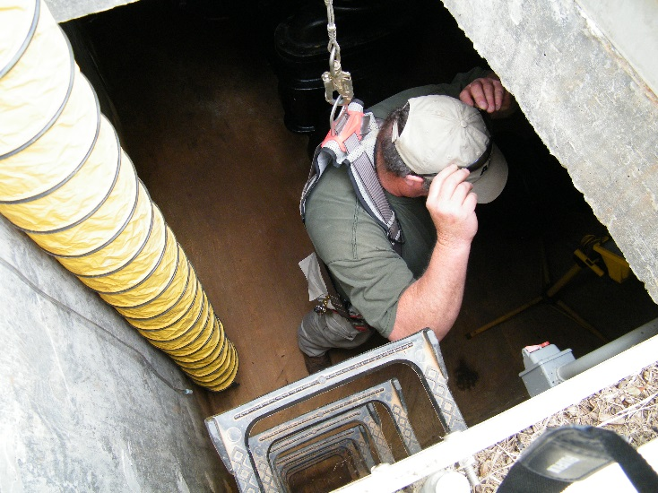
Rescue & Emergency Services
1926.1211(c)(1)
Retrieval systems must meet the following requirements:
  Each authorized entrant must use a chest or full body harness, with a retrieval line attached at center of entrant’s back near shoulder.
  Wristlets or anklets may be used in lieu of the chest or full body harness if their use is safest
  and most effective means when
  a chest or full body harness is
  infeasible.
NCDOL Photo Library

Slide 74
Rescue & Emergency Services
1926.1211(c)(2)-(3)
Other end of retrieval line must be attached to a mechanical device or fixed point outside permit space in a manner that rescue can begin as soon as rescuer becomes aware that rescue is necessary.
  Mechanical device must be available to retrieve personnel from vertical type permit spaces more than 5 feet (1.52 meters) deep.
Equipment that is unsuitable for retrieval must not be used.

Slide 75
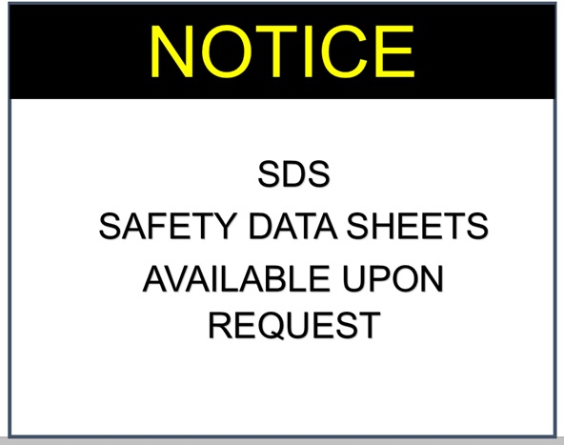
Rescue & Emergency Services
1926.1211(d)
If an injured entrant is exposed to a substance for which a safety data sheet (SDS) or other similar written information must be kept at worksite.
  SDS or written information must be made available to medical facility treating the exposed entrant.

Slide 76
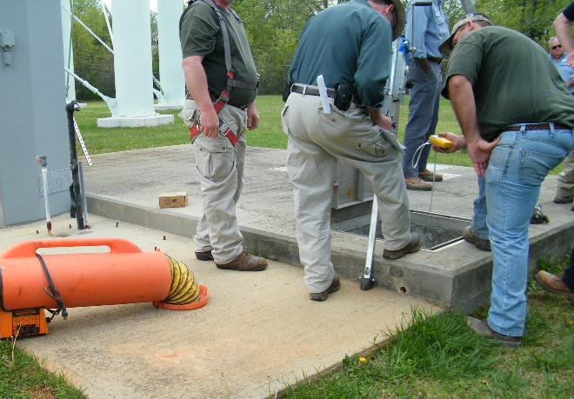
Employee Participation
1926.1212(a)-(b)
Employers must consult with affected employees and their authorized representatives on development and implementation of all aspects of permit space program.
Employers must make available to each affected employee and their authorized representatives all information required to be developed by this standard.
NCDOL Photo Library

Slide 77
Summary
In this presentation, we discussed:
  Definition of a confined space.
  How to recognize difference between a confined space and permit-required confined space.
  Methods used to determine if/when hazards exists within confined space.
  Responsibilities for entrant, attendant and entry supervisor.
  Rescue and emergency services.

Slide 78

Thank You For Attending!
Final Questions?

