Slide 1
Concrete and Masonry in Construction
Subpart Q
Notes:
Revised 6/16/25
The information in this presentation is provided voluntarily by the N.C. Department of Labor, Education Training and Technical Assistance Bureau as a public service and is made available in good faith. This presentation is designed to assist trainers conducting OSHA outreach training for workers. Since workers are the target audience, this presentation emphasizes hazard identification, avoidance, and control – not standards. No attempt has been made to treat the topic exhaustively. It is essential that trainers tailor their presentations to the needs and understanding of their audience.
The information and advice provided on this Site and on Linked Sites is provided solely on the basis that users will be responsible for making their own assessment of the matters discussed herein and are advised to verify all relevant representations, statements, and information.
This presentation is not a substitute for any of the provisions of the Occupational Safety and Health Act of North Carolina or for any standards issued by the N.C. Department of Labor. Mention of trade names, commercial products, or organizations does not imply endorsement by the N.C. Department of Labor.

Slide 2
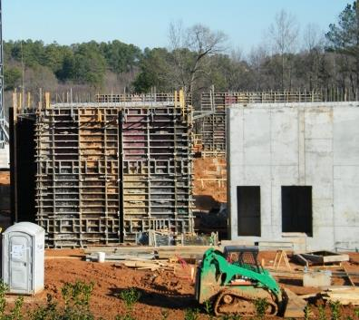
Objectives
  In this course, we will discuss the following:
    OSHA’s minimum requirements for concrete and masonry work in construction
    General requirements, equipment, tools, formwork, shoring, precast concrete, and lift-slab operations
    Hazards associated with concrete and masonry construction operations
    Abatement methods
NCDOL Photo Library

Slide 3
Subpart Q – Concrete and Masonry Construction
1926.700 – Scope, application, and definitions
1926.701 – General requirements
1926.702 – Requirements for equipment and tools
1926.703 – Requirements for cast-in-place concrete
1926.704 – Requirements for precast concrete
1926.705 – Requirements for lift slab operations
1926.706 – Requirements for masonry construction

Slide 4
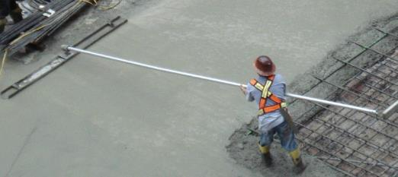
Definitions
1926.700(b)
Bull float
  A tool used to spread out and smooth concrete
Formwork
  The total system of support for freshly placed or partially cured concrete
Lift slab
  A method of concrete construction in which floor and roof slabs are cast on or at ground level and, using jacks, lifted into position
NCDOL Photo Library

Slide 5
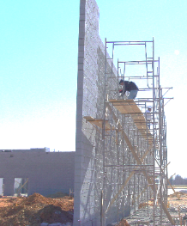
Definitions
1926.700(b)
Limited access zone
  An area alongside a masonry wall, which is under construction, and is clearly demarcated to limit access by employees
Precast concrete
  Concrete members which have been formed, cast, and cured prior to final placement in a structure
Reshoring
  Construction operation in which shoring equipment is placed, as original forms and shores are removed, to support partially cured concrete and construction loads
NCDOL Photo Library
Limited access zone

Slide 6
Definitions
1926.700(b)
Shore
  A supporting member that resists a compressive force imposed by a load
Vertical slipforms
  These forms are jacked vertically during placement of concrete
Jacking operation
  Task of lifting a slab during the construction of a building where the lift-slab process is being used

Slide 7
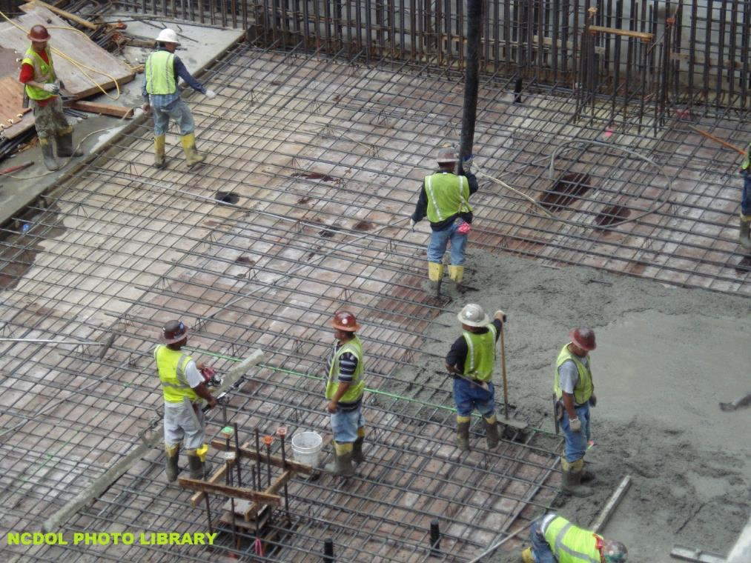
Does Subpart Q Apply?

Slide 8
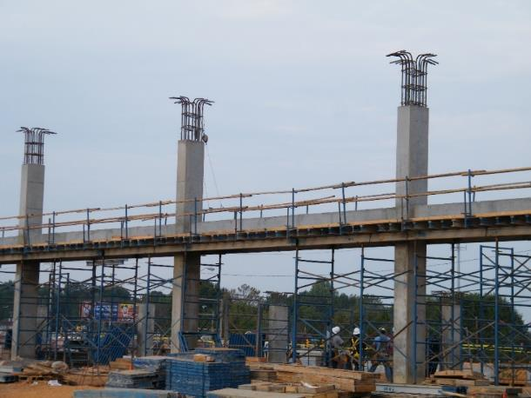
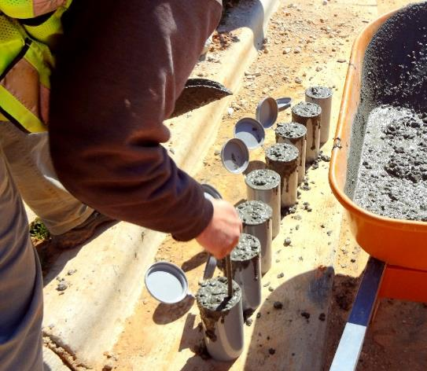
Construction Loads
1926.701(a)
Structures must be capable of supporting loads
NCDOL Photo Library
NCDOL Photo Library
NCDOL Photo Library

Slide 9
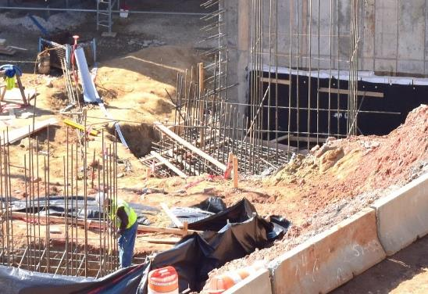
Reinforcing Steel
1926.701(b)
Guard protruding, reinforcing steel
  Letter of interpretation: 05/29/1997
    Addresses use of small plastic rebar caps
  Letter of interpretation: 03/10/2006
    Horizontal protection from impalement
NCDOL Photo Library

Slide 10
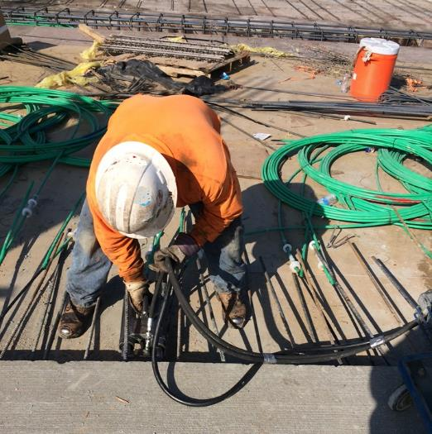
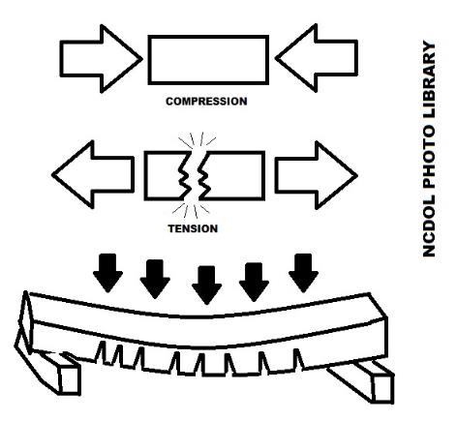
Post-Tensioning Operations
1926.701(c)
Method of reinforcing concrete, masonry, and other structural elements
Strands ½″ diameter are stressed to a force of 33,000 lbs. using a hydraulic jack
NCDOL Photo Library

Slide 11
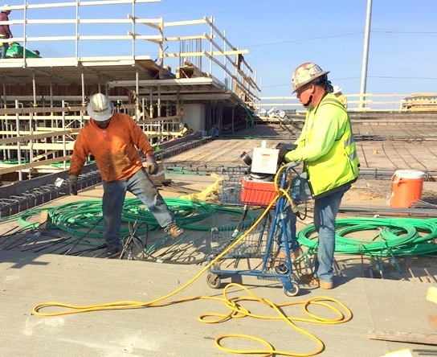
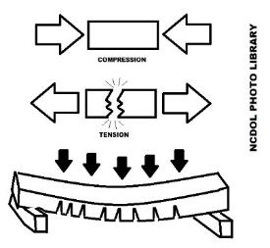
Post-Tensioning Operations
1926.701(c)(1)-(2)
No non-essential employees allowed in hazard zone
Use signs and barriers to limit employees access to work zone
NCDOL Photo Library

Slide 12
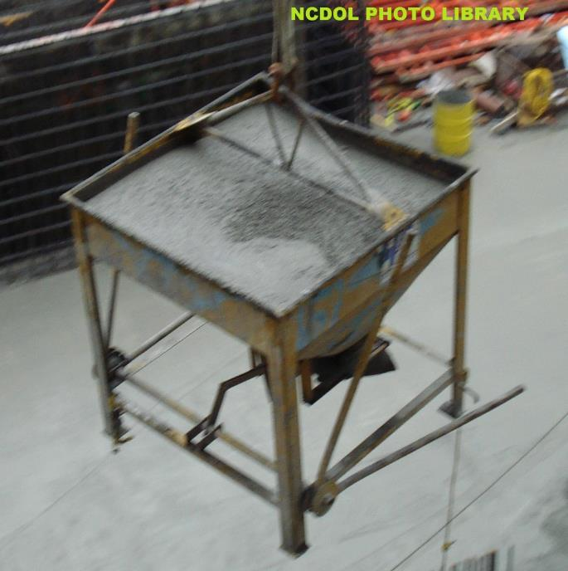
Riding Concrete Buckets
1926.701(d)
No riders

Slide 13
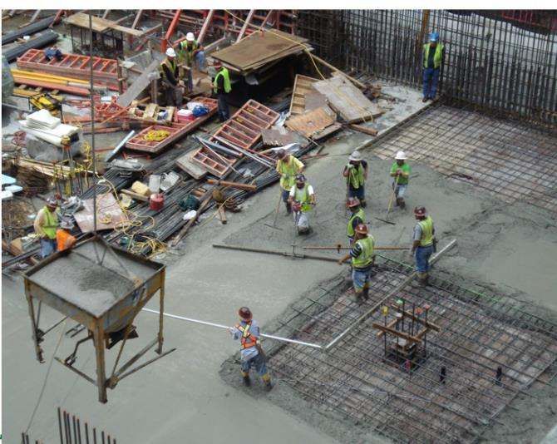
Working Under Loads
1926.701(e)(1)
Employees must not be permitted under concrete buckets while they are being elevated or lowered into position
NCDOL Photo Library

Slide 14
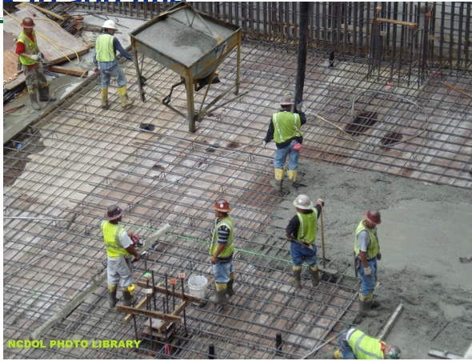
Working Under Loads
1926.701(e)(2)
Elevated concrete bucket routes
NCDOL Photo Library

Slide 15
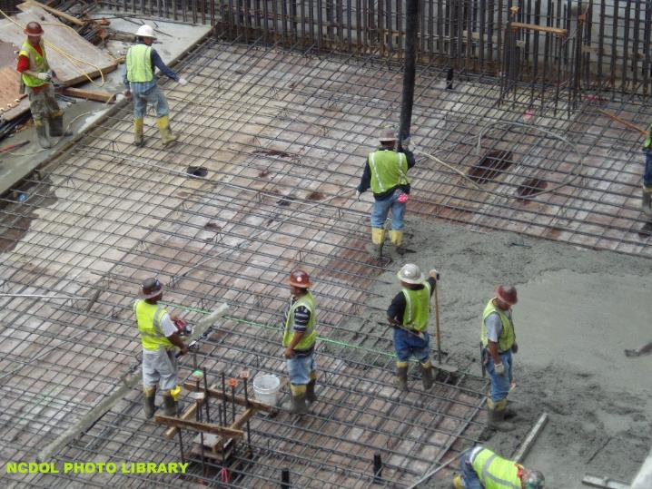
Personal Protective Equipment
1926.701(f)
Employees must wear protective head and face equipment when applying cement, sand, and water mixture through a pneumatic hose

Slide 16
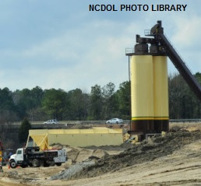
Bulk Cement Storage
1926.702(a)(1)-(2)
Bins, containers, and silos must be equipped with:
  Conical or tapered bottoms
  Mechanical or pneumatic
  means to start flow of
  material
Ejection system must be
shut down, locked and
tagged out prior to entry

Slide 17
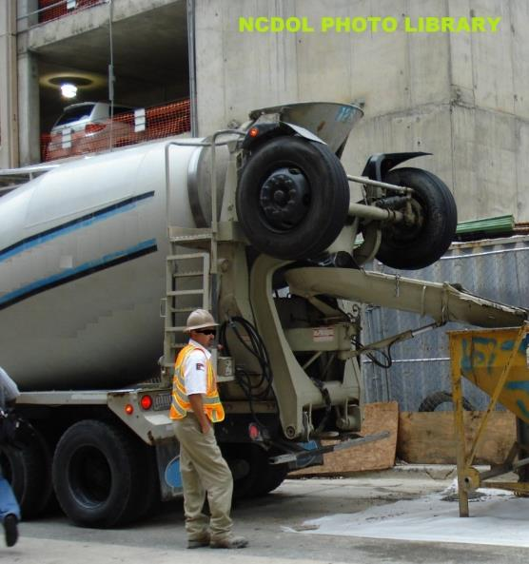
Concrete Mixers
1926.702(b)(1)-(2)
Concrete mixers with one cubic yard or larger loading skips must be equipped with:
  Mechanical device to clear skip of materials
  Guardrails installed on each side of the skip

Slide 18
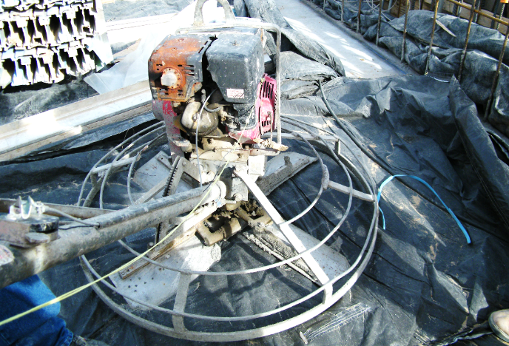
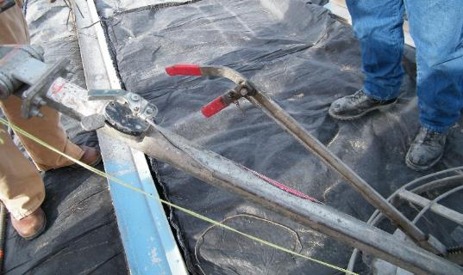
Power Concrete Trowels
1926.702(c)
Manually guided concrete troweling machine must be equipped with:
  Automatic control switches shut off power when hands are removed
NCDOL Photo Library
NCDOL Photo Library

Slide 19
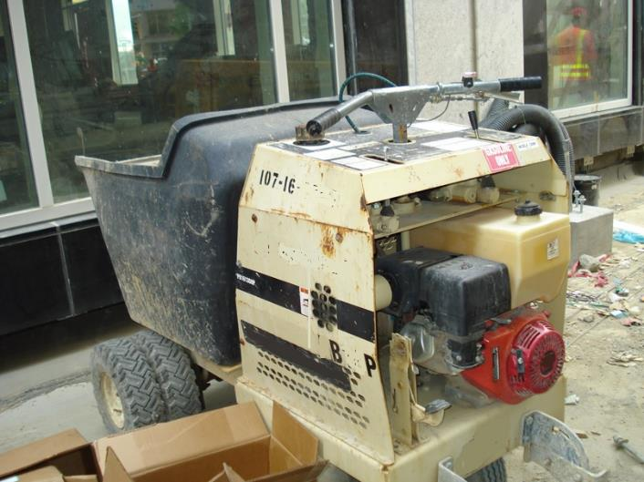
Concrete Buggy
1926.702(d)
Concrete buggy handles must not extend beyond the wheels on either side of the buggy
NCDOL Photo Library

Slide 20
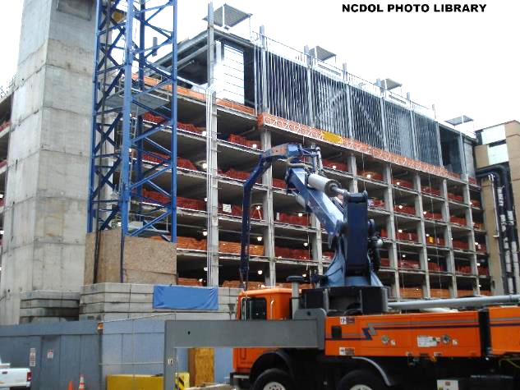
Concrete Pumping System
1926.702(e)(1)-(2)
Discharge pipes must be provided with pipe supports designed for 100 percent overload
Compressed air hoses must be provided with positive fail-safe joint connectors
NCDOL Photo Library

Slide 21
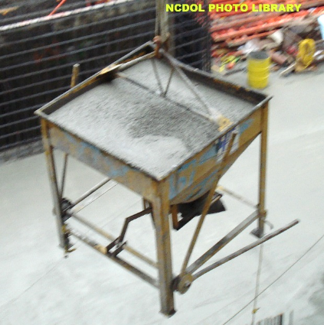
Concrete Buckets
1926.702(f)(1)-(2)
Concrete buckets equipped with hydraulic or pneumatic gates:
  Must have positive safety latches or similar devices to prevent accidental dumping
  Designed to prevent concrete
  from hanging up on top and
  sides

Slide 22
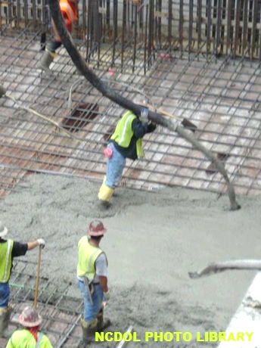
Tremies
1926.702(g)
Sections of tremie and similar concrete conveyances must be secured with wire rope (or equivalent materials) in addition to the regular couplings or connections

Slide 23
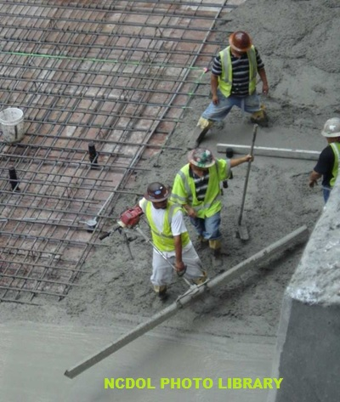
Bull Floats
1926.702(h)
Bull float handles must be constructed of nonconductive material or insulated
  When used where they may contact energized electrical conductors

Slide 24
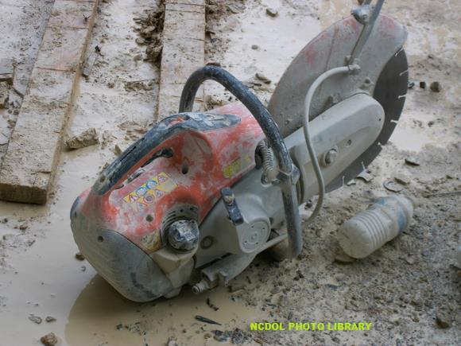
Masonry Saws
1926.702(i)(1)-(2)
Masonry saws must be guarded with a semicircular enclosure over the blade
Method for retaining blade fragments must be incorporated in the
design of the enclosure

Slide 25
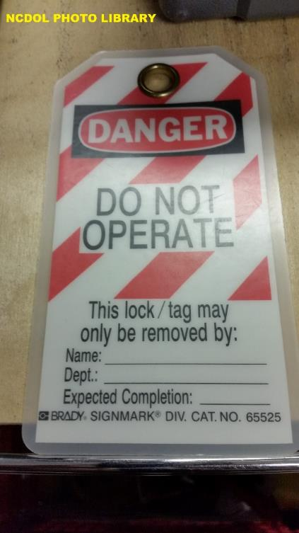
Lockout/Tagout Procedures
1926.702(j)(1)
Employees must not be allowed to perform maintenance or repair activity on equipment
  Unless hazardous energy sources have locked out or tagged out

Slide 26
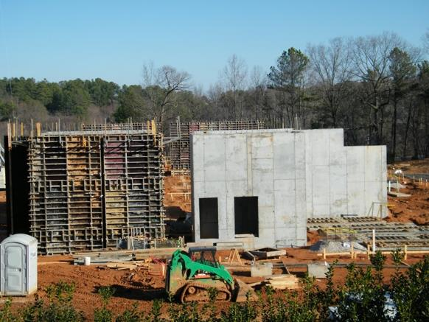
General Requirements
1926.703(a)(1)
Formwork must be designed, fabricated, erected, supported, braced, and maintained
  Must support, without failure, all vertical and lateral loads applied to it
NCDOL Photo Library

Slide 27
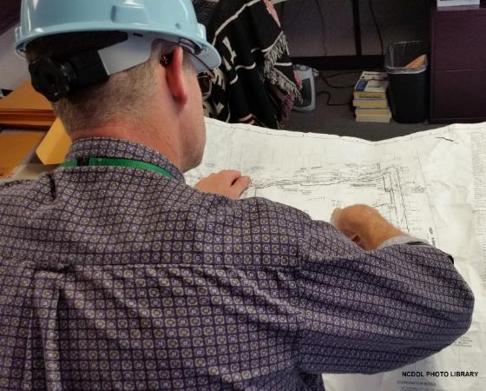
General Requirements
1926.703(a)(2)
Drawings or plans for the jack layout, formwork, working decks, and scaffolds must be available at the jobsite
NCDOL Photo Library

Slide 28
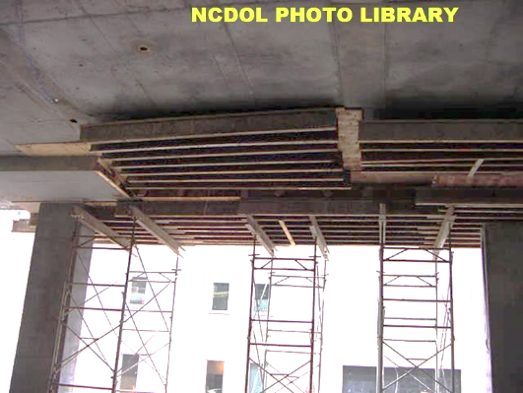
Shoring and Reshoring
1926.703(b)(1)-(3)
Inspected prior to erection
Damaged equipment shall not be used
Inspected immediately prior to, during, and
immediately after concrete placement

Slide 29
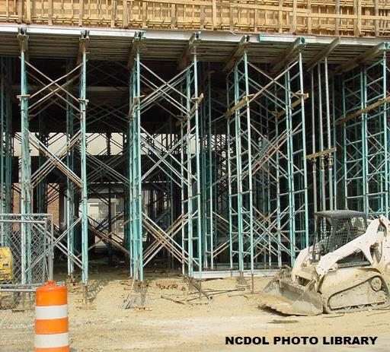
Shoring and Reshoring
1926.703(b)(4)-(5)
Equipment found to be damaged or weakened must be immediately reinforced
Sills must be sound, rigid, and capable of carrying maximum intended load

Slide 30
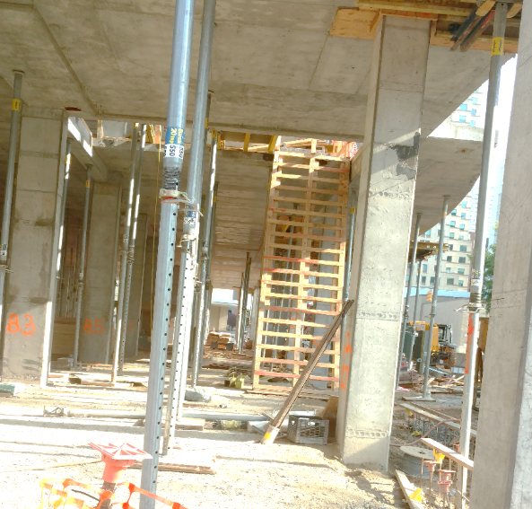
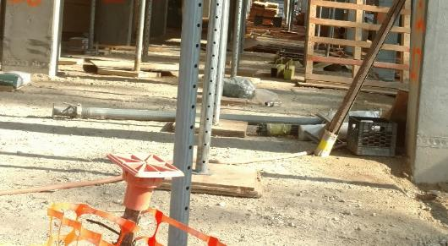
Shoring and Reshoring
1926.703(b)(6)
All base plates, shore heads, extension devices, and adjustment screws must be in firm contact, and secured when necessary, with the foundation and the form
NCDOL Photo Library
NCDOL Photo Library

Slide 31
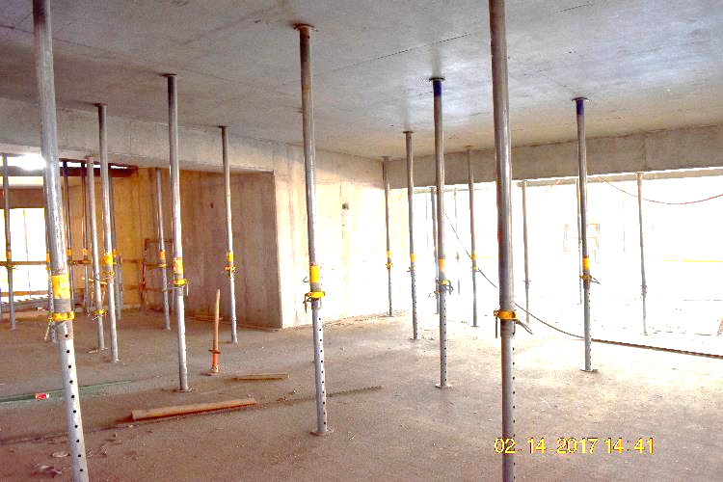
Shoring and Reshoring
1926.703(b)(9)
Adjustment of single post shores to raise formwork must not be made after the placement of concrete
NCDOL Photo Library

Slide 32
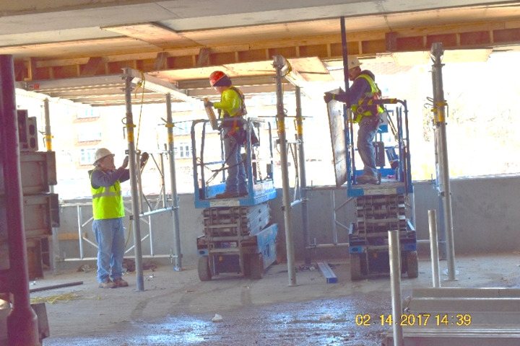
Shoring and Reshoring
1926.703(b)(10)
Reshoring must be erected:
  As the original forms and shores are removed
  Whenever the concrete is required to support loads in excess of its capacity
NCDOL Photo Library

Slide 33
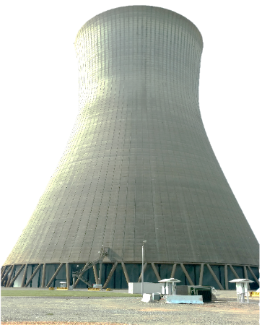
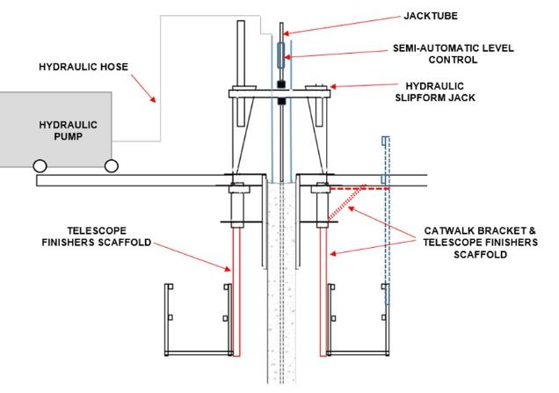
Vertical Slipforms
1926.703(c)(1)-(3)
Form steel rods or pipes on which jacks climb must be:
  Designed for that purpose and adequately braced when not encased in concrete
  Provided with scaffolds or work platform where
  employees required to pass
NCDOL Photo Library
NCDOL Photo Library

Slide 34
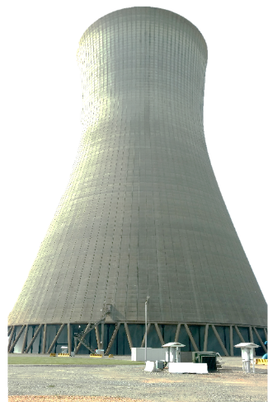
Vertical Slipforms
1926.703(c)(5)
Jacks and lifting devices must be provided with mechanical dogs or other automatic holding devices
NCDOL Photo Library
NCDOL Photo Library

Slide 35
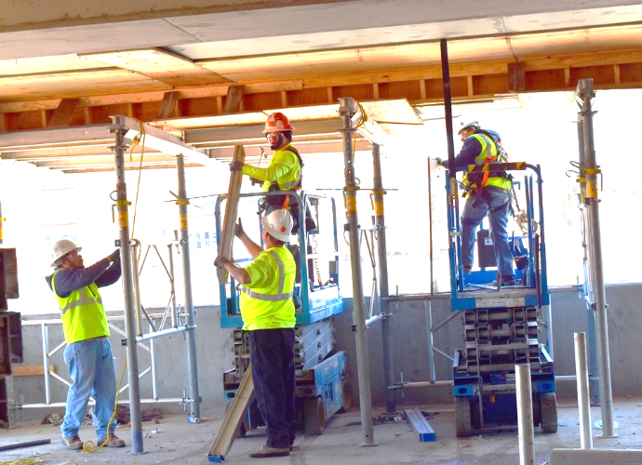
Removal of Formwork
1926.703(e)(1)
Forms and shores must not be removed until employer determines concrete has gained sufficient strength
NCDOL Photo Library

Slide 36
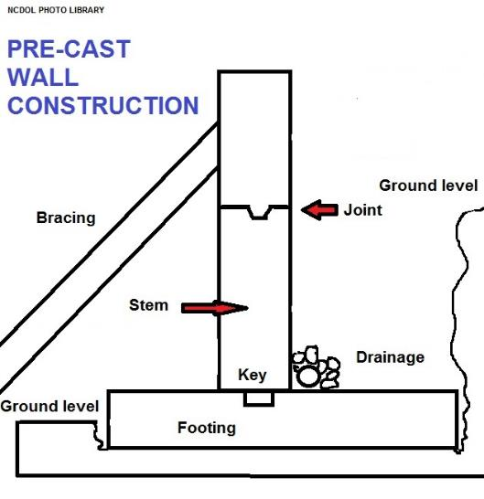
Precast Concrete
1926.704(a)
Wall units, structural framing, and tilt-up wall panels must be adequately supported to prevent overturning

Slide 37
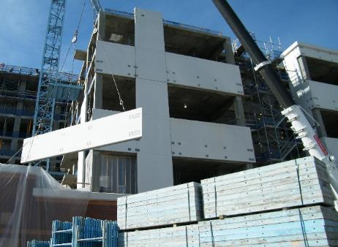
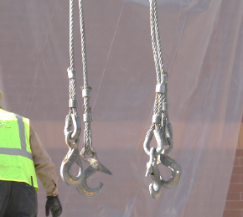
Precast Concrete
1926.704(b) - (c)
Tilt-up precast concrete members
  Lifting inserts embedded or otherwise attached must be capable of supporting at least two times the maximum intended load
Precast concrete members (other than tilt-up members)
  Lifting inserts capable of supporting at
  least four times maximum intended
  load
NCDOL Photo Library
NCDOL Photo Library

Slide 38
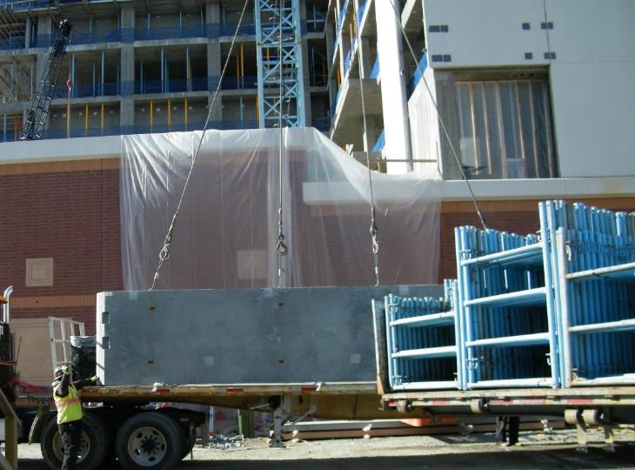
Precast Concrete
1926.704(d)
Lifting hardware must be capable of supporting at least five times maximum intended load
NCDOL Photo Library

Slide 39
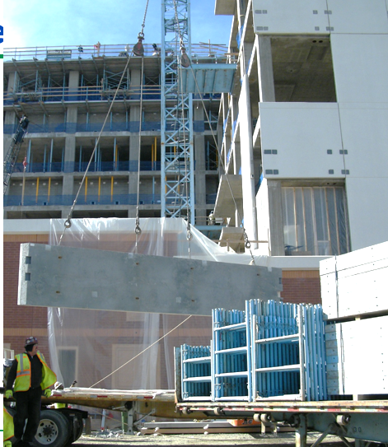
Precast Concrete
1926.704(e)
No employees permitted under precast concrete members being lifted or tilted into position
  Except employees required
  for the erection of those members
NCDOL Photo Library

Slide 40
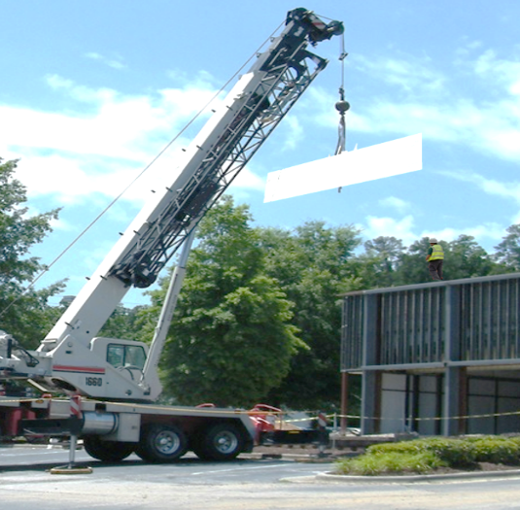
Fall Protection
1926.501(b)(12)
Each employee engaged in the erection of precast concrete members and related operations who is 6 feet or more above lower levels shall be protected from falling
NCDOL Photo Library

Slide 41
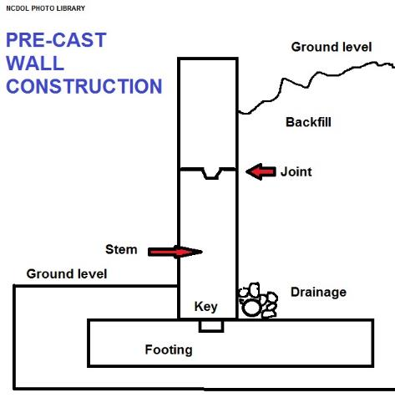
Precast Concrete
Precast walls can be installed quickly
Foundations can be backfilled as soon as the slab is in placed, enhancing jobsite safety

Slide 42
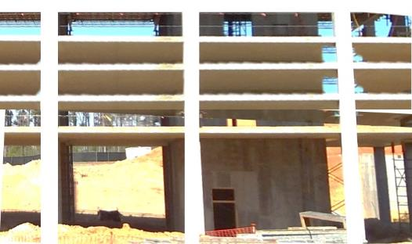
Lift-Slab Operations
1926.705(a)
Designed by a registered professional engineer
Plans and designs implemented by employer must include:
  Detailed instructions
  Sketches indicating method of
  erection
NCDOL Photo Library
Simulating Hydraulic Jacks

Slide 43
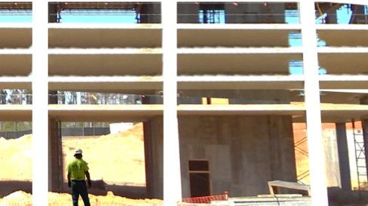
Jack/Lifting Unit
1926.705(b), (c), (g), (i),(k)(1)
Marked to indicate rated capacity
Not loaded beyond capacity
Synchronized lifting to ensure uniform lifting
Manual controls located in central location—attended by competent person (must be experienced)
No employees permitted in the building or structure while any jacking operation is taking place
  Except essential personnel
NCDOL Photo Library

Slide 44
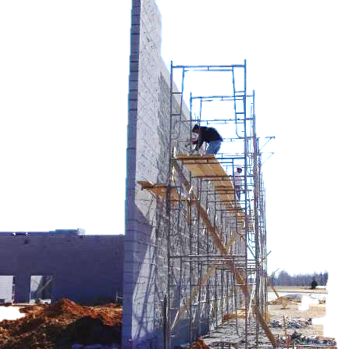
Limited Access Zone
1926.706(a)(1)-(5)
Established prior to the start of construction
Equal to the height of the wall plus four feet
Un-scaffolded side of wall
Restricted to entry by employees constructing the wall
Remain until adequately supported
Limited Access Zone
NCDOL Photo Library

Slide 45
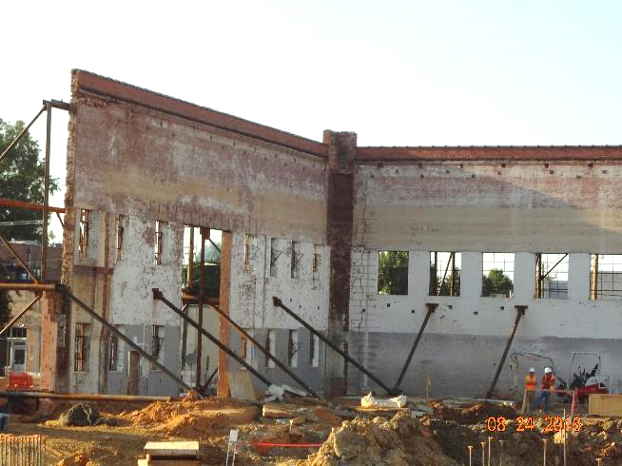
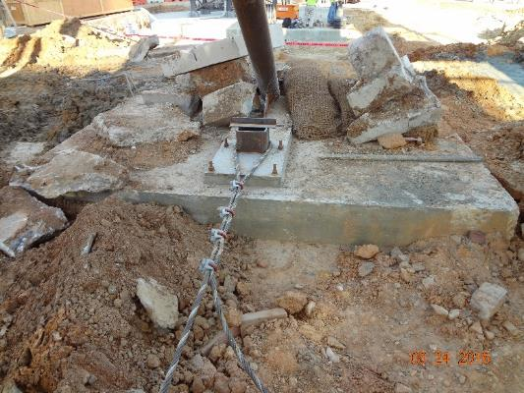
Adequate Bracing
1926.706(b)
Masonry walls over 8 feet in height must be adequately braced
Bracing must remain in place until permanent supporting elements of the structure are in
place
NCDOL Photo Library
NCDOL Photo Library

Slide 46

Adequate Bracing

Slide 47

Summary
We covered the following information:
  OSHA’s minimum requirements for concrete and masonry work in construction
  General requirements for equipment, tools, formwork, shoring, precast concrete, and lift-slab operations
  Hazards associated with
  concrete and masonry
  construction operations
  Abatement methods
NCDOL Photo Library
Notes:
47

Slide 48
Thank You For Attending!
Final Questions?

