Slide 1
Chainsaw Safety
29 CFR 1910.266
Notes:
Revised 06/16/25
The information in this presentation is provided voluntarily by the N.C. Department of Labor, Education Training and Technical Assistance Bureau as a public service and is made available in good faith. This presentation is designed to assist trainers conducting OSHA outreach training for workers. Since workers are the target audience, this presentation emphasizes hazard identification, avoidance, and control – not standards. No attempt has been made to treat the topic exhaustively. It is essential that trainers tailor their presentations to the needs and understanding of their audience.
The information and advice provided on this Site and on Linked Sites is provided solely on the basis that users will be responsible for making their own assessment of the matters discussed herein and are advised to verify all relevant representations, statements, and information.
This presentation is not a substitute for any of the provisions of the Occupational Safety and Health Act of North Carolina or for any standards issued by the N.C. Department of Labor. Mention of trade names, commercial products, or organizations does not imply endorsement by the N.C. Department of Labor.

Slide 2
Objectives
29 CFR 1910.266
At the end of this course, students will:
  Understand relevant definitions
  Know appropriate PPE for chainsaw activities
  Be able to recognize basic chainsaw hazards
  Understand the basics of chainsaw safety
  Understand training requirements

Slide 3
Definitions
1910.266(c)
Backcut (felling cut)
  Final cut in a felling operation.
Bucking
  Sawing felled trees into sections called logs.
Danger tree
  Standing tree that presents a hazard to employees due to deterioration or physical damage to the root system, trunk, stem or limbs, and the direction and lean of the tree.

Slide 4
Definitions
1910.266(c)
Limbing
  To cut branches off felled trees.
Logging operations
  Operations associated with felling and moving trees and logs from the stump to the point of delivery.
Spring pole
  A tree, segment of a tree, limb, or sapling under stress or tension due to pressure or weight of another object.

Slide 5
Definitions
1910.266(c)
Undercut
  A notch cut in a tree to guide the direction of the tree fall and to prevent splitting or kickback.
Yarding
  Movement of logs from the place they are felled to a landing.

Slide 6
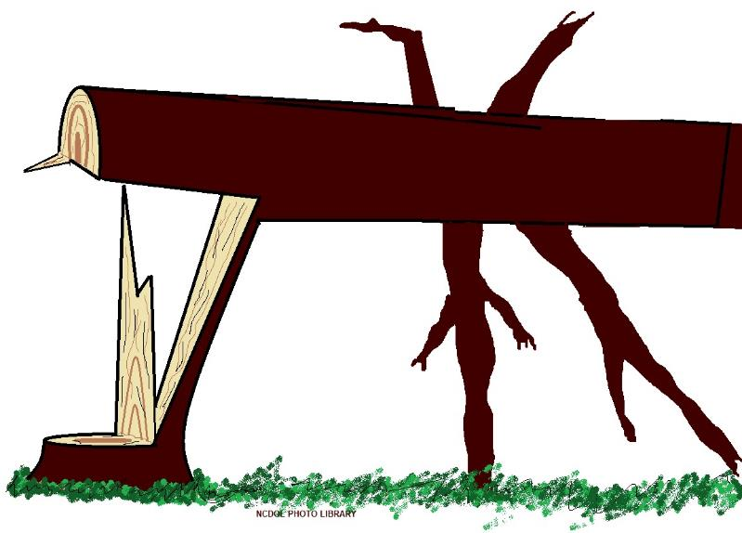
Felling Trees
More people are killed while felling trees than during any other logging activity.
“Barber chair”

Slide 7
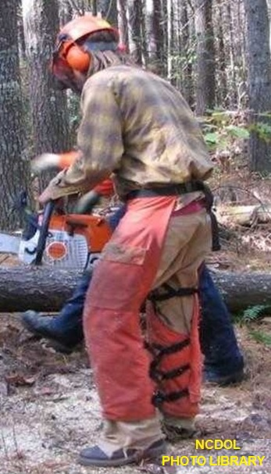
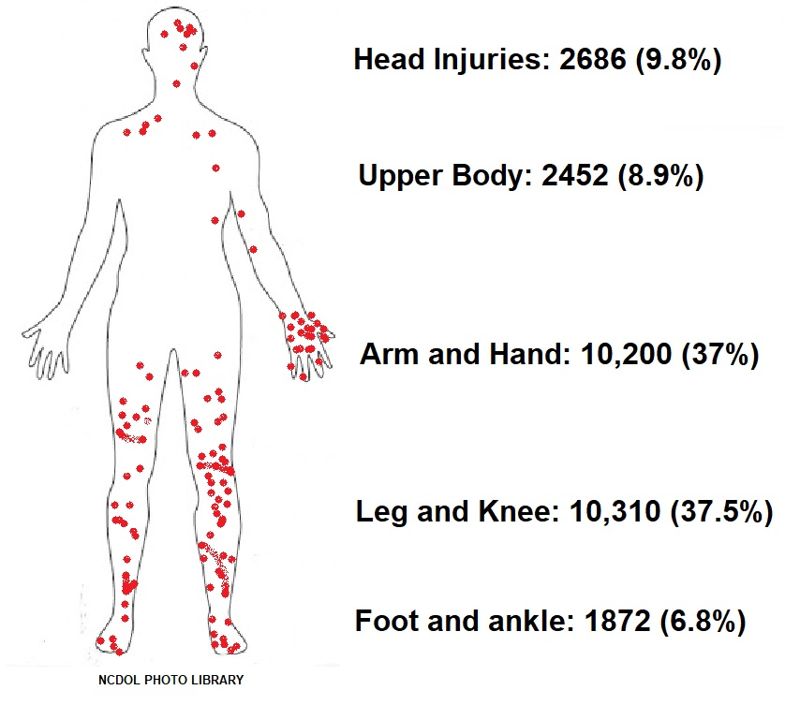
Chainsaw Operator Injuries

Slide 8
Personal Protective Equipment
1910.266(d)(1)
PPE must be inspected prior to use on each workshift to ensure it is in serviceable condition.
PPE must be used when hazards make it necessary.
  Except for foot protection, all PPE must be provided by the employer at no cost to the employee.

Slide 9
Personal Equipment Checklist
Hand protection if handling wire rope
Leg protection
Foot protection
Head protection
Eye and face protection
Hearing protection
First aid kits

Slide 10
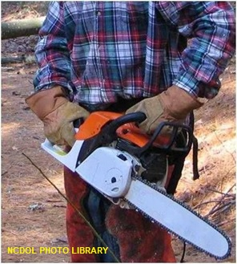
Hand Protection
1910.266(d)(1)(iii)
Employees who handle wire rope are required to wear hand protection that protects against puncture wounds, cuts, and lacerations.

Slide 11
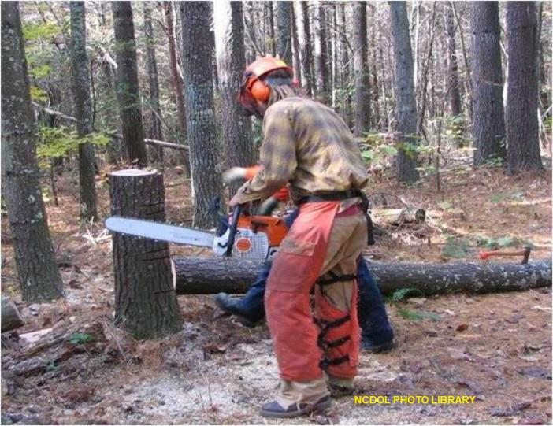
Leg Protection
1910.266(d)(1)(iv)
Each employee who operates a chainsaw must wear leg protection constructed with cut-resistant material.

Slide 12
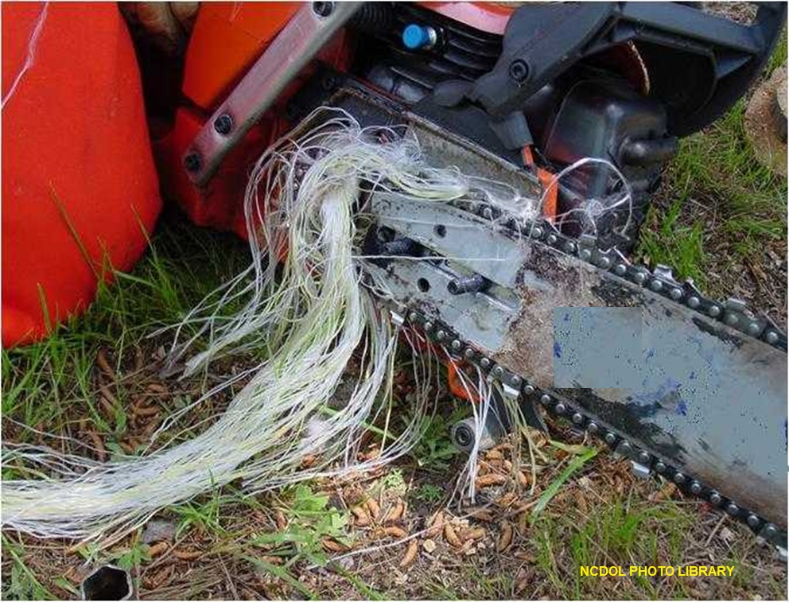
Leg Protection
1910.266(d)(1)(iv)

Slide 13
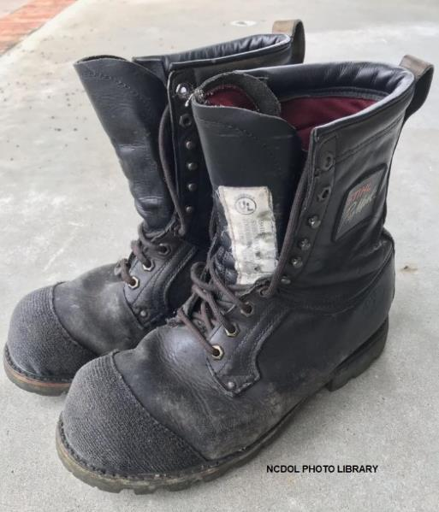
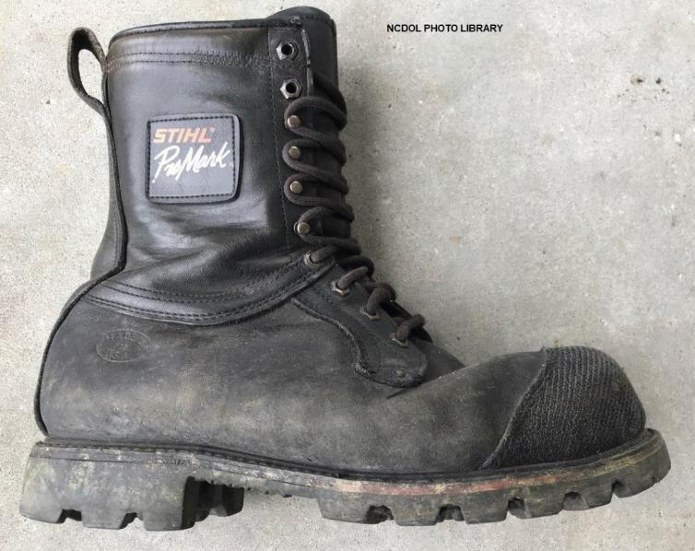
Foot Protection
1910.266(d)(1)(v)
Foot protection that is constructed with cut-resistant material.

Slide 14
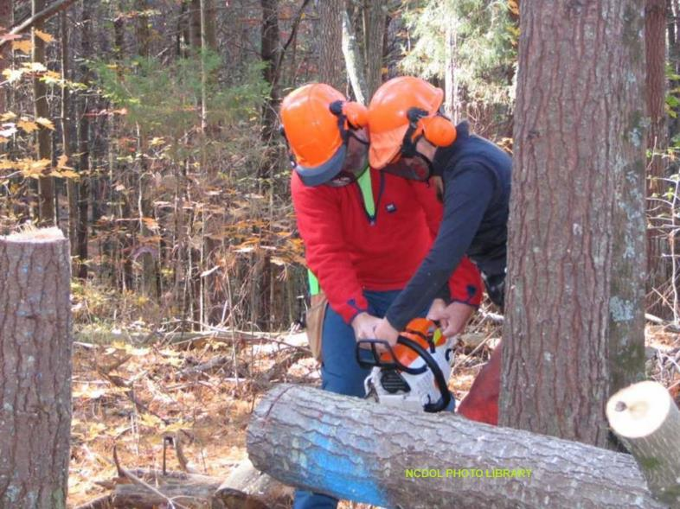
Head Protection
1910.266(d)(1)(vi)
Hard hats must be worn when overhead hazards are present.

Slide 15
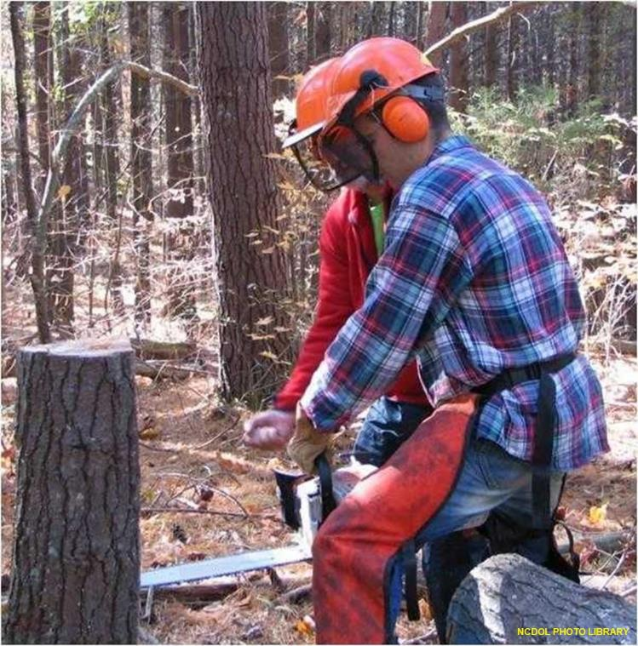
Eye and Face Protection
1910.266(d)(1)(vii)
Eye and face protection must be worn where there is potential for injury to the eyes or face.

Slide 16
Hearing Protection
1910.95
When employees are exposed to sound exceeding levels in Table G-16 (below), feasible administrative or engineering controls shall be utilized.
  If controls fail to reduce sound levels, hearing protections shall be provided.
Duration (hours per day) | dBA
8 | 90
6 | 92
4 | 95
3 | 97
2 | 100
1 ½ | 102
1 | 105
½ | 110
¼ or less | 115

Slide 17
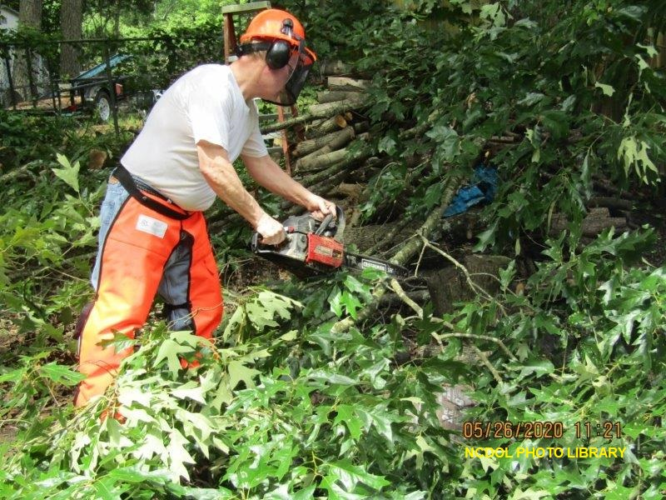
Good, but could it be better?

Slide 18
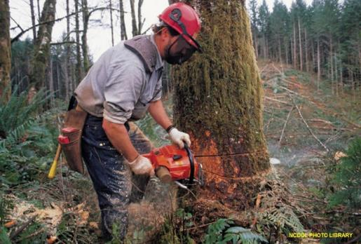
First Aid Kits
1910.266(d)(2)
Provided at each work site where trees are being cut.
Number and contents of each kit shall reflect the degree of isolation, number of employees, and hazards reasonably anticipated at work site.
  Appendix A
  Maintained in serviceable
  condition

Slide 19
Signaling and Signal Equipment
1910.266(d)(7)
Hand signals or audible contact utilized whenever factors prevent clear understanding of voice communications between employees.
Only a designated person gives signals, except in an emergency.

Slide 20
Flammable and Combustible Liquids
1910.266(d)(9)
Flammable and combustible liquids shall be stored, handled, transported, and used in accordance with the requirements of 1910.106.
Flammable and combustible liquids shall not be transported in the driver compartment or in any passenger-occupied area of a machine or vehicle.

Slide 21
Chainsaw Checklist
1910.266(e)(1)-(2)
Chain brake
Throttle interlock
Chain catcher
Chain tension
Muffler
Chainsaw kickback
Chain sharpness, cutter shape, depth usage setting,
lubrication
Handles and guards on tight
No chain movement when engine is idling

Slide 22
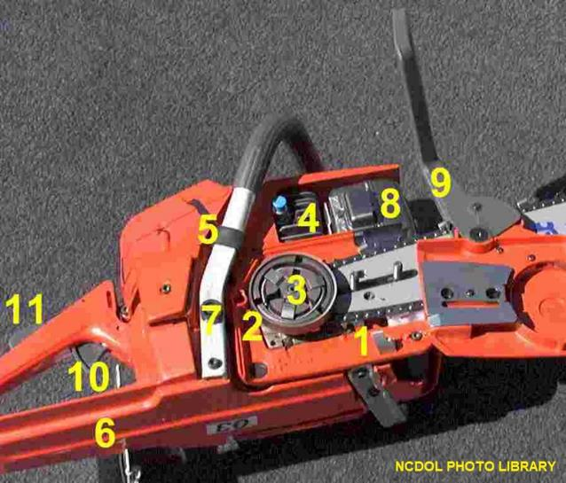
Chainsaw Mechanisms
1910.266(e)(2)
1. Chain catcher – prevents a broken or dislodged chain from striking the logger
2. Flywheel
3. Clutch
4. Decompression valve
5./7. Anti-vibration handle system – recommended by OSHA to limit ergonomic stress to logger’s joints

Slide 23

Chainsaw Mechanisms
1910.266(e)(2)
6. Hand guard
8. Muffler to reduce engine noise
9. Chain brake – stops chain if kickback occurs (if saw was placed into service after 2/9/95)
10. Throttle – will stop chain when
pressure on throttle is released
11. Throttle interlock – prevents
throttle from activating until
interlock is depressed

Slide 24
Before Starting the Saw
1910.266(e)(2)
Chainsaw fueled at least 10 feet from sources of ignition.
Fuel container should meet the following requirements identified in 1910.266(d)(9):
  Must be metal or plastic.
  Must not exceed a 5-gallon capacity.
  Must be approved by the Underwriters Laboratory (UL), Factory Mutual (FM), the Department of Transportation (DOT), or other Nationally Recognized Testing
  Laboratory (NRTL).

Slide 25
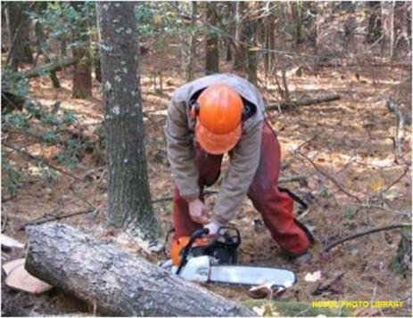
Before Starting the Saw
1910.266(e)(2)
Controls, chain tension, and all bolts and handles checked to ensure they are functioning properly and adjusted according to the manufacturer's instructions.
Chainsaw started at least 10 feet from fueling area, with chain brake engaged, and with chainsaw on the ground or otherwise firmly supported.

Slide 26

While Running the Saw
1910.266(e)(2)
Both hands on the handles
Secure footing maintained
Obstacles cleared that interfere with cutting the tree or retreating
Chainsaw should not be used above shoulder level

Slide 27
While Running the Saw
1910.266(e)(2)
Throttle released, chain brake on prior to retreating
Chainsaw is off or chain brake engaged whenever it’s carried more than two steps or on hazardous terrain

Slide 28
Manual Felling
1910.266(h)(2)
Potential hazards eliminated or minimized
Felling direction determined
Retreat path planned and cleared
Hinge size determined
Proper felling techniques used

Slide 29
Eliminate/Minimize Hazards
1910.266(h)(2)
Primary hazards include unstable logs and hazards associated with using chainsaws.
Prior to limbing, the following is evaluated:
  Overhead hazards
  Butt movement forward
  Butt twist
  Butt off the ground
  “Danger trees”

Slide 30
Limbing and Bucking
1910.266(h)(3)
Limbing and bucking shall be done on the uphill side of each tree or log on any slope where rolling or sliding of trees or logs is reasonably foreseeable.
Loggers should never limb a tree immediately after felling.
Good idea to drop several trees and then refuel the saw prior to limbing.
  Provides time for overhead hazards to come down.

Slide 31

“Danger Trees"
1910.266(h)
Lodged trees
Entangled trees
“Lodged Trees”

Slide 32
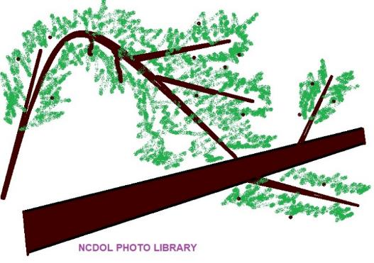
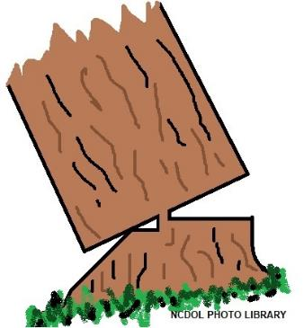
“Danger Trees"
1910.266(h)
Spring poles
Dead trees/limbs
Stalled trees

Slide 33
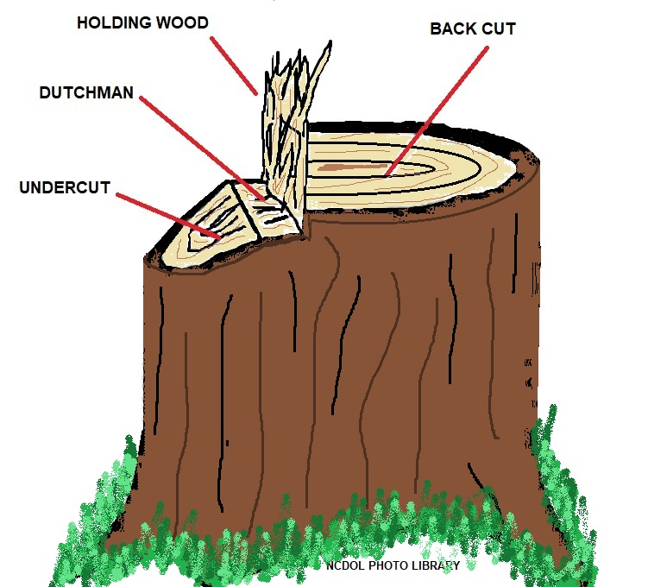
“Dutchman Cut"

Slide 34
Felling Direction
1910.266(h)(2)
Clear fall path
  A clear fall path is an important factor in deciding what direction to fell a tree.
  Fall path should be visualized in all directions and identify those directions that are free of other trees.
  Finding a clear path will eliminate lodged trees, throwback, and damage to the tree being felled as well as the other trees.

Slide 35
Felling Direction
1910.266(h)(2)
Clear landing
  Felling a tree onto stumps, large rocks, or uneven ground should be avoided.
    This will prevent or reduce cracking and other damage to the tree, and limit the potential for rebound of the tree.
Lean of tree
  Generally easier and safer to fell a tree in direction that it is already leaning.
    This makes for a cleaner fall and eliminates the need to use wedges, allowing gravity to do the work.

Slide 36
Felling Direction
1910.266(h)(2)
Ease of removal
  When possible, the butt of felled tree should face the skid road, and tree consistent with felling pattern of other trees.
    Makes for efficient limbing and removal.
Slope of ground
  Fell in direction that will minimize chance the tree will roll/slide.

Slide 37
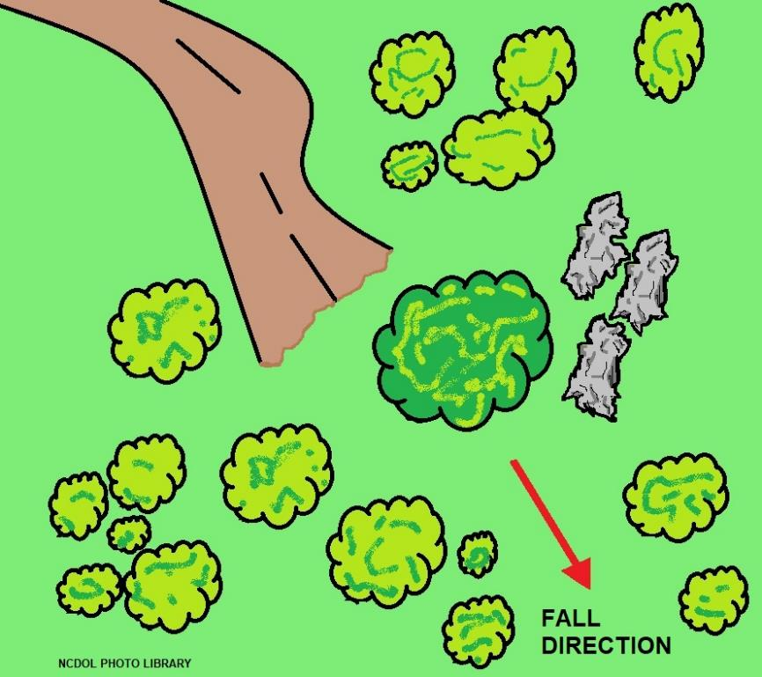
Felling Direction
1910.266(h)(2)

Slide 38
Retreat Path
1910.266(h)(2)(i)
Before felling is started, the feller shall plan and clear a retreat path.
Retreat path shall extend diagonally away from the expected felling line unless the employer demonstrates that such a retreat path poses a greater hazard than an alternate path.
Once the backcut has been made the feller shall immediately move a safe distance away from the tree on the retreat path.

Slide 39
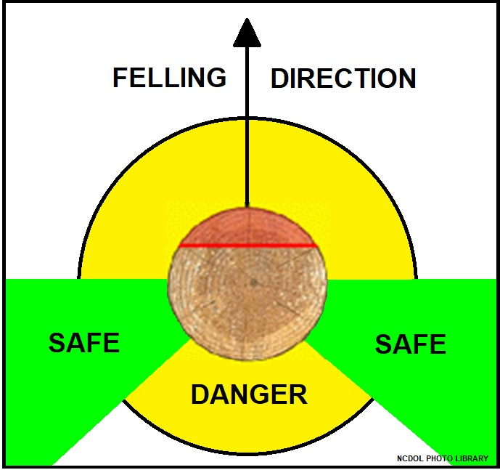
Retreat Path
1910.266(h)(2)(i)

Slide 40
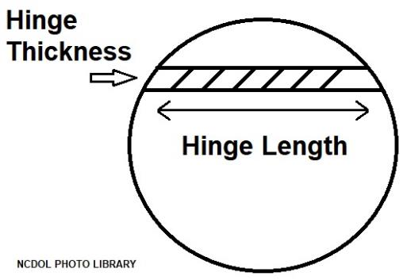
Hinge Size
1910.266(h)(2)(vi)
Hinge length should be 80% of the diameter of the tree at breast height.
Hinge width should be 10% of the diameter of the tree at breast height.
Hinge on a tree with no side lean should be perpendicular to the intended direction of fall.

Slide 41
Felling Techniques
1910.266(h)(2)(v)-(vii)
Backcut
  Shall be made in each tree being felled.
  Shall leave sufficient hinge wood to hold tree to stump during most of its fall so hinge is able to guide the tree's fall in intended direction.
  Shall be above level of horizontal facecut in order to provide an adequate platform to prevent kickback.
    Exception: Backcut may be at or below horizontal facecut in tree pulling operations.
    Requirement does not apply to open face felling where two angled facecuts rather than a horizontal facecut are used.

Slide 42
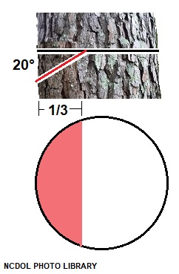
Felling Techniques
1910.266(h)(2)(v)-(vii)
Undercut
  Shall be made in each tree being felled unless the employer demonstrates that felling the tree without an undercut will not create a hazard for an employee.
  Shall be of a size so the tree will not split and will fall in the intended direction.

Slide 43
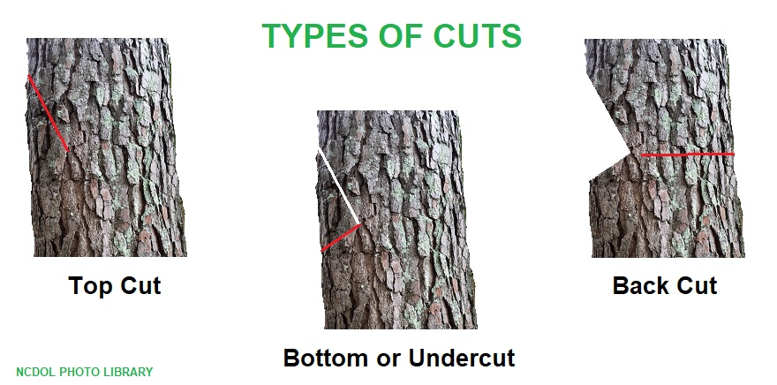
Type of Cuts

Slide 44
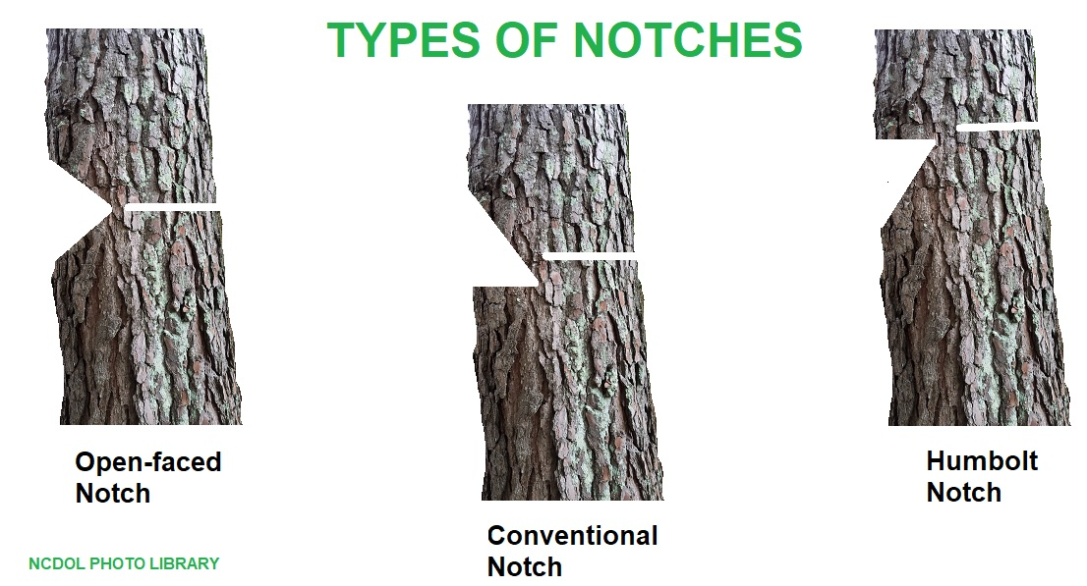
Types of Notches

Slide 45
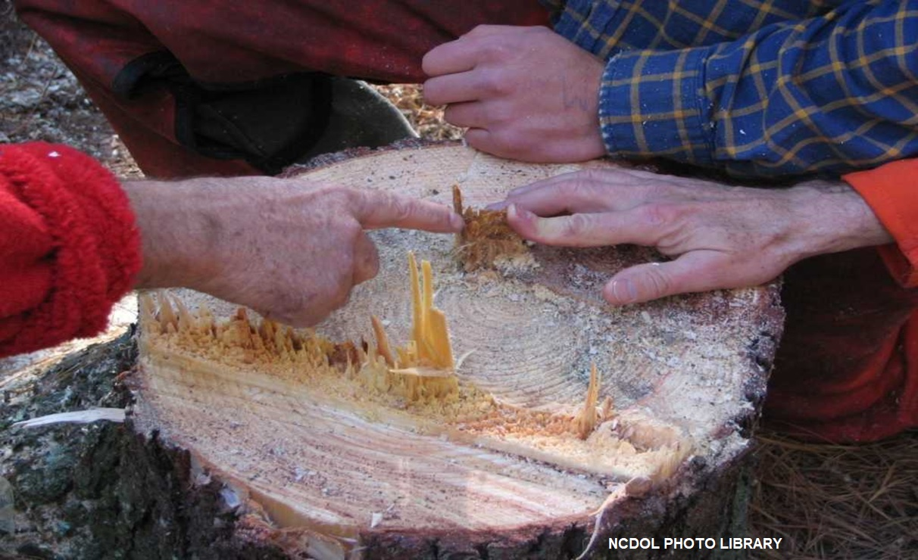
Does this cut look correct?

Slide 46
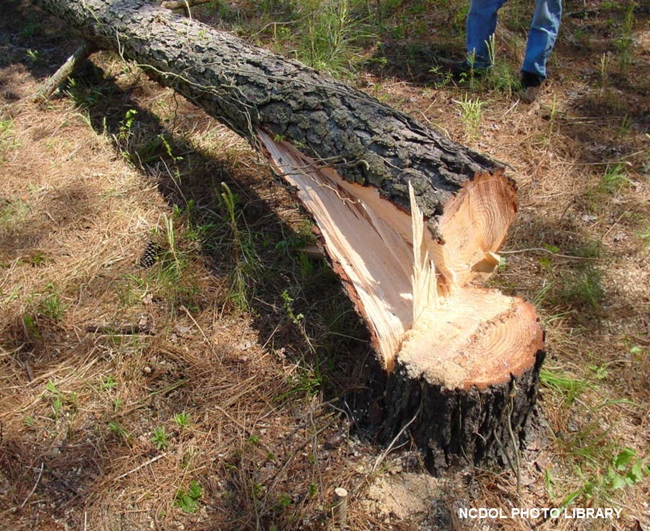
Does this cut look correct?

Slide 47
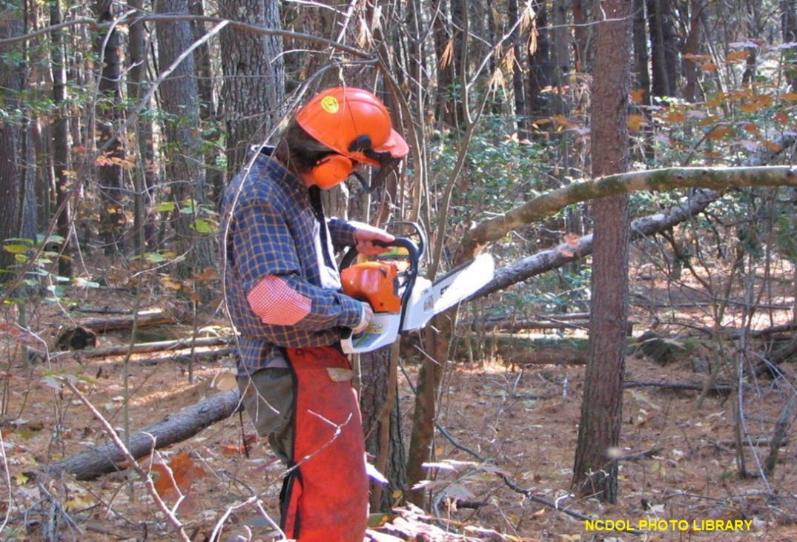
Is he cutting correctly?

Slide 48
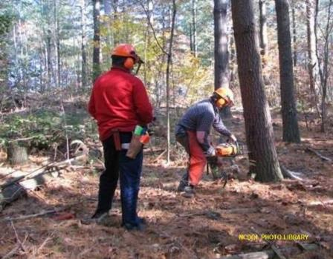
Training
1910.266(i)(2)
Frequency
  Prior to initial assignment
  Whenever assigned new tasks, tools, equipment, machines, or vehicles
  Employee demonstrates unsafe job performance

Slide 49

Training
1910.266(i)(3)
Content
  Safe performance of assigned work tasks
  Recognition of safety and health hazards
  Procedures, practices and requirements of the employer's work site
  Requirements of this standard

Slide 50
Training
1910.266(i)(5) – (6)
Employer must ensure that each employee can properly and safely perform the work tasks and operate tools, equipment, machines, and vehicles used in their job.
Each employee shall work under the close supervision of a designated person until employee demonstrates the ability to safely perform their new duties independently.

Slide 51
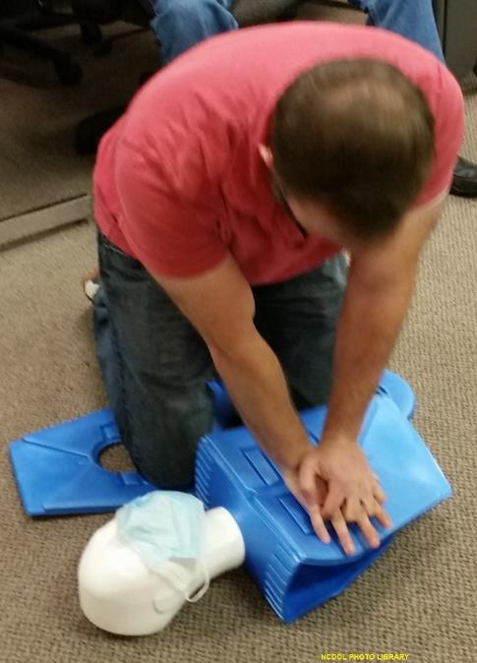
Training
1910.266(i)(7)
First aid training
  Employer shall assure each employee, including supervisors, receives or has received first aid and CPR training.
  Employer shall assure each employee's first aid and CPR training and/or certificate of training remain current.

Slide 52
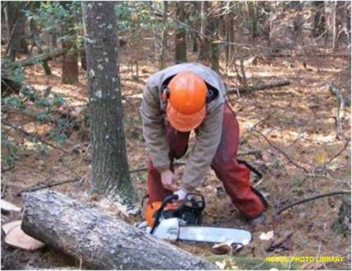
Training
1910.266(i)(8)-(10)
Training conducted by a designated person.
Training presented in a manner that employee is able to understand.
Written certification record

Slide 53
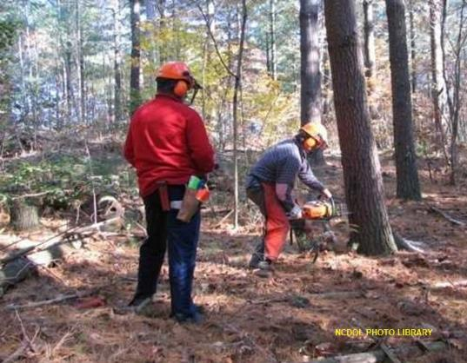
Summary
In this course, we discussed:
  Definitions
  Personal protective equipment
  Hazards
  Chainsaw safety
  Training

Slide 54
Thank You For Attending!
Final Questions?

