Slide 1
Occupational Exposure to Bloodborne Pathogens
29 CFR 1910.1030
Presented by:
Notes:
Revised 06/2025
The information in this presentation is provided voluntarily by the N.C. Department of Labor, Education Training and Technical Assistance Bureau as a public service and is made available in good faith. This presentation is designed to assist trainers conducting OSHA outreach training for workers. Since workers are the target audience, this presentation emphasizes hazard identification, avoidance, and control – not standards. No attempt has been made to treat the topic exhaustively. It is essential that trainers tailor their presentations to the needs and understanding of their audience.
The information and advice provided on this Site and on Linked Sites is provided solely on the basis that users will be responsible for making their own assessment of the matters discussed herein and are advised to verify all relevant representations, statements, and information.
This presentation is not a substitute for any of the provisions of the Occupational Safety and Health Act of North Carolina or for any standards issued by the N.C. Department of Labor. Mention of trade names, commercial products, or organizations does not imply endorsement by the N.C. Department of Labor.

Slide 2

Objectives
1910.1030
At the end of this course, students will be able to:
  Understand the basics of the Bloodborne Pathogens Standard
  Understand OSHA’s requirements regarding bloodborne pathogens, including needlestick safety provisions
Mancomm ©

Slide 3
Scope and Application
1910.1030(a)
Bloodborne Pathogens Standard applies to all employees with occupational exposure to blood and other potentially infectious materials
Occupational Exposure

Slide 4
Scope
1910.1030(a)
The standard covers many types of occupations including those in:
  Healthcare facilities
  Non-healthcare facilities
  Permanent and temporary worksites

Slide 5
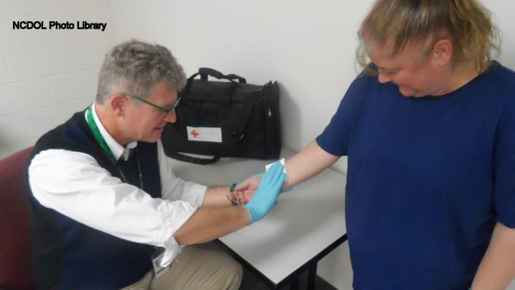
Temporary Operations
Trauma or rescue scene
Mobile blood banks
Crime scenes
Collateral duties

Slide 6
Multi-Employer Worksites
Employment agencies
Personnel services
Home health services
Independent contractors
Independent practices

Slide 7
Employees Potentially At Risk
Physicians and surgeons
Nurses
Phlebotomists
Medical examiners
Dentists and dental workers
Some laundry and housekeeping employees
Clinical/diagnostic laboratory workers
Medical technologists
Nursing home personnel
Dialysis personnel
Other jobs with potential exposure

Slide 8
North Carolina Specific Rule
13 NCAC 07F .0207 - Toxic and Hazardous Substances
  "Occupational Exposure means reasonably anticipated skin, eye, mucous membrane, or parenteral contact with blood or other potentially infectious materials that may result from the performance of collateral first aid duties by an employee in the areas of construction, alteration, or repair, including painting and decorating“.

Slide 9
Amputations Special Emphasis Program
Goal to reduce occupational exposures to amputations
Struck by and caught between injuries
  Lockout/tagout
  Machine guarding
Increase outreach to employers and employees
  Training events (Internal and external)
  Compliance inspections
  Consultation visits
  Publications
Amputations must be reported within 24 hours

Slide 10
Standard Specific Definitions
1910.1030(b)
Blood
Bloodborne pathogens
Other potentially infectious materials (OPIM)
Contaminated
Occupational exposure
Exposure incident
Regulated waste
Sharps with engineered sharps injury protections (SESIP)
Needleless system

Slide 11

Blood
1910.1030(b)
Human blood
Human blood components
Products made from human blood

Slide 12
Bloodborne Pathogens
1910.1030(b)
Pathogenic organisms that are present in human blood, and
  Can cause disease in humans.
Includes but not limited to:
  Hepatitis B virus (HBV)
  Hepatitis C virus (HCV)
  Human immunodeficiency virus (HIV)

Slide 13
Hepatitis
1910.1030(b)
Inflammation of the liver, which may be caused by a viral infection, poisons, or the use of alcohol or other drugs
Types of viral hepatitis
  Hepatitis A, B, C, D, E, G
Outcomes range from acute flu-like illness to jaundice, extreme fatigue and nausea to advanced hospitalization to death
Types of viral bloodborne hepatitis
  Hepatitis B, C, D, G

Slide 14
Human Immunodeficiency Virus
1910.1030(b)
HIV causes Acquired Immune Deficiency Syndrome (AIDS).
AIDS is a serious condition that affects the body's immune system; the body's natural ability to fight infection.

Slide 15
Other Bloodborne Pathogens
Malaria
Syphilis
Babesiosis
Brucellosis
Leptospirosis
Arboviral infections
Relapsing fever
Creutzfeld-Jakob Disease
Human T-Lymphotrophic Virus Type 1 and 2
Viral hemorrhagic fevers (VHF)

Slide 16
OPIM
1910.1030(b)
Other Potentially Infectious Materials
Semen
Vaginal secretions
Cerebrospinal fluid
Synovial fluid
Pleural fluid
Pericardial fluid
Peritoneal fluid
Amniotic fluid
Saliva in dental procedures
Any body fluid visibly contaminated with blood.
All body fluids in situations where it is difficult or impossible to differentiate between body fluids.

Slide 17
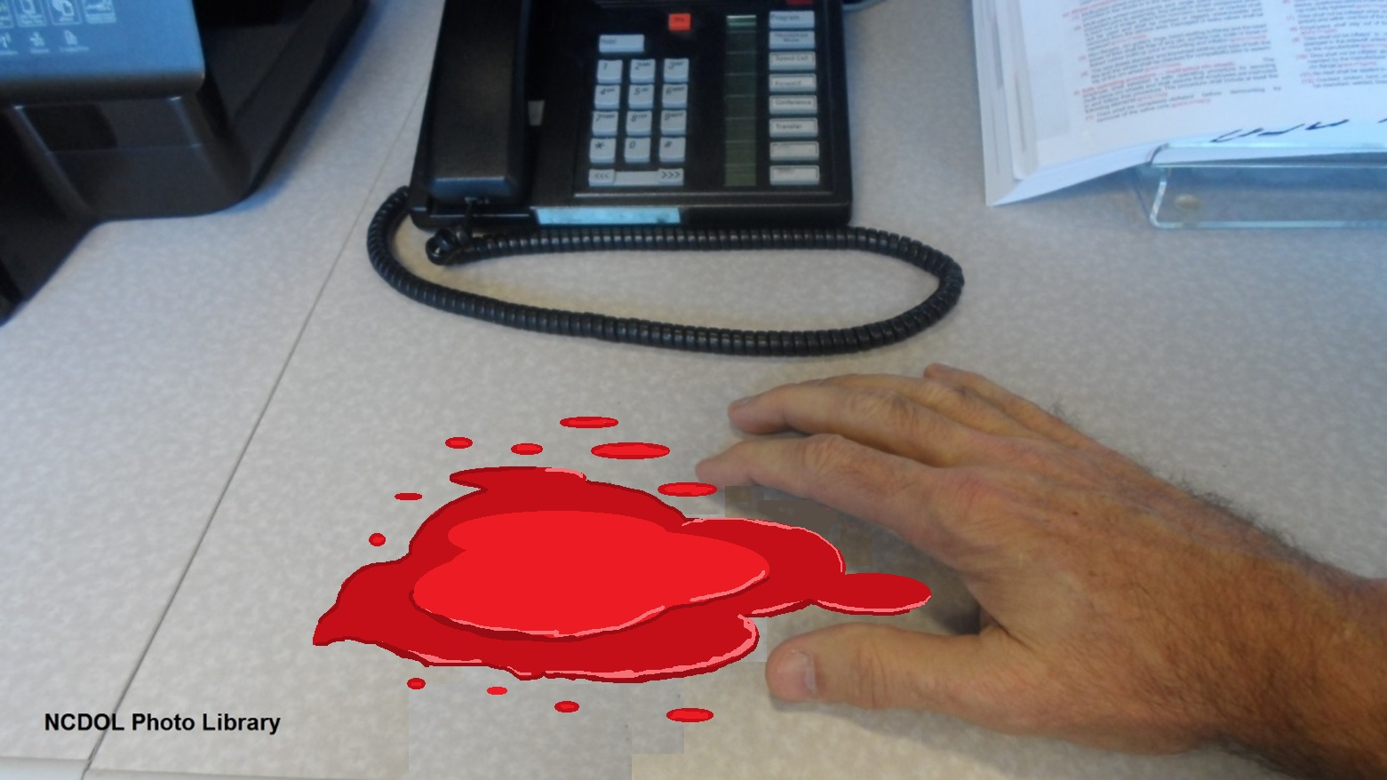
Contaminated
1910.1030(b)
Presence or the reasonably anticipated presence of blood or other potentially infectious material on an item or surface.

Slide 18
Occupational Exposure
1910.1030(b)
Reasonably anticipated contact with blood or OPIM.
  May result from the performance of an employee’s duties.
  Occurs by non-intact skin, eye, mucous membrane, or parenteral contact.

Slide 19
Exposure Incident
1910.1030(b)
A specific contact with:
  Blood or OPIM
  Results from the performance of an employee’s duties
  Contact with:
    Eye, mouth, or other mucous membrane
    Non-intact skin
    Parenteral contact

Slide 20
Regulated Waste
1910.1030(b)
Items contaminated with blood or OPIM which would release these substances in a liquid or semi-liquid state if compressed
Pathological and microbiological wastes containing blood or OPIM
Contaminated sharps
Items caked with dried blood or OPIM and capable of releasing these materials during handling
Liquid or semi-liquid blood or OPIM

Slide 21
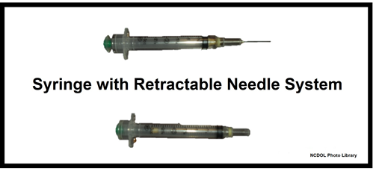
SESIP
1910.1030(b)
  Sharps with Engineered Sharps Injury Protections
    Non-needle sharp or a needle with a built-in safety feature or mechanism that effectively reduces the risk of an exposure incident.

Slide 22
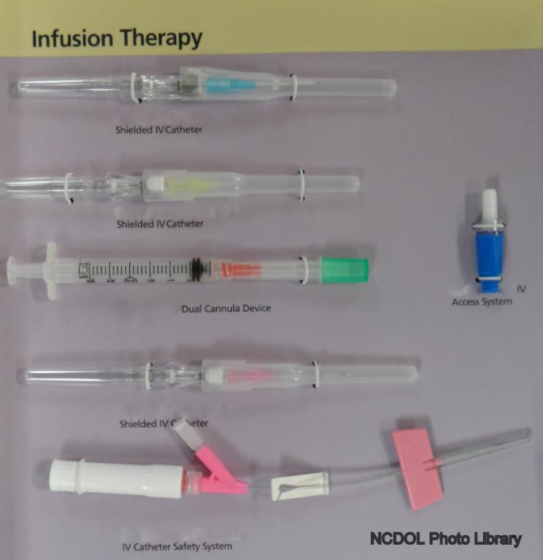
Infusion Therapy Examples

Slide 23
Hypodermic Syringes
“Retractable Technology” safety feature

Slide 24
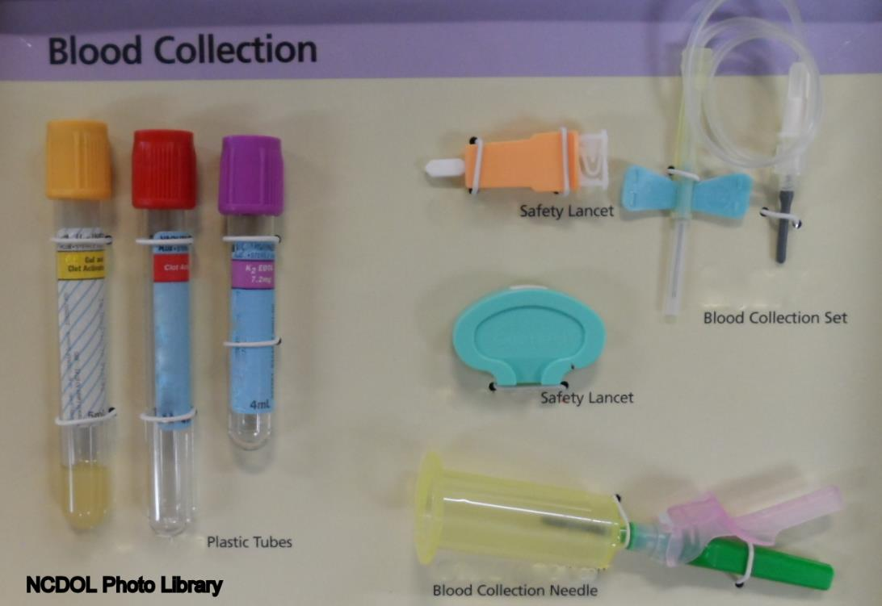
Phlebotomy

Slide 25
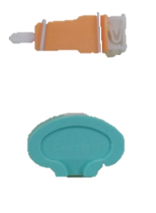
Lancets
Safety Lancets
NCDOL Photo Library

Slide 26
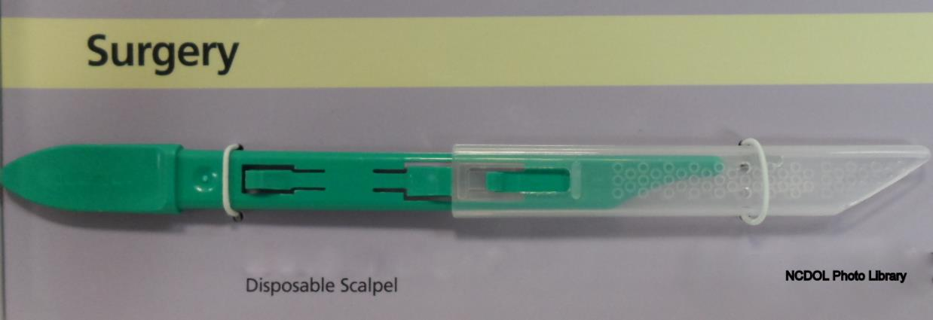
Disposable Scalpels
Safety features
Notes:
NCDOL Photo Library: Surgical scalpel photo staged by NCDOL Tom Wilder 05-25-16

Slide 27
Needleless Systems
1910.1030(b)
Most direct method of preventing needle-stick injuries.
Device that does not use a needle for:
  Collection of bodily fluids
  Administration of medication/fluids
  Any other procedure with potential percutaneous exposure to a contaminated sharp

Slide 28
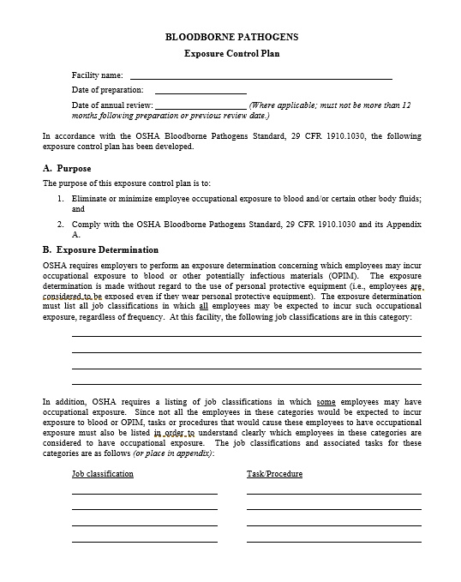
Exposure Control Plan (ECP)
1910.1030(c)
NCDOL Photo Library

Slide 29
Exposure Control Plan
1910.1030(c)(1)(ii)
Written plan designed to eliminate or minimize employee exposure that contains:
  Exposure determination
  Schedule and method of implementing paragraphs
  (d) through (h) of the standard
  Procedures for evaluating circumstances surrounding an exposure incident

Slide 30
Exposure Control Plan
1910.1030(c)(1)(iii)-(vi)
Must be accessible to employees.
Reviewed and updated annually or more often if changes occur.
Available to OSHA and NIOSH representatives.

Slide 31
Exposure Control Plan
1910.1030(c)(1)(iii)-(vi)
ECP must also be updated to include:
  Changes in technology that reduce/eliminate exposure
  Annual documentation of consideration and implementation of safer medical devices
Solicitation of non-managerial employees

Slide 32
Exposure Determination
1910.1030(c)(2)
Employer required to identify job classifications where occupational exposure can occur:
  Job classification in which ALL have occupational exposure.
  Job classification in which SOME have occupational exposure.
  List of all tasks and procedures in which occupational exposure occurs.
Must be made without regard to the use of personal protective equipment (PPE).

Slide 33
Methods of Compliance
1910.1030(d)
General - universal precautions
Engineering and work practice controls
Personal protective equipment
Housekeeping

Slide 34
Universal Precautions
1910.1030(d)(1)
An approach to infection control
Originated by the Centers for Disease Control and Prevention (CDC)
Concept:
  All human blood and certain human body fluids are to be treated as if known to be infectious for HIV, HBV, or other bloodborne pathogens

Slide 35
Engineering & Work Practice Controls
1910.1030(d)(2)
Selection is dependent on the employer’s exposure determination.
Employer must:
  Identify worker exposures to blood and OPIM.
  Review all processes and procedures with exposure potential.
  Re-evaluate when new processes or procedures are being used.

Slide 36
Engineering & Work Practice Controls
1910.1030(d)(2)
Employer must:
  Evaluate available engineering controls (safer medical devices).
  Train employees on safe use and disposal.
  Implement use of appropriate engineering controls/devices.

Slide 37
Engineering & Work Practice Controls
1910.1030(d)(2)
Employer must:
  Document evaluation and implementation in ECP.
  Review and update ECP annually.
  Review devices and new technologies on an annual basis.
  Implement new device use, as appropriate and available.
  Update employee training for new devices and/or procedures and document in ECP.

Slide 38
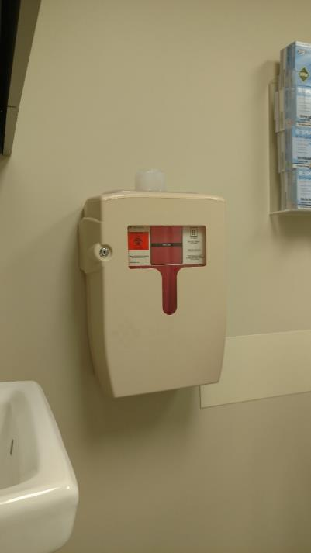
Examples of Engineering Controls
1910.1030(d)(2)
Needleless systems such as IV connectors
Sharps with sharps injury protection
Puncture-resistant sharps containers
Mechanical needle recapping devices
Biosafety cabinets
Mechanical pipetting devices
NCDOL Photo Library
Notes:
38

Slide 39
Work Practice Controls
1910.1030(d)(2)
Altering behaviors
Function
  Protection is based on employer and employee behavior.
  Protection not dependent on installation of a physical device such as protective shield.

Slide 40
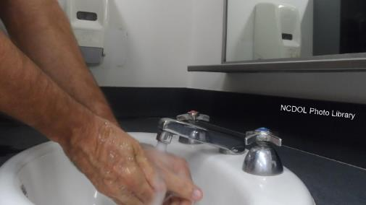
Work Practice Controls
1910.1030(d)(2)
Washing hands
  Employers shall provide readily accessible hand-washing facilities.
  When not feasible, appropriate antiseptic hand cleansers shall be provided.
  When gloves are removed.
  ASAP after contact with body fluids.
Notes:
40

Slide 41
Work Practice Controls
1910.1030(d)(2)(vii)
Do Not Bend or Break
Contaminated Needles

Slide 42
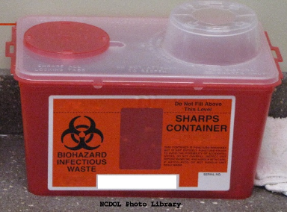
Work Practice Controls
1910.1030(d)(2)
Place contaminated reusable sharps in appropriate container until processing.
Containers must be:
  Puncture-resistant
  Labeled or color-coded
  Leak proof on sides and bottom
  Stored or processed in a safe manner
Prohibiting mouth pipetting or suctioning of blood or OPIM.

Slide 43
Work Practice Controls
1910.1030(d)(2)
Using mechanical devices or one-handed techniques to recap or remove contaminated needles when necessary.
Prohibiting eating, drinking, smoking, etc.
Food and drink must not be kept in the same storage as potentially infectious material.
Performing all procedures involving blood or OPIM so as to minimize splashing, spattering, and droplet generation.

Slide 44
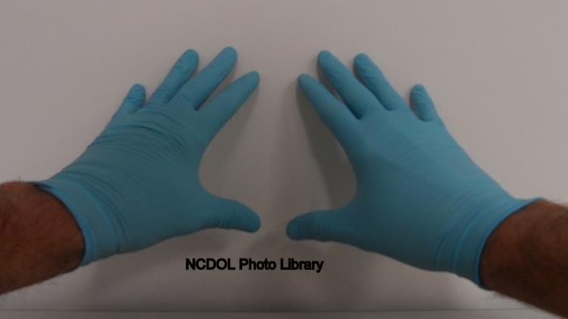
Personal Protective Equipment
1910.1030(d)(3)
Specialized clothing or equipment that is worn by an employee for protection against a hazard.
  General work clothes (uniforms, pants, shirts and blouses) not intended to function as protection against a hazard are not considered personal protective equipment (PPE).

Slide 45
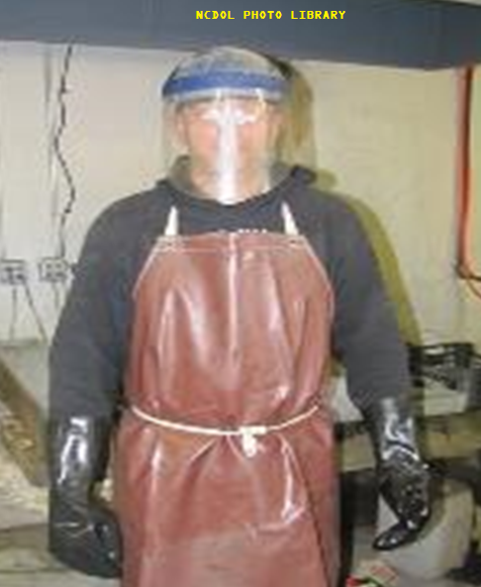
Types of PPE
1910.1030(d)(3)
Gloves
Gowns
Face shields
Eye protection
Mouthpieces and resuscitation devices

Slide 46
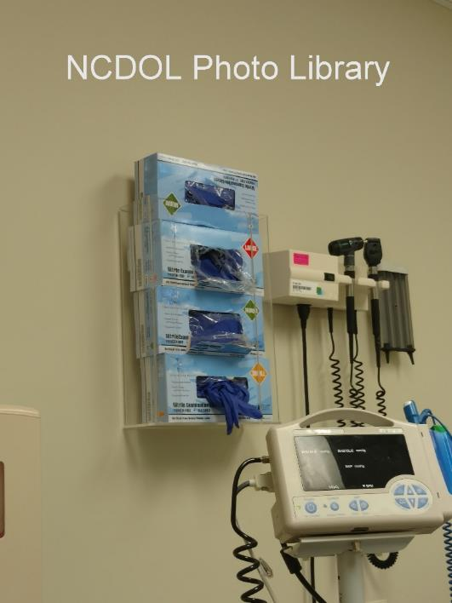
PPE Provisions
1910.1030(d)(3)
Employer must provide appropriate PPE at no cost to the employee.
Employer must ensure that PPE is worn by employees.
Must be accessible and in appropriate sizes for employees at the worksite.

Slide 47
PPE Provisions
1910.1030(d)(3)
PPE must be cleaned, repaired, replaced, and disposed of by employer.
PPE must be removed before leaving work area and when becomes contaminated.
  Cannot wash PPE at home!

Slide 48
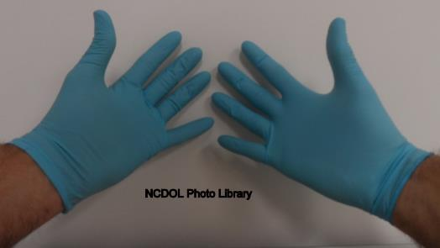
PPE - Gloves
1910.1030(d)(3)(ix)
Gloves shall be worn when:
  Potential contact with blood and OPIM, mucous membrane and non-intact skin
  Performing vascular access procedures
  Handling or touching contaminated surfaces

Slide 49
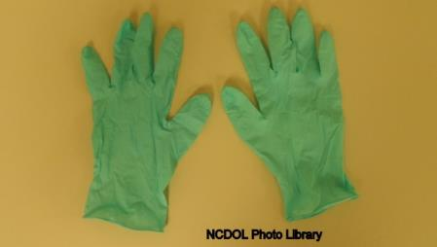
PPE - Gloves
1910.1030(d)(3)(ix)
Disposable (single use) gloves must be replaced when contaminated, torn or punctured.
Disposable (single use) gloves shall not be washed or decontaminated for reuse.
Utility gloves may be cleaned and re-used as long as they continue to provide a barrier for employee.
Notes:
49

Slide 50
Housekeeping - General
1910.1030(d)(4)(i)
Employer shall develop and implement a written schedule for cleaning and decontamination at the worksite.
Schedule is based on the:
  Location within the facility
  Type of surface to be cleaned
  Type of soil present
  Tasks or procedures being performed

Slide 51
Housekeeping Requirements
1910.1030(d)(4)(ii)[A]
Contaminated work surfaces shall be decontaminated:
  After completion of procedures,
  After contact with blood or OPIM, and
  At end of work shift.

Slide 52
Housekeeping Requirements
1910.1030(d)(4)(ii)
All reusable receptacles such as bins, pails, and cans that are likely to be contaminated must be inspected and decontaminated:
  On a regular basis, or
  When visibly contaminated.
Reusable items such as sharps shall be stored or processed in a safe manner.

Slide 53
Appropriate Disinfectants
Household bleach (5% NaOCl₂)
  1:10 - 1:100 in H2O
EPA registered disinfectants
  List A: EPA’s registered antimicrobial products as sterilizers
  List B: EPA registered tuberculocide products effective against Mycobacterium tuberculosis
  List C: EPA’s registered antimicrobial products effective against human HIV-1 Virus
  List D: EPA’s registered antimicrobial products effective against human HIV-1 and Hepatitis B virus
  List E: EPA’s registered antimicrobial products effective against Mycobacterium tuberculosis, human HIV-1 and Hepatitis B virus
  List F: EPA’s registered antimicrobial products against Hepatitis C virus
  List J: EPA’s registered antimicrobial products for medical waste treatment

Slide 54
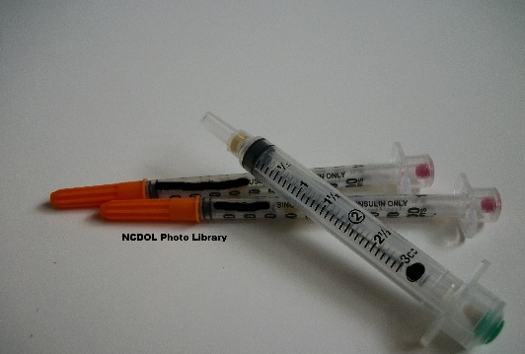
Regulated Waste
1910.1030(d)(4)(iii)(A)
Contaminated sharps disposal
  Must be discarded in containers that are:
    Closable
    Puncture-resistant
    Leak proof (on sides and bottom)
    Labeled or color-coded
  During use, the sharps container must be:
    Placed near the work area
    Maintained upright during use
    Routinely replaced

Slide 55
Regulated Waste
1910.1030(d)(4)(iii)(A)
  When moving, the sharps container must be:
    Closed immediately
    Placed in a secondary container if leaking
  Reusable sharps containers shall not be opened, emptied, or cleaned manually or in any manner which presents a risk of percutaneous injury to employees.
Notes:
55

Slide 56

Regulated Waste
1910.1030(d)(4)(iii)
Other regulated waste containment
  Must be put into containers that are:
    Closable
    Leak proof
    Labeled or color-coded
    Closed prior to removal
  If outside contamination occurs, it shall
  be placed in a secondary container that
  meets the criteria above.
Notes:
56

Slide 57
Contaminated Laundry
1910.1030(d)(4)(iv)
Contaminated laundry must be handled as little as possible with a minimum of agitation.
  Bagged or containerized at its location of use
    It cannot be sorted or rinsed there.
  Placed and transported in bags or containers that are labeled or color-coded.
  Placed in a container that will prevent soak-through to the exterior.

Slide 58
HIV and HBV Research Laboratories and Production Facilities
1910.1030(e)
Paragraph (e) applies to research laboratories and production facilities engaged in the culture, production, concentration, experimentation, and manipulation of HIV and HBV.
  Does not apply to clinical or diagnostic laboratories.
  Requirements apply in addition to other requirements in the standard.

Slide 59
HIV and HBV Research Laboratories and Production Facilities
1910.1030(e)
HIV and HBV production facilities shall meet specific criteria as outlined in paragraph (e).
HIV and HBV research laboratories and production facilities have additional training requirements for their employees.
Notes:
59

Slide 60
Hepatitis B Vaccination
1910.1030(f)
Hepatitis B vaccination and post-exposure evaluation and follow-up including prophylaxis shall be:
  Available to employees at a reasonable time and place and without cost.
  Performed by or under the supervision of a licensed physician or healthcare professional.
  Provided according to current recommendations of the U.S. Public Health Service.

Slide 61
No Cost to the Employee
1910.1030(f)
No out-of-pocket expense.
Employer may not require employee to use his/her health care insurance to pay for series unless:
  Employer pays all of the cost of health insurance, and
  No cost to employee in form of deductibles, co-payments, or other expenses.

Slide 62
Hepatitis B Vaccination
1910.1030(f)(2)(i)
Hepatitis B vaccination shall be made available:
  After employee has received required training, and
  Within 10 days of initial assignment to all employees with occupational exposure.
Exceptions
  If the employee has previously completed the Hepatitis B vaccination series, or
  Immunity is confirmed through antibody testing, or
  Vaccine is contraindicated for medical reasons.

Slide 63
Hepatitis B Vaccination
1910.1030(f)(2)
Participation in prescreening not prerequisite for receiving Hepatitis B vaccination.
Hepatitis B vaccination provided even if employee declines but later accepts treatment.
Employee must sign statement when declining Hepatitis B vaccination.
Hepatitis B vaccination booster doses must be available to employees if recommended by the U.S. Public Health Service.

Slide 64
Post-Exposure and Follow-Up
1910.1030(f)(3)
Documentation of exposure routes and how exposure incident occurred
Identification and documentation of source individual’s infectivity, if possible
Collection and testing of employee’s blood for HBV and HIV serological status (employee’s consent required)
Post exposure prophylaxis when medically indicated
Counseling
Evaluation of reported illnesses
Notes:
Post-Exposure and Follow-Up Requirements
The employee’s consent is required for the collection and testing of employee’s blood for HBV and HIV serological status.
Rules administered by the NC Dept. Health & Human Services permit the collection and testing of source individual’s blood for HIV [10A NCAC 41A.0202(4)] and HBV [10A NCAC 41A.0203(b)(4)] serological status without their consent in case of occupational exposure.

Slide 65
Source Individual
1910.1030(f)(3)(ii)[C]
Source individual’s test results shall be made available to the exposed employee (not the employer).
Employee should also be given information about applicable disclosure laws and regulations concerning source individual’s identity and infection status.

Slide 66
Exposed Employee
1910.1030(f)(3)(iii)
Exposed employee’s blood shall be collected as soon as feasible after consent is obtained.
If employee consents to baseline blood collection, but not to HIV serological testing, sample shall be preserved for 90 days.

Slide 67
Information Provided to Healthcare Professionals
1910.1030(f)(4)
A copy of the Bloodborne Pathogens Standard.
A description of the employee’s duties relevant to the exposure incident.
Documentation of the route of exposure and the circumstances under which the exposure incident occurred.
Results of the source individual’s blood test, if available.
All appropriate medical records relevant to the employee.

Slide 68
Healthcare Professional’s Written Opinion
1910.1030(f)(5)
Within 15 days after evaluation is completed.
Written opinion for Hepatitis B vaccination is limited to whether the employee requires or has received the Hepatitis B vaccination.
Written opinion for post-exposure evaluation and follow-up includes information that the employee has been:
  Informed of the evaluation results, and
  Informed of any medical conditions that require further treatment.

Slide 69
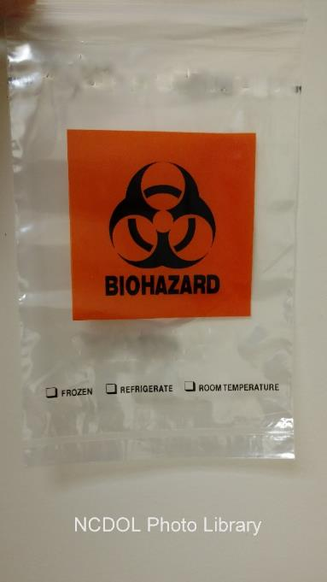
Communication of Hazards to Employees
1910.1030(g)
Warning labels and signs
Information and training

Slide 70
Warning Labels
1910.1030(g)(1)(i)[A]
Must be affixed to:
  Regulated waste containers
  Refrigerators and freezers containing blood or OPIM
  Other containers used to store, transport or ship blood or OPIM

Slide 71

Labels and Signs
1910.1030(g)(1)(i)
Label shall include the following legend.
Labels shall be fluorescent orange or orange-red or predominately so, with lettering and symbols in a contrasting color.
Notes:
71

Slide 72
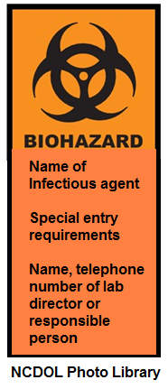
Signs
1910.1030(g)(1)(ii)
Must be posted at the entrance to HIV and HBV research laboratories and production facilities work area with same color scheme as labels.

Slide 73
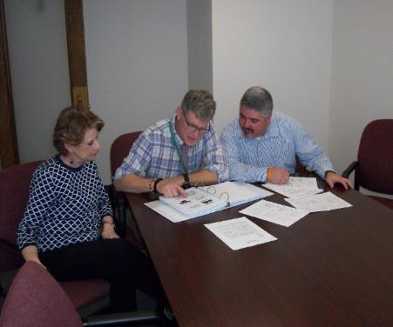
Information and Training
1910.1030(g)(2)
Training shall be provided:
  At the time of initial assignment to tasks where occupational exposure may occur, and
  At least annually thereafter.

Slide 74
Training Program
1910.1030(g)(2)(vii)
Contents of standard
Epidemiology of bloodborne diseases
Modes of transmission
Exposure control plan
Job duties with exposure
Types of control
Protective equipment
Hepatitis B vaccination program
Emergency procedures
Post-exposure procedures
Signs/labels (color-coding)
Question session

Slide 75
Information and Training
1910.1030(g)(2)
Person conducting the training shall be knowledgeable in the subject matter covered in the training program as it relates to the workplace.
Employees in HIV and HBV laboratories and production facilities shall receive other initial training and demonstrate proficiency in handling human pathogens or tissue culture.

Slide 76
Recordkeeping
1910.1030(h)
Medical records
Training records
Sharps injury log

Slide 77
Medical Records
1910.1030(h)(1)
Must contain:
  Employee name and social security number
  Employee Hepatitis B vaccination status
  Examination results, Medical testing, and post-exposure follow-up procedures
  Healthcare professional’s written opinion
  Information provided to the healthcare professional
Be maintained for employment + 30 yrs.

Slide 78
Training Records
1910.1030(h)(2)
Training records shall include:
  Training dates
  Training session content and summary
  Names and qualifications of trainers
  Names and job titles of all trainees
Be maintained for 3 years from the date of training.

Slide 79
Sharps Injury Log
1910.1030(h)(5)(i)
Employer shall create and maintain a sharps log.
  For documenting percutaneous injuries from contaminated needles.
  Must be recorded and maintained separate from the OSHA 300 log and must remain confidential.
  At a minimum, for each incident the log must contain:
    Type and brand of device involved (if known)
    Department or work area of incident
    Description of incident
Mandatory for those keeping records under 29 CFR 1904.
Notes:
79

Slide 80
Exemptions
29 CFR 1904, Appendix A to Subpart B:
  List of partially exempt industries
Not required to keep OSHA injury and illness records unless asked in writing by:
  OSHA
  BLS
  State agency operating under authority of OSHA or BLS
Does not exempt them from responsibility to report fatalities, in-patient hospitalization, amputation, or loss of an eye.

Slide 81
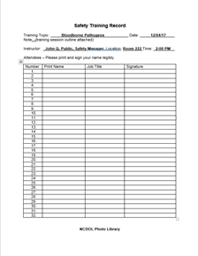
Availability of Records
Training records shall be provided upon request for examination and copying to:
  Employees
  Employee representatives
  Director of National Institute of Occupational Safety and Health (NIOSH)
  OSHA

Slide 82
Availability of Records
Medical records shall be provided upon request for examination and copying to:
  Employee
  Anyone with written consent of employee
  NIOSH
  OSHA

Slide 83
Summary
In this course, we covered:
  Scope and application
  Definitions
  Exposure control
  Methods of compliance
  HIV/HBV Research laboratories and production facilities
  Hepatitis B vaccination and post-exposure evaluation
  Training
  Recordkeeping
Notes:
83

Slide 84
Thank You For Attending!
Final Questions?

