Slide 1
Top 10 Most Frequently Cited Serious Violations in FFY 2023
General Industry
Notes:
Revised: 06/06/25
The information in this presentation is provided voluntarily by the N.C. Department of Labor, Education Training and Technical Assistance Bureau as a public service and is made available in good faith. This presentation is designed to assist trainers conducting OSHA outreach training for workers. Since workers are the target audience, this presentation emphasizes hazard identification, avoidance, and control – not standards. No attempt has been made to treat the topic exhaustively. It is essential that trainers tailor their presentations to the needs and understanding of their audience.
The information and advice provided on this Site and on Linked Sites is provided solely on the basis that users will be responsible for making their own assessment of the matters discussed herein and are advised to verify all relevant representations, statements, and information.
This presentation is not a substitute for any of the provisions of the Occupational Safety and Health Act of North Carolina or for any standards issued by the N.C. Department of Labor. Mention of trade names, commercial products, or organizations does not imply endorsement by the N.C. Department of Labor.

Slide 2
Objectives
In this course, we will discuss the Top Ten cited serious violations in General Industry for federal fiscal year (FFY) 2023.
- The Top Ten list includes data about citations issued 10/01/22 through 9/30/23 in North Carolina.

Slide 3
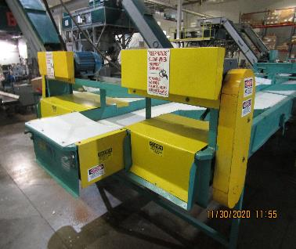
Machine Guarding
1910.212(a)(1)
Number 1: General Requirements
  One or more methods of machine guarding must be provided to protect the operator and other employees in the machine area from hazards:
    Point of operation
    Ingoing nip points
    Rotating parts
    Flying chips and sparks
NCDOL Photo Library
Notes:
3

Slide 4
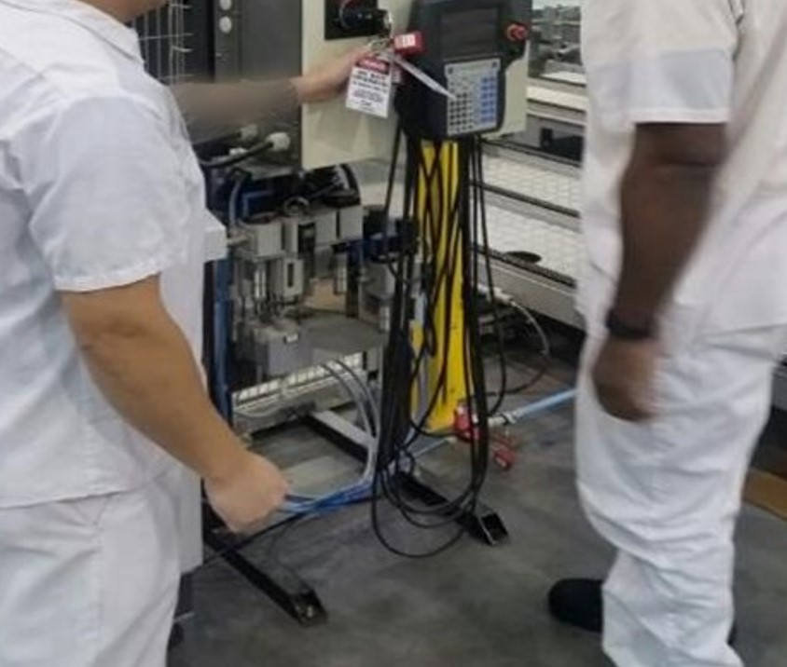
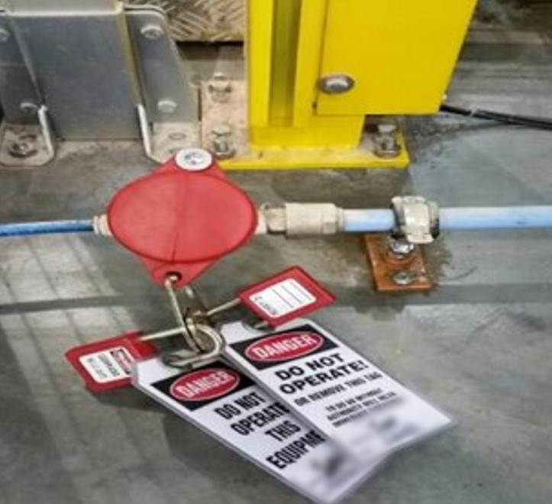
Lockout/Tagout
1910.147(c)(4)(i)
Number 2: Energy Control Procedures
  Procedures shall be developed, documented and utilized for the control of potentially hazardous energy when employees are engaged in the activities covered by this section.
NCDOL Photo Library
NCDOL Photo Library
NCDOL Photo Library
Group LOTO: Electrical and Pneumatic

Slide 5
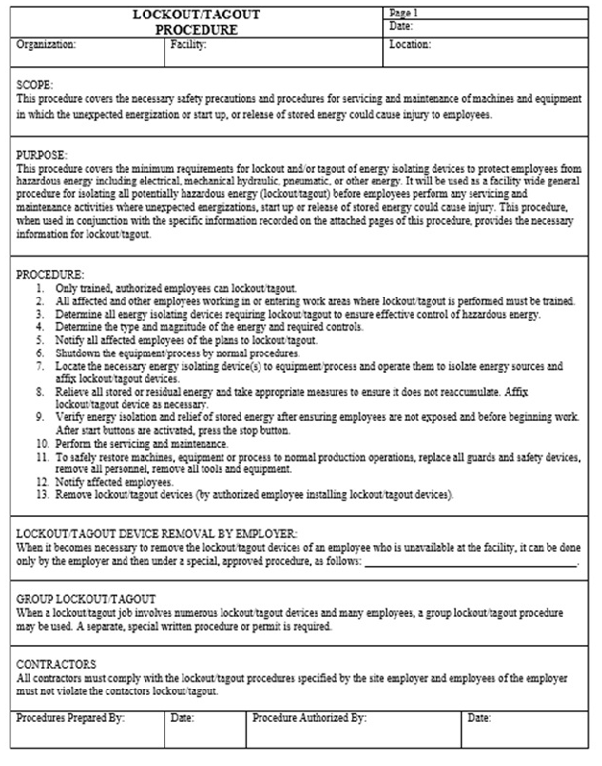
Lockout/Tagout
1910.147(c)(6)(i)
Number 3: Periodic Inspection
  Employers are required to conduct an inspection of energy control procedures at least annually.
NCDOL Photo Library
NCDOL Photo Library

Slide 6
N.C. General Duty Clause
NCGS 95-129(1)
Number 4: N.C. General Duty Clause (GDC)
  Elements necessary for a GDC violation:
    Hazard to which employees were exposed.
    Recognized hazard in the industry.
    Hazard was causing or likely to cause. death or serious injury or physical harm.
    There is a feasible and useful method to correct the hazard.
NCDOL Photo Library
North Carolina General Statutes (NCGS)

Slide 7
GDC Examples
Manual felling of a tree in a residential yard or area not involving timber harvesting or clearing land where the employer did not perform a hazard assessment to remove dead or snagged trees prior to cutting down other trees.
Landfill operations where the employer did not designate a safe barricaded area to protect employees servicing or repairing heavy equipment from customer vehicles.

Slide 8
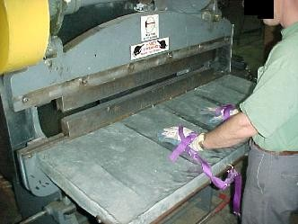
Machine Guarding
1910.212(a)(3)(ii)
Number 5: Point of Operation Guarding
  The point of operation of machines whose operation expose employees to injury, shall be guarded.
NCDOL Photo Library
NCDOL Photo Library

Slide 9
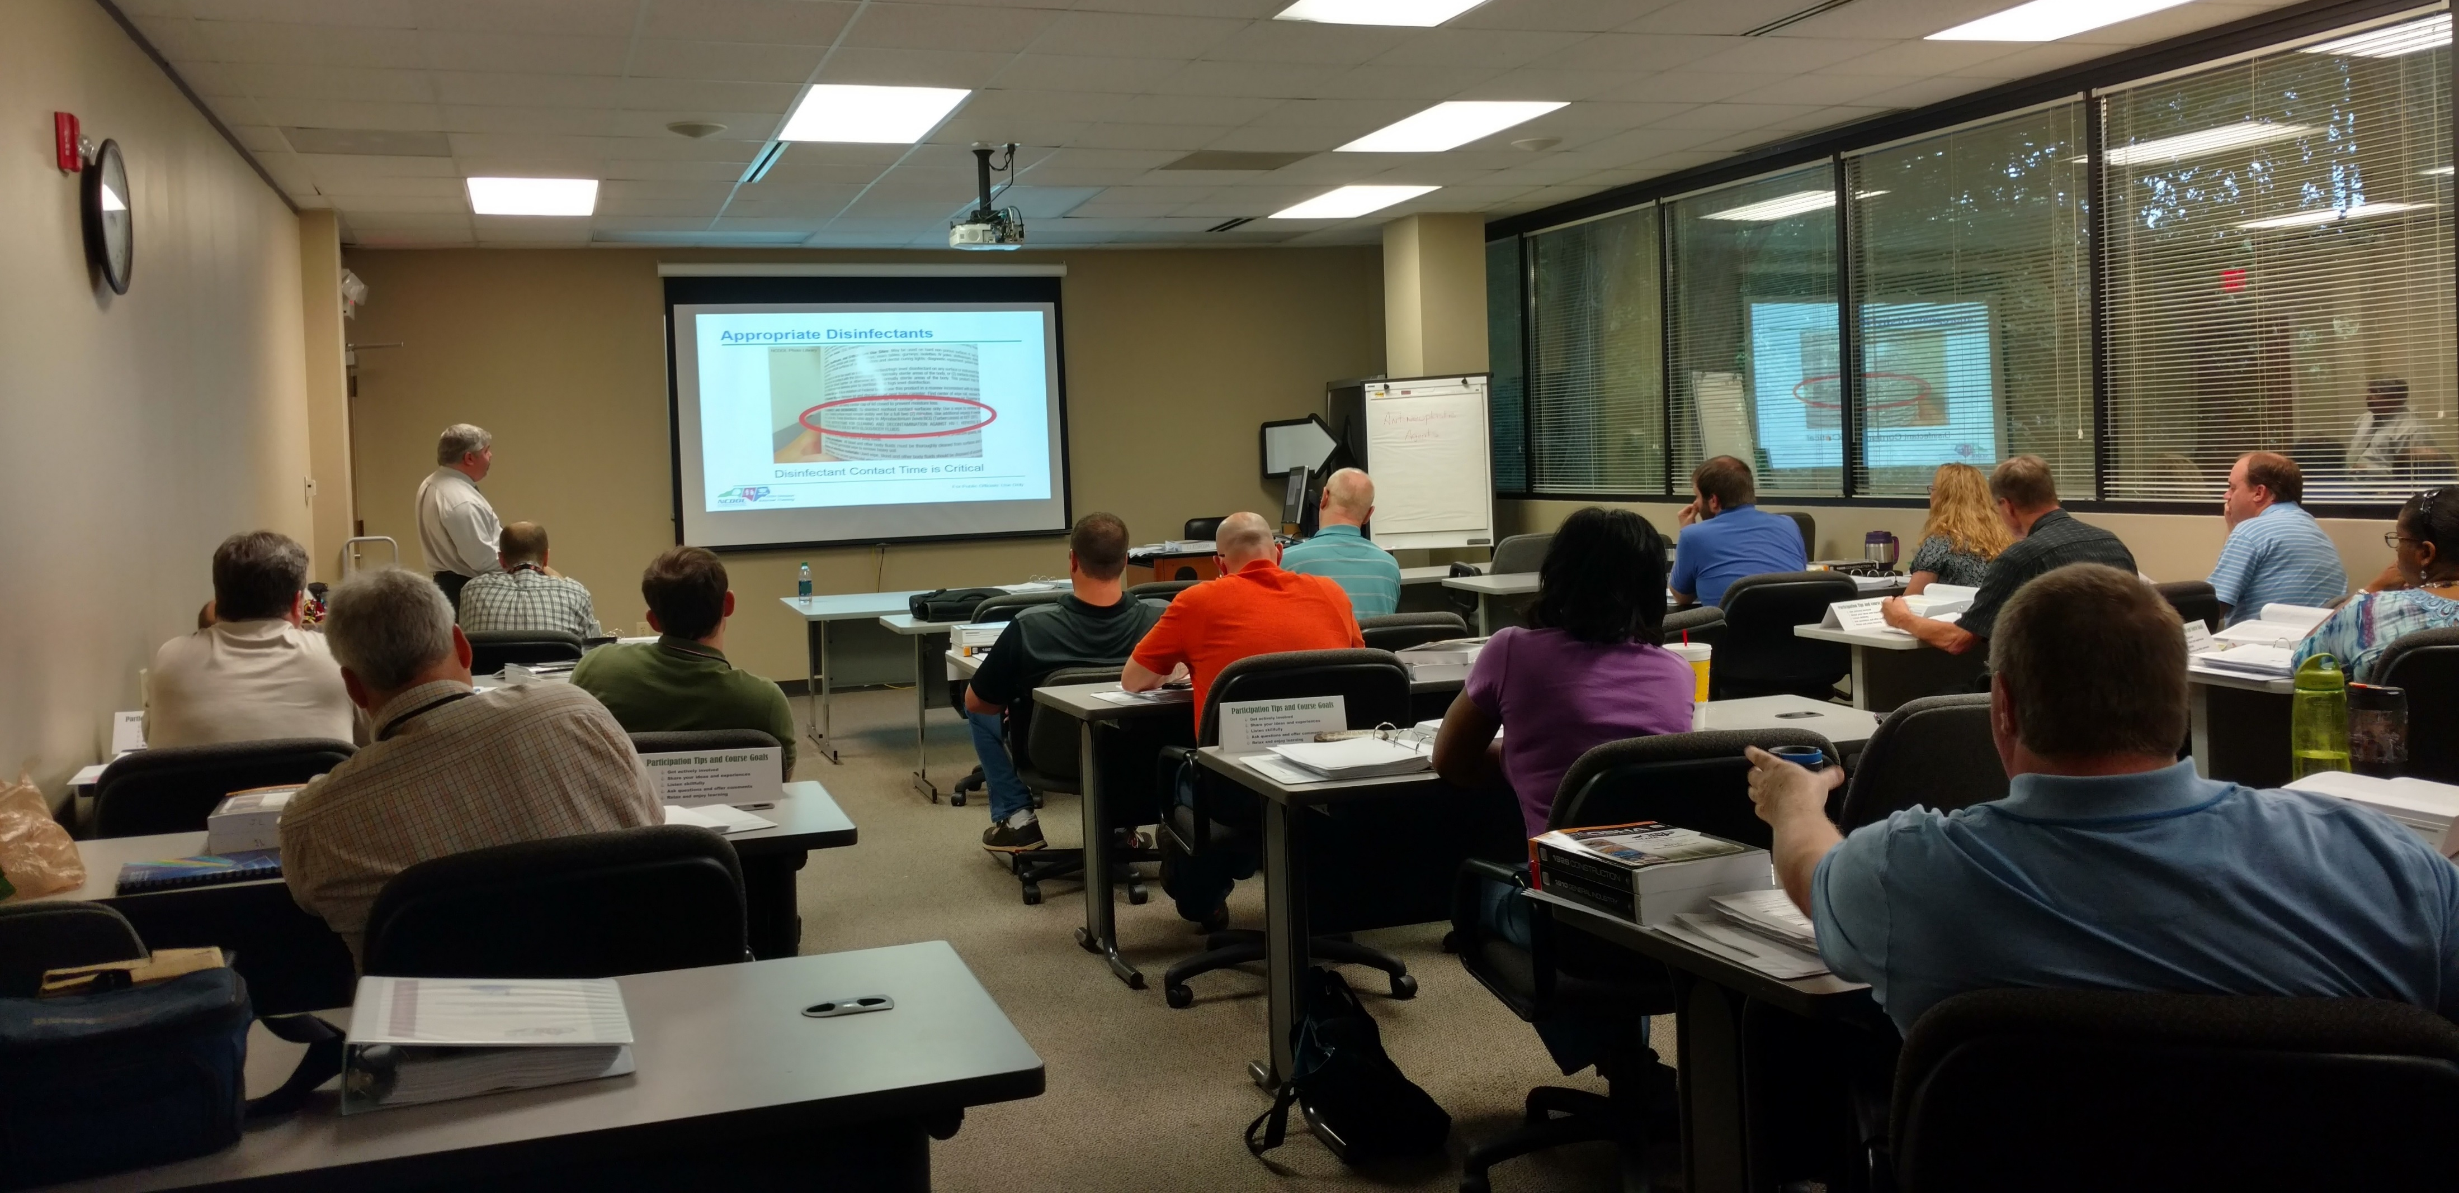
Lockout/Tagout
1910.147(c)(7)(i)(A)
Number 6: Training and Communication
  Each authorized employee shall receive training
  in the recognition of applicable hazardous energy
  sources, the type and magnitude of the energy
  available in the workplace, and the methods and
  means necessary for the energy isolation and
  control.
NCDOL Photo Library
NCDOL Photo Library

Slide 10
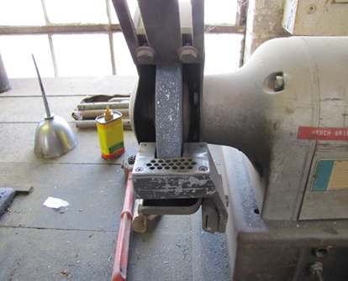
Machine Guarding 1910.215(b)(9)
Number 7: Abrasive Wheel Machinery
  Distance between the wheel periphery and the adjustable tongue must not exceed ¼ inch.
NCDOL Photo Library

Slide 11
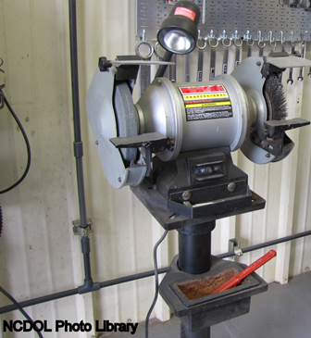
Machine Guarding 1910.215(b)(9)
Corrective Action
  Properly adjust the work rest and tongue guard to allowable openings.

Slide 12
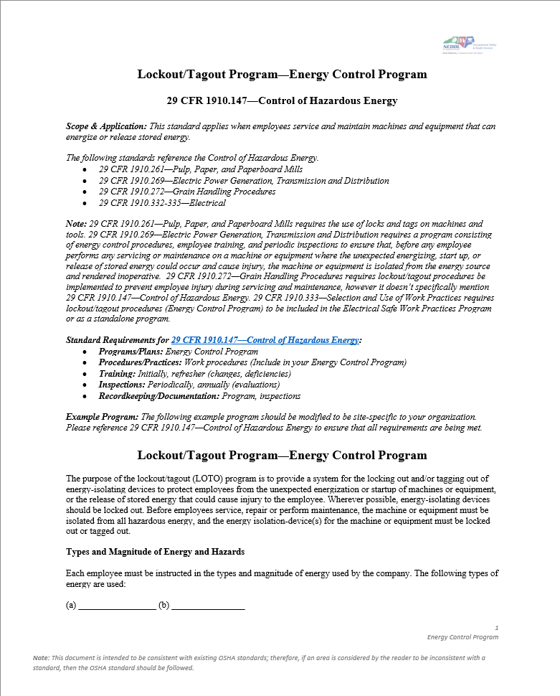
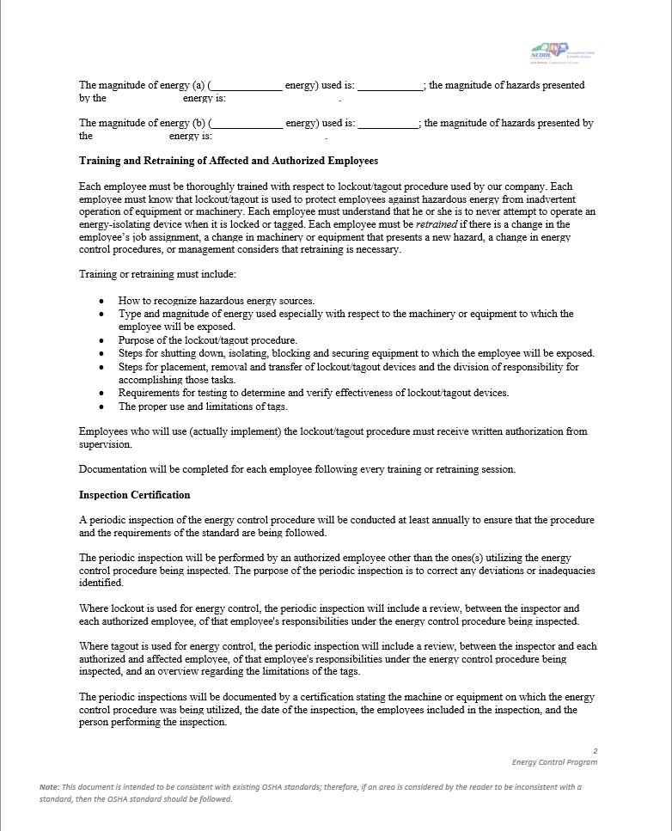
Lockout/Tagout
1910.147(c)(1)
Number 8: Energy Control Program
  Employer shall establish a program consisting of:
    Energy control procedures
    Employee training
    Periodic inspections
NCDOL Photo Library

Slide 13
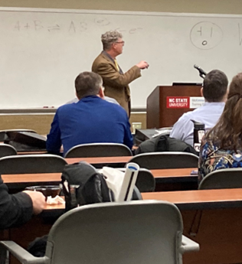
Lockout/Tagout
1910.147(c)(7)(i)
Number 9: Training and Communication
  Employer must provide training to ensure employees have knowledge and skills to perform LOTO safely.
  Topics must include:
    Authorized employees: hazard recognition and means for energy isolation/control
    Affected employees: purpose and use of LOTO
    All other employees: instructed about procedure and prohibitions

Slide 14
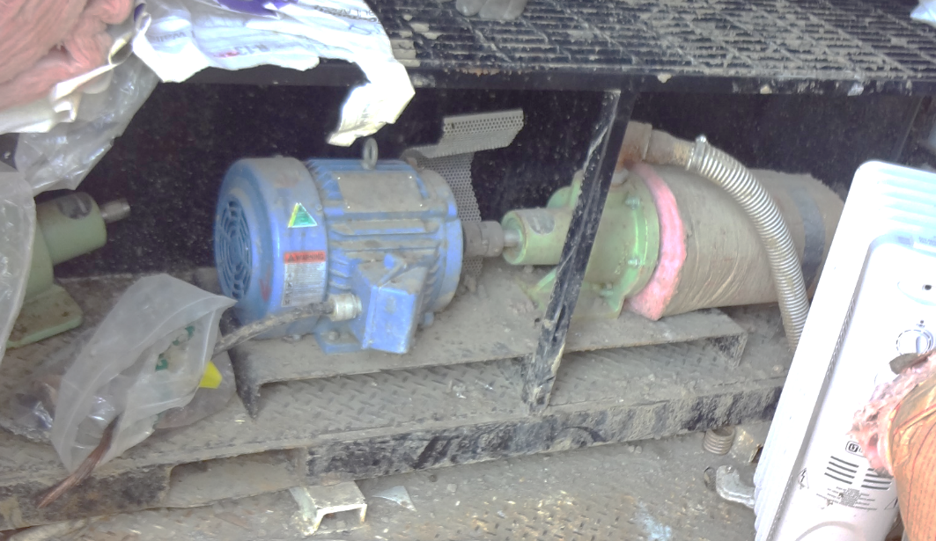
Mechanical Power Transmission
1910.219(c)(2)(i)
Number 10: Rotating, Horizontal Shafts
  Exposed shafting, 7 feet or less from working platform must be guarded/enclosed completely or as location requires.
Notes:
.

Slide 15
Hazard Recognition in General Industry

Slide 16
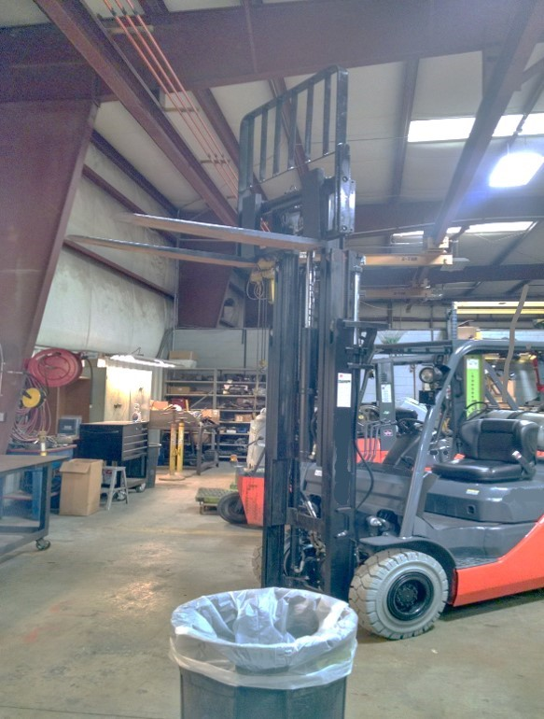
Hazard Recognition
1910.178(m)(2)
Struck-by hazards
NCDOL Photo Library
NCDOL Photo Library

Slide 17
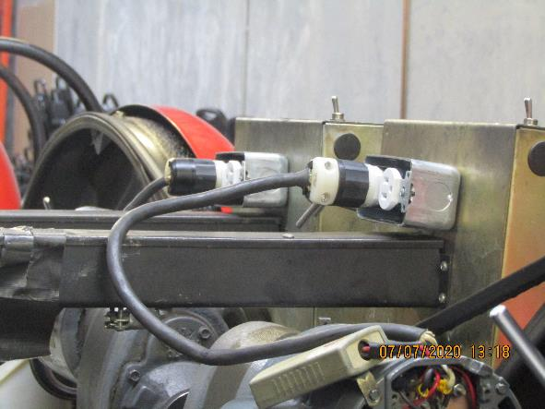
Hazard Recognition
1910.305(b)(2)(i)
1910.305(g)(2)(iii)
Electrical shock hazards
NCDOL Photo Library

Slide 18
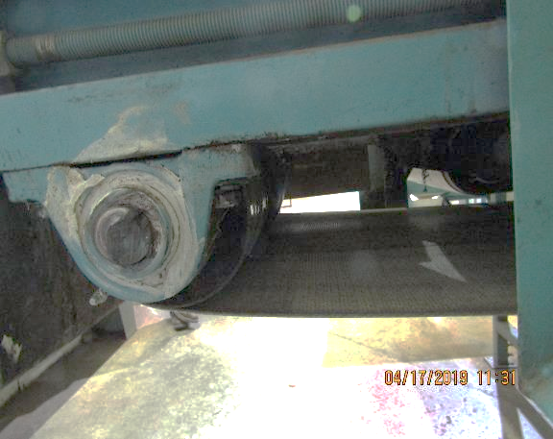
Hazard Recognition
1910.212(a)(1)
Caught-in between hazards
NCDOL Photo Library
Unguarded Conveyor Pinch or Nip Point

Slide 19
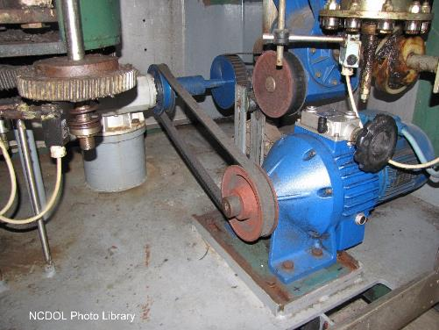
Hazard Recognition
1910.219
Caught-in between hazards: Gears, pulleys, belts must be guarded by complete enclosures or standard guard.
This does not comply
with the requirement.

Slide 20
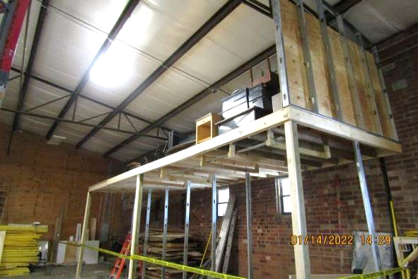
Hazard Recognition
1910.28(b)(1)(i)
Fall hazards
NCDOL Photo Library

Slide 21
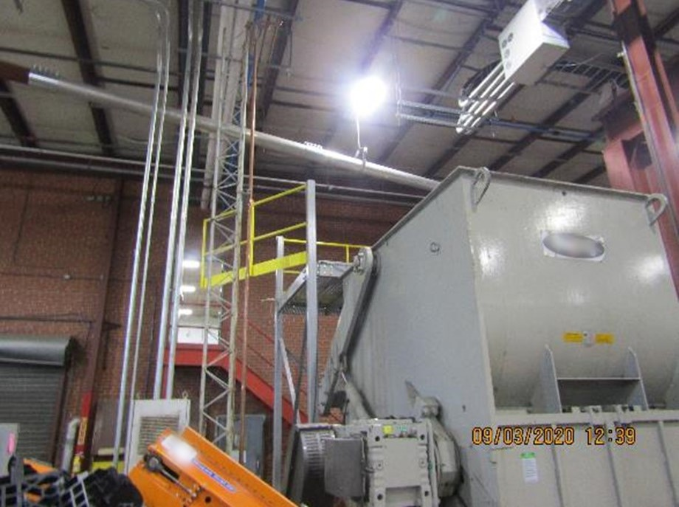
Hazard Recognition
1910.28
Fall hazards
NCDOL Photo Library

Slide 22
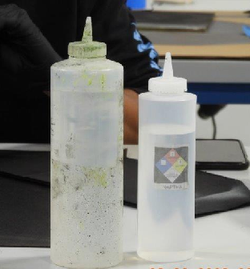
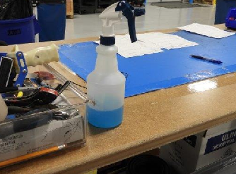
Hazard Recognition
1910.1200(f)(6)(ii)
Hazard communication – Chemical labeling
NCDOL Photo Library
NCDOL Photo Library
NCDOL Photo Library

Slide 23
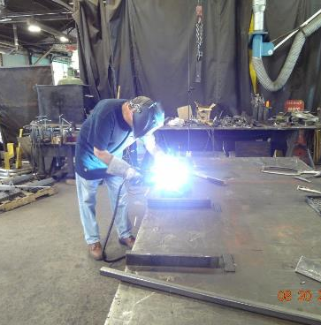
Hazard Recognition
1910.132; 1910.133
1910.134; 1910.138
Personal protective equipment
  No protective screen between employee and other workers or persons to prevent flash burn eye injuries.
NCDOL Photo Library

Slide 24
Summary
In this course, we discussed the Top Ten most frequently cited serious General Industry violations for FFY 2023.
  You should now understand and be able to identify hazards associated with the Top Ten most cited serious OSH violations in general industry.

Slide 25
Thank You For Attending!
Final Questions?

