Slide 1
Top 10 Most Frequently Cited Serious Violations in FFY 2022
General Industry
Presented by:
Notes:
Revised: 01/2024
The information in this presentation is provided voluntarily by the N.C. Department of Labor, Education Training and Technical Assistance Bureau as a public service and is made available in good faith. This presentation is designed to assist trainers conducting OSHA outreach training for workers. Since workers are the target audience, this presentation emphasizes hazard identification, avoidance, and control – not standards. No attempt has been made to treat the topic exhaustively. It is essential that trainers tailor their presentations to the needs and understanding of their audience.
The information and advice provided on this Site and on Linked Sites is provided solely on the basis that users will be responsible for making their own assessment of the matters discussed herein and are advised to verify all relevant representations, statements, and information.
This presentation is not a substitute for any of the provisions of the Occupational Safety and Health Act of North Carolina or for any standards issued by the N.C. Department of Labor. Mention of trade names, commercial products, or organizations does not imply endorsement by the N.C. Department of Labor.

Slide 2
Objectives
In this course, we will discuss the Top Ten cited serious violations in General Industry for federal fiscal year (FFY) 2022.
- The Top Ten list includes data about citations issued 10/01/21 through 9/30/22 in North Carolina.

Slide 3
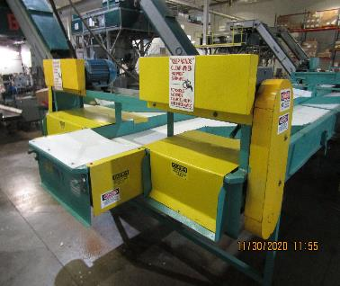
Machine Guarding
1910.212(a)(1)
Number 1: General Requirements
  One or more methods of machine guarding must be provided to protect the operator and other employees in the machine area from hazards:
    Point of operation
    Ingoing nip points
    Rotating parts
    Flying chips and sparks
NCDOL Photo Library
Notes:
3

Slide 4
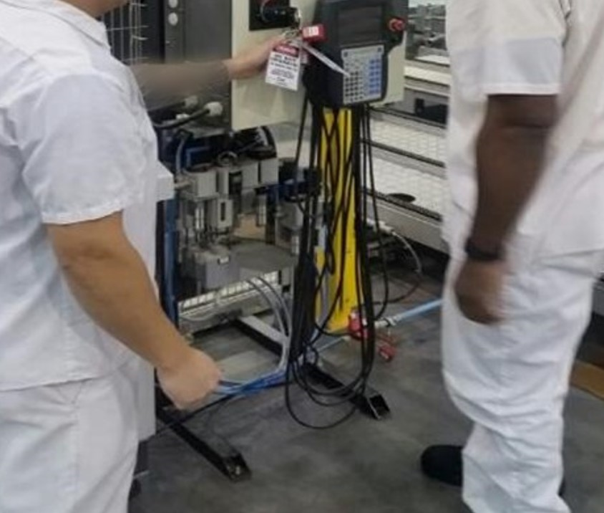
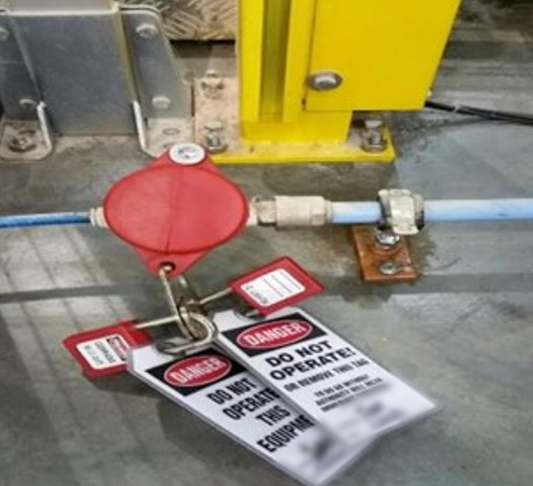
Lockout/Tagout
1910.147(c)(4)(i)
Number 2: Energy Control Procedures
  Procedures shall be developed, documented and utilized for the control of potentially hazardous energy when employees are engaged in the activities covered by this section.
NCDOL Photo Library
NCDOL Photo Library
NCDOL Photo Library
Group LOTO: Electrical and Pneumatic

Slide 5
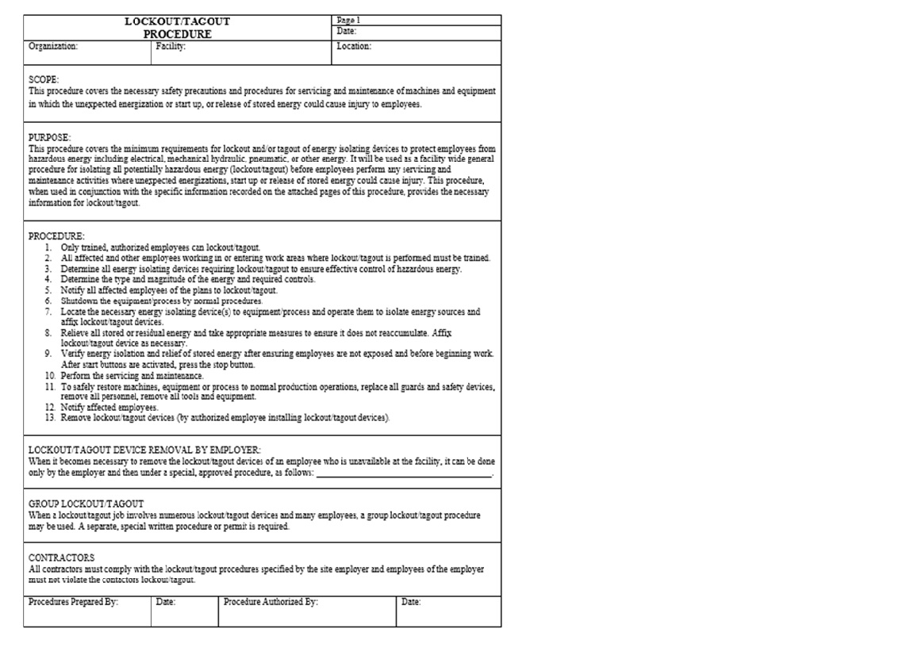
Lockout/Tagout
1910.147(c)(6)(i)
Number 3: Periodic Inspection
  Employers are required to conduct an inspection of energy control procedures at least annually.
NCDOL Photo Library
NCDOL Photo Library

Slide 6
N.C. General Duty Clause
NCGS 95-129(1)
Number 4: N.C. General Duty Clause (GDC)
  Elements necessary for a GDC violation:
    Hazard to which employees were exposed.
    Recognized hazard in the industry.
    Hazard was causing or likely to cause. death or serious injury or physical harm.
    There is a feasible and useful method to correct the hazard.
NCDOL Photo Library
North Carolina General Statutes (NCGS)

Slide 7
GDC Examples
Manual felling of a tree in a residential yard or area not involving timber harvesting or clearing land where the employer did not perform a hazard assessment to remove dead or snagged trees prior to cutting down other trees.
Landfill operations where the employer did not designate a safe barricaded area to protect employees servicing or repairing heavy equipment from customer vehicles.

Slide 8
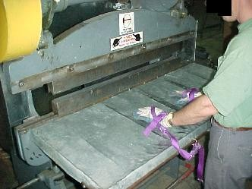
Machine Guarding
1910.212(a)(3)(ii)
Number 5: Point of Operation Guarding
  The point of operation of machines whose operation expose employees to injury, shall be guarded.
NCDOL Photo Library

Slide 9
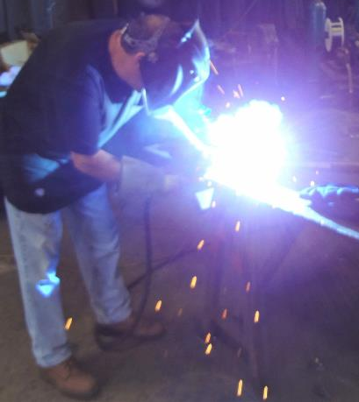
Personal Protective Equipment
1910.133(a)(1)
Number 6: Eye and Face Protection – General Requirements
  Use appropriate eye or face protection when exposed to eye or face hazards.
    Hazards from flying particles
    Molten metal
    Liquid chemicals
    Acids or caustic liquids
    Chemical gases or vapors
    Potentially injurious light radiation
NCDOL Photo Library

Slide 10
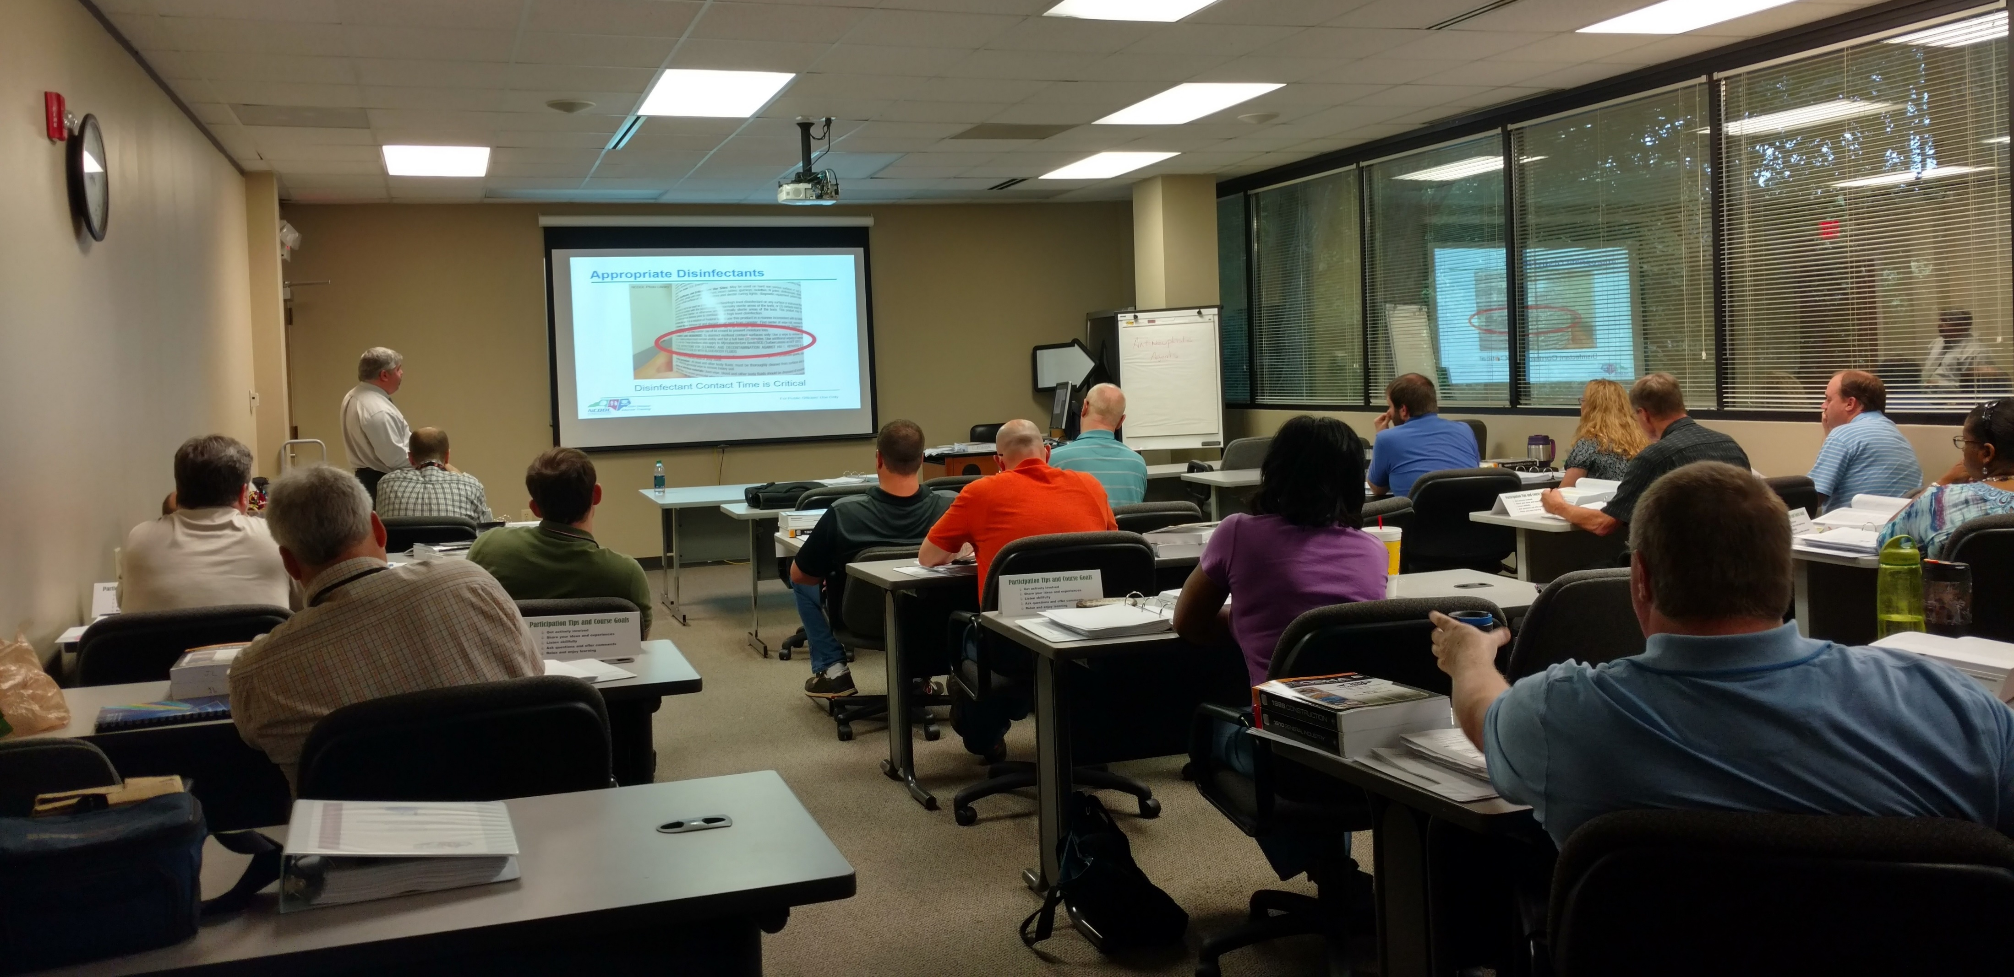
Lockout/Tagout
1910.147(c)(7)(i)(A)
Number 7: Training and Communication
  - Each authorized employee shall receive training in the recognition of applicable hazardous energy sources, the type and magnitude of the energy available in the workplace, and the methods and means necessary for the energy isolation and control.
NCDOL Photo Library
NCDOL Photo Library

Slide 11
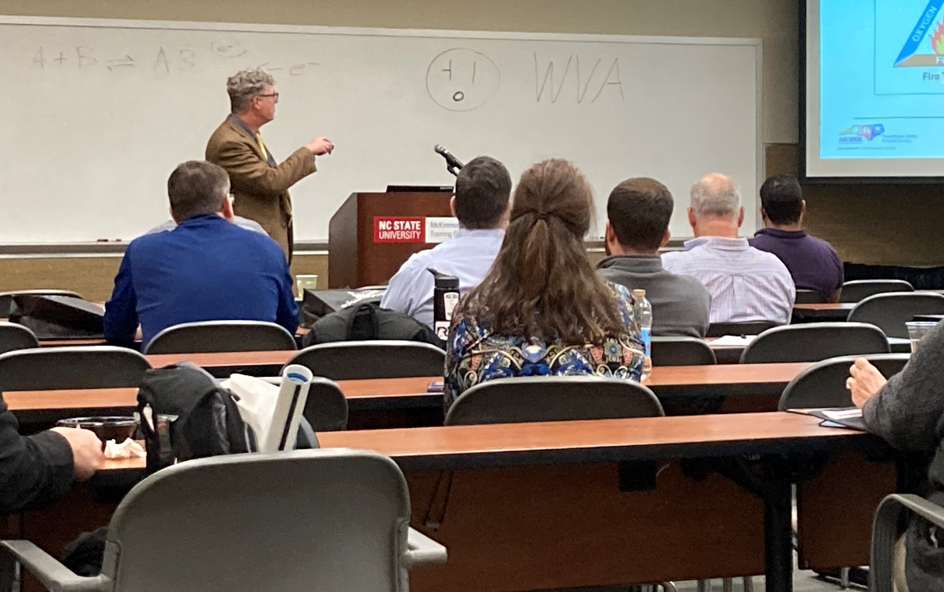
Hazard Communication 1910.1200(h)(1)
Number 8: Employee Information and Training
  Employers shall provide employees with effective information and training on hazardous chemicals in their work area:
    At the time of their initial assignment.
    Whenever a new physical or health hazard is introduced into their work area.
NCDOL Photo Library

Slide 12
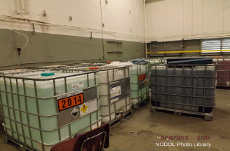
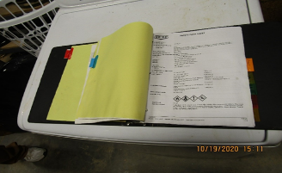
Hazard Communication 1910.1200(h)(1)
Number 8: Employee Information and Training
NCDOL Photo Library

Slide 13
Fall Protection 1910.28(b)(1)(i)
Number 9: Duty to have Fall Protection
  Except as provided elsewhere in this section, the employer must ensure that each employee on a walking-working surface with an unprotected side or edge that is 4 feet (1.2 m) or more above a lower level is protected from falling by one or more of the following:
    (A) Guardrail systems;
    (B) Safety net systems; or
    (C) Personal fall protection systems, such as personal
    fall arrest, travel restraint, or positioning systems.

Slide 14
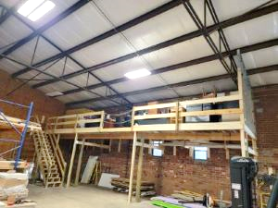
Fall Protection 1910.28(b)(1)(i)
Number 9: Duty to have Fall Protection
NCDOL Photo Library

Slide 15
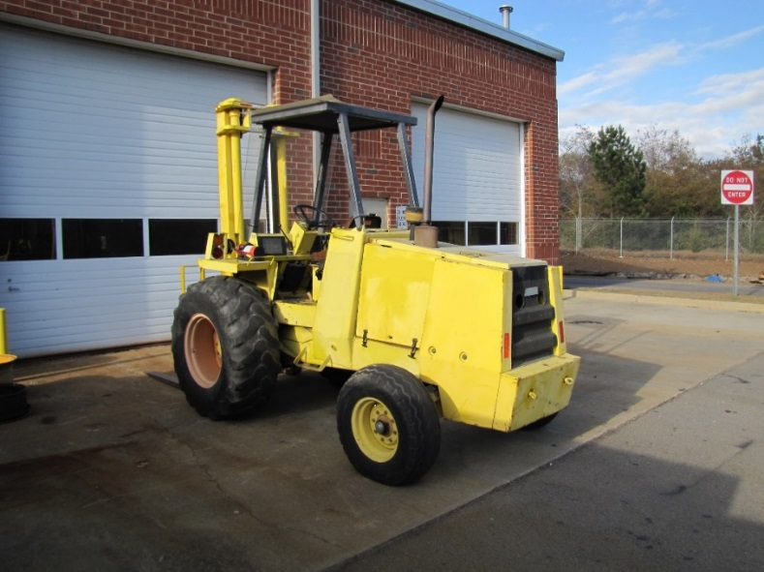
Powered Industrial Trucks 1910.178(l)(1)(i)
Number 10: Operator Training
  Employer shall ensure that each powered industrial truck operator is competent to operate a powered industrial truck safely.
NCDOL Photo Library

Slide 16
Hazard Recognition in General Industry

Slide 17
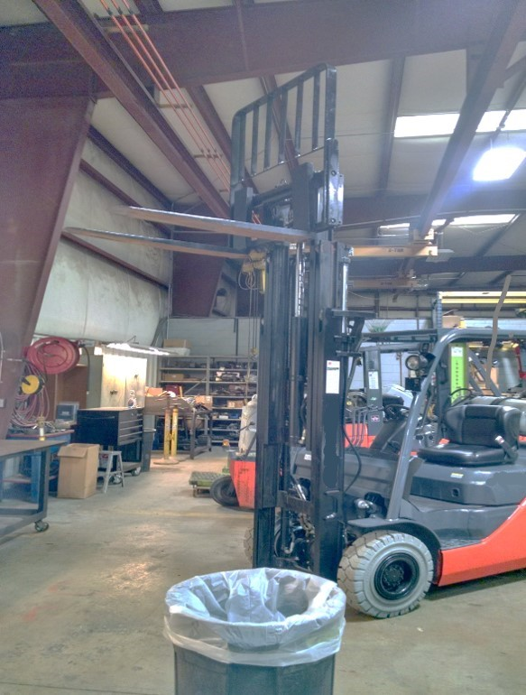
Hazard Recognition
1910.178(m)(2)
Struck-by hazards
NCDOL Photo Library
NCDOL Photo Library

Slide 18
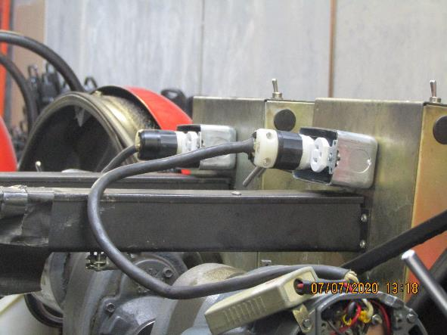
Hazard Recognition
1910.305(b)(2)(i)
1910.305(g)(2)(iii)
● Electrical shock hazards
NCDOL Photo Library

Slide 19
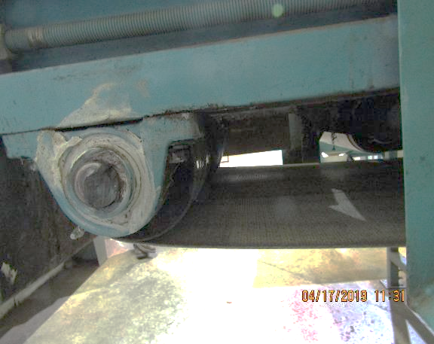
Hazard Recognition
1910.212(a)(1)
● Caught-in between hazards
NCDOL Photo Library
Unguarded Conveyor Pinch or Nip Point

Slide 20
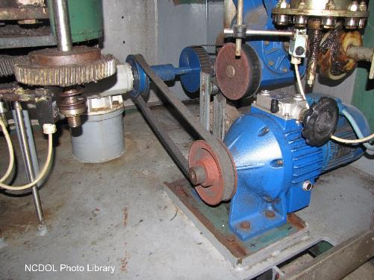
Hazard Recognition
1910.219
Caught-in between hazards: Gears, pulleys, belts must be guarded by complete enclosures or standard guard.
This does not comply
with the requirement.

Slide 21
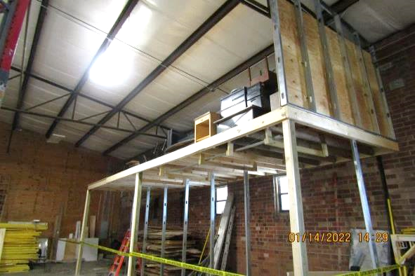
Hazard Recognition
1910.28(b)(1)(i)
● Fall hazards
NCDOL Photo Library

Slide 22
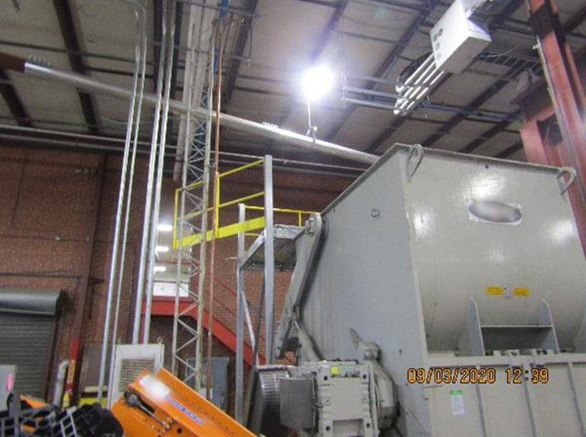
Hazard Recognition
1910.28(b)(1)(i)
● Fall hazards
NCDOL Photo Library

Slide 23
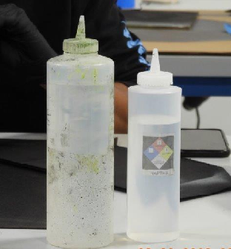
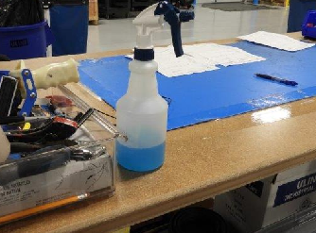
Hazard Recognition
1910.1200(f)(6)(ii)
Hazard communication – Chemical labeling
NCDOL Photo Library

Slide 24
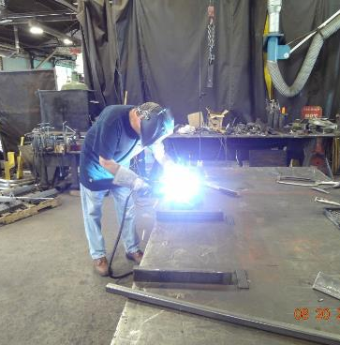
Hazard Recognition
1910.132; 1910.133
1910.134; 1910.138
Personal protective equipment
  No protective screen between employee and other workers or persons to prevent flash burn eye injuries.
NCDOL Photo Library

Slide 25
Summary
In this course, we discussed the Top Ten most frequently cited serious General Industry violations for FFY 2022.
  You should now understand and be able to identify hazards associated with the Top Ten most cited serious OSH violations in the general industry.

Slide 26
Thank You For Attending!
Final Questions?

