Slide 1
Top 10 Most Frequently Citied Serious Violations in FFY 2022
29 CFR 1926 - Construction
Presented by:
Notes:
Revised: 10/23
The information in this presentation is provided voluntarily by the N.C. Department of Labor, Education Training and Technical Assistance Bureau as a public service and is made available in good faith. This presentation is designed to assist trainers conducting OSHA outreach training for workers. Since workers are the target audience, this presentation emphasizes hazard identification, avoidance, and control – not standards. No attempt has been made to treat the topic exhaustively. It is essential that trainers tailor their presentations to the needs and understanding of their audience.
The information and advice provided on this Site and on Linked Sites is provided solely on the basis that users will be responsible for making their own assessment of the matters discussed herein and are advised to verify all relevant representations, statements, and information.
This presentation is not a substitute for any of the provisions of the Occupational Safety and Health Act of North Carolina or for any standards issued by the N.C. Department of Labor. Mention of trade names, commercial products, or organizations does not imply endorsement by the N.C. Department of Labor.

Slide 2
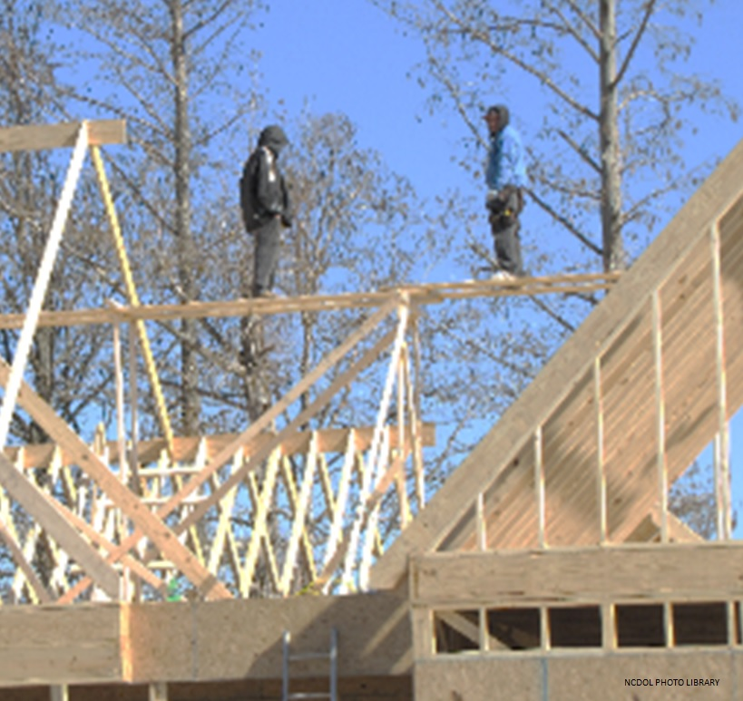
Objectives
In this course, we will discuss the Top Ten most frequently cited serious Construction Industry violations for federal fiscal year (FFY) 2022.
Citations and violations issued from October 1, 2021, thru September 30, 2022, in North Carolina.
NCDOL Photo Library

Slide 3
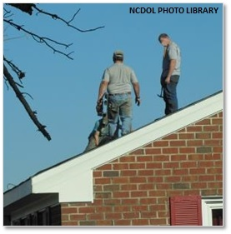
Fall Protection
1926.501(b)(13)
Number 1: Residential Construction
Each employee engaged in residential construction activities 6 feet (1.8 m) or more above lower levels shall be protected.
Personal fall arrest system
Guardrail systems
Safety net system

Slide 4
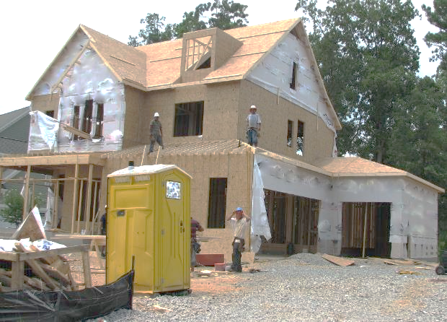
Fall Protection
1926.501(b)(13)
Where is fall protection required?
NCDOL Photo Library

Slide 5
Personal Protective Equipment
1926.102(a)(1)
Number 2: Eye and Face Protection - General Requirements
Provide employees with eye and face protection when machines or operations present potential eye or face injury from physical, chemical, or radiation agents.

Slide 6
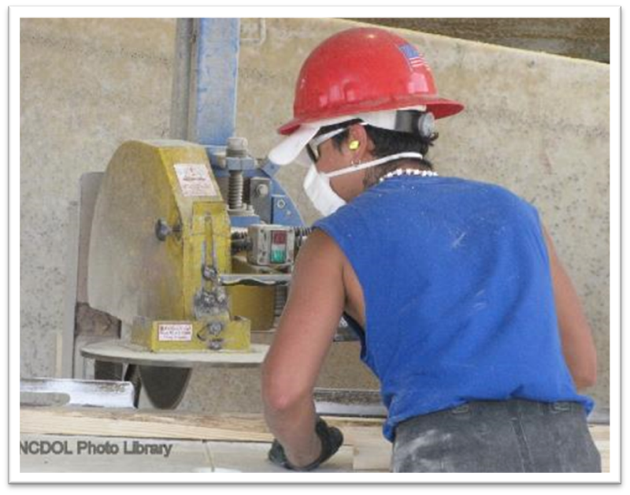
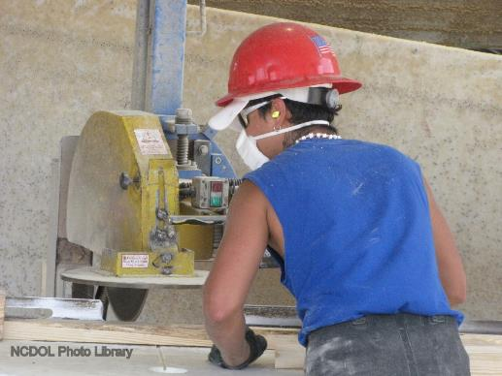
Eye and Face Protection
1926.102(a)(1)
Is the type and use of this PPE appropriate?
ANSI Z87.1-1989

Slide 7
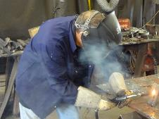
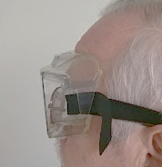
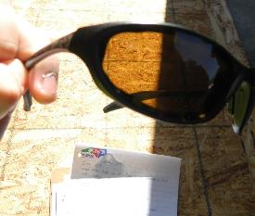
Examples of Eye and Face Protection
Eye and face protection
NCDOL Photo Library
Welding
Helmet
NCDOL Photo Library
Safety Goggles
Safety Glasses
ANSI/ISEA Z87.1
NCDOL Photo Library

Slide 8
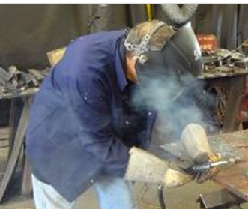
Any other hazards?
Ventilation
Noise
UV/IR rays
Metal fumes
NCDOL PHOTO LIBRARY

Slide 9
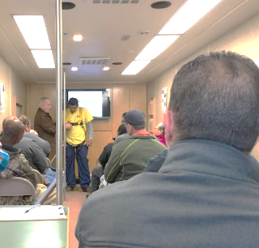
Fall Protection
1926.503(b)(1)
Number 3: Certification of Training
Employer must verify fall protection training by preparing a written certification record.
Record shall contain the name or other identity of the employee trained.
The date(s) of the training, and the signature of the person who conducted the training, or the signature of the employer.
NCDOL Photo Library

Slide 10
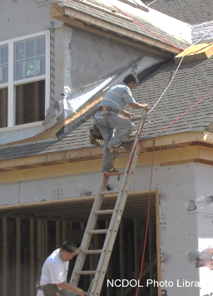
Portable Ladders
1926.503(b)(1)
Number 4: Ladders
When portable ladders are used for access to an upper landing surface, they must:
Extend 3 feet above landing.
Be properly secured at the top
with a grasping device provided
(such as a grab rail).

Slide 11
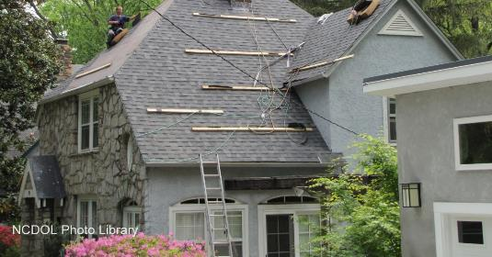
Portable Ladders
1926.503(b)(1)
Portable ladder not extended at least 3 feet above upper landing surface.

Slide 12
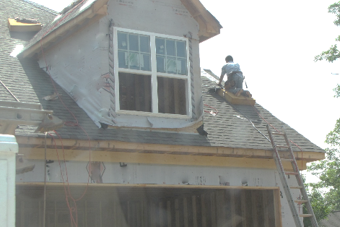
Portable Ladders
1926.503(b)(1)
Portable ladder not extended at least 3 feet above upper landing surface.
NCDOL Photo Library

Slide 13
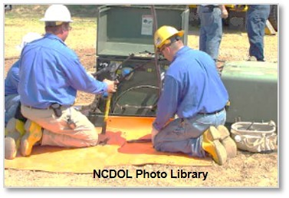
Personal Protective Equipment
1926.100(a)
Number 5: Head Protection - General Requirements
Employees working in areas where there is a possible danger of head injury from impact, or from falling or flying objects, or from electrical shock and burns, must be protected by protective helmets.
Protective helmets must comply with:
ANSI Z89.1-2009
ANSI Z89.1-2003
ANSI Z89.1-1997

Slide 14
Head Protection
1926.100(a)
Head Protection - General Requirements
Is there a possible danger to the head from an impact, or from falling or flying objects, or from electrical shock and burns?
NCDOL Photo Library

Slide 15
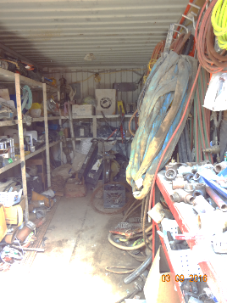
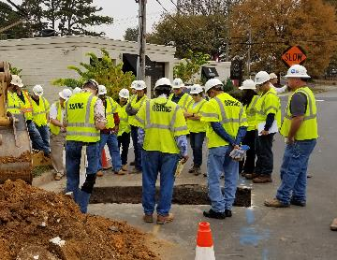
General Safety and Health Provisions
1926.20(b)(2)
Number 6: Accident Prevention Responsibilities
Provide for frequent and regular inspections of job sites, materials, and equipment to be made by competent persons designated by employers.
NCDOL Photo Library
NCDOL Photo Library

Slide 16
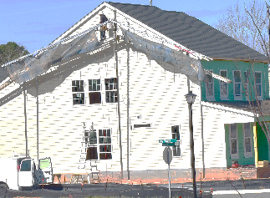
Fall Protection
1926.503(a)(1)
Number 7: Training Program
Employer must provide a training program for each employee who might be exposed to fall hazards.
NCDOL Photo Library
NCDOL Photo Library

Slide 17
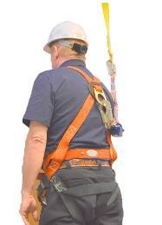
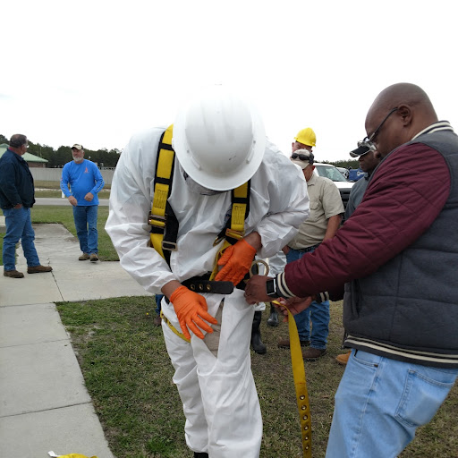
Fall Protection
1926.503(a)(2)
Employees must know:
How to properly wear equipment
Where to tie off
NCDOL Photo Library
NCDOL Photo Library

Slide 18
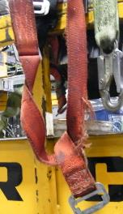
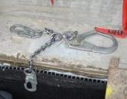
Fall Protection
1926.503(a)(2)
Is equipment inspected and properly maintained?
NCDOL Photo Library
NCDOL Photo Library
NCDOL Photo Library
NCDOL Photo Library

Slide 19
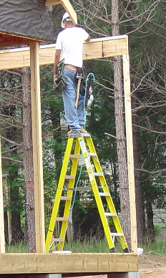
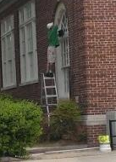
Stairways and Ladders Usage
1926.1053(b)(13)
Number 8: Self-supporting top (top cap) or top step must not be used as a step.
NCDOL Photo Library
NCDOL Photo Library

Slide 20
Stairways and Ladders Usage
1926.1060(a)
Number 9: Stairways and ladders - Employer must provide a training program for each employee using ladders and stairways.
Competent person
Nature of fall hazards in the work area;
Correct procedures for erecting, maintaining, and disassembling the fall protection systems to be used;
Proper construction, use, placement, and care in handling of all stairways and ladders; and
Maximum intended load-carrying capacities of ladders used.

Slide 21
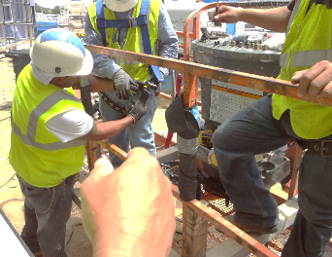
Competent Person
1926.32(f)
A "competent person" is defined as one who is capable of identifying existing and predictable hazards in the surroundings or working conditions,
Which are unsanitary, hazardous, or dangerous to employees, and who has authorization to take prompt corrective measures to eliminate them.
NCDOL Photo Library

Slide 22
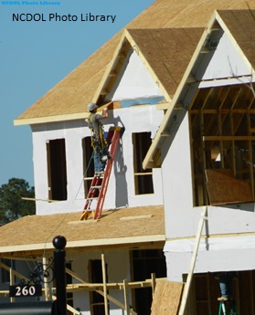
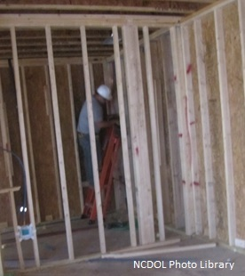
Portable Ladders
1926.1053(b)(4)
Number 10: Used only for designed purpose - Ladders shall be used only for the purpose for which they were designed.

Slide 23
Hazard Recognition in the Construction Industry

Slide 24
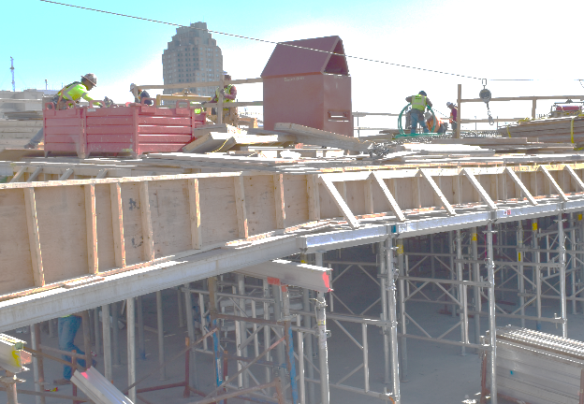
Hazard Recognition
1926.501(b)(1)
Circular saw
NCDOL Photo Library
Notes:
24

Slide 25
Hazard Recognition
1926.501(b)(1)
Anchor
NCDOL Photo Library
Lanyard
Notes:
them. (1910.501(b)(2)
25

Slide 26
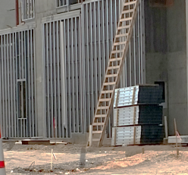
Hazard Recognition
NCGS 95-129
Impalement
hazard
NCDOL Photo Library
NCDOL Photo Library
Notes:
26

Slide 27
Hazard Recognition
1926.1053(b)(13)
NCDOL Photo Library
Using the top of the ladder
Employees
Notes:
27

Slide 28
Hazard Recognition
1926.1053(b)(1)
1926.1053(b)(4)
Ladder hazards
NCDOL Photo Library
Notes:
28

Slide 29
Hazard Recognition
1926.96
1926.102
1926.501(b)(13)
No eye protection
No protective footwear
NCDOL Photo Library
Notes:
29

Slide 30
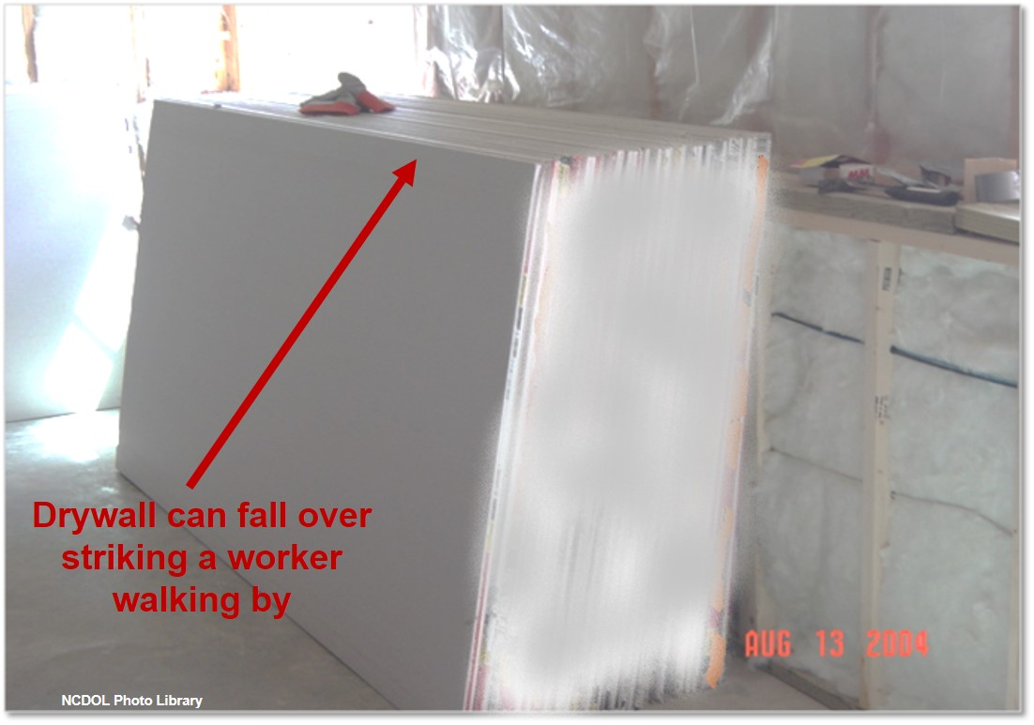
Hazard Recognition
1926.250(c)
Notes:
30

Slide 31
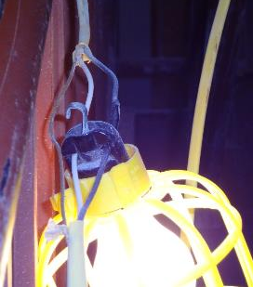
Hazard Recognition
1926.403(b)(2)
1926.404
Listed and labeled
No ground - bypassed
NCDOL Photo Library
NCDOL Photo Library
Notes:
31

Slide 32
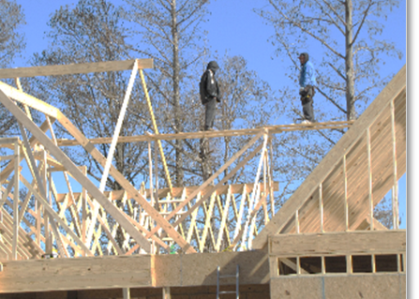
Hazard Recognition
1926.501(b)(13)
No fall protection
> 20 ft elevation
NCDOL Photo Library

Slide 33
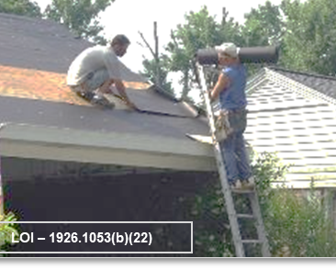
What’s the Hazard?
1926.501(b)(13)
1926.1053(b)(21) – (22)
No fall protection
One hand must grasp ladder
NCDOL Photo Library

Slide 34
Summary
In this course, we discussed the Top Ten most frequently cited serious Construction Industry violations for FFY 2022.
You should now understand and be able to identify hazards associated with the Top Ten most cited serious OSH violations in the Construction Industry.

Slide 35
Thank You For Attending!
Final Questions?

