Slide 1
Occupational Noise Exposure
29 CFR 1910.95
Presented by:
Notes:
Revised 06/16/25
The information in this presentation is provided voluntarily by the N.C. Department of Labor, Education Training and Technical Assistance Bureau as a public service and is made available in good faith. This presentation is designed to assist trainers conducting OSHA outreach training for workers. Since workers are the target audience, this presentation emphasizes hazard identification, avoidance, and control – not standards. No attempt has been made to treat the topic exhaustively. It is essential that trainers tailor their presentations to the needs and understanding of their audience.
The information and advice provided on this Site and on Linked Sites is provided solely on the basis that users will be responsible for making their own assessment of the matters discussed herein and are advised to verify all relevant representations, statements, and information.
This presentation is not a substitute for any of the provisions of the Occupational Safety and Health Act of North Carolina or for any standards issued by the N.C. Department of Labor. Mention of trade names, commercial products, or organizations does not imply endorsement by the N.C. Department of Labor.
Trainer Notes: Updated NCDOL logo, bolded revision date, objective and summary slide match.

Slide 2
Objectives
29 CFR 1910.95
At the end of this course, students will:
  Be able to distinguish between sound and noise
  Be able list and discuss types of hearing loss
  Become familiar with types of noise measuring equipment
  Understand the requirements of 29 CFR 1910.95
Notes:
2

Slide 3
Sound Versus Noise
Sound is a pressure change detectable by the
human ear
  Pitch ranges between 20 to 20,000 hertz (Hz)
  Volume ranges between 0 to 140 decibels (dB)
Noise is a type of sound
  Carries no information
  Random
  Generally described as undesirable or unwanted sound
Notes:
3

Slide 4
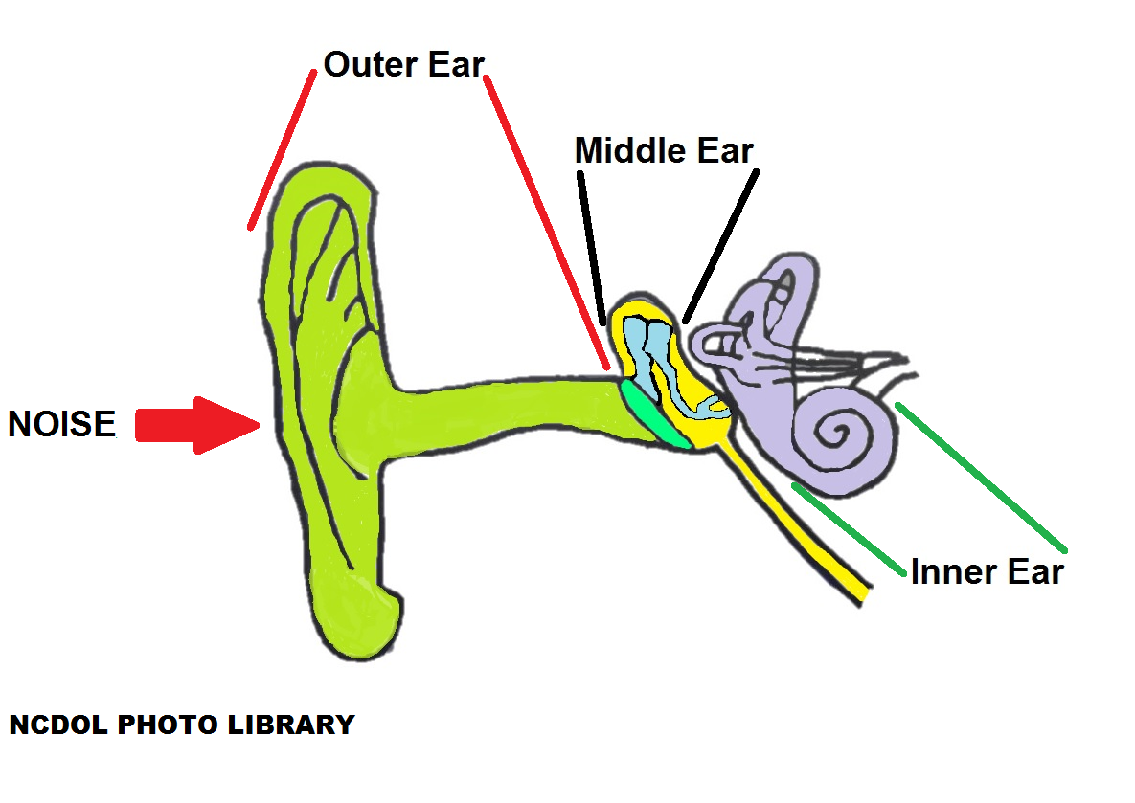
An Ear’s Anatomy
Notes:
4

Slide 5
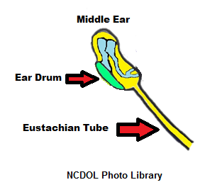
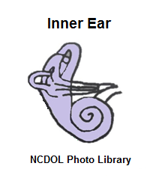
Types of Hearing Loss
Middle ear hearing loss results from lack of conduction
  Impacted wax
  Broken ear drum
Inner ear hearing loss results from lack of neural connections
  Naturally due to aging
  Loud noises
  Disease
Notes:
5

Slide 6
Occupational Hearing Loss
Noise-induced hearing loss (NIHL)
  Initially effects high frequencies
    Speech recognition
  Temporary threshold shifts (TTS)
    Short-term exposure to high noise levels, hearing returns to normal after a period of time
  Permanent threshold shifts (PTS)
    Prolonged exposure to high noise levels, hearing ranges will not return to normal
  OSHA’s standard threshold shifts (STS)
    > 10 dB average loss in 2000, 3000, or 4000 Hz in either ear
Notes:
6

Slide 7
Non-Auditory Effects of Noise
Effects cardiovascular system
Effects the nervous system
Interferes with speech and concentration
Causes annoyance, stress, and fatigue
Reduces work efficiency
Lowers morale
Notes:
7

Slide 8
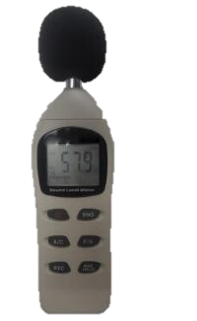
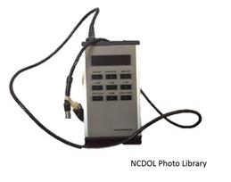
Noise Measuring Equipment
Sound level meter (SLM)
  Basic instrument to measure sound pressure variations in air
Noise dosimeter
  Combines sound pressure and time for employee exposure monitoring
NCDOL Photo Library
Notes:
8

Slide 9
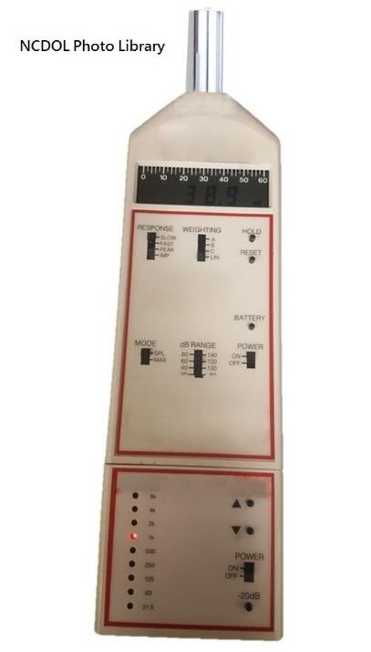
Noise Measuring Equipment
Octave band analyzer (OBA)
  Diagnostic tool to help find appropriate engineering controls to reduce noise levels
Notes:
9

Slide 10
Permissible Exposure Level
1910.95(b)
No employee shall be exposed above the permissible exposure level (PEL).
  PEL = 90 decibels on the A scale (dBA) for an 8-hour time-weighted average (TWA).
Feasible administrative or engineering controls are required.
Hearing protection provided and used to reduce sound to within levels of Table G -16.
Notes:
10

Slide 11
Table G-16 - Permissible Noise Exposures
Duration per day, hours | Sound level dBA slow response
8 | 90
6 | 92
4 | 95
3 | 97
2 | 100
1.5 | 102
1 | 105
0.5 | 110
0.25 or less | 115 NCDOL Photo Library

Slide 12
Noise Action Level
1910.95(c)-(d)
Action level (AL) = 85 dBA for an 8-hour TWA
  Determined without regard to hearing protector attenuation.
Hearing conservation program (HCP) required when noise exposures equal or exceed the action level.
Monitoring program implemented when noise exposures equal or exceed the action level.
Notes:
12

Slide 13
Monitoring
1910.95(d)
Strategy to identify all employees who could be exposed at or above the AL (85 dBA) and to enable proper selection of hearing protectors
Conduct representative sampling
  Each job classification
  All shifts
Repeat monitoring when:
  Change in process, equipment, controls
  Additional employees are exposed
  Hearing protectors are inadequate
Notes:
13

Slide 14
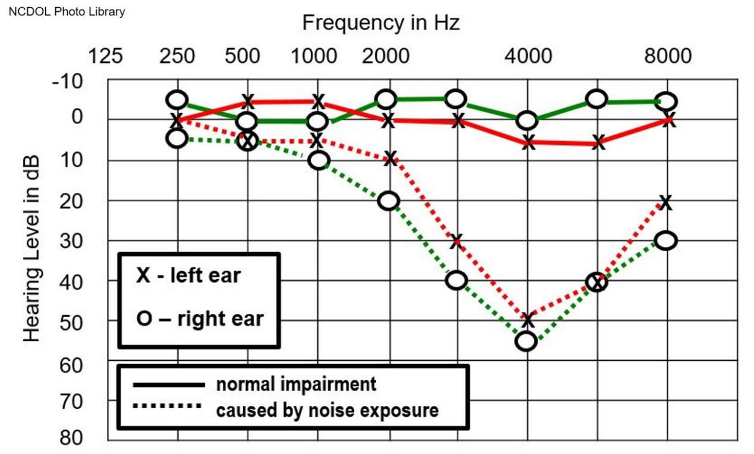
Notification
1910.95(e)
Employer shall notify each employee exposed at or above 85 dBA of the monitoring results.
Notes:
14

Slide 15
Audiometric Testing Program
1910.95(g)
Audiometric testing program implemented when noise exposures equal or exceed the action level.
  Qualified person performs the hearing test, usually an audiologist.
  Results interpreted by qualified person.
Audiometer checked before each use and calibrated acoustically annually.
  Records of calibrations required.
Notes:
15

Slide 16
Audiometric Testing
1910.95(g)
Provided at no cost to the employee.
  Baseline audiogram within 6 months of first exposure at or above action level.
    For mobile test van, < 12 months
Provided initially and annually.
  Allowance for aging
  STS notification
Notes:
16

Slide 17
Example of an Audiogram

Slide 18
STS Notification
1910.95(g)
Recall standard threshold shift definition:
  > 10 dB average loss at 2000, 3000 and 4000 kHz
Employer may retest within 30 days to verify the STS.
Audiologist shall determine need for further evaluation.
Employer shall notify the employee of the STS in writing within 21 days.
Notes:
18

Slide 19
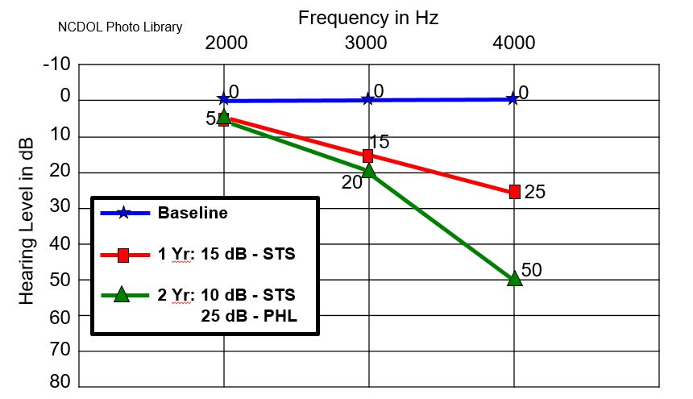
Audiogram with 2 STS, 1 PHL
PHL – Permanent hearing loss

Slide 20
STS Requirements
1910.95(g)
If a work-related STS occurs, employees:
  Not using hearing protection shall be fitted for hearing protection and trained.
  Shall be refitted and retrained, if already using hearing protection.
  Shall be referred for audiological or ontological exam, if necessary and appropriate.
Notes:
20

Slide 21
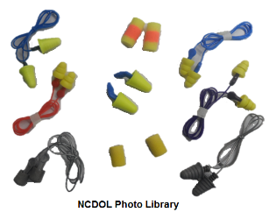
Hearing Protectors
1910.95(i)
Shall be available when employees are exposed at or above the “action level”.
Employees are required to use when:
  Exposed at or above 90 dBA
  Exposed at or above 85 dBA
    Who has not yet had a baseline audiogram
    Experienced an STS
Notes:
21

Slide 22
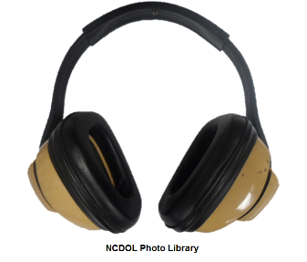

Hearing Protectors
1910.95(i)
Provided at no cost to the employee
Selection from a variety of hearing protector types
Properly fitted
Replaced as necessary
Notes:
22

Slide 23
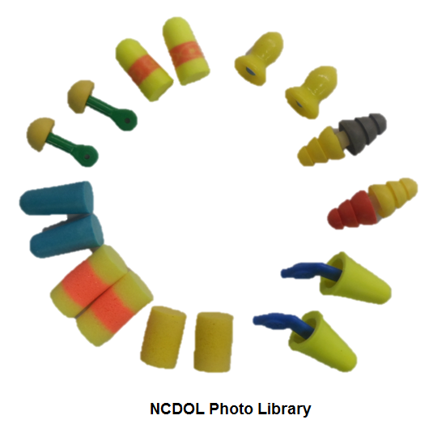
Hearing Protector Attenuation
1910.95(j)
Hearing protectors shall:
  For overexposed employees
    Attenuate < 90 dBA 8-hr TWA
  For employees that had a STS
    Attenuate < 85 dBA 8-hr TWA
  Whenever noise exposures increase
    Be reevaluated to determine adequacy
Notes:
23

Slide 24
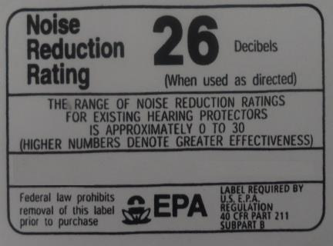
Noise Reduction Rating (NRR)
Appendix B
Defined as the maximum number of decibels that the hearing protector will reduce the sound level when worn.
NRR must be on the hearing
protector package.
NRR example for A-weighted
data
NCDOL Photo Library
  - Estimated exposure (dBA) = TWA (dBA) - (NRR - 7)

Slide 25
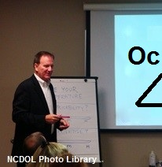
Training
1910.95(k)
Initially and annually
Must include:
  Effects of noise on hearing
  Purpose of hearing protectors
  Instruction in protector hearing protector selection, fitting, use and care
  Purpose of audiometric test and explanation of the procedures and results
Notes:
25

Slide 26
Post the Standard
1910.95(l)
Employer shall make available to affected employees or their representative’s copies of the standard.
Employer shall also post a copy of the
standard in the workplace.
Notes:
26

Slide 27
Recordkeeping
1910.95(m)
Provide employee and DOL access, and transfer records to successive employer
Noise measurements: > 2 years
Audiometric tests > employment duration:
  Name, job classification and dBA-TWA
  Date, examiner’s name and calibration date
  Background measurements of audiometric test room
Notes:
27

Slide 28
Other Paragraphs
1910.95
(f) - Observation of monitoring
(h) - Audiometric test requirements
(o) - Exemptions
Note: 1926.52 applies to construction
Notes:
28

Slide 29
Appendices
1910.95(n)
Appendix A - Noise exposure computation
Appendix B - Methods for establishing the adequacy of hearing protector attenuation
Appendix C - Audiometric measuring equipment
Appendix D - Audiometric test rooms
Appendix E - Acoustical calibration of audiometers
Appendix F - Calculations and application of age corrections to audiograms
Appendix G - Monitoring noise levels
Notes:
29

Slide 30
Summary
1910.95
In this course, we covered:
  The difference between sound and noise
  Types of hearing loss
  Types of noise measuring equipment
  The requirements of 29 CFR 1910.95

Slide 31
Thank You For Attending!
Final Questions?

