Slide 1
Josh Dobson, Commissioner
What You Need To Know
North Carolina Wage and Hour Laws
North Carolina Wage and Hour Bureau

Slide 2
Disclaimer
The material in this presentation has been prepared by the NC Department of Labor for educational purposes only. This presentation contains general information relative to the North Carolina Wage and Hour Act and related state laws. This information is given in summary form and is not purported to be complete. Information in this presentation should not be considered as advice or recommendation for enforcement of laws of the State of North Carolina. This presentation may contain copyrighted material without having asked permission from the owner, but which use falls within the standards of "fair use." Any copyrighted material is being used for educational purposes only. Pursuant to the Fair Use Copyright Disclaimer under section 107 of the Copyright Act of 1976, allowance is made for “fair use” for purposes such as criticism, comment, news reporting, teaching, scholarship, education and research.

Slide 3
Housekeeping Items
We want to ensure everyone enjoys the presentation; therefore, questions may be asked using the Teams chat feature, at any time during the presentation. All attendees have access to the chat.
Questions asked in the chat, will be answered at the end of the presentation.
Mics have been muted. However, please double check to ensure your mic is on mute.

Slide 4
Mission Statement
The N.C. Department of Labor’s mission is to foster a safe, healthy, fair and productive North Carolina by:
Providing responsive, effective and efficient services.
Providing and encouraging quality education and training.
Administering consistently and fairly our regulatory mandates.
Enhancing public confidence in the Department of Labor.

Slide 5
Overview - Wage and Hour Bureau
The Wage and Hour Bureau primarily administers the NC Wage and Hour Act. The Wage and Hour Act consists of statutes that enforce minimum wage, overtime, recordkeeping, wage payment and youth employment.
The Wage and Hour Bureau consists of eight case analysts, an administrative assistant, ten investigators, five senior investigators, an administrative supervisor, two district supervisors, a deputy administrator and an administrator.
The case analysts make up the Wage and Hour call center. They are the first point of contact for most customers. The call center is open Monday through Friday, between the hours of 8am and 4:45pm. The case analysts answer questions regarding the Wage and Hour laws, enter complaints, contact employers to advise them of complaints filed and refer callers to other state and federal agencies.
Investigators investigate complaints filed with the Wage and Hour Bureau. They also educate employers, employees and youth of the Wage and Hour laws, through online and onsite presentations.

Slide 6
Overview – NCDOL Wage and Hour Bureau
The Wage and Hour Bureau administers the N.C. Wage and Hour Act, which includes
Minimum Wage
Overtime
Youth Employment
Record Keeping
Wage Payment (promised wages including wage benefits, such as vacation pay, sick leave, holiday pay, bonuses and commissions).
The bureau also enforces the statutes that regulate:
Controlled Substance Examination Regulation Act
Expunction of Records
Medical Payment Law
The licensure and reporting requirements of Private Personnel Services
Verification of Work Authorization (E-Verify)

Slide 7
Wage and Hour Statistics – FY 2023
• Substantiated more than $1.3 million due to employees.
• Recovered more than $1.6 million in wages for over 2,800 workers.
• Opened 2,816 complaints from employees.
• Closed 2,812 cases.
• Issued 83,635 youth employment certificates online using the Youth Employment Certificate automated process.
• 100% of youth employment certificates were issued using the Youth Employment online automated system.
• Answered 99.9% of 28,487 calls received on the first attempt.

Slide 8
What are Wage and Hour laws?
Federal or State laws that regulate:
Minimum Wage
Overtime
Recordkeeping
Youth Employment
Wage Payment

Slide 9
NC Wage and Hour Act - Definitions
Employ – Suffer or permit to work (allow or require).
Employee – Any individual employed by an employer.
Employer – Any person acting directly or indirectly in the interest of an employer in relation to an employee.
Hours Worked – All time an employee is employed.
Payday – The day designated by the employer for the payment of wages due.
Pay Periods
Daily
Weekly
Bi-Weekly
Semi Monthly
Monthly
Wage – Compensation for labor or services rendered by an employee.
Workweek – Any period of 168 consecutive hours.

Slide 10
What is considered a “Wage”?
Sick pay
Vacation pay
Severance pay
Commissions
Bonuses, and
Other amounts promised when the employer has a policy or a practice of making such payments, which include but aren’t limited to
Travel expenses
Holiday pay
Birthday pay
Jury duty pay
Shift premium pay
Prizes
Moving expenses
Educational expenses, or
Telephone expenses

Slide 11
Determining State and Federal Coverage
To determine State or Federal coverage, additional factors must be considered for the following:
Minimum Wage
Overtime
Youth Employment*
Recordkeeping as it applies to the above provisions.
Independent Contractors do not fall under state or federal coverage. If an employer claims an employee as an independent contractor, an investigation will continue to determine if the individual is an employee or independent contractor.
*Certain provisions of Youth Employment will always be covered by both the State and Federal Department of Labor.

Slide 12
North Carolina Department of Labor - NC Wage and Hour Act
Any person that works at an establishment where there is an employee/employer relationship is covered by all or some of the NC Wage and Hour Act. For cases involving any of the below, the business annual dollar volume or gross sales should be under $500,000 and no interstate commerce exists.
Minimum Wage
Overtime
Youth Employment

Slide 13
United States Department of Labor - Fair Labor Standards Act
Individuals Involved in Interstate Commerce or the Production of Goods or Services for Interstate Commerce.
Minimum Wage
Overtime
Youth Employment
Enterprise Coverage
Related Activities Either Through “Unified Operation or Common Control” for a Common Business Purpose
Agriculture
Annual Dollar Volume over $500,000
Care of physically or mentally ill, disabled, or aged (nursing homes)
Hospital
Individual Interstate Commerce
Institution of Higher Education
Public Agency (government)
Schools

Slide 14
Minimum Wage
Federal: $7.25 (As of July 24, 2009)
State: $7.25 (As of July 24, 2009)
Effective Date | NC Minimum Wage | Tip Credit Allowed | Cash Wage
Jan. 1, 2007 | $6.15 | $3.02 | $3.13
July 24, 2007 | $6.15 | $3.72 | $2.43
July 24, 2008 | $6.55 | $4.42 | $2.13
July 24, 2009 | $7.25 | $5.12 | $2.13

Slide 15
Overtime
Based on “regular” rate of pay, and must be time and a half
Determined on “workweek” basis
Must be paid within the pay period earned

Slide 16
Overtime Example
Employee is paid $10 per hour and works 50 hours in a workweek. Based on the employee working 50 hours in a workweek, the employer would be required to pay the employee for 10 hours of overtime.
$10.00 per hour (time rate)
x 50 hours
$500.00 Straight Wages Due
$10.00 / 2 = $5.00 (one half rate)
10 hours ( hours over 40)
$50.00 Overtime Wages Due
Employee is due $50.00 in overtime wages.
Total wages received would be $550.00

Slide 17
Exemptions
Exempt Employees
No requirement for minimum wage and/or overtime.
Non-Exempt Employees
Must be paid overtime after 40 hours in a workweek.
Employees are not automatically exempt because they receive a salary.
Exemptions are based on what the employee does, not how much the employee makes.
Employee must meet the exemption test.
Refer to USDOL Factsheet 17A.

Slide 18
Wage Payment Provisions of NC Wage and Hour Act
Wage Payment or “promised wages” are not covered by the US Department of Labor.
Employer shall pay all wages owed on the next regularly scheduled pay date.
Wages shall be paid on the next regularly scheduled pay date after separation.
A signed authorization is required if an an employer makes deductions from an employee’s paycheck. The authorization must be signed prior to the deduction being made.
Employers are expected to give vacation time off in accordance with the company policy.
Employers must explain what happens to bonus, commission and vacation earned at the time of separation from employment.
Anything promised in regard to wages, must be in writing.
Advanced notice (at least one pay period) must be given prior to making any changes to anything promised.
Employees must receive a statement of deductions.
Employers must maintain records for a period of 3 years.

Slide 19
Examples of Complaint Investigations
A few examples of complaints that the Wage and Hour Bureau receives/investigates are
Employer failed to pay wages earned beginning January 1, 2024, through January 7, 2024.
Employer failed to pay final check for hours work December 7, 2023, through December 21, 2023.
Employer made an unauthorized deduction in the amount of $400.
Employer failed to provide rate of pay, in writing, at the time of hire.
Employer failed to maintain the commission policy, regarding commissions owed.
Employer reduced rate of pay from $24 per hour to $7.25.
Employer failed to pay vacation.
Employer does not E-Verify employees.
Employer performed a quick test for a drug screen administered.

Slide 20
Typical Problems that could potentially cause an Investigation
Employer keeps the employee’s paycheck because they did not return property of the employer (keys, uniforms, electronics, etc.).
Employer makes a deduction from wages because the employee has a cash drawer shortage.
Employer reduces the employee’s rate of pay without notification because the employee failed to provide a two-week notice.
Employer fails to pay an employee because the employee did not turn in their hours of work.
Employer pays the employee at least minimum wage and keeps the employee’s tips.
Employer reduces the employee’s pay to minimum wage and makes a deduction from the minimum wage wages due.

Slide 21
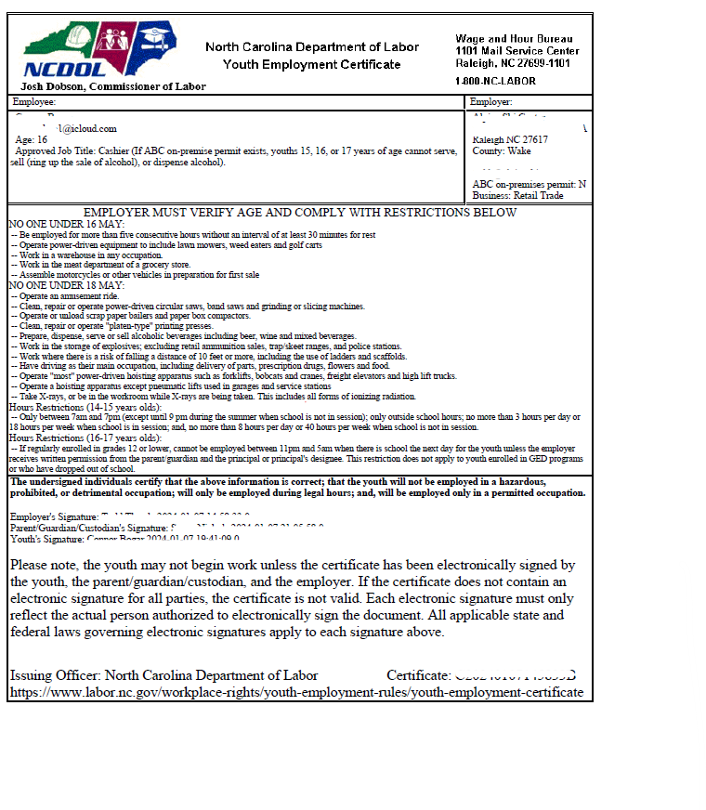
Youth Employment Certificates
Youth Employment Certificates(YEC) are required for youths employed under 18 years of age.
A YEC will not be issued if the youth’s employment will violate child labor or youth employment requirements of either state or federal laws.
A YEC is not required if there is no employer-employee relationship and no YEC is needed for a few other jobs such as bona fide volunteer employment.
Youths working for their parent(s), who are sole owner(s) of the business, may work at any age however, a YEC is required (NO exception for manufacturing, mining, hazardous and/or detrimental occupations);

Slide 22
At what age can a youth begin work?
Under age 14
May not work unless you they fall into one of the following:
Youths age 12-13 may work in newspaper delivery as long as direct distribution to consumer and do not work during school hours; no YEC is required.
Youths working for their parents may work at any age, but a youth employment certificate is required.
Models, Actors, and Performers on motion pictures or theatrical radio or television productions; a youth employment certificate is required.

Slide 23
At what age can a youth begin work?
Age 14 is generally the minimum wage for a youth to work. Work may be performed in retail businesses, food service establishments, service stations and offices of other businesses. Work is not permitted in manufacturing, mining, on construction sites, with power-driven machinery, inside the premise of a business holding an ABC permit for the on-premises sale or consumption of alcoholic beverages, or in hazardous or detrimental occupations.
Age 16 is the minimum age youths may be employed in any occupation, other than a non-agricultural occupation declared to be hazardous or detrimental (NO parental exception).
Age 18
No youth employment certificate required.

Slide 24
Are their exemptions that don’t require a Youth Employment Certificate?
YEC NOT REQUIRED
Governmental Employees
Agriculture
Domestic Workers
Volunteers
Newspaper Delivery
YEC REQUIRED
Models, Actors, and Performers
Outdoor Drama Production
Employed by Parent(s) who are sole owner(s) of the business

Slide 25
Detrimental Occupations – State of NC Enforcement
1. Welding, brazing and torch cutting
2. Any processes where quartz or any other form of silicon dioxide or asbestos silicate is present in powdered form.
3. Any work involving exposure to lead or any of its compounds in any form.
4. At any work involving exposure to benzene or any benzene compound that is volatile or can penetrate the skin.
5. Occupations in canneries, seafood and poultry processing that involve cutting or slicing machines, or freezing or packaging activities.
6. Any work which involves the risk of falling a distance of 10 feet or more, including ladders and scaffolds.
7. Any work as an electrician or electrician’s helper.
8. Any work in confined spaces.
9. Occupations requiring the use of respirators.

Slide 26
Hazardous Occupations
US Department of Labor – Federal Enforcement under Fair Labor Standards Act
1. Manufacturing and storing explosives.
2. Motor-vehicle driving and outside helper
3. Coal mining
4. Logging and sawmilling
5. Power-driven woodworking machines
6. Exposure to radioactive substances
7. Power-driven hoisting apparatus
8. Power-driven metal-forming, punching and shearing machines
9. Mining, other than coal mining
10. Slaughtering, meat-packing processing or rendering
11. Power-driven bakery machines
12. Power-driven paper-products machines
13. Manufacturing brick, tile and kindred products
14. Power-driven circular saws, band saws and guillotine shears
15. Wrecking, demolition and ship-breaking operations
16. Roofing operations
17. Excavation operations

Slide 27
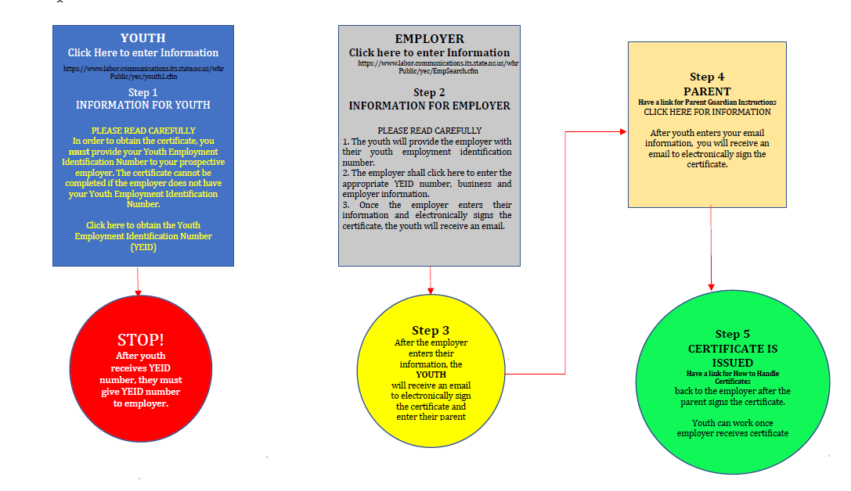
Process to Obtain a Youth Employment Certificate

Slide 28
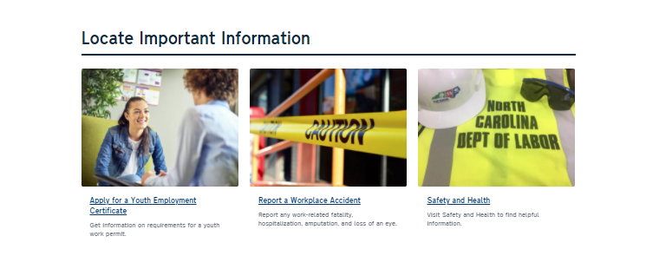
Obtaining a Youth Employment Certificate www.labor.nc.gov

Slide 29
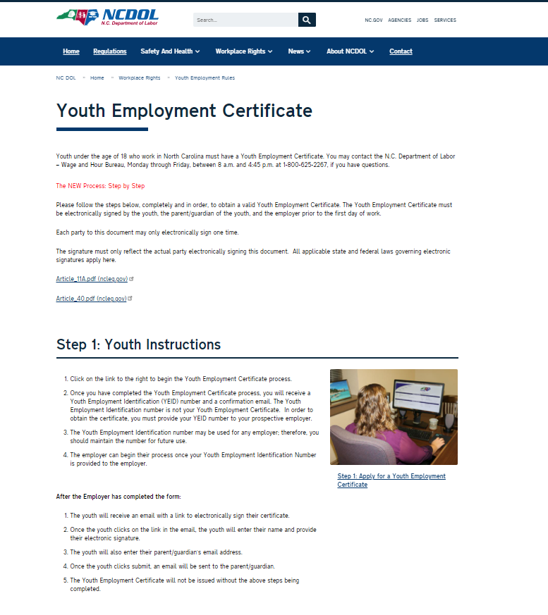
Obtaining a Youth Employment Certificate

Slide 30
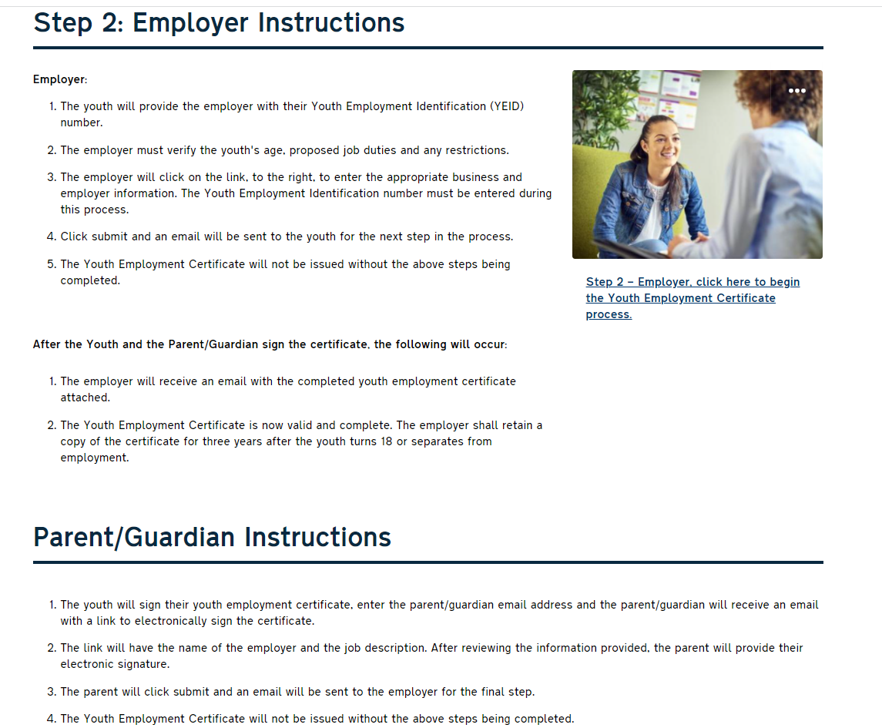
Obtaining a Youth Employment Certificate

Slide 31
Obtaining a Youth Employment Certificate

Slide 32
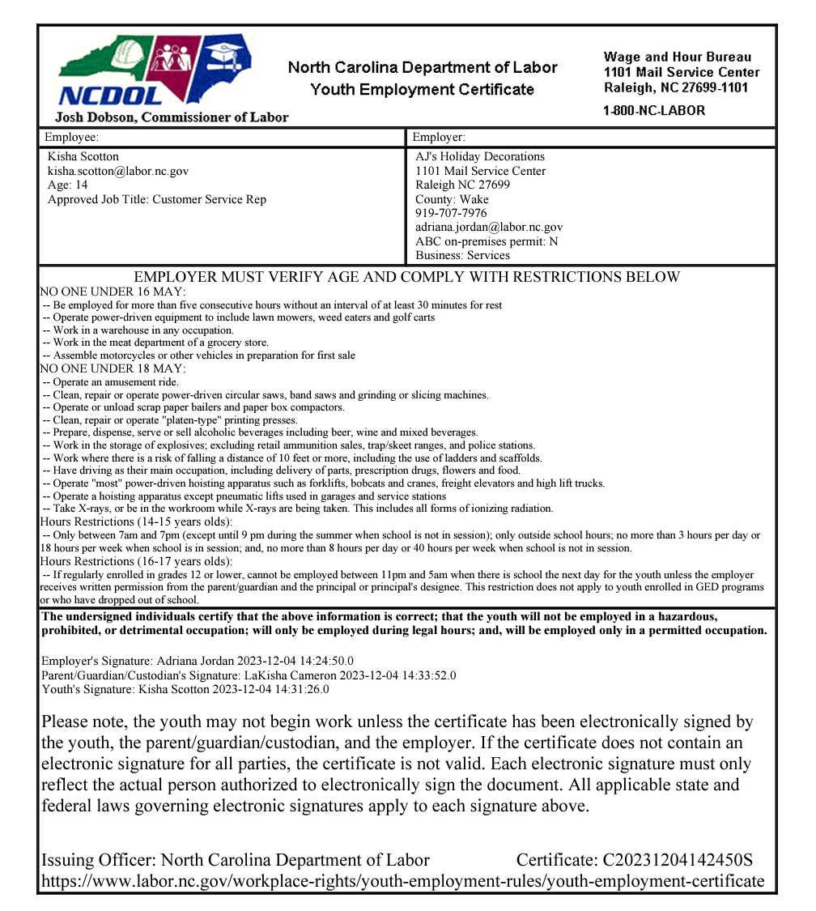
Employers should verify that the
Youth Employment Certificate is signed by a parent or legal guardian.
Signatures are appropriately noted
Youth’s signature is noted for the youth.
Parent’s signature is noted for the parent.
Certificate is signed by all parties prior to the first day of work.
3 Signatures, Dates & Time

Slide 33
Violations and Penalties
Any employer who violates the Youth Employment Provisions of the NC Wage and Hour Act may be subject to a civil penalty for each violation that is assessed.
The maximum amount of the penalty will be based on the nature and gravity of the violation(s).
Reductions in penalty amount may be made based on the size of the business and its past record of compliance with youth employment requirements.
An employer may take an exception to civil money penalty by filing a petition for a hearing with the Office of Administrative Hearings.

Slide 34
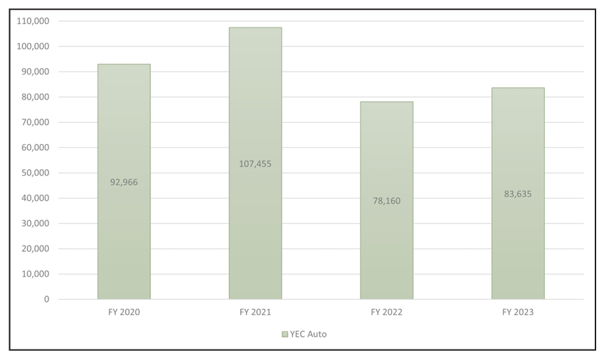
Youth Employment Statistics

Slide 35
Record Keeping Requirements
1. Full name of the employee
2. Home address, including phone number
3. Date of birth if employee is under 20
4. Occupation or job title
5. Time of day and day of week the employee’s workweek begins
Regular rate of pay (hourly or salary)
Hours worked each workday
Total hours worked each workweek
Total straight-time earnings each workweek
Total overtime earnings each workweek
Total additions to or deductions from wages
Total gross wages paid each pay period
Date of each payment
(b) All other records required by statute or rule for the enforcement of any provision of the Wage and Hour Act must also be maintained by the employer. Such records include, but are not limited to, the following: tip credits; costs of meals, lodging or other facilities; start and end time for youth under age 18; youth employment certificates; wage deductions; vacation and sick leave policies; policies and procedures relating to promised wages; and records required to compute wages.

Slide 36
Penalties
Any employer who violates the Record Keeping Provisions of the NC Wage and Hour Act may be subject to a civil penalty for each violation that is assessed.
The maximum amount of the penalty will be based on the nature and gravity of the violation(s).
Reductions in penalty amount may be made based on the size of the business and its past record of compliance with record keeping requirements.
An employer may take an exception to civil money penalty by filing a petition for a hearing with the Office of Administrative Hearings.

Slide 37
Additional Regulations Enforced
Controlled Substance Act
Expungement of Records
Medical Payment Law
Private Personnel Service Act
Verification of Work Authorization Act

Slide 38
Controlled Substance Examination Regulation Act
The Wage and Hour Bureau enforces the Controlled Substance Examination Regulation Act, which protects individuals from unreliable and inadequate examinations and screening and ensures procedural requirements for the administration of controlled substance examinations are established.

Slide 39
Effect of Expunction
The Wage and Hour Bureau enforces Effect of Expunction which prohibits employers and educational institutions from asking a person about a charge or conviction that has been expunged.

Slide 40
Medical Payment Law
The Wage and Hour Bureau enforces Medical Payment Law which states that it shall be unlawful for any employer with twenty-five (25) or more employees to require any applicant for employment to pay the cost of a medical examination or the cost of providing any records required by the employer as a condition of the initial act of hiring.

Slide 41
Private Personnel Services
The Wage and Hour Bureau enforces the Private Personnel Services Act which ensures that companies providing such services comply with the licensing and fee requirements.
"Private personnel service" means any business operated in the State of North Carolina by any person for profit which secures employment or holds itself out to applicants as able to secure employment or to provide information or service of any kind purporting to promote, lead to or result in employment for the applicant with any employer other than itself, where any applicant may become liable for the payment of a fee to the private personnel service, either directly or indirectly.

Slide 42
Verification of Work Authorization
The Wage and Hour Bureau handles complaints concerning alleged failure to properly check work authorizations or failure to E-Verify. This applies to businesses with more than 25 employees in a nine-month calendar year.

Slide 43
Online Training Dates
The Wage and Hour Bureau offers a monthly presentation on the Wage and Hour Laws, every third Thursday of each month at 1pm.
To register, please visit our website at www.labor.nc.gov.
In person and/or virtual presentations can be requested. To submit a request, please visit our website at www.labor.nc.gov.

Slide 44
Where to get more information
NC Department of Labor
Wage and Hour Bureau
1101 Mail Service Center
Raleigh, NC 27699‑1101
1-800-625-2267
NCDOL Web Site: www. labor.nc.gov
US Department of Labor
Wage and Hour Division
1-866-4-USWAGE
(1-866-487-9243)
USDOL Web Site: www.dol.gov/agencies/whd

Slide 45
Thank you for attending the
North Carolina Wage and Hour Laws
What You Should Know
North Carolina Wage and Hour Bureau
Josh Dobson, Commissioner

