Slide 1
Machinery and Machine Guarding
29 CFR 1910.211–219
29 CFR 1910.241–244
Presented by:
Notes:
Revised 10/21
The information in this presentation is provided voluntarily by the N.C. Department of Labor, Education, Training and Technical Assistance Bureau as a public service and is made available in good faith. This presentation is designed to assist trainers conducting OSHA outreach training for workers. Since workers are the target audience, this presentation emphasizes hazard identification, avoidance, and control – not standards. No attempt has been made to treat the topic exhaustively. It is essential that trainers tailor their presentations to the needs and understanding of their audience.
The information and advice provided on this Site and on Linked Sites is provided solely on the basis that users will be responsible for making their own assessment of the matters discussed herein and are advised to verify all relevant representations, statements, and information.
This presentation is not a substitute for any of the provisions of the Occupational Safety and Health Act of North Carolina or for any standards issued by the N.C. Department of Labor. Mention of trade names, commercial products, or organizations does not imply endorsement by the N.C. Department of Labor.
NCDOL References: MACHINERY AND MACHINE GUARDING
CPL 02-01-025 Power Press Brakes, SN 56A Heavy and Light Duty Pneumatic Staplers
STD 1-12.1 Guarding of Fan Blades, STD 1-12.4 Radial Saws - Labeling
STD 1-12.5 Circular Meat Cutting Saws, STD 1-12.6 Forging Machines
STD 1-12.7 Platen Presses, STD 1-12.10 Machine Guarding –Food Waste Disposal Equipment
STD 1-12.14 Power Transmission Belts, STD 1-12.15 Automatic Cut-off Saws - Guards
STD 1-12.17 Radial Saws – Guards, STD 1-12.18 Ripsaws, Cutoff Saws, & Radial Saws
STD 1-12.19 Sewing Machines – Guards, STD 1-12.22 Engraving Presses – Guards
STD 1-12.23A Three-Roller Printing Ink Mills – Guards, STD 1-12.25A Metal Cutting Shears – Awareness Barriers
STD 1-12.26A Cutoff Wheels and Masonry Saws, STD 1-12.27 Mechanical Power Presses and Iron Workers
STD 1-13.4 Portable Belt Sanders – Guards, CFR 170 Mechanical Power Transmission Apparatus

Slide 2
Objectives
After this course, students will be able to:
Identify machine guarding hazards
Understand machine guarding abatement methods
Become familiar with the machine guarding standards

Slide 3
Machinery and Machine Guarding
1910.211 – Definitions
1910.212 – General requirements for all machines
1910.213 – Woodworking machinery requirements
1910.215 – Abrasive wheel machinery
1910.217 – Mechanical power presses
1910.219 – Mechanical power-transmission apparatus

Slide 4
Hand and Portable Powered Tools
1910.241 – Definitions
1910.242 – Hand and portable powered tools and equipment, general
1910.243 – Guarding of portable powered tools
1910.244 – Other portable tools and equipment

Slide 5
Amputations Special Emphasis Program
Goal to reduce occupational exposures to amputations
Struck by and caught between injuries
Lockout/tagout
Machine guarding
Increase outreach to employers and employees
Training events (Internal and external)
Compliance inspections
Consultation visits
Publications
Amputations must be reported within 24 hours

Slide 6
Mechanical Hazards
MOTIONS | ACTIONS
Rotating | Cutting
In-running nip points | Punching
Reciprocating | Shearing
Transverse | Bending
Notes:
6

Slide 7
Methods of Guarding
Guards
Devices
Location/distance
Feed mechanisms
Miscellaneous aids

Slide 8
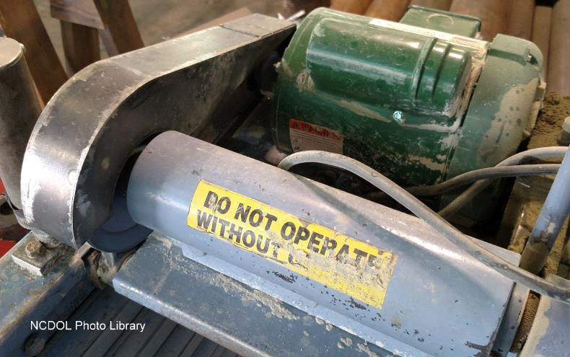
Machine Guards
Guards are barriers that prevent access to danger areas
Fixed guards
Interlocks
Adjustable
Self-adjusting

Slide 9
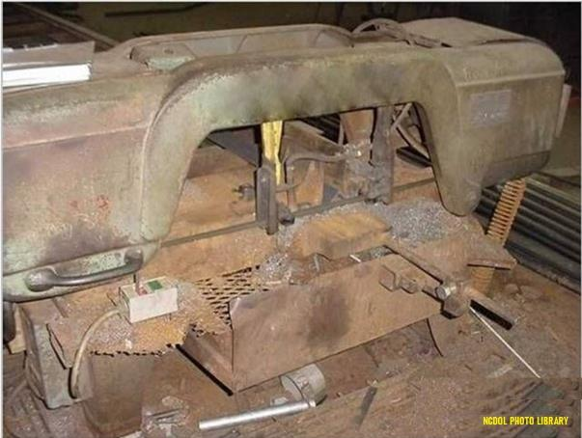
Machine Guarding 1910.212(a)(1)
Guarding provided to protect employees from hazards created by:
Point of operation
Ingoing nip points
Rotating parts
Flying chips and sparks

Slide 10
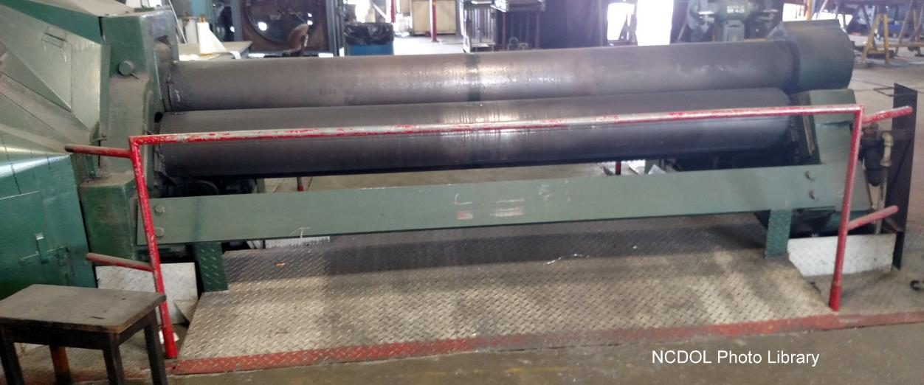
Machine Guarding 1910.212(a)(1)
Barrier guards

Slide 11
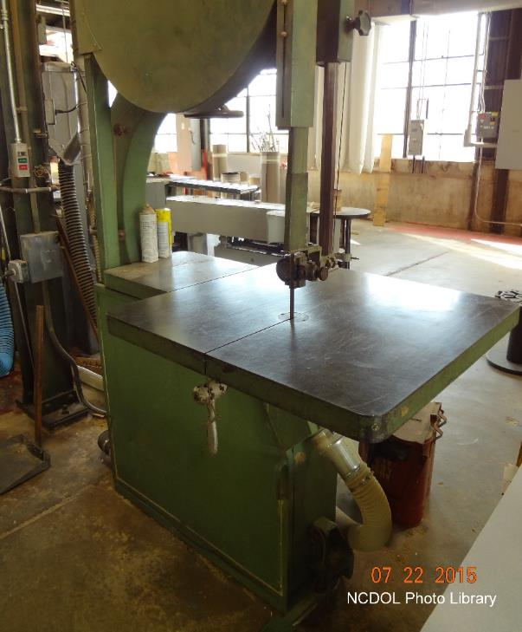
Machine Guarding 1910.212(a)(1)
Adjustable guard

Slide 12
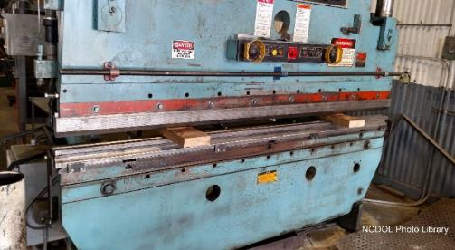
Safeguarding Devices
Photoelectric presence-sensing
Radiofrequency
Electromechanical sensing device
Pullbacks
Restraints
Safety trip controls
Two-hand controls
Two-hand trip
Gates
NCDOL Photo Library
Two Hand Control

Slide 13
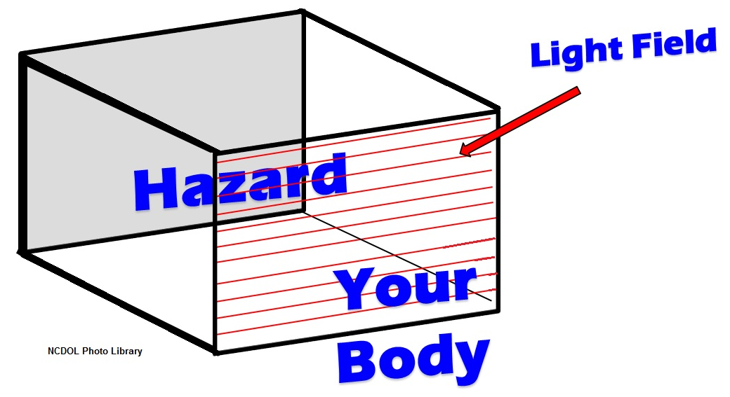
Machine Guarding 1910.212(a)(1)
Presence-sensing device

Slide 14
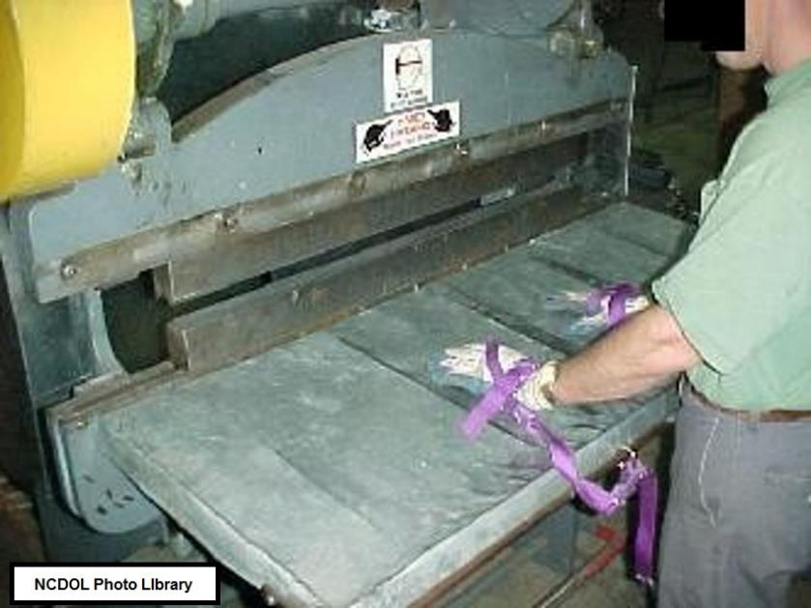
Machine Guarding 1910.212(a)(1)
Pull-out device

Slide 15
Machine Guarding 1910.212(a)(1)
A holdout or restraint device

Slide 16
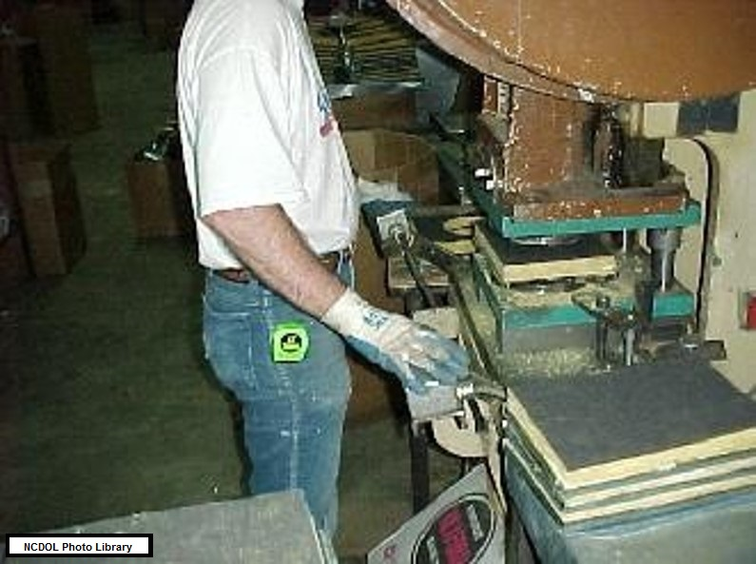
Machine Guarding 1910.212(a)(1)
Two-hand tripping devices

Slide 17
Location/Distance
Hazard analysis
Hazards are not accessible
Walls
Fences
Height
Stock dimension
Operator’s station

Slide 18
Feed Mechanisms
Automatic feeding
Semi-automatic feed
Automatic ejection
Semi-automatic ejection
Robots

Slide 19
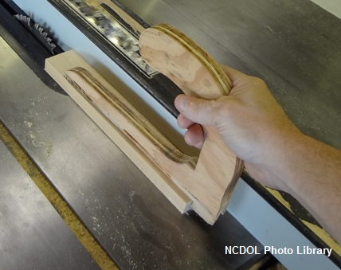
Miscellaneous Aids
Awareness barriers
Shields
Holding tools
Push stick or block

Slide 20
Safeguard Requirements
Prevent contact
Properly secured
Protect from falling objects
Create no hazards
Create no interference (greater hazard)
Allow safe lubrication (removal of guards)

Slide 21
General Requirements 1910.212(a)(2)
Guards affixed to machine where possible
Guard must not offer an accident hazard in itself

Slide 22
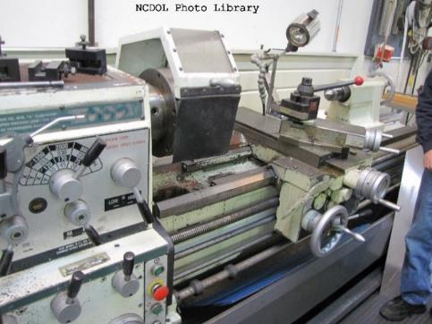
General Requirements 1910.212(a)(3)
Machine guarding for all machines
Point of operation of
machines whose operation
exposes an employee to injury,
shall be guarded
Special hand tools for placing
and removing material must
permit easy handling of material
Without the operator placing a hand in
the danger zone

Slide 23
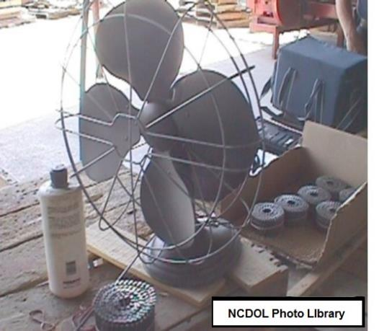
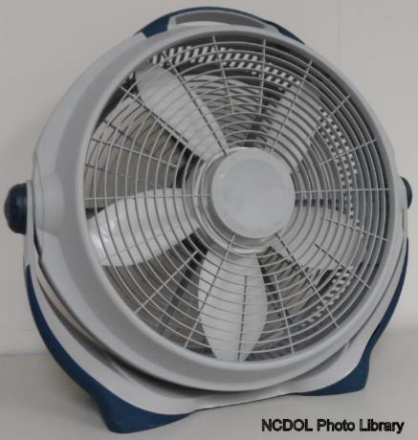
General Requirements 1910.212(a)(5)
Exposure of blades
Blades of fans less than 7 feet above floor or working level must be guarded
Guard openings must be no larger than ½ inch
vs.

Slide 24
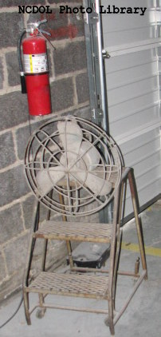
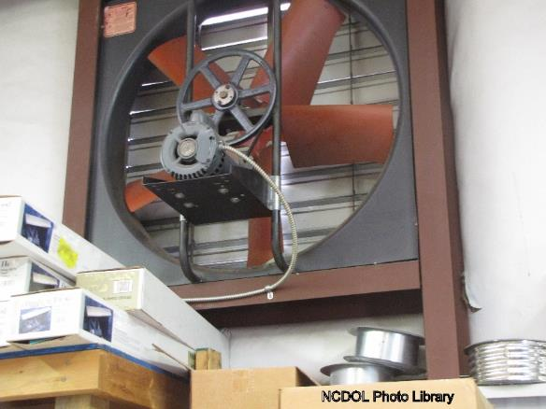
Fan Blades Not Properly Guarded
Corrective action
Install proper guard over fan blades with opening no larger than ½ inch

Slide 25
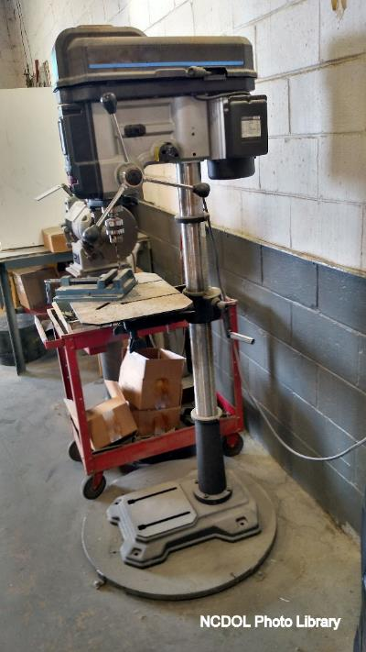
General Requirements 1910.212(b)
Anchoring fixed machinery
Machines designed for fixed location must be anchored to prevent walking or moving

Slide 26
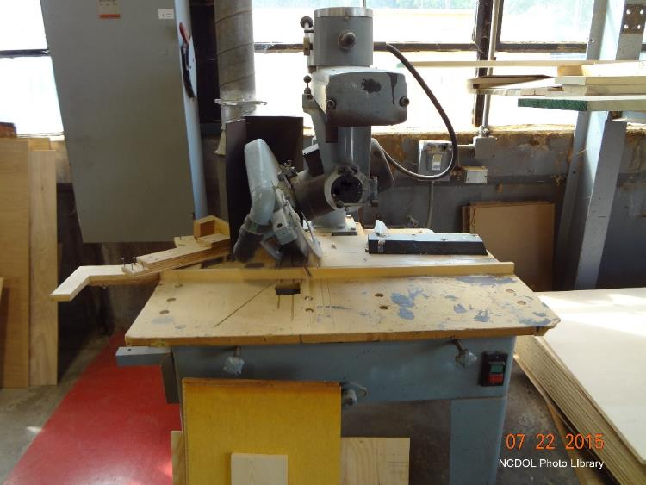
Woodworking Machinery 1910.213(b)(1)
Machine controls and equipment
Mechanical or electrical power control provided for operator to cut off power
Located on machine
where operator does
not have to leave his
position at the point
of operation

Slide 27
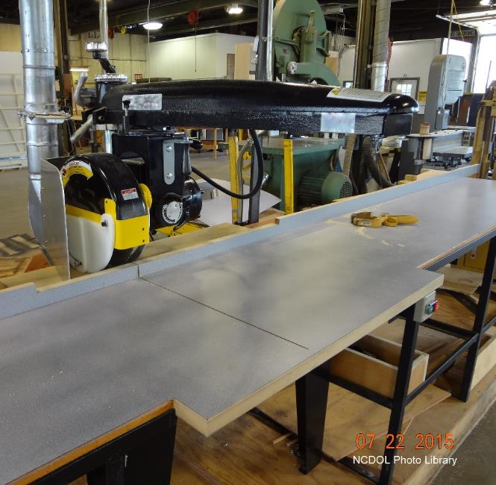
Woodworking Machinery 1910.213(b)(3)
Machine controls and equipment
Provision to prevent machines from automatically restarting upon restoration of power

Slide 28
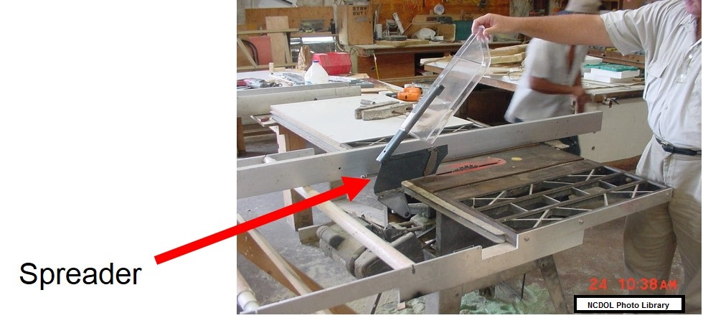
Woodworking Machinery 1910.213(c)(1)-(c)(3)
Hand-fed ripsaw
Provided with a hood guard
Provided with a spreader
Provided with non-kickback fingers or dogs

Slide 29
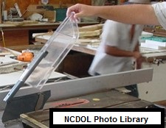
Woodworking Machinery 1910.213(c)(1)
Hand-fed ripsaw
Hood guard must automatically adjust itself to thickness of material being cut
Remain in contact
with material
USDOL Photo Library

Slide 30
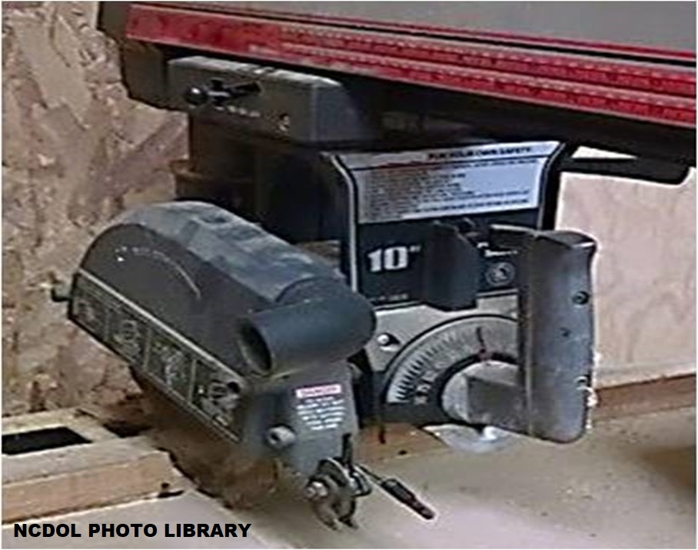
Woodworking Machinery 1910.213(h)(1)
Radial saws
Upper hood must completely enclose upper portion of blade
Must include the end of
the saw arbor

Slide 31
Woodworking Machinery 1910.213(h)(1)
Radial saws
Lower portion of blade must be guarded on both sides
Guarded to the full diameter of the blade
Will adjust itself to the thickness of the stock

Slide 32
Woodworking Machinery 1910.213(h)(1)

Slide 33
Woodworking Machinery 1910.213(h)(2)–(h)(5)
Radial saws
Saw used for ripping provided with non-kickback fingers or dogs
Ripping must be against the direction which the saw turns
Adjustable stops preventing forward travel of blade beyond position necessary to complete cut
Cutting head must return to starting position when released

Slide 34
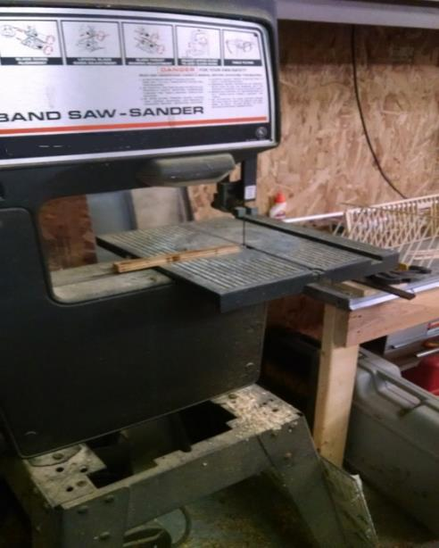
Woodworking Machinery 1910.213(i)(1)
Bandsaws and band re-saws
All portions of saw blade must be enclosed or guarded
Except working portion between guide rollers and the table
NCDOL Photo Library

Slide 35
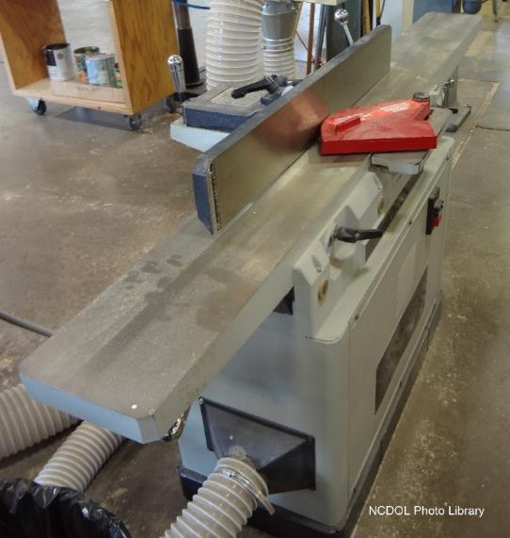
Woodworking Machinery 1910.213(j)(3)-(j)(4)
Jointers
Hand-fed jointers with horizontal cutting heads must have an automatic guard that covers the working side of the fence or gage and automatically adjusts and covers the unused portion of the head
Hand-fed jointers with horizontal cutting heads must also have a guard that covers the section of head back of the gage or fence

Slide 36
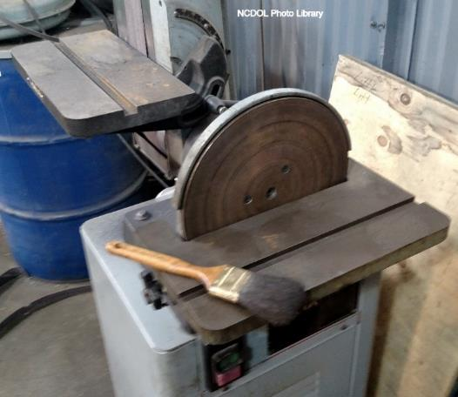
Woodworking Machinery 1910.213(p)(3)
Disk sanding machine
Exhaust hood or guard arranged to enclose revolving disk
Except portion above table

Slide 37
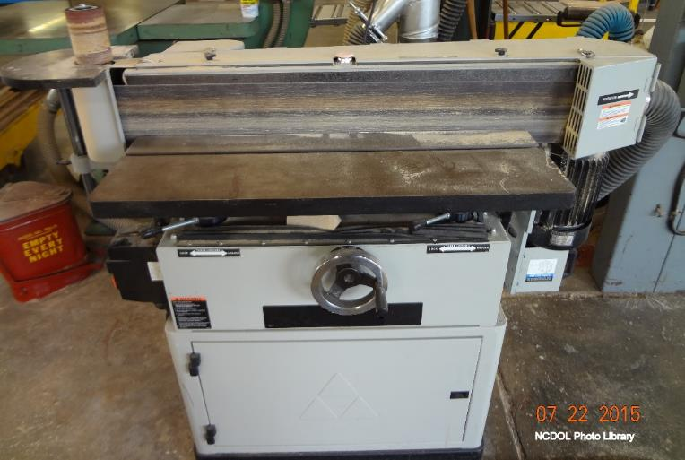
Woodworking Machinery 1910.213(p)(4)
Belt sanding machines
Guards provided at each nip point where sanding belt runs on to a pulley

Slide 38
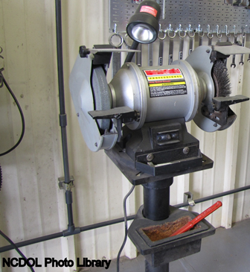
Abrasive Wheel Machinery 1910.215(a)(4)
Work rests must be adjusted closely to the wheel with a maximum opening of ⅛ inch

Slide 39
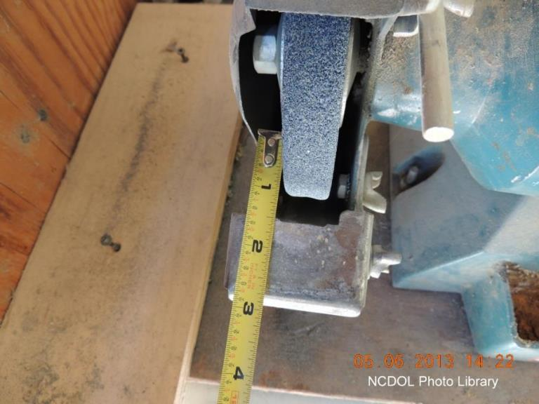
Abrasive Wheel Machinery 1910.215(a)(4)
Work rests must be adjusted closely to the wheel with a maximum opening of ⅛ inch

Slide 40
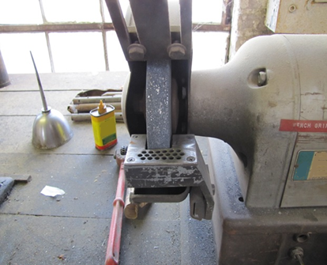
Abrasive Wheel Machinery 1910.215(b)(9)
Distance between the wheel periphery and the adjustable tongue must not exceed ¼ inch
NCDOL Photo Library

Slide 41
Abrasive Wheel Machinery 1910.215(b)(9)
Corrective action
Properly adjust the work rest and tongue guard to allowable openings

Slide 42
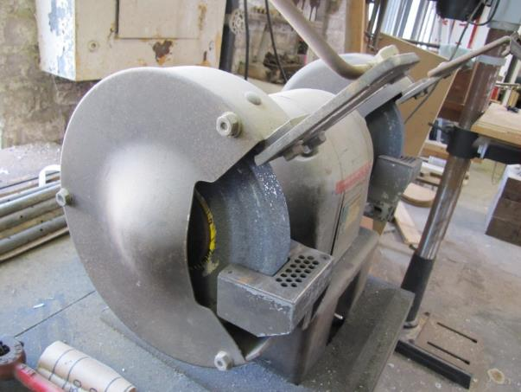
Abrasive Wheel Machinery 1910.215(b)(3)
Bench and floor stands
The angular exposure of the grinding wheel periphery and sides for safety guards used on machines should not exceed 90 degrees or ¼ of the periphery
NCDOL Photo Library
NCDOL Photo Library

Slide 43
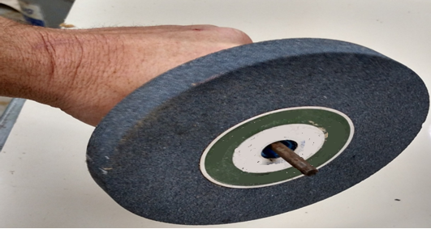
Abrasive Wheel Machinery 1910.215(d)(1)
Inspection
All abrasive wheels must be closely inspected and ring-tested before mounting to ensure that they are free from cracks and defects
NCDOL Photo Library

Slide 44
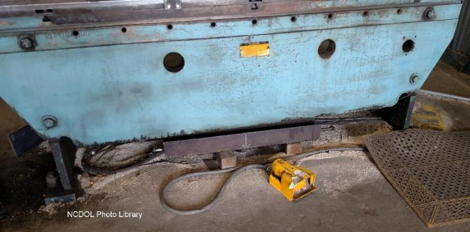
Mechanical Power Presses 1910.217(b)(4)(i)
Foot pedals (treadle)
Pedal mechanism shall be protected to prevent unintended operation
From falling or moving
objects
Accidental stepping
onto the pedal

Slide 45
Mechanical Power Presses
1910.217(c)(1), (c)(3)(iii)-(iii)(a)
Safeguarding the point of operation
Point of operation must be provided with guards or point of operation devices
Presence sensing point of operation device
Must be interlocked into the control circuit to
prevent or stop slide motion if part of operator’s body is within sensing field during down stroke of press slide
Presence sensing point of operation device
Presence sensing devices cannot be used on machines using full revolution clutches

Slide 46
Mechanical Power Presses 1910.217(c)(3)(iv)
Pull-out device shall include attachments for each of operator’s hands
Connected to and operated only by press slide of upper die
Visually inspected and properly adjusted at start of each operator shift
Properly adjusted

Slide 47
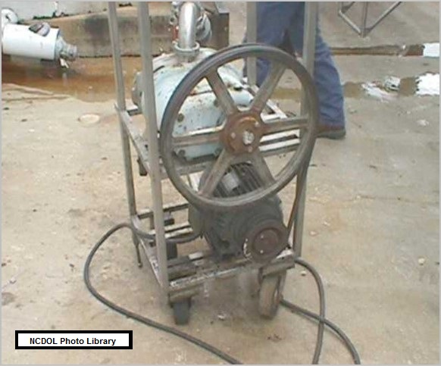
Mechanical Power-Transmission Apparatus
1910.219(b)(1)
Prime-mover guards
Flywheels with any part 7 feet or less above floor or platform must be guarded

Slide 48
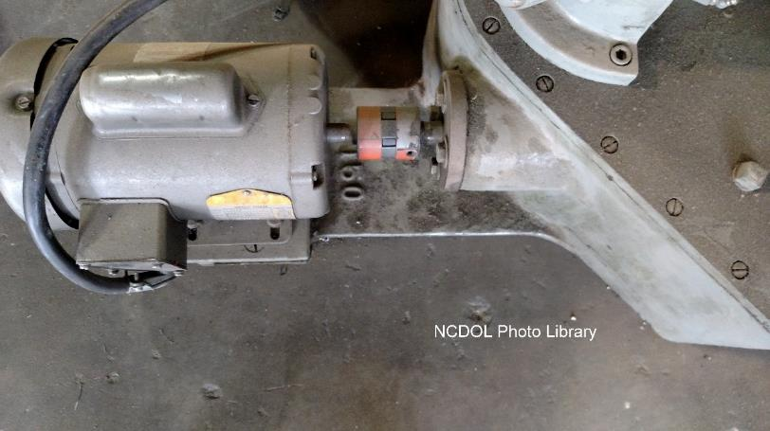
Mechanical Power-Transmission Apparatus
1910.219(c)(2)(i)
Shafting
Exposed parts of horizontal shafting 7 feet or less from floor or working platform must be guarded

Slide 49
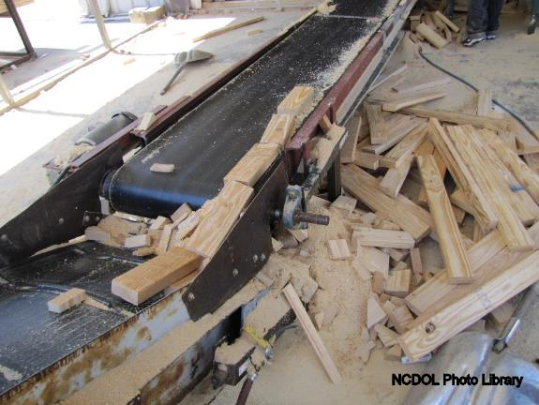
Mechanical Power-Transmission Apparatus
1910.219(c)(4)(i)
Projecting shaft ends
Must not project more than ½ the diameter of the shaft
Unless guarded by non-rotating caps or safety sleeves
NCDOL Photo Library

Slide 50
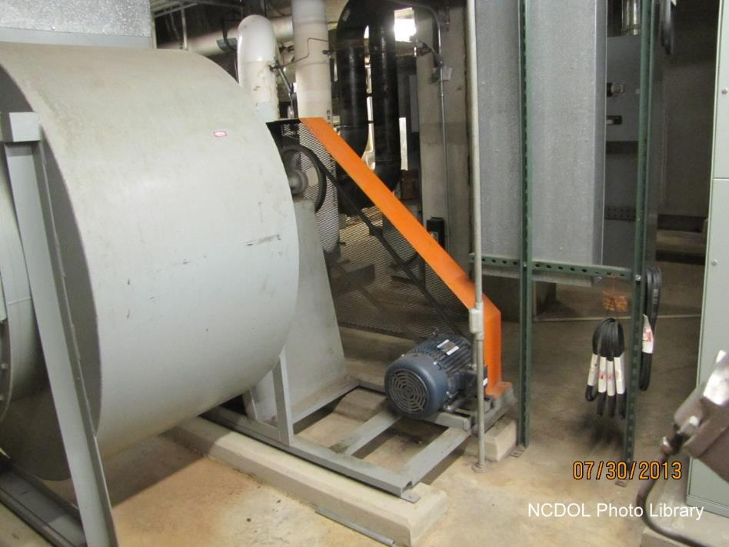
Mechanical Power-Transmission Apparatus
1910.219(d)(1)
Pulleys
Any parts of pulleys which are 7 feet or less from floor or working platform must be guarded

Slide 51
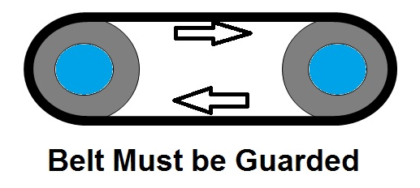
Mechanical Power-Transmission Apparatus
1910.219(e)(1)(i)
Where both runs of horizontal belts are 7 feet or less from floor level
Guard must extend at least 15 inches above
the belt
Horizontal belt with both runs 42 inches or less from floor must be fully enclosed
NCDOL Photo Library

Slide 52
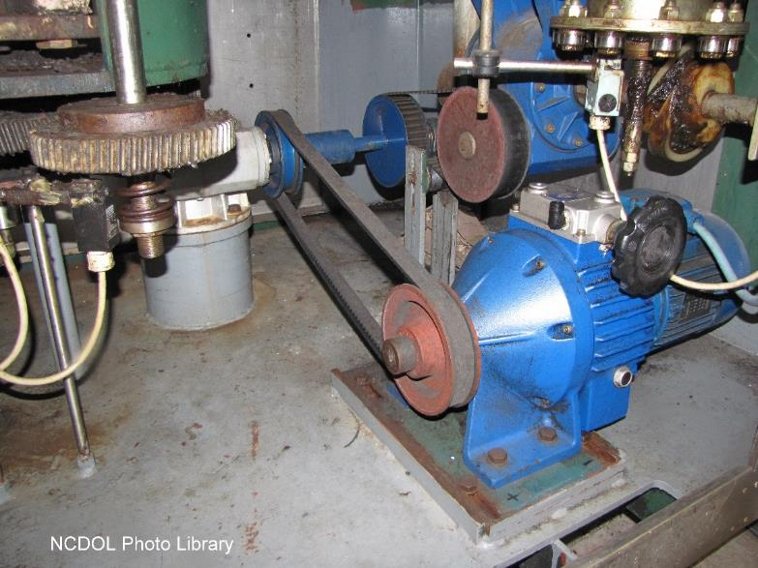
Mechanical Power-Transmission Apparatus
1910.219(e)(3)(i)
Vertical and inclined belts must be enclosed
by a guard

Slide 53
Mechanical Power-Transmission Apparatus
1910.219(f)(1)
Gears must be guarded by complete enclosures or standard guard

Slide 54
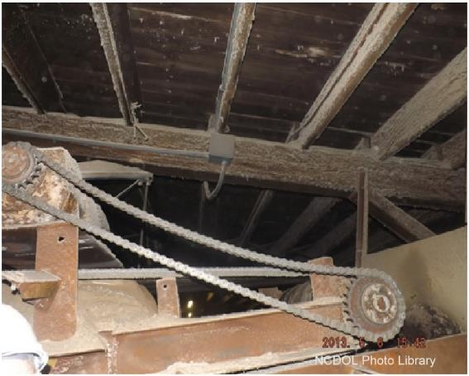
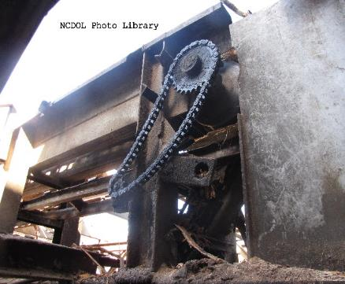
Mechanical Power-Transmission Apparatus
1910.219(f)(3)
Sprockets and chains
Sprocket wheels and chains located 7 feet or less above the floor or platform must be enclosed

Slide 55
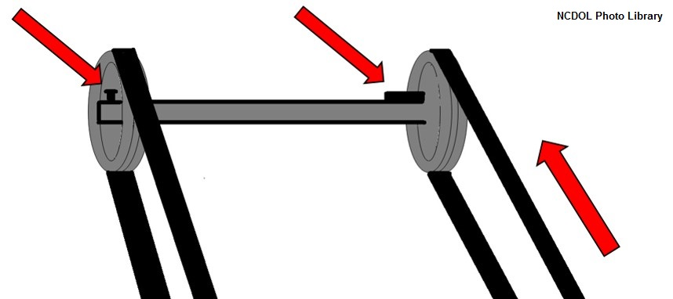
Mechanical Power-Transmission Apparatus
1910.219(h)(1)
Keys, setscrews, and other projections
Projecting keys, setscrews, and other projections in revolving parts must be removed, made flush, or guarded

Slide 56
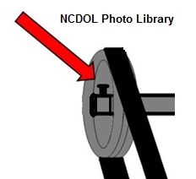
Mechanical Power-Transmission Apparatus
1910.219(i)(2)
Shaft couplings must be constructed as to present no hazard from bolts, nuts, setscrews, or revolving surfaces
Permitted where they are
covered with safety sleeves
or countersunk and do not
extend beyond the flange
of the coupling

Slide 57
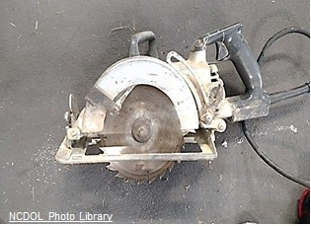
Portable Powered Tools 1910.243(a)(1)(i)
Portable circular saws
Must be equipped with guards above and below the base plate or shoe
Lower guard must cover the saw to the depth of the teeth

Slide 58
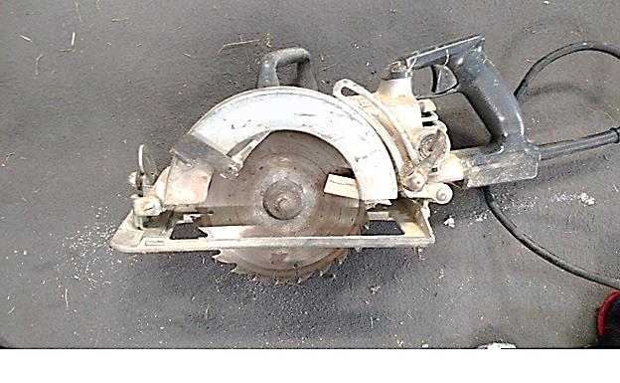
Portable Powered Tools 1910.243(a)(1)(i)
Portable circular saws
Lower guard must automatically return to the covering position over the blade teeth
When tool is withdrawn from the work
NCDOL Photo Library

Slide 59
Portable Powered Tools 1910.243(a)(2)(i)
Switches and controls
All hand-held powered circular saws must be equipped with a constant pressure switch or control
Will shut off the power when the pressure is released

Slide 60
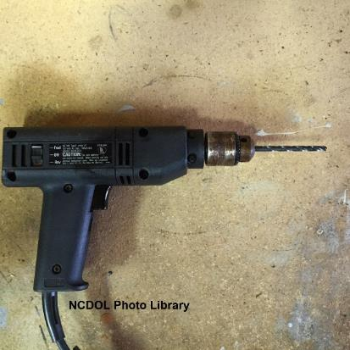
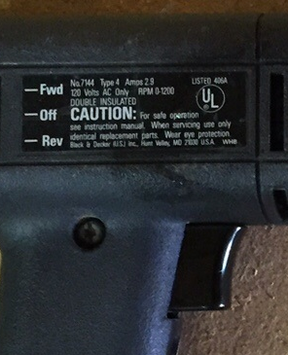
Portable Powered Tools 1910.243(a)(2)(ii)
Electric tools must be equipped with switches that must be equipped with a constant pressure switch, or
Turnoff can be accomplished by a single motion of same finger or fingers that turn it on
NCDOL Photo Library

Slide 61
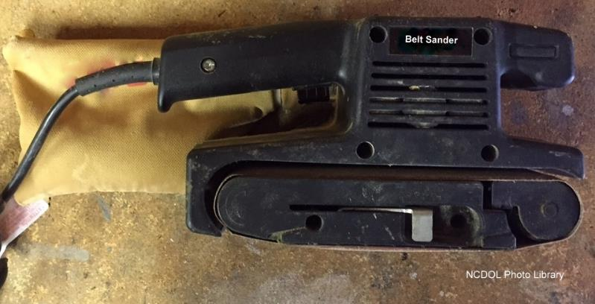
Portable Powered Tools 1910.243(a)(3)
Portable belt sanding machines
Must have guards at nip points where belt runs onto a pulley
Unused portion of the belt must be guarded

Slide 62
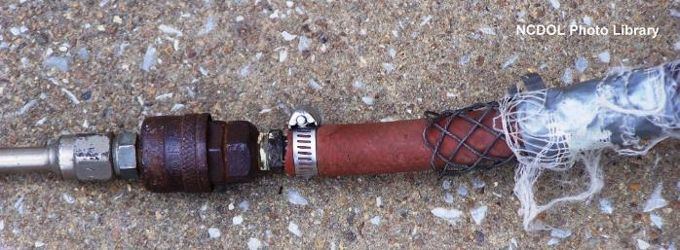
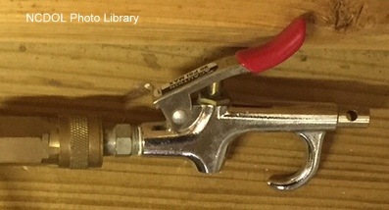
Portable Powered Tools 1910.243(b)(2)
Pneumatic powered tools and hose
Hose and hose connections shall be designed for pressure and service which they are subjected
Improper Hose Connection
Proper Tool Connection

Slide 63
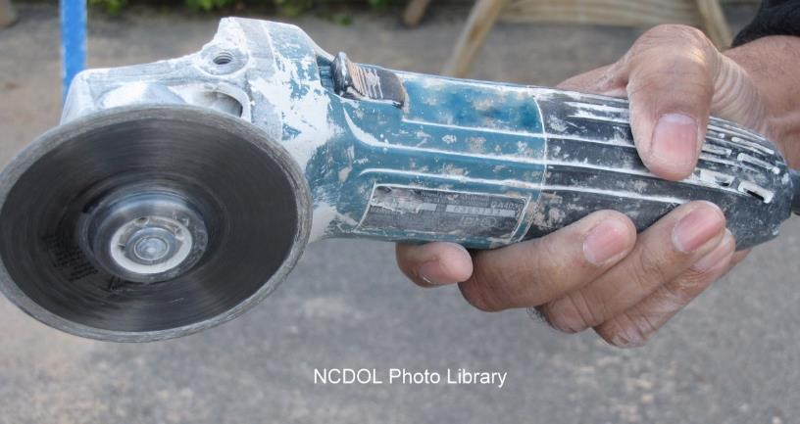
Portable Powered Tools 1910.243(c)(3)
Vertical portable grinders
Must have safety guard on tool with a maximum exposure angle of 180 degrees

Slide 64
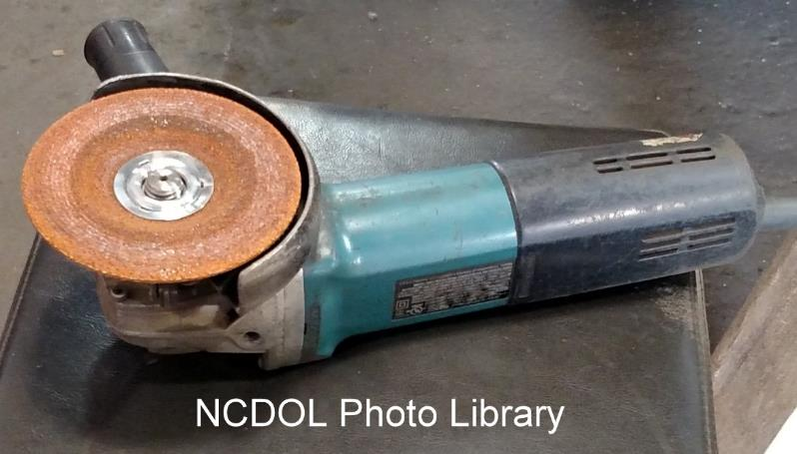
Portable Powered Tools 1910.243(c)(3)
Corrective action
Install proper type of guard
Guard must be located so as to be between the operator and the wheel during use

Slide 65
Summary
In this course, we covered:
Machine guarding hazards
Machine guarding abatement methods
Machine guarding standards

Slide 66
Thank You For Attending!
Final Questions?

