Slide 1
Health Hazards
Special Emphasis Program, OPN 135
Notes:
Revised 6/16/25
The information in this presentation is provided voluntarily by the N.C. Department of Labor, Education Training and Technical Assistance Bureau as a public service and is made available in good faith. This presentation is designed to assist trainers conducting OSHA outreach training for workers. Since workers are the target audience, this presentation emphasizes hazard identification, avoidance, and control – not standards. No attempt has been made to treat the topic exhaustively. It is essential that trainers tailor their presentations to the needs and understanding of their audience.
The information and advice provided on this Site and on Linked Sites is provided solely on the basis that users will be responsible for making their own assessment of the matters discussed herein and are advised to verify all relevant representations, statements, and information.
This presentation is not a substitute for any of the provisions of the Occupational Safety and Health Act of North Carolina or for any standards issued by the N.C. Department of Labor. Mention of trade names, commercial products, or organizations does not imply endorsement by the N.C. Department of Labor.
NCDOL Reference:
MOU - NC Department of Health and Human Services-Occupational Health Surveillance Program

Slide 2
Objectives
After this course, students will:
  Understand the NCDOL Health Hazards Special Emphasis Program (SEP) requirements for:
    Lead
    Hexavalent chromium (CrVI) or Chrome 6
    Isocyanates
    Beryllium
    Silica
  Recognize exposure effects, health effects and abatement methods for each

Slide 3
Why a Health Hazards SEP?
Overexposures to these chemicals can lead to serious health effects.
Focus: to increase inspections in industries that use these chemicals and substances.

Slide 4
Health Hazards SEP
Lead
29 CFR 1910.1025
29 CFR 1926.62

Slide 5
Lead Standard
1910.1025
1926.62
Means metallic lead, all inorganic lead compounds, and organic lead soaps
  Excluded from this definition are all other organic lead compounds.
Exposure sources
  Lead-based paint, batteries, battery recycling, foundries, welding/cutting and brazing
  Lead shot, indoor/outdoor shooting ranges

Slide 6
How Lead Enters the Body
Inhalation:
  Lead as a dust, fume, or mist
  Absorbed into the body via lungs, upper respiratory tract
Ingestion:
  Can be transferred from hands to food, cigarettes, etc.
  Poor housekeeping and hygiene practices are typical root causes

Slide 7
Lead Health Effects
1910.1025, Appendix A
1926.62, Appendix A
Acute effects: Intense exposure/short duration
  Symptoms include metallic taste, stomach pain, vomiting, diarrhea and black stools
  Could potentially cause intoxication, coma, respiratory arrest, or death.
  Short term occupational exposures of this magnitude are highly unusual, but not impossible.

Slide 8
Lead Health Effects
1910.1025, Appendix A
1926.62, Appendix A
Chronic effects: Longer to develop/lower cumulative exposures over time
  Symptoms include tiredness, weakness, weight loss, insomnia, headache, nervous irritability, fine tremors, numbness, dizziness, anxiety and hyperactivity which could potentially lead to:
    Damage of the nervous system and brain
    Anemia
    Kidney disease

Slide 9
Lead Exposure Limits
1910.1025
1926.62
Permissible exposure limit (PEL) = 50 µg/m³ as an 8-hour time-weighted average (TWA)
  Employers shall implement engineering controls and safe work practices to prevent exposure
  Employers shall provide protective clothing and where necessary, and respiratory protection in accordance with 29 CFR 1910.134
Action level (AL) = 30 µg/m³ as an 8-hour TWA

Slide 10
Medical Surveillance
1910.1025
1926.62
General Industry
  Medical surveillance program required for employees who are/may be exposed above the action level for more than 30 days per year.
    Biological Monitoring/Blood Samples
  Appendix C - Medical Surveillance Guidelines
Construction
  Initial medical surveillance required for any employee exposed at or above the action level for any one day.

Slide 11

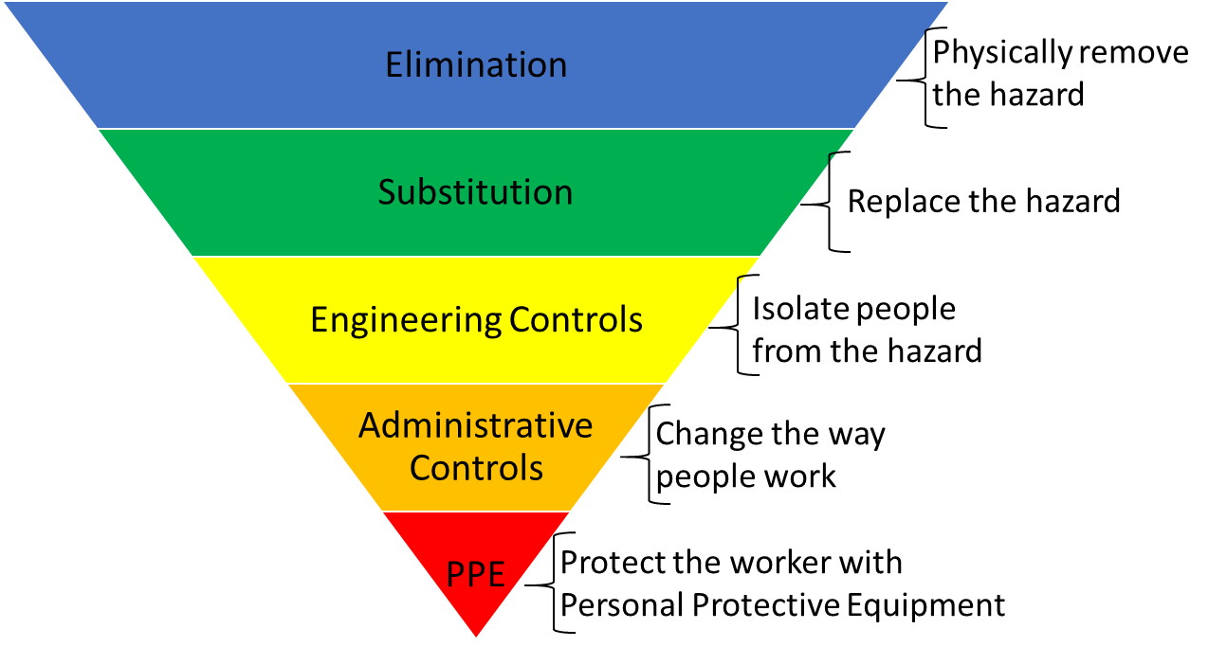
Hierarchy of Controls
1910.1025
1926.62
NCDOL Photo Library

Slide 12

Abatement Methods - Lead
1910.1025
1926.62
Elimination
Substitution
Engineering controls
  Mechanical ventilation
  Isolation
Administrative controls
  Housekeeping
  Personal hygiene practices
  Designated break areas
Personal protective equipment (PPE)
  Respiratory protection
  Protective work clothing
NCDOL Photo Library
Notes:
ensure that the proper procedures are followed.

Slide 13
Health Hazards SEP
Hexavalent Chromium
29 CFR 1910.1026
29 CFR 1926.1126

Slide 14
Hexavalent Chromium
Toxic form of chromium metal that is generally man-made.
Used in many industrial applications primarily for its anti-corrosive properties.
Can be created during “hot work” processes
  High temp oxidize chromium to Hexavalent form

Slide 15
Examples of Cr(VI) Compounds
Ammonium dichromate
Calcium chromate
Chromium trioxide or chromic acid
Lead chromate (chromium yellow)
Potassium chromate
Potassium dichromate
Sodium chromate
Strontium chromate
Zinc chromate
(NH₄)₂Cr₂O₇
CaCrO₄
CrO₃
PbCrO₄
K₂CrO₄
K₂Cr₂O₇
Na₂CrO₄
SrCrO₄
ZnCrO₄

Slide 16
Affected Operations
1910.1026
1926.1126
Electroplating
Welding on stainless steel or Cr(VI) painted surfaces
Painting
  Aerospace
  Auto body repair
Chromate pigment
and chemical production
Chromium dye and catalyst production
Glass manufacturing
Plastic colorant production
Construction
Refractory brick restoration
Paint removal from bridges
Traffic painting

Slide 17
Health Effects of Cr(VI)
Lung cancer (via inhalation of Cr(VI)
Irritation or damage to the nose, throat, and lung (respiratory tract) at high levels
Irritation or damage to the eyes and skin if contact at high concentrations
NCDOL Photo Library

Slide 18
Major Provisions
1910.1026
1926.1126
Scope
Permissible exposure limit
Exposure determination
Recordkeeping
Methods of compliance
Respiratory protection
Protective work clothing
and equipment
  *General Industry only
Hygiene areas and practices
Medical surveillance dates
Communication of hazards
Regulated areas*
Housekeeping*

Slide 19
Exposure Limits – Cr(VI)
1910.1026
1926.1126
Permissible exposure limit
  5 µg/m³, calculated as an 8-hour time-weighted average
Action level
  2.5 µg/m³
Exposure determination
  See paragraph (d) for more specifics
NCDOL Photo Library

Slide 20
Monitoring Methods
1910.1026
1926.1126
Scheduled
  Initial monitoring indicates exposures are:
    Below the AL: monitoring can be discontinued
    At or above the AL: monitor every 6 months
    Above the PEL: monitor every 3 months
  Periodic personal monitoring
Performance-oriented option
  To determine 8-hour TWA for each employee
  based on any combination of the following:
    Air-monitoring data
    Historical monitoring data
    Objective data

Slide 21
Regulated Areas – Cr(VI)
1910.1026(e)
Areas where exposures exceed or reasonably expected to exceed the PEL:
    Must be demarcated from other areas.
    Must limit access to required employees
Applies to General Industry employers only

Slide 22
Medical Surveillance is Required…
Employee shows signs and symptoms of adverse health effects or signs and symptoms of exposure
Employee occupationally exposed for 30 days or more at or above the AL
Physician/Licensed Healthcare Provider (PLHCP) written medical opinion (w/in 30 days of receipt)
Employee initially assigned or exposure of uncontrolled release (w/in 30 days of event)
Annually
Upon termination of employee

Slide 23
Abatement – Cr(VI)
1910.1026
1926.1126
Elimination
Substitution
Engineering controls
  Mechanical ventilation
Administrative controls
  Housekeeping
  Hygiene facilities
  Regulated areas of work
PPE
  Respiratory protection
  Protective work clothing
NCDOL Photo Library

Slide 24
Health Hazards SEP
Isocyanates
29 CFR 1910.1000
29 CFR 1926.55

Slide 25
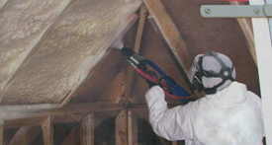
Isocyanates
Compounds containing the isocyanate group
(-NCO)
  React with compounds containing alcohol (hydroxyl) groups to produce polyurethane polymers, which are components of polyurethane foams, thermoplastic elastomers, spandex fibers, and polyurethane paints.
NCDOL Photo Library

Slide 26
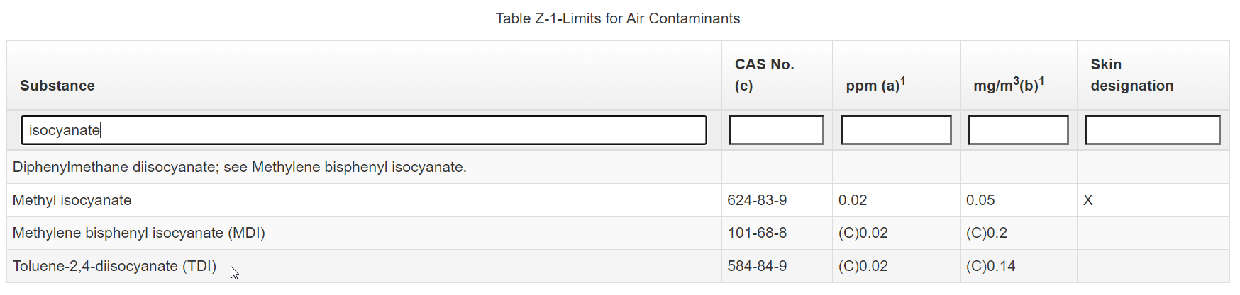
Isocyanates
1910.1000
1926.55
Isocyanates also found in raw materials that make up polyurethane products.
PELs/Threshold Limit Values (TLVs): <1 ppm.
NCDOL Photo Library

Slide 27
Health Effects of Isocyanates
Irritation of skin and mucous membranes, chest tightness, and difficult breathing common.
  Isocyanates include compounds classified as potential human carcinogens and are known to cause cancer in animals.
Main effects of hazardous exposures are:
  Occupational asthma and other lung problems,
  Irritation of the eyes, nose, throat, and skin.

Slide 28
Isocyanates
NCDOL Photo Library

Slide 29
How Isocyanates Can Affect the Body
Exposure: A worker is exposed via skin contact, mucous membranes or by inhalation
Sensitization: Worker develops allergy
More/continued exposure: Worker is exposed again to even a small amount

Slide 30
Medical Surveillance - Isocyanates
Recommendations for exposures at/above PEL/TLV
  Annual Medical Exams
  Health surveillance under the supervision of a PLHCP
Physical examination should detail the workers demographic and occupational history
Pulmonary function test (spirometry) and blood sampling recommended to monitor systemic effects

Slide 31
Abatement - Isocyanates
1910.1000
1926.55
Elimination
Substitution
Engineering controls
  Mechanical ventilation
Administrative controls
  Housekeeping
  Personal hygiene
  Regulated areas of work
PPE
  Respiratory protection/Full-face Supplied Air
  Protective work clothing
NCDOL Photo Library

Slide 32
Health Hazards SEP
Beryllium
29 CFR 1910.1024
29 CFR 1926.1124

Slide 33
What is Beryllium (Be)?
Lightweight metal stronger that steel and lighter than aluminum
Essential in multiple industries due to:
  High strength to weight ratio
  High melting point
  Thermal stability and conductivity
  Transparent to X-rays
Highly toxic
Used industrially in 3 forms:
  Pure metal
  Beryllium oxide
  Alloy w/copper, aluminum, magnesium, or nickel

Slide 34
Industries with Beryllium Exposure
Aerospace industry
Automotive parts
Computers
Construction trades
Electronics
Industrial ceramics
Laboratory workers
Metal recycling
Nuclear weapons
Precision machine shops
Smelting/foundry
Tool and die manufacturing
Welding

Slide 35
Why is Beryllium a Hazard?
Exposure occurs via inhalation or skin contact
A sensitizer that can lead to more serious health problems with continued exposure
Ingestion may cause stomach damage

Slide 36
Health Effects of Beryllium Exposure
Beryllium Sensitization
  From inhalation or skin exposure
Berylliosis or Chronic Beryllium Disease
  From inhaling Beryllium after sensitization
  Can occur from exposures below PEL
Lung Cancer
  Beryllium = known human carcinogen
Acute Beryllium Disease
  Form of chemical pneumonia

Slide 37
Written Exposure Control Plan
1910.1024
1926.1124
Requirements:
  List of operations/job titles with exposure
  Procedures for:
    Minimizing cross-contamination/migration
    Keeping surfaces free of Be
    Removing, laundering, storing, cleaning, disposing of Be contaminated PPE and equipment
  List of engineering controls, work practices, and respiratory protection
  List of PPE
  Review/evaluate plan annually and as needed

Slide 38
Beryllium Exposure Limits
1910.1024
1926.1124
PEL (Permissible Exposure Limits)
  0.2 µg/m³, as an 8 hr. TWA
AL (Action Level)
  0.1 µg/m³, as an 8 hr. TWA
15 - minute STEL (Short Term Exposure Limit)
  2.0 µg/m³, over 15 min. sampling period

Slide 39
Monitoring - Beryllium
1910.1024
1926.1124
Performance Option
  Assess each employee's exposure data (8-hr TWA and 15 min. STEL) and
  Any objective relevant data (airborne exposure)
Scheduled Monitoring Option
  Initial monitoring indicates exposures are:
    Below the AL or ≤ STEL: monitoring can be discontinued
    At or above the AL or ≤ STEL: monitor every 6 months
    Above the PEL: monitor every 3 months
  Reassessment whenever change in production, process, or new exposures

Slide 40
Medical Surveillance - Beryllium
1910.1024
1926.1124
Offered to employees w/in 30 days
Must include:
  Medical/work history of airborne/dermal exposure
  History of smoking and respiratory dysfunction
  Physical exam focuses on respiratory system
  Pulmonary function tests
  BeLPT (or equivalent)
    Measures immune response to beryllium
  Any other tests deemed necessary

Slide 41
Required Written Medical Opinion
Provided to employee w/in 30 days of exam
From a licensed physician
Must include:
  PPE/respirator recommendations
  Limitations on exposure
  Recommendations for medical referrals, surveillance or removal
  Date of exam
  Explanation that results were explained to employee

Slide 42
Abatement - Beryllium
1910.1024
1926.1124
Elimination
Substitution
Engineering controls
  Isolate source of exposure
  Local exhaust ventilation
  Process controls – ex. Wet methods
Administrative controls
  Housekeeping/proper cleaning methods
  Personal hygiene
  Regulated areas of work
PPE
  Powered air-purifying respirator (PAPR)
  Protective work clothing
    Changing rooms, washing & storage facilities
NCDOL Photo Library

Slide 43
Health Hazards SEP
Silica
29 CFR 1910.1053
29 CFR 1926.1153

Slide 44
Silica Standard
1910.1053
1926.1153
Applies to occupational exposure to Crystalline Silica
Crystalline Silica:
  Found in sand, stone, concrete, and mortar
  Used to make glass, pottery, ceramics, bricks, more
  Most common form = quartz
Respirable Crystalline Silica
  Travels deep into lungs

Slide 45
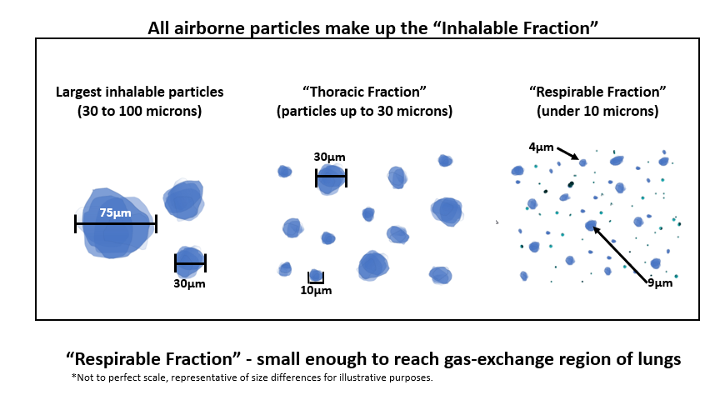
With Silica, Size Matters
NCDOL Photo Library

Slide 46
Silicosis
An irreversible but preventable disease, is the illness most closely associated with occupational exposure to the material, which also is known as silica dust.
Silicosis Type | Exposure Level | Latency Period | Illness Severity
Acute | Very High | Weeks to Months | Severe Morbidity/Mortality
Accelerated | High | 5 to 10 yrs. | Variable, often severe
Chronic | Lower than Accelerated | More than 10 yrs. | Variable, mild to severe

Slide 47
Health Effects of Silica
Silicosis
Lung Cancer
Chronic Obstructive Pulmonary Disease (COPD)
Kidney Diseases
Autoimmune Diseases
USDOL Photo Archive

Slide 48
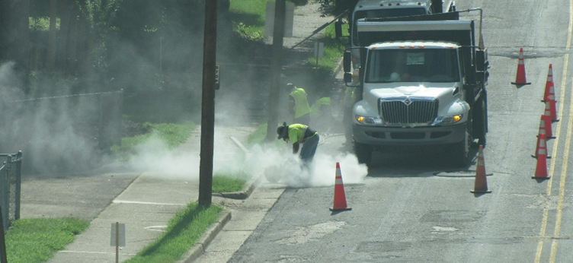
Silica Hazards
1910.1053
1926.1153
If silica is suspected, the employer is required to communicate the potential hazard to employees and how to protect themselves.
Example job tasks:
  Abrasive blasting
  Blast furnaces
  Cement manufacturing
  Ceramics, clay, and pottery
NCDOL Photo Library

Slide 49
Silica Hazards
NCDOL Photo Library

Slide 50
Industries with Silica Exposure
1910.1053
1926.1153
Concrete mixing
Demolition
Electronics industry
Foundry industry: grinding, molding, shakeout, core room (high risk)
Hand molding, casting, and forming
Jack hammer operations
Manufacturing abrasives, paints, soaps, and glass
Mining
Rolling and finishing mills
Sandblasting
Setting, laying, and repairing railroad track

Slide 51
Silica Exposure Limits
1910.1053
1926.1153
AL = 25 µg/m³ as an 8-hour TWA
  Written Exposure Control Plan (ECP)
PEL = 50 µg/m³ as an 8-hour TWA
  Employers must use engineering controls to prevent or reduce exposure
  Respiratory protection is required when exposure remains above PEL after engineering controls are utilized or when required by Table 1.

Slide 52
Medical Surveillance
1910.1053
1926.1153
At no cost to the employee.
At a reasonable time and place.
General Industry
  When exposed at or above 25 µg/m³ for 30 or more days for any 12 consecutive months.
Construction
  When employee is required to wear a respirator 30 or more days for any 12 consecutive months.

Slide 53
Specific Control Methods
1926.1153(c)(1)
In Construction
  Table 1
    18 specific tasks
    Identifies specific engineering controls to use
      Water delivery systems
      Dust collection systems
    Fully and properly implemented controls listed
      Do not have to comply with PEL
      Do not have to conduct exposure assessment

Slide 54
Table 1 - Example
1926.1153(c)(1)
Equipment/Task | Engineering and work practice control methods | Required respiratory protection and minimum assigned protection factor (APF)
 |  | ≤ 4 hours/shift | >4 hours/shift
Handheld power saws (any blade diameter) | Use saw equipped with integrated water delivery system that continuously feeds water to the blade Operate and maintain tool in accordance with manufacturer's instructions to minimize dust emissions:
 | When used outdoors | None | APF 10
 | When used indoors or in an enclosed area | APF 10 | APF 10

Slide 55
Abatement - Silica
1910.1053
1926.1153
Elimination
Substitution
Engineering controls
  Integrated water/dust collection
Administrative controls
  Housekeeping
  Dustless cleaning methods
  Personal hygiene
  Regulated areas of work
PPE
  Respiratory protection/Full-face Suppled Air
  Protective work clothing
NCDOL Photo Library

Slide 56
Summary
In this course, we discussed the following:
  Health Hazards Special Emphasis Program for:
    Hexavalent chromium (CrVI) or Chrome 6
    Isocyanates
    Lead
    Beryllium
    Silica
  Exposures, health effects and abatement methods for each

Slide 57

Thank You For Attending!
Final Questions?

