Slide 1
Hazard Communication
29 CFR 1910.1200
Presented by:
Notes:
Revised 06/2025
The information in this presentation is provided voluntarily by the N.C. Department of Labor’s Education, Training and Technical Assistance Bureau as a public service and is made available in good faith. This presentation is designed to assist trainers conducting OSHA outreach training for workers. No attempt has been made to treat the topic exhaustively. In addition, it is essential that trainers tailor their presentations to the needs and understanding of their audience.
The information and advice provided on this Site and on Linked Sites is provided solely on the basis that users will be responsible for making their own assessment of the matters discussed herein and are advised to verify all relevant representations, statements, and information.
This presentation is not a substitute for any of the provisions of the Occupational Safety and Health Act of North Carolina or for any standards issued by the N.C. Department of Labor. Mention of trade names, commercial products, or organizations does not imply endorsement by the N.C. Department of Labor.

Slide 2
Objectives
29 CFR 1910.1200
After this course, students will recognize and understand:
  Purpose and scope of hazard communication in the workplace
  Role management and employee’s responsibilities in complying with this standard
  General requirements regarding chemical hazard classifications
  Requirements for an effective written hazard communication program

Slide 3
Appendixes
Appendix A, Health Hazard Criteria (Mandatory)
Appendix B, Physical Criteria (Mandatory)
Appendix C, Allocation of Label Elements
  (Mandatory)
Appendix D, Safety Data Sheets (Mandatory)
Appendix E, Definition of “Trade Secret” (Mandatory)
Appendix F, Guidance for Hazard Classifications
  Re: Carcinogenicity (Non-Mandatory)

Slide 4
Purpose
1910.1200(a)
Ensure hazards of all chemicals produced or imported are classified and that information concerning the classified hazards is transmitted to employers and employees.
Classified Chemical Hazards

Slide 5
Scope and Application
1910.1200(b)(1)
Requires chemical manufacturers or importers to classify the hazards of chemicals that they produce or import.
Requires distributors to transmit the required information to employers.
Transmit Information

Slide 6
Scope and Application
1910.1200(b)(1)
Requires employers to provide information to their employees about the hazardous chemicals to which they are exposed by the following means:
  Hazard communication (HazCom) program
  Labels and other forms of warning
  Safety data sheets (SDS)
  Information and training

Slide 7

Scope and Application
1910.1200(b)(2)
Applies to chemicals known to be present in the workplace.
Employees that may have a potential for exposure.
  Under normal conditions
  or
  Foreseeable emergency
Nova Development

Slide 8
Scope and Application
1910.1200(b)(3)
Application for laboratories only
  Labels are not to be removed or defaced
  Maintain SDS for each chemical
  SDS must be readily available
  Provide information and training
  A laboratory that ships chemicals is considered to be a distributor or manufacturer:
  Must ensure that containers are appropriately labeled prior to shipment, and
  SDS is provided to other distributor(s) or employer(s)

Slide 9
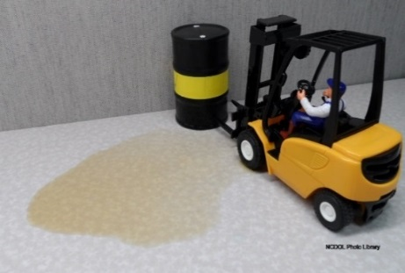
Scope and Application
1910.1200(b)(4)
Application for work operations where chemicals are handled only in sealed containers:
  Labels not to be removed or defaced
  Maintain SDS for each chemical
  SDS must be readily accessible
  Provide information and training
    Except location and availability of HazCom program
    Trained to protect themselves in the event of a spill or leak

Slide 10
Scope and Application
1910.1200(b)(5)
Exemptions for labeling
  Pesticides (Federal insecticide, fungicide, and rodenticide Act 7 U.S.C. 136)
  Chemical Substance or mixture (Toxic Substances Control Act 15 U.S.C. 2601 et seq.)
  Food, food additive, color additive (FDA 21 U.S.C. 301)
  Cosmetic, medical or vet device (FDA 21 U.S.C. 301)
  Distilled spirits (Federal Alcohol Administration Act 21 U.S.C. 201)
  Consumer products (Consumer Product Safety Act 15 U.S.C. 2501)
  Agricultural or vegetable seed (Federal Seed Act 7 U.S.C. 1551)
Notes:
10

Slide 11

Scope and Application
1910.1200(b)(6)
Standard does not apply to:
  Hazardous wastes and substances
  Tobacco or tobacco products
  Wood or wood products
  Articles as defined in the standard
  Food or alcoholic beverages
  Drugs

Slide 12
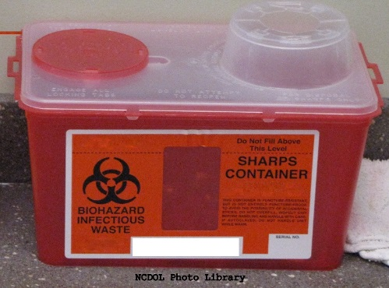
Scope and Application
1910.1200(b)(6)
Standard does not apply to:
  Cosmetics for retail sale
  Consumer products
  Nuisance particulates
  Ionizing and nonionizing radiation
  Biological hazards

Slide 13
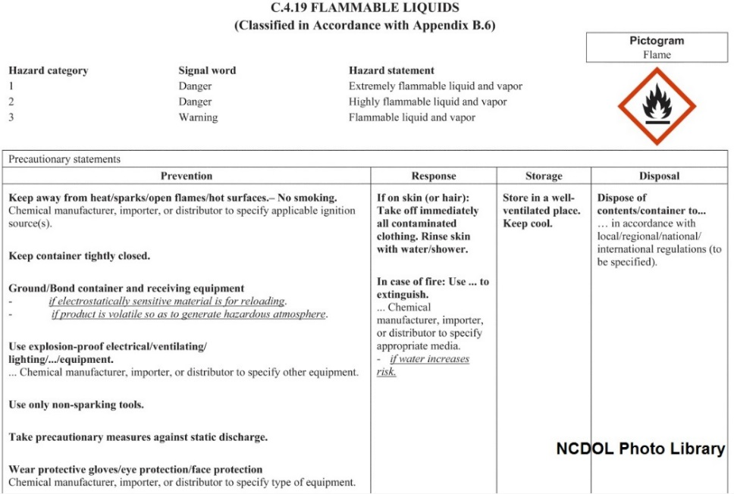
Key Elements of HazCom
1910.1200
Hazard classification
Written program
Labeling
SDS
Employee training

Slide 14
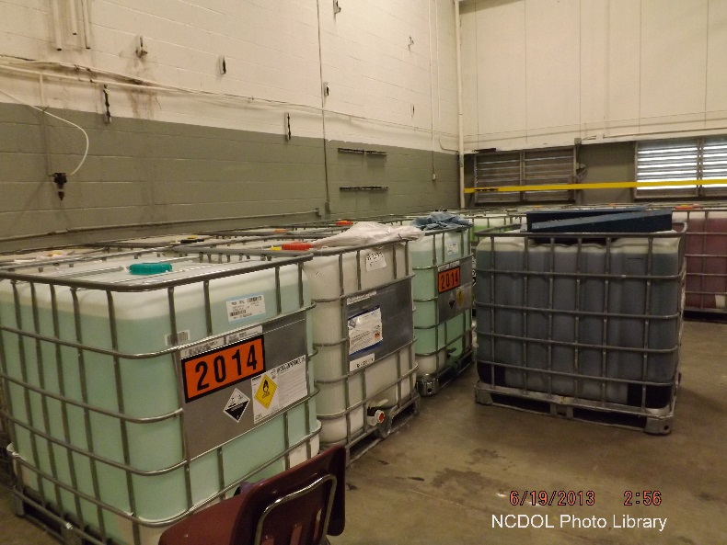
Definitions
1910.1200(c)
“Hazardous chemical”
  Any chemical that is classified as a:
    Physical hazard
    Health hazard
    Simple asphyxiant
    Combustible dust
    Pyrophoric gas
    Hazard not otherwise classified

Slide 15
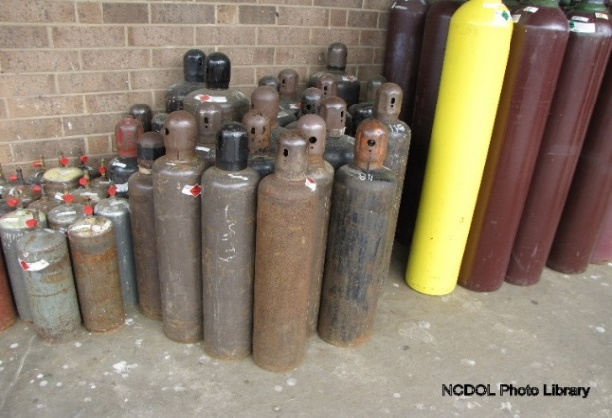
Definitions
1910.1200(c)
“Physical hazard”
  A chemical classified as posing one of the following hazardous effects:
    Explosive
    Oxidizer (liquid, solid or gas)
    Self-reactive
    Pyrophoric (liquid or solid)
    Self-heating
    Organic peroxide
    Corrosive to metal
    Gas under pressure
    Emits flammable gas in contact with water
    Flammable (gases, aerosols, liquids or solids)
What’s the hazard?

Slide 16

Definitions
1910.1200(c)
“Health hazard”
  A chemical that is classified as posing one of the following hazardous effects:
    Acute toxicity (any route of exposure)
    Skin corrosion or irritation
    Serious eye damage or eye irritation
    Respiratory or skin sensitization
    Germ cell mutagenicity
    Carcinogenicity
    Reproductive toxicity
    Specific target organ toxicity
    (single or repeated exposure)
    Aspiration hazard

Slide 17
Definitions
1910.1200(c)
“Pyrophoric gas”
  A chemical in a gaseous state that will ignite spontaneously in air at a temperature of 130 degrees F (54.4 degrees C) or below.
Arsine Gas (AsH3)

Slide 18

Definitions
1910.1200(c)
“Simple asphyxiant”
  A substance or mixture that displaces oxygen in the ambient atmosphere and can cause oxygen deprivation in those who are exposed, leading to unconsciousness and death.

Slide 19
Definitions
1910.1200(c)
“Hazard not otherwise classified (HNOC)”
  An adverse physical or health effect identified through evaluation of scientific evidence during the classification process that does not meet the specified criteria for the physical and health hazard classes addressed in this section (standard).
  The effect either:
    Falls below the cut-off value/concentration limit of this hazard class, or
    Is under a Globally Harmonized System (GHS) hazard category not adopted by OSHA (e.g., acute toxicity Category 5)

Slide 20
Hazard Classification
1910.1200(d)
Each type of hazard covered is considered a “hazard class”.
  Examples: acute toxicity, carcinogenicity
Most hazard classes are also subdivided into “hazard categories” to reflect the degree of severity of the effect.
This is the concept of “classification”—rather than just determining that there is a hazardous effect (e.g., carcinogenicity), there is also a finding of how severe that effect might be (e.g., category 1 or 2).

Slide 21
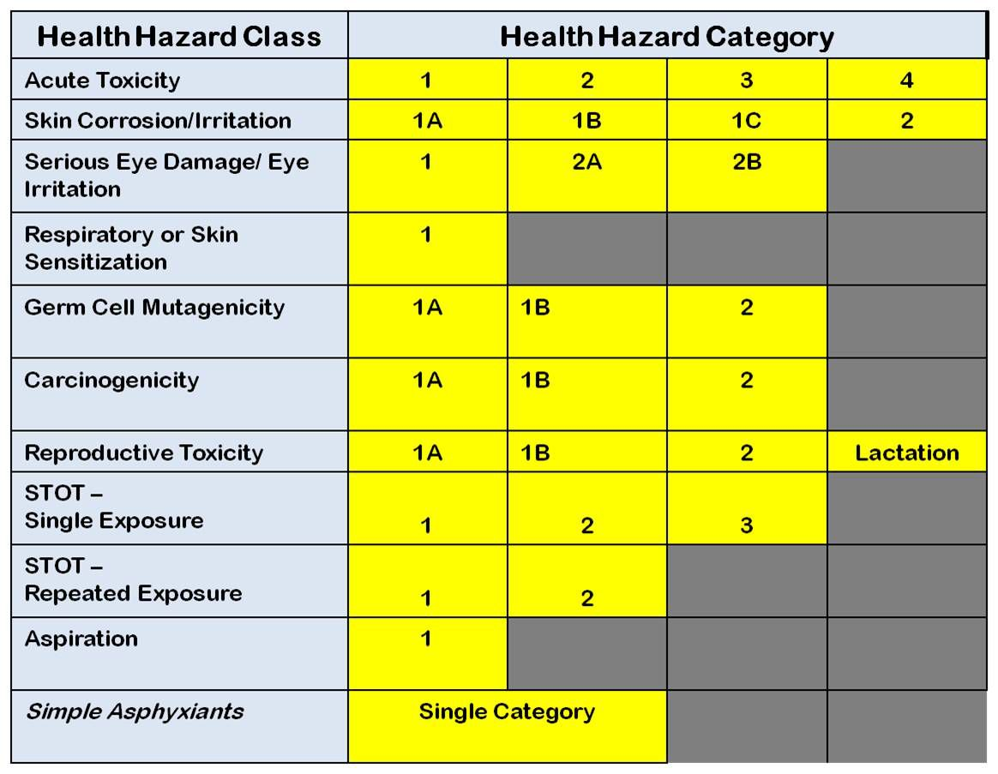
Appendix A - Health Hazard Criteria
STOT – Specific Target Organ Toxicity

Slide 22
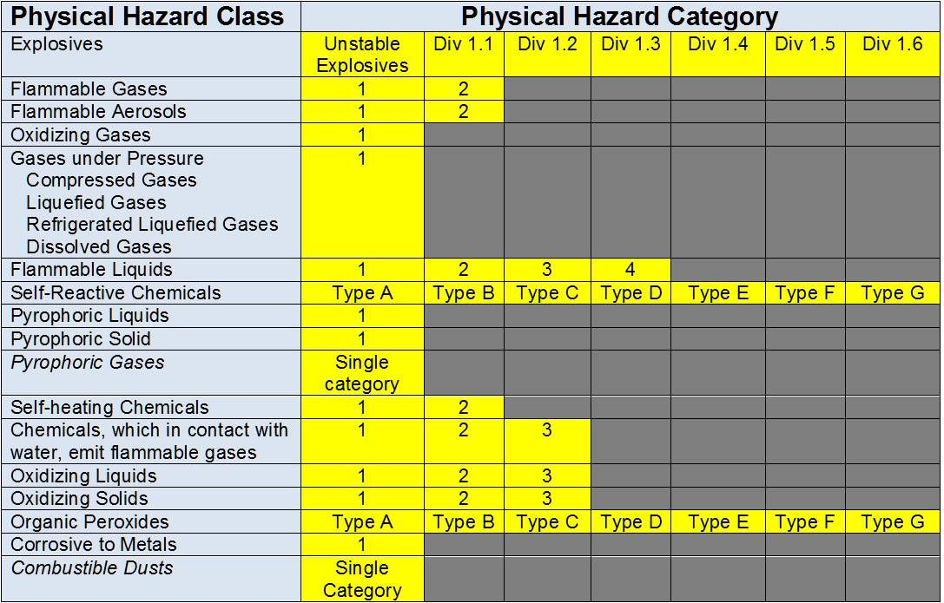
Appendix B – Physical Criteria

Slide 23
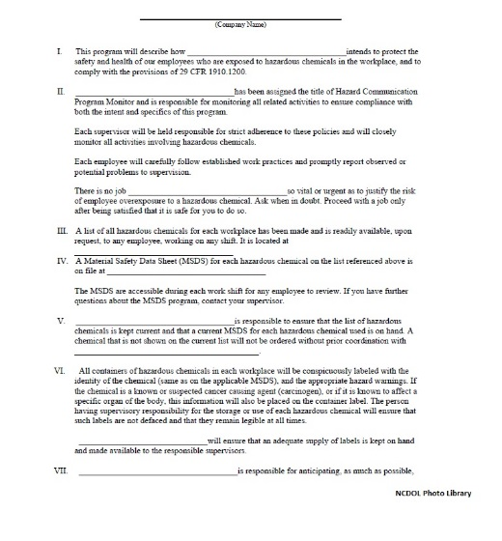
Written Program
1910.1200(e)(1) & (4)
Employer must have a written hazard communication program.
It must be available upon request to:
  Employees and/or their designated representative
  OSHA

Slide 24
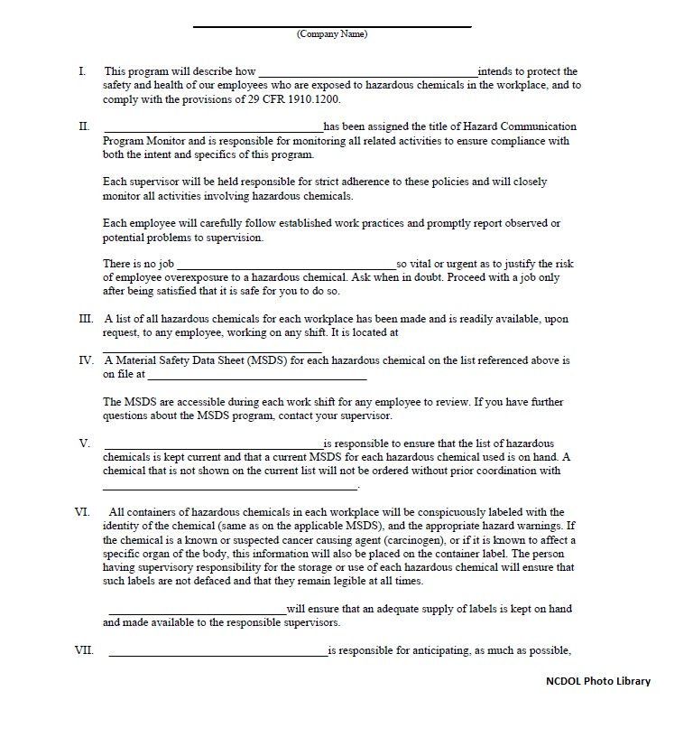
Written Program
1910.1200(e)
Must contain how the following will be met:
  Labels and other forms
  of warning
  Safety data sheets
  Information and training
  List of chemicals

Slide 25
Written Program
1910.1200(e)(1)(ii)
Must also contain:
  Methods used to inform employees of the hazards associated with non-routine tasks.
    Example: Cleaning a reactor vessel
  Hazards associated with chemicals contained in unlabeled pipes in the workplace.

Slide 26
Written Program
1910.1200(e)(2)
Multi-employer workplaces
  Methods used to inform other employer(s):
    SDS access
    Precautionary measures during normal operating conditions and in foreseeable emergencies
    Labeling system (in-house or workplace labeling)

Slide 27
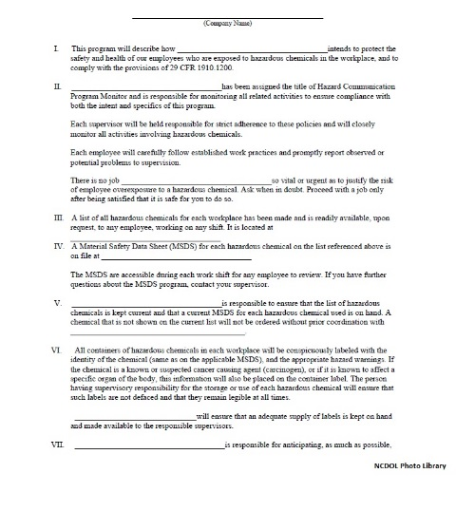
Written Program
1910.1200(e)(5)
When employees travel between workplaces during a work shift (their work is carried out at more than one geographical location).
  HazCom program may be kept at a primary workplace facility.

Slide 28
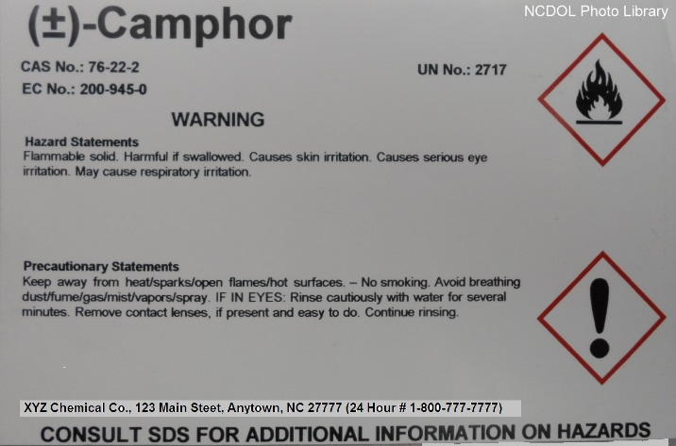
Labeling
1910.1200(c)
“Label” - An appropriate group of written, printed or graphic information elements concerning a hazardous chemical that is affixed to, printed on, or attached to the immediate container of a hazardous chemical, or to the outside packaging.

Slide 29
Labeling
1910.1200(f)
Must be in English and prominently displayed:
  Product identifier
  Signal word
  Hazard statements
  Pictogram(s)
  Precautionary statement(s)
  Name, address and telephone number of manufacturer/importer/responsible party

Slide 30
Harmonized Information
Danger vs. Warning
“Signal word” - A word used to indicate the relative level of severity of hazard and alert the reader to a potential hazard on the label.
  “Danger” is used for the more severe hazards.
  “Warning” is used for the less severe.

Slide 31


Hazard Statements
“Hazard statement” - A statement assigned to a hazard class and category that describes the nature of the hazard(s) of a chemical, including, where appropriate, the degree of hazard.
  Example: Harmful if inhaled (for Category 4 Acute Toxicity - Inhalation)
Pictogram
Signal word | Danger | Danger | Danger | Warning
Hazard statement | Fatal if inhaled | Fatal if inhaled | Toxic if inhaled | Harmful if inhaled

Slide 32

Pictograms
“Pictogram” means a composition that may include a symbol plus other graphic elements, such as a border, background pattern or color, that is intended to convey specific information about the hazards of a chemical.
  Eight pictograms are designated under this standard for application to a hazard category.
    GHS Environmental pictogram is not
    used by OSHA

Slide 33
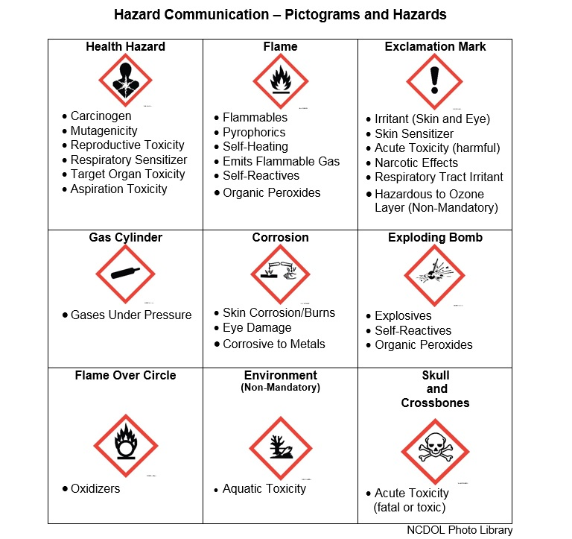

Slide 34
Precautionary Statements
“Precautionary statement” means a phrase that describes recommended measures that should be taken to minimize or prevent adverse effects resulting from exposure to a hazardous chemical, or improper storage or handling.
  Example for Explosives, Division 1.1, 1.2 and 1.3
    Keep away from heat/sparks/open flames/hot surfaces. No smoking
    Keep wetted with…
    Ground/bond container and receiving equipment
    Do not subject to grinding/shock/…/friction
    Wear face protection

Slide 35
Additional Requirements
Harmonized information is to be provided together on the label.
  Signal words, pictograms and hazard statements
All information is to be prominently displayed and in English (although other languages may also be provided).
Requirement that information not conflict with transport labels remains the same.

Slide 36
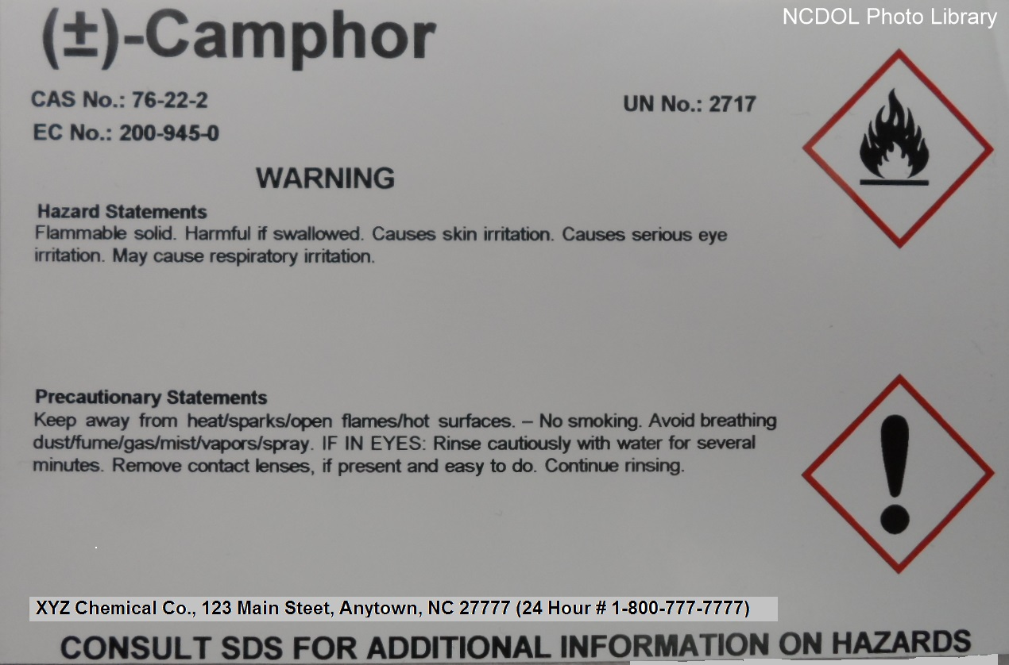
Label Example
36

Slide 37
Labeling
1910.1200(f)
Solid materials
  Solid metal, wood or plastic items not exempted as articles due to downstream use.
    Label must be transmitted to customer with initial shipment.
    Does not apply to any chemicals used with or present with materials to which employees may be exposed by handling.
      Examples: cutting fluids, pesticides

Slide 38

Labeling
1910.1200(f)(6)
Workplace labeling
  Each hazardous chemical container must be labeled, tagged or marked with either:
    Information required for labels on shipped containers
    Or
    Product identifier and words, pictures, symbols, or combination thereof, which provide at least general information regarding the hazards of the chemicals.
(In conjunction with the other information immediately available to employees under the hazard communication program)

Slide 39
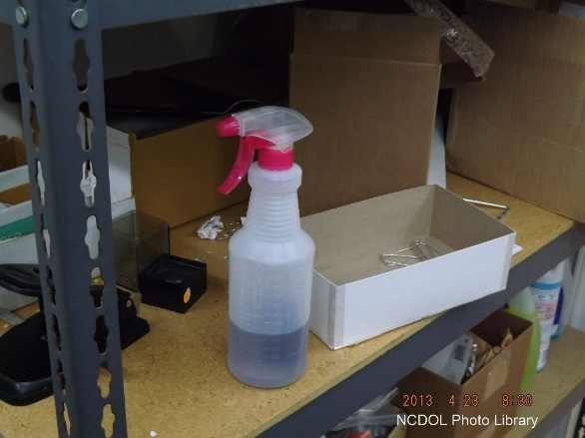
Labeling
1910.1200(f)(8)
Labeling exemption
  Portable containers that are intended for immediate use by the employee who performs the transfer of hazardous chemical from a labeled container.
  Immediate use
    Under the control of, and
    Used only by the employee, and
    Within the work shift of transfer
Unlabeled and
Uncontrolled Portable Container

Slide 40
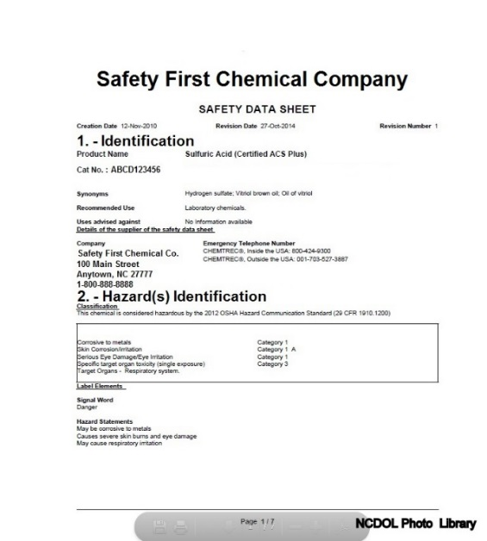
Safety Data Sheets
1910.1200(g)
“Safety Data Sheet”
  Written or printed material concerning a hazardous
  chemical that is prepared in accordance with paragraph (g)—Safety Data Sheets.

Slide 41
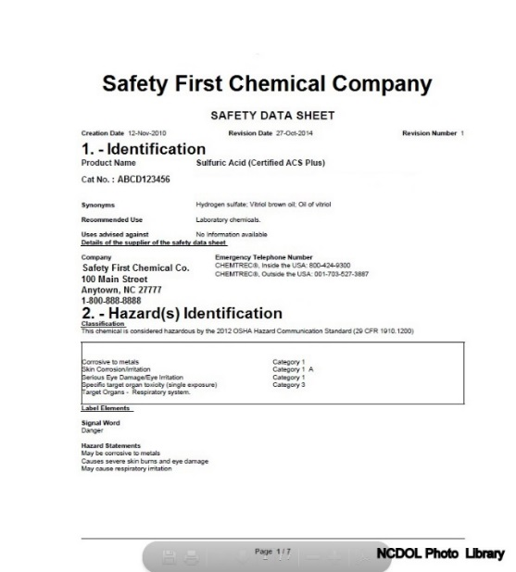
Safety Data Sheets
1910.1200(g)
Chemical manufacturers and importers must obtain or develop an SDS.
Employers must have an SDS in the workplace for each chemical they use.
Must be in English.

Slide 42
Safety Data Sheets
1910.1200(g)
16-section safety data sheet
Several sections are not mandatory since they address information outside OSHA’s jurisdiction (Sections 12-15)
Appendix D—Safety Data Sheets (Mandatory) provides the details of what is to be included in each section
No subheading in Sections 1-11 and 16 can be left blank

Slide 43
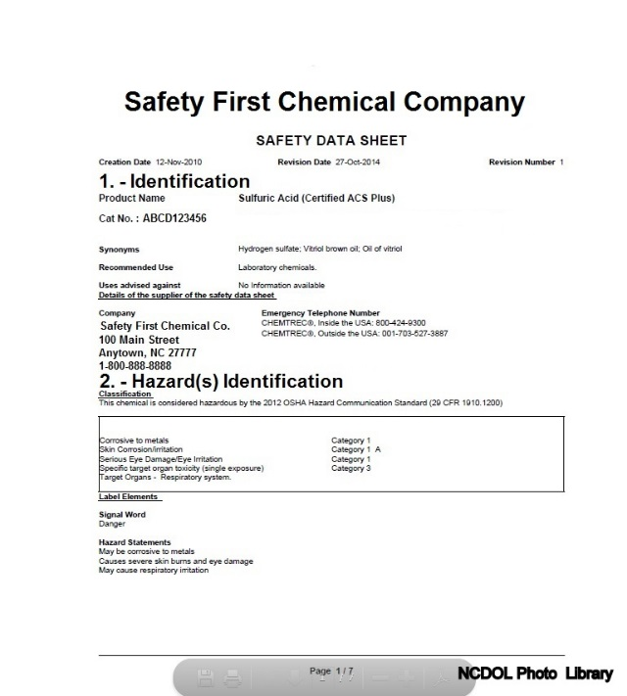
Safety Data Sheet Format
1910.1200(g)
1. Identification of the substance or mixture and of the supplier
2. Hazard identification
3. Composition/information on ingredients
4. First-aid measures
5. Fire-fighting measures
6. Accidental release measures
7. Handling and storage
8. Exposure controls/personal protection
9. Physical and chemical properties
10. Stability and reactivity
11. Toxicological information
12. Ecological information (non-mandatory)
13. Disposal considerations (non-mandatory)
14. Transport information (non-mandatory)
15. Regulatory information (non-mandatory)
16. Other information, including date of preparation or last revision

Slide 44
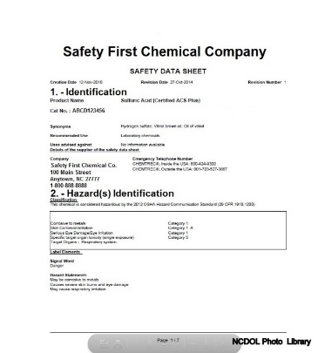
Safety Data Sheets
1910.1200(g)
Chemical manufacturers or importers must ensure that distributors and employers are provided an appropriate SDS.
  With their initial shipment, and
  With the first shipment after an SDS is updated.

Slide 45
Safety Data Sheets
1910.1200(g)
SDS access for employees
  Readily accessible
  During work shift
Electronic and other alternatives are acceptable
  No barriers to immediate employee access.
When employees travel between workplaces during a work shift
  May be kept at primary workplace.

Slide 46
Employee Exposure Records
1910.1200(g)(11)
References 1910.1020—Access to Employee Exposure and Medical Records
  An “employee exposure record” must include Safety Data Sheets (SDS)*.
  In the absence of an SDS, a chemical inventory
  Must be held and maintained at least 30 years.
  Employee access to records.
* The 3/26/2012 final rule did not include a revision to 1910.1020

Slide 47
Information and Training
1910.1200(h)
Training provided to employees upon:
  Initial employment
  When new hazards are introduced into the workplace
Information
  Requirements of this section
  Operations in their work area where hazardous chemicals are present
  Location and availability:
      Written hazard communication program
      List(s) of hazardous chemicals
      Safety data sheets

Slide 48
Information and Training
1910.1200(h)
Training
  Methods and observations to detect presence
  or release of chemicals
  Physical, health, simple asphyxiation, combustible dust and pyrophoric gas hazards
  Hazards not otherwise classified
  Measures to protect themselves
  Details of the hazard communication program:
    An explanation of the labeling system
    Safety data sheets
    How employees can obtain/use the appropriate hazard information

Slide 49
Trade Secrets
1910.1200(i)
Under the N.C. Right to Know Act (NCGS 95-173, Article 18), hazard information on chemicals deemed as a trade secret are to be provided to the local fire chief, who must hold the information in confidence.
Chemical manufacturers, importers or employers may withhold specific information from the SDS.
  They must be able to support that the information withheld is a trade secret.

Slide 50
Trade Secrets
1910.1200(i)(2)
Emergencies
  Where a treating physician or nurse determines that a medical emergency exists, the chemical identity and/or specific percentage of the composition of the trade secret must be disclosed.
Medical Emergency

Slide 51
Trade Secrets
1910.1200(i)(3)
Non-emergencies
  Disclose to health professional if:
    Requested in writing; and
    Describes one or more occupational health need
      Used to assess an employee’s exposure
      Provide medical treatment
      Design engineering controls
      Assessing hazards
      Conducting medical surveillance
      Assessing personal protective equipment
      Conducting medical studies

Slide 52
Summary
In this course, we discussed the following:
  Purpose and scope of hazard communication in the workplace
  Role management and employee’s responsibilities in complying with this standard
  General requirements regarding chemical hazard classifications
  Requirements for an effective written hazard communication program

Slide 53
Thank You For Attending!
Final Questions?

