Slide 1
Electrical Workshop
29 CFR 1910, Subpart S
29 CFR 1926, Subpart K
Presented by:
Notes:
Revised: 6/16/25
The information in this presentation is provided voluntarily by the N.C. Department of Labor’s Education, Training and Technical Assistance Bureau as a public service and is made available in good faith. This presentation is designed to assist trainers conducting OSHA outreach training for workers. Since workers are the target audience, this presentation emphasizes hazard identification, avoidance, and control – not standards. No attempt has been made to treat the topic exhaustively. It is essential that trainers tailor their presentations to the needs and understanding of their audience.
The information and advice provided on this site and on linked sites is provided solely on the basis that users will be responsible for making their own assessment of the matters discussed herein and are advised to verify all relevant representations, statements, and information.
This presentation is not a substitute for any of the provisions of the Occupational Safety and Health Act of North Carolina or for any standards issued by the N.C. Department of Labor. Mention of trade names, commercial products, or organizations does not imply endorsement by the N.C. Department of Labor.

Slide 2
Objectives
At the end of this course, students will be able to:
Understand the basic principles of electricity
Know how to work safely with electricity
Understand how to identify safe working loads for equipment, extension cords, receptacles, and circuits
Understand how loads are calculated on electrical receptacles and circuits

Slide 3
Definitions
29 CFR 1910.301-399
Competent person
A person who is capable of identifying existing and predictable hazards … and who has authorization to take prompt corrective measures to eliminate them.
Qualified person
A person who, by possession of a recognized degree, certificate, or professional standing, or who by extensive knowledge, training and experience, successfully demonstrated an ability to solve/resolve problems relating to the subject matter, the work, or the project.

Slide 4
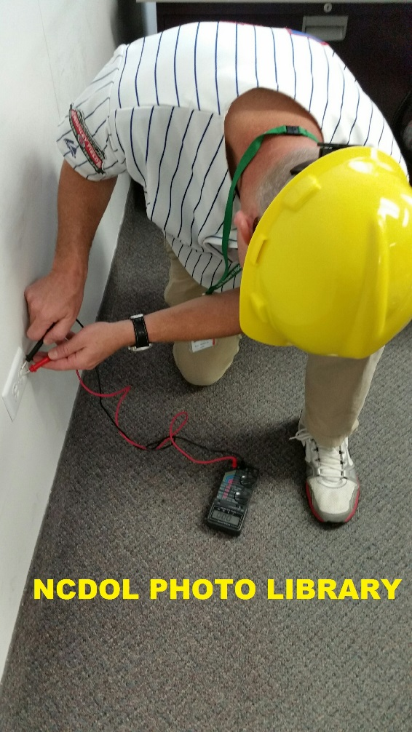
Working with Electricity
Working with electricity can be dangerous due to potential exposure to electrical hazards.
Engineers, linemen, electricians, and others work with electricity directly (including work with overhead lines, cable harnesses, and circuit assemblies).
Office workers and numerous other trades work with electricity indirectly.

Slide 5
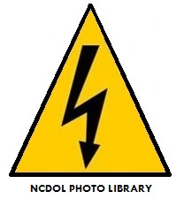
Electrical Safety Tips
General
Use caution when working near electricity
Assume that all electrical wires are energized at lethal voltages
Never repair electrical cords or equipment unless qualified and authorized

Slide 6
Electrical Safety Tips
Wet or damp conditions
Have a qualified electrician inspect electrical equipment that has gotten wet before energizing it.
If working in damp locations, inspect electric cords and equipment to ensure that they are in good condition and free of defects, and use a ground-fault circuit interrupter (GFCI).
Never operate electrical equipment while you are standing in water.

Slide 7
What Is Electricity?
Electricity is the flow of electrical power or charge.
The definition of electricity is the flow of charge, typically free-flowing electrons.
Negatively-charged electrons are loosely held to atoms of conductive materials.
A closed circuit of conductive material provides a path for electrons to continuously flow.

Slide 8
How Is Electricity Generated?
Electricity is a secondary energy source which is typically generated with steam turbines powered by primary fuels such as:
Fossil fuels such as coal, natural gas, oil, biomass
Nuclear power
Geothermal
Solar thermal energy
Other major electricity generation technologies include gas turbines, hydro turbines, wind turbines, and solar photovoltaics.

Slide 9
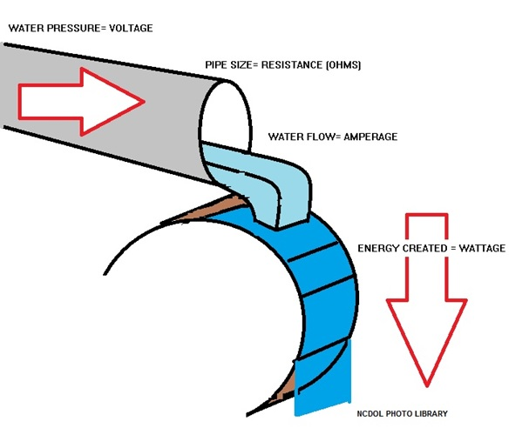
How Does Electricity Flow?

Slide 10
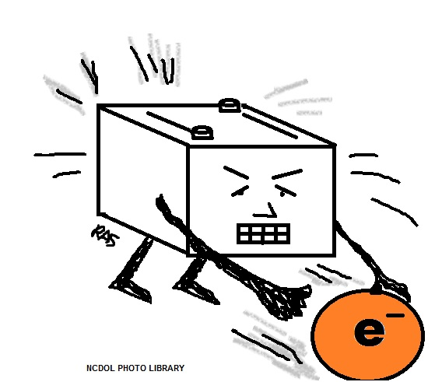
What Is a Volt?
Volt - Unit of measure for the potential difference in electrical force, or “pressure,” between two points on a circuit.
Notes:
.

Slide 11
How Does Voltage Work?
Voltage - electrical force that makes electricity move through a wire (conductor) and we measure it in volts.
Current electricity - Electricity that moves from one place to another. A flow of electrons (current) travels through a conductor.
Current - The movement of electrical charge.
Circuit - A complete path for the flow of current.

Slide 12
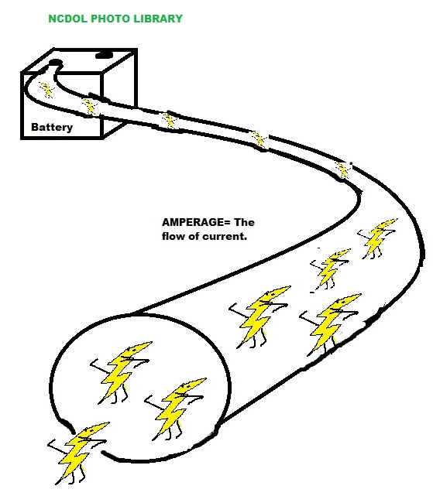
What Is an Ampere?
Ampere (Amp) - The unit of measure for the amount of current that flows past a given point on a circuit each second.
If you have a 100-watt (100 W) light and you know your electricity supply is rated as 120 volts, the current flowing must be 100/120 = 0.833 amps.

Slide 13
Typical Household Current
In a normal electrical circuit:
Current flows to a machine or piece of equipment through a hot wire (typically black or red) at 120 volts.
Current flows back to the service panel through a neutral wire (white) at 0 volts because they are connected at a grounded neutral bus bar.
Any stray current will go to ground (green) which is often routed to a copper rod driven into the earth.

Slide 14
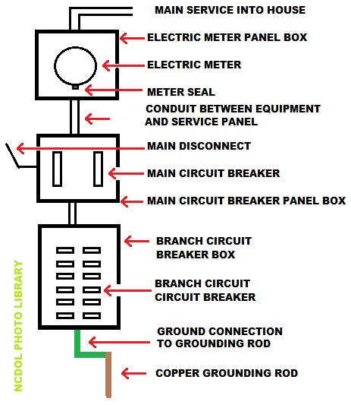
Typical Household Current

Slide 15
What is a Watt?
Watt
A derived unit of power (W) named after Scottish engineer James Watt.
A watt is defined as the current flow of one ampere with voltage of one volt.
1W = 1V × 1A
Watts are also expressed as one joule per second and are used to express the rate of energy conversion or transfer.
1W = 1J / 1s

Slide 16
Volts, Amps and Watts
The relationship is commonly expressed in a simple equation that enables you to make calculations you may need for projects or accident investigations.
Volts x Amps = Watts
If the current is 120 volts and a device requires 4 amps of current, what is the wattage?
120 volts x 4 amps = 480 watts

Slide 17
Volts, Amps and Watts
To figure the current needed for a device rated in watts, turn the equation around:
Watts ÷ Volts = Amps
What is the amperage for an appliance that uses 1,200 watts and is supplied by a 120-volt receptacle?
1,200 watts ÷ 120 volts = 10 amps

Slide 18
Supplying Voltage to Customers
Electricity generated from most utility suppliers can run as high as 760,000 volts (V) because less energy is lost when it is transmitted at high voltages.
At points along the way, lines branch off to step-down transformers at facilities or companies.
Volts can range between:
120 V
240 V
480 V or higher (depending on your requirements)

Slide 19
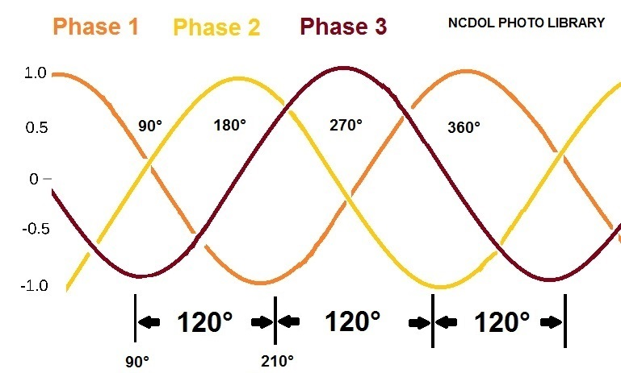
3-Phase Power Supply
Why do we use 3-phase power supply for heavy loads?
With 3-phase power, however, there is never a time when all the voltages go to zero. When extracting power from all 3 phases, the power stays constant throughout the whole cycle. The advantage is a continuous, vibration-free drive.

Slide 20
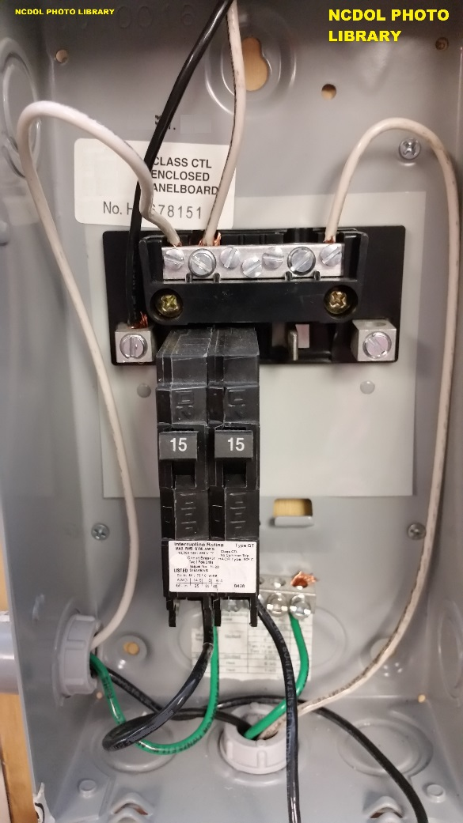
Electrical Wiring
In normal electrical circuit:
Current flows to a machine or piece of equipment through a hot wire (typically black or red).
Current flows back to the service panel through a neutral wire (white).
Any stray current will go to ground (green).

Slide 21
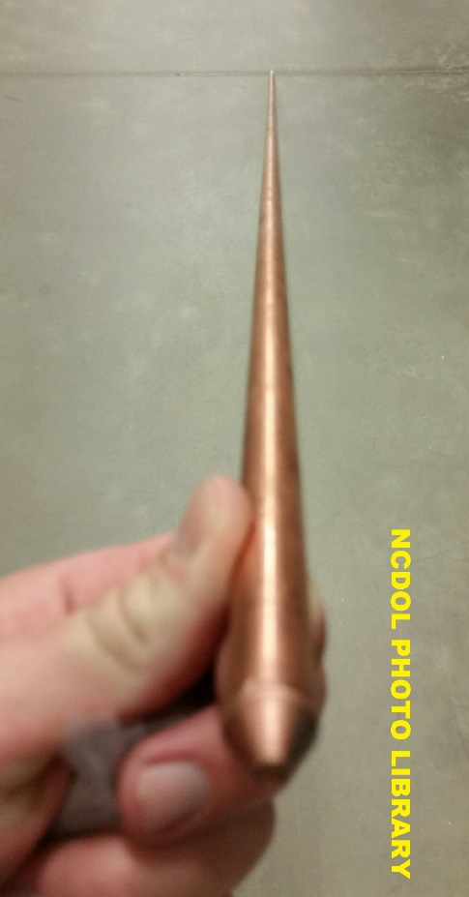
Grounding Safety
Grounding guards against fire and shock hazards:
Fire hazards: A fire can result from a short circuit, in which current leaks from a broken hot wire or connection and reaches a point of zero voltage by some path other than the normal one, across worn insulation.
Note: Such a path offers high resistance, so that the current can generate enough heat to start a fire.

Slide 22
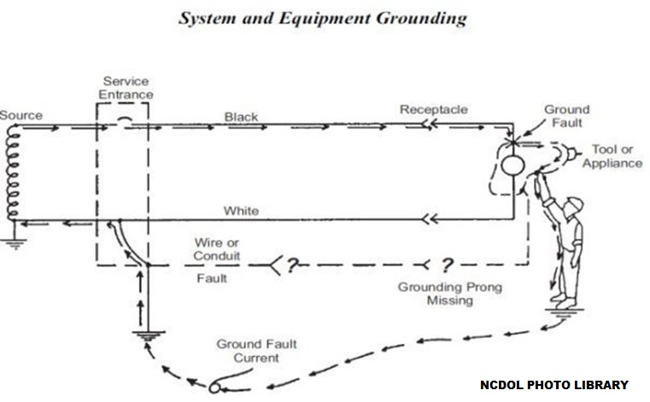
Grounding Safety

Slide 23
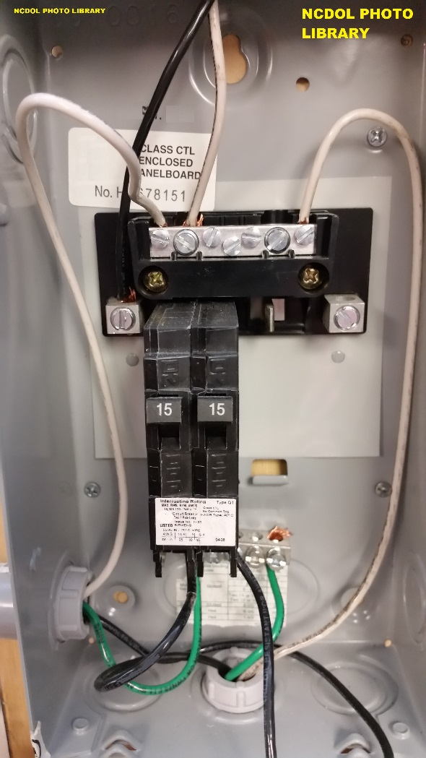
Grounding Safety
Grounding wires (green or bare) carry leaking current or abnormal voltage directly to a grounding point (zero voltage).
If the electricity encounters little resistance, the amperage may be high enough to blow a fuse or trip off a circuit breaker.

Slide 24
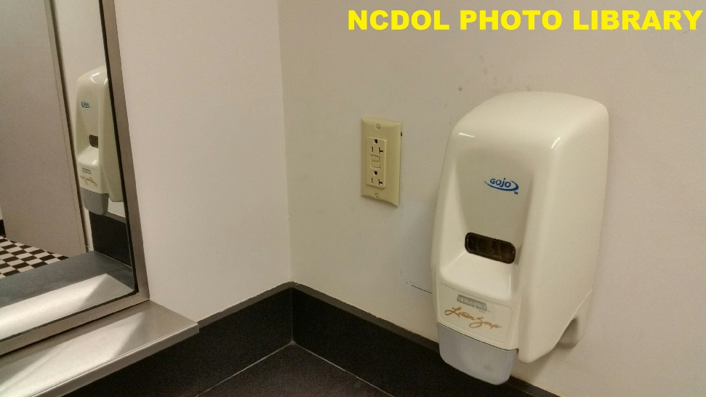
Grounding Safety
Wherever electricity is used in a damp location, a minor fault can cause a dangerous shock even though the circuit is properly grounded.
For this reason, a Ground Fault Circuit Interrupter (GFCI) is required for receptacles in many areas such as bathrooms, outside outlets or near water sources where power cords are used.

Slide 25
Resources and Standards
29 CFR 1910.301–399, Subpart S, Electrical
The subpart address electrical safety requirements that are necessary for the practical safeguarding of employees in their workplaces.
National Electrical Codes
Standard Handbook for Electrical Engineers

Slide 26
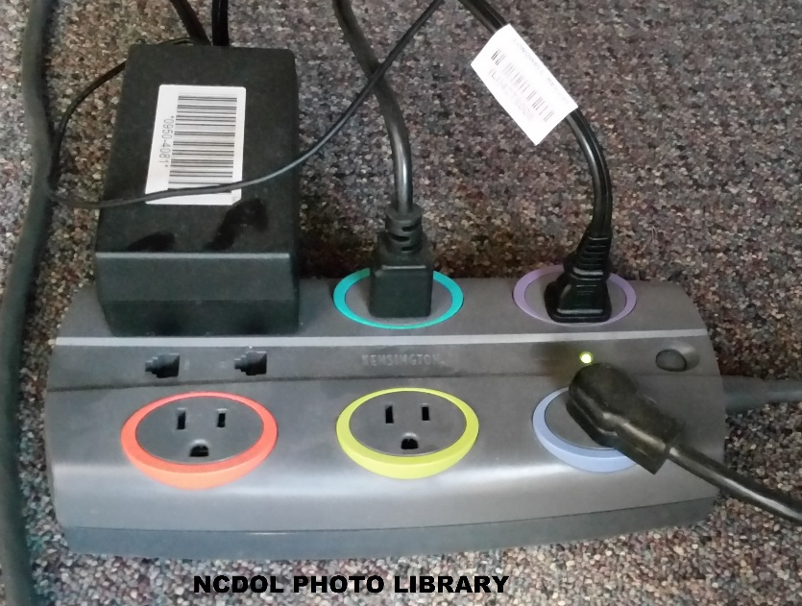
Calculating the Load
First: List all devices including any additions that will be operated simultaneously on the circuit and total the wattage that each consumes.
This information is printed on equipment or machine bulbs and data plates.

Slide 27
Calculating the Load
Then divide the total wattage by 120 VAC to calculate the amperage.
The total amperage must not exceed the circuit capacity, which is marked on the fuse or circuit breaker. By OSHA standards, it shouldn’t exceed 80%.

Slide 28
Predicting Electrical Action
Some basic electrical rules:
Nothing happens unless current flows.
No current flows unless there is a complete path (circuit).
The only low reactance path (circuit) has all portions of the path (conductors) close together.
Ohm’s Law
{Wattage (P)} = {Voltage (E)} x {Amperage (I)}
Easier way to remember: West Virginia (W=VA)

Slide 29
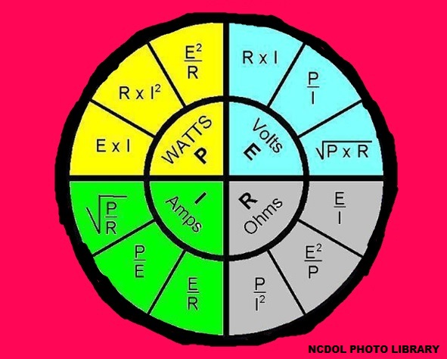
Ohm’s Law Formulas

Slide 30
Examples of Wattage and Amperage Consumed
Appliance | Estimated Load in Watts | Estimated Load in Amperage
Blender | 300 | 2.7
Clock Radio | 70 | 0.6
Coffee Maker | 1200 | 10.9
Heating Pad | 65 | 0.6
Microwave Oven | 1450 | 13.2
Toaster | 1150 | 10.5
Vacuum Cleaner | 1350 | 12.3
Circular Saw | 1200 | 10.9
Drill Press | 1100 | 10.0
Load in calculated based on typical household current of 110 volts.

Slide 31
Extension Cords
Generally, current delivered to static loads is lowered by increased extension cord length.
Resistance goes up; current goes down (I = E ÷ R)
Amperes = I
Volts = E
Ohms = R
Resistance increases with extension cord length, thus voltage drop across the line lowers the voltage available at the end of the cord for use by the equipment.
A heavier extension cord (one with more copper in it) has less resistance than a lighter cord.

Slide 32
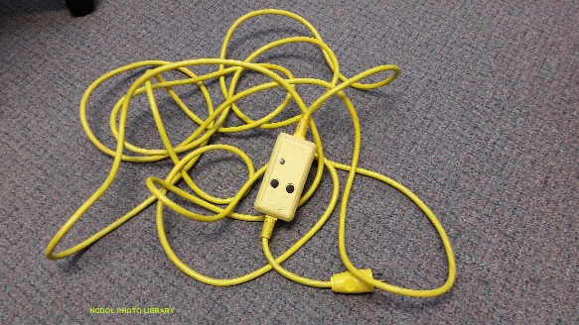
Extension Cords
Extension cords are rated by an AWG (American Wire Gauge) number.
The higher the number, the smaller the cross-section (roughly diameter) of the (usually copper) conductors in the cord.
Stranded wires of the same AWG rating have higher resistance per linear foot than do solid wires. Thus, solid copper (such as building wire) drops less voltage over longer runs.

Slide 33
Relocatable Power Taps (RPT)/Strips
RPT strips are designed for use with a number of low-powered loads, such as computers, peripherals, or audio/video components.

Slide 34
RPT/Strips
OSHA’s letter of interpretation, dated 11/18/2002, provides compliance requirements for relocatable power taps or “power strips”.
29 CFR 1910.304(b)(4), “Outlet devices shall have an ampere rating not less than the load to be served.” Power strips are not designed for high power loads such as space heaters, refrigerators and microwave ovens, which can easily exceed the recommended ampere ratings on many power strips.

Slide 35
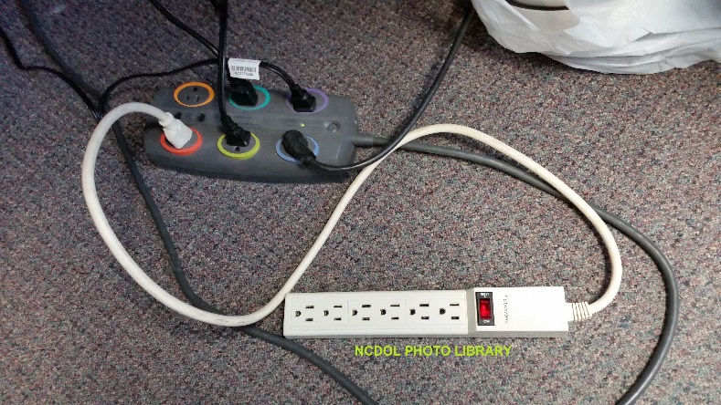
RPT/Strips
Manufacturers and nationally recognized testing laboratories determine the proper uses for power strips.
They are not to be series-connected to other RPTs or connected to extension cords.
UL also specifies that RPTs are not intended for use at construction sites and similar locations.

Slide 36
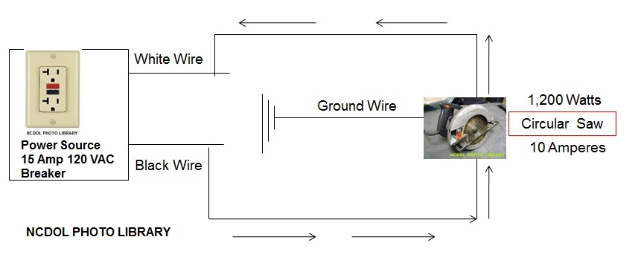
Single Circuit

Slide 37
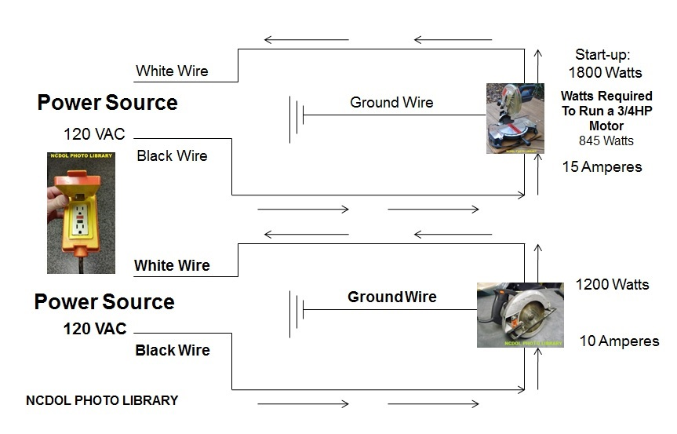
Single Circuit 15 Amp 120 VAC Breaker

Slide 38
Safe Wattage and Amperage
15 Amp Circuit
Total Wattage Capacity: 15 amps x 120 volts = 1,800 watts
Safe Wattage Capacity: 1,800 watts x 80% = 1,440 watts
Safe Amperage Capacity: 15 amps x 80% = 12 amps
20 Amp Circuit
Total Wattage Capacity: 20 amps x 120 volts = 2,400 watts
Safe Wattage Capacity: 2,400 watts x 80% = 1,920 watts
Safe Amperage Capacity: 20 amps x 80% = 16 amps
30 Amp Circuit
Total Wattage Capacity: 30 amps x 120 volts = 3,600 watts
Safe Wattage Capacity: 3,600 watts x 80% = 2,880 watts
Safe Amperage Capacity: 30 amps x 80% = 24 amps

Slide 39
Frayed or Underground Power Lines
Underground electric power lines
Locate underground facilities before digging.
It is a free service that will mark underground lines and pipes of participating utility services to ensure you are digging in accordance with the law.

Slide 40
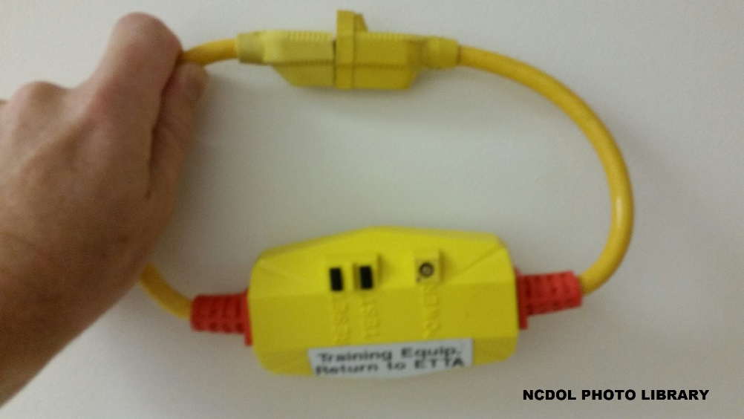
What is the Difference?
GFCI protects from ground faults (such as an electrical short), whereas a surge protector protects against surges (such as a lightning strike or a power outage).

Slide 41
Extension Cords
Look up the amp rating on the power tool or appliance.
Determine the maximum distance the tool or appliance will be from the electrical outlet.
Use the extension cord selection chart to identify the
proper gauge.

Slide 42
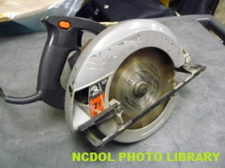
Test Question
What is the resistance (in ohms) for a 10 Amp 7¼″ circular saw?
Volts (E) ÷ Amps (I) = Ohms (R)
120 Volts ÷ 10 Amps = 12 Ohms
From the chart on the previous page, can a 100-foot extension cord be used
with this saw?

Slide 43
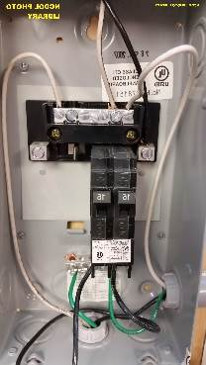
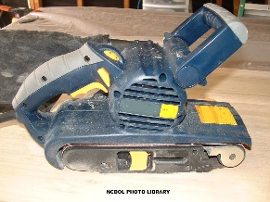
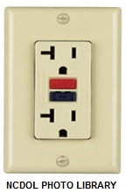
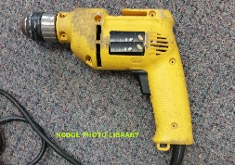
Electrical Exercise 1: Power Tools Power Source: 120 VAC – 15 Amp Breaker
What is the safe (amperage) capacity for this receptacle?
What is the safe (amperage) load for this receptacle when cord- and
plug-connected equipment is attached?
Can we plug this belt sander into this outlet?
Can we also plug this hammer drill into this outlet?
Volts: 120 VAC
Watts : 1000
Amps : 8.3
Volts:120 VAC
Watts: 720
Amps:
6
Total Amps: 14.3

Slide 44
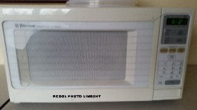
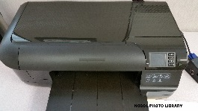
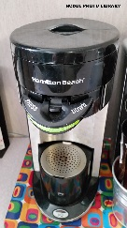
Electrical Exercise 2: Office Equipment Power Source: 120 VAC – 20 Amp Breaker
What is the safe (amperage) load for this receptacle when cord- and
plug-connected equipment is attached?
Can we plug the microwave and office printer into this receptacle?
If we add a surge protector, can we plug in the coffee maker?
Microwave Oven
Volts: 120 VAC
Watts:1,020
Amps:
8.5
Office printer
Volts:120 VAC
Watts:
Amps: 3.3
396
Total Amps: 11.8
Coffee maker
Voltage:120 VAC
Watts: 480
Amps:
Total Amps: 15.8
Surge Protector
Rated for 15 Amps
20 Amp Receptacle
4

Slide 45
Summary
In this course, we covered:
The basic principles of electricity.
How to work safely with electricity.
How to identify safe working loads for equipment, extension cords, receptacles, and circuits.
How to calculate loads on electrical receptacles and circuits.

Slide 46
Thank You For Attending!
Final Questions?

