Slide 1
Cranes and Derricks
29 CFR 1926 - Subpart CC
Notes:
Revised: 6/25
The information in this presentation is provided voluntarily by the N.C. Department of Labor, Education Training and Technical Assistance Bureau as a public service and is made available in good faith. This presentation is designed to assist trainers conducting OSHA outreach training for workers. Since workers are the target audience, this presentation emphasizes hazard identification, avoidance, and control – not standards. No attempt has been made to treat the topic exhaustively. It is essential that trainers tailor their presentations to the needs and understanding of their audience.
The information and advice provided on this Site and on Linked Sites is provided solely on the basis that users will be responsible for making their own assessment of the matters discussed herein and are advised to verify all relevant representations, statements, and information.
This presentation is not a substitute for any of the provisions of the Occupational Safety and Health Act of North Carolina or for any standards issued by the N.C. Department of Labor. Mention of trade names, commercial products, or organizations does not imply endorsement by the N.C. Department of Labor.

Slide 2
Objectives
1926.1400
At the end of this course, students will be able to:
  Familiarize themselves with the scope of the standard
  Identify proper ground conditions
  Recognize assembly/disassembly hazards
  Recognize power line safety hazards
  Understand the importance of Inspections
  Incorporate fall protection into their crane program
  Understand operator and signal person qualifications
  Understand signals and their importance to safe operations
  Understand tower cranes hazards
  Identify training elements specific to cranes

Slide 3
Amputations Special Emphasis Program
Goal to reduce occupational exposures to amputations
Struck by and caught between injuries
  Lockout/tagout
  Machine guarding
Increase outreach to employers and employees
  Training events (Internal and external)
  Compliance inspections
  Consultation visits
  Publications
Amputations must be reported within 24 hours

Slide 4
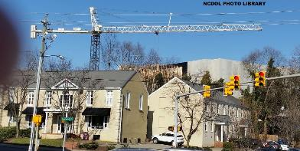
Scope
1926.1400(a)-(b)
Applies to power-operated equipment, when used in construction, that can hoist, lower and horizontally move a suspended load
Applies to the same equipment when used with attachments

Slide 5
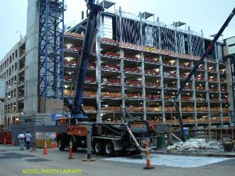
Scope
1926.1400(c)
Specific exclusions
  Machinery while it is converted or adapted for non-hoisting/lifting use
    Such as power shovels, excavators and concrete pumps
Limited exclusions
  Digger derricks, articulating/
  knuckle-boom truck cranes

Slide 6
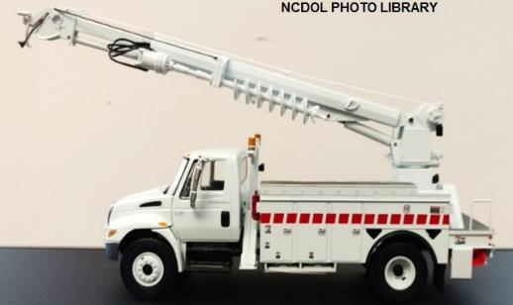
Equipment Not Covered
1926.1400(c)(4)
Digger derricks
  Equipped with auger for drilling holes to set poles
  Handling materials installed or removed from poles

Slide 7
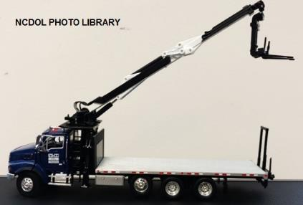
Equipment Not Covered 1926.1400(c)(17)(i)-(ii)
Articulating/knuckle-boom truck crane
  Delivering materials to construction site
  Transferring materials from truck crane to ground or onto structure using fork/cradle at end of boom

Slide 8
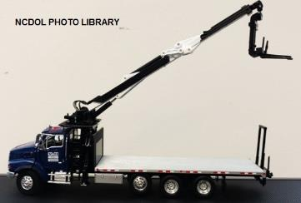
Equipment Covered 1926.1400(c)(17)(iii)(A)–(C)
Articulating/knuckle-boom truck crane
  Holding, supporting or stabilizing material to facilitate construction activity
  Handling prefabricated components
  Handling structural steel members

Slide 9
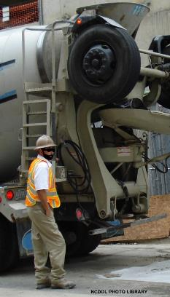
Definitions
1926.1401
Competent person
  A person who is capable of identifying existing and predictable hazards … and who has authorization to take prompt corrective measures to eliminate them.

Slide 10
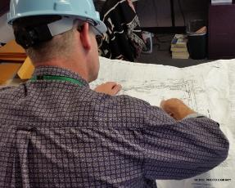
Definitions
1926.1401
Qualified person
  A person who, by possession of a recognized degree, certificate, or professional standing, or who by extensive knowledge, training and experience, successfully demonstrated an ability to solve/resolve problems relating to the subject matter, the work, or the project.

Slide 11
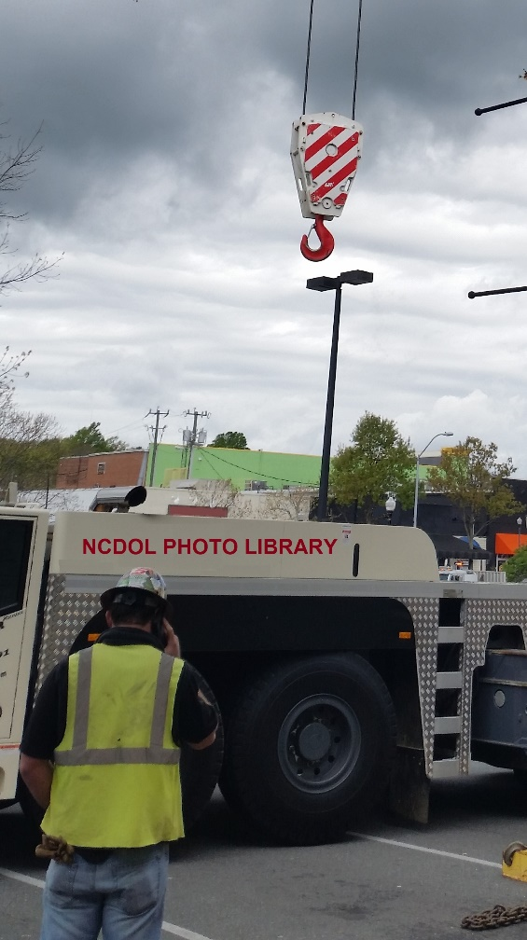
Definitions
1926.1401
Dedicated spotter (power lines)
  Person who meets requirements of 1926.1428 (signal person qualifications).
    Responsibility to watch separation between power line and equipment.
    Ensure communication with operator that minimum approach distance not breached.

Slide 12
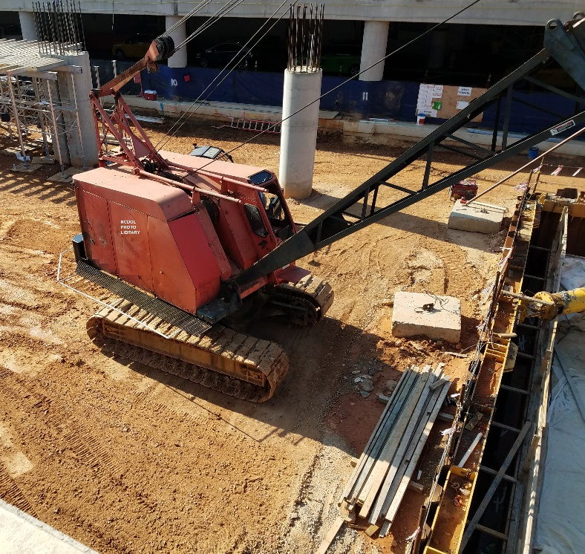
Ground Conditions 1926.1402(c)(1)
Controlling entity
  Provide adequate conditions
    Firm, drained, and graded
    So that with the use of supporting materials, the equipment manufacturer’s specifications for adequate support and degree of level of the equipment are met

Slide 13
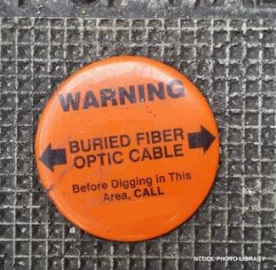
Ground Conditions 1926.1402(c)(2)
Inform user of the equipment and operator of the location of hazards beneath the equipment set-up area.
  Voids
  Tanks
  Utilities

Slide 14
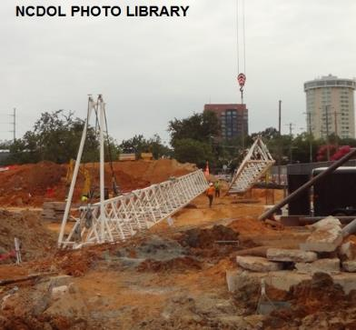
Assembly/Disassembly 1926.1403
Two options
  Manufacturer procedures
  Employer procedures

Slide 15
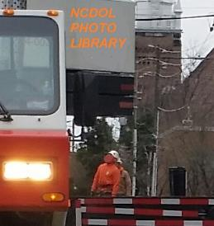
Assembly/Disassembly
1926.1403, .1404, .1435
Crane assembly and disassembly procedures
  Comply with manufacturer or employer procedures
  Supervision—Competent-qualified person = A/D director
    Knowledge of procedures
    Review of procedures
    Ensure crew members understand
    their tasks and hazards associated
    with tasks
Tower crane
  Pre-erection inspection
    Each crane component inspected by qualified person

Slide 16
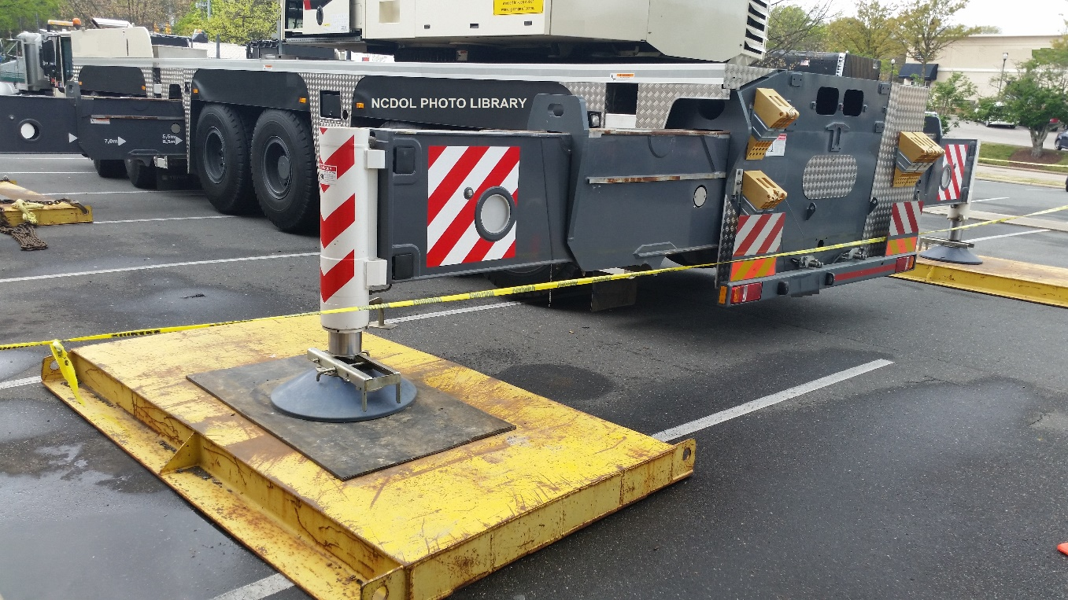
Assembly/Disassembly 1926.1404(h)
Site and ground conditions must be adequate
When required, block under outrigger floats

Slide 17
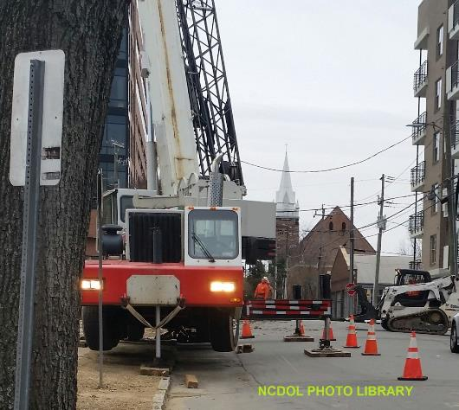
How is this set up? 1926.1404

Slide 18
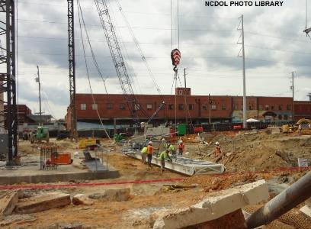
Power Line Safety 1926.1407(f)
Power lines presumed energized
  Unless utility owner/operator confirms lines deenergized
  Visibly grounded at worksite

Slide 19

Power Line Safety 1926.1408
Identify the work zone
  Demarcating boundaries (such as with flags, or a device such as a range limit device or range control warning device) or
  Define the work zone as the area 360 degrees around the equipment, up to equipment’s maximum working radius.

Slide 20
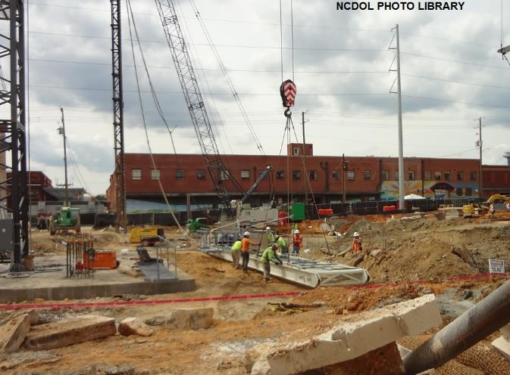
Power Line Safety 1926.1408
Notes:
.

Slide 21
Could you get within 20 feet of power line?
YES
NO
Option #1
De-energize and ground
Encroachment prevention measures
(equipment operations)
No further action
Option #2
20-foot clearance
Planning meeting
If tag lines used - Non-conductive
Elevated warning lines, barricade
or line of signs
  PLUS (Choose one):
Proximity alarm, spotter, warning
device, range limiter, or insulating
link
Option #3
Ask utility for voltage and
use Table A
(with minimum clearance distance)
NCDOL Photo Library
Notes:
21

Slide 22
Power Line Safety 1926.1408
Table A – Minimum Clearance Distances
Voltage (nominal, kV, Minimum clearance
alternating current) distance (feet)
up to 50 10
over 50 to 200 15
over 200 to 350 20
over 350 to 500 25
over 500 to 750 35
over 750 to 1,000 45
over 1,000
(As established by the utility owner/operator or registered professional
engineer who is a qualified person with respect to electrical power transmission and distribution.)
NCDOL Photo Library

Slide 23
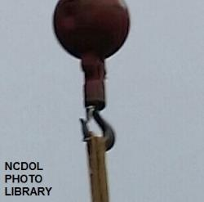
Intentionally Working Closer Than Table A Zone
Must Show:
Staying outside zone is
infeasible
Infeasible to deenergize
and ground
All of the following are required:
Power line owner – sets minimum approach distance
Planning meeting – minimum procedures
  - Deactivate automatic re-energizer
  - Dedicated spotter
- Elevated warning line or barricade
- Insulating link/device
- Nonconductive rigging
- Range limiter (if equipped)
- Nonconductive tag line (if used)
- Barricades - 10 feet from equipment
- Limit access to essential workers
- Prohibit non-operator workers from touching
above insulating link
- Properly ground crane
- Insulating line cover-up installed
NCDOL Photo Library

Slide 24
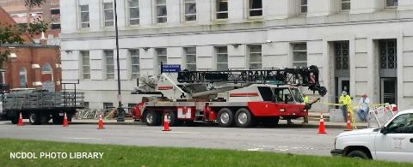
Power Line Safety 1926.1411(a)–(b)
Equipment traveling under power line with no load
  Boom/mast and boom/mast support system lowered sufficiently to meet requirements
  Clearances in Table T maintained
  Effects of speed and terrain on equipment movement
  Dedicated spotter
  Precautions for traveling in poor visibility

Slide 25
Power Line Safety 1926.1411
Table T – Minimum Clearance Distances While
Traveling With No Load
Voltage (nominal, kV, While traveling – Minimum alternating current) clearance distance (feet)
up to 0.75 4
over .75 to 50 6
over 50 to 345 10
over 345 to 750 16
over 750 to 1,000 20
over 1,000
(As established by the utility owner/operator or registered professional engineer who
is a qualified person with respect to electrical power transmission and distribution.)
NCDOL Photo Library

Slide 26
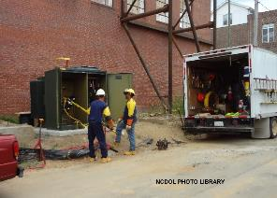
Electric Utilities 1926.1400(g)
Employers whose employees are qualified to perform power distribution and transmission work
  Deemed compliance with 1926.1407 through 1926.1411 when performing work covered by Subpart V work in accordance with 1910.269(p)

Slide 27

Inspections 1926.1412(d)–(e)
Visual inspection by competent person prior to each shift and completed before or during shift.
Monthly inspection by competent person with documentation.

Slide 28
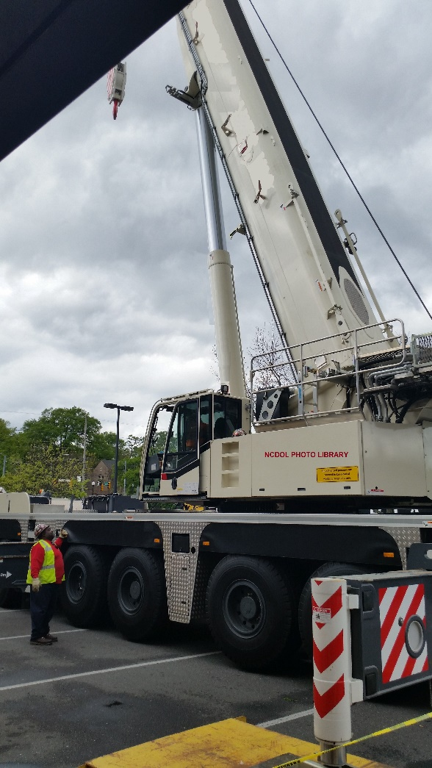
Inspections 1926.1412(a)–(c)
Other inspections required under this section done by qualified person – with documentation
  Annual/comprehensive
  Post-assembly
  Repaired/adjusted equipment
  Modified equipment
  Severe service
  Equipment not in regular use

Slide 29
Inspections 1926.1412(a)–(c)
Type of Inspection | Who Inspects
Modified or repaired/adjusted | Qualified person
Post-assembly | Qualified person
Shift | Competent person
Monthly | Competent person
Annual | Qualified person
NCDOL Photo Library

Slide 30
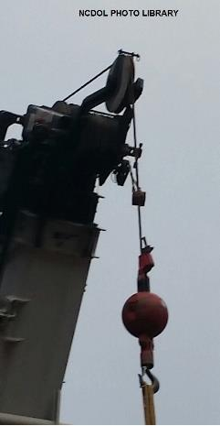
Safety Devices 1926.1415(a)–(b)
Required and are in proper working order at all times
Includes:
  Crane level indicator
  Boom stops (except for derricks and hydraulic booms)
  Jib stops (except for derricks)
  Foot pedal brakes with locks
  Hydraulic outrigger jacks/hydraulic stabilizer
  jacks with integral holding device
  Equipment on rails with rail clamps/stops
  Horn

Slide 31

Operational Aids 1926.1416(b)
Operations must not begin unless the listed operational aids are in proper working order, except when being repaired and a specified temporary alternative measure is used.
IF THE LIMITING DEVICE IS NOT FUNCTIONING, STOP!

Slide 32
Operational Aids 1926.1416(d)–(e)
Category 1
  Boom hoist limiting device, luffing jib limiting device, and anti two-blocking device
    Must be repaired no later than 7 calendar days after the deficiency occurs
Category 2
  Boom angle or radius indicator, boom length indicator, load weighing devices, jib angle indicator, outrigger/stabilizer position sensor/monitor, and hoist drum rotation indicator
    Must be repaired no later than 30 calendar days after the deficiency occurs

Slide 33
Operations 1926.1417(a)–(c)
When manufacturer procedures are unavailable, the employer must develop and ensure compliance with procedures necessary for safe operation of equipment and attachments.
Procedures for the operational controls must be developed by a qualified person.
Procedures, including rated capacities, recommended operating speeds, special hazard warnings, instructions, and operator’s manual, must be available in the cab at all times for use by the operator.

Slide 34
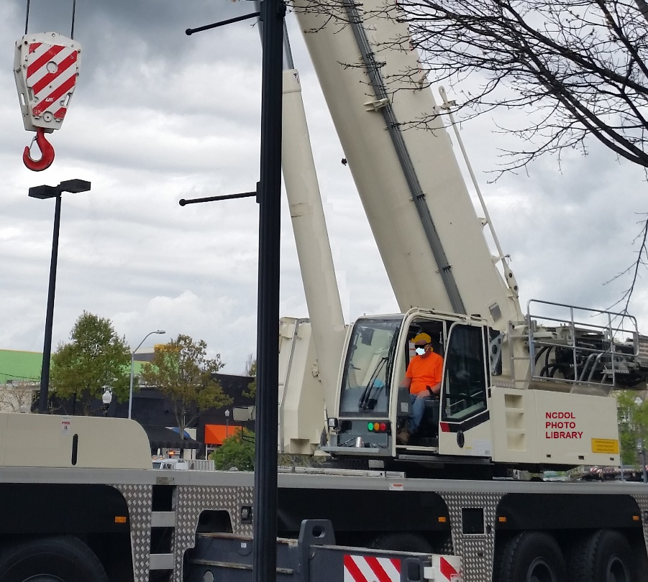
Operations 1926.1417(d)
Operator must not engage in any practice or activity that diverts their attention while engaged in operating the equipment, such as the use of cellular phones (other than when used for signal communications).

Slide 35
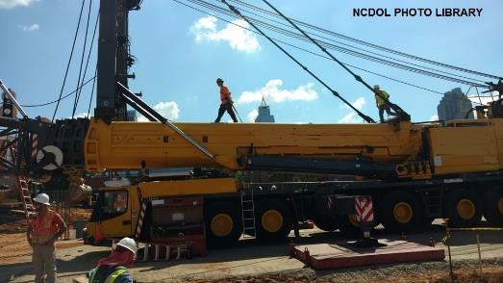
Fall Protection 1926.1423(b)-(c)
Boom walkways
Steps, handholds, ladders, grab rails, guardrails, and railings

Slide 36
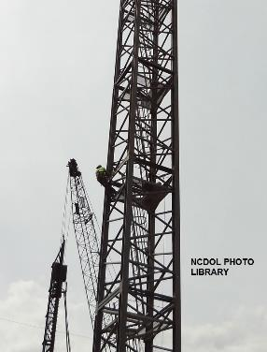
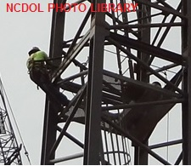
Fall Protection 1926.1423(d)–(k)
Personal fall arrest and positioning device systems
Anchorage criteria
Training

Slide 37
Keeping Clear of the Load 1926.1425(c)–(d)
When employees are hooking, unhooking, or guiding the load, or in the initial connection of a load to a component/structure and are within the fall zone:
  Materials being hoisted must be rigged by a qualified rigger
  Hooks with self-closing latches must be used
Only employees receiving a load are permitted within the fall zone when a load is being landed

Slide 38
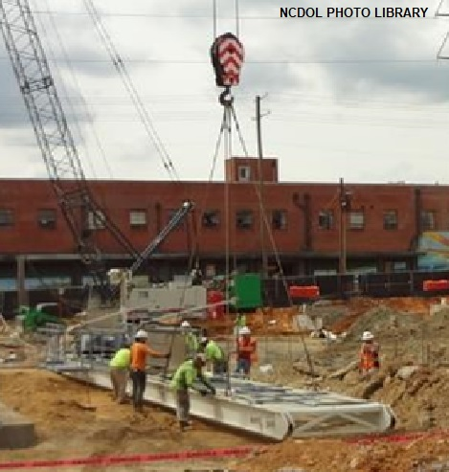
Rigging 1926.1404(r) & 1425(c)
Rigging work done by qualified rigger
  During assembly/disassembly
  When workers are within the fall zone to handle a load

Slide 39
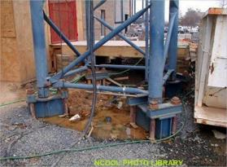
Tower Crane Requirements 1926.1435
Foundations and structural supports
  Designed by manufacturer or professional engineer
Plumb tolerance
  Verified by qualified person
Climbing procedures
Pre- and post-erection inspection
  By qualified person
Post-erection load test
Monthly/annual inspection

Slide 40
Operator Qualification and Certification
1926.1427
Knowledge (written test)
  Controls/performance characteristics
  Calculate capacity
  Preventing power line contact
  Ground conditions and equipment support
  Use and locate info in operating manual
  Appendix C subjects
Practical test

Slide 41
Operator Qualification/Certification 1926.1427
Portable |  | Valid
Accredited Testing Organization | YES * | 5 years
Audited Employer Program | NO | 5 years
U.S. Military License | NO * | Set by issuing entity
Government License | NO * Valid only in jurisdiction | Set by issuing entity, not > 5 years
*Subject to state and local requirements and whether or not the military/state training meets accredited requirements.
NCDOL Photo Library

Slide 42
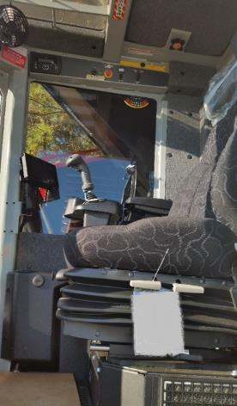
Operator Qualification/Certification 1926.1427
Operator qualification or certification not required:
  Equipment with rated hoisting/lifting capacity of 2,000 pounds or less
  Derricks
  Side-boom cranes
Operator trained on safe
operation of equipment
NCDOL Photo Library

Slide 43

Operator Qualification/Certification 1926.1427(a)(4)
Employer must provide the qualification or certification at no cost to operators.

Slide 44
Language Requirements 1926.1427(h)
Tests under this section may be administered in any language the operator candidate understands.
Operator’s certificate must note the language in which the test was given.
Equipment operation materials must be in the language of certification.

Slide 45
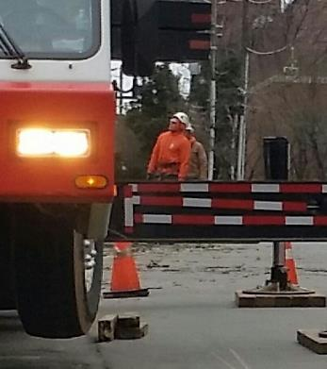
Signals
1926.1419 and .1422
Signal person provided
  Load not in view of operator
  View in direction of travel is
  obstructed
  Due to site-specific safety concerns
Types of signals
  Hand
  Voice
  Audible
  New signals
Hand signal chart posted on equipment or at site
NCDOL Photo Library

Slide 46
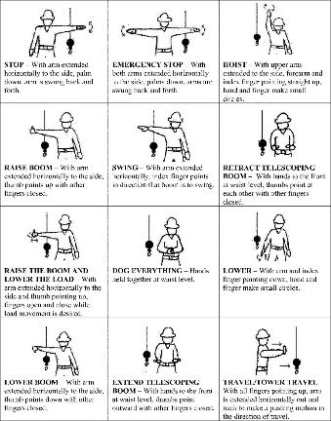
Signal Person Qualifications 1926.1428(c)
Know and understand type of signals used
Competent in using signals
Basic understanding of equipment operation and limitations
Know and understand relevant requirements
Demonstrate knowledge through an oral or written test and practical test
NCDOL Photo Library

Slide 47
Signal Person Qualifications 1926.1428(c)
Option | Documentation | Portable
Option (1): Third party qualified evaluator | Yes | Yes
Option (2): Employer’s qualified evaluator | Yes | No
NCDOL Photo Library

Slide 48
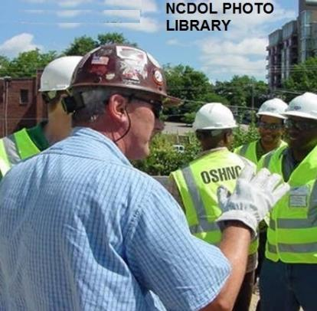
Training Requirements 1926.1430(a)–(f)
Overhead powerlines
Signal persons
Operators
Competent persons/ qualified persons
Crush/pinch points
Tag-out

Slide 49
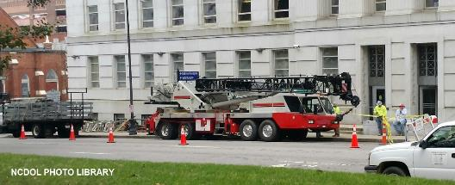
Training Administration 1926.1430(g)
Employees trained and evaluated on their understanding of the information provided
Refresher training
Training provided at no cost to employee

Slide 50
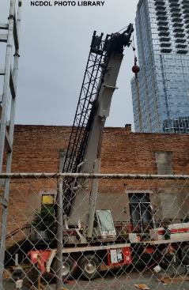
Summary
1926.1400
In this course, we discussed the following:
  Scope of the standard
  Ground conditions
  Assembly/disassembly
  Power line safety
  Inspections
  Fall protection
  Operator and signal person qualifications
  Signals
  Tower cranes
  Training

Slide 51
Thank You For Attending!
Final Questions?

