Slide 1
North Carolina Department of Labor Consultative Services Bureau

Slide 2
Consultative Services Bureau
The Bureau’s Consultation Program assists small employers, especially those in high hazard industries, who want to be pro-active in reaching their goal of achieving a safe and healthful workplace for their employees
NCDOL Photo Library

Slide 3
Consultation Program
The services are Free
Professional and highly trained staff (Previous Compliance Officers) conduct the surveys
It is Confidential
No Fines or Penalties are issued

Slide 4
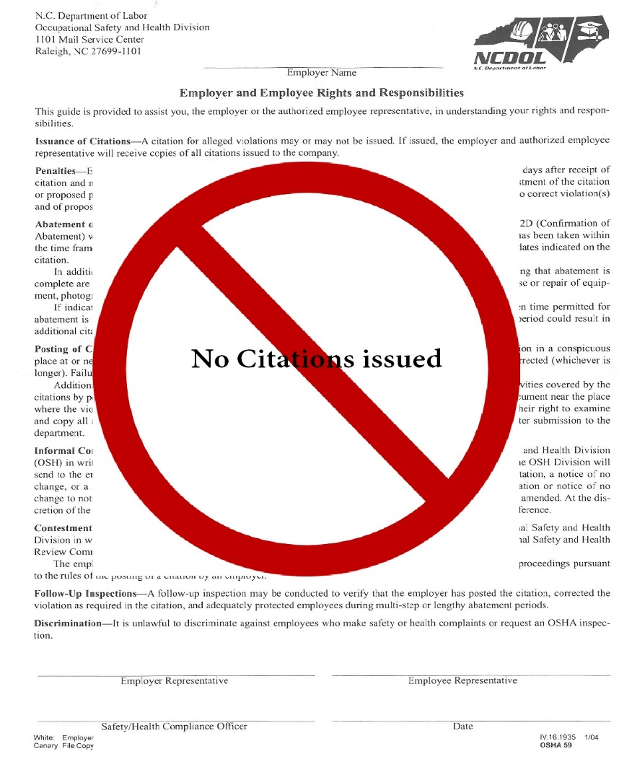
Consultation Program
We do not:
Issue citations or proposed penalties for non-compliance hazards found
Report hazards/violations to enforcement (Compliance)
NCDOL Photo Library

Slide 5
What Consultative Services Will Do!
On-site consultation includes:
Review required written programs
Conduct comprehensive or specific surveys and help detect potential safety and health hazards
Provide recommendations for correction
Provide a technical written report
Provide training and education

Slide 6
What Consultative Services Will Do!
Provide technical information
Assist in evaluating, developing, or maintaining an effective safety and health program
Answer your general questions about Compliance
Assist you in qualifying for recognition/exemption program (SHARP)
NCDOL Photo Library

Slide 7
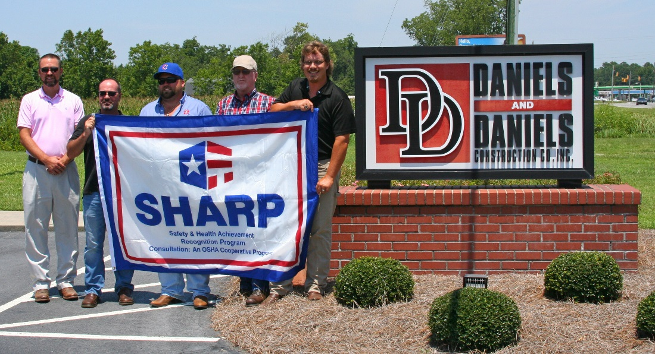
SHARP
S – safety
H – health
A – achievement
R – recognition
P – program
This program provides incentives and support to smaller, high-hazard
employers to develop, implement, and continuously improve safety and
health programs at their worksite(s).
NCDOL Photo Library

Slide 8
SHARP – What do I need to do?
Must have a comprehensive full service safety and health consultation visit; complete the request form
Correct all workplace safety and health hazards that are found
Adopt, implement, and maintain an exceptional workplace safety and health management system with employee involvement
Agree to request additional consultation visits if major changes occur
Must have a Days Away, Restricted or Transferred (DART) and Total Recordable Case (TRC) rate less than the average for your NAICS code

Slide 9
SHARP – What do I get in return?
General Industry/Public Sector employers meeting the specific program requirements are exempt from general scheduled OSHA inspections for two years
Construction Industry employers meeting the specific program requirements are exempt from general scheduled OSHA inspections until the survey is closed
Workplace injuries are reduced, thereby workers compensation costs are also reduced
Productivity goes up
SHARP Flag Ceremony with the North Carolina Commissioner of Labor in attendance
Community recognition

Slide 10
Thank You For Attending!
Final Questions?

